Slide 1
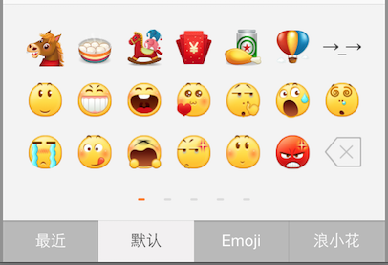
HWEmotionListView
HWEmotionKeyboard
HWEmotionTabBar

Slide 2
HWEmotionListView
最近
HWEmotionKeyboard
HWEmotionListView
Emoji
HWEmotionListView
默认
HWEmotionListView
浪小花
HWEmotionTabBar

Slide 3
UIScrollView
HWEmotionListView
0
4
15
16
17
19
15
16
17
19
20
24
20
24
14
14
14
UIPageControl

