Slide 1
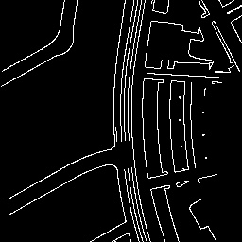
Add & Norm
Feed
Forward
Traj Decoder
Layer Norm
Add & Norm
N × DiT Block
Multi-Head
Self-attention
Layer Norm
patchify
vectorize
Add & Norm
Multi-Head
Self-attention
noise
MLP
Layer Norm
input
condition
noise

Slide 2
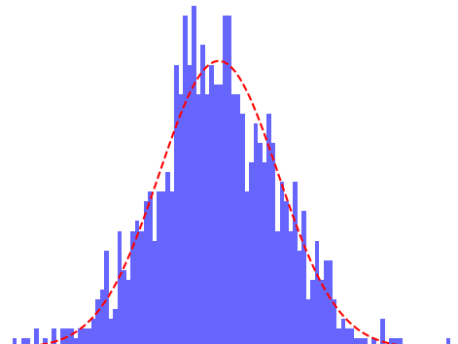
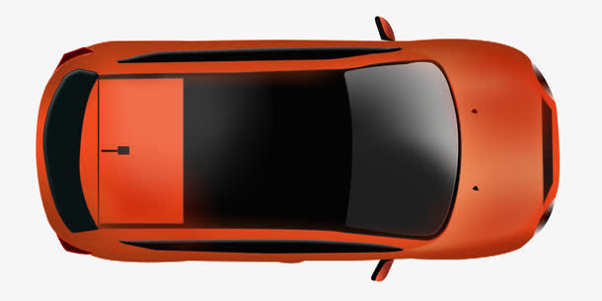
Feed
Forward
MLP Blocks and Reshape
Multi-Head
Cross-attention
N × DiT Block
Layer Norm
Multi-Head
Self-attention
Concate
Layer Norm
input
Condition
Embedding
Timestep t
noise
agents history

Slide 3
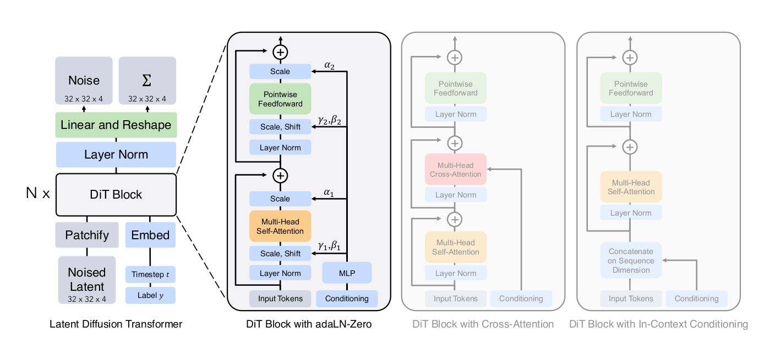

Slide 4
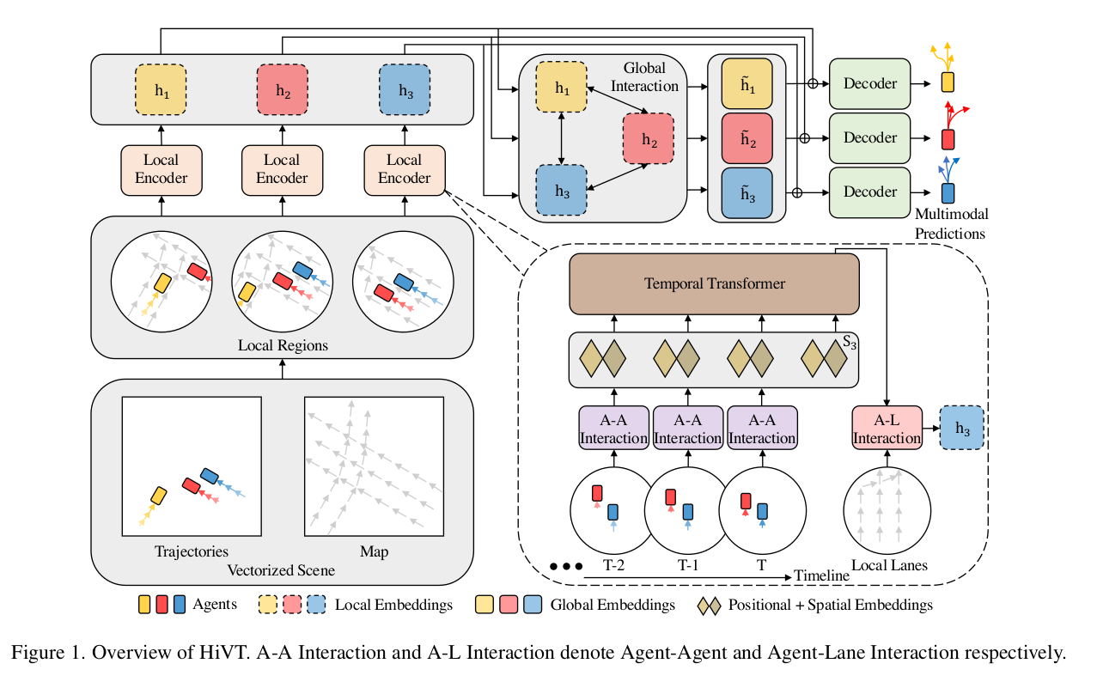

Slide 5
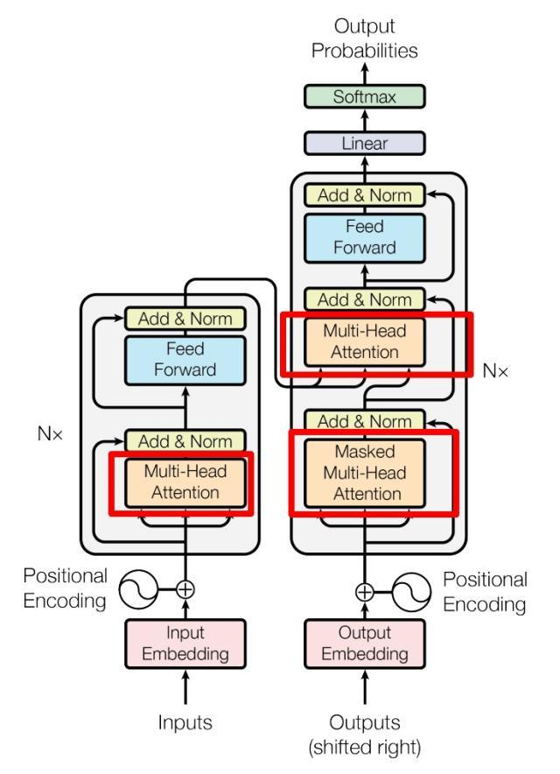

Slide 6
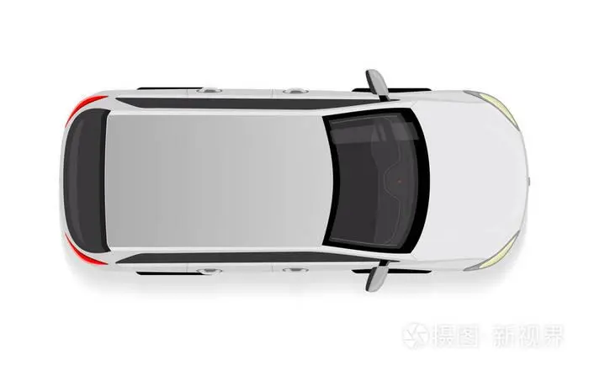
Encoder
Map Former
Cross-attention
Embedding Block
Feed
Forward
HD map
Self-attention
Feature-embedding
Concat
Pose-embedding
Other Agent Former
other agents
Action Latent
Cross-attention
Feed
Forward
Add
Self-attention
predicted agents

Slide 7
Diffusion
T
Dit Block
Self-attention
Noise
Linear
Output Linear
Concat
Add
Feed
Forward
predicted agents

Slide 8
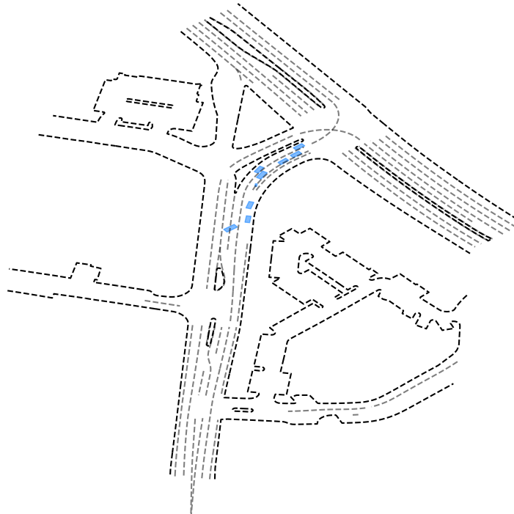
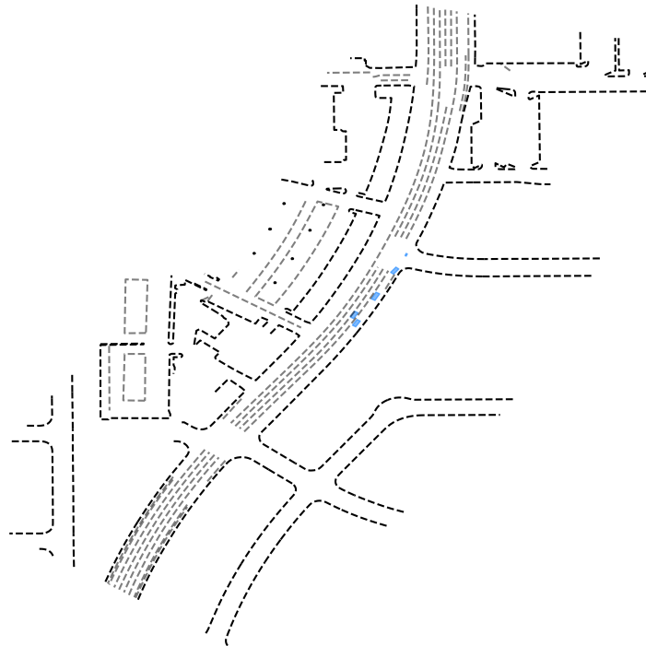
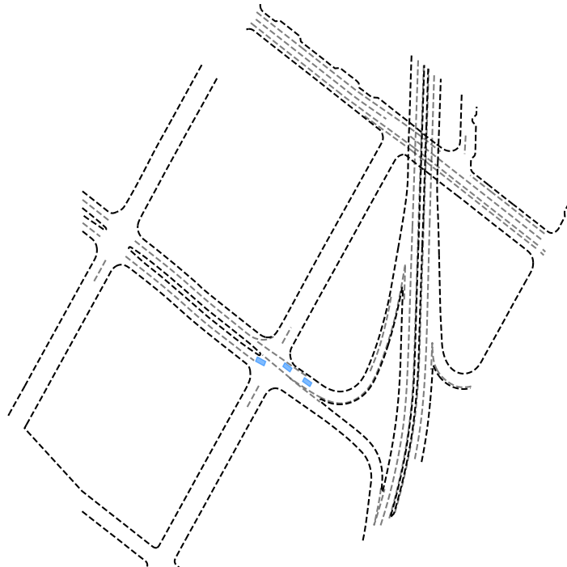
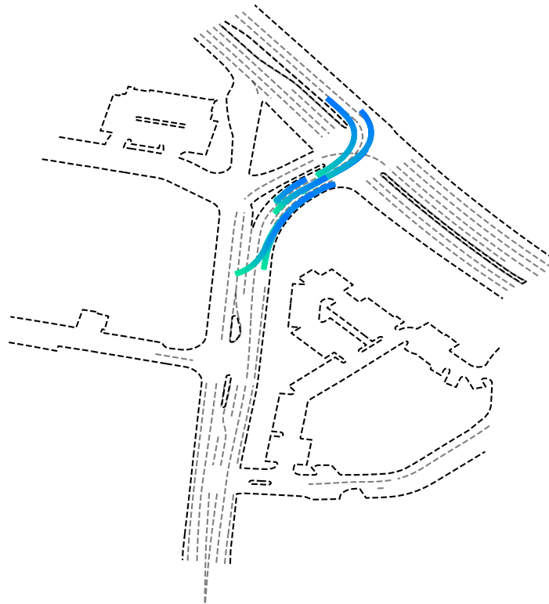
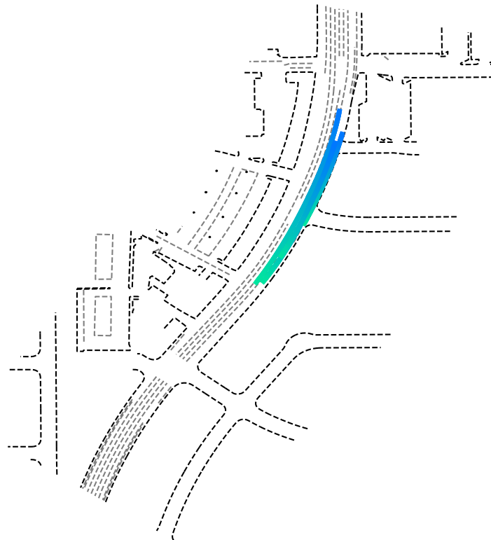
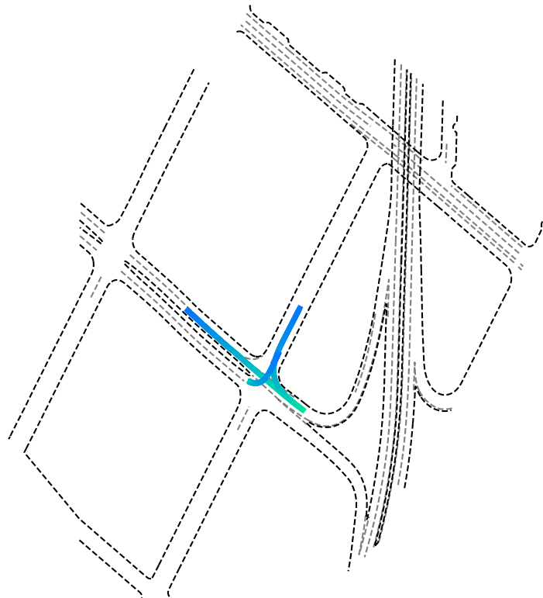
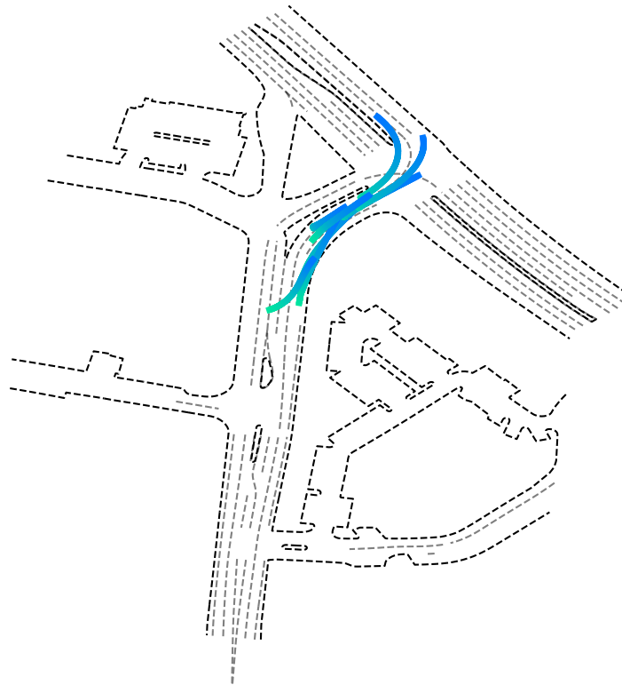



scenario input
ground truth
model output
time stemp (s)

Slide 9
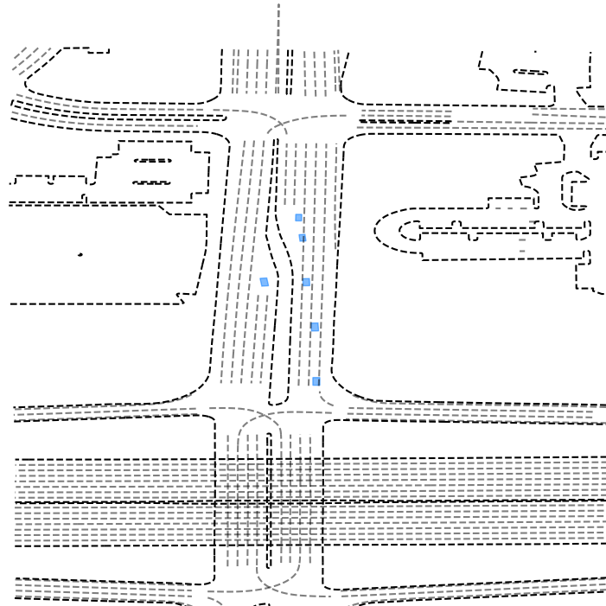
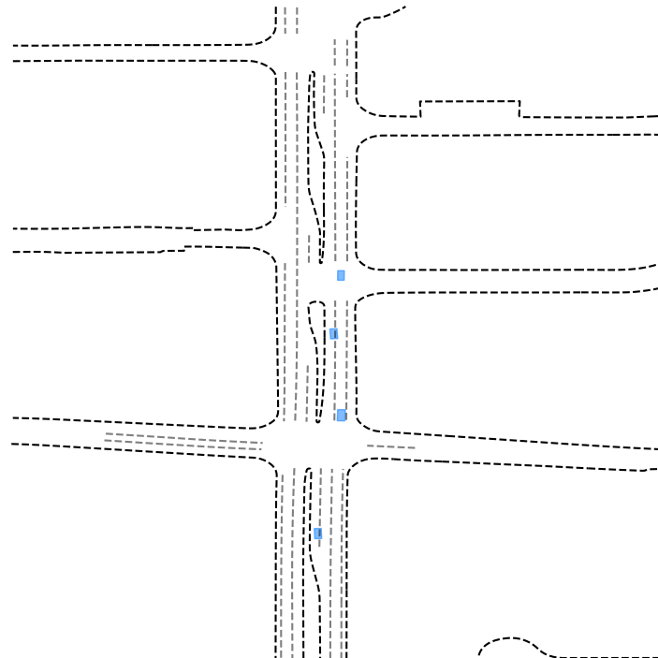
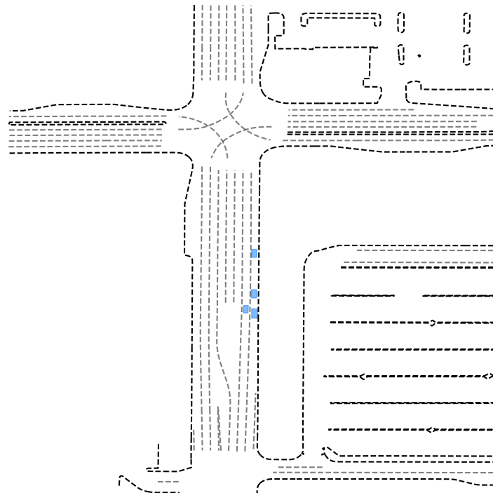
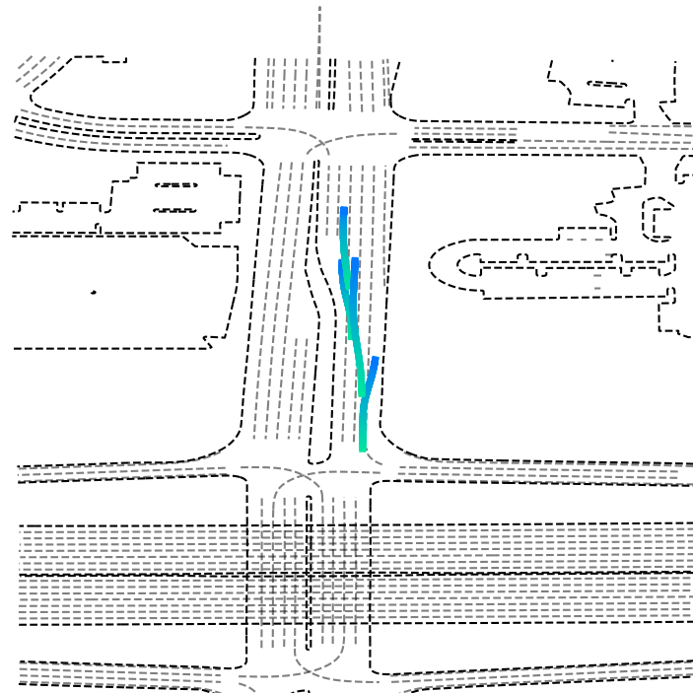
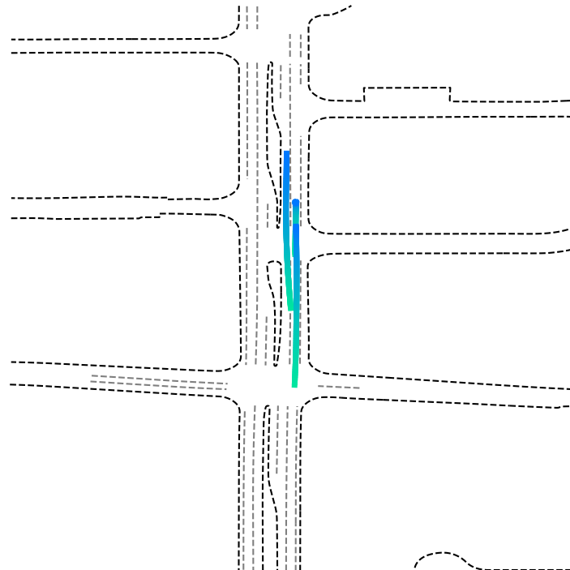
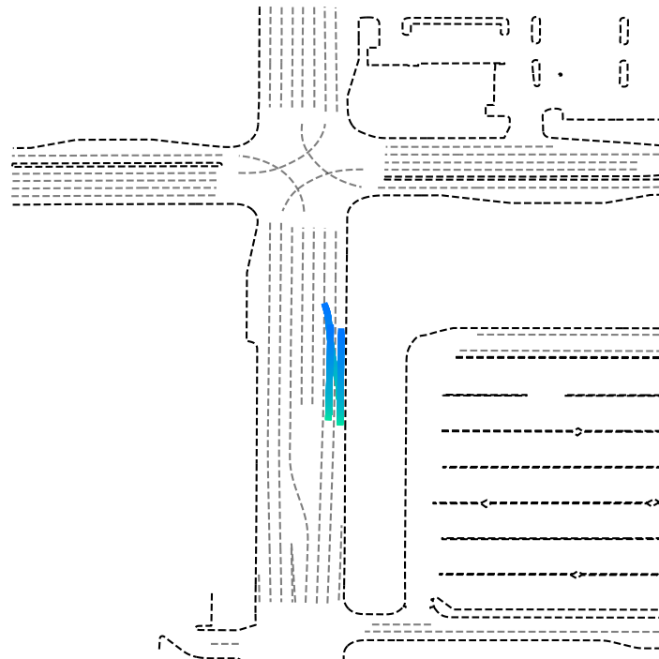

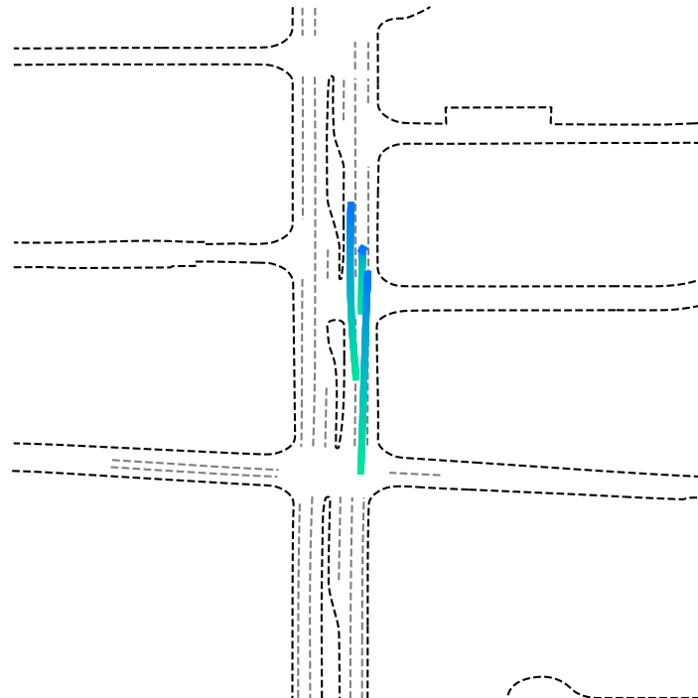
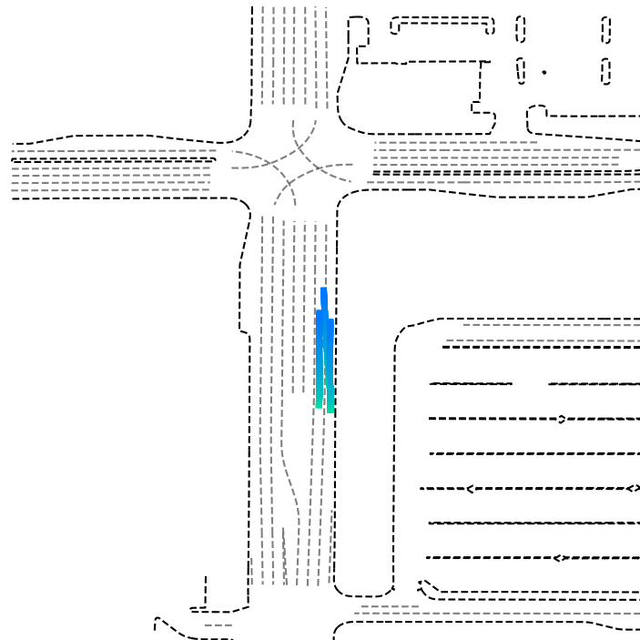
scenario input
ground truth
model output
time stemp (s)

