Slide 1
PointCLIP: Point Cloud Understanding by CLIP
Yang Cheng
yang.cheng@tum.de

Slide 2
Outline
Introduction
Main contributions
Method
Experimental results
Summary and future work
Q&A

Slide 3
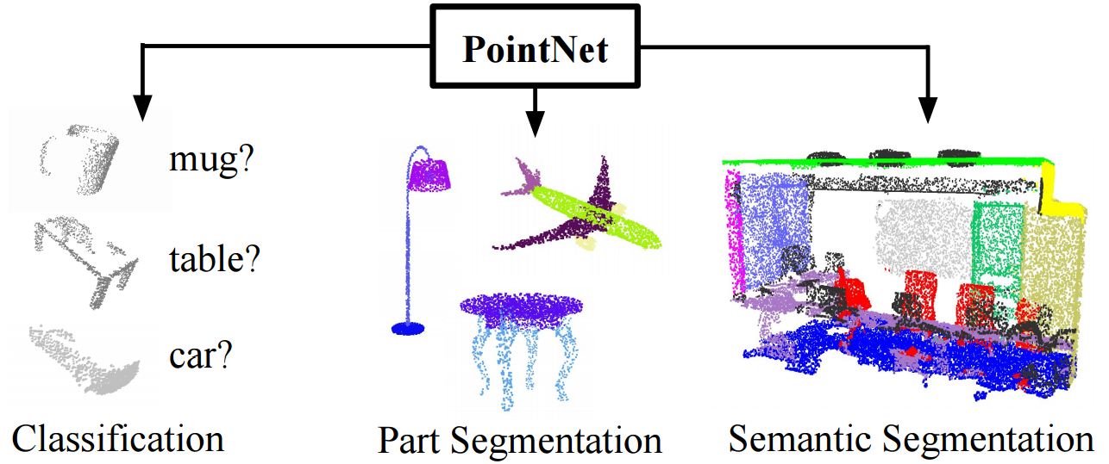
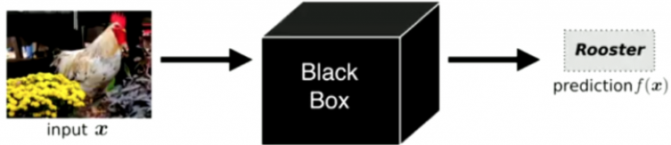
Introduction
Fact 1:deep learning dominates 2D and 3D computer vision tasks.^{1，2，3}
Figure 1. DL acts as a black box
Figure 2. Tasks PointNet⁴ can solve

Slide 4
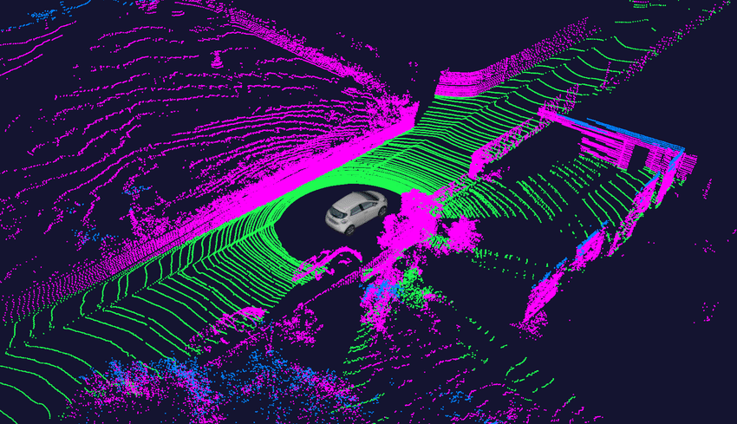
Introduction
Fact 2:the need to process 3D point cloud data rises dramatically.^{4,5}
Figure 3. Real world perceived as 3D point cloud data

Slide 5
Introduction
Bad news: the recognition of 3D point cloud data is still a challenge.
Reason: the input 3D point cloud data is often unseen to the model, due to the small number of classes in 3D point cloud dataset.
Dataset | Numbers of classes
ImageNet | 21841
ModelNet10 | 10
ModelNet40 | 40
ScanObjectNN | 15
Table 1. Comparison between ImageNet and widely used 3D point cloud datasets

Slide 6
Introduction
Good news: the CLIP(Contrastive Language-image Pre-training) technique can recognize unseen class in 2D domain.
Natural idea: we can transfer the knowledge of CLIP to 3D domain.
This is the origin of PointCLIP.

Slide 7
Main contributions
Proposes PointCLIP to extend CLIP for handling 3D cloud data.
An inter-view adapter is introduced upon PointCLIP and largely improves the performance by few-shot fine-tuning.
PointCLIP can be utilized as a multi-knowledge ensemble module to enhance the performance of existing fully-trained 3D networks.

Slide 8
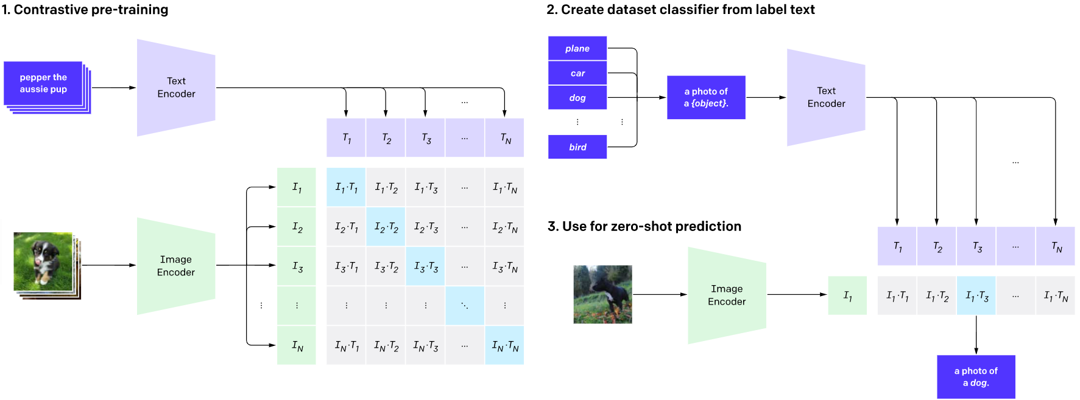
Method
A revisit of CLIP⁶
Figure 4. Pipeline of CLIP

Slide 9
Method
Zero-shot classification: the model recognize a certain class, without having been trained on any sample of this class.
Few-shot classification: the model recognize a certain class, with having been trained on only a few samples of this class.

Slide 10
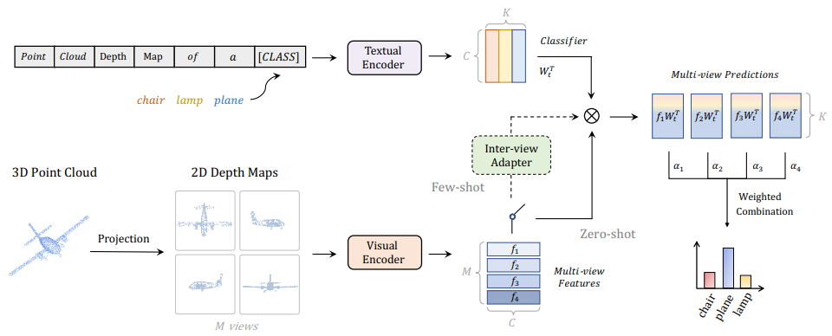
Method
Zero-shot Classification of PointCLIP.
Figure 5. Pipeline of PointCLIP

Slide 11
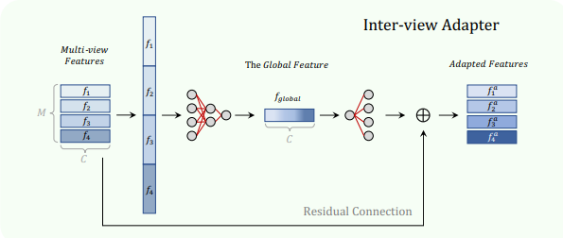
Method
Few-shot Classification of PointCLIP.
Figure 6. Pipeline of PointCLIP’s adapter

Slide 12
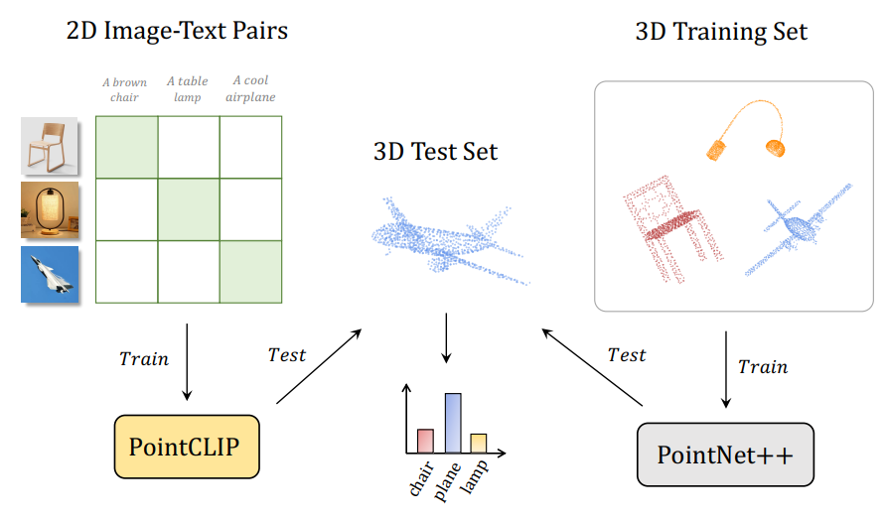
Method
Multi-knowledge Ensemble
Main idea: ensemble the 2D pre-trained knowledge of PointCLIP with the 3D knowledge of classical 3D networks.
Figure 7. Comparison of Training-testing Schemes between PointClip and PointNet++

Slide 13
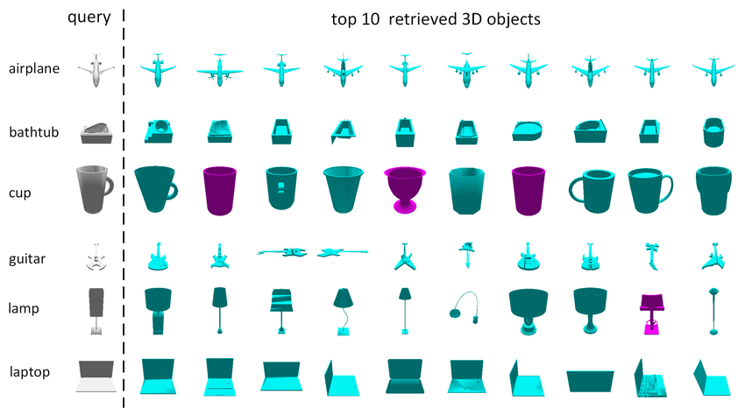
Experimental Results
Dataset: ModelNet10,ModelNet40 and ScanObjectNN, they almost only include indoor items, and have 10,40,15 categories,respectively.
Evaluation protocol: the recognition accuracy.
Figure 8. 6 categories in ModelNet40

Slide 14
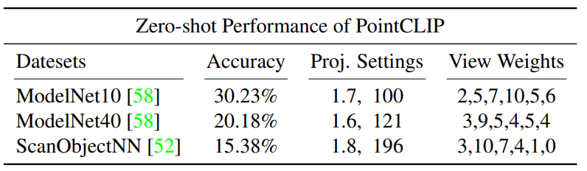
Experimental Results
Zero-shot performance.
Table 2. Zero-shot Performance on different datasets with the best-performing settings.

Slide 15
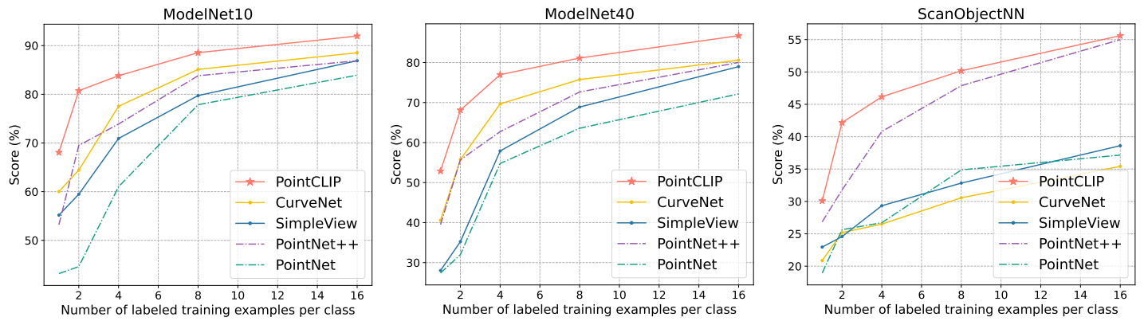
Experimental Results
Few-shot performance
Figure 9. Few-shot performance comparison between PointCLIP and other classical 3D networks on 3 datasets.

Slide 16
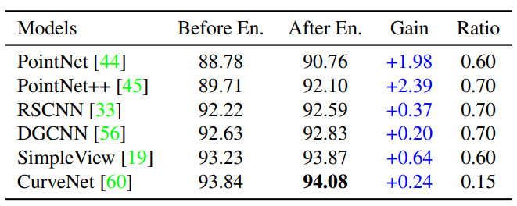
Experimental Results
Performance under multi-knowledge ensemble
Table 3. The enhancement (%) of multi-knowledge ensemble by 16-shot PointCLIP, which achieves 87.20% on ModelNet40.

Slide 17
Summary and future work
The researchers proposed PointCLIP, which conducts zero-shot recognition on point cloud without any 3D training.
Via multi-view projection, PointCLIP effienctly transfers CLIP’s pre-trained 2D knowledge into 3D domains.
Designed an inter-view adapter to aggregate multi-view features and fuse the 3D learned knowledge into pre-trained CLIP under few-shot settings.
PointCLIP could serve as a plug-and-play module to provide complementary knowledge for the classical 3D networks.

Slide 18
Summary and future work
Besides recognition, the future work will focus on generalizing CLIP for wider 3D applications, such as semantic segmentation,part segmentation etc.

Slide 19
Q&A session
Do you have any questions?
?

Slide 20
References
[1]. He K., et al. Deep residual learning for image recognition. In Proceedings of the IEEE conference on computer vision and pattern recognition, pages 770–778, 2016.
[2]. Carion N., et al. End-toend object detection with transformers. In European Conference on Computer Vision, pages 213–229. Springer, 2020.
[3]. Chen L., et al. Semantic image segmentation with deep convolutional nets, atrous convolution, and fully connected crfs. IEEE transactions on pattern analysis and machine intelligence, 40(4):834–848, 2017.
[4]. Qi C., et al. Pointnet: Deep learning on point sets for 3d classification and segmentation. In Proceedings of the IEEE conference on computer vision and pattern recognition, pages 652–660, 2017.
[5]. Guo M., et al. Pct: Point cloud transformer. Computational Visual Media, 7(2):187–199, 2021.

Slide 21
References
[6]. Radford A., et al. Learning transferable visual models from natural language supervision. arXiv preprint arXiv:2103.00020, 2021.

