Slide 1
專題研究 WEEK2
Prof. Lin-shan Lee
TA. Chih-Wei Lee

Slide 2


語音辨識系統
Use Kaldi as tool
Feature
Vectors
Input Speech
Output
Sentence
Front-end
Signal Processing
Linguistic Decoding
and
Search Algorithm
Speech
Corpora
Acoustic
Model
Training
Acoustic
Models
Language
Model
Language
Model
Construction
Text
Corpora
Lexicon
Lexical
Knowledge-base
Grammar

Slide 3

Feature Extraction (7)
Feature Extraction

Slide 4

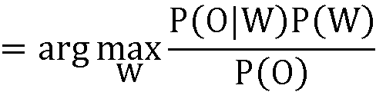

How to do recognition? (2.8)
How to map speech O to a word sequence W ?
P(O|W): acoustic model
P(W): language model
Notes:
如何做recognition? 上面這邊老師上課有講過，要提醒一下的是下面的這兩個式子的意義
P(W) 算word機率多少的model就叫language model
把observation跟W一起看然後算機率的model就是叫acoustic model

Slide 5
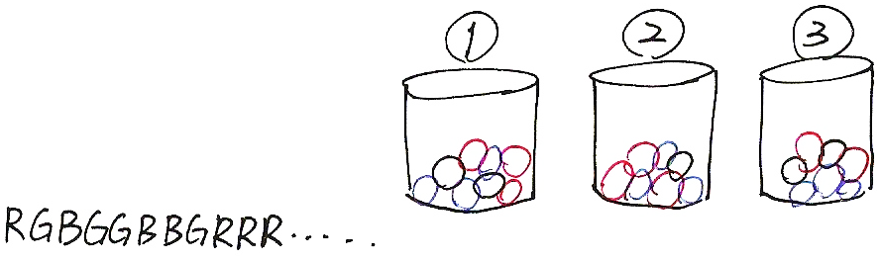
Hidden Markov Model
0.6
s₁
{A:.3,B:.2,C:.5}
0.3
0.3
0.3
0.1
0.7
s₂
0.2
s₃
0.7
0.2
{A:.7,B:.1,C:.2}
{A:.3,B:.6,C:.1}
Simplified HMM
RGBGGBBGRRR……
Notes:
我們用這三籃球來模擬HMM 我們被given的是一串observation，而且我們不知道每個observation個別是從哪個籃子抽出，我們需要根據這observation來推測一個籃子的sequence

Slide 6
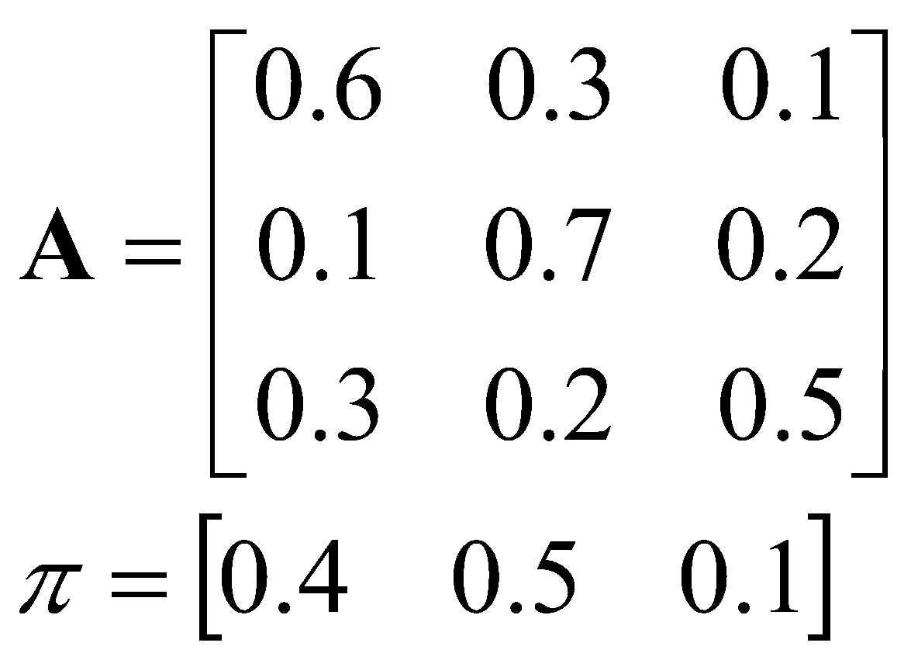
Hidden Markov Model
Elements of an HMM {S,A,B,π}
S is a set of N states
A is the N✕N matrix of state transition probabilities
B is a set of N probability functions, each describing the observation probability with respect to a state
π is the vector of initial state probabilities
0.6
s₁
{A:.3,B:.2,C:.5}
0.3
0.3
0.3
0.1
0.7
s₂
0.2
s₃
0.7
0.2
{A:.7,B:.1,C:.2}
{A:.3,B:.6,C:.1}
Notes:
B就是籃子內球的分布的情況

Slide 7
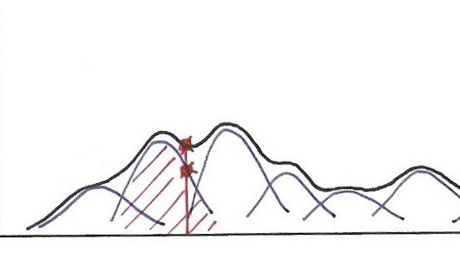
Gaussian Mixture Model (GMM)

Slide 8
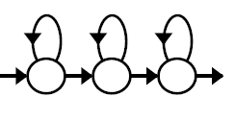
Acoustic Model P(O|W)
How to compute P(O|W) ?
ㄐ
一ㄣ
ㄊ
一ㄢ

Slide 9
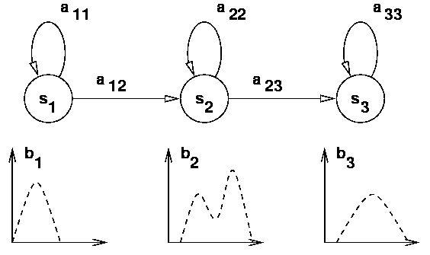

Acoustic Model P(O|W)
Model of a phone
Markov Model
(2.1, 4.1-4.5)
Gaussian Mixture Model (2.2)
Notes:
對於一個phone，比如說ㄋ這音，中間可能就會經過三個state，每個state我們都會用GMM去描述他

Slide 10
An example of Modifying HMM
State
s₃
s₃
s₃
s₃
s₃
s₃
s₃
s₃
s₃
s₃
s₂
s₂
s₂
s₂
s₂
s₂
s₂
s₂
s₂
s₂
s₁
s₁
s₁
s₁
s₁
s₁
s₁
s₁
s₁
s₁
1 2 3 4 5 6 7 8 9 10
O₁
O₂
O₃
O₄
O₅
O₆
O₇
O₈
O₉
O₁₀
v₁
b₁(v₁)=3/4, b₁(v₂)=1/4
b₂(v₁)=1/3, b₂(v₂)=2/3
b₃(v₁)=2/3, b₃(v₂)=1/3
v₂
Notes:
假設我們求出一個state sequence後，我們要重新modify我們的參數 v1, v2 is the content of the observation, i.e., there are only two kinds of observations. state sequence is given, we need to calculate bi(v). state1 has four observations, 3 v1 and 1 v2. As a result, the

Slide 11
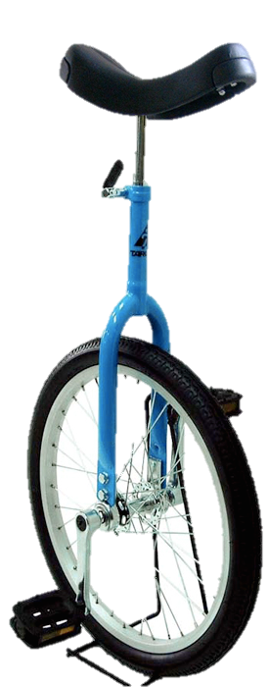
Monophone vs. triphone
Monophone
a phone model uses only one phone.
Triphone
a phone model taking into consideration both left and right neighboring phones (60)³→ 216,000
Notes:
前後不一樣就是不一樣

Slide 12
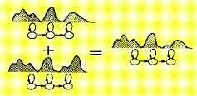
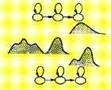
Triphone
a phone model taking into consideration both left and right neighboring phones (60)³→ 216,000
Sharing at Model Level
Sharing at State Level
Generalized Triphone
Shared Distribution Model (SDM)
Notes:
我們可以把兩個data 量很少的tri-phone完全綁在一起，當然也可以有彈性的只對其中某幾個phone做binding
~h p1 <state1> ~s p1p2_1 <State2> ~s p1p2_2 <state3> p1_own_state
~h p2 <state1> ~s p1p2_1 <State2> ~s p1p2_2 <state3> p2_own_state
what happened if we turn on the three free states?
too free, hard to find common feature(the binded states)
might be misleaded by other minor noise

Slide 13
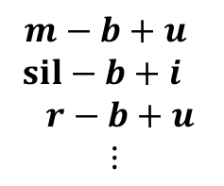
Training Tri-phone Models with Decision Trees
An Example: “( _ ‒ ) b ( +_ )”
12
yes
no
30
sil-b+u
a-b+u
o-b+u
y-b+u
Y-b+u
32
46
42
U-b+u
u-b+u
24
i-b+u
Example Questions:
12: Is left context a vowel?
24: Is left context a back-vowel?
30: Is left context a low-vowel?
32: Is left context a rounded-vowel?
e-b+u
r-b+u
50
N-b+u
M-b+u
E-b+u
Notes:
我們用decision tree來決定哪些phone該合併

Slide 14
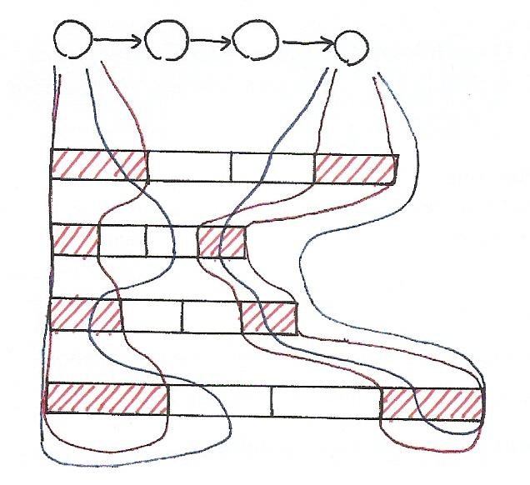
Segmental K-means
Notes:
第一次大家平均切，紅色部分
之後就開始重新切，黑色曲線

Slide 15
Acoustic Model Training
03.mono.train.sh
05.tree.build.sh
06.tri.train.sh

Slide 16
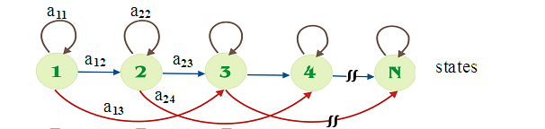
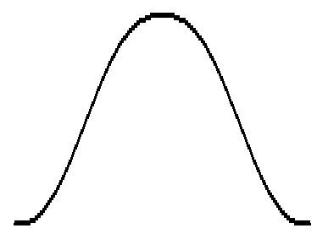
Acoustic Model
16
Hidden Markov Model/Gaussian Mixture Model
3 states per model
Example
Notes:
接下來就是要講acoustic model，什麼是acoustic model?就是前面說的有observation sequence我們要decode出state sequence到後面更進一步的decoding

Slide 17
Implementation
Bash script, HMM training.

Slide 18

Bash script
#!/bin/bash
count=99
if [ $count -eq 100 ]
then
echo "Count is 100"
elif [ $count -gt 100 ]
then
echo "Count is greater than 100"
else
echo "Count is less than 100"
fi

Slide 19

Bash script
[ condition ] uses ‘test’ to check. Ex. test -e ~/tmp; echo $?
File [ -e filename ]
-e 該『檔名』是否存在？
-f 該『檔名』是否存在且為檔案(file)？
-d 該『檔名』是否存在且為目錄(directory)？
Number [ n1 -eq n2 ]
-eq 兩數值相等 (equal)
-ne 兩數值不等 (not equal)
-gt n1 大於 n2 (greater than)
-lt n1 小於 n2 (less than)
-ge n1 大於等於 n2 (greater than or equal)
-le n1 小於等於 n2 (less than or equal)
空白不能少！！！！！！！

Slide 20

Bash script
Logic
-a (and)兩狀況同時成立！
-o (or)兩狀況任何一個成立！
! 反相狀態
[ "$yn" == "Y" -o "$yn" == "y" ]
[ "$yn" == "Y" ] || [ "$yn" == "y" ]
雙引號不可少！！！！！

Slide 21

Bash script
i=0
while [ $i -lt 10 ]
do
echo $i
i=$(($i+1))
done
for (( i=1; i<=10; i=i+1 ))
do
echo $i
done
空白不可少！！！！

Slide 22
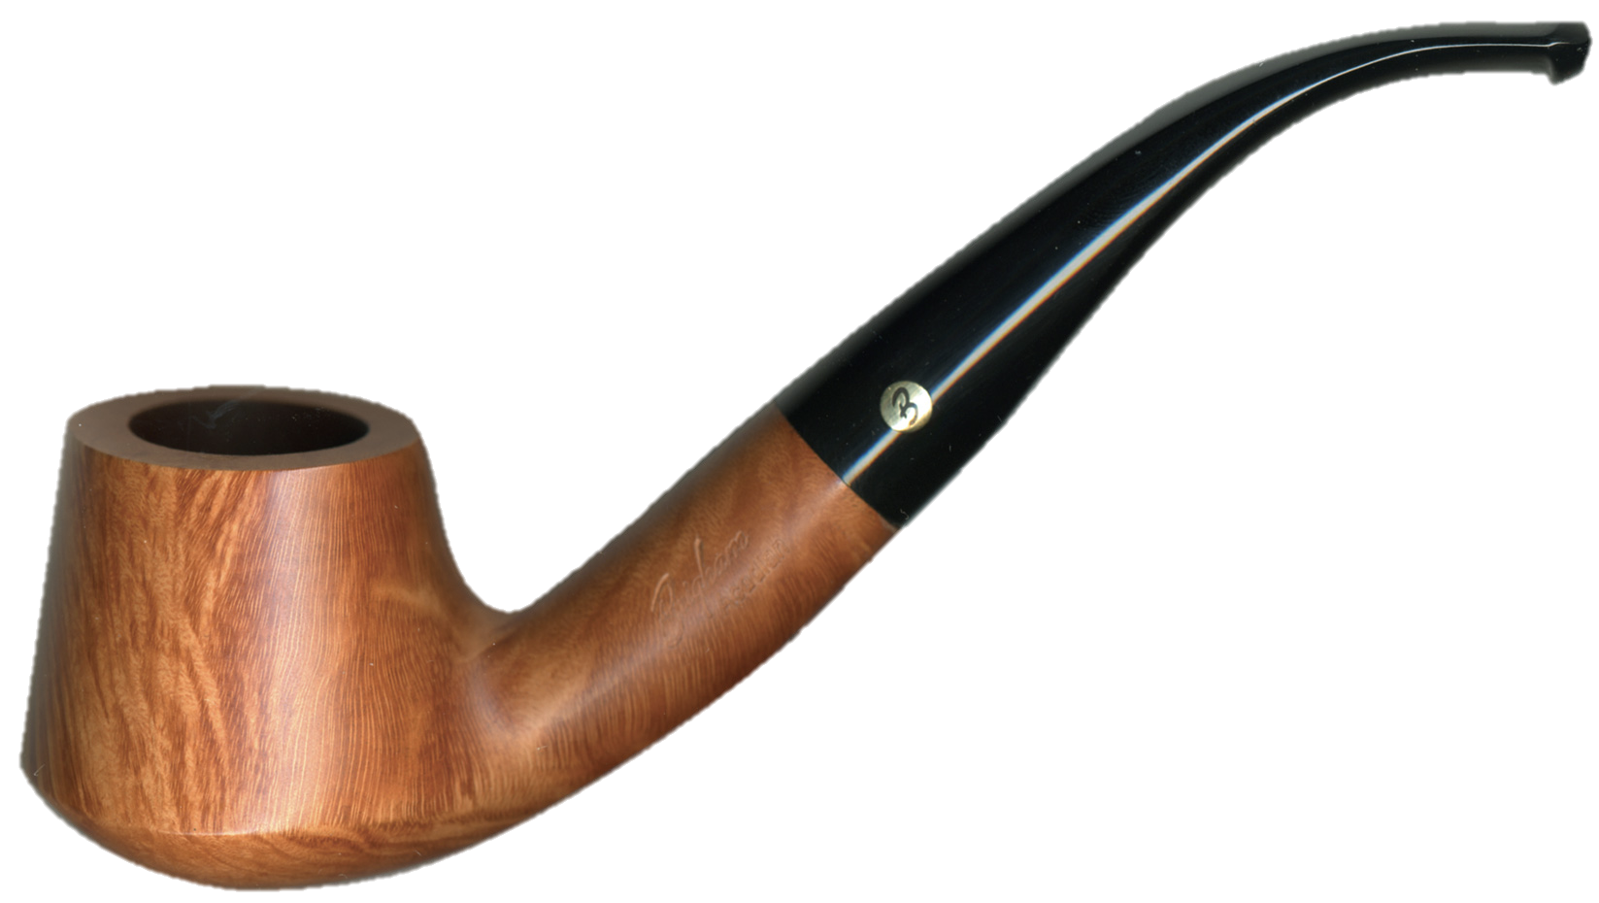
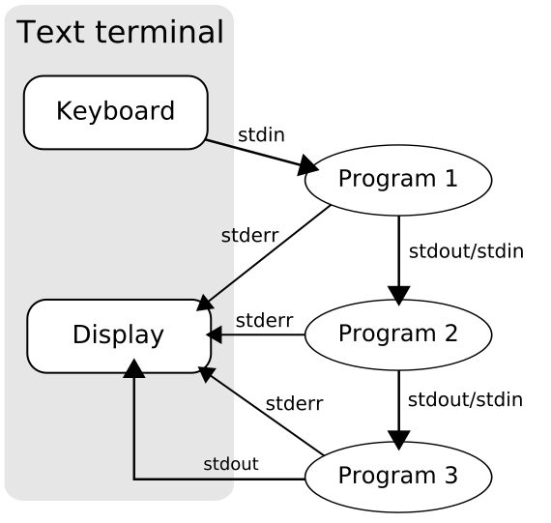
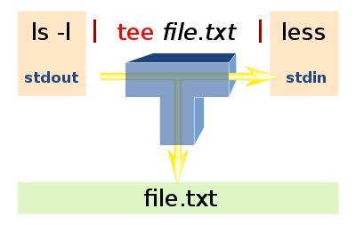
Bash script
Pipeline
cat filename | head
ls -l | grep key | less
program1 | program2 | program3
echo “hello” | tee log

Slide 23
Bash script
` operation
echo `ls`
my_date=`date`
echo $my_date
&& || ; operation
echo hello || echo no~
echo hello && echo no~
[ -f tmp ] && cat tmp || echo "file not found”
[ -f tmp ] ; cat tmp ; echo "file not found”
Some useful commands.
grep, sed, touch, awk, ln

Slide 24
Training steps
Get features(previous section)
Train monophone model
a. gmm-init-mono initial monophone model
b. compile-train-graphs get train graph
c. align-equal-compiled model -> decode&align
(gmm-align-compiled for later iteration)
d. gmm-acc-stats-ali EM training: E step
e. gmm-est EM training: M step
Use previous model to build decision tree(for triphone).
Train triphone model
Notes:
其實不是go to step c, 是做了一次EM後，iteration裡是做gmm-align-compiled

Slide 25
Training steps
Get features(previous section)
Train monophone model
Use previous model to build decision tree(for triphone).
Train triphone model
a. gmm-init-model Initialize GMM ( from decision tree)
b. gmm-mixup Gaussian merging (increase #gaussian)
c. convert-ali Convert alignments(model <-> decisoin tree)
d. compile-train-graphs get train graph
e. gmm-align-compiled model -> decode&align
f. gmm-acc-stats-ali EM training: E step
g. gmm-est EM training: M step
h. Goto step e. train several times
Notes:
EM In HMM, the E-step is to estimate gamma and episilon
The M-Step is use gamma and episilon to re-estimate pi, aij, bj

Slide 26
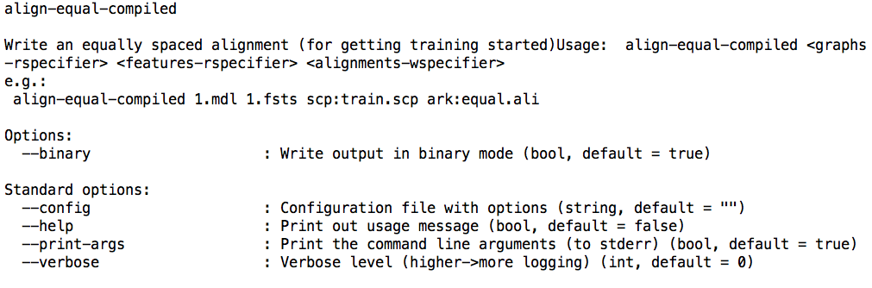
How to get Kaldi usage?
source setup.sh
align-equal-compiled --help

Slide 27
align-equal-compiled
Write an equally spaced alignment (for getting training started)
Usage: align-equal-compiled <graphs-rspecifier> <features-rspecifier> <alignments-wspecifier>
e.g.:
align-equal-compiled 1.mdl 1.fsts scp:train.scp ark:equal.ali
gmm-align-compiled $scale_opts --beam=$beam --retry-beam=$[$beam*4] <hmm-model*> ark:$dir/train.graph ark,s,cs:$feat ark:<alignment*>
For first iteration(in monophone) beamwidth = 6, others = 10;
Only realign at
$realign_iters="1 2 3 4 5 6 7 8 9 10 12 14 16 18 20 23 26 29 32 35 38”
$realign_iters=“10 20 30”
Notes:
在mono train realign多次一點，在其他像是tri training就可以少一點

Slide 28
gmm-acc-stats-ali
Accumulate stats for GMM training.(E step)
Usage: gmm-acc-stats-ali [options] <model-in> <feature-rspecifier> <alignments-rspecifier> <stats-out>
e.g.:
gmm-acc-stats-ali 1.mdl scp:train.scp ark:1.ali 1.acc
gmm-acc-stats-ali --binary=false <hmm-model*> ark,s,cs:$feat ark,s,cs:<alignment*> <stats>

Slide 29
gmm-est
Do Maximum Likelihood re-estimation of GMM-based acoustic model
Usage: gmm-est [options] <model-in> <stats-in> <model-out>
e.g.: gmm-est 1.mdl 1.acc 2.mdl
gmm-est --binary=false --write-occs=<*.occs> --mix-up=$numgauss <hmm-model-in> <stats> <hmm-model-out>
--write-occs : File to write pdf occupation counts to.
$numgauss increases every time.
Notes:
pdf occupation counts: basic problem3 裡面的gamma episilon算那些個數的東西出現的個數

Slide 30
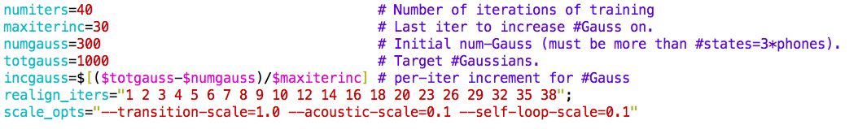

Hint (extremely important!!)
03.mono.train.sh
Use the variables already defined.
Use these formula:
Pipe for error
compute-mfcc-feats … 2> $log

Slide 31
Homework
HMM training. Unix shell programming.
03.mono.train.sh
05.tree.build.sh
06.tri.train.sh

Slide 32
Homework(Opt)
閱讀：
數位語音概論 ch4, ch5.

Slide 33
ToDo
Step1. Execute the following commands.
script/03.mono.train.sh | tee log/03.mono.train.log
script/05.tree.build.sh | tee log/05.tree.build.log
script/06.tri.train.sh | tee log/06.tri.train.log
Step2. finish code in ToDo
script/03.mono.train.sh
script/06.tri.train.sh
Step3. Observe the output and results.
Step4.(Opt.) tune #gaussian and #iteration.

Slide 34
Questions?
Try drawing the workflow of training.

