Slide 1
深度學習 暑期訓練 (2016)
李宏毅專題 Track A, B, C 的時間、地點開學前通知

Slide 2
作業繳交
四個作業
因為是暑假，所以並不強迫繳交
請加入 FB 社團「深度學習暑期訓練 (2016)」
如果有做的話，可以上傳到FB 社團給助教、同學、老師看
建議修李宏毅專題的同學如果對deep learning 沒有概念的話一定要做
等一下會講作業大概的內容
都很簡單
作業詳細內容和做法提示預計下周二(8/09)公告在社團上
會使用 keras 這套工具 (歡迎自學 Tensorflow )

Slide 3
學習教材
「資料科學愛好者年會」六小時演講錄影
嚴禁外流

Slide 4
學習教材
Lecture 1
深度學習簡介
Lecture 2
深度學習技巧
Lecture 3
Convolutional Neural Network (CNN) 和 Recurrent Neural Network (RNN)
Lecture 4
深度學習應用與展望
投影片: http://www.slideshare.net/tw_dsconf/ss-62245351 (可公開)

Slide 5
助教
作業一: 盧柏儒
作業二: 黃邦齊
作業三: 李致緯
作業四: 萬家宏
其他助教：莊舜博、鍾佩宏、張瓊之、楊棋宇
作業問題在社團上討論

Slide 6
工作站
專題工作站
在週四 (8/04) 中午前以下 google doc 登記
下週二前(8/09)開帳號
如果每組自己有 linux 系統會比較快樂
如果每組自己有 GPU 會更快樂

Slide 7
作業說明

Slide 8
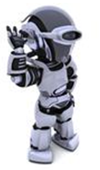
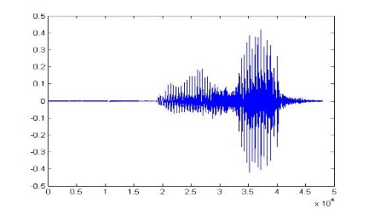
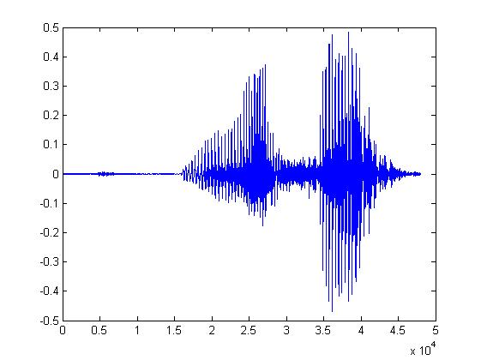
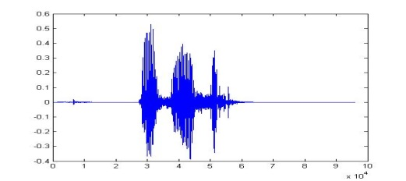
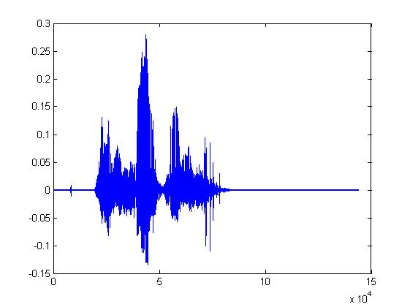
Machine Learning
Learning ......
“Hi”
“How are you”
You said “Hello”
“Good bye”
You write the program for learning.
A large amount of audio data

Slide 9

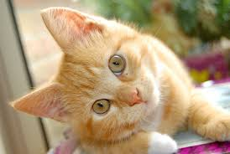
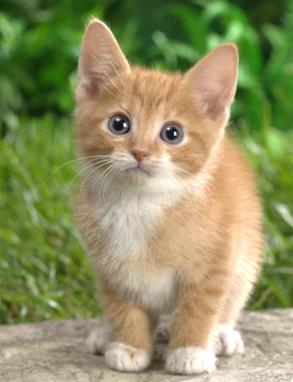

Machine Learning
Learning ......
“monkey”
“cat”
This is “cat”
“dog”
You write the program for learning.
A large amount of images

Slide 10

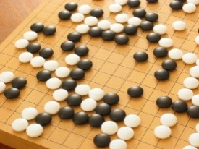
Machine Learning ≈ Looking for a Function
Speech Recognition
Image Recognition
Playing Go
Dialogue System
“How are you”
“Cat”
“5-5”
(next move)
“Hi”
“Hello”
(what the user said)
(system response)

Slide 11
Framework
Image Recognition:
“cat”
A set of function
Model
“cat”
“money”
“dot”
“snake”
Notes:
Repeat again

Slide 12
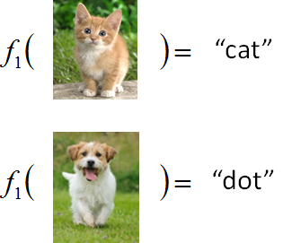
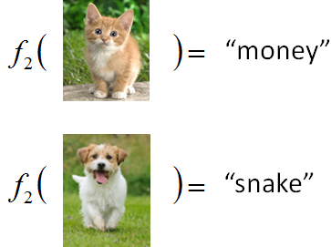
Framework
Image Recognition:
“cat”
A set of function
Model
Better!
Goodness of function f
Supervised Learning
Training
Data
function input:
function output:
“monkey”
“cat”
“dog”
Notes:
Repeat again

Slide 13
Framework
Image Recognition:
“cat”
Neural Network
Testing
A set of function
Model
Training
“cat”
Step 1
Goodness of function f
Pick the “Best” Function
Using
Step 2
Step 3
Training
Data
“monkey”
“cat”
“dog”
Notes:
Repeat again

Slide 14
Neural Network
neuron
Input
Layer 1
Layer 2
Layer L
Output
……
y₁
……
y₂
……
……
……
……
……
……
y_{M}
Input Layer
Output Layer
Hidden Layers
Deep means many hidden layers
Notes:
You can connect the neurons by other ways you like ☺
How many layer is deep?
CNN just another way to connect the neuros.
You can always connect the neurons in your own way.
“+” is ignored
Each dimension corresponds to a digit (10 dimension is needed)

Slide 15
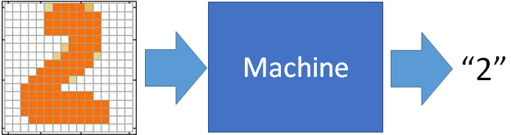




作業一
教材: lecture 1, lecture 2
Task 1
“5”
“0”
“4”
“1”
basic：higher than a specific accuracy (等助教公布)
option：analyze the output of each layer

Slide 16



作業一
教材: lecture 1, lecture 2
Task 2
Network
政治
體育
政治
財經
http://top-breaking-news.com/
basic：higher than a specific accuracy (等助教公布)
option：analyze the output of each layer

Slide 17
作業一
教材: lecture 1, lecture 2
More reference:
Example code of task 1: https://github.com/fchollet/keras/blob/master/examples/mnist_mlp.py
Example code of task 2: https://github.com/fchollet/keras/blob/master/examples/reuters_mlp.py
Neural Networks and Deep Learning
http://neuralnetworksanddeeplearning.com/
Chapter 1 - 3

Slide 18

作業二
教材: lecture 3 – Convolutional Neural Network
Image Recognition
“monkey”
“monkey”
Network
“cat”
“cat”
“dog”
“dog”

Slide 19
作業二
教材: lecture 3 – Convolutional Neural Network
Basic：higher than a specific accuracy (等助教公布)
option：analyze the functionality of “filter”
More Reference:
Example code: https://github.com/fchollet/keras/blob/master/examples/cifar10_cnn.py
http://cs231n.github.io/convolutional-networks/
Neural Networks and Deep Learning (Chapter 6)

Slide 20

作業三
教材: lecture 3 – Recurrent neural network
Machine learns human language
Machine writes documents
The life is …….
You do not have to teach machine grammars …….
Basic: Let machine generate an English sentence
Option: Let machine generate a Chinese sentence

Slide 21
作業三
教材: lecture 3 – Recurrent neural network
Machine learns human language
More reference
Example code: https://github.com/fchollet/keras/blob/master/examples/lstm_text_generation.py
http://karpathy.github.io/2015/05/21/rnn-effectiveness/
http://colah.github.io/posts/2015-08-Understanding-LSTMs/

Slide 22
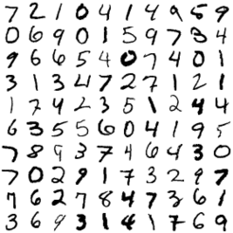

作業四
教材: lecture 4
Auto-encoder: unsupervised learning
NN
Encoder
code
Basic: visualize the “code”. Does different digits represent by different “code”?
NN
Decoder
code
Option: Given a “code”, can machine write a digit?

Slide 23
作業四
教材: lecture 4
Auto-encoder: unsupervised learning
More reference:
https://blog.keras.io/building-autoencoders-in-keras.html
Advanced:
Auto-Encoding Variational Bayes, https://arxiv.org/abs/1312.6114
Generative Adversarial Networks, http://arxiv.org/abs/1406.2661
Replacing “digits” with “images”

Slide 24
Have Fun! ☺

