Slide 1
專題研究 week3 Language Model and Decoding
Prof. Lin-Shan Lee
TA. 張瀞婷, r05942066@ntu.edu.tw

Slide 2

語音辨識系統
Use Kaldi
Hw 1
Input Speech
Front-end
Signal Processing
Feature
Vectors
Linguistic Decoding
and
Search Algorithm
Output
Sentence
Speech
Corpora
Acoustic
Model
Training
Acoustic
Models
Language
Model
Language
Model
Construction
Text
Corpora
Lexicon
Hw 2
Lexical
Knowledge-base
Grammar

Slide 3
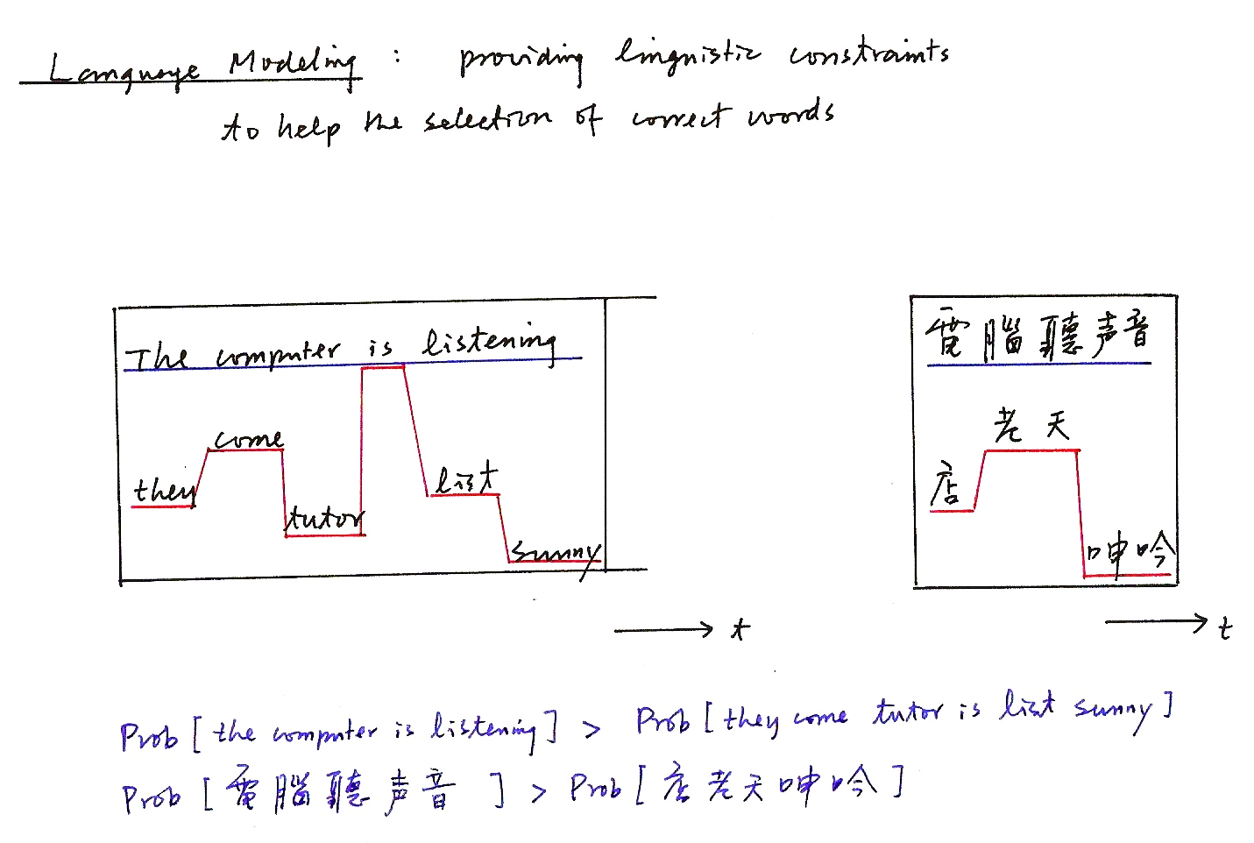
Language Modeling: providing linguistic constraints to help the selection of correct words
t
t
Prob [the computer is listening] > Prob [they come tutor is list sunny]
Prob [電腦聽聲音] > Prob [店老天呻吟]

Slide 4
Language Model Training
00.train_lm.sh
01.format.sh

Slide 5
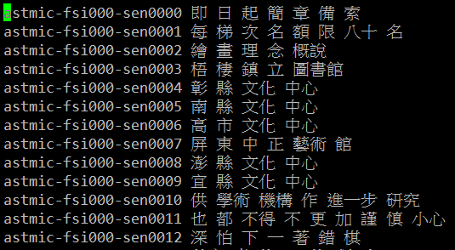
Language Model : Training Text (1/2)
train_text=ASTMIC_transcription/train.text
cut -d ' ' -f 2- $train_text > exp/lm/LM_train.text
remove the first column

Slide 6
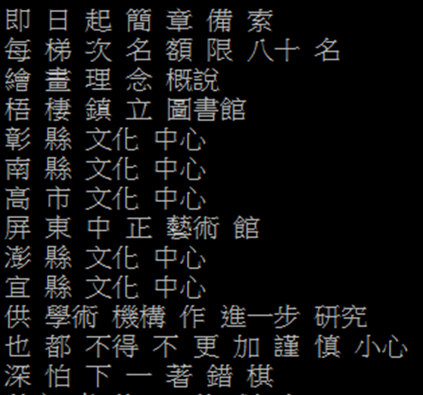
Language Model : Training Text (2/2)
cut -d ' ' -f 2- $train_text > exp/lm/LM_train.text

Slide 7
Language Model : ngram-count (1/3)
/share/srilm/bin/i686-m64/ngram-count
-order 2 (You can modify it from 1~3)
-kndiscount (modified Kneser-Ney smoothing)
-text exp/lm/LM_train.text
(Your training data file name on p.6)
-vocab $lexicon (Lexicon, as shown on p.9)
-unk (Build open vocabulary language model)
-lm $lm_output (Your language model name)
http://www.speech.sri.com/projects/srilm/manpages/ngram-count.1.html
ngram-count -help

Slide 8
Language Model : ngram-count (2/3)
Smoothing
Many events never occur in the training data
e.g. Prob [Jason immediately stands up]=0 because Prob [immediately| Jason]=0
Try to assign some non-zero probabilities to all events even if they never occur in the training data.

Slide 9
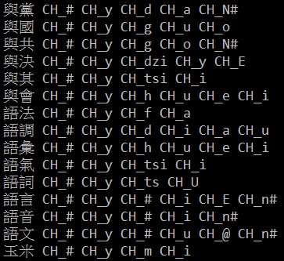
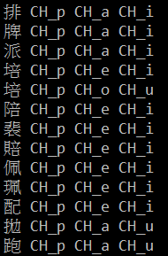
Language Model : ngram-count (3/3)
Lexicon
lexicon=material/lexicon.train.txt

Slide 10
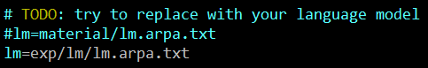
01.format.sh
Try to replace with YOUR language model !

Slide 11
Decoding

Slide 12
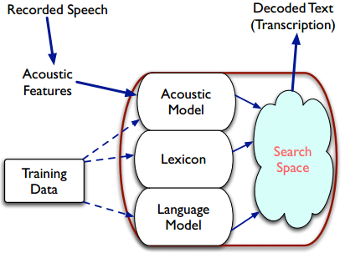

Decoding
Find the most probable word sequence $\hat{W}=w_{1} , w_{2}, …, w_{m}$
given the acoustic observations $\hat{X}=x_{1} , x_{2}, …, x_{n}$

Slide 13
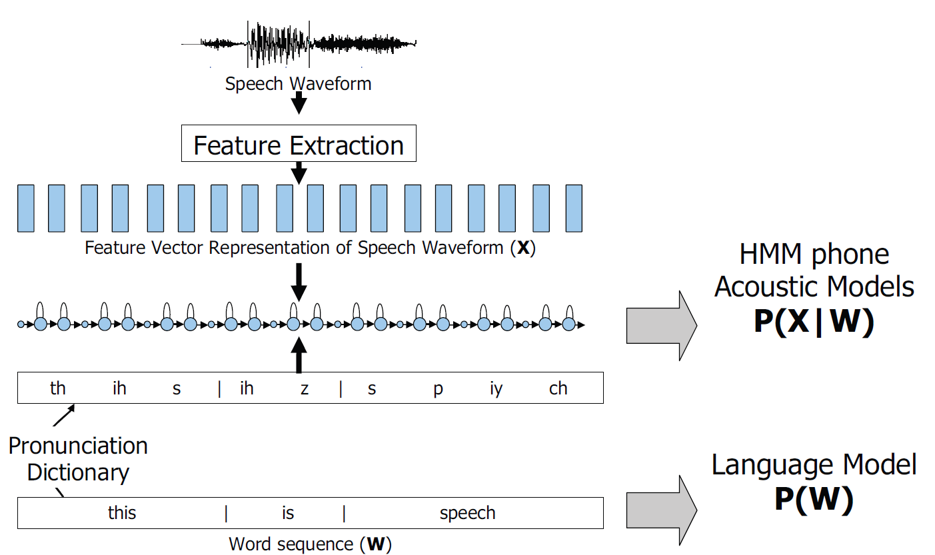
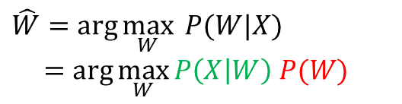
Framework for Speech Recognition
$$\hat{W}=\arg{\max_{W}{ P(W|X)}}$$
$=\arg{\max_{W}{P\left(X | W\right) P(W)}}$
(Lexicon)

Slide 14
Decoding
WFST Decoding
04a.01.mono.mkgraph.sh
04a.02.mono.fst.sh
07a.01.tri.mkgraph.sh
07a.02.tri.fst.sh

Slide 15
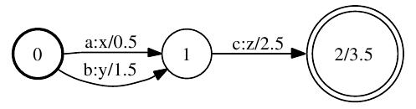
WFST Decoder
WFST
Like a weighted FSA but with two tapes : input and output.
Ex. Input tape : “ac” → Output tape : “xz”
Cost = 0.5 + 2.5 + 3.5 = 6.5
Ex. Input tape : “bc” → Output tape : “yz”
Cost = 1.5 + 2.5 + 3.5 = 7.5

Slide 16
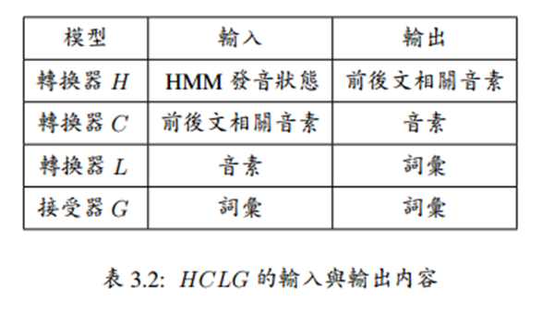
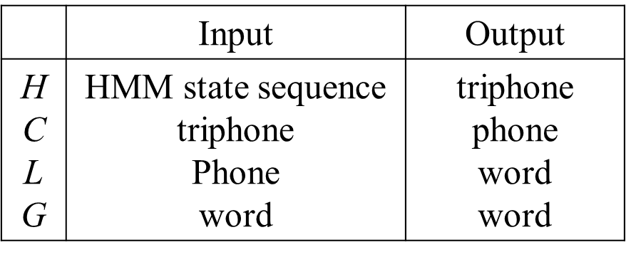
WFST Decoder: Component
HCLG = H。C。L。G
H: HMM structure
C: Context-dependent relabeling
L: Lexicon
G: language model acceptor

Slide 17
WFST Component
Where is C ?
(Context-Dependent)
H (HMM)
L(Lexicon)
G (Language Model)

Slide 18
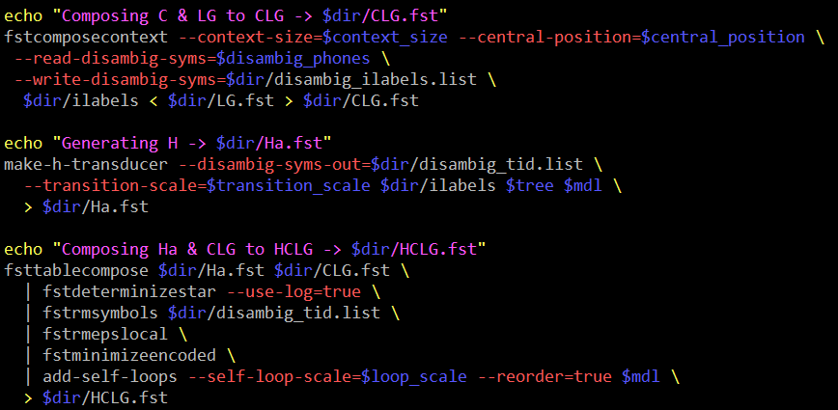
Training WFST
04a.01.mono.mkgraph.sh
07a.01.tri.mkgraph.sh

Slide 19
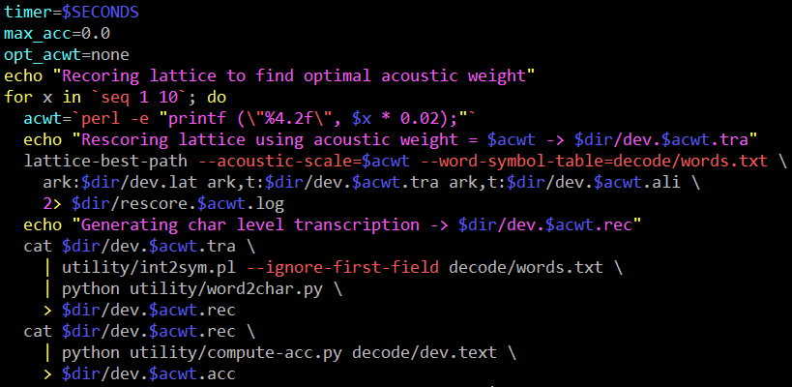
Decoding WFST (1/2)
04a.02.mono.fst.sh
07a.02.tri.fst.sh

Slide 20
Decoding WFST (2/2)
During decoding, we need to specify the weight respectively for acoustic model and language model
Split the corpus to Train, Test, Dev set
Training set used to training acoustic model
Test all of the acoustic model weight on Dev set, and use the best
Test set used to test our performance (Word Error Rate, WER)

Slide 21
Decoding
Viterbi Decoding
04b.mono.viterbi.sh
07b.tri.viterbi.sh

Slide 22
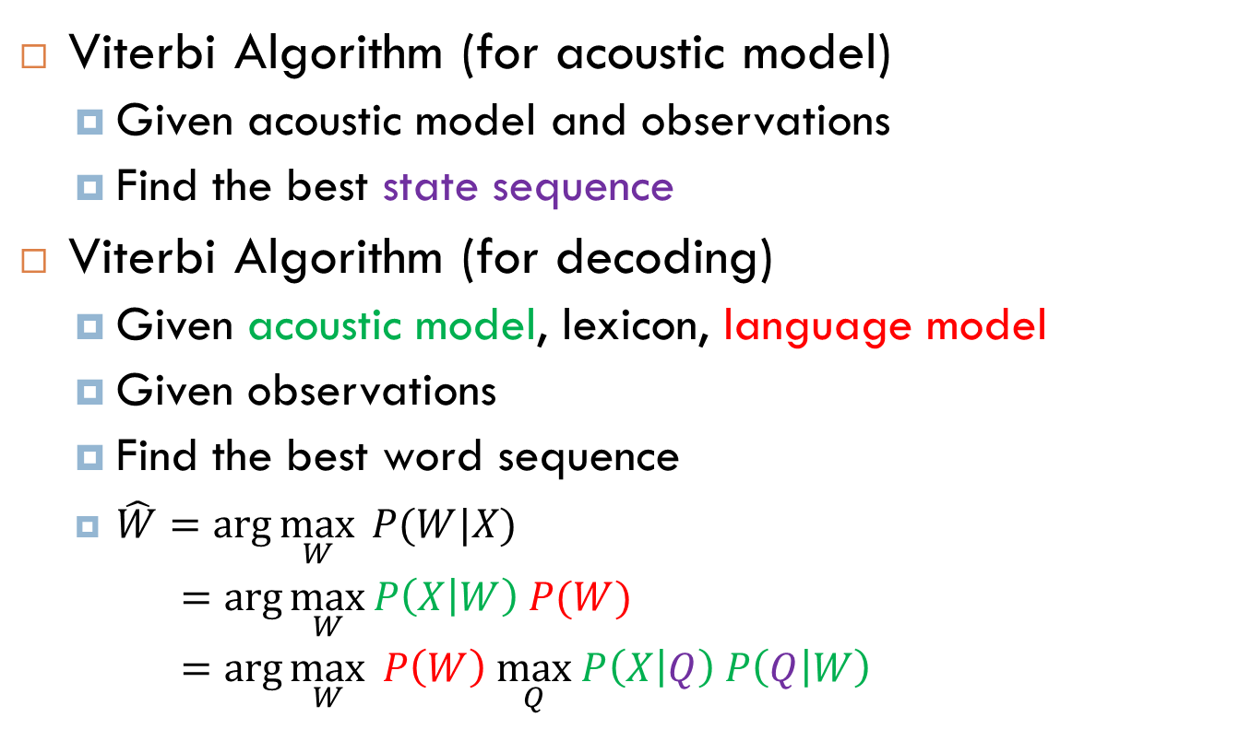
Viterbi Decoding
Viterbi Algorithm (for acoustic model)
Given acoustic model and observations
Find the best state sequence
Viterbi Algorithm (for decoding)
Given acoustic model, lexicon, language model
Given observations
Find the best word sequence
$\hat{W}=\arg{\max_{W}{ P(W|X)}}$
$=\arg{\max_{W}{P\left(X | W\right) P(W)}}$
$=\arg{\max_{W}{ P\left(W\right) \max_{Q} P\left(X | Q\right) P\left(Q | W\right)}}$

Slide 23
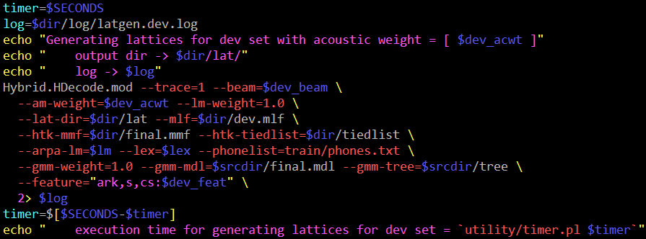
Viterbi Decoding
04b.mono.viterbi.sh
07b.tri.viterbi.sh

Slide 24
Homework
Language model training , WFST decoding , Viterbi decoding
00.train_lm.sh
01.format.sh
04a.01.mono.mkgraph.sh
04a.02.mono.fst.sh
07a.01.tri.mkgraph.sh
07a.02.tri.fst.sh
04b.mono.viterbi.sh
07b.tri.viterbi.sh

Slide 25
ToDo
Step1. Finish code in 00.train_lm.sh and get your LM.
Step2. Use your LM in 01.format.sh
Step3.1. Run 04a.01.mono.mkgraph.sh and 04a.02.mono.fst.sh (WFST decode for mono-phone)
Step3.2 Run 07a.01.tri.mkgraph.sh and
07a.02.tri.fst.sh (WFST decode for tri-phone)
Step4.1 Run 04b.mono.viterbi.sh (Viterbi for mono)
Step4.2 Run 07b.tri.viterbi.sh (Viterbi for tri-phone)

Slide 26
ToDo (Opt.)
Train LM : Use YOUR training text or even YOUR lexicon.
Train LM (ngram-count) : Try different arguments.
http://www.speech.sri.com/projects/srilm/manpages/ngram-count.1.html
Try different AM/LM combinations and report the recognition results.

Slide 27
Questions ?

