Slide 1
專題研究 WEEK 4 - LIVE DEMO
Prof. Lin-shan Lee
TA. Roy Lu (R05942070@ntu.edu.tw)

Slide 2
Outline
Review
Live Demo introduction
Restriction
TODO
To think
FAQ

Slide 3
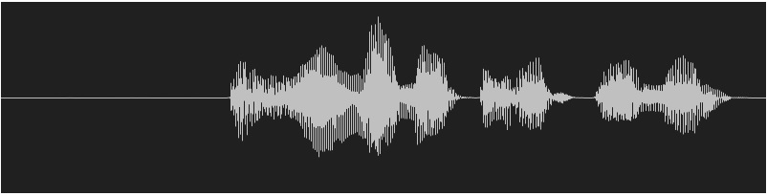
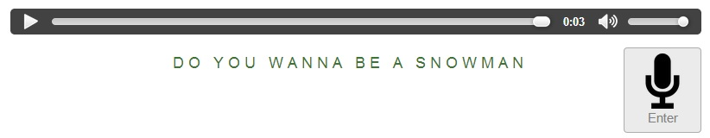
Review: achieving ASR system
Automatic Speech Recognition System
Input wave -> output text

Slide 4
Review
Week 1: feature extraction
compute-mfcc-feat
add-delta
compute-cmvn-stats
apply-cmvn
File format: scp,ark

Slide 5
Review
Week 2: training acoustic model
monophone
clustering tree
triphone
Models: final.mdl, tree

Slide 6
Review
Week 3: decoding and training lm
SRILM( ngram-count/ kn-smoothing )
Kaldi – WFST decoding
HTK – Viterbi decoding
Vulcan( kaldi format -> HTK format )
Models: final.mmf tiedlist

Slide 7
Live Demo
Now we integrated them into a real-world ASR system for you.
You could upload your own models.
Now give a shot! Experience your own ASR in a “real” way.

Slide 8
Live Demo
https://140.112.21.35:54285/
Demo
Remember: use https.
Ignore the warnings.

Slide 9
Restriction
MFCC with dim 39 only.
Fixed phone set. (Chinese phones)
LM must be one of unigram/bigram/trigram model.

Slide 10


To Do
Sign up Live Demo with your account.
Please inform TA of your account name for activation.
FB Group: 數位語音專題
Test with basic model embedded in the system.
Upload your model
LM/LEX/TREE/MDL
For better performance, you may re-train your models.
Test with your own models.

Slide 11
To Think
Compare the basic models with your own models, what is the main difference?
Do you know of what kind your training data are?
train.text/dev.text/test.text
How about manually tagging your own lexicon and train your own language model?
Guess about the training data of the basic models.
Exemplify your description.

Slide 12
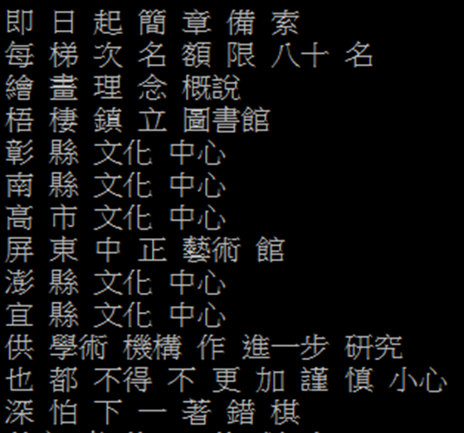
Language Model : Training Text (2/2)
cut -d ' ' -f 1 --complement $train_text > ./exp/lm/LM_train.text

Slide 13
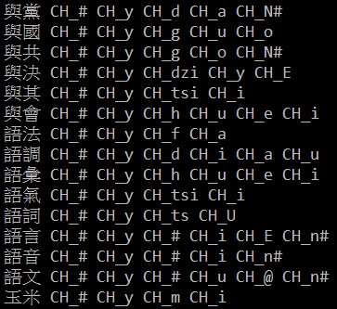
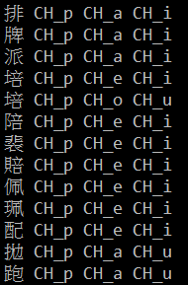
Language Model : ngram-count (3/3)
Lexicon
lexicon=material/lexicon.train.txt

Slide 14
FAQ
Q: How to download the models in the workstation?
A:
FileZilla
MobaXterm
“sftp” or “scp” command in your linux OS.

Slide 15
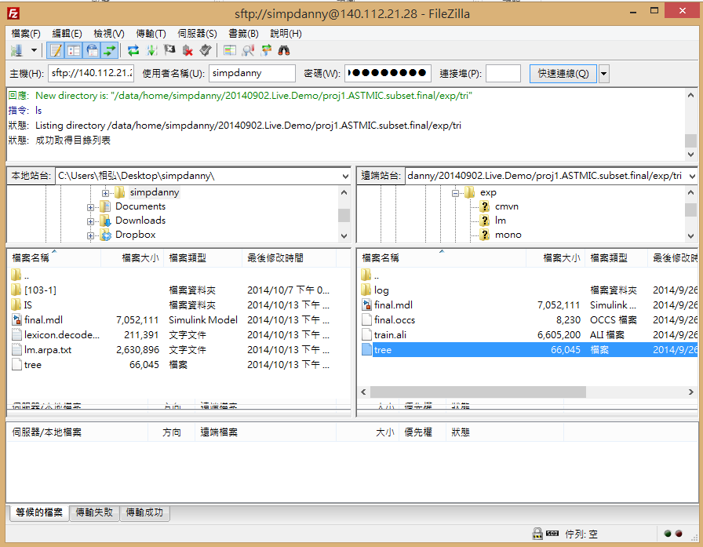

Slide 16
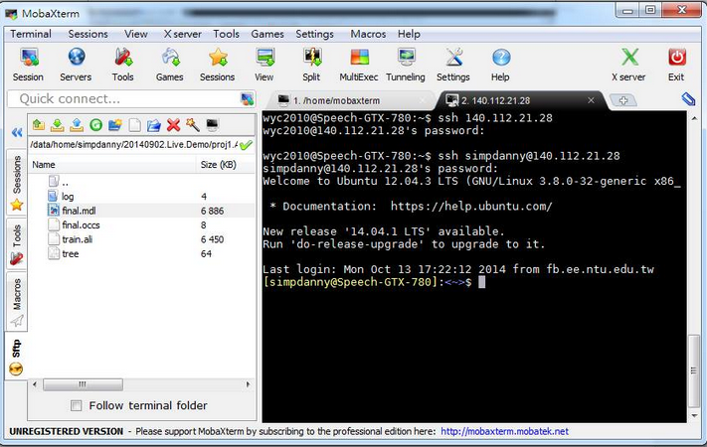

Slide 17
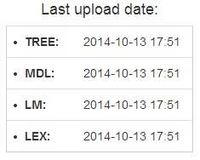
FAQ
Q: Why I always got server error?
A:
Make sure you got models uploaded.
Is the timestamp empty?

Slide 18
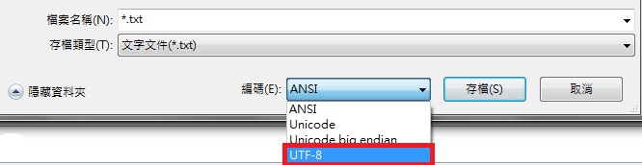
FAQ
Q: In corpus mode, why I always got error or 0 accuracy?
A:
Make sure your corpus is written under UTF-8 encoding.
In notepad, the default is ANSI.
In vim, the default is UTF-8.

Slide 19
FAQ
Q: In corpus mode, why I got negative accuracy?
A:
Accuracy is actually calculated by (length – error ) / length.
請參考數位語音處理概論 ch8 page 11

Slide 20
Q&A
This system is just online.
Any bug is expected.
If you got any question, contact TA through FB group or email instantly.
We need you feedback about UI/function.
Feel free saying about anything.
Email:R05942070@ntu.edu.tw

