Slide 1
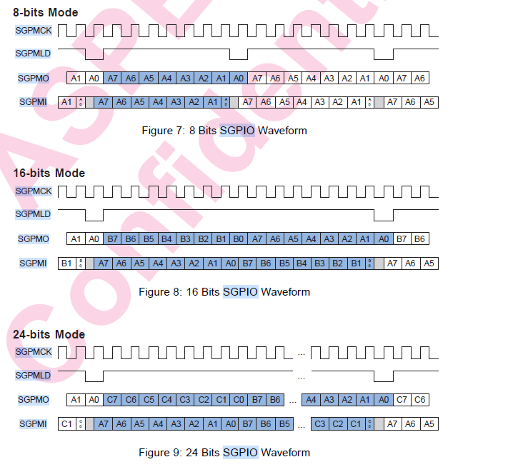
AST2600 SGPIO
8Bits To 128Bits Support

Slide 2
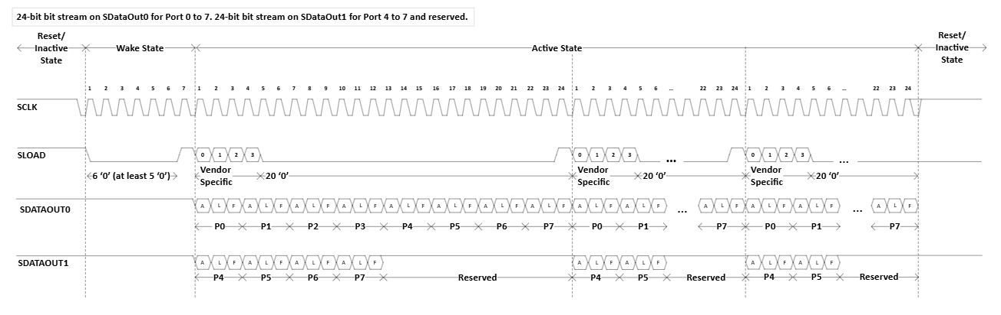
Intel SGPIO WAVE

Slide 3
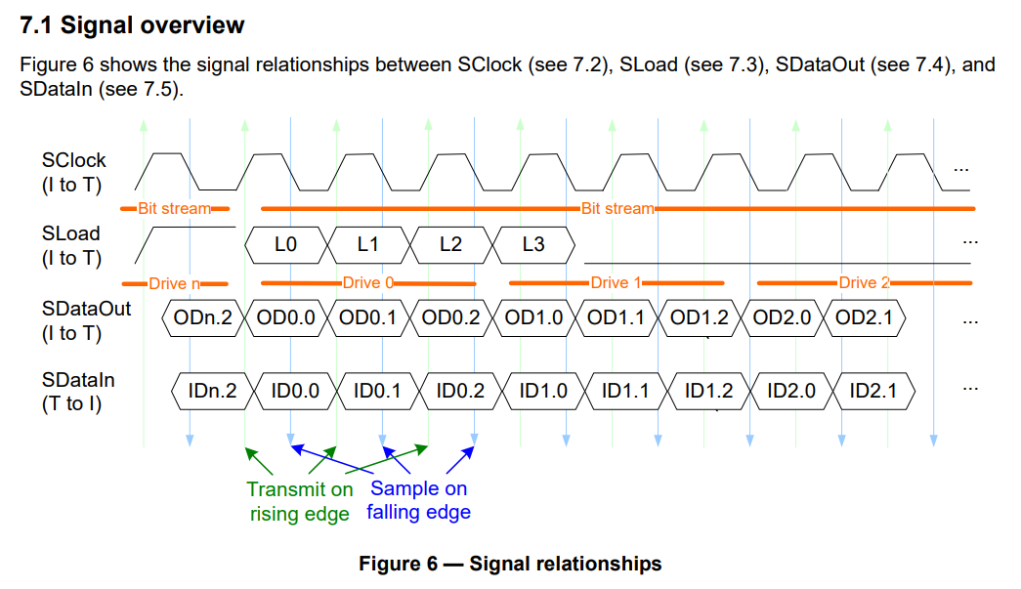
SGPIO TX Design

Slide 4
SGPIO RX Design

Slide 5
SGPIO System Architecture Diagram
CPU
A53
REG
Input deglitch
PIN MUX
SCLK
Generator
Sequencer
x3
TX FIFO
x6
SCLK
Monitor
Recorder
x3
Output delay
(Phase)
3.3V
IO
APB BUS
(NIC-400)
Master and Slave x2
RX FIFO
x6
SGPIO
Controller
Interrupt
(GIC-600)

Slide 6
SGPIO Check List
1. Need 3.3V IO
2. Check Intel Wave
3. Check AST2600 Wave
4. Need all io

Slide 7
SGPIO Controller
Timer
Setting 8Bits to 128 Bits by one flame
BANK0
Master Function
x2
SCLK : Setting 32Hz To 2M Flag
BANK1
Slave Function
x2

Slide 8
SGPIO Controller
Timer
Setting 8Bits to 128 Bits by one flame
BANK0
SCLK : Setting 32Hz To 2M Flag
BANK1
Master Sequencer
x2
Slave Function
x2

Slide 9
SGPIO System Architecture Diagram
CPU
A53
REG
Input deglitch
and phase
PIN MUX
SCLK
Generator
Sequencer
x3
TX FIFO
Recorder
x1
Output delay
(Phase)
3.3V
IO
APB BUS
(NIC-400)
Master x2
RX FIFO
SCLK
Monitor
Recorder
x3
Interrupt
(GIC-600)
Sequencer
x1
SGPIO
Controller
Slave x2

