Slide 1
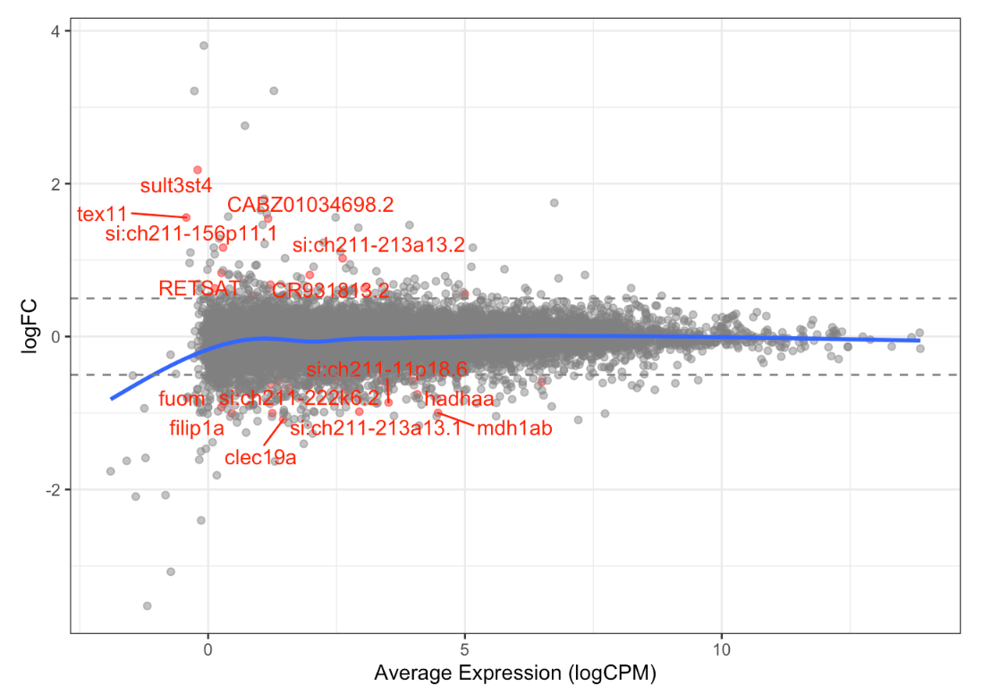
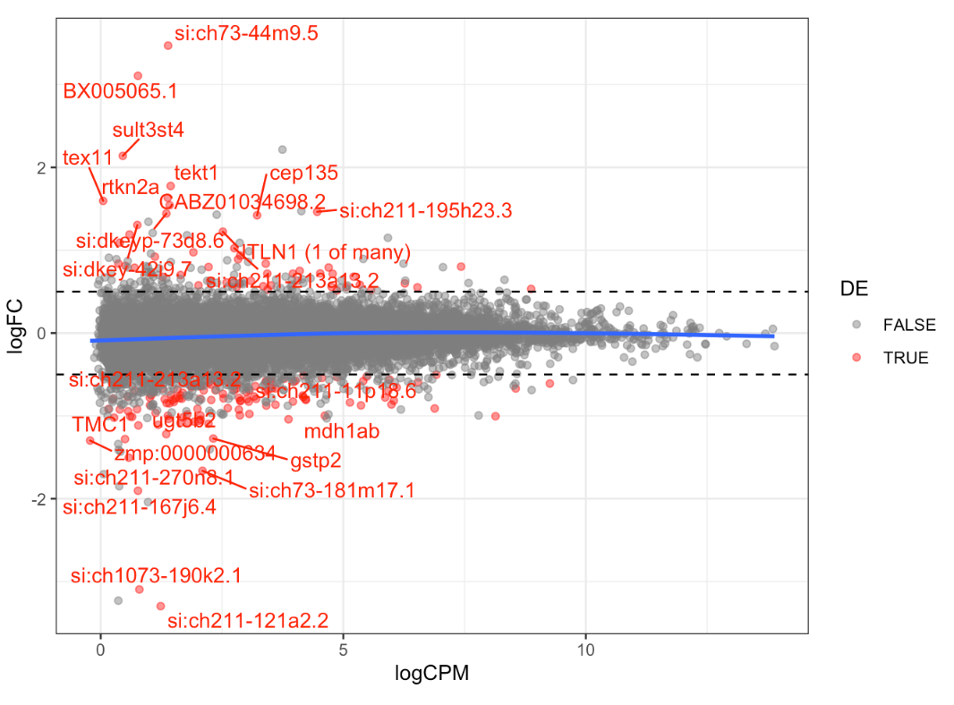
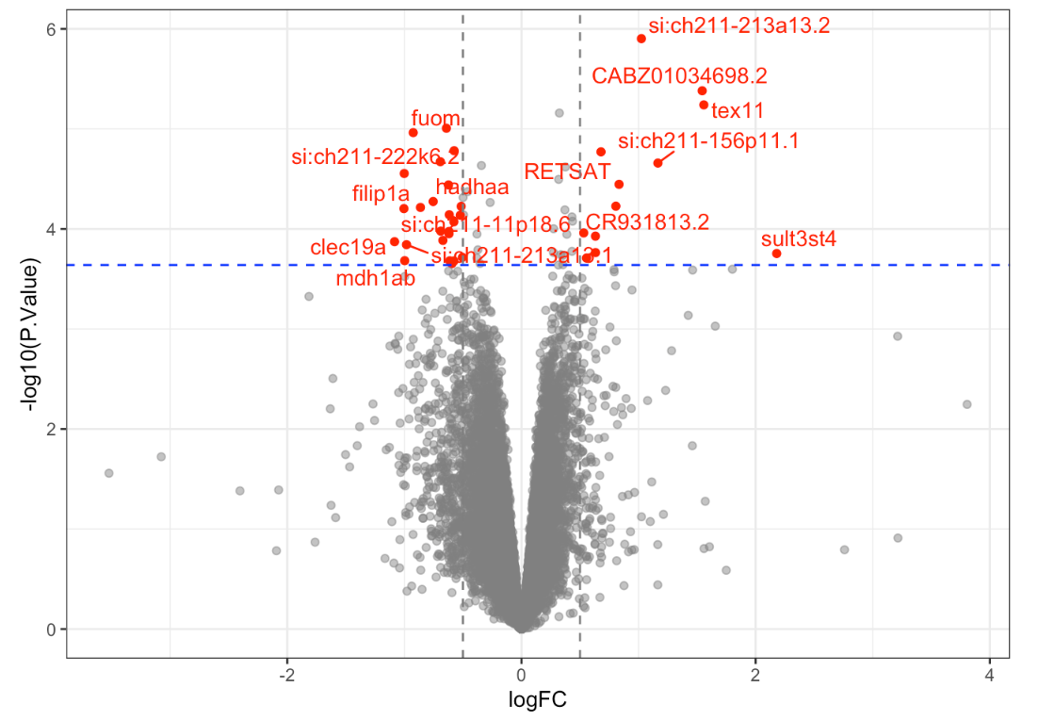
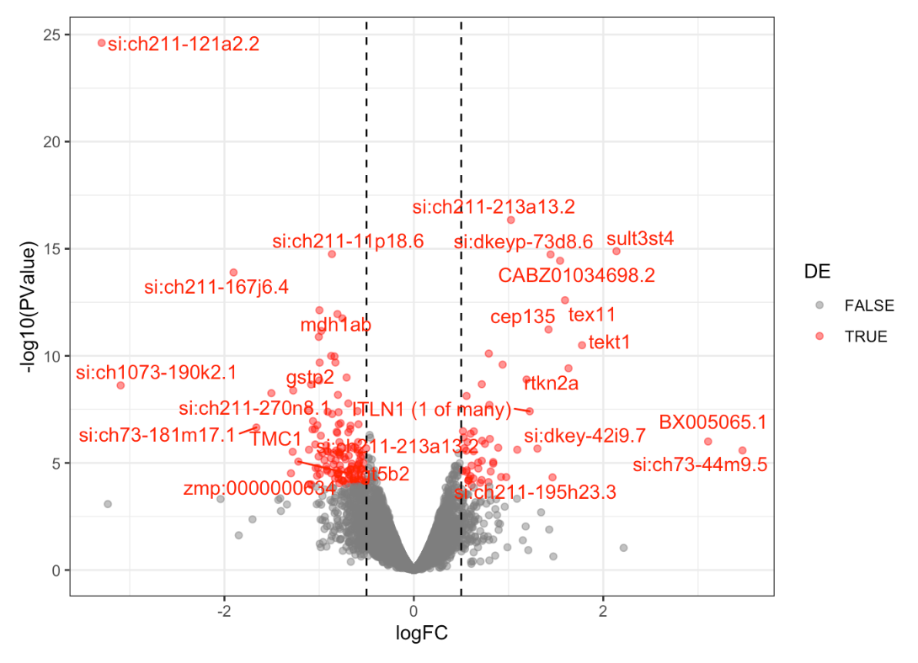
RUV treated
DE genes
q<0.05
60
q < 0.05 & abs(logFC) > 0.5
37
DE genes
FDR<0.01
231
FDR<0.01 & abs(logFC) > 0.5
186
q < 0.05 & abs(logFC) > 0.5
FDR < 0.01 & abs(logFC) > 0.5

Slide 2
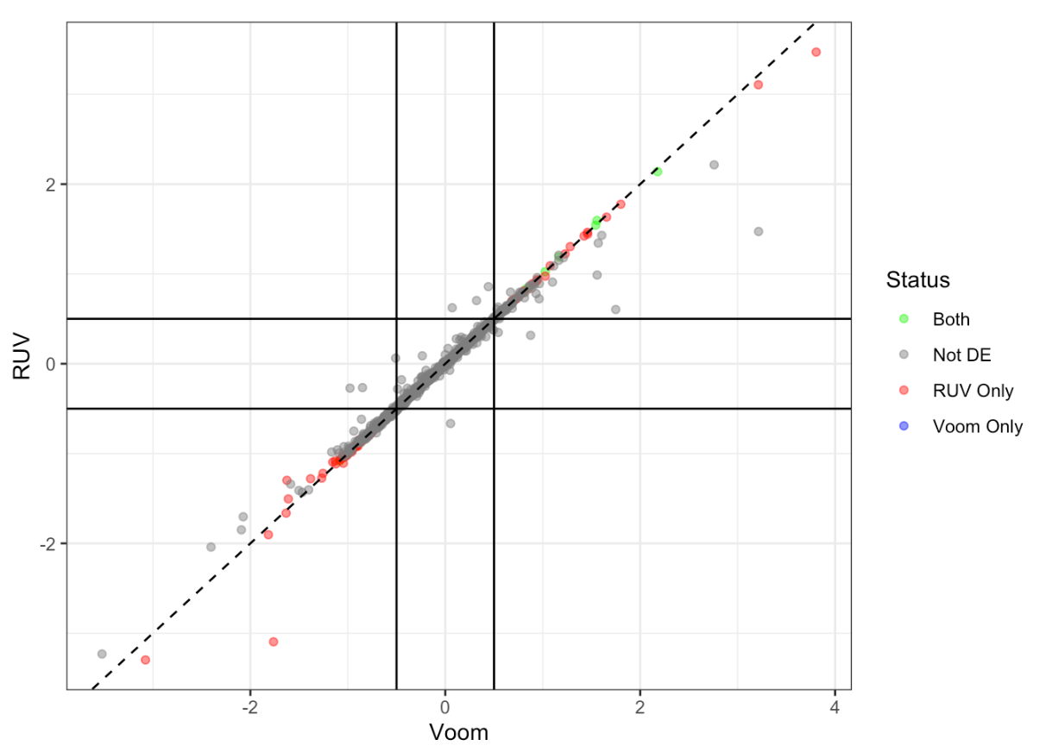
DE list comparison

Slide 3
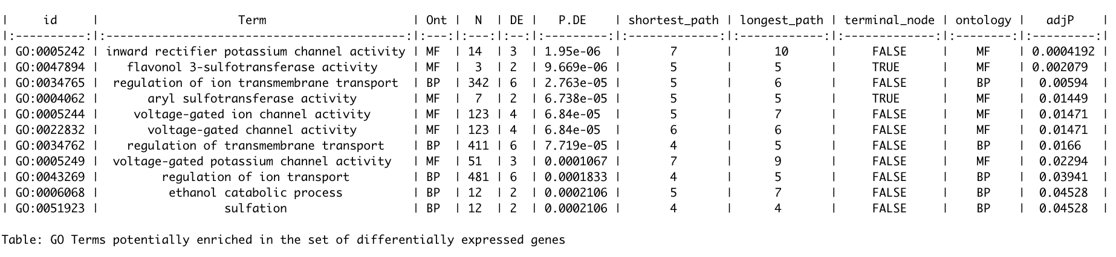
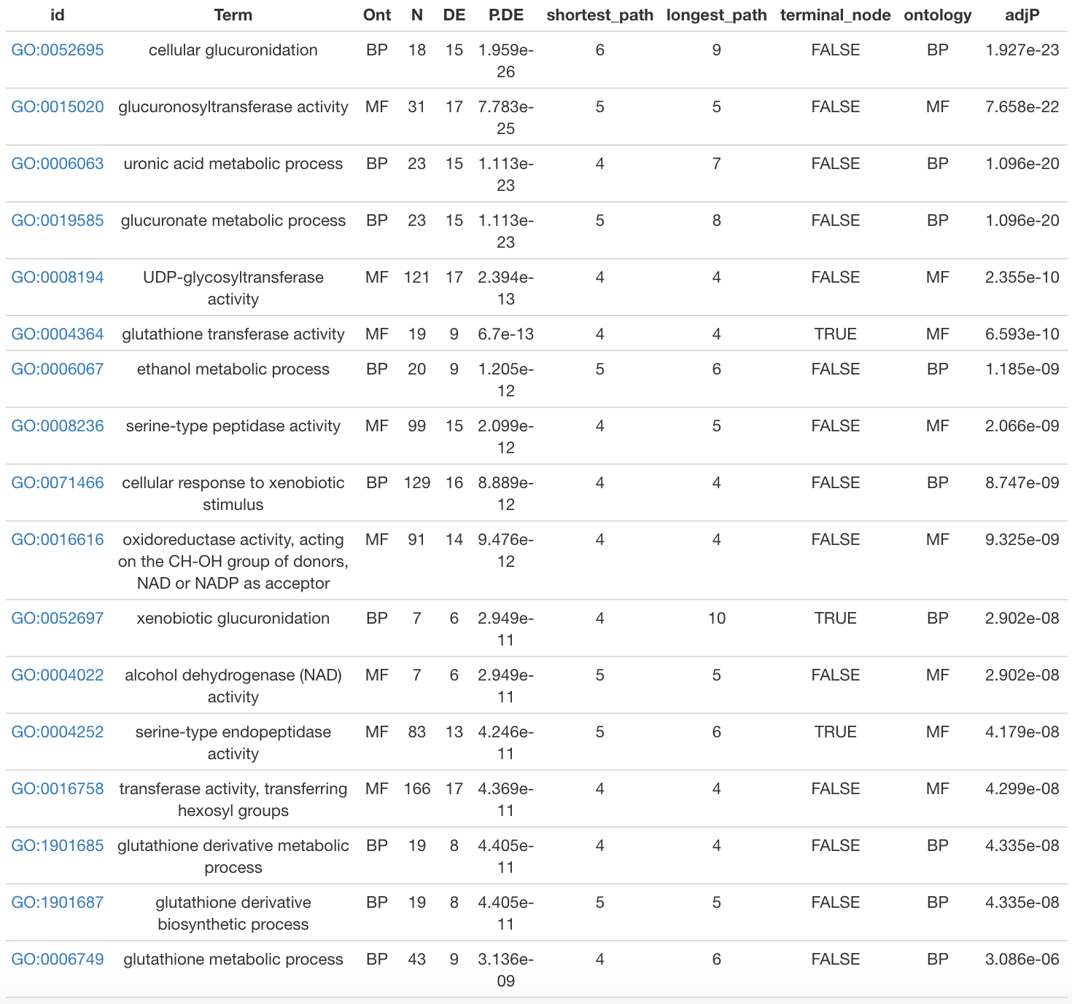
GO analysis
RUV treated
q < 0.05 & abs(logFC) > 0.5
FDR < 0.01 & abs(logFC) > 0.5
TOP 17

Slide 4
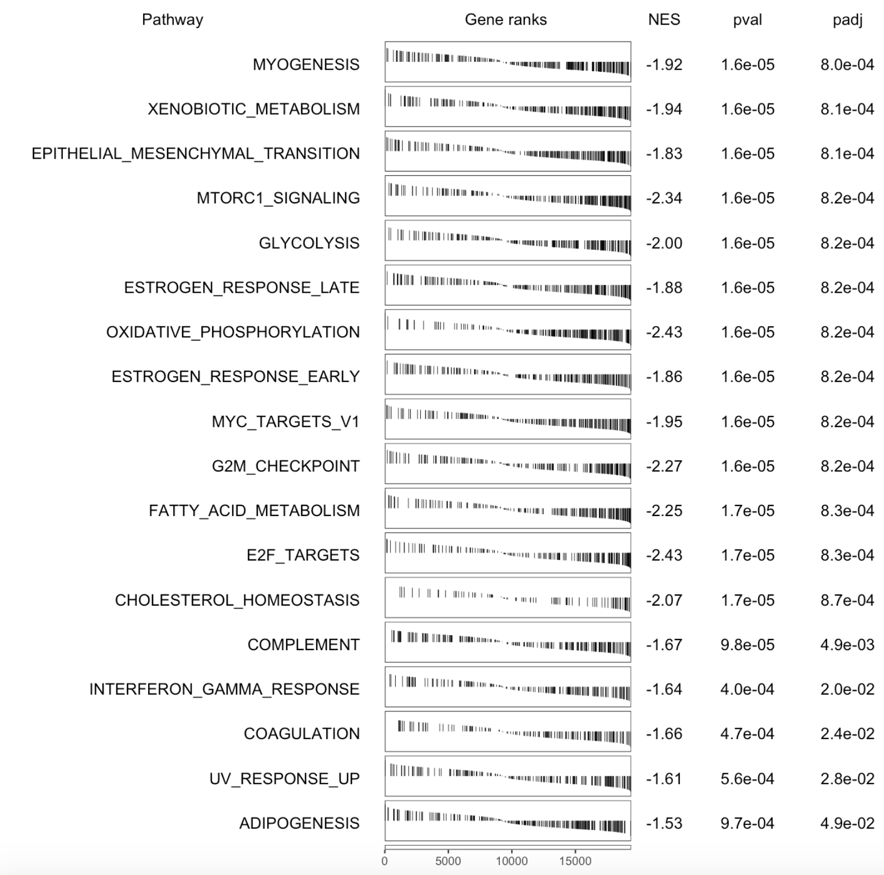
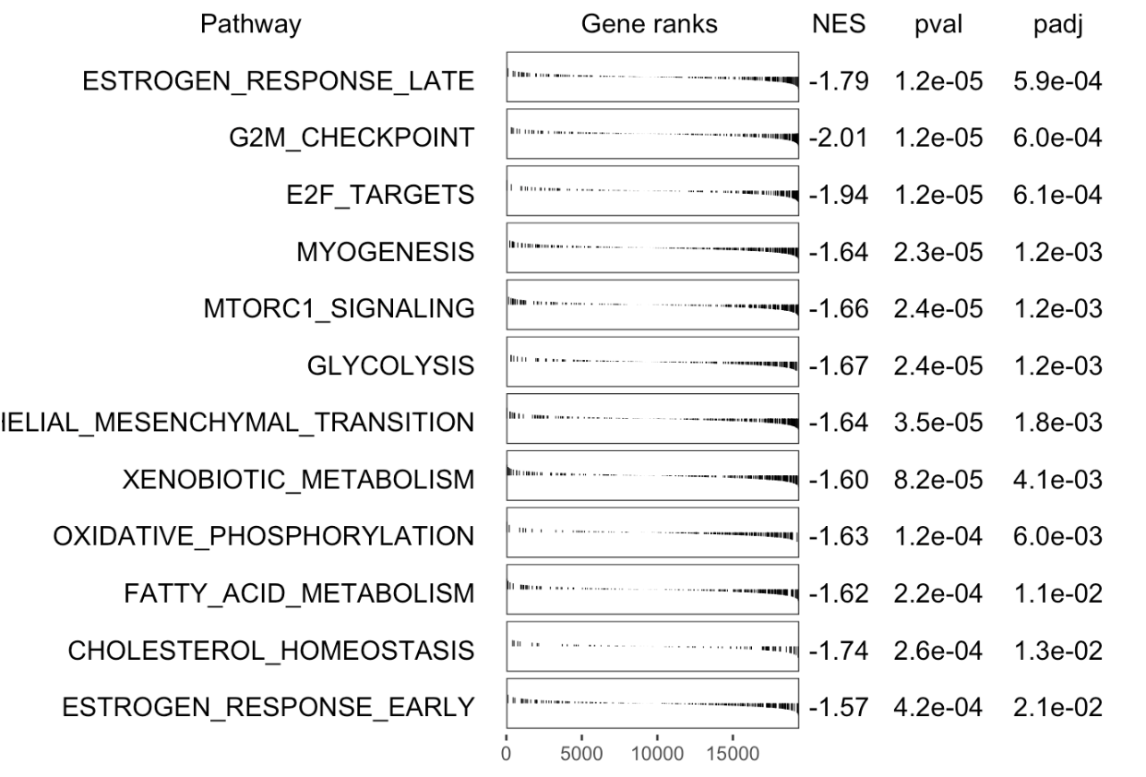
GSEA analysis
Hallmark
RUV treated

Slide 5
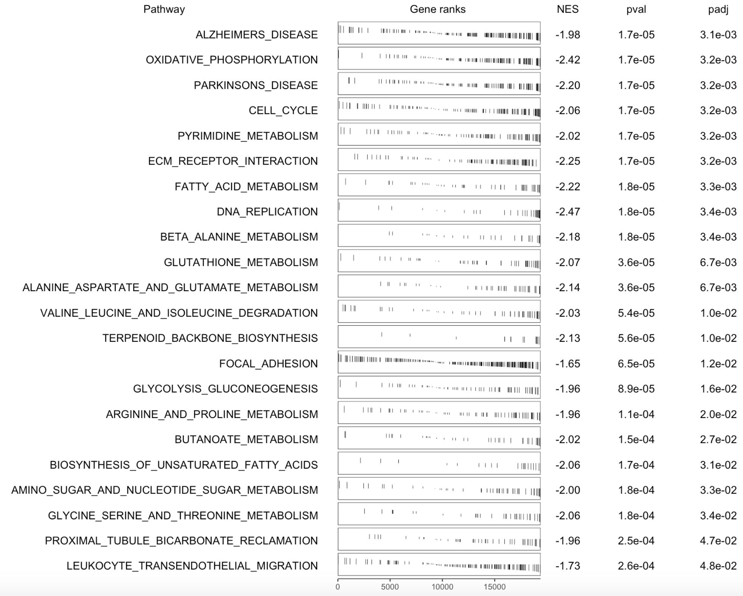
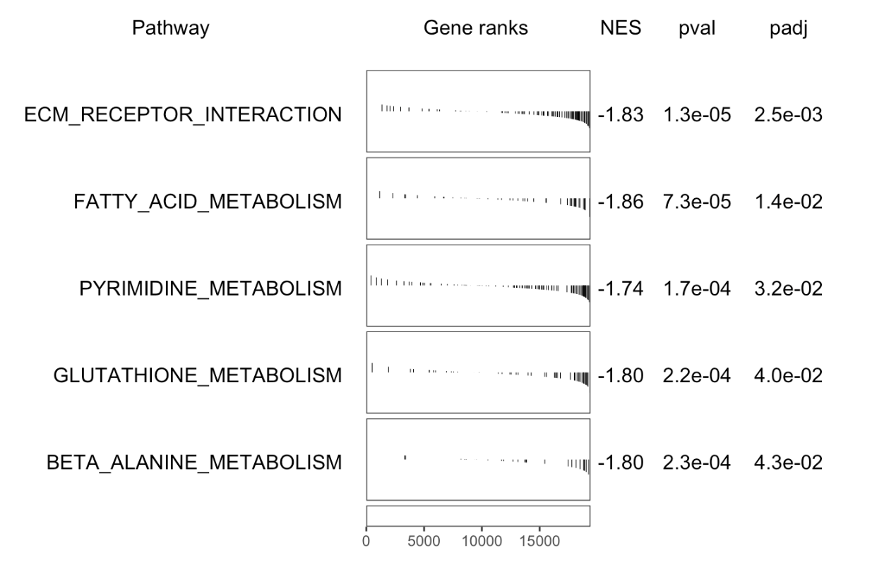
GSEA analysis
KEGG
RUV treated

Slide 6
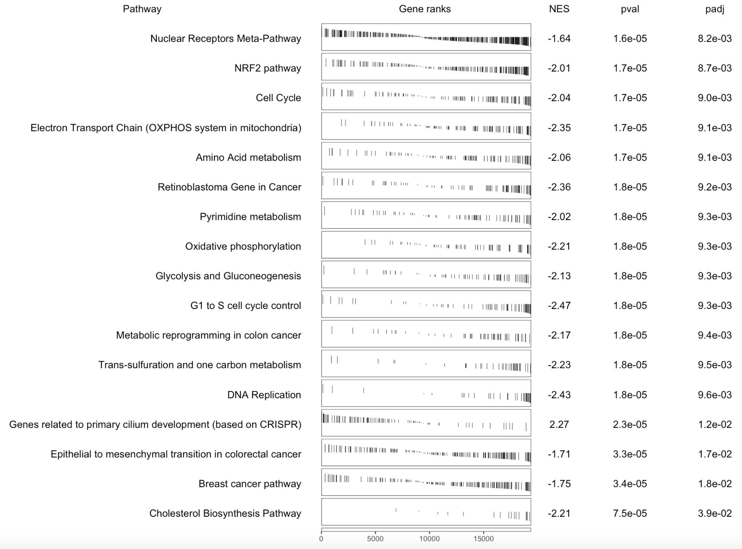
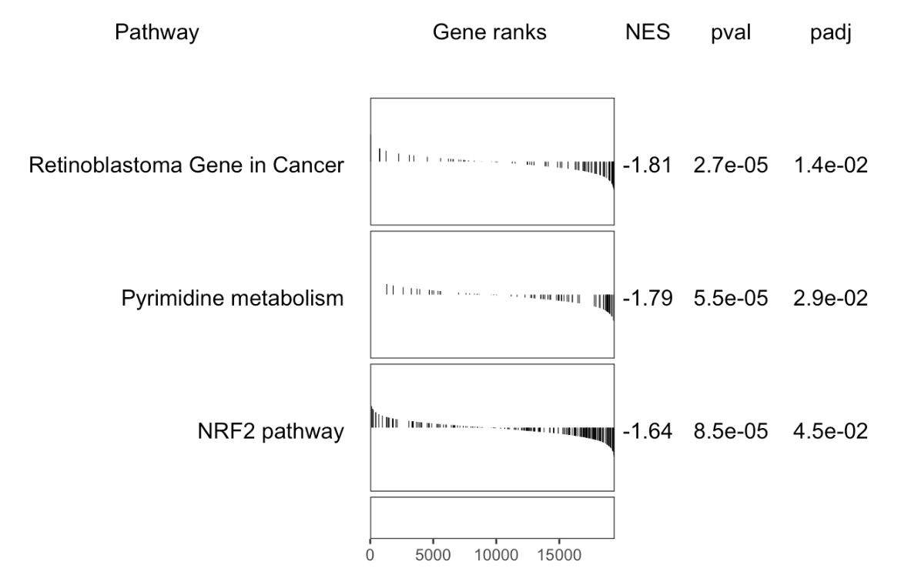
GSEA analysis
wiki
RUV treated

