Slide 1
Block layer multi-queue
Dongsheng Yang

Slide 2
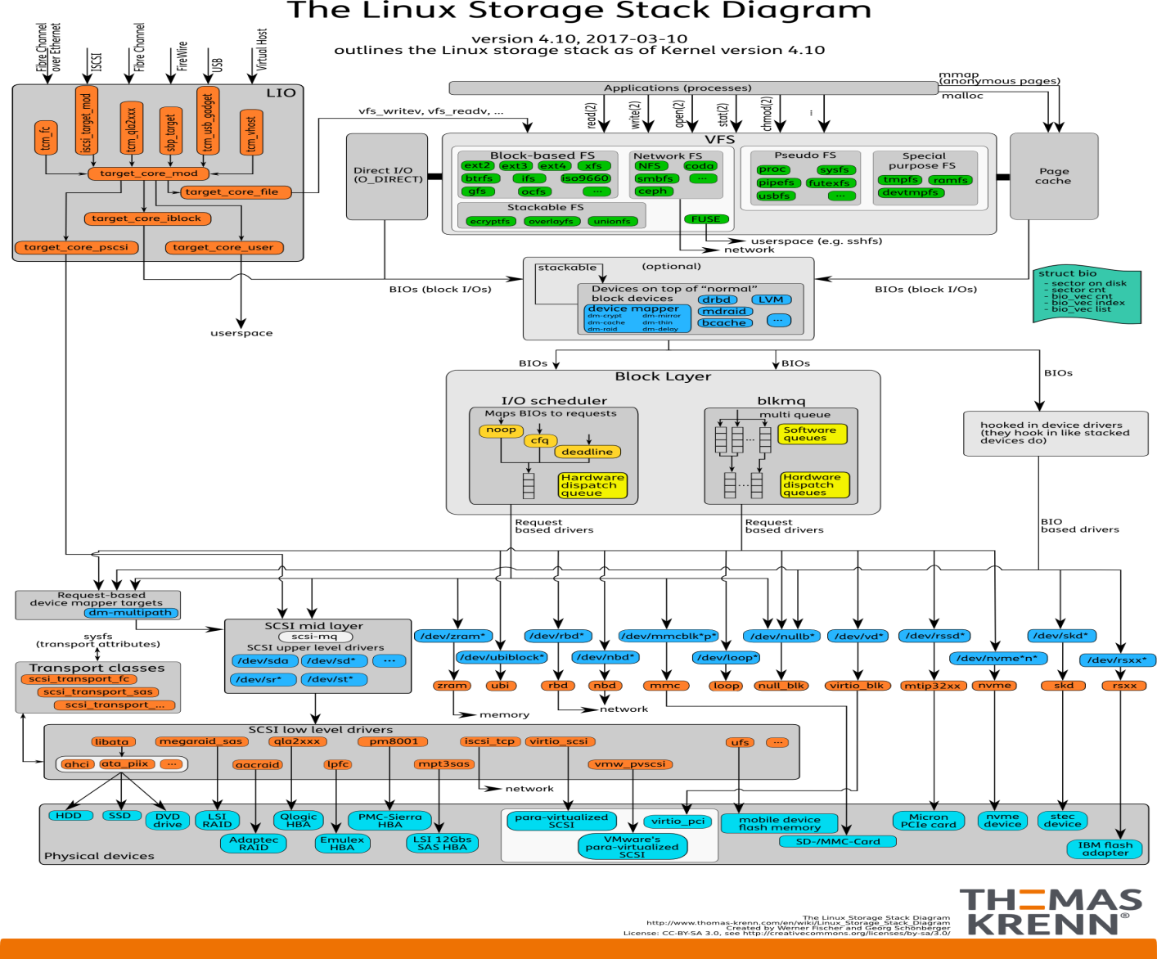
Linux storae diagram

Slide 3
Why multiqueue
The IO performance of storage devices has accelerated from hundreds of IOPS ve years ago, to hundreds of thousands of IOPS today, and tens of millions of IOPS projected in five years. (2012)
some applications and device drivers are already choosing to bypass the Linux block layer in order to improve performance. Introducing duplicate code, and removes generic features, such as io scheduling and qos.

Slide 4
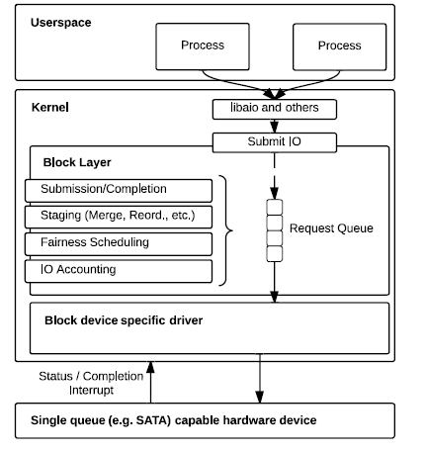
Current single queue
1. Applications submit IOs via a kernel system call,
2. Once an IO request is submitted, the corresponding block IO is buered
in the staging area, request queue.
3. Once a request is in the staging area, the block layer may perform IO scheduling and adjust accounting information before scheduling IO submissions to the appropriate storage driver.
4. noop (no scheduling), deadline-based
scheduling [12], and CFQ

Slide 5
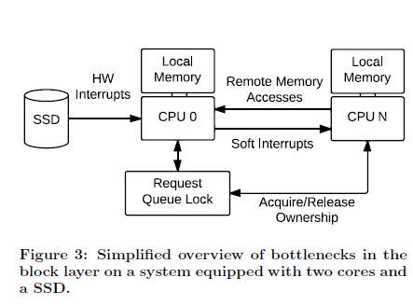
bottlenecks
Request Queue Locking
Hardware Interrupts
Remote Memory Accesses

Slide 6
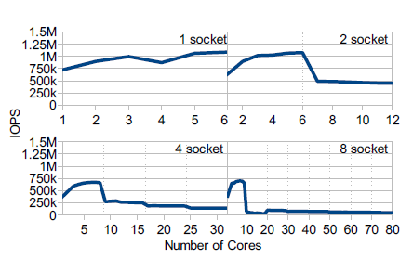
NUMA
1. Single socket, throughput improves with cores
2. For 2, 4, and 8-socket architecture, absolute performance drops
3. Remote cacheline invalidation of the request queue lock is
signicantly more costly on complex four and eight socket
systems

Slide 7
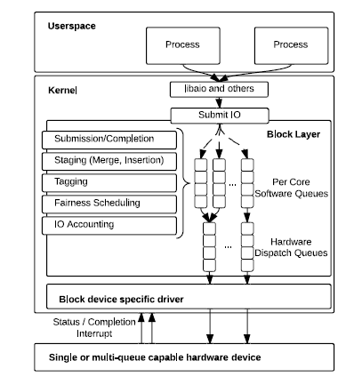
Two-levels multi-queue
IO-Scheduling
Number of Hardware Queues
Tagged IO and IO Accounting

Slide 8
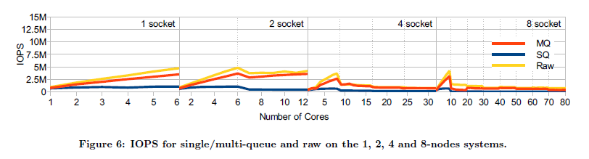
SQ vs MQ vs RAW
MQ performance is similar to SQ performance on a single core.
MQ scales linearly within one socket.
For all systems, MQ follows the performance of Raw closely.

Slide 9
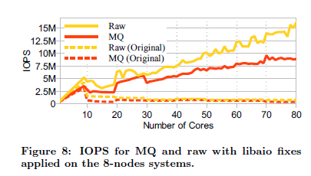
libaio
1. a context list lock is issued for each request
2. a completion ring in libaio used to manage sleep/wakeup cycles
3. a number of shared variables are being updated throughout the library.

Slide 10
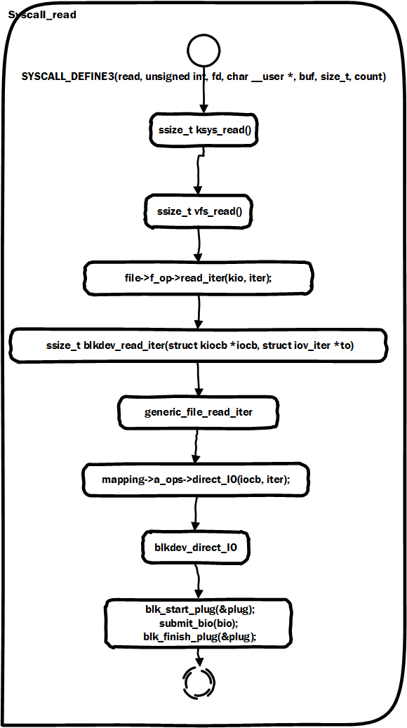
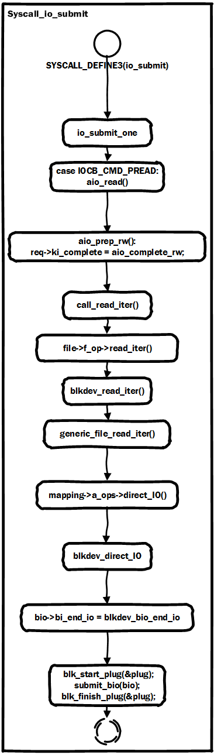
Syscall -> submit_bio

Slide 11
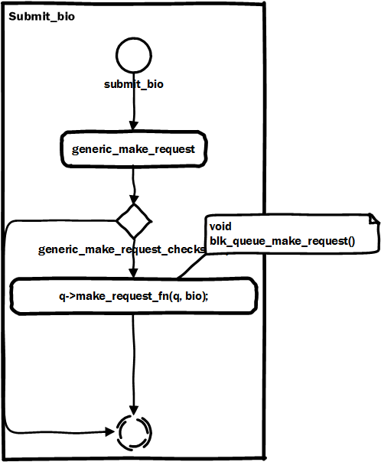
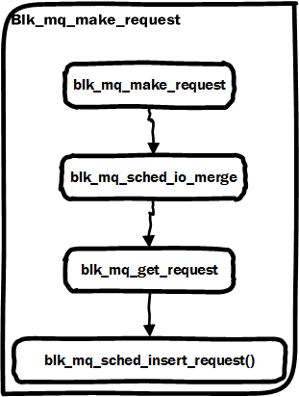
Submit_bio()->blk_mq

Slide 12
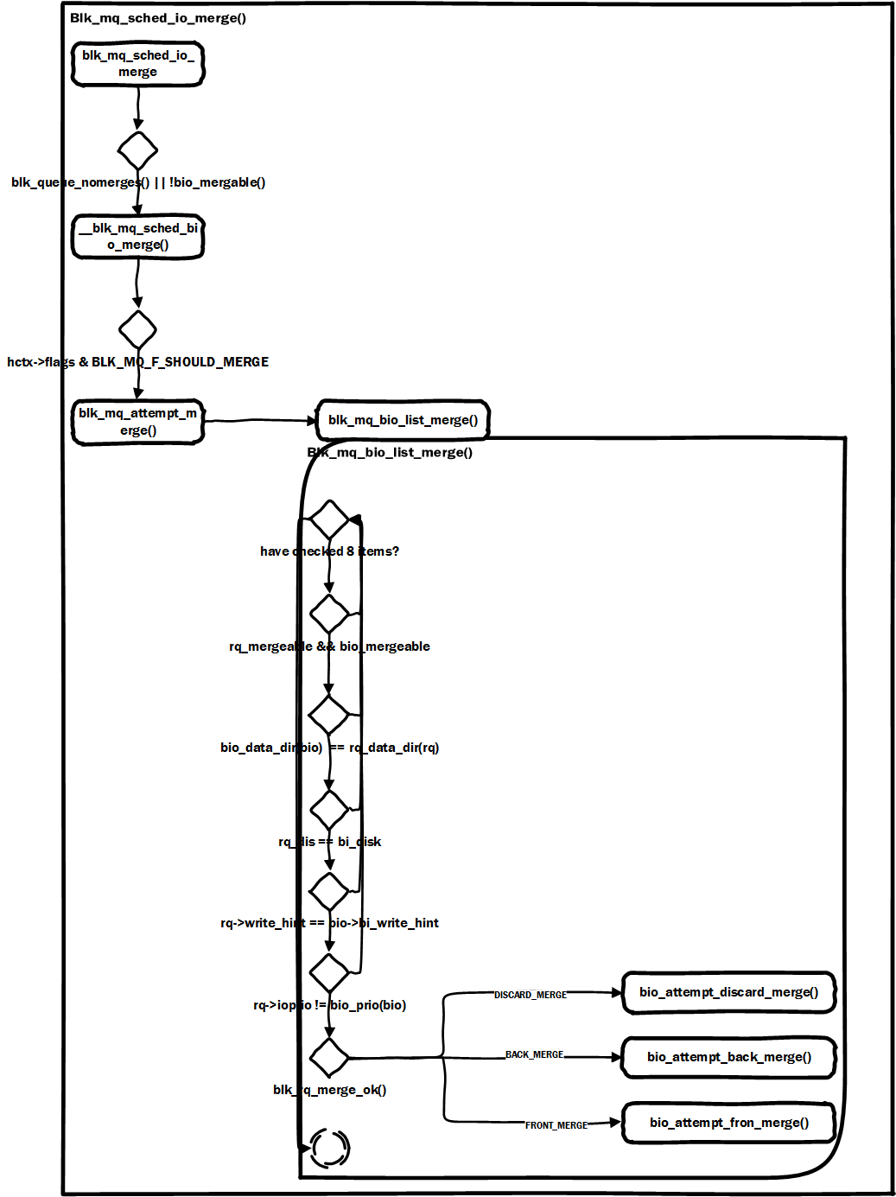
Blk_mq_sched_io_merge
Discard merge
Back merge
Front merge

Slide 13
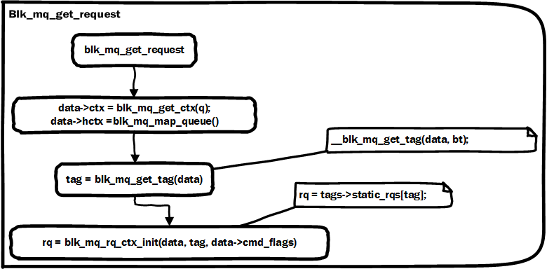
Blk_mq_get_request

Slide 14
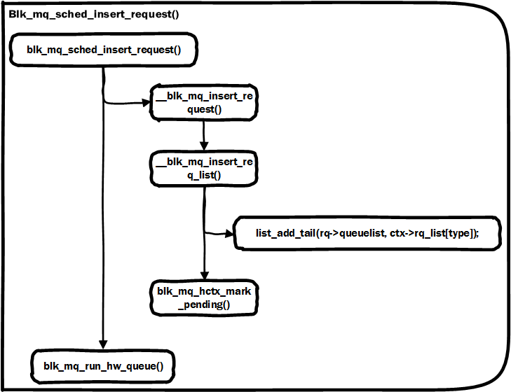
Blk_mq_sched_insert_request

Slide 15
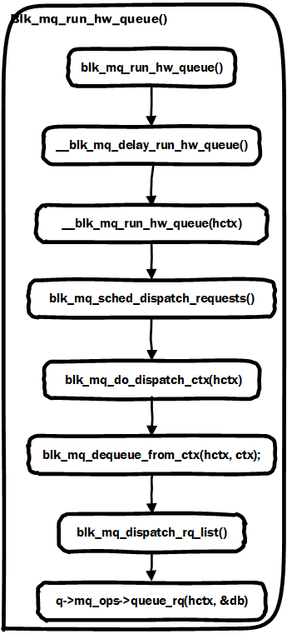
Blk_mq_run_hw_queue()
Get rq_list from ctx
Call q->mq_ops->queue_rq()

Slide 16
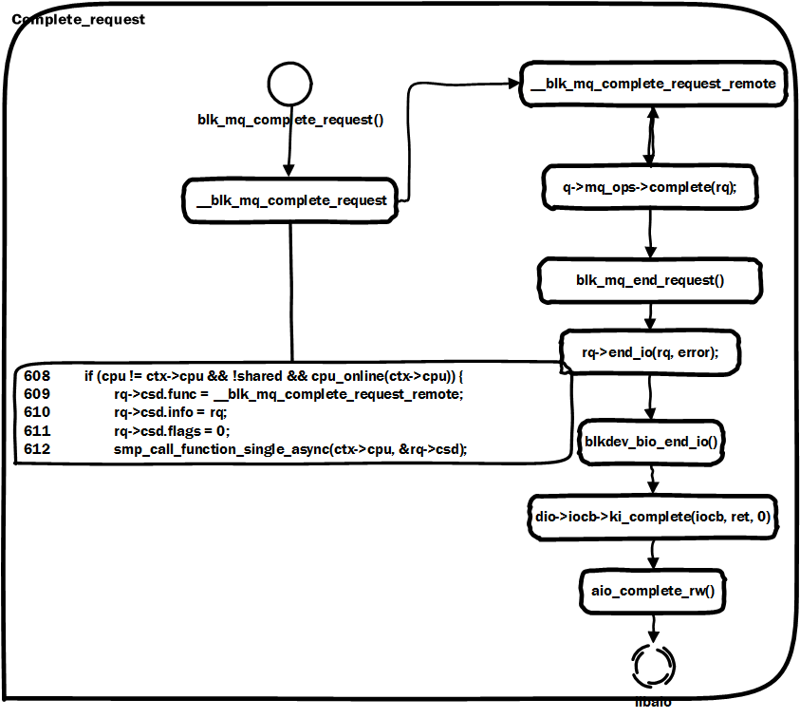
Blk_mq_complete_request()

Slide 17
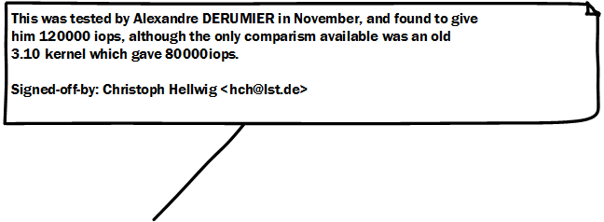
Ceph rbd (rados block device)
 | Read | Randread | Write | randwrite
4.20-rc2 | 26758 | 16697 | 5465 | 1221
4.20-rc2.es | 38832 | 16721 | 7743 | 1268

Slide 18
Thank you

