Slide 1
Weekly report
Dongsheng Yang

Slide 2
What I have before this week
1. Grouping result
spectral analysis
Louvain
Following network/ mention network/ co-hashtag network
2. Method to compute robustness
bootstrap sampling >> Deviation
change through time
3. Sentiment analysis library
Vader/ NLTK/ Combination

Slide 3
What I do this week
1. Think of other ways to mine sentiment.
2. Predict relations between groups
3. Observe the relationship between locations and sentiments.

Slide 4
sentiment mining
Motivation:
General sentiment library works poor in specific fields (Turkey), because words’ meanings change in the field. So the most important thing is to find out the meaning of words in the field.
Therefore, I build a semi-supervised model to find the representative words
for negative/ positive sentiments.
I was inspired by LDA (Latent Dirichlet Allocation). LDA uses the probability distribution of words to represent topics.
Sentiments are similar to topics, which can also be represented by words’ distribution.

Slide 5
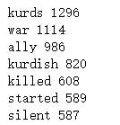
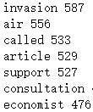


sentiment mining
Example:
Among tweets mentioning both ‘NATO’ and ‘Turkey’, find out those against Turkey.
Fisrt find negative words. Then use negative words to find negative tweets.
Step 1:
Extract keywords from tweets.

Slide 6

sentiment mining
Step 2:
Input some negative words as seeds.
I will use seeds to find other negative words iteratively.
I quickly look through the keywords and choose these words as negative words.

Slide 7
sentiment mining
Step 3:
Find users mentioning the negative seeds and identify them as negative users.
I suppose all tweets from negative users are against Turkey.
Step 4:
Classify negative users’ tweets into two sets:
1) mentioning negative seeds 2) not mentioning negative seeds
(known information) (unknown information)

Slide 8
sentiment mining
Step 5:
In set 1 and set 2, compute TF/IDF score for every keyword.
Multiply the two scores for each keyword.
If the product of a keyword is above the threshold (0.2), that keyword is added into the negative word set.
This step is similar to a BFS.
The set 2 score is used to expand the tree, while the set 1 score is used to prune the tree.

Slide 9
sentiment mining
Step 6:
Repeat the step 3-5 until the negative word set stop expanding.
In each iteration, the threshold is adjusted according to the size of ‘negative tweets’ and the number of iteration to ensure a convergence:
In the ith iteration, keywords obey the following inequation are added to the negative words set:
Score_1*Score_2 > Threshold_1 * i * Size_i / Size_1

Slide 10
sentiment mining
Negative word set: Only valid under this data set (Turkey&NATO)
instead
bomb
eject
kick
kurd
expel
terrorist
bless
sign
nightmare
kill
strike
thin
lean
logged
woman
shit
USA
real
rogue
oppose
air
wouldn't
native
commander
responsible
America
after
naked
under
pregnant
people
soldier
crime
YPG

Slide 11
sentiment Classify
A naïve version:
If the tweet contains at least one negative word, it is regarded to be negative (-1).
Otherwise, the tweet is regarded as non-negative(1).
Compare my result with Vader’s:
I choose the first 16 tweets which they have different results.
I find that my model is correct on 10 tweets while Vader is correct on 6 tweets.
Sample

Slide 12
Key idea
Search new negative words on user-level instead of tweet-level.
If I identify top words in ‘negative tweets’ as new negative words, these words cannot introduce many new ‘negative tweets’. So the negative word set will soon stop expanding and many negative words cannot be found.
Instead, identify top words written by ‘negative users’ as new negative words can introduce many new ‘negative tweets/users’, so the negative word set can expand to a larger size. Also, by examine the co-occurrence of those top words with known negative words, the top words with none negative sentiments are filtered out.

Slide 13
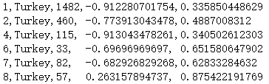
Groups sentiment
Filter out the groups with less than 30 tweets about Turkey.
Calculate the means of tweets’ sentiment as groups’ sentiments.
Calculate robustness by bootstrap sampling deviation.

Slide 14
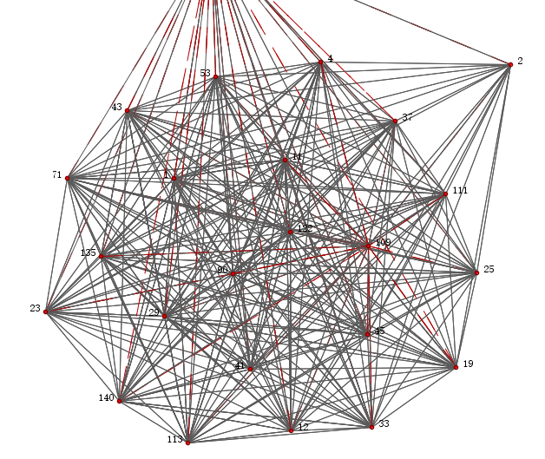
Groups relation
Predict the relationship between two groups:
m: means, d: deviations
If abs(m1-m2) > 1:
negative link density 0.1 >>
elif abs(m1-m2) < 0.3 & (d1+d2) < 0.5:
positive link density 0.4 >>
else:
no link

Slide 15
Groups relation
Validation by following network:
precision: positive links with following links/ positive links
recall: positive links with following links/ following links
The precision rate is 374/451 = 83%
The recall rate is 374/473 = 79%
That is a very good result. I am thinking that in terms of positive links, two groups using similar words is a stronger sign than two groups having similar sentiment.

Slide 16
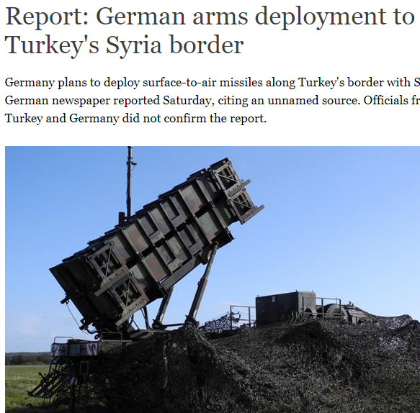
Geo and sentiment
The average sentiment is -0.73
Berlin: -0.30 Greenland: -1
Istanbul: -0.48 Brisbane: -1
Jakarta: -0.53 Edinburgh: -1
Beijing: -0.53 Europe/London: -1

Slide 17
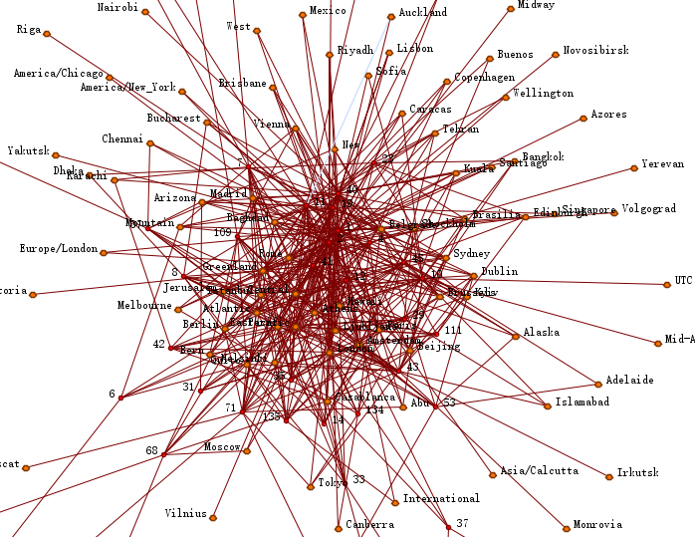
Geo and Group
Groups are composed of
users with variant locations.
“The world is connected by
the Internet”

Slide 18
introspection
1. The seeds of my sentiment model are chosen manually.
2. The negative words are not weighted.
3. I should test my model under other topics, such as Russia, Syria.
4. I can use more than one topic to predict links between groups.

