Slide 1



Misrepresentation of Model Performance by RMSE:
From Mathematical Proof to Case Demonstration
Fanglin Yang
Environmental Modeling Center
National Centers for Environmental Prediction
Camp Springs, Maryland, USA
GCWMB Bi-weekly Briefing, November 4, 2010

Slide 2
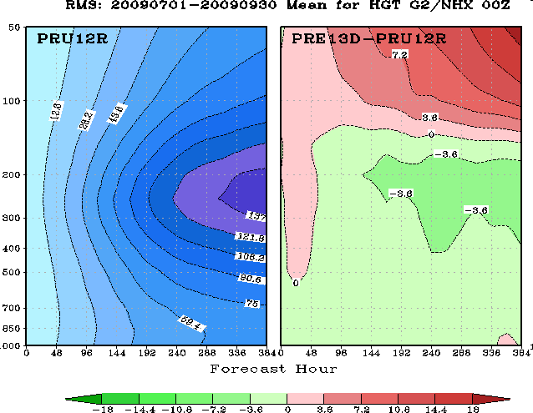
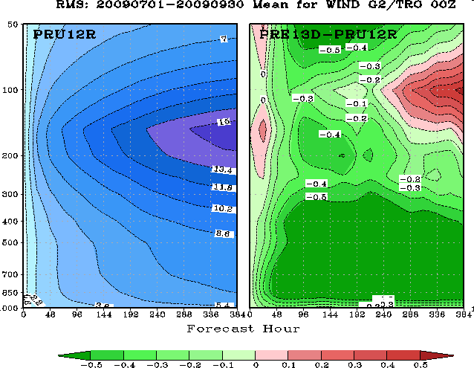
RMSE Has long been used as a performance metric for model evaluation. In this presentation I will show mathematically that RMSE can at times misrepresent model performances. A normalized RMSE is proposed, however, the normalization is not always effective.
Examples of NCEP/EMC Verification Maps
T382L64
T574L64
T382L64
T574L64

Slide 3
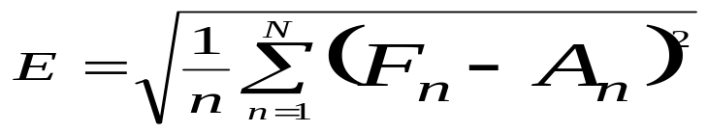
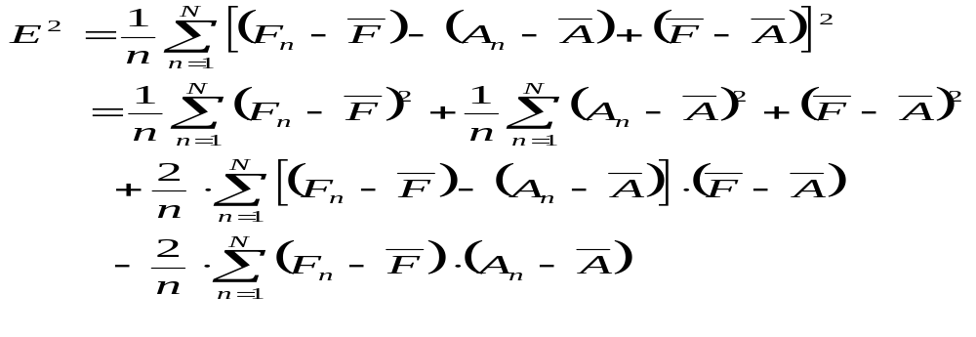
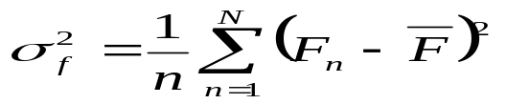
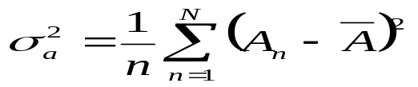
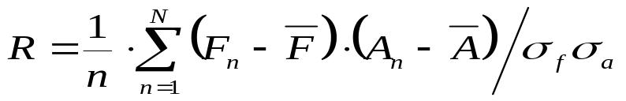
Root-Mean Squared Error (E)
Where, F is forecast, A is either analysis or observation, N is the total number of points in a temporal or spatial domain, or a spatial-temporal combined space.
Mean squared error
where
Variances of forecast & analysis
anomalous pattern correlation

Slide 4
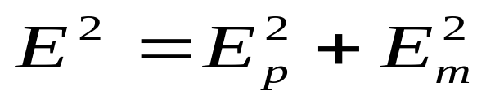
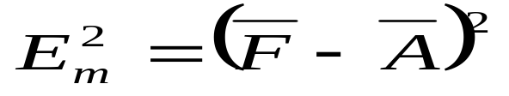
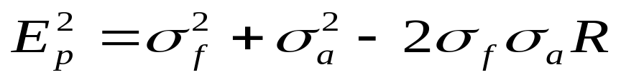


Mean Squared Error: MSE
MSE by Mean Difference
MSE by Pattern Variation
Discussion:
Total MSE can be decomposed into two parts: the error due to differences in the mean and the error due to differences in pattern variation, which depends on standard deviation over the domain in question and anomalous pattern correlation to observation/analysis.
If a forecast has a larger mean bias than the other, its MSE can still be smaller if it has much smaller error in pattern variation, and vice versa.
If two forecasts are verified against different analyses/observations, differences in analysis variance and mean complicate the interpretation of forecast MSE.
Model performance evaluation should include both and
The following pages present characteristics of , and the concept of normalized MSE.

Slide 5
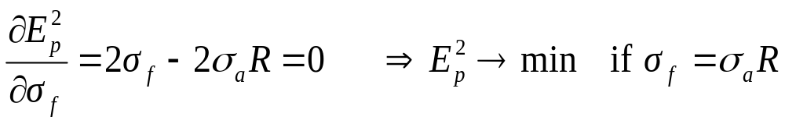






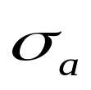
A: Given the same mean difference, will a forecast with smaller variance always give smaller MSE? The answer is no.
Case 1) R =1, perfect pattern correlation
One can see that if a forecast having either too
large or too small a variance away from the analysis variance , its error of pattern variation increases.
If R=1, does not award smooth forecasts that have smaller variances . It is not biased.

Slide 6








Case 2) R =0.5, imperfect pattern correlation
In this case, if one forecast has a better variance ( ) than the other ( ), the former will have a larger than the latter. Good forecasts are actually penalized.
In general, if 0 < R < 1, awards smooth forecasts which have smaller variances close to .
worse
forecast
better
forecast

Slide 7





Case 3) For cases where ,
Increase monotonically with
In this case, always awards smoother forecasts that have smaller variances .

Slide 8








B: Will MSE normalized by analysis variance be unbiased?
Assume
 | – 1.0 | – 0.8 | – 0.6 | – 0.4 | – 0.2 | 0.0 | 0.2 | 0.4 | 0.6 | 0.8 | 1.0
0.0 | 1.00 | 1.00 | 1.00 | 1.00 | 1.00 | 1.00 | 1.00 | 1.00 | 1.00 | 1.00 | 1.00
0.2 | 1.44 | 1.36 | 1.28 | 1.20 | 1.12 | 1.04 | 0.96 | 0.88 | 0.80 | 0.72 | 0.64
0.4 | 1.96 | 1.80 | 1.64 | 1.48 | 1.32 | 1.16 | 1.00 | 0.84 | 0.68 | 0.52 | 0.36
0.6 | 2.56 | 2.32 | 2.08 | 1.84 | 1.60 | 1.36 | 1.12 | 0.88 | 0.64 | 0.40 | 0.16
0.8 | 3.24 | 2.92 | 2.60 | 2.28 | 1.96 | 1.64 | 1.32 | 1.00 | 0.68 | 0.36 | 0.04
1.0 | 4.00 | 3.60 | 3.20 | 2.80 | 2.40 | 2.00 | 1.60 | 1.20 | 0.80 | 0.40 | 0.00
1.2 | 4.84 | 4.36 | 3.88 | 3.40 | 2.92 | 2.44 | 1.96 | 1.48 | 1.00 | 0.52 | 0.04
1.4 | 5.76 | 5.20 | 4.64 | 4.08 | 3.52 | 2.96 | 2.40 | 1.84 | 1.28 | 0.72 | 0.16
1.6 | 6.76 | 6.12 | 5.48 | 4.84 | 4.20 | 3.56 | 2.92 | 2.28 | 1.64 | 1.00 | 0.36
1.8 | 7.84 | 7.12 | 6.40 | 5.68 | 4.96 | 4.24 | 3.52 | 2.80 | 2.08 | 1.36 | 0.64
2.0 | 9.00 | 8.20 | 7.40 | 6.60 | 5.80 | 5.00 | 4.20 | 3.40 | 2.60 | 1.80 | 1.00
Ideally, for a given correlation R, the normalized error should always decrease as the ratio of forecast variance to analysis variance reaches to one from both sides. In the above table only when R is close to one (highly corrected patterns) does this feature exist. For most other cases, especially when R is negative, the normalized error decreases as the variance ratio decrease from two to zero. In other words, the normalized error still favors smoother forecasts that have a variance smaller than the analysis variance (the truth).

Slide 9


C: Mean-Squared-Error Skill Score (Murphy, MWR, 1988, p2419)
Assume
 | – 1.0 | – 0.8 | – 0.6 | – 0.4 | – 0.2 | 0.0 | 0.2 | 0.4 | 0.6 | 0.8 | 1.0
0.0 | 0.00 | 0.00 | 0.00 | 0.00 | 0.00 | 0.00 | 0.00 | 0.00 | 0.00 | 0.00 | 0.00
0.2 | – 0.44 | – 0.36 | – 0.28 | – 0.20 | – 0.12 | – 0.04 | 0.04 | 0.12 | 0.20 | 0.28 | 0.36
0.4 | – 0.96 | – 0.80 | – 0.64 | – 0.48 | – 0.32 | – 0.16 | 0.00 | 0.16 | 0.32 | 0.48 | 0.64
0.6 | – 1.56 | – 1.32 | – 1.08 | – 0.84 | – 0.60 | – 0.36 | – 0.12 | 0.12 | 0.36 | 0.60 | 0.84
0.8 | – 2.24 | – 1.92 | – 1.60 | – 1.28 | – 0.96 | – 0.64 | – 0.32 | 0.00 | 0.32 | 0.64 | 0.96
1.0 | – 3.00 | – 2.60 | – 2.20 | – 1.80 | – 1.40 | – 1.00 | – 0.60 | – 0.20 | 0.20 | 0.60 | 1.00
1.2 | – 3.84 | – 3.36 | – 2.88 | – 2.40 | – 1.92 | – 1.44 | – 0.96 | – 0.48 | 0.00 | –0.48 | 0.96
1.4 | – 4.76 | – 4.20 | – 3.64 | – 3.08 | – 2.52 | – 1.96 | – 1.40 | – 0.84 | – 0.28 | 0.28 | 0.84
1.6 | – 5.76 | – 5.12 | – 4.48 | – 3.84 | – 3.20 | – 2.56 | – 1.92 | – 1.28 | – 0.64 | 0.00 | 0.64
1.8 | – 6.84 | – 6.12 | – 5.40 | – 4.68 | – 3.96 | – 3.24 | – 2.52 | – 1.80 | – 1.08 | – 0.36 | 0.36
2.0 | – 8.00 | – 7.20 | – 6.40 | – 5.60 | – 4.80 | – 4.00 | – 3.20 | – 2.40 | – 1.60 | – 0.80 | 0.00
The best case is MSESS=1 when R=1 and Lambda=1. For most cases, especially when R is negative, MSESS decreases monotonically with Lambda. Therefore, MSESS still favors smoother forecasts that have a variance smaller than the analysis variance.

Slide 10
Summary I
Conventional RMSE can be decomposed into Error of Mean Difference (Em) and Error of Patter Variation (Ep)
Ep is unbiased and can be used as an objective measure of model performance only if the anomalous pattern correlation R between forecasts and analysis is one (or very close to one)
If R <1, Ep is biased and favors smoother forecasts that have smaller variances.
Ep normalized by analysis variance is still biased and favors forecasts with smaller variance if anomalous pattern correlation is not perfect. An ideal normalization method is yet to be found.
A complete model verification should include Anomalous Pattern Correlation, Ratio of Forecast Variance to Analysis Variance, Error of Mean Difference, and Error of Pattern Variation. At NCEP EMC, only RMSE has been used as a metric to verify tropical vector wind. RMSE can at times be misleading, especially when different forecasts are verified against different analyses, and/or the anomalous pattern correlation between forecast and analysis is low.

Slide 11


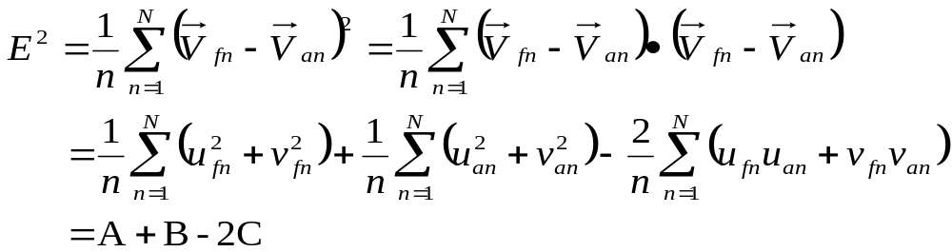
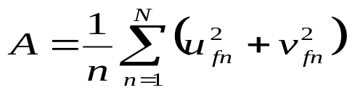
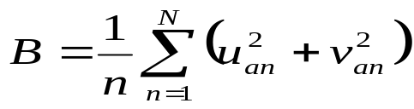
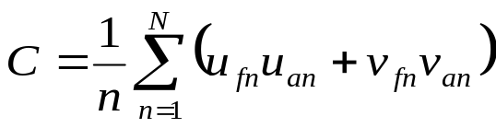
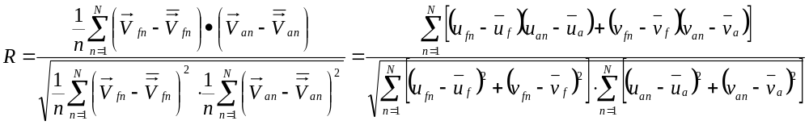
Vector Wind Stats
So far the deviations are for scalar variables. For vector wind, the corresponding stats are defined in the following way.
Define
Then MSE:
where
A, B, and C are partial sums in NCEP EMC VSDB database
Anomalous Pattern Correlation:

Slide 12
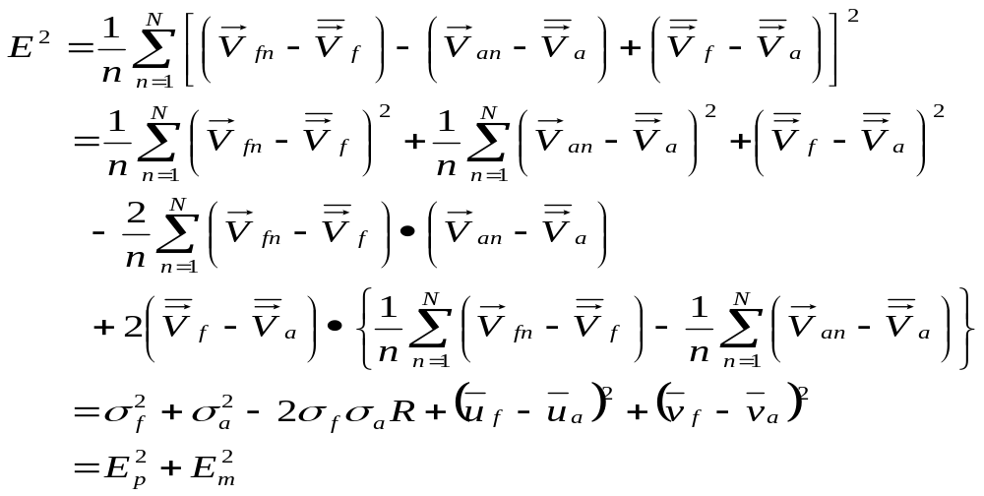
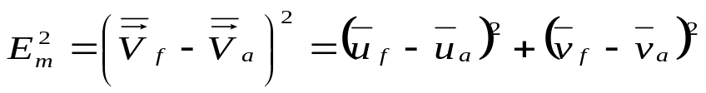
Vector Wind Stats
where
MSE by Mean Difference
MSE by Pattern Variation
Variance of forecast
Variance of analysis

Slide 13
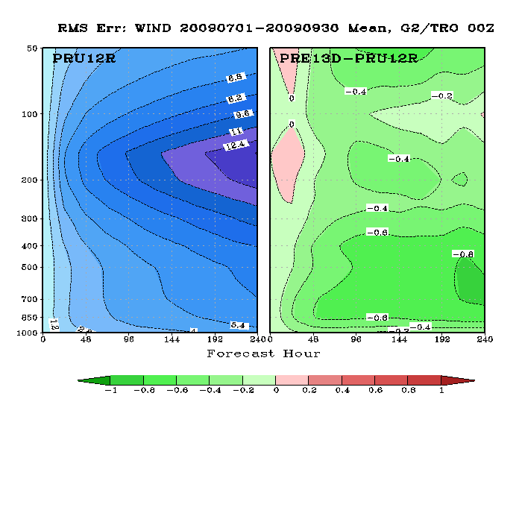
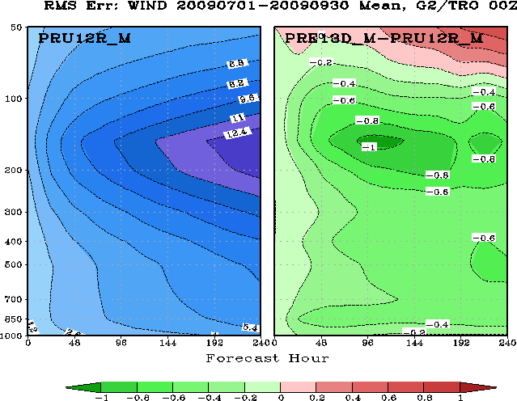
Case Demonstration:
Impact of Analyses on Tropical Vector Wind RMSE
T382L64
T574L64
T382L64
T574L64
Each experiment is verified against its own analysis.
Both experiments are verified against the same analysis, which is the mean of the two experiments.

Slide 14
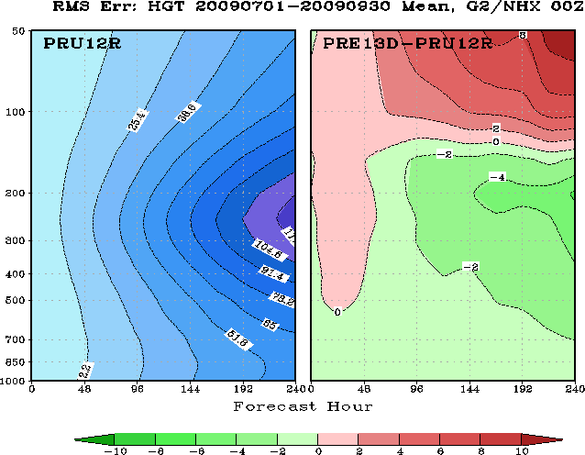
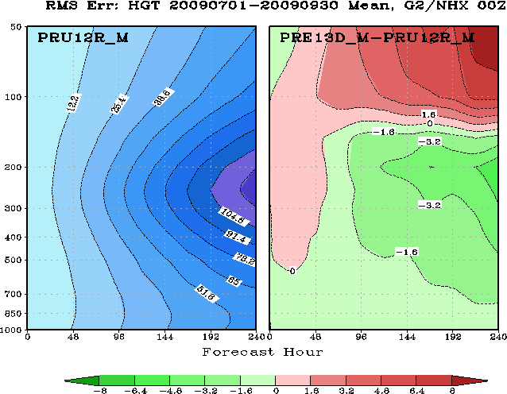
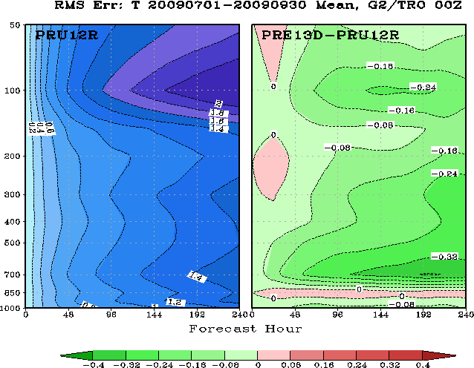
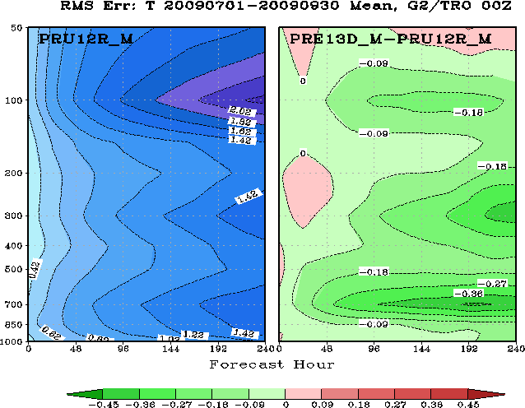
Impact of Analyses on RMSE
NH HGT
own analysis
same analysis
TRO T

Slide 15
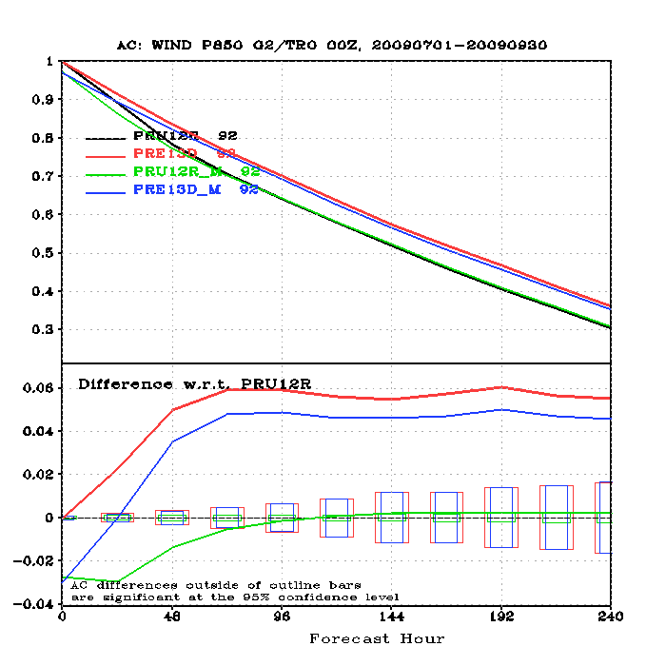
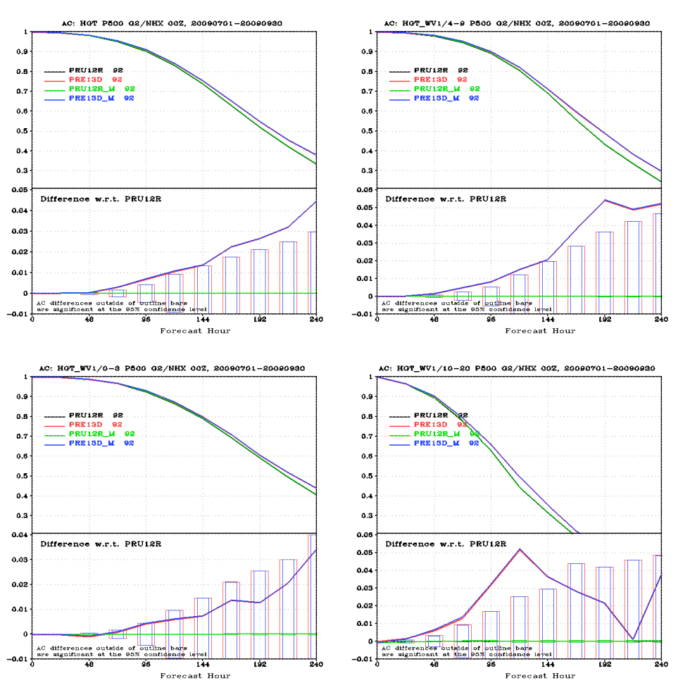
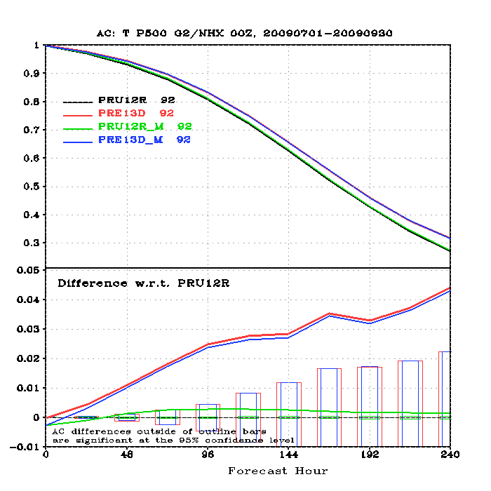
Impact of Analyses on Anomaly Correlation
NH 500hPa Height
Tropical 850hPa Wind
Using different analysis has little impact on anomaly correlation for all variables except for winds at initial forecast time
NH 500hPa Temp

Slide 16
Summary II
Using different analysis has significant impact on the RMSE of winds. Its impact on the RMSE of height and temperature is smaller.
Using different analysis has negligible impact on Anomaly Correlation, except for winds at initial time.
Recommendation: the same analysis should be used for verification when comparing different models and/or different experiments.
In the next few slides the same analysis is used for verification.

Slide 17



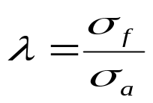
Case Demonstration: Decomposing MSE of Scalar Variables
The following five components will be examined. All forecasts are verified against the same analysis, i.e., the mean of the two experiments pru12r and pre13d.
Total MSE
MSE by Mean Difference
MSE by Pattern Variation
Ratio of Standard Deviation: Fcst/Anal
Murphy’s Mean-Squared Error Skill Score
Anomalous Pattern Correlation

Slide 18

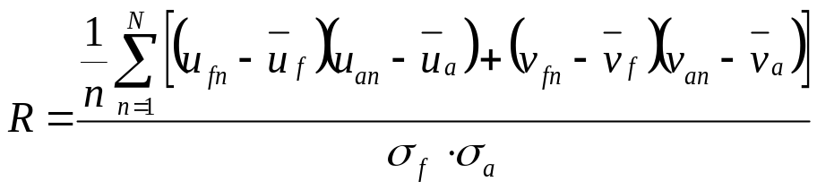
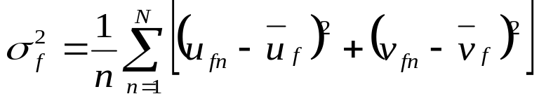
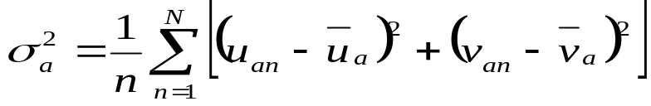
Case Demonstration: Decomposing RMSE of Vector Wind
The following five components will be examined. All forecasts are verified against the same analysis, i.e., the mean of the two experiments pru12r and pre13d.
Total MSE
MSE by Mean Difference
MSE by Pattern Variation
Ratio of Standard Deviation: Fcst/Anal
Murphy’s Mean-Squared Error Skill Score
Anomalous Pattern Correlation

Slide 19
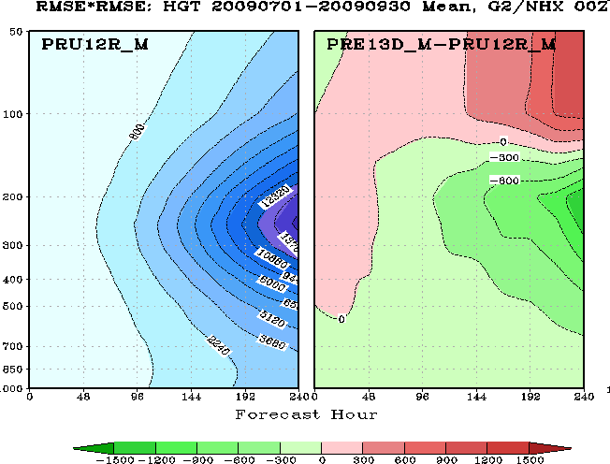
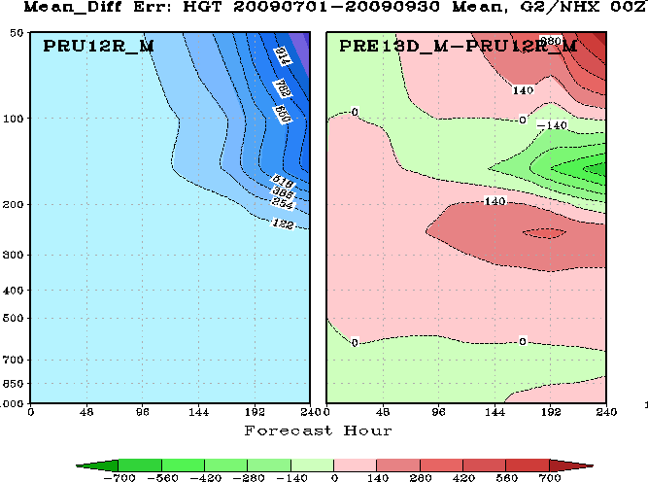
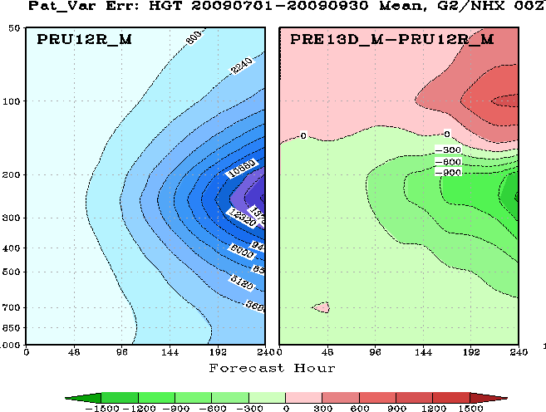
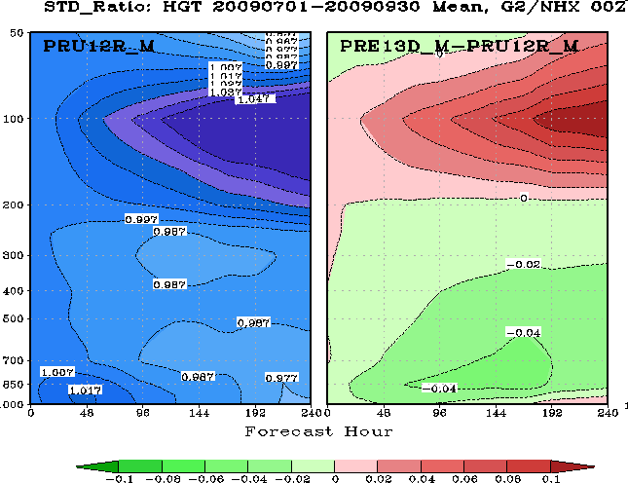
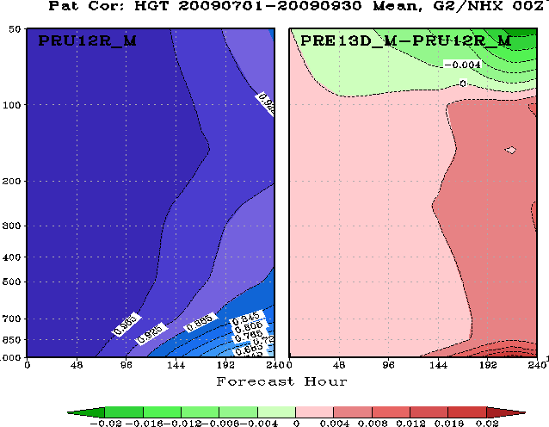
Decomposing NH HGT RMSE^2, T382L64 GFS, 200907-200909
Total MSE
MSE by Mean Difference
MSE by Pattern Variation
Ratio of Standard Deviation
Anomalous Pattern Correlation
Total RMSE is primarily composed of EMD in the lower stratosphere and EPV in the troposphere.
HGT generally has high anomalous pattern correlation.
The forecast variance is lower than that of analysis in the lower troposphere and stratosphere, and larger near the tropopause.
Forecast variance near tropopause increases with forecast lead time .

Slide 20
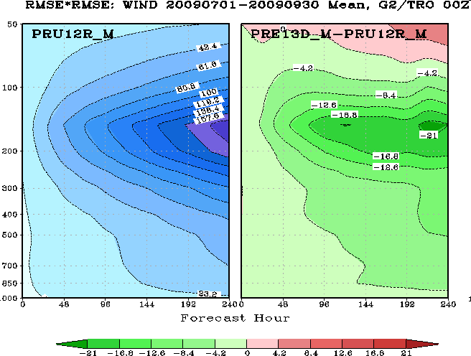
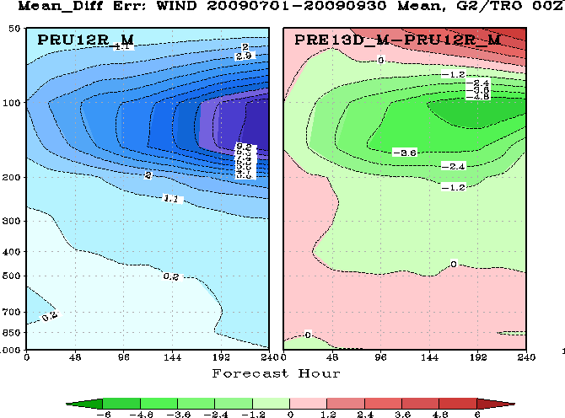
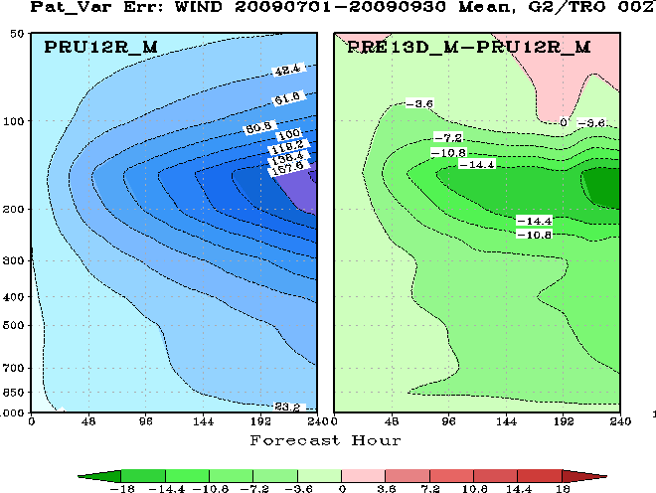
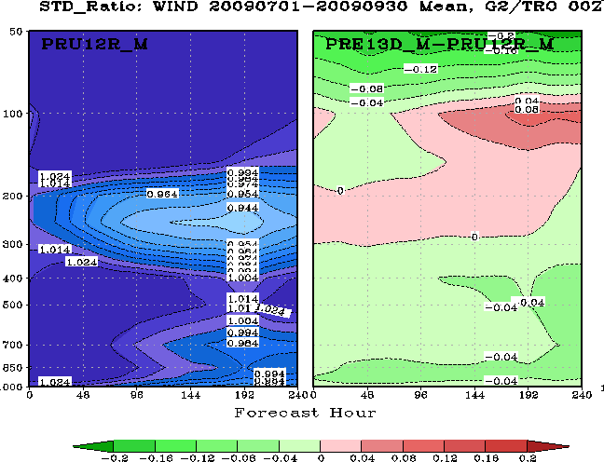
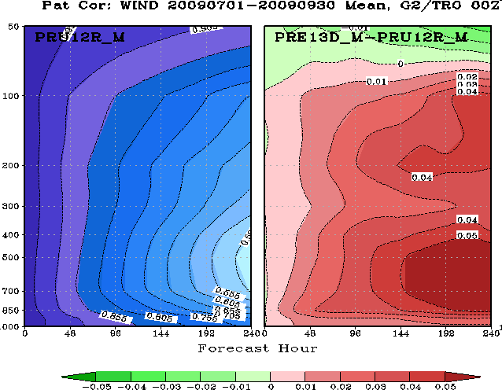
Decomposing Tropical Vector Wind RMSE^2, T382L64 GFS, 200907-200909
Total MSE
MSE by Mean Difference
MSE by Pattern Variation
Ratio of Standard Deviation
Anomalous Pattern Correlation
For tropical Wind, both EMD and EPV are concentrated near the tropopause , and increase with forecast lead time.
T382 GFS is not able to maintain wind variance near the tropopause, and has stronger variance everywhere else.
Wind anomalous pattern correlation is much poorer than that of HGT, and faints quickly with forecast lead time, especially in the lower troposphere.

Slide 21
Decomposing NH HGT RMSE^2, Comparing T574 to T382, 200907-200909
Total MSE
MSE by Mean Difference
MSE by Pattern Variation
Ratio of Standard Deviation
Anomalous Pattern Correlation
The reduction of total HGT RMSE in the troposphere comes from EPV reduction. Both EMD and EPV increased in the lower stratosphere.
Compare to T382, T574 has larger forecast variance near the tropospause, and smaller variance in the lower troposphere.
Compare to T382, T574 has better HGT AC in the troposphere and worse AC in the lower stratosphere.

Slide 22
Decomposing Tropical Vector Wind RMSE^2, Compare T574 with T382, 200907-200909
Total MSE
MSE by Mean Difference
MSE by Pattern Variation
Compared to T382, T574 has smaller RMSE in the troposphere, coming from reduction in both EMD and EPV. In the lower stratosphere, EMD increased.
Compare to T382, T574 has much weaker wind variance in the lower stratosphere.
T574 has better anomalous pattern correlation in the troposphere. Therefore, the reduction in EPV near the tropopause is credible, and the wind variance is also stronger.
Ratio of Standard Deviation
Anomalous Pattern Correlation

Slide 23
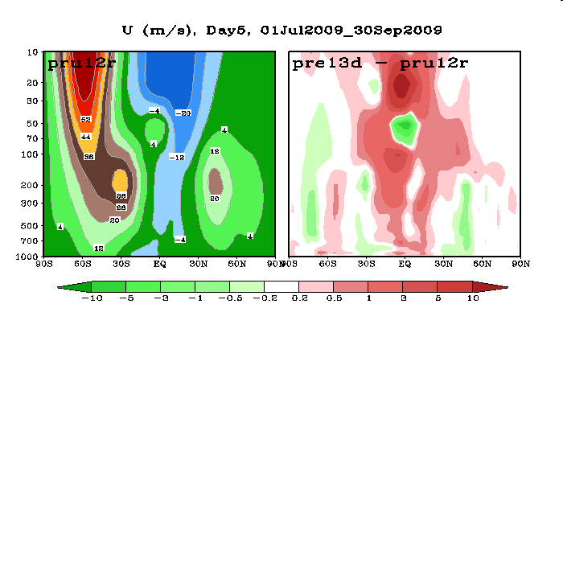
Compared to T382 GFS, T574 GFS has better forecast skills in the troposphere.
T574 reduced tropical wind variance in the lower stratosphere. Mean tropical wind in the lower stratosphere is also weaker.

Slide 24
Summary
RMSE/MSE can be at times misleading. Its fairness as a performance metric depends on the goodness of mean difference, standard deviation, and pattern correlation.
If pattern correlation is low, RMSE tends to award forecasts with smoother fields. The implication is that RMSE should not be used for extended NWP forecasts and seasonal forecasts either.
The same analysis should be used for verification when comparing different models and/or different experiments. The impact of analysis is on anomaly correlation than on RMSE, and less on height than on winds.
At NCEP/EMC, RMSE has been almost exclusively used to measure the performance of tropical wind. A more comprehensive verification should at least include MSE, MSE by Mean Difference, Anomalous Pattern Correlation, and Ratio of Forecast Variance to Analysis Variance.
MSE should be used instead of RMSE or standard deviation, the summation of the latter is hard to interpret in math terms.

