Slide 1
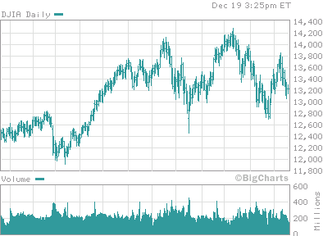

Dropout
Fanglin Yang
EMC/NCEP, December 20 2007

Slide 2
Part I
How often does dropout occur?
A Review of forecast consistence

Slide 3
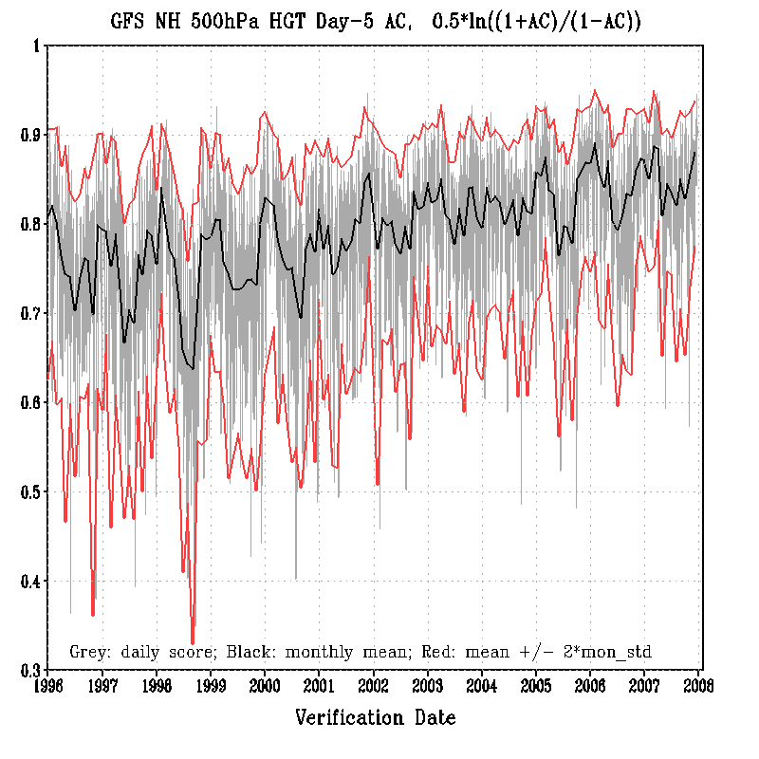
Standard deviation is computed using Fisher transformed AC. Shown in the map are real ACs after reverse transform
Daily AC
Monthly AC
2 Standard Deviation
05/14/07
10/22/07
1996 ~ 2007: 184 cases | AC_d – AC_m | > 2*std, 4.1%
50 cases | AC_d – AC_m | > 0.2 1.1%

Slide 4
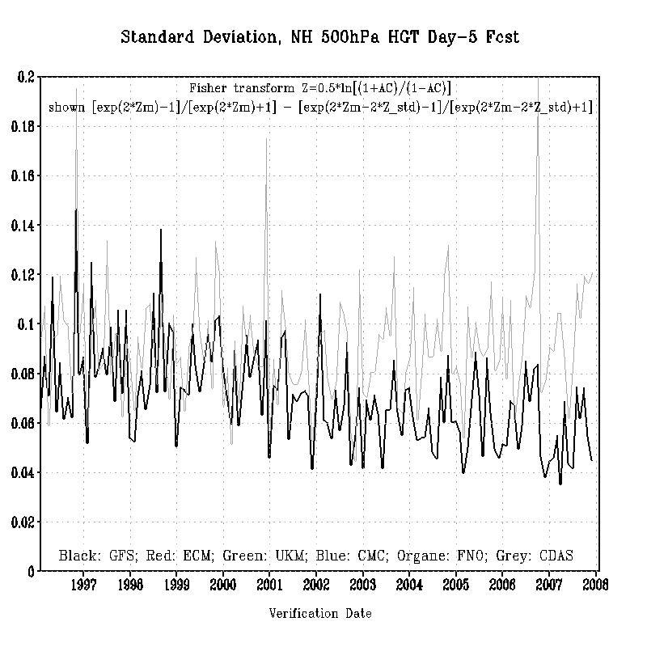
CDAS
GFS
GFS forecast consistence has been improving.
The forecasts in summer are less consistent than the forecasts in winter.

Slide 5
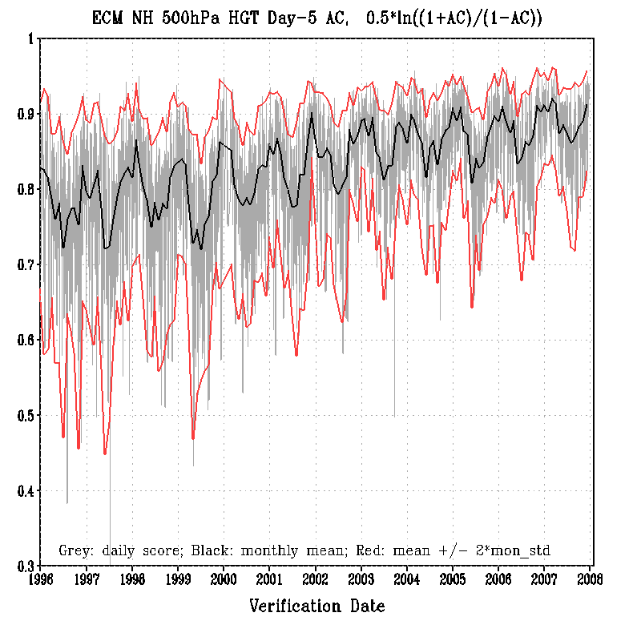
ECMWF
Daily AC
Monthly AC
2 Standard Deviation
1996 ~ 2007: 171 cases | AC_d – AC_m | > 2*std 4.0%
30 cases | AC_d – AC_m | > 0.2 0.7%

Slide 6
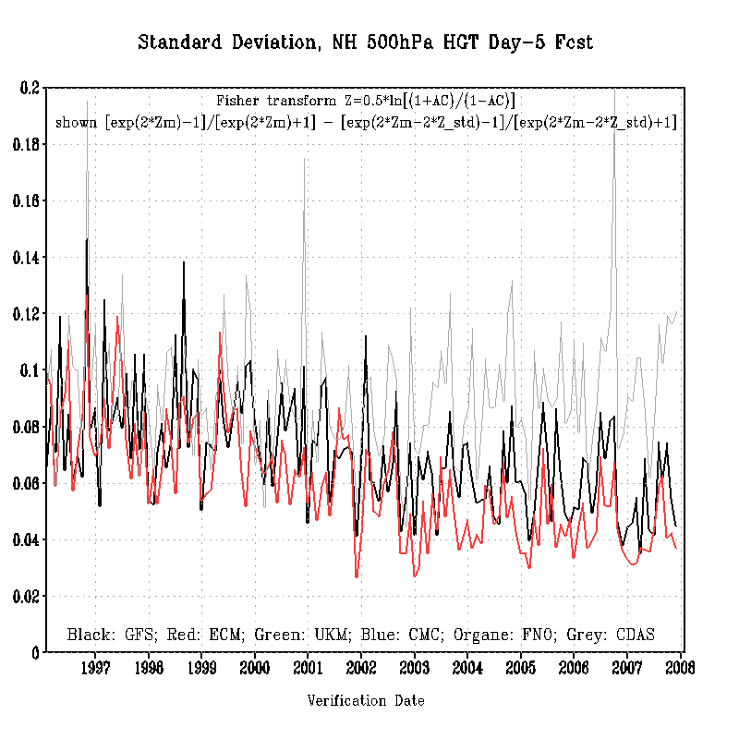
CDAS
GFS
ECMWF
EC has slightly better forecast consistence than the GFS

Slide 7
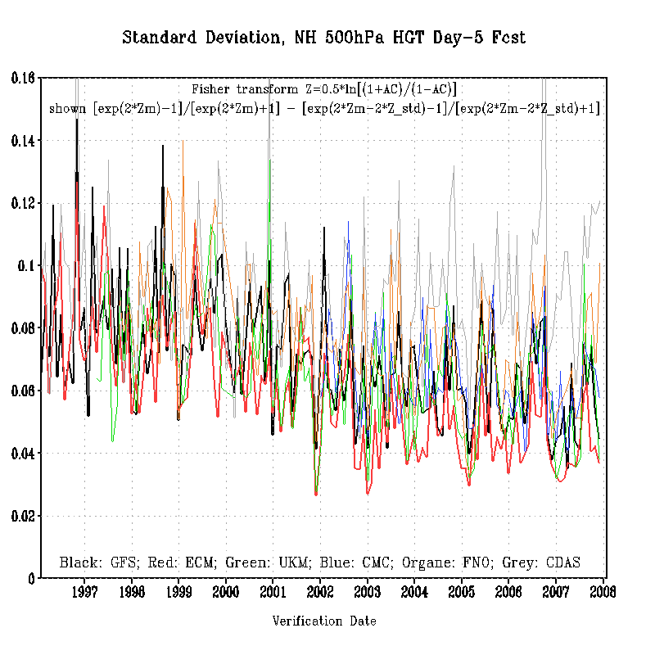
FNOMC
CDAS
CMC
GFS
UKM
ECMWF

Slide 8
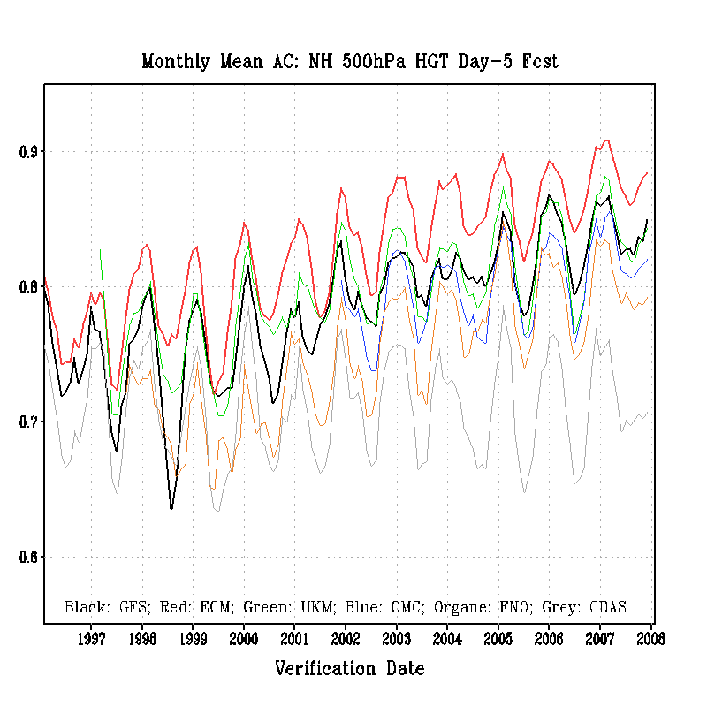
ECMWF
GFS
CDAS
UKM
FNOMC
CMC

Slide 9
Part II
10-22-2007 Dropout

Slide 10
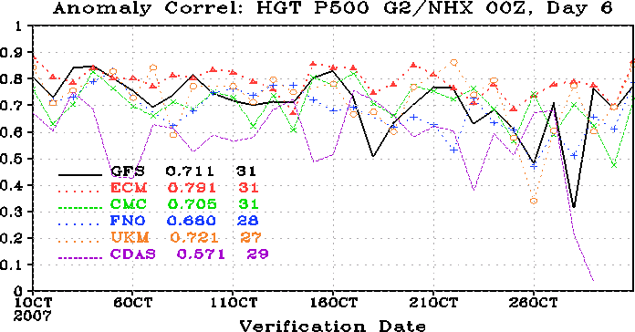
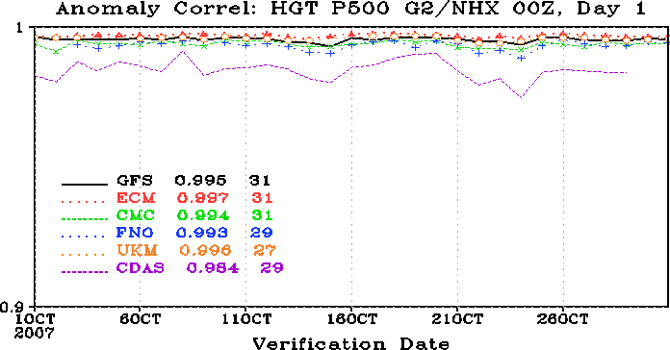
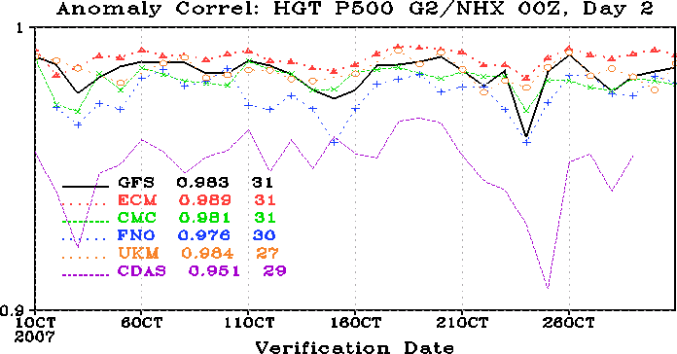
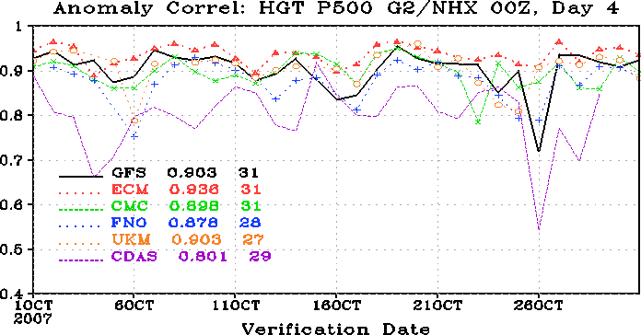
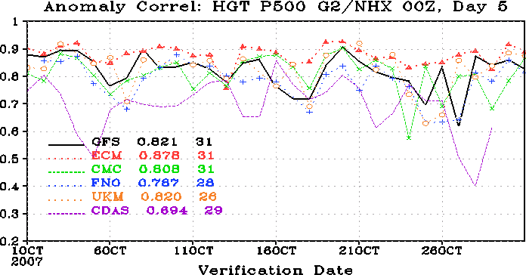
Multi-Model 00Z Cycle

Slide 11
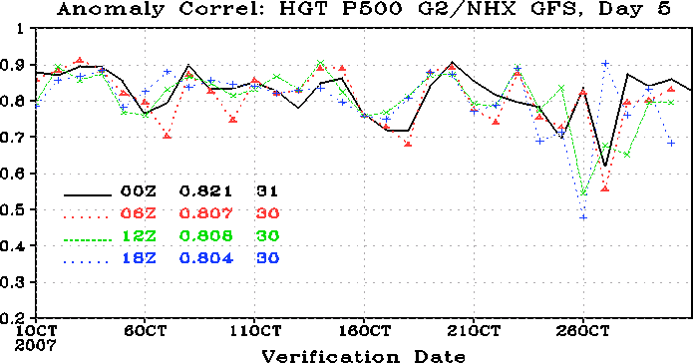
GFS: 00Z, 06Z, 12Z, 18Z Cycles
Dropouts
12Z 10/21 cycle
18Z 10/21 cycle
00Z 10/22 cycle
06Z 10/22 cycle
Questions:
1. Why did the GFS forecast fail? What was the circulation pattern?
2. Is this a case that is unpredictable for the GFS?
3. Is this a bad case that caused by poor initial conditions?

Slide 12
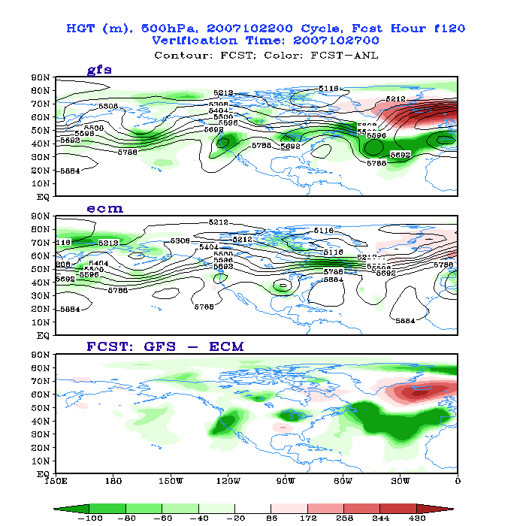
00Z Oct 27, f120
Bias up to
10%

Slide 13
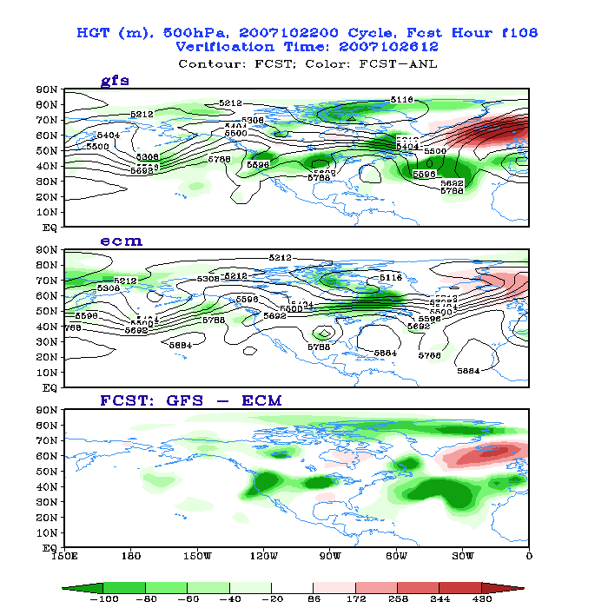
12Z Oct 26, f108

Slide 14
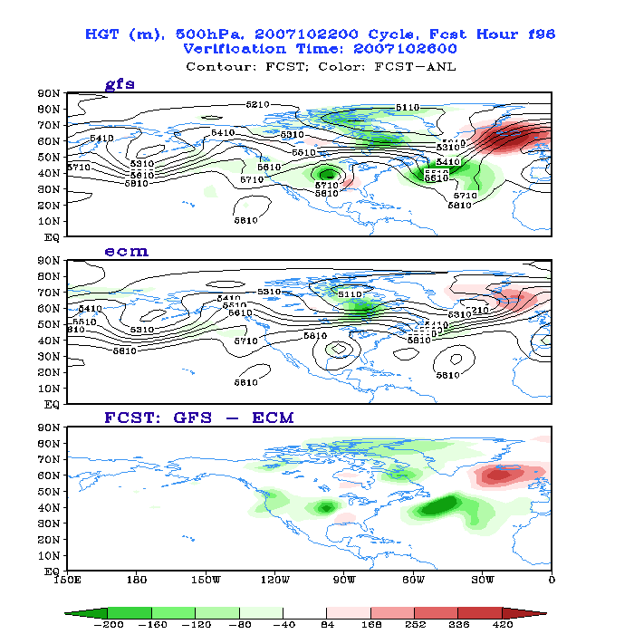
00Z Oct 26, f96

Slide 15
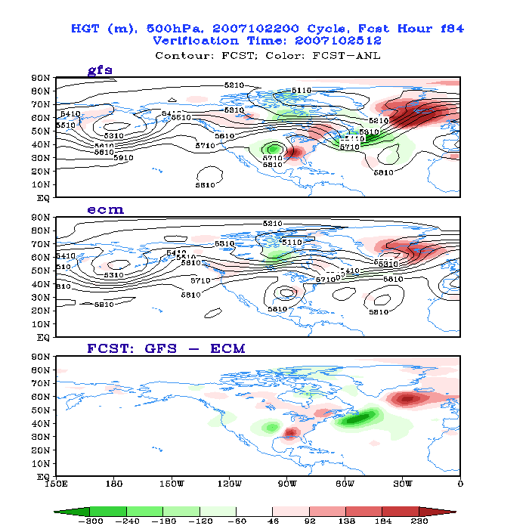
12Z Oct 25, f84

Slide 16
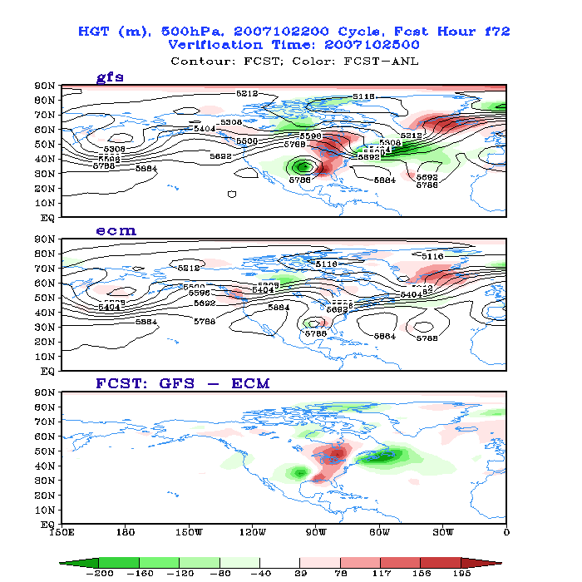
00Z Oct 25, f72

Slide 17
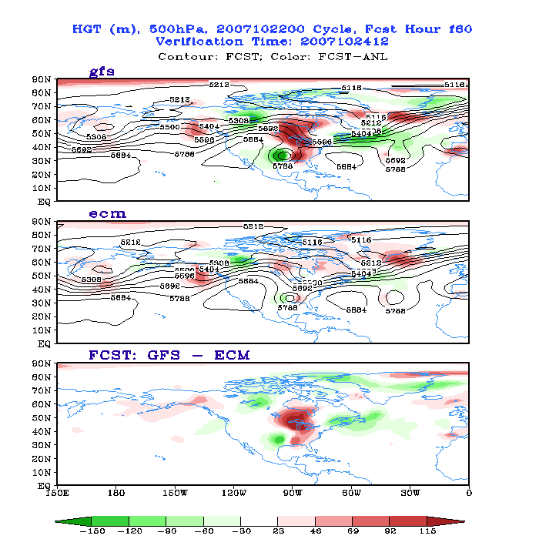
12Z Oct 24, f60

Slide 18
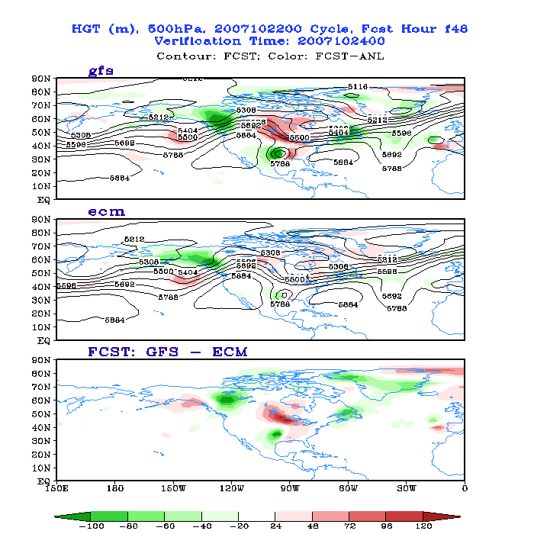
00Z Oct 24, f48

Slide 19
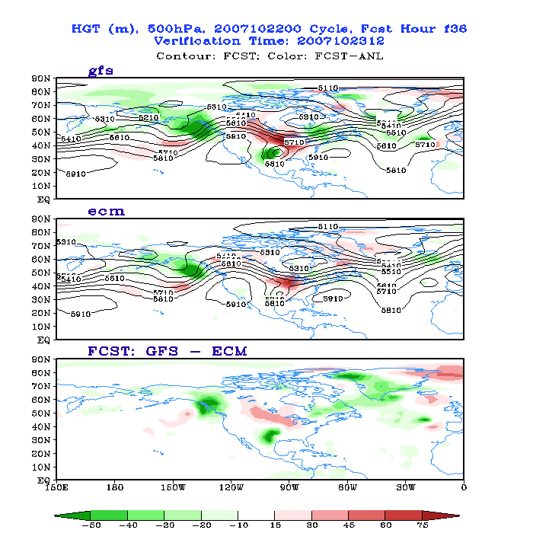
12Z Oct 23, f36

Slide 20
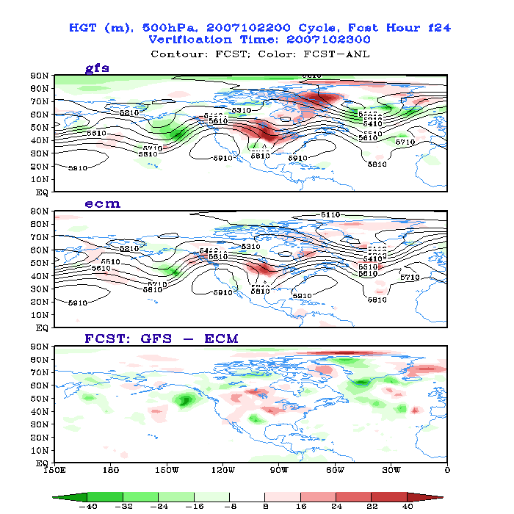
00Z Oct 23, f24

Slide 21
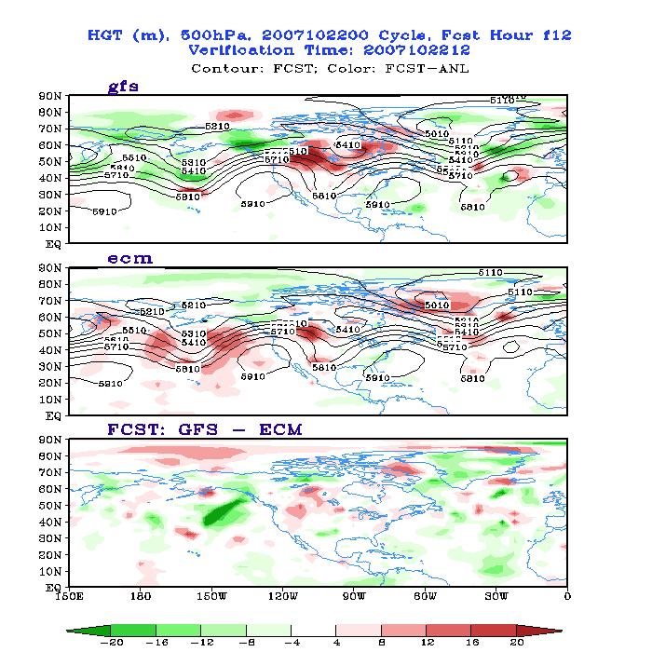
12Z Oct 22, f12

Slide 22
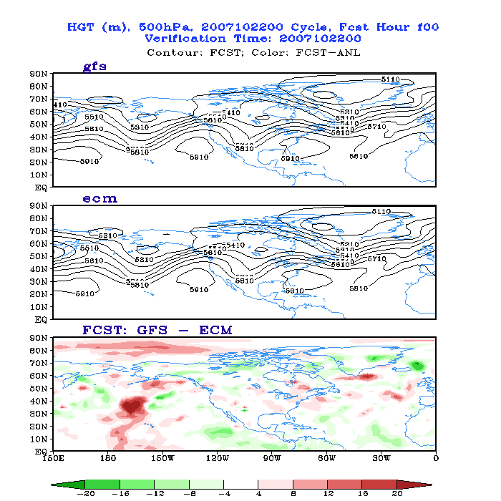
00Z Oct 22
Analysis

Slide 23
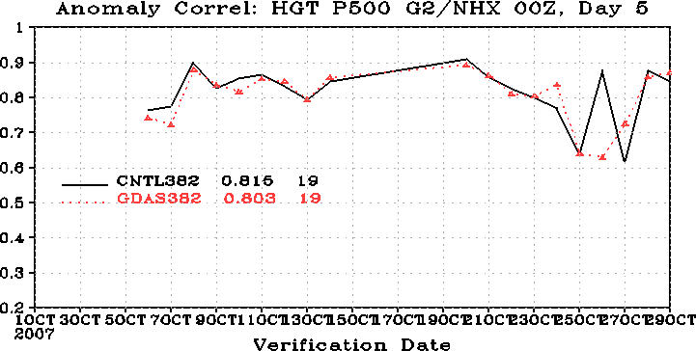
Sensitivity to Initial Conditions: GFS vs GDAS
The GFS cycle has a narrower truncation window (~2.5 hours) for assimilating observations than the GDAS does (~ 6 hours).
Reran the forecasts for the entire month of October 2007 with GDAS initial conditions, which contain more observational data than the GFS initial conditions do.
Conclusion: Using the GDAS initial conditions do not improve the AC scores.

Slide 24
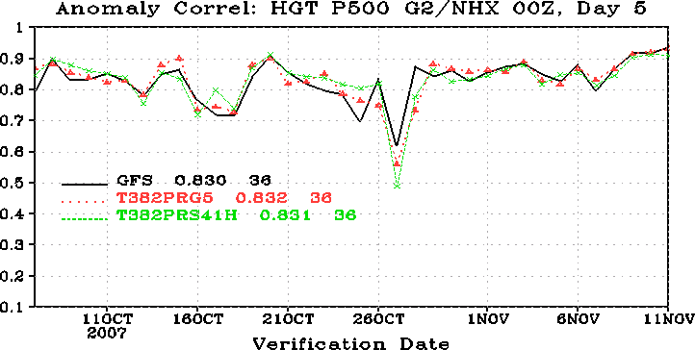
Sensitivity to Model Physics: opnl vs new parallel
Perturbing model physics does not remove the dropout. It is unlikely this is a random error (noise).

Slide 25
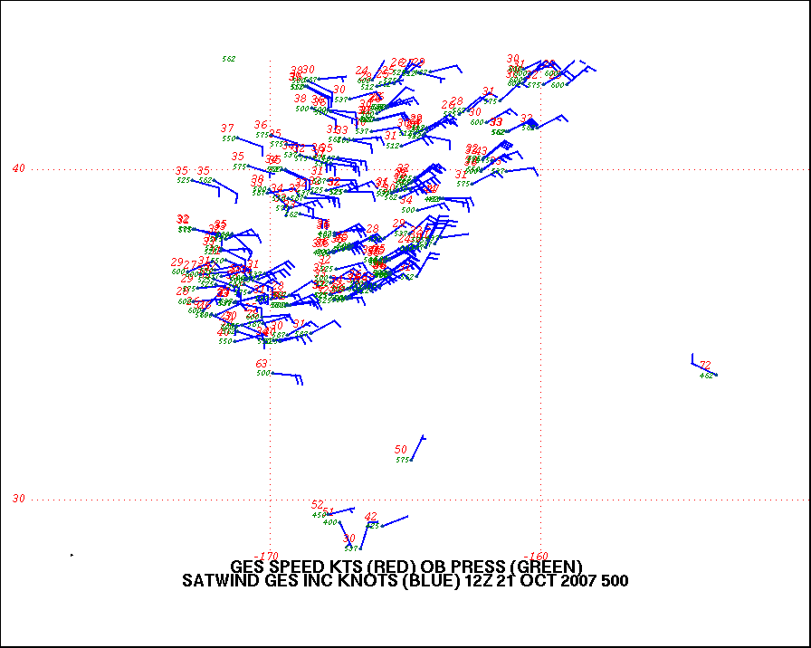
Satellite Wind Increment, 12Z 10/21/2007
170W
160W
40N
30N
From Bradley Ballish

Slide 26
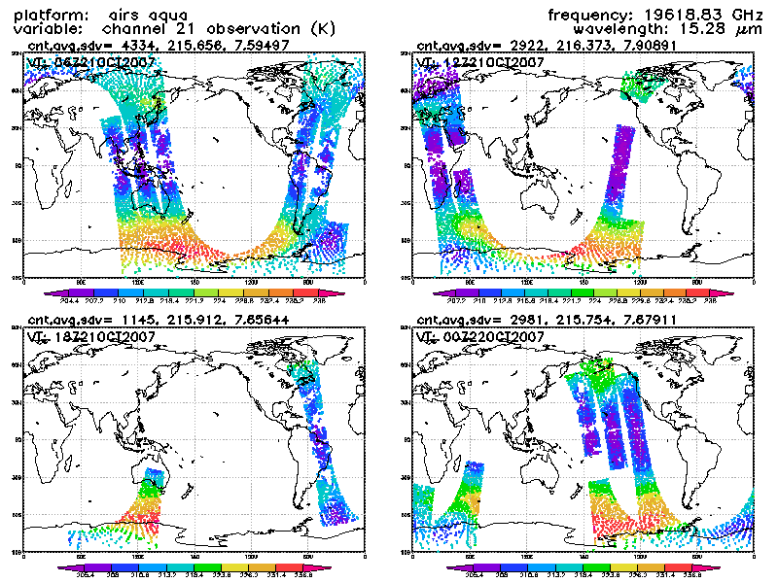
AIRS Satellite Data Intake
06Z 21OCT
12Z 21OCT
18Z 21OCT
00Z 22OCT
Provided by Xujuan Su

Slide 27
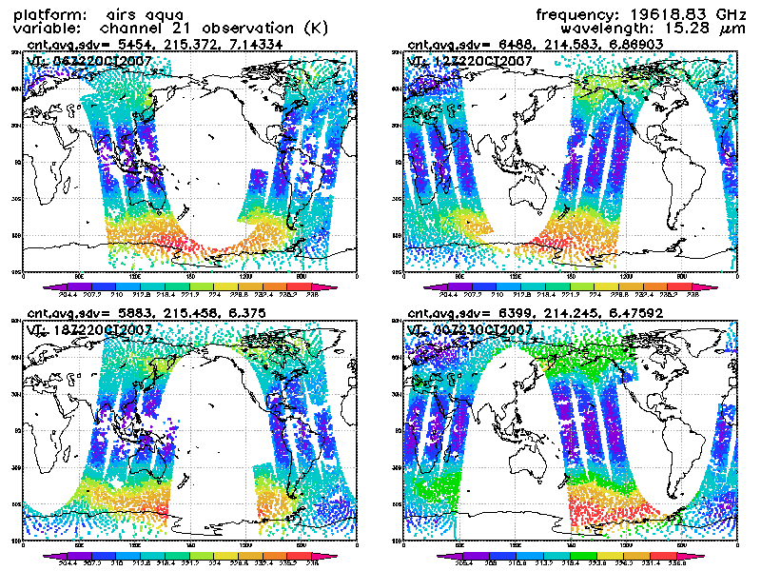
AIRS Satellite Data Intake
06Z 22OCT
12Z 22OCT
18Z 22OCT
00Z 23OCT
Provided by Xujuan Su

Slide 28


Is the loss of AIRS data really responsible for the dropout?
Or is it merely a coincidence?
Do we have a definite answer?
Not really ……
Happy Holidays!

