Slide 1
Evolution of GFS Forecast Skill
S. Lord and Fanglin Yang
5/20/2010

Slide 2
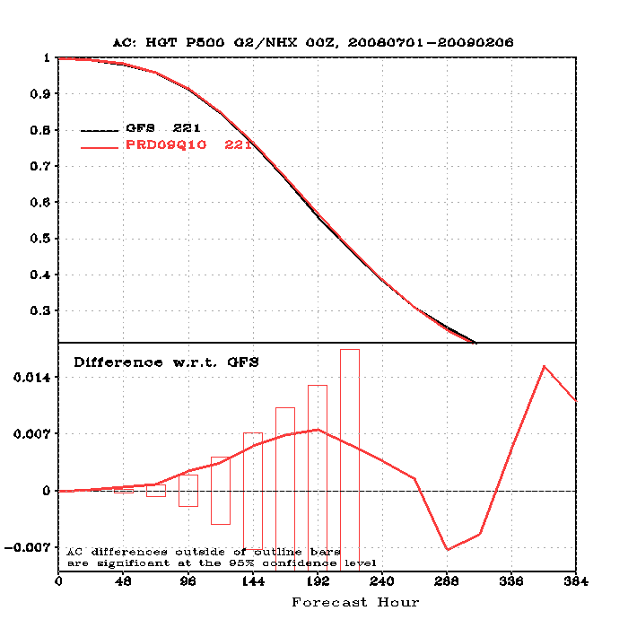
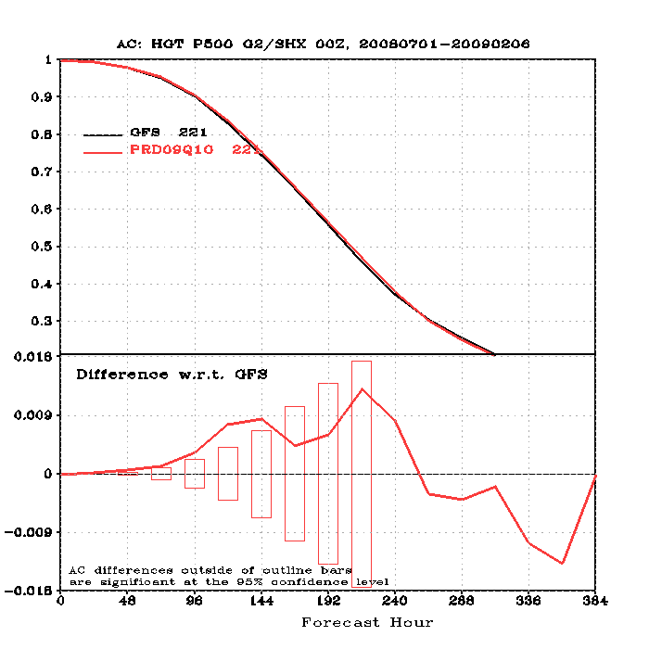
500 hPa Anomaly Correlation
“But these are just ‘width of the line’ improvements…”
Why are these changes important to users?
How can you justify $M for new computing power based on these anticipated improvements?

Slide 3
500 hPa Anomaly Correlation
Fanglin
Yang
“They are statistically significant…”
Why are these changes important to users?
How can you justify $M for new computing power based on these anticipated improvements?

Slide 4
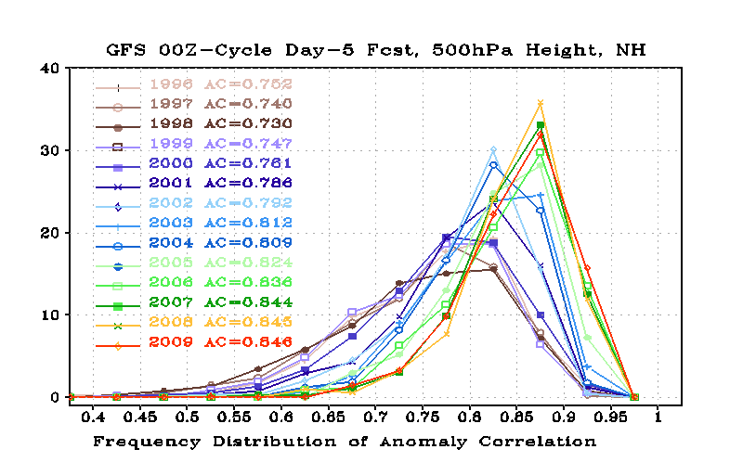
Fanglin
Yang
Why are these changes important to users?
  Primary users are forecasters
  Secondary and tertiary users, e.g. the American public, are well beyond EMC’s scope
How can you justify $M for new computing power based on these anticipated improvements?
  Only the secondary and tertiary users can answer this question for us
  Plausibility arguments do not appear to work

Slide 5
GFS Changes
3/1999
  AMSU-A and HIRS-3 data
  Next major change: 2/2000
2/2000
  Resolution change 100 → 70 km
  Next changes
    7/2000 (hurricane relocation)
    8/2000 (data cutoff for 06 and 18 UTC)
    10/2000 – package of minor changes
    2/2001 – radiance and moisture analysis changes
  Next major change: 5/2001
5/2001
  Major physics upgrade (prognostic cloud water, cumulus momentum transport)
  Improved QC for AMSU radiances
  Next changes
    6/2001 – vegetation fraction
    7/2001 – SST satellite data
    8/200 – sea ice mask, gravity wave drag adjustment, random cloud tops, land surface evaporation, cloud microphysics…)
    10/ 2001 – snow depth from model background
    1/2002 – Quikscat included

Slide 6
GFS Changes (cont)
11/2002
  Resolution change 70 → 55 km
  Recomputed background error
  AMSU-A and HIRS channels added
  Divergence tendency constraint in tropics turned off
  Next changes
    3/2003 – NOAA-17 radiances, NOAA-16 AMSU restored, Quikscat 0.5 degree data
    8/2003 – RRTM longwave and trace gases
    10/2003 – NOAA-17 AMSU-A turned off
    11/2003 – Minor analysis changes
    2/2004 – mountain blocking added
    5/2004 – NOAA-16 HIRS turned off
5/2005
  Resolution change 55 km → 38 km
  Reduce background vertical diffusion
  Retune mountain blocking
  Upgrade Land Surface Model
  Next changes
    6/2005 – Increase vegetation canopy resistance
    7/2005 – Correct temperature error near top of model

Slide 7
GFS Changes (cont)
8/2006
  Revised orography and land-sea mask
  NRL ozone physics
  Upgrade snow analysis
  Next changes 5/2007
5/2007
  Gridpoint Statistical Interpolation (GSI) analysis replaces Spectral Statistical Interpolation (SSI)
  Added new observations (COSMIC, full resolution AIRS, METOP HIRS, AMSU-A and MHS)
  Vertical coordinate changed to hybrid sigma-pressure
  Next changes 12/2007
12/2007
  JMA high resolution winds and SBUV-8 ozone observations added
  Next changes 2/2009
2/2009
  Flow-dependent weighting of background error variances
  Variational Quality Control
  METOP IASI observations added
  Updated Community Radiative Transfer Model coefficients
  Minor changes to glacier ice points

Slide 8
Caveats and Comments
Major and minor changes are included in each implementation
  They all contribute to improving the system
  Accumulated impact of many small changes is significant but not measurable
  Some major changes also bundled
Everyone’s work is, and has been, important
Predictability may change from one year to next
  Annual mean scores used
Beware of “Post hoc, ergo propter hoc” fallacy
  I.e. “It came before, therefore it is the cause…”
EMC developers probably know the conclusions already
  Purpose is to make case to upper managers
Will this analysis make a difference?
  In how forecasters use products?
  To ability to sell system development?

Slide 9
Fanglin
Yang
Look at the history of extremes in the distribution
  Scores <0.7 (dropout criterion)
  Excellent forecasts (>0.9)

Slide 10
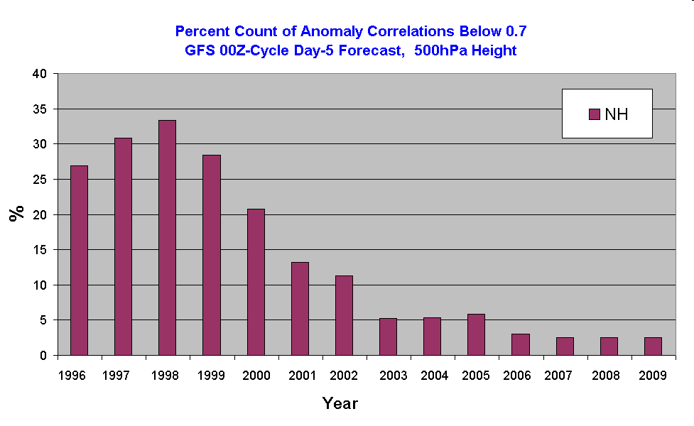
Percent of Poor (Busted) Forecasts
?
Beware: “post hoc, ergo
proper hoc”

Slide 11
Percent of Poor (Busted) Forecasts
?
11/2002: Res. Incr. 70 → 55 km
6/2005: Res. Incr. 55 → 38 km
2/2000: Res. Incr. 100 → 70 km

Slide 12
Percent of Poor (Busted) Forecasts
5/2001 physics upgrade
?
11/2002: Res. Incr. 70 → 55 km
6/2005: Res. Incr. 55 → 38 km
2/2000: Res. Incr. 100 → 70 km

Slide 13
Percent of Poor (Busted) Forecasts
3/1999: AMSU-A
5/2001 physics upgrade
11/2002: Res. Incr. 70 → 55 km
6/2005: Res. Incr. 55 → 38 km
AIRS, Model upgrade
5/2007 GSI
Model upgrade
2/2009
GSI
IASI
2/2000: Res. Incr. 100 → 70 km

Slide 14
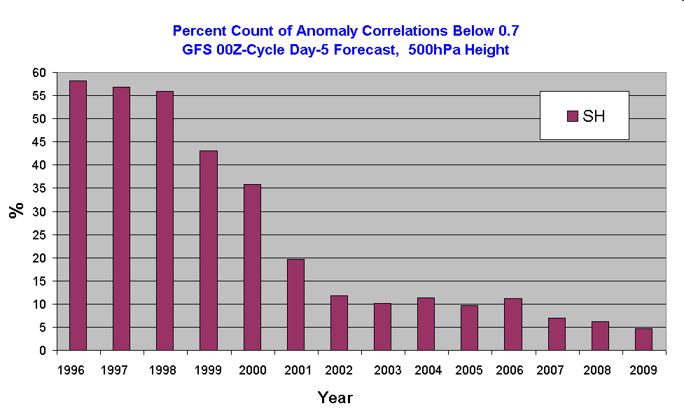
Percent of Poor (Busted) Forecasts
?
Beware: “post hoc, ergo
proper hoc”

Slide 15
Percent of Poor (Busted) Forecasts
3/1999: AMSU-A
5/2001 physics upgrade
?
5/2007 GSI
Model upgrade
2/2009
GSI
IASI
2/2000: Res. Incr. 100 → 70 km

Slide 16
Percent of Poor (Busted) Forecasts
3/1999: AMSU-A
5/2001 physics upgrade
11/2002: Res. Incr. 70 → 55 km
6/2005: Res. Incr. 55 → 38 km
AIRS, Model upgrade
5/2007 GSI
Model upgrade
2/2009
GSI
IASI
Beware: “post hoc, ergo
proper hoc”
2/2000: Res. Incr. 100 → 70 km

Slide 17
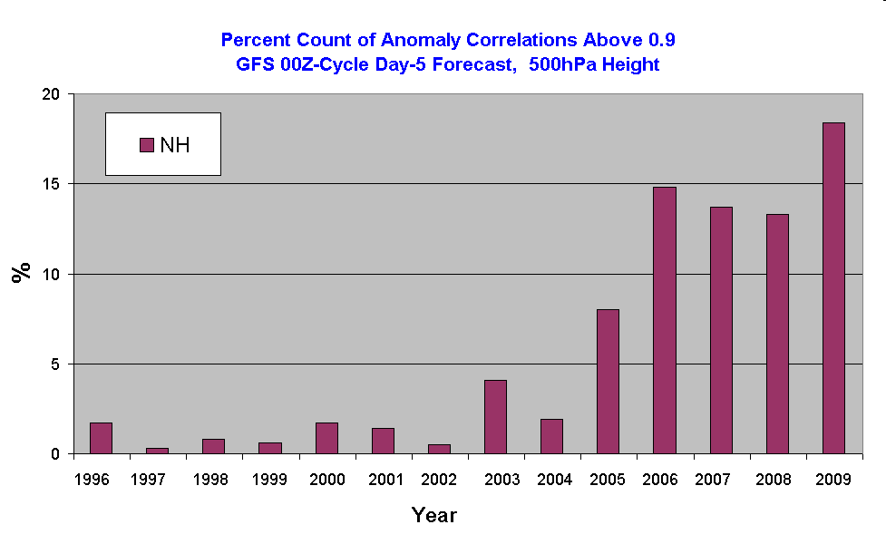
Percent of Excellent Forecasts
5/2001 physics upgrade
6/2005: Res. Incr. 55 → 38 km
AIRS, Model upgrade
11/2002: Res. Incr. 70 → 55 km
5/2007 GSI
Model upgrade
2/2009
GSI
IASI
3/1999: AMSU-A
2/2000: Res. Incr. 100 → 70 km

Slide 18
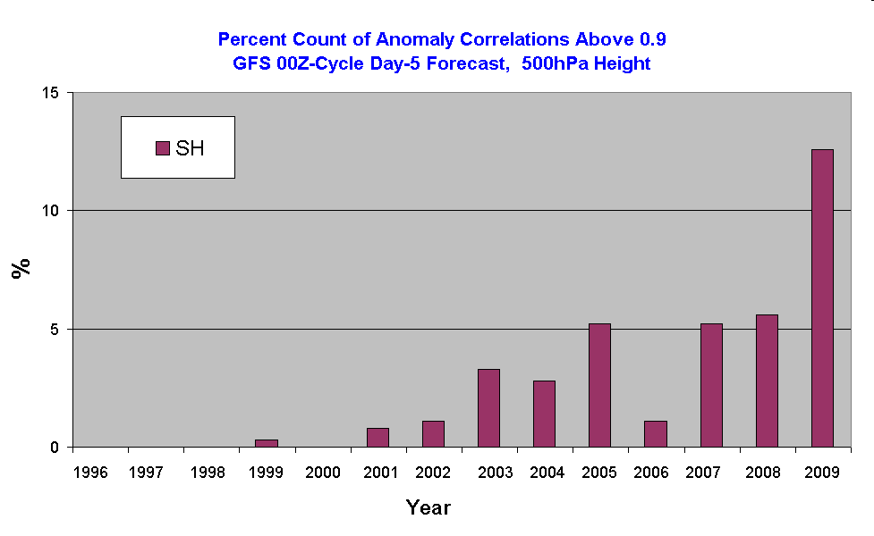
Percent of Excellent Forecasts
5/2001 physics upgrade
6/2005: Res. Incr. 55 → 38 km
AIRS Model upgrade
2/2009
GSI
IASI
5/2007 GSI
Model upgrade
11/2002: Res. Incr. 70 → 55 km
3/1999: AMSU-A
2/2000: Res. Incr. 100 → 70 km

Slide 19
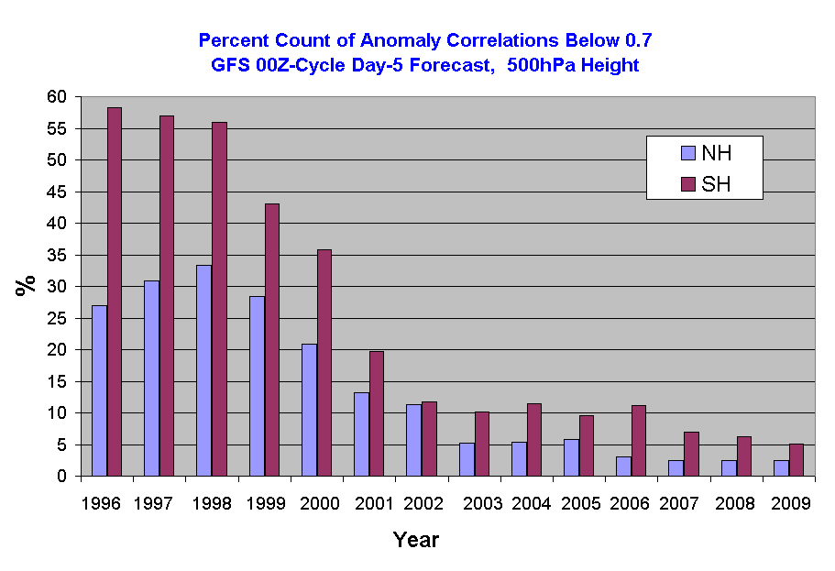
Percent of Poor (Busted) Forecasts
Model Resolution: NH > SH
GSI & Observations: SH > NH
Model Changes: both NH & SH
3/1999: AMSU-A
5/2001 physics upgrade
11/2002: Res. Incr. 70 → 55 km
6/2005: Res. Incr. 55 → 38 km
AIRS Model upgrade
5/2007 GSI
Model upgrade
2/2009
GSI
IASI
2/2000: Res. Incr. 100 → 70 km

Slide 20
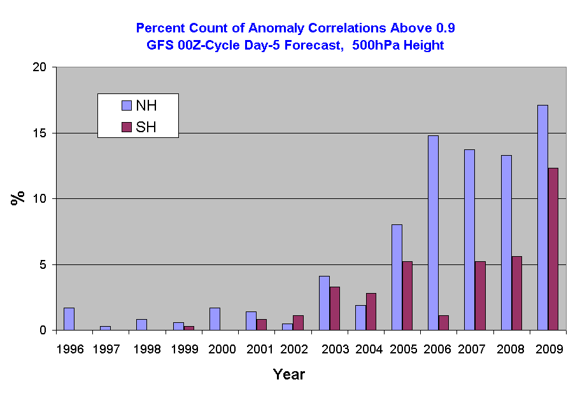
Percent of Excellent Forecasts
Model Resolution: NH > SH
GSI & Observations: NH & SH
Model Changes: both NH & SH
2/2009
GSI
IASI
5/2007 GSI
Model upgrade
6/2005: Res. Incr. 55 → 38 km
AIRS Model upgrade
11/2002: Res. Incr. 70 → 55 km
5/2001 physics upgrade
3/1999: AMSU-A
2/2000: Res. Incr. 100 → 70 km

Slide 21
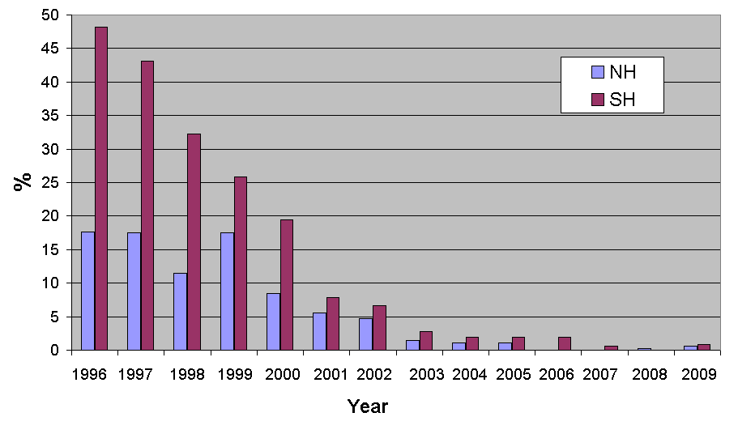
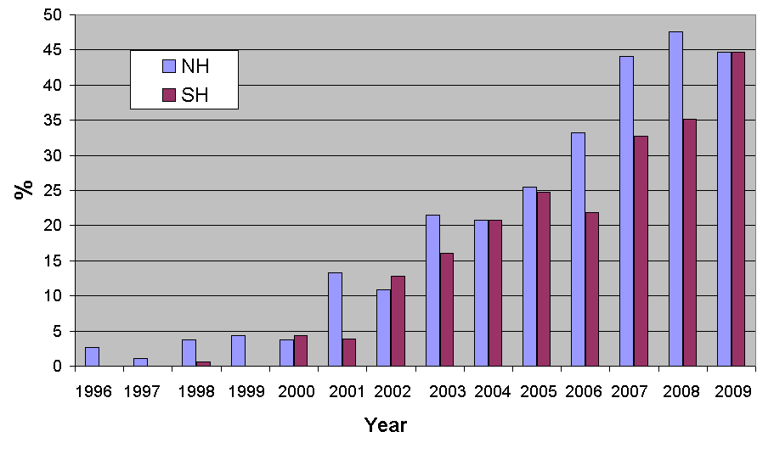
Does It Make a Difference to
How Forecasters Use Product?
Percent Poor Forecasts
Percent Good Forecasts
NCEP
NCEP
ECMWF
ECMWF

