Slide 1
Monte Carlo Significance Test of Precipitation Skill Scores
Fanglin Yang
EMC/NCEP, January 2010
Acknowledgment: Thank Mark Iredell for helpful discussion

Slide 2
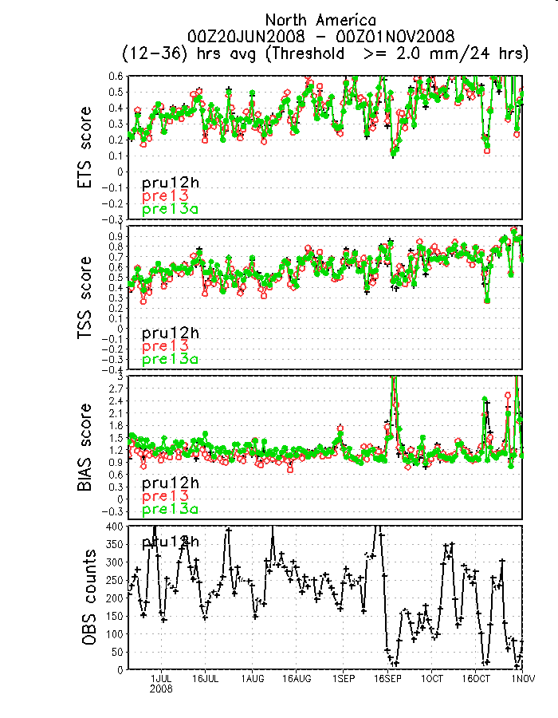
Time series of daily precip skill scores above a given threshold
A typical map of forecast verification circulated in EMC GCWMB

Slide 3
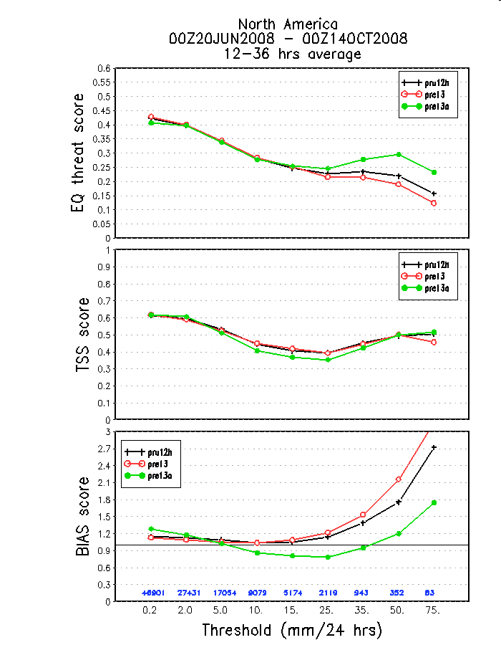
Mean skill scores over a certain time period
Are the differences significant?
How to perform statistical significance test?
Dilemma: the mean score at a given threshold shown in this map is not the arithmetic mean of daily skill scores shown in the previous map, rather it is a computed with all samples in all days assembled together (more details coming). Conventional method of significance test, for instance, the student-t test, which is often applied to a (time) series, is not applicable for this case.

Slide 4
Precip Skill Scores
 | Obs Yes | Obs NO
Fcst YES | a | b
Fcst NO | c | d
contingency table:
  Hits (a): occasions/counts where both forecast and observation are greater than or equal to a threshold over, say, CONUS;
  False alarms (b): occasions where forecast is above a threshold whereas observation is under the same threshold;
  Misses (c): occasions where the observation is above a threshold and forecast is under the same threshold;
  No forecasts (d): occasions where both forecast and observation are under the threshold.
Bias Score: BS=(a + b)/(a + c)
measures over-forecasts (BS>1) or under-forecasts (BS<1) precipitation frequency over an area for a selected threshold.
Equitable Threat Score: EQ_TS=(a - ar)/(a + b + c - ar)
where ar is the expected number of correct forecasts above the threshold in a random forecast where forecast occurrence/non-occurrence is independent from observation/non-observation, ar=(a + b)*(a + c)/(a + b + c + d). EQ_TS=1 means a perfect forecast. EQ_TS <=0 means the forecast is useless.

Slide 5
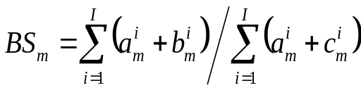
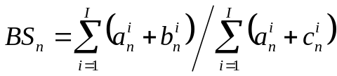

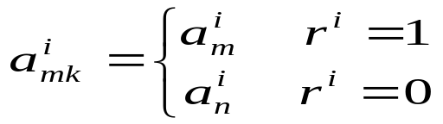
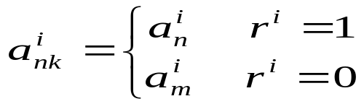



Design of Monte Carlo Significance Test
Taking the BIAS score as an example
For a given precip threshold,
Experiment m:
Experiment n:
where i =1,2,3,…I, is time index of verification period
Samples in all days are grouped together !
Re-sampling:
Create a random-number time series:
i =1,2,3,…I
Also resample b and c using the same random number time series
Re-compute
and
Repeat the re-sampling process, say, for K=10,000 times.
Then, exam the distributions and compute the standard deviation of

Slide 6
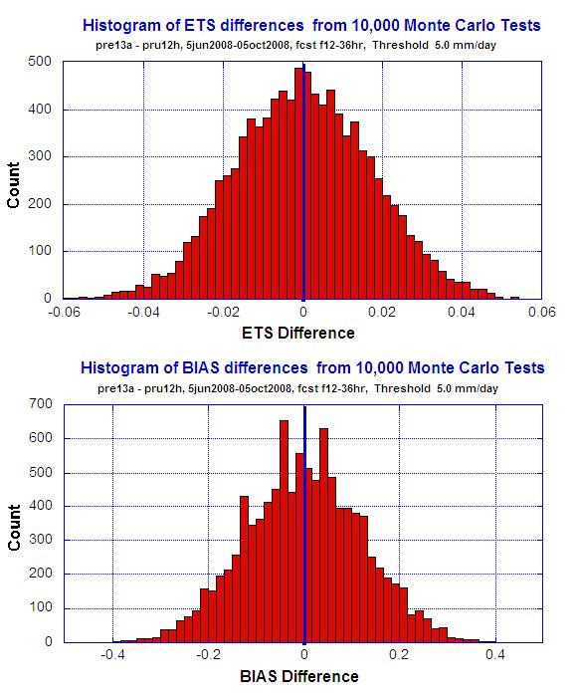
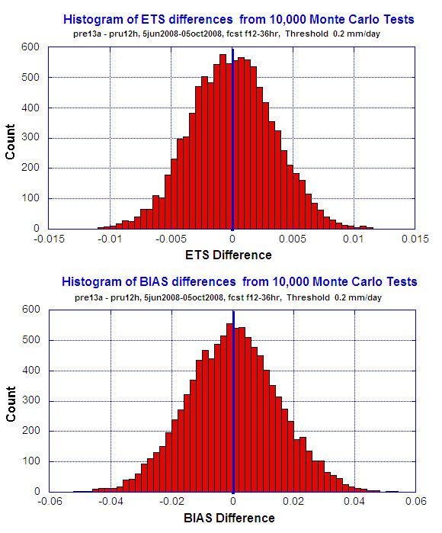
Distribution Shape of ETS/BIAS Differences ?
0.2 mm/day
5.0 mm/day
actual
difference
Gaussian -- normal distribution
1.96 * std → 95% confidence level
3 * std → 99% confidence level
Rare events,
significantly
different

Slide 7
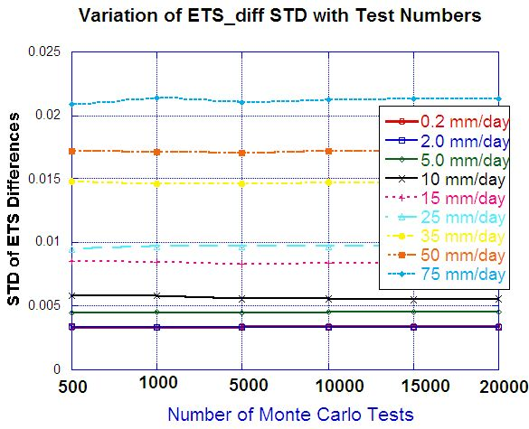
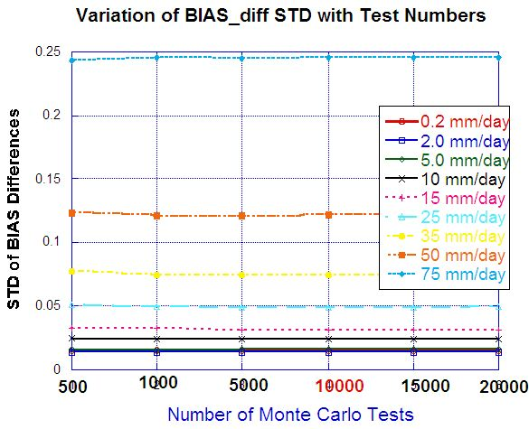
Optimum Size of Monte Carlo Test ? how does std change with test numbers?
10,000 looks sufficient

Slide 8
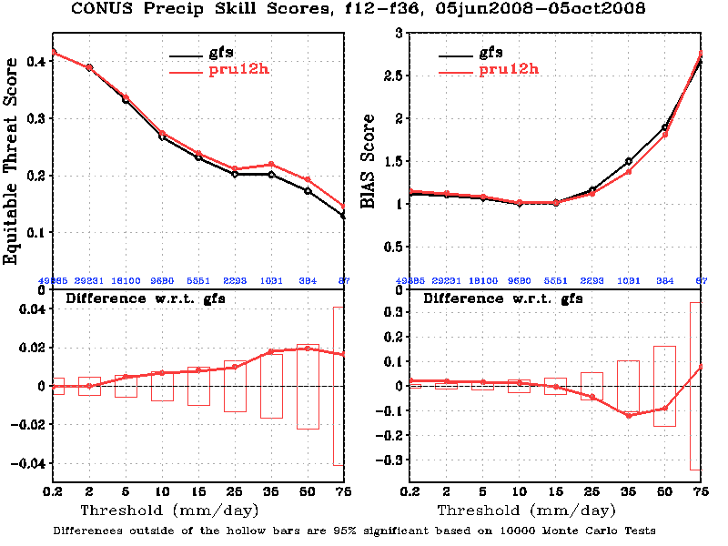
Mean Precip Skill Scores with Significance Test, Case I
Pru12h is the Q1FY10 GFS parallel implemented on 15 Dec 2009. GFS is the 2008 operational.
Pru12h is slightly better than the GFS, but the improvement is insignificant.

Slide 9
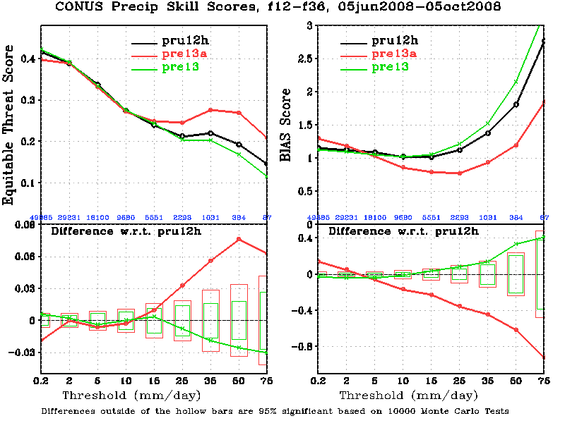
Mean Precip Skill Scores with Significance Test, Case II
pre13a is significantly better than pru12h for heavy precip events, but worse for light rains.
The differences in ET scores between pru1h an pre13 are insignificant at all thresholds.
The differences in BIAS scores between pre13a and pru12h are significant at all thresholds. Pre13a significantly reduced the high BIAS for heavy precip.
The differences between pru1h an pre13 are insignificant for all but one thresholds.

Slide 10
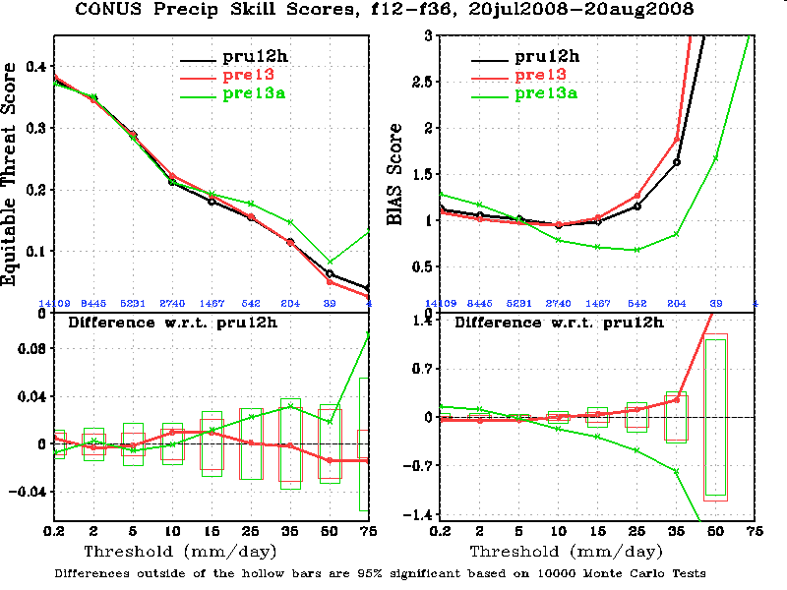
Mean Precip Skill Scores with Significance Test, Case III
After the verification period is shortened from four months to one month, the differences in ET scores become insignificant. The difference in BIAS scores are still significant.

Slide 11
For those who have interest in using this tool :
If you have been using the VSDB-based verification package, and are running sub-scripts from my directory, you do not need to do anything. Old maps will be automatically replaced by the new ones.
For those who’d like to know more, please see the Fortran code and GrADS scripts saved at /climate/save/wx24fy/VRFY/vsdb_exp/precip on both Cirrus and Stratus

