Slide 1





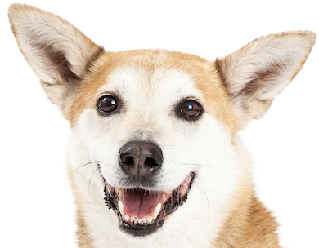
student
professor
artist
salesperson
?
student
professor
artist
salesperson
?
Target
Sources
MTL
TL

Slide 3






Task $1$
Task $2$
Task $3$
$n_{1}$ observations
$n_{2}$ observations
$n_{3}$ observations

Slide 4












$${\hat{μ}}_{1}^{\left(1\right)\left[0\right]}$$
$${\hat{μ}}_{2}^{\left(1\right)\left[0\right]}$$
$${\hat{μ}}_{1}^{\left(1\right)\left[0\right]}$$
$${\hat{μ}}_{2}^{\left(1\right)\left[0\right]}$$
Task $1$
Task $1$
$${\hat{μ}}_{1}^{\left(2\right)\left[0\right]}$$
$${\hat{μ}}_{2}^{\left(2\right)\left[0\right]}$$
$${\hat{μ}}_{2}^{\left(2\right)\left[0\right]}$$
$${\hat{μ}}_{1}^{\left(2\right)\left[0\right]}$$
Task $2$
Task $2$
Good alignment
Bad alignment

Slide 5
