Slide 1
Vending Machine
Group 29

Slide 2
What we have done

Slide 3
Requirement

Slide 4
System Objective
In this project, we are developing a software that simulates a normal and classical vending machine. The software will take care of the User Interface, ensure every merchandise can be sold correctly and the user can get correct change. Also, a manager will check all merchandise for its stock and the money box to ensure the machine’s normal operation. A UPPAAL model will be provided to check whether the machine works correctly.

Slide 5
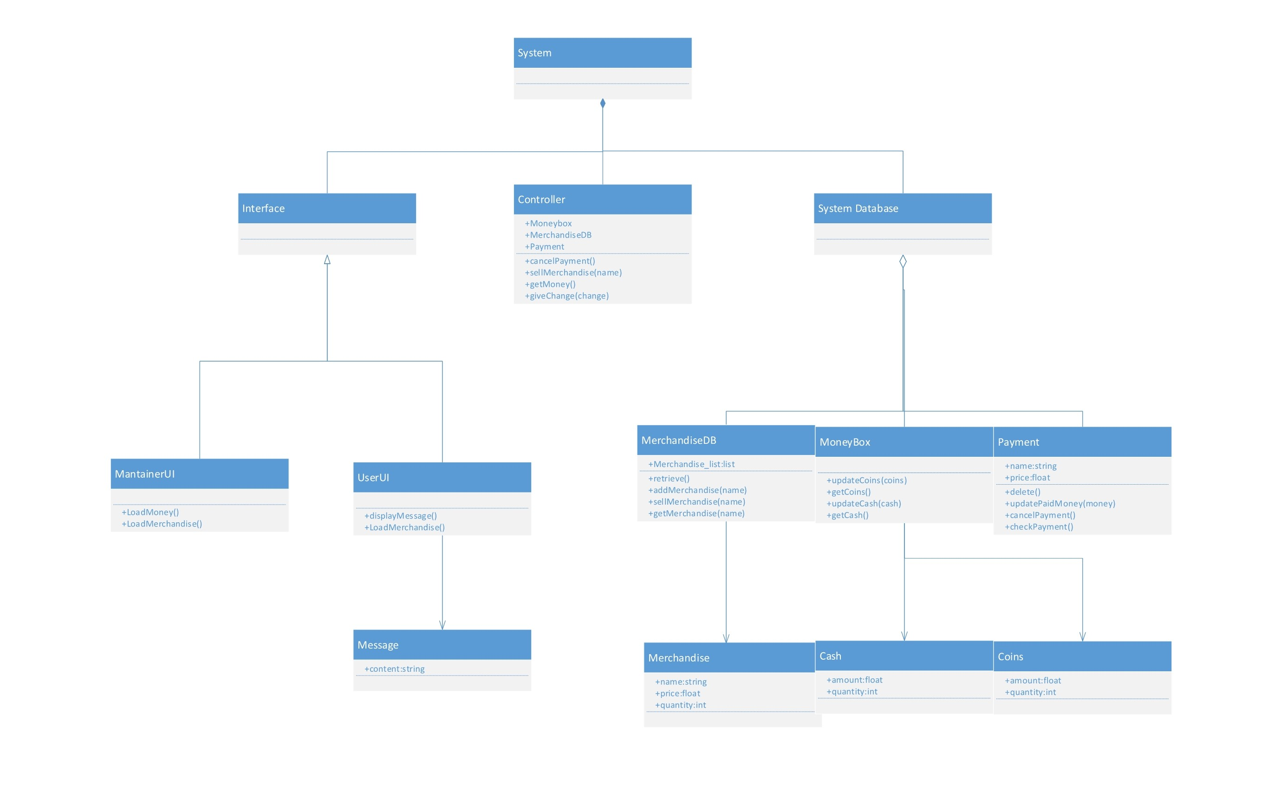
Domain Analysis

Slide 6
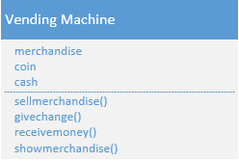
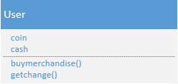
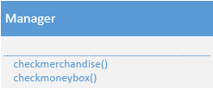
Domain Analysis

Slide 7
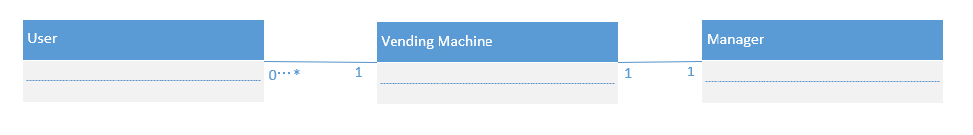
Domain Analysis

Slide 8
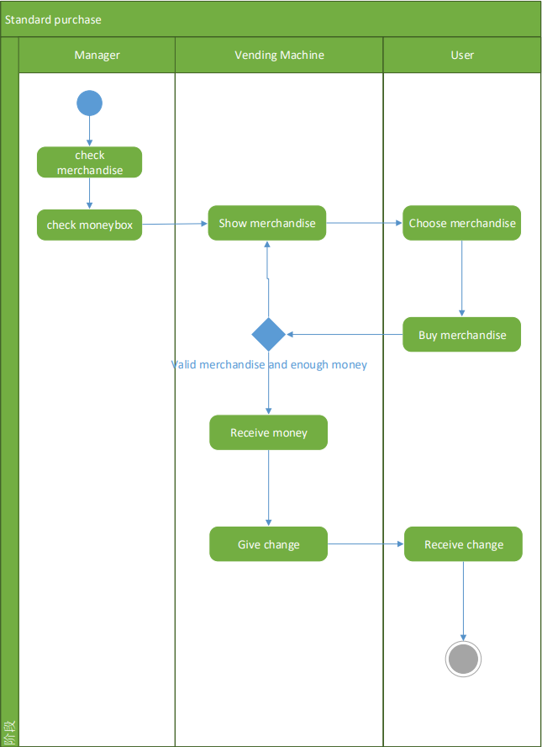
Domain Analysis

Slide 9
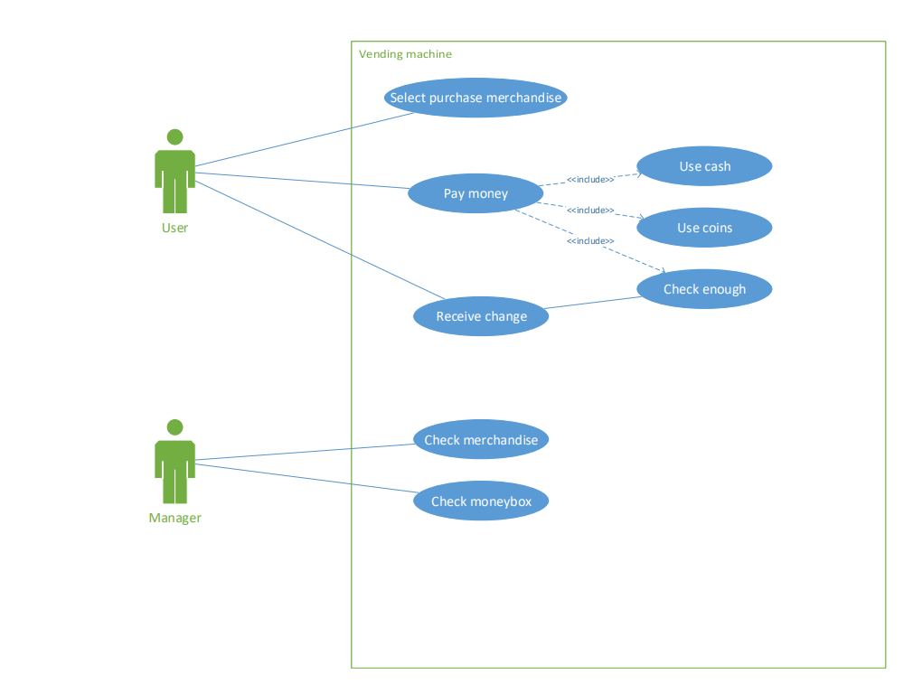
Use Case

Slide 10
Software Requirements
R1: User UI
R2: Maintainer UI
R3: Controller

Slide 11
Development

Slide 12
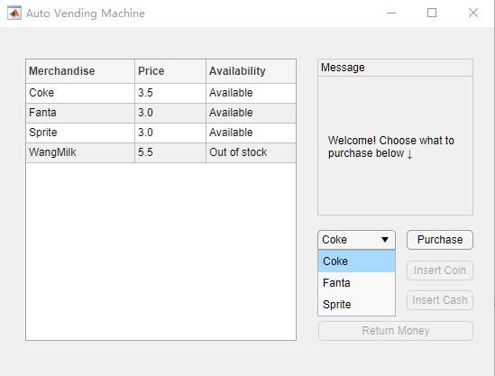
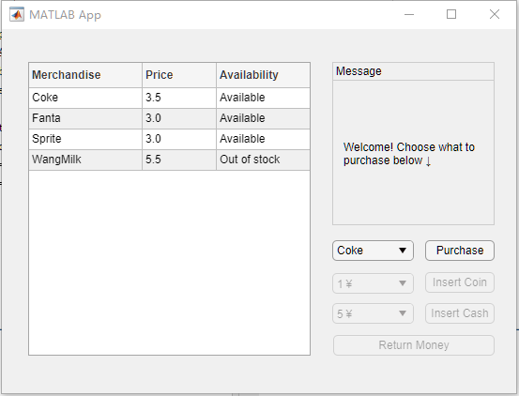
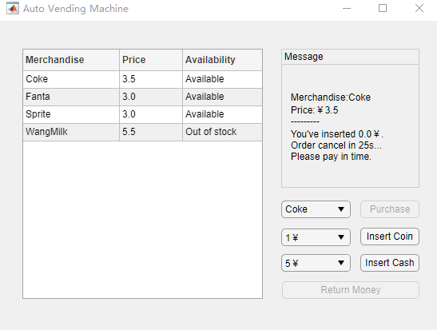
User UI

Slide 13
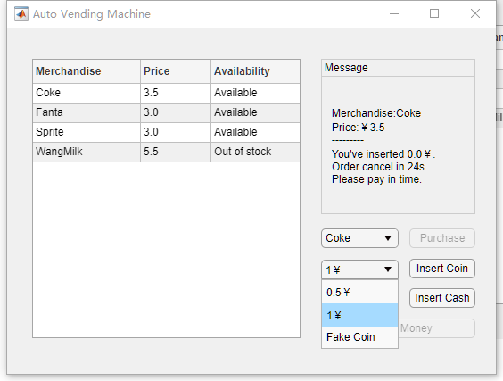
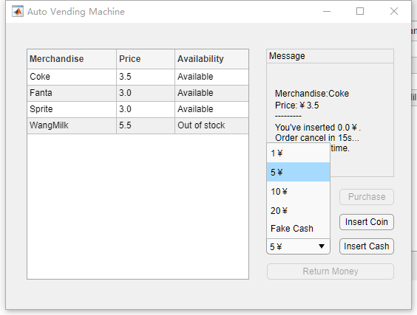
User UI

Slide 14
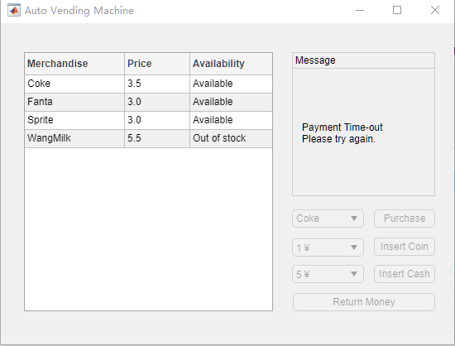
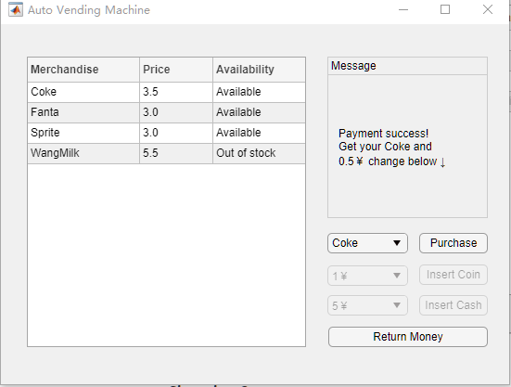
User UI

Slide 15
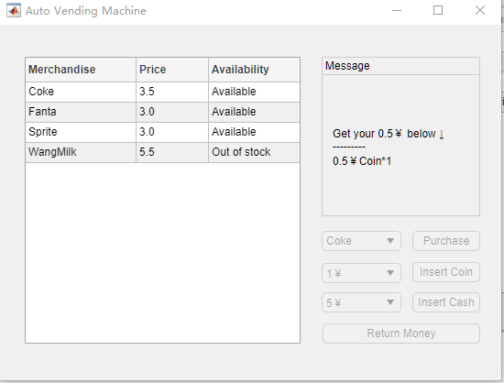
User UI

Slide 16
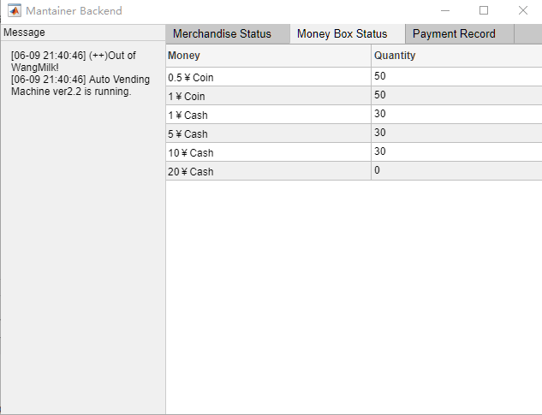
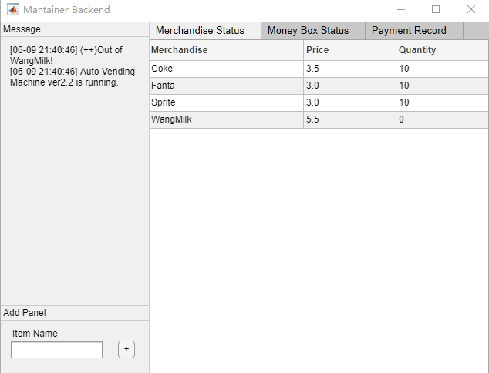
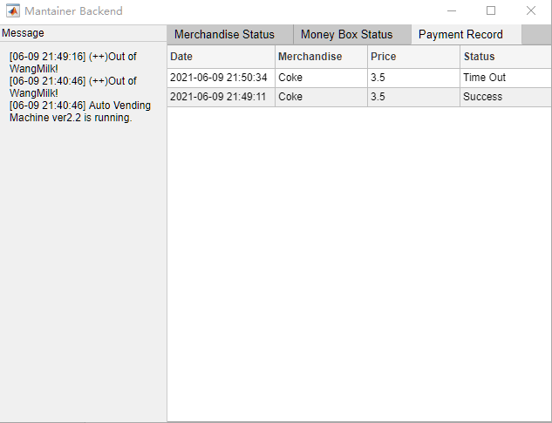
Maintainer UI

Slide 17
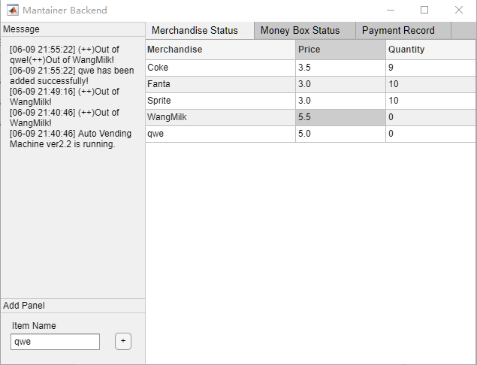
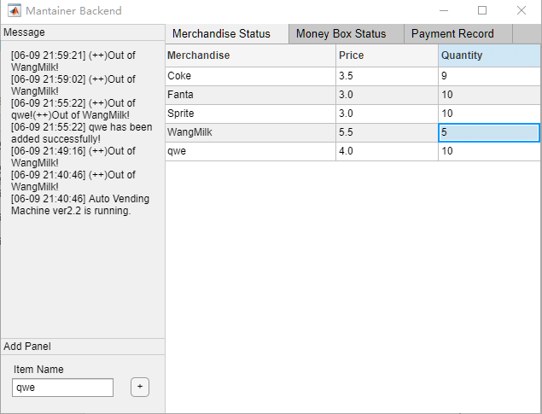
Maintainer UI

Slide 18
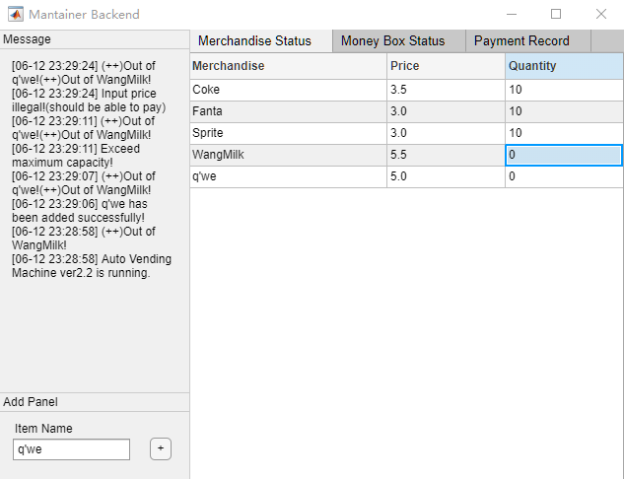
Maintainer UI

Slide 19
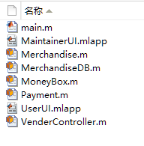
OOP

Slide 20
Vending Display

Slide 21
What we’re going to do next

