Slide 1
Elevator
Group 29

Slide 2
What we have done

Slide 3
Requirement

Slide 4
System Objective
In this project, we are developing a software that simulates 2 elevators in a building with 3 floors and 1 basement and design an automated algorithm to schedule and control them according to user requests. The key difference between two elevators is that only one can reach basement floor when another cannot.
The software will take care of the graphic interface, display real-time movements of elevators and determine how to process service direction and order of elevators, which ensures every passenger to reach target floor promptly. Also a status HUD is provided for maintainers to check physical parameters and service status of elevators.

Slide 5
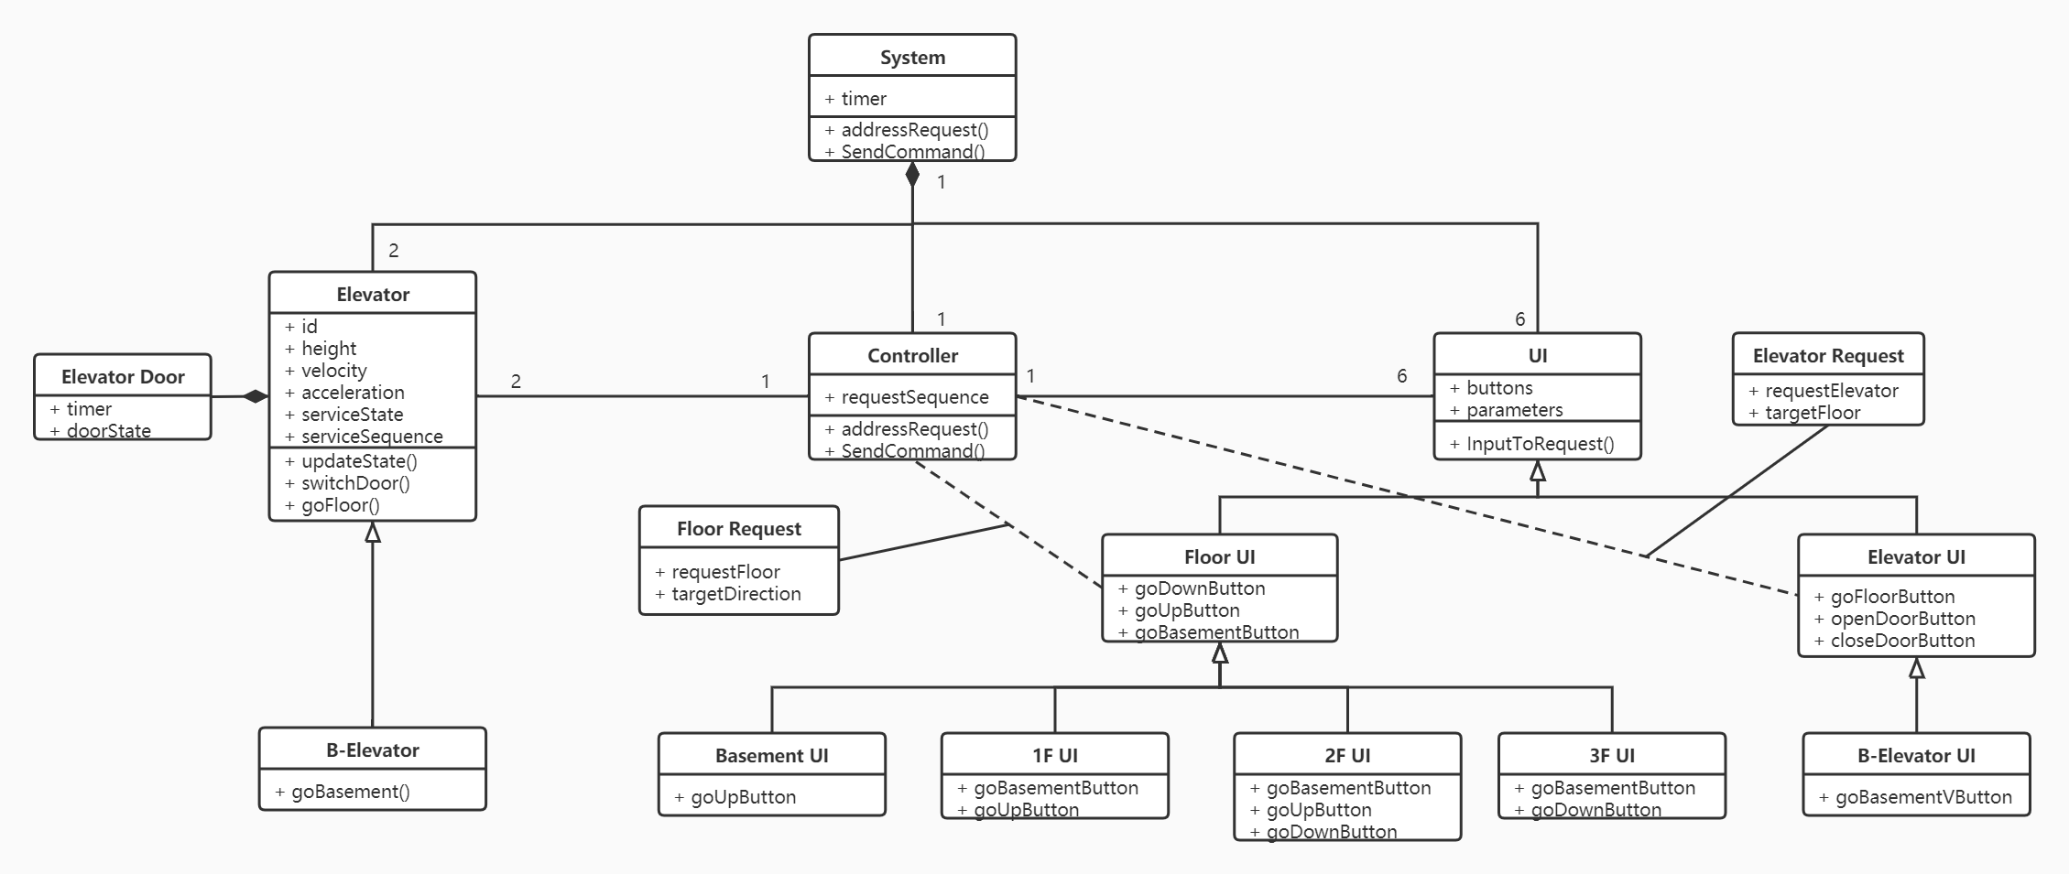
Domain Analysis

Slide 6
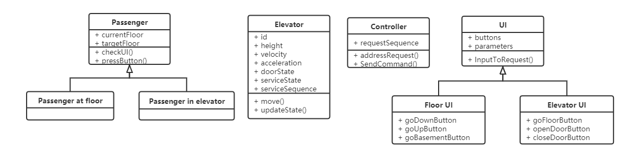
Domain Analysis

Slide 7
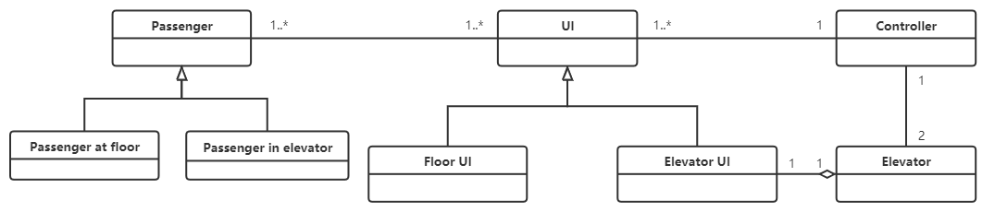
Domain Analysis

Slide 8
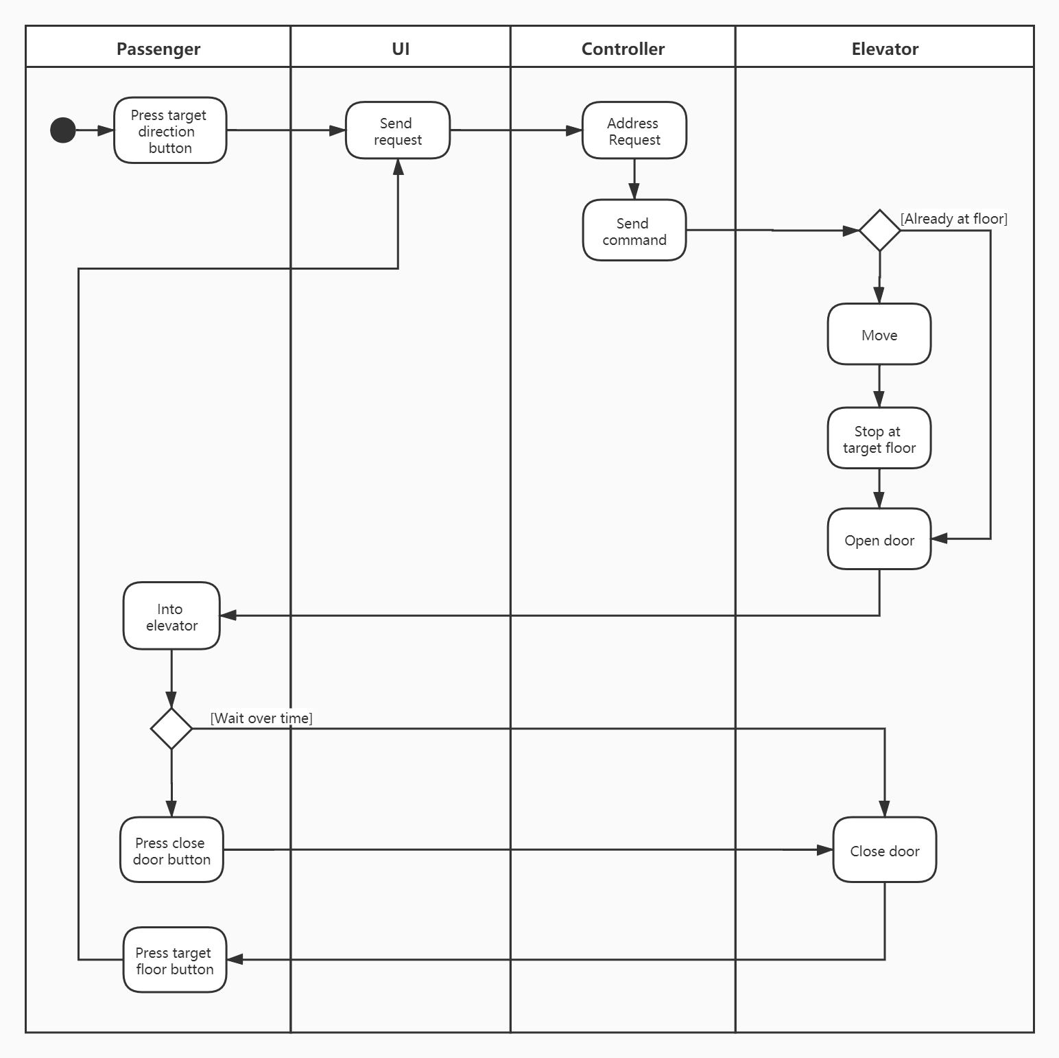
Domain Analysis

Slide 9
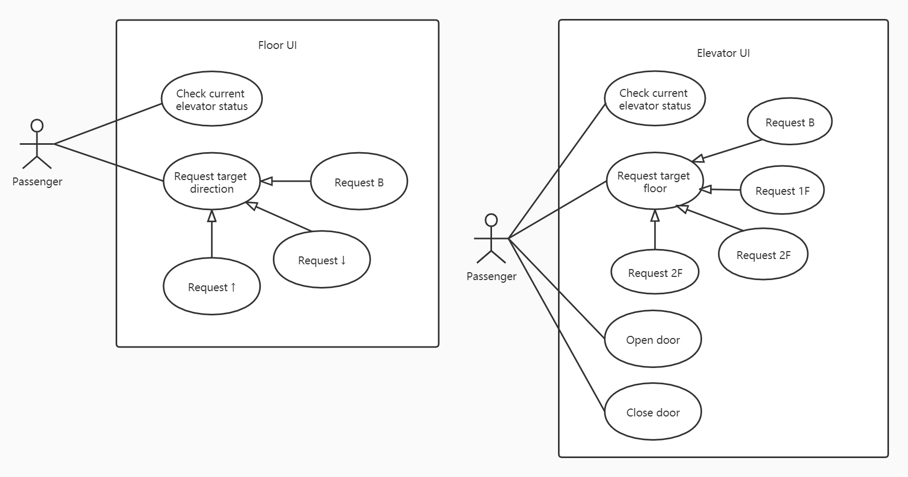
Use Case

Slide 10
Software Requirements
R1: Floor UI
R2: Elevator UI
R3: Controller

Slide 11
Development

Slide 12
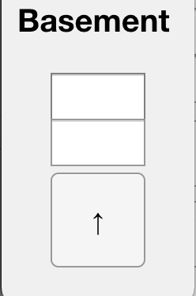
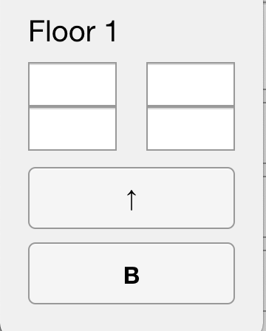
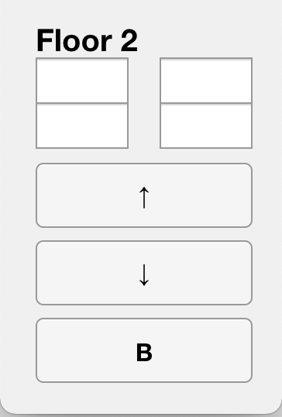
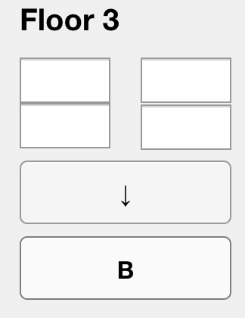
Floor UI

Slide 13
Basement UI and its function
Person at basement have the ability to know where the left elevator is and its move state.
Person at basement have the ability to go up.

Slide 14
Floor1 UI and its function
Person at Floor1 have the ability to know where the both elevators are and their move state.
Person at Floor1 have the ability to go up.
Person at Floor1 have the ability to go down(basement).

Slide 15
Floor2 UI and its function
Person at Floor2 have the ability to know where the both elevators are and their move state.
Person at Floor2 have the ability to go up.
Person at Floor2 have the ability to go down.
Person at Floor2 have the ability to go to basement.

Slide 16
Floor3 UI and its function
Person at Floor3 have the ability to know where the both elevators are and their move state.
Person at Floor3 have the ability to go down.
Person at Floor3 have the ability to go basement.

Slide 17
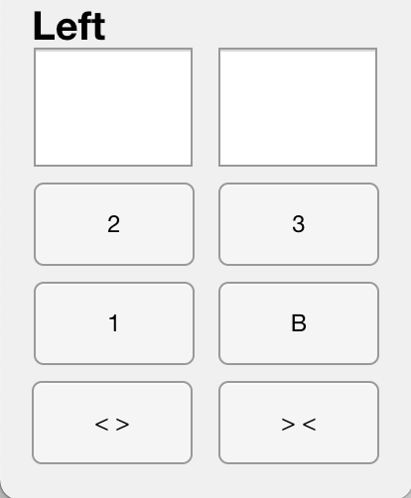
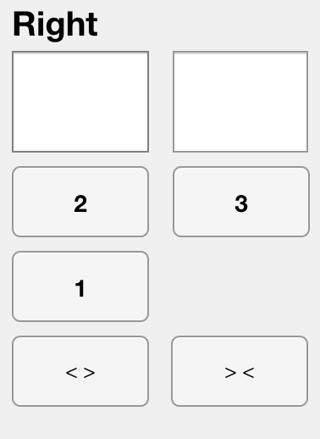
Elevator UI

Slide 18
Left Elevator UI and its function
Person at Left Elevator have the ability to know where the elevator is and its move state.
Person at Left Elevator have the ability to go to any floor.
Person at Left Elevator have the ability to close the door while the door is fully opened.
Person at Left Elevator have the ability to open the door while the elevator is stopped.

Slide 19
Right Elevator UI and its function
Person at Right Elevator have the ability to know where the elevator is and its move state.
Person at Right Elevator have the ability to go to any floor except the Basement .
Person at Right Elevator have the ability to close the door while the door is fully opened.
Person at Right Elevator have the ability to open the door while the elevator is stopped.

Slide 20
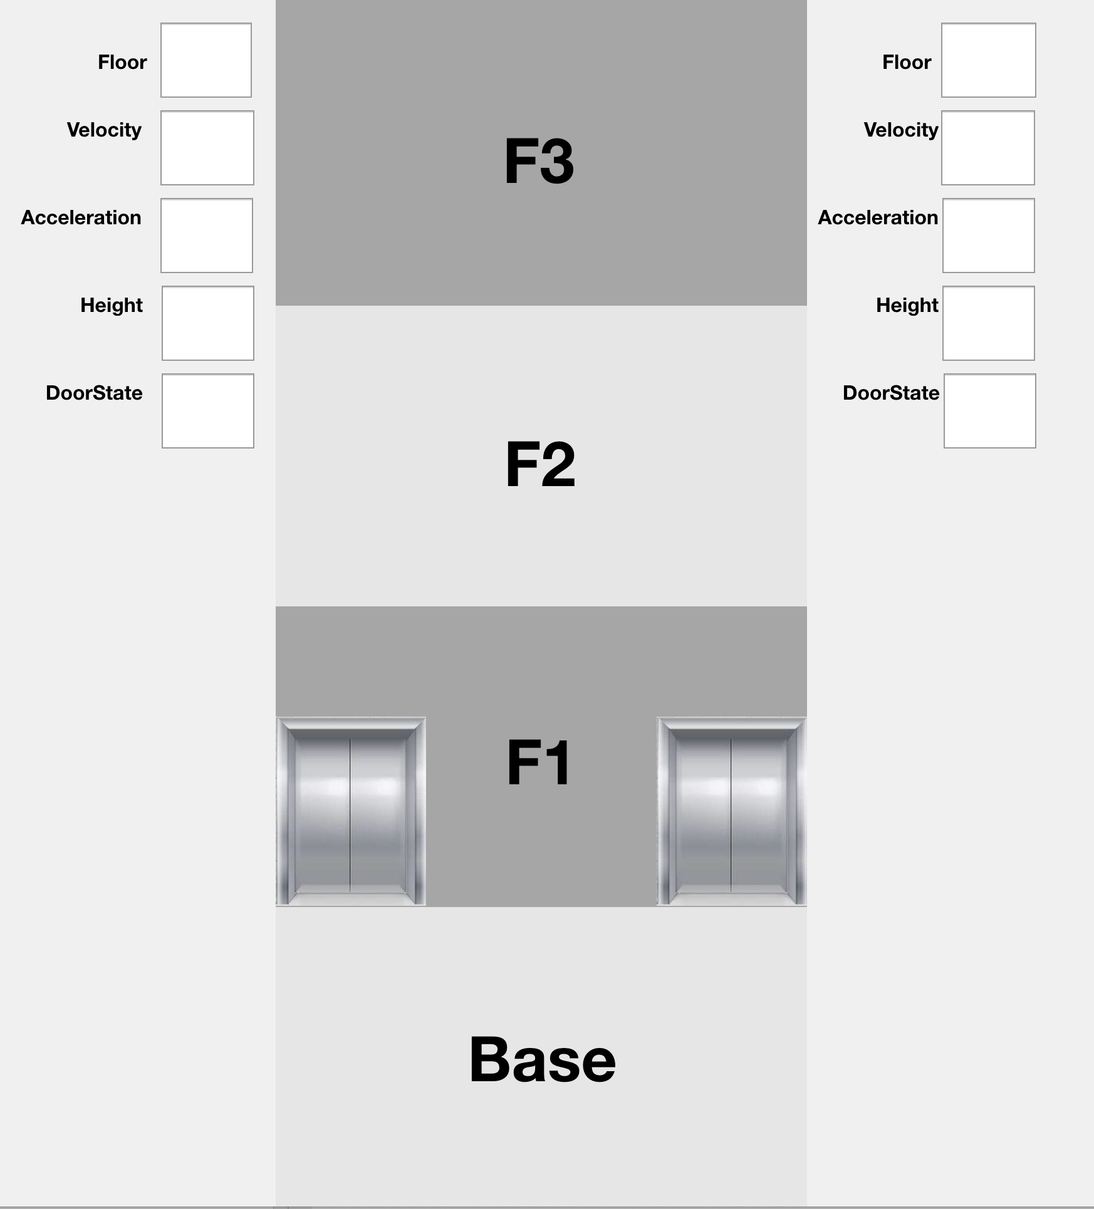
HUD Version

Slide 21
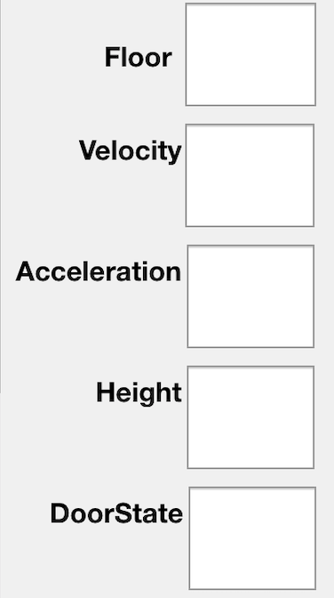
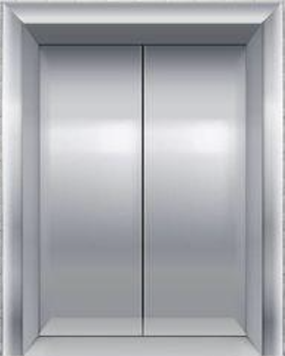
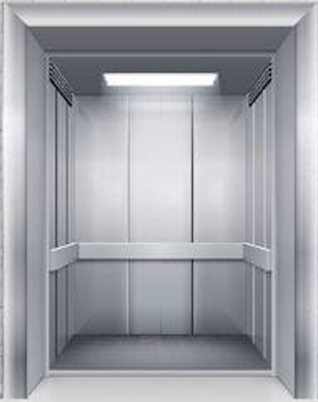
HUD Version

Slide 22
HUD function
Person use HUD have the ability to know where the elevators are and its states.
Floor
Speed
Acceleration
Height
Door(opened or closed or moving).

Slide 23
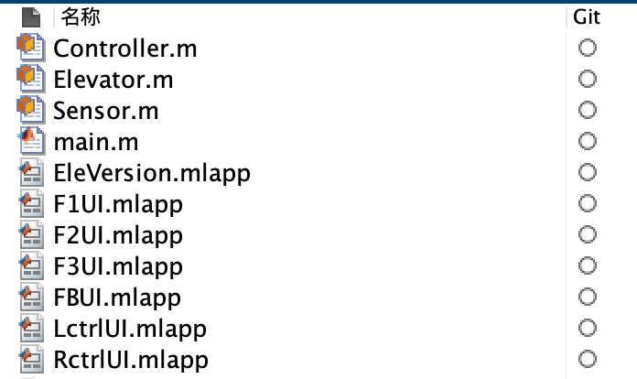
OOP

Slide 24
Elevator Display

Slide 25
What we’re going to do next

