Slide 1
TODO

Slide 2
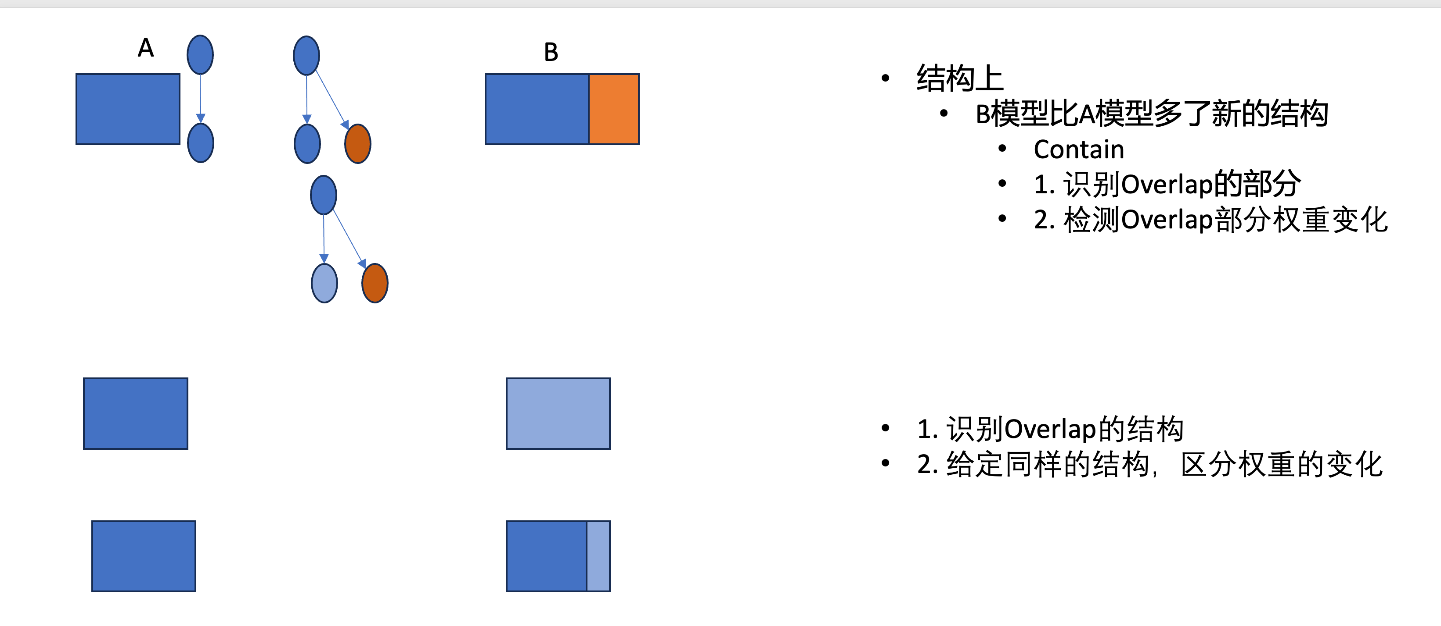

Slide 3
LLM Coarse grained Component Analysis
Experiment Setup
Collect “LLM_{A} ---<Composition type>-> LLM_{B}”
100 Pair
<deepseek, nicoboss/DeepSeek-R1-Distill-Llama-70B-Uncensored, Adapter>
Composition type
Fine-tune: LoRA
Adapter
Merge
Quantization
Empirical Study
RQ1 柱状图，横轴是Fine-tune, 纵轴是White-box 结构/权重的区别
Challenge
Tool Approach
Database： LLM_{A} 200个 + None
给定 LLM_{B} 判断是否与Database中的某个 LLM_{A} 存在<Composition type>关系，如果是，那么是什么<Composition type>
Experiment
RQ2 Accuracy=90%, Precision, Recall
RQ3 Real-world detection, 80%

Slide 4
LLM Fine grained Fine-tune Analysis
Experiment Setup
Collect “LLM_{A} ---Fine-tune--> LLM_{B}”
100 Pair
Fine-tune 原理
全参数微调 50 Pair
Adapter
LoRA
QLoRA
XXXX
…
Tool
Database： LLM_{A} 200个 + None
给定 LLM_{B} 判断是否与Database中的某个 LLM_{A} 存在Fine-tune关系，如果是，那么是什么fine-tune
Adapter
LoRA
QLoRA
XXXX
Evaluation
全参数微调二分类任务：precision recall

