Slide 1
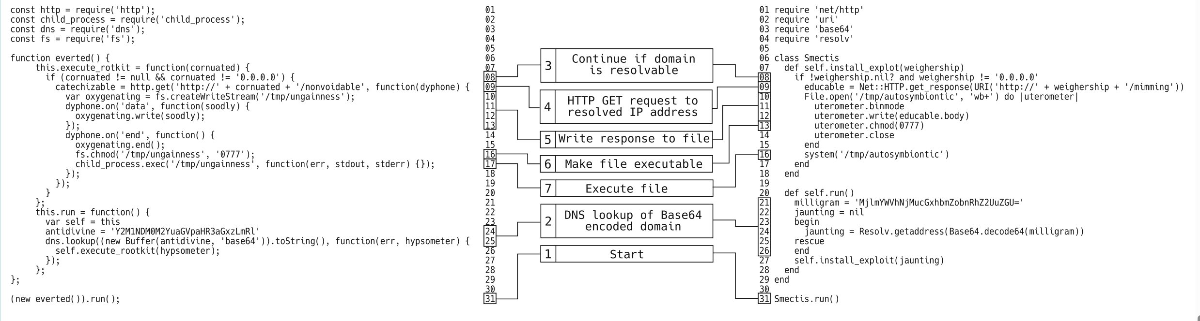
Backstabber’s Knife Collection: A Review of Open Source Software Supply Chain Attacks
数据集：Backstabber’s Knife Collection | Backstabbers-Knife-Collection (dasfreak.github.io)

Slide 2
Sect.5 174个恶意代码包分析分类：
1. Pypi和npm能简便地被用来传播恶意代码由于代码包管理员在安装时可以执行任意代码的权限；而RubyGems不允许，但却被作为大量的攻击对象（PyPI和npm会阻止攻击者滥用他们的包库）
2. 通过下载附加文件实现——最简单的方法
3. Npm包比PyPI包需要更多的信任关系（dependency）
4. 41%的Malicious的包会先进行状态检查再触发更多的执行——找到有价值的目标并避免沙箱检查
5. Malicious code不能在沙盒中运行原因：check其他包是否在依赖树中运行或程序包是否是在某一操作系统上执行（可能有些函数调用的是系统的函数）
6. Typosquatting占61%——平均莱温斯坦距离为2.3。常用连字符(hyphen)、单字母误拼
7. 少数针对特定的OS(47%)，例如if platform.system() is ’Windows’
8. 使用Base64或16进制编码来对存疑变量和恶意函数进行编码
Domain name——域名
9. 字符串采样——文件压缩后变成恶意的代码

Slide 3
Defending Against Package Typosquatting
Laborious——typosquatting confuses manual inspection by definition
贡献：Develop TypoGard，high level TPR(true positive rate), 推广性强
npm package loadsh, which was typosquatting lodash, providing an outdated version of the code vulnerable to prototype pollution
建立typogard：
即使莱温斯坦距离值为1，但考虑键盘字母之间的位置关系，部分情况省略以减少报错量
Typo的后果
Attacks against end-users
Attacks against developers using a package
Degradation of functionality
Latent vulnerabilities
莱温斯坦距离——衡量字符串的相似性

Slide 4
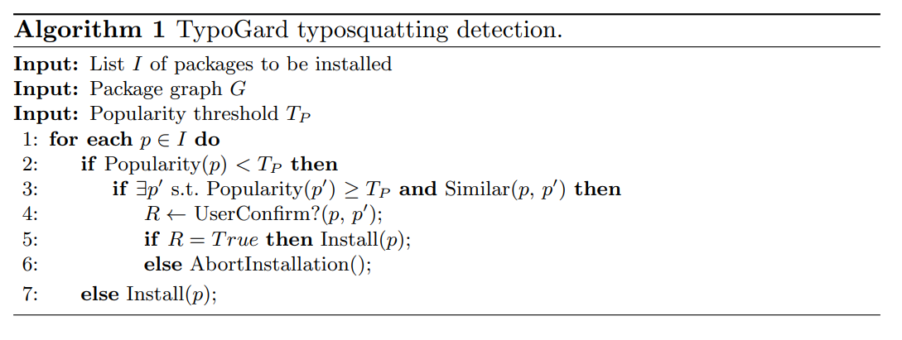
常见typosquatting情况：
1.Repeat characters
2.Omit characters
3.Swap characters
4.Swap words
5.键盘靠近键输入错误
6.常见拼写错误
7.外观相似字符的替代
8.添加下划线
9.版本数字问题
Typogard实现的伪代码

Slide 5
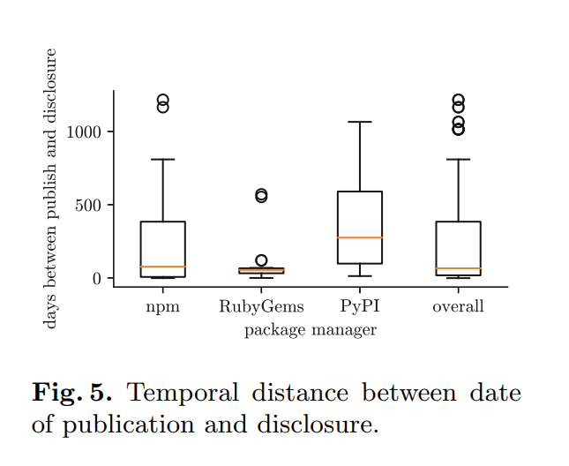
问题(2024.05.28)
1.
2. dynamic analysis(暂时保留)
3. Levenshtein distance（已解决）
4.数据来源，PyPI

Slide 6
笔记（2024.05.28）：
1.文件深度
2.外部负载——external payloads
3.获得shell——powershell？
4.cdn内容分发网络
5.箱线图
6.Ntu开头的论文、作者来自南洋理工
mirror网站不同步——为追求数据集更大的话使用
7.precision and recall

Slide 8
Towards Measuring Supply Chain Attacks on Package Managers for Interpreted Languages
一、前人的工作：
1.off-the-shelf tools suffer from accuracy and lack of domain knowledge
2. since these packages can have a large number of dependencies, directly applying existing static analysis tools to them not only incurs significant time and space overhead, but also wastes computing resources in repeatedly analyzing commonly used packages
3. these packages are written in dynamically typed languages and are flexible in terms of execution, leading to inaccurate static analysis and complicated runtime requirements in dynamic analysis
4. three registries currently have little to no review process for publishing packages and existing supply chain attacks are mainly reported by the community without automation
二、完成的工作：
1. Propose a framework
2. Apply metadata(元数据), static and dynamic analysis
3. Anti-analysis Techniques and Logic Bomb(executed only under certain circumstancess)
4. 安全分析障碍
CVE——公共漏洞和暴露
hook——通过拦截系统或者应用中的事件，信号和调用，来更改系统或者应用的默认行为
元数据

Slide 9
Poster: Towards Using Source Code Repositories to Identify Software Supply Chain Attacks
一、之前研究的工作情况
SpellBound: Defending Against Package Typosquatting. arXiv (2020)——the lack of essential features (e.g., source code similarity of suspected packages) might cause the approach to generate a high number of false alerts.
MalOSS:the proposed system is computationally expensive, and only process packages of a specific environment (e.g., Linux Ubuntu).
Garret:features extracted from packages’ metadata and source code to detect suspicious updates
Ohm:恶意包同早先版本的比较，但早先版本不宜获得
目前问题：错误率较高、无法实时检测上传的包
二、完成的工作
it is suspicious if the code in the source code repository differs from the code in the artifacts distributed in the package repository.
malicious imports focus on opening URLs, establishing connections, and encoding/decoding data
reduces the review effort for distributed software releases by 97 percent
问题：仍需手动处理恶意非恶意，计划未来实现自动化

Slide 10
An Empirical Study of Data Disruption by Ransomware Attacks
一、之前研究的工作情况
1.采用动态分析，缺乏普遍性
二、完成的工作
1.显著增强对ransomware的检测能力(41%-69%)，无额外的fp(false positive)
2. open-source dataset MarauderMap1, comprising 7,796 active ransomware samples and analysis metadata
3.Log collection
4.ransomware: Data Reconnaissance, Data Tampering, Data Exfiltration
5.process injection, registry modification, and file scanning are common procedures used by ransomware during the data reconnaissance phase
局限：
涵盖OS单一
Data Reconnaissance:
1.Inject
2.Keep persistence
3.Identify network environment
4.Locate C&C Server
5.Profile Crucial Data
Data Tampering
1.Modify firewall
2.Download Payload
3.Prevent Rollback
4.Encrypt Data
问题： Redemption

Slide 11
笔记：
1.A needle is an outlier in a hay stack
2.An empirical study of malicious code in pypi ecosystem
3.混淆技术
4.开始收集数据
5.混淆的代码表现过多可以向这个方向
6.跑数据将false展出思考(从数据出发)
7.Ntu数据集
8.pypi_malregistry
数据集＋方案

Slide 13
LastPyMile: Identifying the Discrepancy between Sources and Packages
一、之前研究的工作情况
1.Ohm: hijacking and typosquatting attacks to be the most common
二、完成的工作
deploying malicious code during package installation
LastPyMile
合法包与恶意包都会对源代码进行修改
花费时间较命令git log更短
问题：
1.jellyfish

Slide 14
1.Typosquatting
2.Package(steal credentials, install backdoors)
3.url引入
4.ransomware

