Slide 1


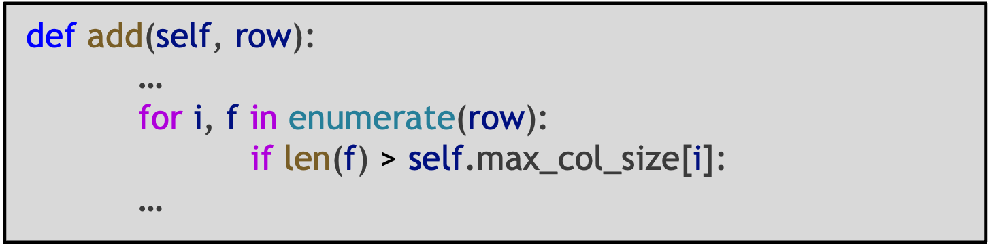
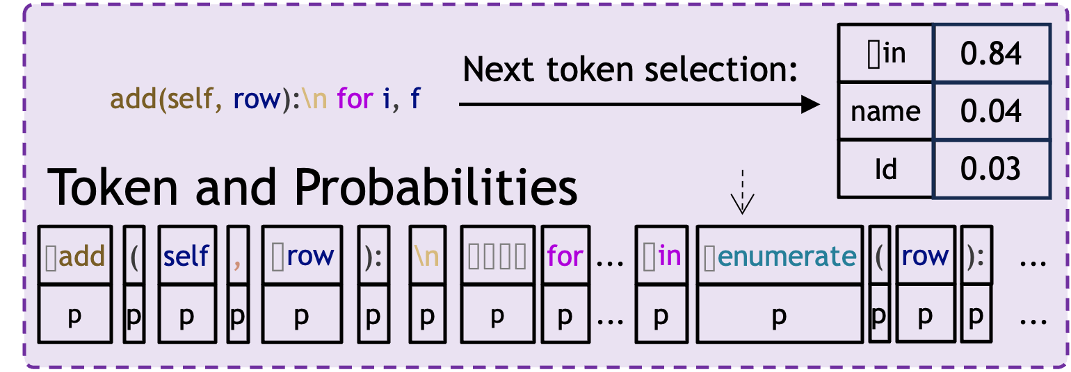
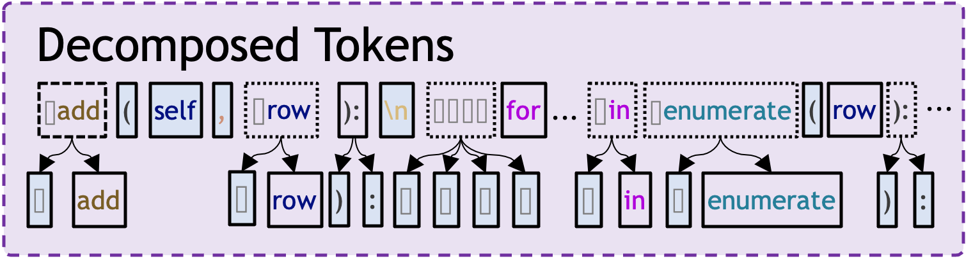
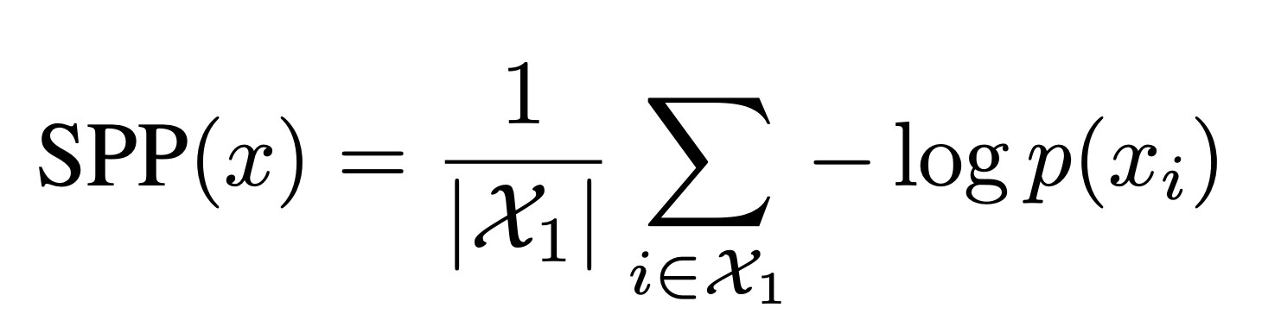

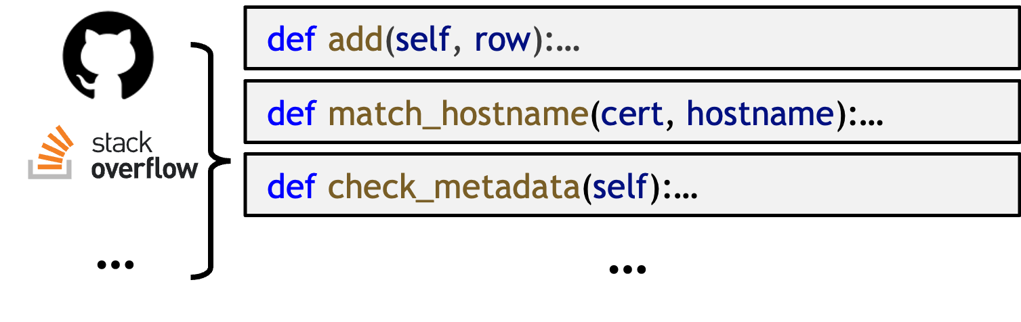


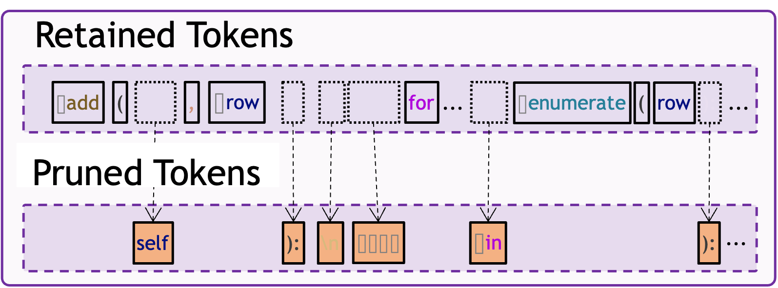
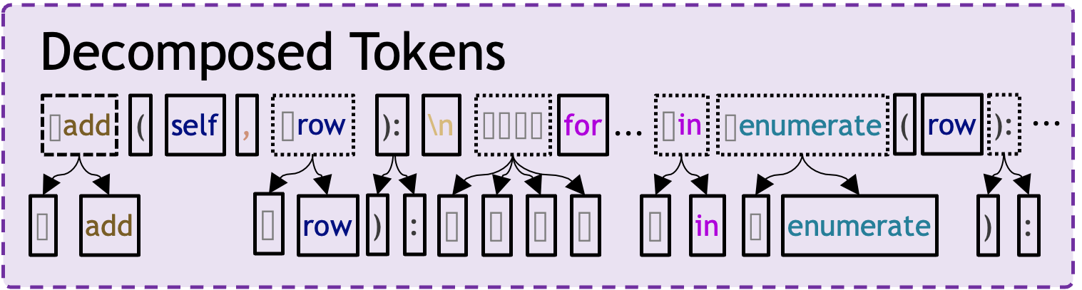
Token Preprocessing
Syntax-Convention-based Token Pruning
Task
Requirement
Language Syntax
Copyright-Owned Code
Getting Probs
Matching
Member Probabilities Calculation
Developer Programming
Syntax-convention-pruned Member Probabilities
Decomposing
Pruning
Code Resources
Codebase
LLMs
LLM Vendor Training
Our Solution
Notes:
General Logic
Condition
Consequent

Slide 2
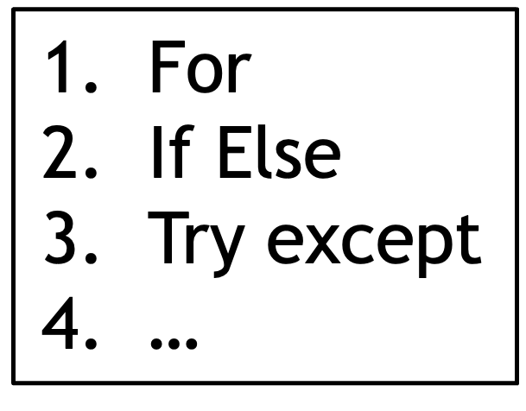

Programming
Token Preprocessing
Syntax-Convention-based Token Pruning
Copyright-Owned Code
Syntax Conventions
Member Probabilities Calculation
Task Specification
Language Syntax
Copyright-Owned Code
Getting Probs
Matching Decomposed Tokens
Developer Accomplishing Programming Tasks
Syntax-convention-pruned Member Probabilities
Syntax-Oriented Pruning
Decomposing
Collecting
Training
Code Resources
Codebase
LLMs
Training LLMs Using Accesible Corpus
Our Solution
Notes:
General Logic
Condition
Consequent

Slide 3


For
If Else
Try except
…
Programming
def add(self, row):
…
for i, f in enumerate(row):
if len(f) > self.max_col_size[i]:
…
Token Preprocessing
Syntax-Convention-based Token Pruning
Copyright-Owned Code
Syntax Conventions
Member Probabilities Calculation
Task Specification
Language Syntax
Copyright-Owned Code
Getting Probs
Matching Decomposed Tokens
add(self, row):\n for i, f
Next token selection:
⌷in
0.84
Decomposed Tokens
...
Syntax-convention-pruned Member Probabilities
name
0.04
⌷add
(
self
,
⌷row
):
\n
⌷⌷⌷⌷
for
...
⌷in
⌷enumerate
(
row
):
Developer Accomplishing Programming Tasks
Token and Probabilities
Id
0.03
⌷
add
⌷
row
)
:
⌷
⌷
⌷
⌷
⌷
in
⌷
enumerate
)
:
⌷add
(
self
,
⌷row
):
\n
⌷⌷⌷⌷
for
...
⌷in
⌷enumerate
(
row
):
...
p
p
p
p
p
p
p
p
p
...
p
p
p
p
p
...
Syntax-Oriented Pruning
def add(self, row):…
Decomposing
Retained Tokens
def match_hostname(cert, hostname):…
Collecting
Training
Decomposed Tokens
⌷add
(
,
⌷row
for
...
⌷enumerate
(
row
):
...
…
def check_metadata(self):…
⌷add
(
self
,
⌷row
):
\n
⌷⌷⌷⌷
for
...
⌷in
⌷enumerate
(
row
):
...
Pruned Tokens
…
Code Resources
Codebase
LLMs
⌷
add
⌷
row
)
:
⌷
⌷
⌷
⌷
⌷
in
⌷
enumerate
)
:
self
):
\n
⌷⌷⌷⌷
⌷in
):
...
Training LLMs Using Accesible Corpus
Our Solution
Notes:
General Logic
Condition
Consequent

Slide 4
For
If Else
Try except
…
编程
def add(self, row):
…
for i, f in enumerate(row):
if len(f) > self.max_col_size[i]:
…
任务说明
语言语法
版权所有代码
开发人员完成编程任务
def add(self, row):…
def match_hostname(cert, hostname):…
收集
训练
…
def check_metadata(self):…
…
代码资源
代码库
大语言模型
使用可获取语料库训练大型语言模型
令牌预处理
基于语法规范的标记修剪
版权所有代码
语法约定
成员可能性计算
获取概率值
匹配分解令牌
add(self, row):\n for i, f
下一个令牌选择：
⌷in
0.84
分解令牌
...
语法约定修剪后的成员概率
name
0.04
⌷add
(
self
,
⌷row
):
\n
⌷⌷⌷⌷
for
...
⌷in
⌷enumerate
(
row
):
令牌与概率
Id
0.03
⌷
add
⌷
row
)
:
⌷
⌷
⌷
⌷
⌷
in
⌷
enumerate
)
:
⌷add
(
self
,
⌷row
):
\n
⌷⌷⌷⌷
for
...
⌷in
⌷enumerate
(
row
):
...
p
p
p
p
p
p
p
p
p
...
p
p
p
p
p
...
语法导向的剪枝
分解
保留令牌
分解令牌
...
⌷add
(
,
⌷row
for
...
⌷enumerate
(
row
):
...
⌷add
(
self
,
⌷row
):
\n
⌷⌷⌷⌷
for
...
⌷in
⌷enumerate
(
row
):
修剪令牌
⌷
add
⌷
row
)
:
⌷
⌷
⌷
⌷
⌷
in
⌷
enumerate
)
:
self
):
\n
⌷⌷⌷⌷
⌷in
):
...
我们的方法
Notes:
General Logic
Condition
Consequent

Slide 5

For
If Else
Try except
…
Tokens with High Likelihood
Syntax-bonding Probability Pruning
Syntax-bonding Probability Pruning
Programming
def add(self, row):
…
for i, f in enumerate(row):
if len(f) > self.max_col_size[i]:
…
Variable Resumption
Original Tokens
Ranked Token Probabilities
Task Specification
Language Syntax
Copyright-Owned Code
⌷add
(
self
,
⌷row
):
\n
⌷⌷⌷⌷
for
...
⌷in
⌷enumerate
...
⌷self
.
max_col_size
[
i
]:
...
Prob
Getting Conditioned Probabilities
Developer Accomplishing Programming Tasks
Copyright-Owned Code
Enumerating each tokens
Next Token Selection:
⌷in
0.84
Tokenizing
add(self, row):\n for i, f
name
0.04
Code Tokens
Token Probabilities
Id
0.03
⌷add
(
self
,
⌷row
):
\n
⌷add
(
self
,
⌷row
):
\n
⌷⌷⌷⌷
for
...
⌷in
⌷enumerate
...
⌷self
.
max_col_size
[
i
]:
...
⌷enumerate
i
,
[
⌷self
(
for
⌷add
⌷row
max_col_size
⌷⌷⌷⌷
for
⌷i
,
⌷f
⌷in
⌷enumerate
(
row
):
\n
p
p
p
p
p
p
p
p
p
...
p
p
...
p
p
p
p
p
p
...
⌷⌷⌷⌷
⌷⌷⌷⌷
if
⌷len
(
f
)
⌷>
⌷self
.
max
_
col
_
size
[
i
]:
\n
Syntax-Oriented Token Pruning
Truncating and Averaging Probabilities
def add(self, row):…
Resuming variables
Retained Tokens
def match_hostname(cert, hostname):…
Collecting
Training
Code Tokens
⌷add
(
,
⌷row
for
...
⌷enumerate
...
⌷self
[
i
...
…
def check_metadata(self):…
⌷add
(
self
,
⌷row
):
\n
…
⌷⌷⌷⌷
for
⌷i
,
⌷f
⌷in
⌷enumerate
(
row
):
\n
Pruned Tokens
P()
Code Resources
Codebase
LLMs
⌷⌷⌷⌷
⌷⌷⌷⌷
if
⌷len
(
f
)
⌷>
⌷self
.
max_col_size
[
i
]:
\n
self
):
\n
⌷⌷⌷⌷
⌷in
.
max_col_size
]:
Training LLMs Using Accesible Corpus
Our Solution

Slide 6

Pretraining Corpus
Tokens:
for
…
in
…
if
…
else
…
Task Specification
for … in …
if …
else …
Copyright-Retained Tokenizer
Probabilities:
0.98
0.01
0.08
0.09
0.98
0.78
Developer Coding
for
…
in
…
Get token probabilities
for … in …
if …
else …
Copyright-Protected Code
if
…
else
…
Token iteration
Syntax-bonding Probabilities
Code Tokens
1st
Programming Language Syntax
2nd
0.98
3rd
0.98
def add(self, row):
n = len(row) - len(self.max_col_size)
if n > 0:
self.max_col_size += [0] * n
for i, f in enumerate(row):
if len(f) > self.max_col_size[i]:
self.max_col_size[i] = len(f)
self.rows.append(row)
4th
0.78
…
Syntax Knowledge-based Pruning
0.09
Ranking Probabilities
0.08
Thresholded
Sum
Pruned Probabilities:
0.01

Slide 7
Pretraining Corpus
Tokens:
for
…
in
…
if
…
else
…
Task Specification
for … in …
if …
else …
Copyright-Retained Tokenizer
Probabilities:
0.98
0.01
0.08
0.09
0.98
0.78
Developer Coding
for
…
in
…
Get token probabilities
for … in …
if …
else …
Copyright-Protected Code
if
…
else
…
Token iteration
Syntax-bonding Probabilities
Code Tokens
1st
Programming Language Syntax
2nd
0.98
3rd
0.98
def add(self, row):
…
for i, f in enumerate(row):
if len(f) > self.max_col_size[i]:
self.max_col_size[i] = len(f)
self.rows.append(row)
4th
0.78
…
Syntax Knowledge-based Pruning
0.09
Ranking Probabilities
0.08
Thresholded
Sum
Pruned Probabilities:
0.01

Slide 8
⌷add
(
self
,
⌷row
):
\n
⌷⌷⌷⌷
for
⌷i
,
⌷f
⌷in
⌷enumerate
(
row
):
\n
⌷⌷⌷⌷
⌷⌷⌷⌷
if
⌷len
(
f
)
⌷>
⌷self
.
max
_
col
_
size
[
i
]:
\n
⌷⌷⌷⌷
⌷⌷⌷⌷
⌷⌷⌷⌷
self
.
max
_
col
_
size
[
i
]
⌷=
⌷len
(
f
)

Slide 9

For
If Else
Try except
…
Programming
def add(self, row):
…
for i, f in enumerate(row):
if len(f) > self.max_col_size[i]:
self.max_col_size[i] = len(f)
…
⌷add
(
self
,
⌷row
):
\n
⌷⌷⌷⌷
for
⌷i
,
⌷f
⌷in
⌷enumerate
(
row
):
\n
Code Tokens
⌷⌷⌷⌷
⌷⌷⌷⌷
if
⌷len
(
f
)
⌷>
⌷self
.
max
_
col
_
size
[
i
]:
\n
Task Specification
Language Syntax
Copyright-Protected Code
Code Tokens
⌷add
(
self
,
⌷row
):
\n
⌷⌷⌷⌷
for
⌷i
,
⌷f
⌷in
⌷enumerate
(
row
):
\n
⌷⌷⌷⌷
⌷⌷⌷⌷
if
⌷len
(
f
)
⌷>
⌷self
.
max_col_size
[
i
]:
\n
Probabilities:
Syntax-bonding Probabilities
0.98
Developer Accomplishing Tasks Using Prior Knowlledge
Tokenizing
Variable Resumption
1st iteration
0.98
Ranking
0.98
Variable Token Resumption
2nd iteration
0.98
0.01
0.48
3rd iteration
0.98
0.01
0.08
0.38
⌷add
(
self
,
⌷row
):
\n
4th iteration
0.98
0.01
0.08
0.09
def add(self, row):…
Collecting
Training
⌷⌷⌷⌷
for
⌷i
,
⌷f
⌷in
⌷enumerate
(
row
):
\n
5th iteration
0.98
0.01
0.08
0.09
0.98
Truncating and Averaging (Summing?
def match_hostname(cert, hostname):…
…
⌷⌷⌷⌷
⌷⌷⌷⌷
if
⌷len
(
f
)
⌷>
⌷self
.
max_col_size
[
i
]:
\n
…
def check_metadata(self):…
⌷⌷⌷⌷
⌷⌷⌷⌷
⌷⌷⌷⌷
self
.
max_col_size
[
i
]
⌷=
⌷len
(
f
)
6th iteration
0.98
0.01
0.08
0.09
0.98
0.78
Code Resources
Codebase
LLMs
Code Tokens
…
P()
Syntax Knowledge-based Pruning
LLM Trained Using Open Source Code
Pruned Probabilities:
0.98
0.01
0.09
0.98
Copyright-Protected Code

Slide 10
For
If Else
Try except
…
Tokens with High Likelihood
Syntax-bonding Probability Pruning
Syntax-bonding Probability Pruning
Programming
def add(self, row):
…
for i, f in enumerate(row):
if len(f) > self.max_col_size[i]:
…
Variable Resumption
Original Tokens
Ranked Token Probabilities
Task Specification
Language Syntax
Copyright-Owned Code
⌷add
(
self
,
⌷row
):
\n
⌷⌷⌷⌷
for
...
⌷in
⌷enumerate
...
⌷self
.
max_col_size
[
i
]:
...
Prob
Getting Conditioned Probabilities
Developer Accomplishing Programming Tasks
Copyright-Owned Code
Enumerating each tokens
Next Token Selection:
⌷in
0.98
Tokenizing
add(self, row):\n for i, f
?
?
Code Tokens
Token Probabilities
?
?
⌷add
(
self
,
⌷row
):
\n
⌷add
(
self
,
⌷row
):
\n
⌷⌷⌷⌷
for
...
⌷in
⌷enumerate
...
⌷self
.
max_col_size
[
i
]:
...
⌷enumerate
i
,
[
⌷self
(
for
⌷add
⌷row
max_col_size
⌷⌷⌷⌷
for
⌷i
,
⌷f
⌷in
⌷enumerate
(
row
):
\n
p
p
p
p
p
p
p
p
p
...
p
p
...
p
p
p
p
p
p
...
⌷⌷⌷⌷
⌷⌷⌷⌷
if
⌷len
(
f
)
⌷>
⌷self
.
max
_
col
_
size
[
i
]:
\n
Syntax-Oriented Token Pruning
Truncating and Averaging Probabilities
def add(self, row):…
Resuming variables
Retained Tokens
def match_hostname(cert, hostname):…
Collecting
Training
Code Tokens
⌷add
(
,
⌷row
for
...
⌷enumerate
...
⌷self
[
i
...
…
def check_metadata(self):…
⌷add
(
self
,
⌷row
):
\n
…
⌷⌷⌷⌷
for
⌷i
,
⌷f
⌷in
⌷enumerate
(
row
):
\n
Pruned Tokens
P()
Code Resources
Codebase
LLMs
⌷⌷⌷⌷
⌷⌷⌷⌷
if
⌷len
(
f
)
⌷>
⌷self
.
max_col_size
[
i
]:
\n
self
):
\n
⌷⌷⌷⌷
⌷in
.
max_col_size
]:
Training LLMs Using Accesible Corpus
Our Solution
AST：完整variable
Token： variable拆分
Self.max -> self . max
Self.max_size -> self. Max _ size
Member
Non-member

