Slide 1
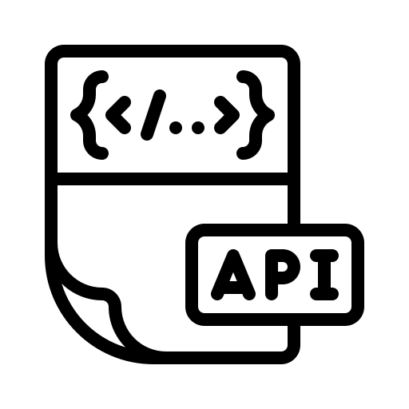

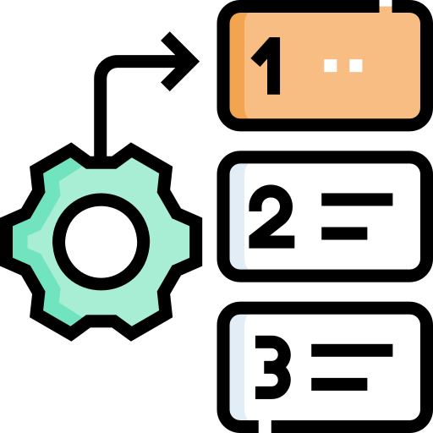







Static-oriented Incompatibility Reasoning
Dynamic Simulated Reflection
Control Flow Graph Construction
Test Case Generator
LLM
Source-Sink Labeling
API_{b}
Step-by-Step
Simulator
Identified Incompatibilities
Graph Traversing
API_{a}
Incompatibility Analysis
Simulated Result
Analyzer

Slide 2
CI1: The required parameter ‘amount’ from API_{b} is removed in API_{a}.
Passing deprecated arguments (e.g., amount=1) triggers an “unexpected keyword argument” exception in API_{a}.
1 -
2 +
3
4 -
5
6
7 -
8 -
9 -
10+
11+
12+
13
14
15-
16+
17
def fun(self, amount, n_size = 0, flag = True, **kwargs):
def fun(self, n_dim = 0, flag = False, **kwargs):
global GLOBALX
self.mFlag = flag
if flag:
return True
GLOBALX = n_size
new_var = [0] * n_size
if kwargs.get('key’) and n_size > 0:
GLOBALX = n_dim if n_dim > 0 else None
new_var = [0] * n_dim
if kwargs.get('key_for_check') and n_dim >= 0:
raise TypeError('message’)
if len(new_var) == 0:
raise ValueError('msg1')
raise LENError(‘msg2’)
return new_var
CI3: The parameter 'n_size' from API_{b} is renamed to 'n_dim' in API_{a}.
Passing the argument n_size=10 to API_{a} triggers an “unexpected keyword argument” exception.
CI4: The default value of parameter 'flag' is changed from True in API_{b} to False in API_{a}.
Without explicitly altering the default value, the same client code may lead to divergent execution logic.
CI9: The assignment statement in API_{b} is removed in API_{a}. Consequently, API_{a} no longer defines the instance attribute mFlag.
The use of mFlag in other APIs (i.e., self.mFlag) may trigger an “object has no attribute 'mFlag’ ” exception.
CI8: API_{a} explicitly assigns None to the global variable when n_dim is less than zero, while API_{b} may assign an empty instance.
Changes to the value of GLOBALX in other APIs may result in inconsistent behavior.
CI2: The 'key’ in kwargs from from API_{b} is changed to 'key_for_check ' in API_{a}.
Using the same kwargs as in API_{b} when invoking API_{a} may trigger an KeyError exception.
CI6: The raised exception ValueError from API_{b} is changed to LENError in API_{a}.
API_{a} raises a different exception, which may not be properly handled by existing exception-handling logic.
CI5: The condition that triggers the TypeError exception is changed from Line 9 in API_{b} to Line 12 in API_{a}.
The assumed exception value changes, which may not be correctly handled by existing exception-handling logic.
CI7: Given flag as the default input value, API_{b} returns true at Line 5, while API_{a} returns new_var.
The returned value differs for the same input, leading to inconsistent results.
Change Description
Incompatible API Consequences
Notes:
Compatibility Example

Slide 3
CI1: API_{b} removes The required parameter ‘amount’ from API_{b} is removed in API_{a}. Using old arguments like ‘amount=1’ triggers “unexpected keyword argument” errors.
1 -
2 +
3
4 -
5
6
7 -
8 -
9 -
10+
11+
12+
13
14
15-
16+
17
def fun(self, amount, n_size = 0, flag = True, **kwargs):
def fun(self, n_dim = 0, is_good = False, **kwargs):
global GLOBALX
self.amount = amount
if flag:
return True
GLOBALX = n_size
new_var = [0] * n_size
if kwargs.get('key'):
GLOBALX = n_dim if n_dim > 0 else None
new_var = [0] * n_dim
if kwargs.get('key_for_check') and self.type_bad():
raise TypeError('message’)
if len(new_var) == 0:
raise ValueError('msg1')
raise LENError(‘msg2’)
return new_var
CI3: API_{a} renames 'n_size' to 'n_dim'. Using 'n_size=10' in the new API throws "unexpected keyword argument" error
CI4: API_{a} changes 'is_good’'s default from True to False. Without explicit assignment, the old API returns True, while the new API returns a list, causing behavioral differences.
CI9: API_{a} deletes 'self.amount = amount', so self.amount is unassigned after calling the new API. Accessing obj.amount in upper code triggers AttributeError or gets unexpected values.
CI2: API_{a} changes the TypeError trigger key from 'key' to 'key_for_check’. Only passing 'key=test’ may raise a KeyError in new API.
CI6: Code_v2 replaces ValueError with custom LENError when len(new_var)==0. The new API raises different exception
CI7: With the same input (e.g., no explicit is_good), the old API returns True, while the new one returns a list of length n_dim.
CI5: The same input leads to inconsistent exception triggering (e.g., 'key=test' no longer raises TypeError).
Notes:
Compatibility Example

Slide 5
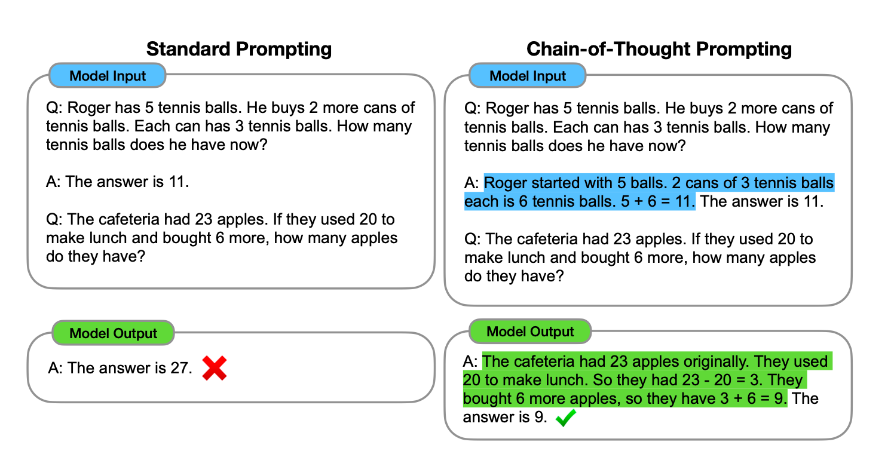
One-by-one API Incompatibilities Prompting
One-in-all API Incompatibilities Prompting
Model Input
Model Input
Q：

Slide 6
CI4: Code_v2 changes 'is_good’'s default from True to False. Without explicit assignment, the old API returns True, while the new API returns a list, causing behavioral differences.
CI1: Code_v2 removes required parameter ‘amount’. Using old arguments like ‘amount=1’ triggers “unexpected keyword argument” errors.
CI7: With the same input (e.g., no explicit is_good), the old API returns True, while the new one returns a list of length n_dim.
CI3: Code_v2 renames 'n_size' to 'n_dim'. Using 'n_size=10' in the new API throws "unexpected keyword argument" error
def fun(self, amount, n_size = 0, is_good = True, **kwargs):
nonlocal GLOBALX
self.amount = amount
if is_good:
return True
GLOBALX = n_dim
new_var = [0] * n_size
if kwargs.get('key’):
raise TypeError('message’)
if len(new_var) == 0:
raise ValueError('another message’)
return new_var
def fun(self, n_dim = 0, is_good = False, **kwargs):
nonlocal GLOBALX
if is_good:
return True
GLOBALX = n_dim if n_dim > 0 else None
new_var = [0] * n_dim
if kwargs.get(‘key_for_check’) and self.type_bad():
raise TypeError('message’)
if len(new_var) == 0:
raise LENError('another message’)
return new_var
CI8: Code_v2 assigns n_dim/None to GLOBALX, while the old only assigns n_dim. The same input leads to different GLOBALX values/types, breaking dependent logic.
CI2: Code_v2 changes the TypeError trigger key from 'key' to 'key_for_check’. Only passing 'key=test’ may raise a KeyError in new API
CI5: The same input leads to inconsistent exception triggering (e.g., 'key=test' no longer raises TypeError).
CI1 param add or delete
CI2 key of keyword argument add or delete
CI3 param rename
CI4 param default value change
CI5 param range change
CI6 throw different exception
CI7 return value change
CI8 global variable change
CI9 reference parameter change
CI9: Code_v2 deletes 'self.amount = amount', so self.amount is unassigned after calling the new API. Accessing obj.amount in upper code triggers AttributeError or gets unexpected values.
CI6: Code_v2 replaces ValueError with custom LENError when len(new_var)==0. The new API raises different exception

Slide 7
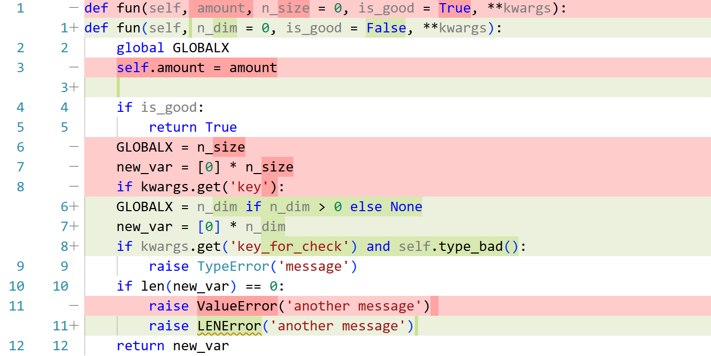
CI2: Code_v2 changes the TypeError trigger key from 'key' to 'key_for_check’. Only passing 'key=test’ may raise a KeyError in new API
CI1: Code_v2 removes required parameter ‘amount’. Using old arguments like ‘amount=1’ triggers “unexpected keyword argument” errors.
1 -
2 +
3
4 -
5
6
7 -
8 -
9 -
10+
11+
12+
13
14
15-
16+
17
def fun(self, amount, n_size = 0, is_good = True, **kwargs):
def fun(self, n_dim = 0, is_good = False, **kwargs):
global GLOBALX
self.amount = amount
if is_good:
return True
GLOBALX = n_size
new_var = [0] * n_size
if kwargs.get('key'):
GLOBALX = n_dim if n_dim > 0 else None
new_var = [0] * n_dim
if kwargs.get('key_for_check') and self.type_bad():
raise TypeError('message’)
if len(new_var) == 0:
raise ValueError('another message')
raise LENError('another message’)
return new_var

Slide 8
用户使用LLM推荐的lib版本存在vul，需要推荐无vul的版本；使用LLM推荐的lib存在漏洞的版本，需要做自动化code 适配
Create R Update Delete
I: 10 Post, II: 2 Post, II’ 1 Post
URL Stackoverflow Post
Title
Body
I & II & Others
Title
Body
Rewrite
II Package Name+ version
II’
Signed by?
base
DB
LLM
RiskDB
LLM
LLM
Stackoverflow DB
Semantic理解 + Filter
匹配
重写
I
Q:What library?
LLM: log4j 1.0 ?
II
Q:I am using log4j, 1.0? However vul, how to adapt to new code in version 2.0
LLM: aaa(); -→ aaa(true);

Slide 9
User Input:
Answer:
RiskDB
User Input: 1.0 -> 2.0
Answer:

