Slide 1

Based on the real data from 2006 to 2014
Momentum Effect in China
Presented by
Xilin Shi
Yang Hu

Slide 2
AGENDA
Data Set Summary
Momentum Effect
Reversal Effect
Conclusion

Slide 3
Part one

Slide 4





DATA SET SUMMARY
Key features of the original data set
Date
Ticker
GICS
Close
Volume
From 2006-01-01,
to 2014-11-17
17 months
2147 trading days
2569 unique stocks
Both SH & SZ market
Global Industry Classification Standard
Take values from 10 to 55
Each value stands for a sector
Daily close price
Unit: RMB Yuan
1402842 NAs*
Daily trading volumes
1639761 NAs*
* NA values exist mainly due to different listing time of firms

Slide 5
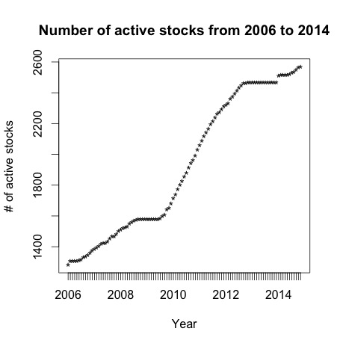
DATA SET SUMMARY
Take a more detailed look
Number of active stocks change because:
New firms list on the stock market
Firms suspend trading shares in a specific period of time
Firms quit the stock market
Only 4% stocks have price record less than 1 year
Min | 1st Q | Medium | 3rd Q | Max
1282 | 1526 | 1856 | 2454 | 2569

Slide 6
Part two

Slide 7
MOMENTUM EFFECT
Data structure change
Time Range
Daily index was transformed into monthly index. Past and forward returns are available only in 2007.01 – 2013.10
Recorded in the first column of the new data frame for backtesting
2006.01 2007.01 2013.10 2014.10
Columns
Date Ticker GICS Close Volume
We calculate 3, 6, 9, 12 month past and forward returns
ret.x.0 --- past x month return (monthly)
ret.0.x --- forward x month return (monthly)
ret.wk.x --- past x week return (weekly)
Month Ticker ret.3.0 ret.6.0 ret.9.0 ret.12.0 ret.0.3 ret.0.6 ret.0.9 ret.0.12 ret.wk.1 ret.wk.2 ret.wk.3
Example
......
On the first trading day of Jan 2007, stock “000001.SZ”, has a 3 month past return of 24.72% per month.
If we buy it and hold for 9 months, we will receive a profit of 29.44% per month.
Also, it has a 1 week past return for 5.69% per week.

Slide 8
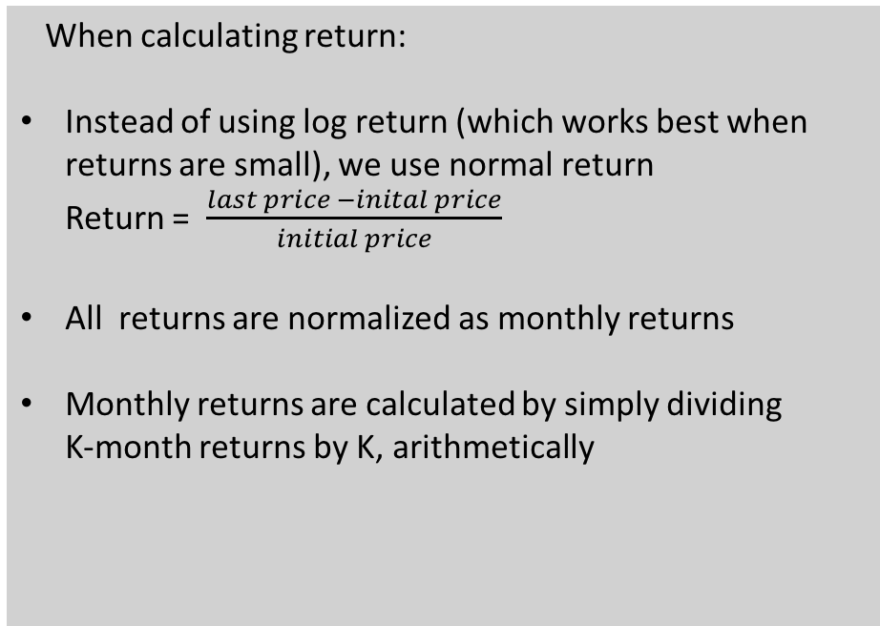
MOMENTUM EFFECT
Assumptions
No transaction cost
Stock can be short easily without costs
All trading profits are subject to the same tax rate (or no tax rate)
Dealing with NA in return data
All stocks with available returns data in the J months preceding the portfolio formation date are included in the sample from which the buy and sell portfolios are constructed
NA in forward returns are removed when calculating buy and sell portfolio returns
When calculating return:
Instead of using log return (which works best when returns are small), we use normal return Return = $\frac{last price −inital price}{initial price}$
All returns are normalized as monthly returns
Monthly returns are calculated by simply dividing K-month returns by K, arithmetically
* Reverse effect is caused by bid-ask spread, price pressure, and lagged reaction effects, according to Jegadeesh and Lehmann (1990)

Slide 9
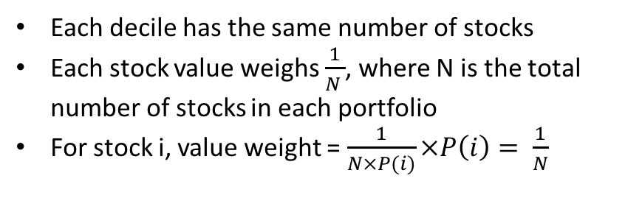
MOMENTUM EFFECT
Trading strategy and portfolio return
At the first trading day of each month
Rank the securities in ascending order based on their returns in the past J months
Form 10 decile portfolios that equally weight the stocks contained in each decile
Buy “winners” portfolio (bottom decile) and sell “losers” portfolio (top decile), holding this position for K months
On the last trading day of Kth month
Close out the position initiated in month t-K and calculate returns
Portfolio Construction
Include portfolios with overlapping holding periods
J-month/K-month strategy (Jegadeesh): Select stocks on the basis over the past J months and hold them for K months
Equally Weighted Portfolio
Each decile has the same number of stocks
Each stock value weighs $\frac{1}{N }$, where N is the total number of stocks in each portfolio
For stock i, value weight = $\frac{1}{N×P(i)}×P\left(i\right)= \frac{1}{N}$
Zero Cost Portfolio
Buy the winner portfolio and sell equal value of the loser portfolio, creating a zero cost portfolio
The buy-sell portfolio return = return from winners portfolio – return from losers portfolio

Slide 10
MOMENTUM EFFECT
Two set of strategies and t statistics
First set of strategy –portfolios are formed immediately after the lagged returns are measured for the purpose of portfolio formation
A total of 16 strategies
Select stocks based on their returns over the past 3, 6, 9, and 12 months, denoted as J
Consider holding periods that vary from 3, 6, 9, and 12 months, denoted as K
Second set of strategy – portfolios are formed 1 week after the lagged returns used for forming these portfolios are measured
Skip a period (e.g. a month) between the portfolio formation period and the holding period
By skipping period, we can avoid some of the bid-ask spread, price pressure, and lagged reaction effects
T-statistics
Test whether the zero-cost portfolios have a significant return
One-sample T-test
Null hypothesis: sample mean is zero

Slide 11
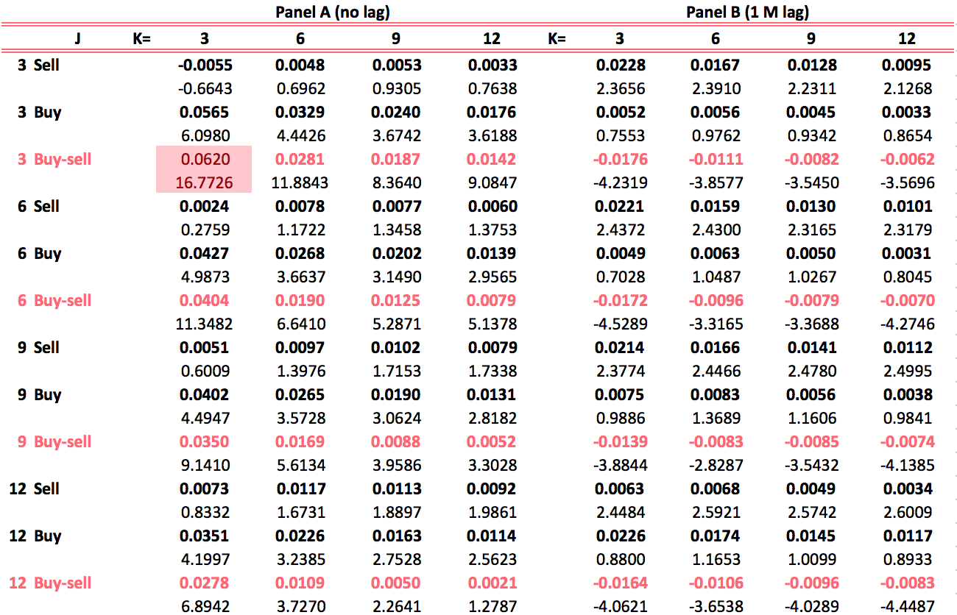
MOMENTUM EFFECT
Returns of J-month/K-month strategy
Most significant positive return
We mainly focus on Buy-sell rows.
3-month/3-month strategy exhibits a very significant positive return.
In panel A (form the portfolio immediately), as J and K increases, positive returns become less significant. When it comes to 12-month/12-month strategy, the positive return almost fades away.
In panel B (1 month lag to form the portfolio), there are no obvious trend and ALL the strategies have significantly negative return.
Less significant
No obvious trend

Slide 12
Part three

Slide 13
REVERSAL EFFECT
Literature and introduction
Jegadeesh’s finding on reversal effect
Jegadeesh (1990) documents profits of about 2% per month over 1934–1987 using a reversal strategy that buys and sells stocks on the basis of their prior-month returns and holds them for one month. *
Two possible explanations
1. Supported by Shiller (1984), Black (1986), Stiglitz (1989), Summers and Summers (1989)*
Market prices reflect investor overreaction to information
Maybe they are not mutually exclusive
2. Supported by Grossman and Miller (1988), Jegadeesh and Titman (1993)*
Market prices change when large quantities of stocks are traded, or price pressure
Hypothesis on Chinese stock market
We expect to see stronger reversal effect in China
Why? -- Large number of individual investors, who tend to overreact towards information
-- Poor market efficiency and stock prices are event-driven
* See Zhi Da (2014) A Closer Look at the Short-Term Return Reversal

Slide 14
REVERSAL EFFECT
Take holding period as the independent variable
We analyze reversal effect in lagging period scale, as well as holding period scale. Every time we control one variable constant and change the other variable.
First we take a glance at holding period scale. The table shows returns under different holding period.
Though there are no obvious trend in t statistics, we still observe something interesting!
Returns obviously decrease as J and K increases, but t statistics stay stable or even increase.
Let’s check the standard deviation and kurtosis of returns.
No
obvious
trend
No obvious trend

Slide 15
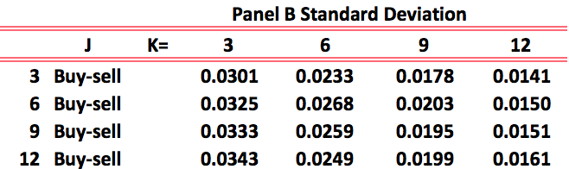
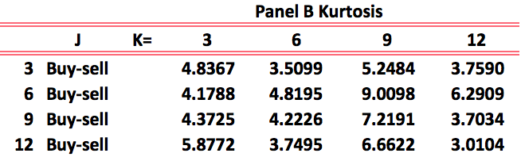
REVERSAL EFFECT
Take holding period as the independent variable
SD decreases as holding period increases.
It is less risky to hold for longer period.
It seems to contradict with GBM assumptions: Volatility of stock returns is linear to the square root of time.
Chinese stock markets are, to some extent, predicable
Heavy tails are not severe in this strategy, which indicates that it is of little possibility to suffer extreme loss.
Evidence so far proved that Chinese stock market DO have a strong reversal effect, at least it is in 1M lagging period. Now we hope to examine different lagging periods.

Slide 16
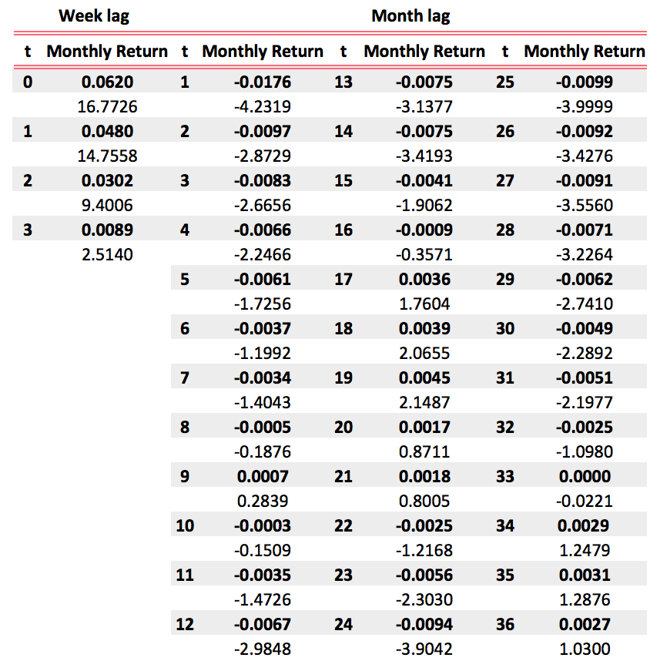
REVERSAL EFFECT
Take the lagging period as the independent variable
We pick 3 month/3 month strategy for reversal effect analysis.
We test portfolio performance based on a sequence of: No lag, 1 week lag, 2 weeks lag, 3 weeks lag, 1 month lag, … up to 36 months lag.
We observe that in short term (less than 1 M), there are positive momentum effects. As lag period grows, positive returns fade away.
1 M < t < 16 M, there are reversal effects and returns tend to be negative.
However, in longer term, returns are positive again, though some of them are not significant.
Less significant
Positive again

Slide 17
Part four

Slide 18
CONCLUSION
Returns of J-month/K-month strategy
We indeed observed momentum effect in China and the strategy returns
are significantly positive.
However, the momentum time scale distribution seems to be very different…
01 Momentum
02 Short Term
Momentum in China tend to be short-term. It will be more profitable to form portfolio based on past return in a short period of time and hold it for a short time as well
03 Reverse
Chinese stock market has a strong reversal effect which changed the time structure of momentum
Commonly known momentum and reversal effect
Momentum and reversal effect in China
< 1 M
Reverse
> 1 M
< 12 M
Momentum
> 12 M
Reverse
< 1 M
Momentum
> 1 M
< 16 M
Reverse
> 12 M
Hard to predict

Slide 19
THANK YOU

