Slide 1
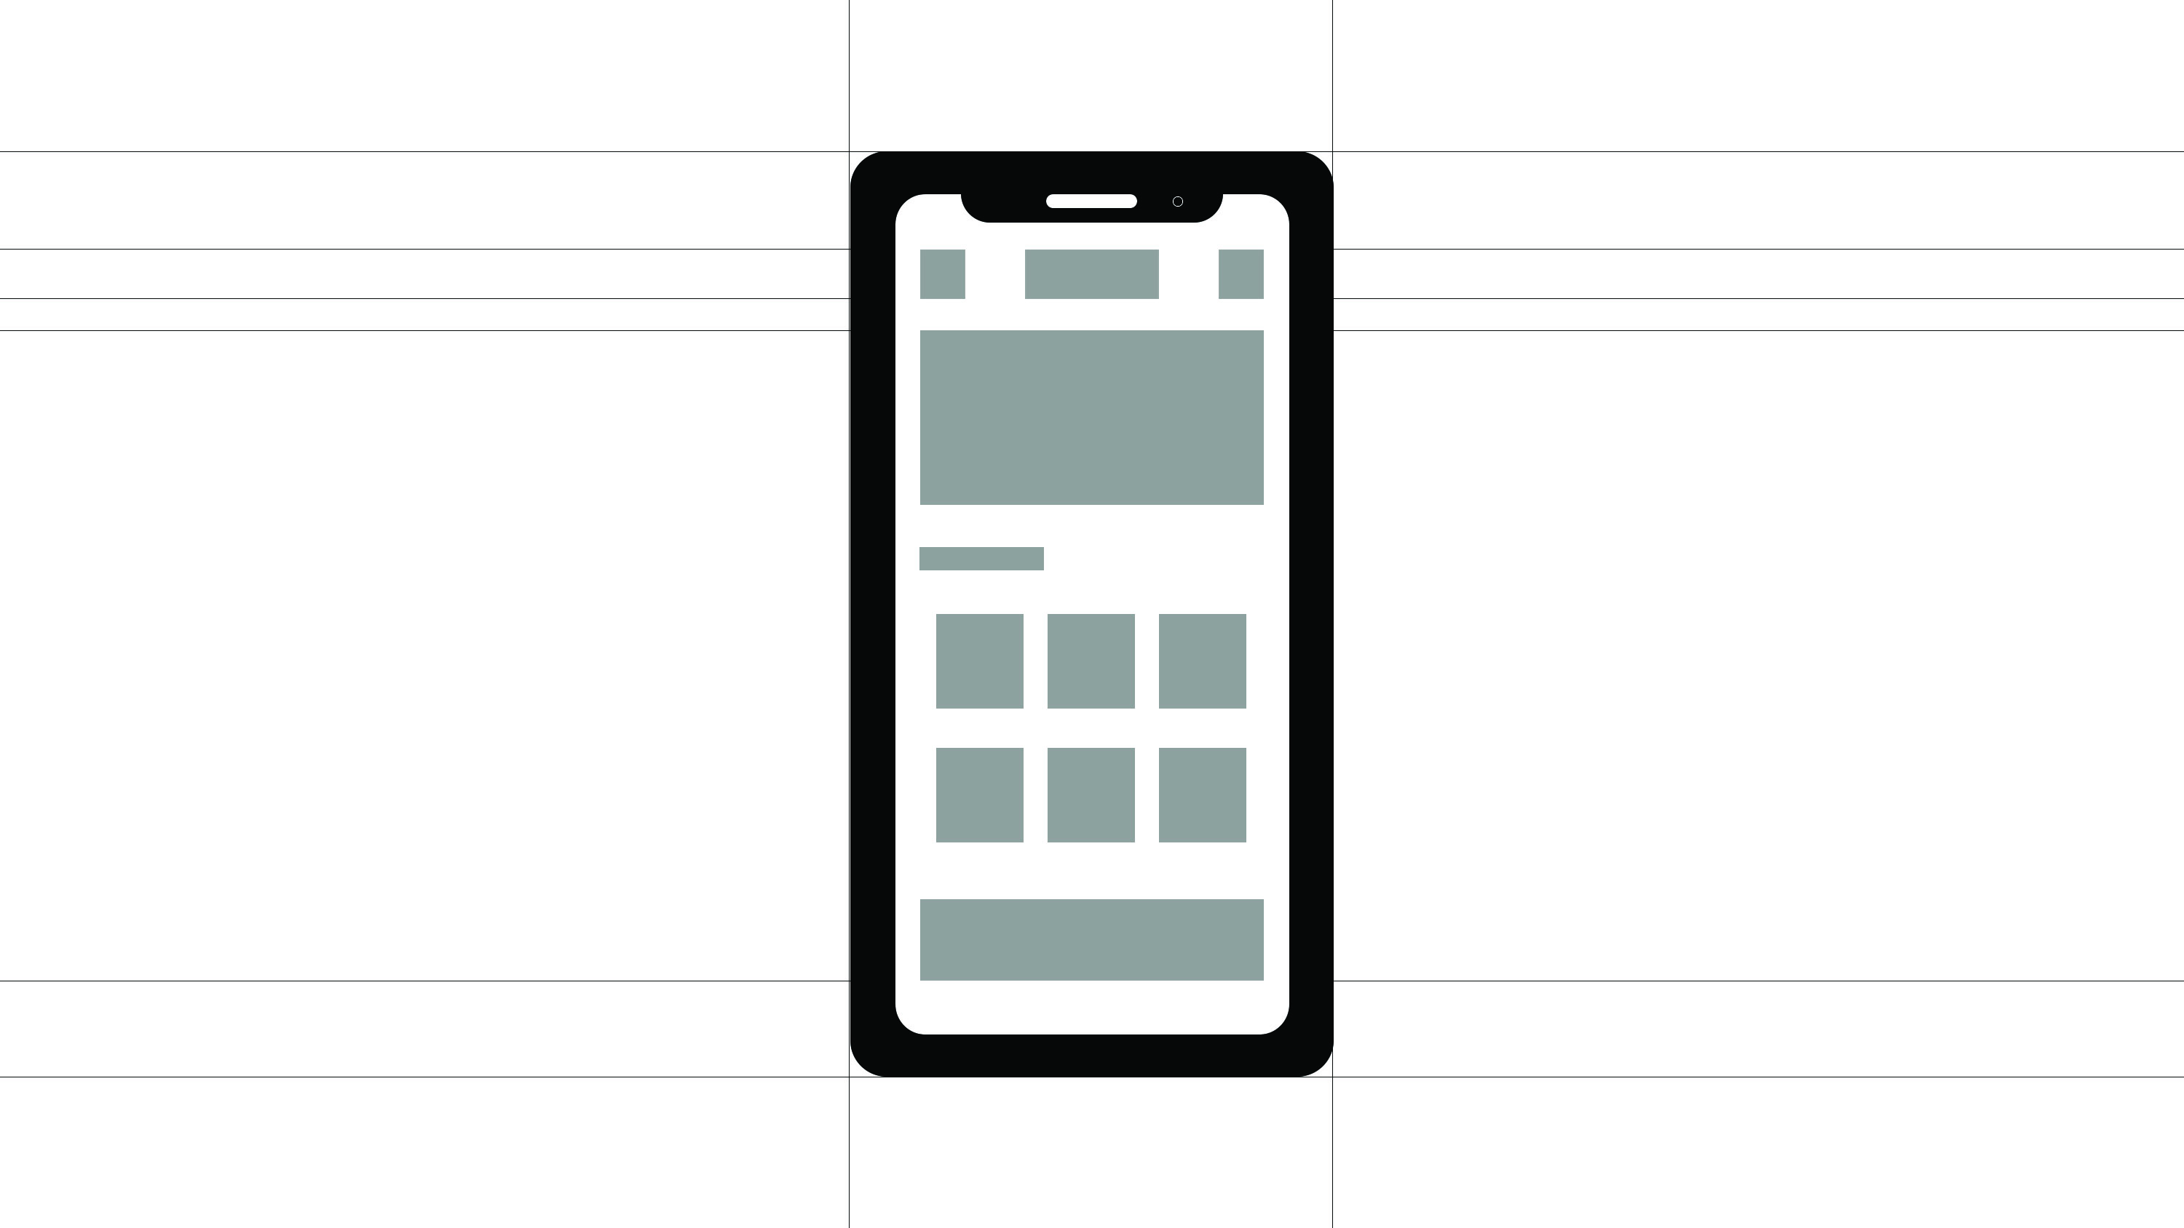
Mobile WebSite Introduce
그린컴퓨터 아카데미
양 희 언

Slide 2
Mobile Web Dev. Introduce
ONE. Mobile WebSite Introduce
Two. Color && Fonts
Thr. Design
Fur. Code

Slide 3

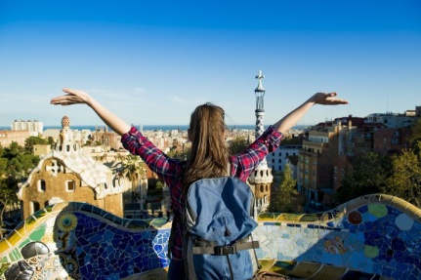
ONE. Mobile WebSite Introduce ( 모바일 웹사이트 소개 )
TITLE :
TOUR PUZZLE
가이드투어, 패스, 입장권, 교통권, 레스토랑, 공연, 아울렛 쇼핑 등 원하는 상품을 하나 하나 선택할 수 있는 여행 사이트입니다.
패키지 여행은 싫지만 간편하게 뭔가를 얻고 싶어하는 사람들이 많이 좋아할 사이트라고 생각합니다.
기존에 있는 사이트를 좀 더 심플하고 디자인적으로 바꿨습니다.

Slide 4
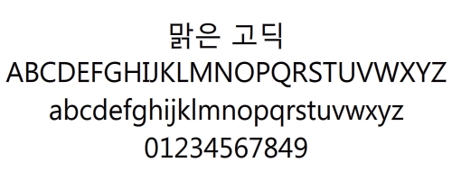
Two. Color && Fonts ( 색상 및 폰트 선택)
Color
로고 이미지에 표현된 빨강과 노랑을 이용했다
로고에는 4가지 색이 있지만 너무 많은 색을
줄 경우 좀 난잡한 느낌을 주기에 가장 산뜻한
색으로 선택했다
여행사이트만의 밝고 자유로운 느낌을 준다
그리고 흰색으로 심플하고 깔끔한 더해준다
빨강(#ff3333)
노랑(#ffff00)
흰색(#ffffff)
Fonts
맑은 고딕 은 기본서체다.
그래서 사람들에게 더 익숙하고
표현되는 영어폰트또한 간결하고 이쁘다
그래서 영어로 된 표현들이 많지만 따로
영어폰트를 사용하지 않았다

Slide 5
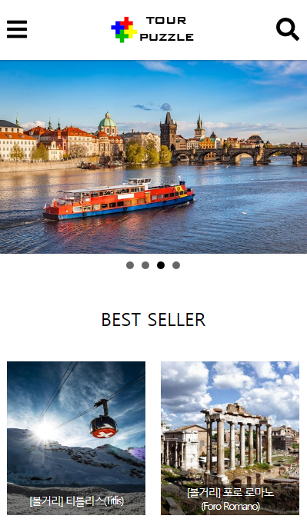
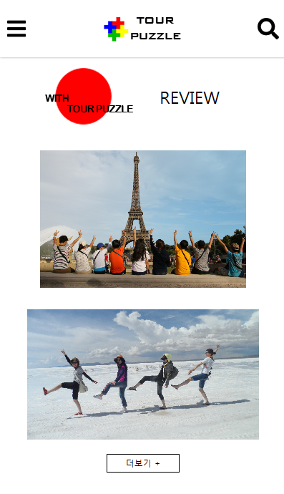
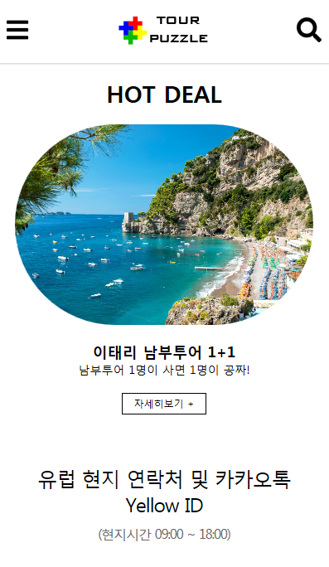
Thr. Design ( 모바일 웹 디자인 )
Top
Middle
Under

Slide 6
Thr. Code ( HTML CODE )
<!DOCTYPE html>
<html lang="ko">
<head>
<meta charset="UTF-8">
<meta name="viewport" content="width=device-width, initial-scale=1, minimum-scale=1, maximum-scale=1, user-scalable=no">
<meta http-equiv="X-UA-Compatible" content="ie=edge">
<script src="https://code.jquery.com/jquery-1.12.1.js"></script>
<script src="https://code.jquery.com/ui/1.12.1/jquery-ui.js"></script>
<script defer src="https://use.fontawesome.com/releases/v5.0.8/js/all.js"></script>
<link rel="stylesheet" href="https://cdn.jsdelivr.net/bxslider/4.2.12/jquery.bxslider.css">
<!-- <script src="https://ajax.googleapis.com/ajax/libs/jquery/3.1.1/jquery.min.js"></script> -->
<script src="https://cdn.jsdelivr.net/bxslider/4.2.12/jquery.bxslider.min.js"></script>
<link rel="stylesheet" href="css/base.css">
<link rel="stylesheet" href="css/tourstyle.css">
<title>TOUR PUZZLE</title>
</head>
<body>
<div id="wrap">
<header>
<div id="headerin">

Slide 7
Thr. Code ( HTML CODE )
<!-- 오픈메뉴버튼 -->
<div class="navi">
<a href="#"><span class="fas fa-bars"></span></a>
</div>
<div class="logo"><a href="#"><img src="images/logo1.png" alt=""></a></div>
<div class="search">
<a href="#"><span class="fas fa-search"></span></a>
</div>
</div>
<nav id="gnb">
<div>TOUR PUZZLE</div>
<ul>
<li><a href="#">투어퍼즐상품</a>
<ul class="depth2">
<li><a href="#">영국</a></li>
<li><a href="#">프랑스</a></li>
<li><a href="#">이탈리아</a></li>
<li><a href="#">스페인</a></li>
<li><a href="#">체코</a></li>
<li><a href="#">오스트리아</a></li>
<li><a href="#">스위스</a></li>
<li><a href="#">두바이</a></li>
<li><a href="#">그외유럽</a></li>

Slide 8
Thr. Code ( HTML CODE )
</ul>
</li>
<li><a href="#">추천SPOT</a>
<ul class="depth2">
<li><a href="#">볼거리</a></li>
<li><a href="#">레스토랑</a></li>
<li><a href="#">쇼핑체험</a></li>
<li><a href="#">호텔</a></li>
<li><a href="#">카페</a></li>
<li><a href="#">기타</a></li>
</ul>
</li>
<li><a href="#">여행후기</a>
<ul class="depth2">
<li><a href="#">BEST후기</a></li>
<li><a href="#">데이투어</a></li>
<li><a href="#">입장권</a></li>
<li><a href="#">교통권</a></li>
<li><a href="#">트랜스퍼</a></li>
<li><a href="#">레스토랑</a></li>
<li><a href="#">스냅</a></li>
<li><a href="#">기타</a></li>
</ul>
</li>
<li><a href="#">이벤트/쿠폰</a>
<ul class="depth2">

Slide 9
Thr. Code ( HTML CODE )
<li><a href="#">제휴쿠폰</a></li>
<li><a href="#">퍼즐쿠폰</a></li>
</ul>
</li>
<li><a href="#">고객센터</a>
<ul class="depth2">
<li><a href="#">공지사항</a></li>
<li><a href="#">자주 묻는 질문 </a></li>
</ul>
</li>
</ul>
</nav>
<div id="searchBar">
<input type="search" name="sch" id="sch" placeholder="무엇을 찾으세요?">
</div>
</header>
<main>
<div id="mainvisual">
<!-- <a href="#"><img src="images/6.jpg" alt=""></a> -->
<ul class="slider">
<li><img src="images/2.jpg" alt=""></li>
<li><img src="images/3.jpg" alt=""></li>
<li><img src="images/4.jpg" alt=""></li>
<li><img src="images/5.jpg" alt=""></li>

Slide 10
Thr. Code ( HTML CODE )
</ul>
</div>
<div id="gall">
<p>BEST SELLER</p>
<ul>
<li class="b1">
<a href="#">
<img src="images/01.jpg" alt="">
<p>[볼거리] 티틀리스(Titlis)</p>
</a>
</li>
<li class="b2">
<a href="#">
<img src="images/02.jpg" alt="">
<p>[볼거리] 포로 로마노 <br>
(Foro Romano)</p>
</a>
</li>
<li class="b3">
<a href="#">
<img src="images/03.jpg" alt="">
<p>[볼거리] 트레비분수 <br>
(Fontana di Trevi)</p>
</a>

Slide 11
Thr. Code ( HTML CODE )
</li>
<li class="b4">
<a href="#">
<img src="images/04.jpg" alt="">
<p>[볼거리] 나보나 광장 <br>
(Piazza Navona)</p>
</a>
</li>
<li class="b5">
<a href="#">
<img src="images/05.jpg" alt="">
<p>[체험] 세체니 온천 <br>
(Szechenyi Baths and pool)</p>
</a>
</li>
<li class="b5">
<a href="#">
<img src="images/06.jpg" alt="">
<p>[볼거리] 보르게세 미술관 <br>
(Galleria Borghese)</p>
</a>
</li>

Slide 12
Thr. Code ( HTML CODE )
<li class="b5">
<a href="#">
<img src="images/07.jpg" alt="">
<p>[레스토랑] 일 포르테일 <br>
(Il Portale)</p>
</a>
</li>
<li class="b5">
<a href="#">
<img src="images/08.jpg" alt="">
<p>[볼거리] 나보나 광장 <br>
(Piazza Navona)</p>
</a>
</li>
<li class="b5">
<a href="#">
<img src="images/09.jpg" alt="">
<p>[볼거리] 포폴로 광장 <br>
(Piazza del Popolo)</p>
</a>
</li>
<li class="b5">
<a href="#">
<img src="images/10.jpg" alt="">

Slide 13
Thr. Code ( HTML CODE )
<p>[볼거리] 산탄젤로 성 <br>
(Castel Sant` Angelo)</p>
</a>
</li>
</ul>
<div id="btn0"><a href="#">∨</a></div>
</div>
<div id="review">
<ul>
<li><img src="images/red.png" alt=""></li>
<li><p>REVIEW</p></li>
</ul>
<div class="r1"><a href="#"><img src="images/r1.jpg" alt=""></a></div>
<div class="r2"><a href="#"><img src="images/r2.jpg" alt=""></a></div>
<div id="btn"><a href="#">더보기 + </a></div>
</div>
<div id="banner">
<a href="#">
<h3>TOUR PUZZLE EVENT</h3>
<p class="p1">event 1</p>
<p class="p2">데이투어 조기예약 할인</p>
<p class="p3">21일전 예약시 최대 20%할인 </p>
</a>
</div>

Slide 14
Thr. Code ( HTML CODE )
<div id="hotdeal">
<h1> HOT DEAL</h1>
<img src="images/hot.jpg" alt="">
<p><span>이태리 남부투어 1+1</span> <br> 남부투어 1명이 사면 1명이 공짜!</p>
<a href="#">자세히보기 +</a>
</div>
<div id="call">
<p>유럽 현지 연락처 및 카카오톡 Yellow ID <br>
<span>(현지시간 09:00 ~ 18:00)</span></p>
<ul>
<li><h3>FRANCE</h3>
<p>Tel : +33 6 <br>
6996 1441</p>
<span>ID : parispuzzle</span>
</li>
<li><h3>ROMA</h3>
<p>Tel : +39 327 <br>
222 3300</p>
<span>ID : romapz</span>
</li>
<li><h3>PRAHA</h3>
<p>Tel : +420 776 <br>
541 111</p>

Slide 15
Thr. Code ( HTML CODE )
<span>ID : prahapuzzle</span>
</li>
</ul>
<div id="callin">
<ul>
<li><img src="images/kakao.png" alt=""></li>
<li><p>KakaoTalk<span>@투어퍼즐 </span></p> </li>
</ul>
</div>
</div>
</main>
<footer>
<div id="footerin1">
<ul>
<li><a href="#">회사소개</a></li>
<li><a href="#">투어퍼즐이란</a></li>
<li><a href="#">이용약관</a></li>
<li><a href="#">개인정보취급방침</a></li>
<li><a href="#">찾아오시는 길</a></li>
<li><a href="#">B2B</a></li>
<li><a href="#">제휴문의</a></li>
</ul>
</div>

Slide 16
Thr. Code ( HTML CODE )
<div id="footerin2">
<p>
주)인터유로 대표 : 윤원영 04516 서울특별시 중구
서소문로 99 (57-9 서영빌딩) 202호 <br>
전화 : 02-777-4040 팩스 : 02-777-5302 <br>
사업자등록번호 : 104-81-98993 통신판매업신고 : <br>
제 2010-서울중구-0145호 <br>
관광사업등록 : 국외 제 2010-1호 개인정보보호 관리자 : <br>
윤지영 Copyright © 2015 INTEREURO, Co., Ltd. & CAFEDEEUROPE.COM All rights reserved.
</p>
</div>
<div id="sns">
<ul>
<li><a href="#"><img src="images/icon1.png" alt=""></a></li>
<li><a href="#"><img src="images/icon2.png" alt=""></a></li>
<li><a href="#"><img src="images/icon3.png" alt=""></a></li>
</ul>
</div>
</footer>
</div>
</body>

Slide 17
Thr. Code ( CSS CODE )
@charset "utf-8";
body,html{
font-size: 14px;
font-family: "맑은 고딕", sans-serif;
}
#wrap{
width:100%;
}
header,main,footer{
width:100%;
position: relative;
}
header{
position: fixed;
z-index: 999;
}
#headerin{
position: relative;
width:100%;
height:80px;
display: flex;
justify-content: space-between;
align-items: center;

Slide 18
Thr. Code ( CSS CODE )
box-shadow: 0 0 5px rgba(0,0,0,0.5);
background: #fff;
}
.navi, .search{
position: relative;
width:30px;
height:30px;
}
.navi{
left:10px;
}
.search{
right: 10px;
}
.navi>a, .search>a{
display: block;
width:30px;
height:30px;
}
.navi span, .search span{
display: block;
width:30px;

Slide 19
Thr. Code ( CSS CODE )
height:30px;
margin:0 auto;
}
.fa-bars, .fa-search{
font-size: 30px;
}
.logo1>a>img{
width: 120px;
height: 50px;
}
.logo1>a{
display: block;
width: 120px;
height: 60px;
background:#ccc;
}
#gnb{
position: fixed;
left:-100%;
width: 100%;
height:100%;
background:beige;
display: none;

Slide 20
Thr. Code ( CSS CODE )
z-index: 999;
}
#gnb>div{
font-size: 24px;
font-family: "BankGothic Md BT";
text-align: center;
margin: 10px 0;
}
#gnb>ul>li>a{
position: relative;
display: block;
font-size:16px;
/* text-indent: 10px; */
padding:10px 0;
text-align: center;
}
#gnb>ul>li>a:after{
content:"▼";
display:block;
width:20px;
height:20px;
position: absolute;
top:50%;

Slide 21
Thr. Code ( CSS CODE )
transform: translateY(-50%);
right:10px;
color:brown;
}
.depth2{
display:none;
}
.depth2 a{
display:block;
padding:8px;
font-size:14px;
text-align: center;
color:#666
/* text-indent: 20px; */
}
#searchBar{
position: relative;
width:100%;
height:50px;
/* background: #ccc; */
display: none;
}
#sch{

Slide 22
Thr. Code ( CSS CODE )
position: relative;
display: block;
width:80%;
height: 40px;
margin: 0 auto;
border:1px solid #ccc;
text-indent: 10px;
top:5px;
background: rgba(255,255,255,0.3);
color:#000;
}
#mainvisual{
position: relative;
top: 80px;
width:100%;
height:300px;
}
#mainvisual>a>img{
display: block;
width: 100%;
height: 100%;
}
#mainvisual .bx-wrapper{
border:0;

Slide 23
Thr. Code ( CSS CODE )
}
.bx-wrapper .bx-pager,
.bx-wrapper .bx-controls-auto {
bottom: -20px;
}
.slider{
width:100%;
}
.slider>li>img{
width: 100%;
height: 100%;
}
#gall{
width: 100%;
height: auto;
margin-top:100px; }
#gall>ul{
display:flex;
flex-wrap: wrap;

Slide 24
Thr. Code ( CSS CODE )
overflow: hidden;
height: 430px;
}
#gall>p{
/* font-family: Arial; */
width: 90%;
margin:0 auto;
text-align: center;
font-size: 24px;
margin-bottom:40px;
}
#gall li{
width:45%;
height:200px;
margin:0 auto 20px auto;
}
#gall a{
display:block;
width:100%;
height: auto;
}
#gall img {
width: 100%;
height: 200px;
}

Slide 25
Thr. Code ( CSS CODE )
#gall>ul>li{
position:relative;
height: 200px;
}
#gall>ul>li>a>p{
width:100%;
height: 40px;
position:absolute;
bottom:0;
text-align: center;
background: rgba(0,0,0,0.5);
font-size: 14px;
line-height: 18px;
color: #fff;
letter-spacing: -1.5px;
}
#gall>ul>li:nth-child(1)>a>p{
line-height: 40px;
}
#btn0>a{
position: relative;
width:30px;
height: 30px;
border:1px solid #000;

Slide 26
Thr. Code ( CSS CODE )
border-radius: 50%;
margin:0 auto;
text-align: center;
line-height: 30px;
font-weight: bold;
}
#review{
width:90%;
height:auto;
margin:40px auto 0 auto;
}
#review>ul{
display:flex;
align-items: center;
justify-content: space-around;
}
#review>ul>li>p{
font-size:24px;
position: relative;
right:40px;
}
.r1{

Slide 27
Thr. Code ( CSS CODE )
width:80%;
height: 100%;
margin:0 auto;
}
.r1>a>img{
width: 100%;
height: auto;
margin: 30px auto;
}
.r2{
width:90%;
height: 100%;
margin: 0 auto;
}
.r2>a>img{
width: 100%;
height: auto;
margin: 0 auto;
}
#btn>a{
display:block;
width: 100px;

Slide 28
Thr. Code ( CSS CODE )
height: 24px;
line-height:22px;
font-size: 12px;
border:1px solid #000;
text-align:center;
margin:20px auto;
}
#banner{
width:100%;
height: 200px;
background: #ffff00;
margin:40px 0;
}
#banner>a{
display: block;
width:80%;
height: auto;
margin: 0 auto;
position: relative;
top:30px;
}
#banner>a>h3{
text-align: center;
}

Slide 29
Thr. Code ( CSS CODE )
.p1{
text-align: center;
font-size: 18px;
margin-top:20px;
}
.p2{
font-size: 20px;
line-height: 45px;
text-align: center;
}
.p3{
font-size: 14px;
text-align: center;
}
#hotdeal{
width: 90%;
margin:0 auto;
text-align: center;
}
.p1{
text-align: center;
font-size: 18px;
margin-top:20px;
}
.p2{
font-size: 20px;
line-height: 45px;
text-align: center;
}
.p3{
font-size: 14px;
text-align: center;
}
#hotdeal{
width: 90%;
margin:0 auto;
text-align: center;
}
#hotdeal>img{
width: 100%;
border-radius:200px;
}

Slide 30
Thr. Code ( CSS CODE )
#hotdeal>h1{
margin: 20px auto ;
text-align: center;
}
#hotdeal>p>span{
margin:20px 0;
font-size: 18px;
font-weight:600;
}
#hotdeal>p{
font-size:14px;
margin:20px 0;
}
#hotdeal>a{
display:block;
width: 100px;
height: 24px;
line-height:22px;
font-size: 12px;
border:1px solid #000;
text-align:center;
margin:20px auto;
}

Slide 31
Thr. Code ( CSS CODE )
#call{
width: 80%;
margin: 0 auto;
}
#call>p{
font-size: 24px;
text-align: center;
margin: 60px 0 30px 0;
letter-spacing: -1px;
}
#call>p>span{
font-size: 16px;
color:#666;
}
#call>ul{
display: flex;
justify-content: space-between;
text-align: center;
}
#call>ul>li>p{
margin:15px 0;
font-size: 14px;
letter-spacing: -1px;

Slide 32
Thr. Code ( CSS CODE )
}
#callin>ul{
display: flex;
margin: 0 auto;
text-align: center;
width:190px;
}
#callin{
margin-top:20px;
}
#callin>ul>li>p>span{
font-weight:bold;
border-bottom: 1px solid #000;
}
#footerin1{
width:100%;
height: 80px;
background:#f5f5f5;
margin-top:60px;
font-size: 12px;
}
#footerin1>ul{
width:90%;
height: 80px;

Slide 33
Thr. Code ( CSS CODE )
display: flex;
flex-wrap: wrap;
justify-content: space-around;
margin: 0 auto;
align-items: center;
text-align: center;
}
#footerin1>ul>li{
padding:8px 8px;
}
#footerin2{
width: 90%;
margin:0 auto;
}
#footerin2>p{
font-size:12px;
margin:15px 0;
}
#sns{
width:50%;
height:50px;
margin: 0 auto;
}

Slide 34
Thr. Code ( CSS CODE )
#sns>ul{
margin-top:30px;
display: flex;
justify-content:space-around;
align-items: center;
/* border:1px solid #000; */
}
#sns>ul>li>a>img{
width:30px;
height: 30px;
}

Slide 35
Thr. Code ( JS CODE )
<script>
$(".search>a").click(function(){
$("#searchBar").slideToggle("500","easeOutBounce");
return false;
});
$(".navi>a").click(function(){
var poi = $("#gnb").css("display");
if(poi=="none"){
$("#gnb").show(100).animate({left:"0"});
}else if(poi =="block"){
$("#gnb").animate({left:"-100%"});
$("#gnb").fadeOut(200);
$(".depth2").slideUp();
}
return false;
});
//아코디언메뉴
$("#gnb>ul>li>a").click(function(){
var dis = $(this).siblings(".depth2");
var two = dis.css("display");

Slide 36
Thr. Code ( JS CODE )
if(two == "none"){
$(".depth2").slideUp();
dis.slideDown();
}else if(two == "block"){
dis.slideUp();
}
return false;
});
$("#btn0>a").click(function(){
var di = $(this).parents("#gall").children("ul");
var tw = di.css("height");
if(tw == "430px"){
$("#btn0>a").text("∧");
di.animate({height:"1100px"});
}else if(tw == "1100px"){
$("#btn0>a").text("∨");
di.animate({height:"430px"})
}
return false;
});

Slide 37
Thr. Code ( JS CODE )
//메인슬라이드
$(document).ready(function(){
$('.slider').bxSlider({
auto:true,//자동슬라이드 진행
controls:false,//next,prev버튼 생성여부
speed:200,//1000:1초 200:0.2프레임
responsive:false,//슬라이드 구성이 적응형으로 설정
pause:2000,//멈추는 속도
});
});

