Slide 1


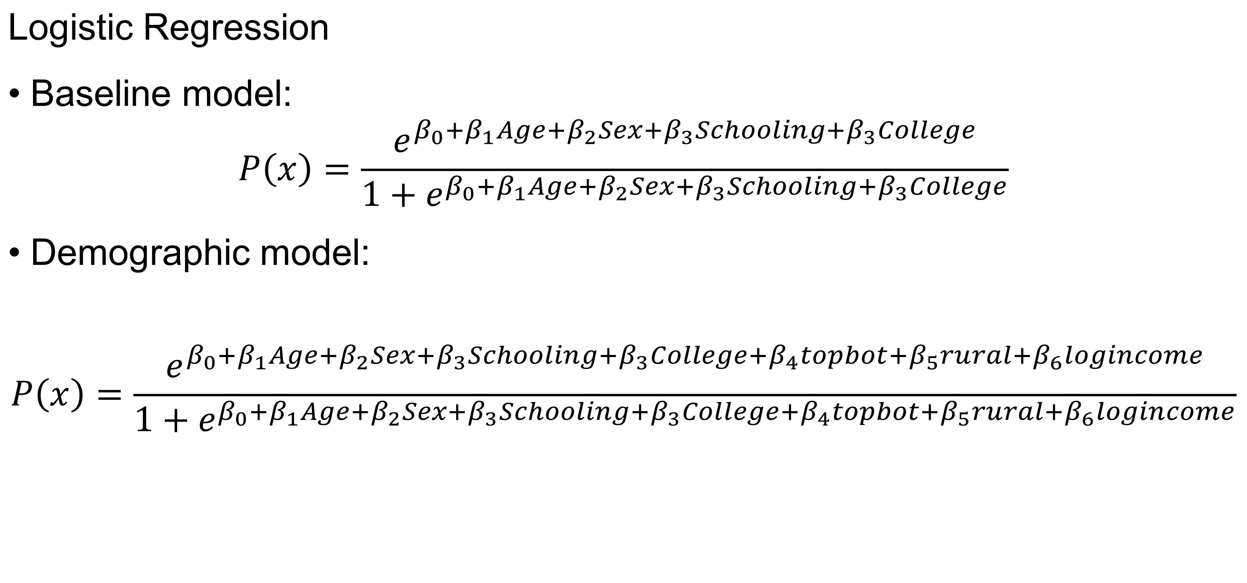
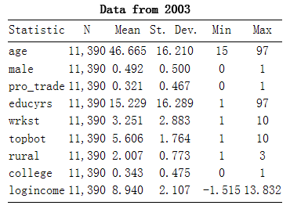
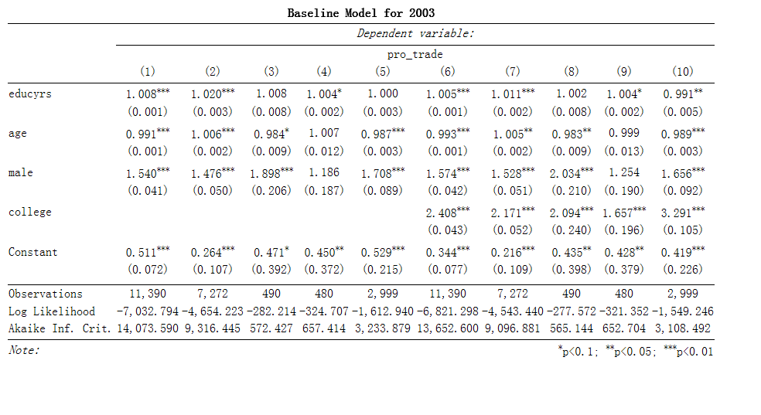
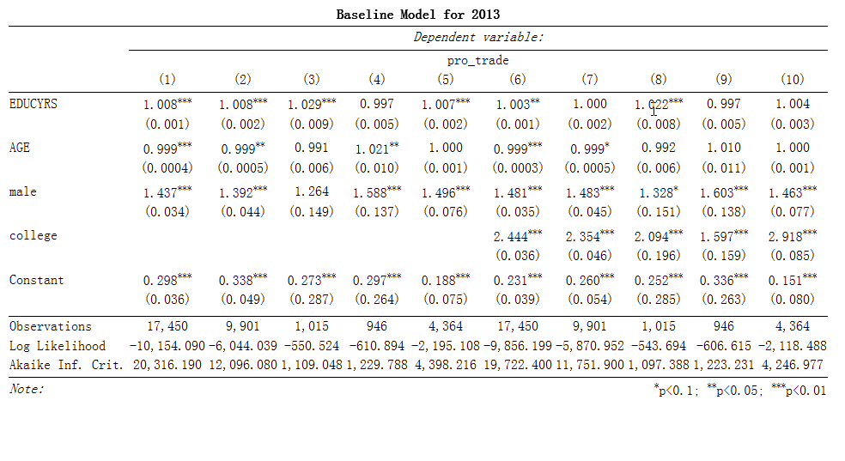
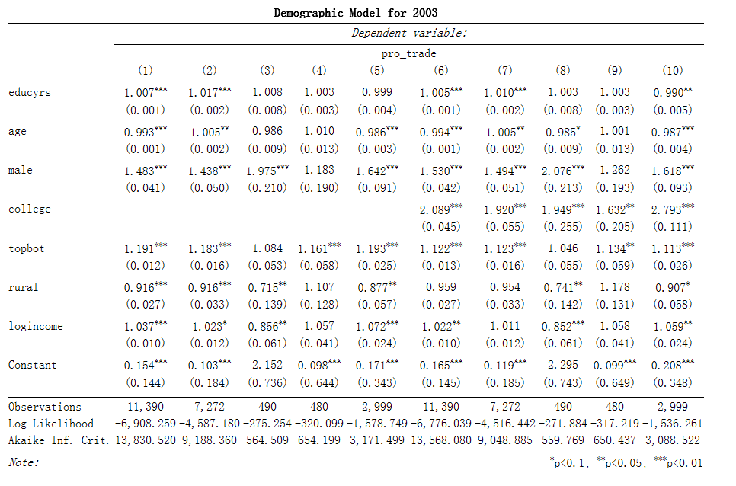
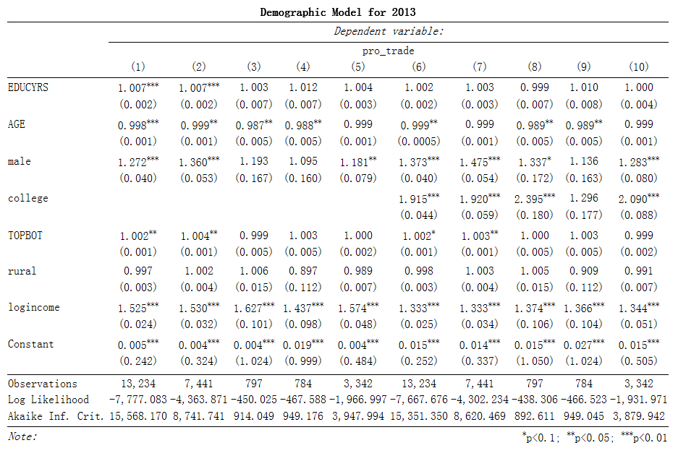
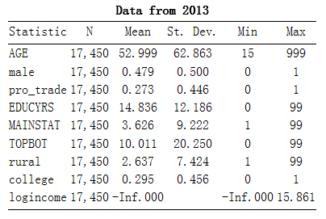
Determinants of Individual Trade Preference
Yang Hou
Social Science Division, Computational Social Science, University of Chicago
Background
Specific Aims
Methods
Conclusion
Many researches have been done to reveal the determinants of individual trade preference, and many models have been established and tested. Two most classical models are factor-endowments model and the specific-factors model, which point out the relationship between material income and trade preference. Then Scheve and Slaughter suggest not only material income, but also accumulated wealth will also determine trade preference. Later on, the positive correlation between college level education was discovered. Some researchers argued that it is the exposure to economic ideas during college really matters. Evidence for community’s collective recognition influences individual’s trade preference is also fund, supporting the idea of college environment is a critical determinant. However, the situation is changed. Nowadays, college is no longer the only channel to spread economic ideas, also external crisis may alter or enhance people’s belief. This research intents to re-exam theories with changing demographics.
Exam the theory that education, especially college education will largely influence one’s trade preference with newly released data.
Test whether the series of financial dilemmas after 2008 have weaken the positive correlation between college education and individual trade preference.
The analysis supports the theory that education, especially college level education is a strong determinant for individual’s trade preference. However, cross year comparison does not show significant change of the influential power of college education, though some changes in sub-population occurs.
Data
Limitations
The data used for the research is the National Identity Survey in International Social Survey Program (ISSP). Both datasets from 2003 and 2013 are used.
Results
More data with larger time variation may be able to capture the change of the influence of education towards individual’s trade preference.
References
Hainmueller, J., Hiscox, M. 2006. Learning to love globalization: Education and individual attitudes toward international trade. International Organization, 60(02), 469-498.
Mansfield, E., Mutz, D., 2009. Support for free trade: Self-interest, sociotropic politics, and out-group anxiety. International Organization, 63(03), 425-457.
Krugman, P., Obstfeld, M., Melitz, M., 2015. " International Economics". Theory and policy. Pearson Education Limited. pp:83-97. ISBN 1292019557
Scheve, K. F., & Slaughter, M. J. 2001. What determines individual trade-policy preferences?. Journal of International Economics, 54(2), 267-292.
A glance of the data suggests that pro_trade rate declined from 2003 to 2013.
In all the models above, model number (1),(6) represent full sample. Model number (2),(7) represent population with jobs. Model number (3),(8) represent population unemployed and looking for jobs. Model number (4),(9) represent population in education. Model number (5),(10) represent population not in the labor force.

