Slide 1


POLITECNICO DI MILANO
A.A. 2016/2017
Amico Simone
Chianella Claudia
Giovanakis Yannick

Slide 2
PROJECT OVERVIEW
Requirements and Specifications Document
Design Document
Integration Test Plan Document
Project Plan Document
Code Inspection Document

Slide 3
1.REQUIREMENTS AND SPECIFICATIONS
Purpose: give an overview of requirements (functional and non-functional) analyzing needs of future costumers and stakeholders. Goals: what are the objectives of the system?
Applications : what must be developed?
Functional requirements & scenarios : what are the functionalities of the system and how can they be used in the real world?

Slide 4
1. GOALS
PRACTICAL & CONVENIENT: offer a price competitive and eco friendly solution that common public transport often can’t offer.
USER FRIENDLY: using the system must be intuitive and easy for every kind of potential user.
FAST:
- Search time : < 30s.
- Reservation time : < 1 min
AVAILABILITY: run as application on the most common mobile devices (phones, tablets ,computers ) but offer also a web page reachable from the most common browsers.

Slide 5
1. APPLICATIONS
Client-side applications:
Mobile application
Web applications
On-board application
Server-side application:
Back-end application

Slide 6
1. APPLICATIONS – Web & Mobile
Addressed towards the end users.
Accessible from any internet enabled devices.
Both offer the same core functionalities:
Manage user profile and user data
Search for a car
Reserve a car
User friendly intuitive graphic interfaces

Slide 7
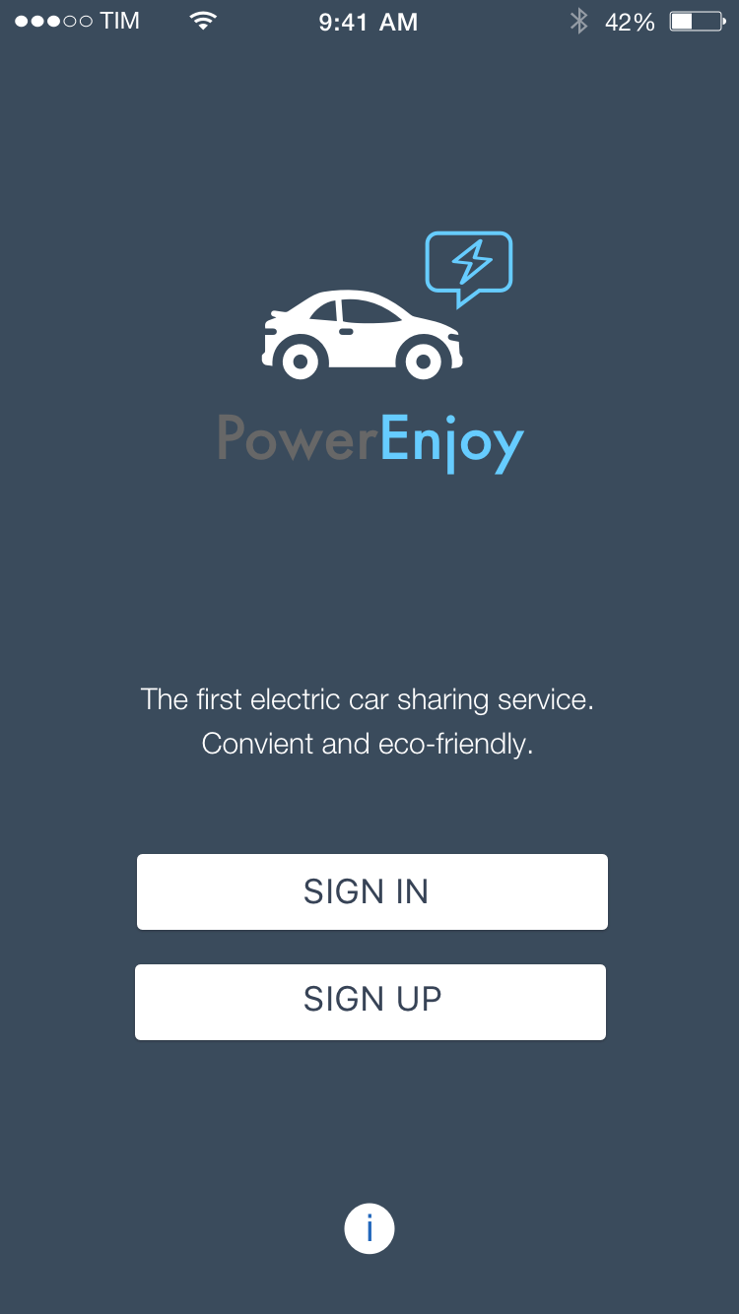
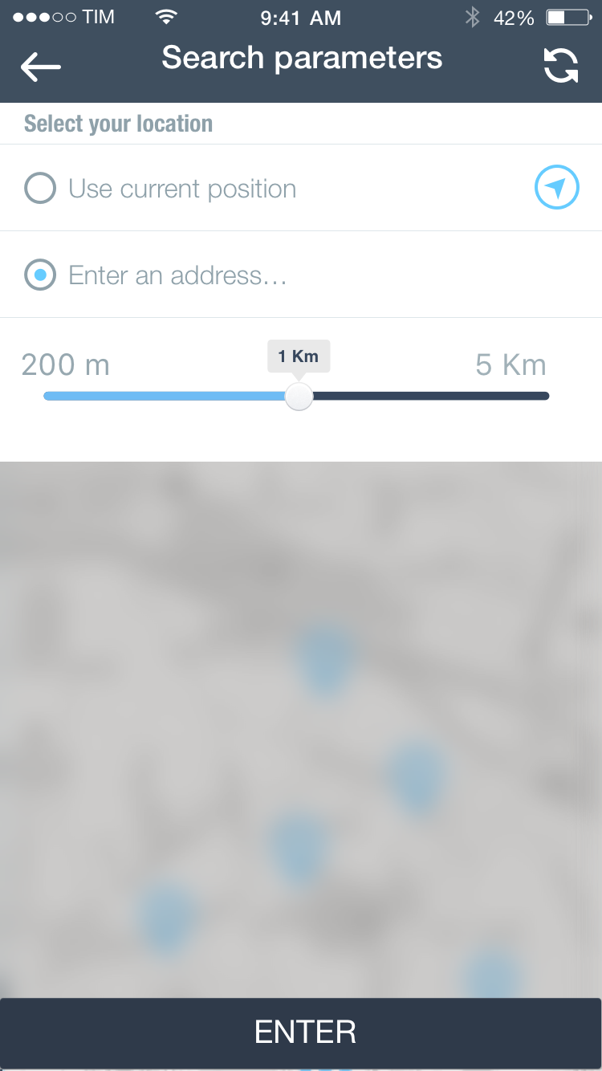
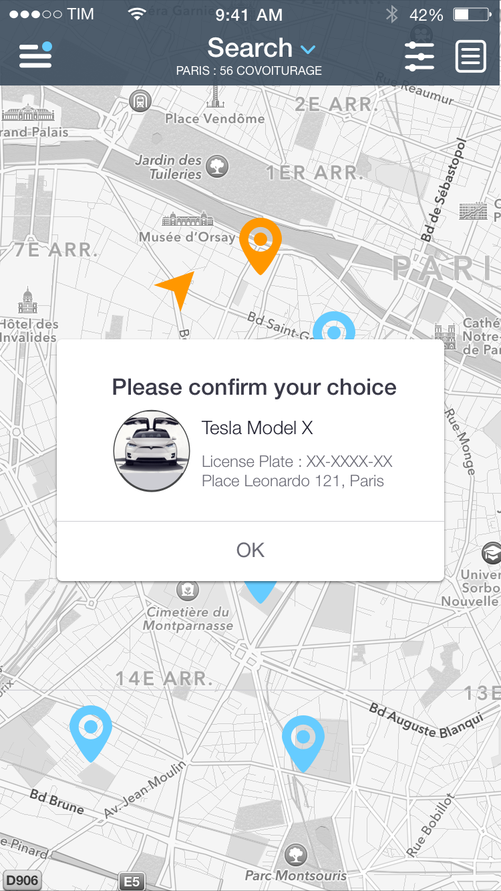
APPLICATIONS – Mobile example
Home
Car search
Confirm reservation

Slide 8
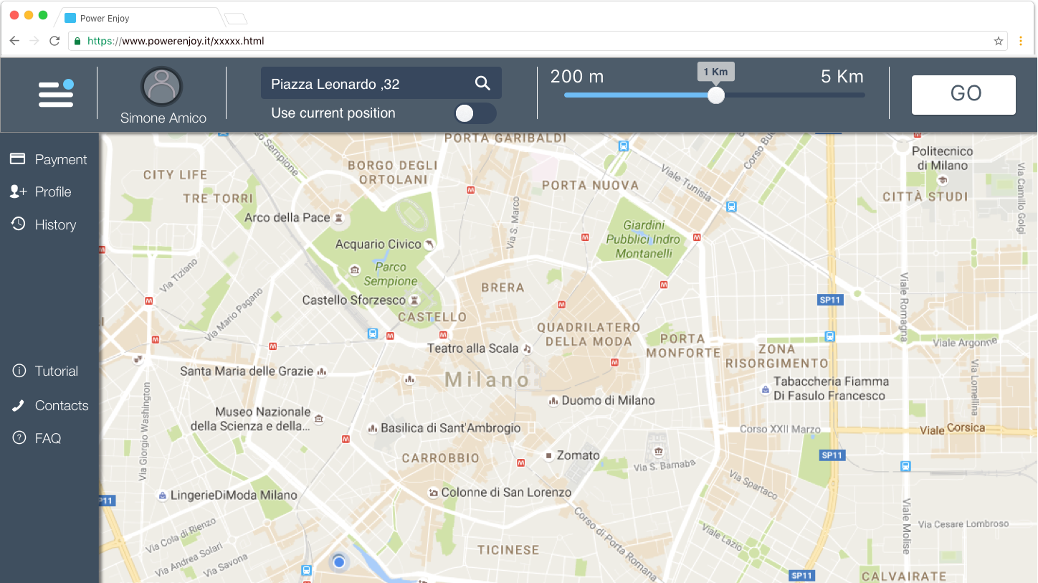
APPLICATIONS – Web example
Main page with side menu

Slide 9
APPLICATIONS – On-Board
Addressed towards the end users .
System always connected to the internet
Functionalities:
- User login
Navigation via Google API
Enable route preferences and money saving options.
- Show current car information
- Allow car charging
User friendly intuitive graphic interfaces

Slide 10
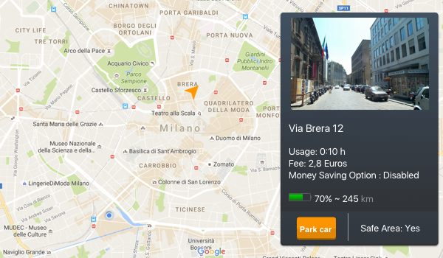
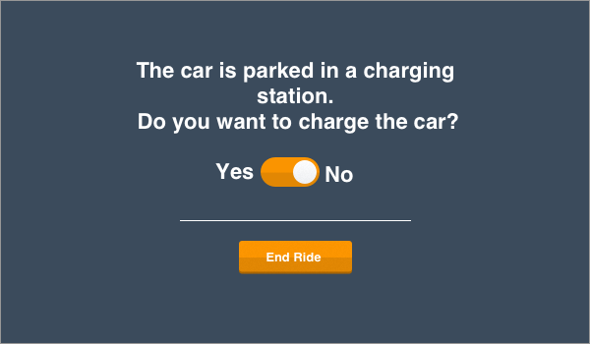
APPLICATIONS – On-Board example
Main navigation page
End ride with charging option

Slide 11
APPLICATIONS – Back-End
Addressed towards the company’s employees.
Implements the main business logic of the system
Functionalities:
Manages user requests (search, booking ,parking ...)
Manages user data
- Manages the cars and charging stations
Manages database requests and interactions
Manages interaction with external payment system.
Must be expandable and easy to maintain.

Slide 12
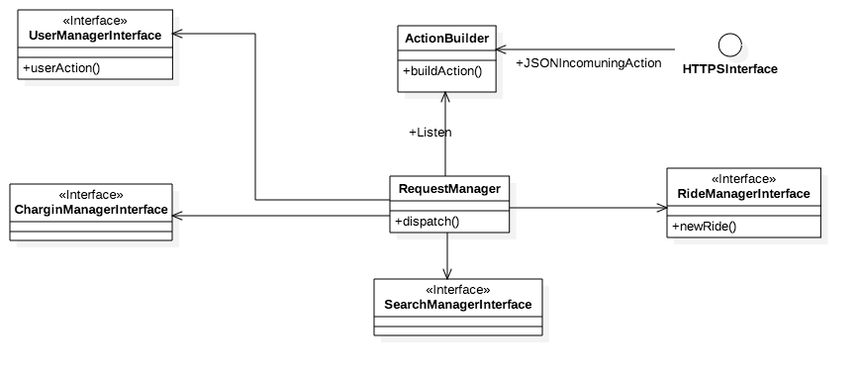
APPLICATIONS – Back-End example
User request handling

Slide 13
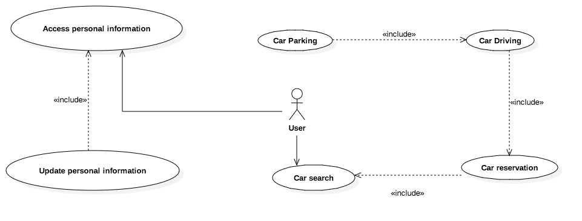
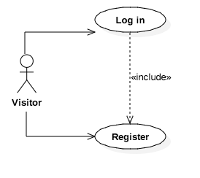
FUNCTIONAL REQ. & SCENARIOS
What must the system do in order to meet the goals and specifications? Uses case help explaining what each actor in the system should be able to do.
Note: the uses cases have been simplified to show only some of the
main functionalities

Slide 14
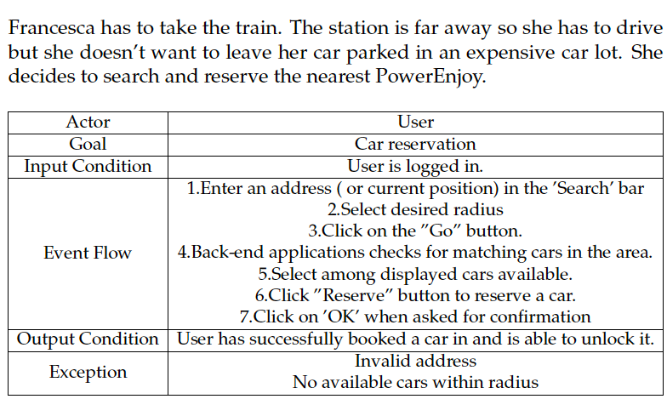
FUNCTIONAL REQ. & SCENARIOS
Scenarios help to understand how system functions are applied in the real world by future customers and why they have been selected to be implemented.
Functional requirement: Allow a registered user to make a reservation.

Slide 15
RASD: Final considerations
Considered most important part of the project development
Difficulties :
How is car charging achieved?
How are bonus/penalties assigned?
When should doors lock?
When should the car be listed as available again?
Can reservations be cancelled ?

Slide 16
2.DESIGN DOCUMENT
Purpose: give an overview of the system architecture and design styles and patterns.
High level architecture
Low Level Architecture
Algorithm Design

Slide 17
2.DESIGN DOCUMENT - Considerations
Take in account functional and non-functional requirements
How should the system behave ?
How can the system evolve ?
What happens in above average traffic situations ?
Is the data-storage fault tolerant ?
Is the system easily maintainable ?
Our choice: 3-Tier architecture

Slide 18
2.HIGH LEVEL ARCHITECTURE
Why 3-Tiers?
Advantages:
-Usual advantages of modular software
-Upgrade or replacement independently in response to changes in technology.
-Further middleware tiers easy to implement.
- Enhances data security.

Slide 19
2.HIGH LEVEL ARCHITECTURE
3-Tier Architecture
First Tier
Presentation
Minor functionalities
Second Tier
Core functionalities (Business Logic)
Non-persistent data storage
Third Tier
Persistent data storage
Back-up
HTTPS + REST + Firewall
SQL + JDBC

Slide 20
2.HIGH LEVEL ARCH. - Communication
First Tier -> Second Tier
HTTPS
Identity verification
Data Integrity
Firewall:
Additional low cost security layer
SQL:
Query RDB through well defined standard that allows high speeds
RESTful:
Stateless
Cacheable
Layered
JDBC:
Makes Java – DB connection easy and cost effective
Second Tier -> Third Tier

Slide 21
2.LOW LEVEL ARCHITECTURE
Subdivision in components and modules + communication
Done for each application ( client and server).
Use of design patterns and styles for efficiency :
Publish/Subscribe
Push

Slide 22
2.LOW LEVEL ARCHITECTURE - Example
Depending on their type , Actions are forwarded to a Server according to the Load-Balancer where the request is encapsulated in an object by the ActionBuilder.
+JSONOnRequest
The object is then managed by the RequestManager that is in charge of dispatching the request to the right component.
ActionBuilder
buildAction()
HTTPS Interface
RequestManager
dispatch()
SearchManager Interface
RideManager Interface
....
....
UserManager Interface

Slide 23
2. ALGORITHM DESIGN
Code written on Java EE platform for enterprise software development including network and web-services using Glassfish as application server.
General coding rules:
Encapsulation, inheritance and polymorphism.
Promote code reuse and follow common Design Patterns.
Document and comment code in order to promote simple refactoring and maintenance.
An example : Car Search Algorithm

Slide 24
2. ALGORITHM DESIGN- Example
/* Server-Side in Search Manager */
getAvailableCars(SearchData data){
List<VehicleManager> nearbyCars=new ArrayList<>();
Position p = data.getPosition();
Radius r = data.getRadius();
nerabyCars=queryPosManager(p,r);
notificationManager.send(“Message”,data,data.getUserDevice);
}
/* Server-Side in Position Manager */
getAvailableCarList(Position p , Radius r){
List<VehicleManager> cars = new ArrayList<>();
for(VehicleManager v : Vehicles){
if(distance(v.position(),p)<r && v.isAvailable())
cars.add(v);
}
return cars;

Slide 25
2. DD – Final considerations
Difficulties
Approach the development of the system architecture
Top down approach:
1.How many tiers and layers?
2.How do components interact?
3.What does each component do?
4. How does each component do its work?

Slide 26
3. INTEGRATION TEST PLAN
Purpose : provide a high level specific of integration tests along with a testing strategy and an overview of testing tools.
Entry criteria :
design and check unit tests
design and implementations of mocks/stubs
design and creation of test data

Slide 27
3. INTEGRATION STRATEGY
Functional grouping test strategy:
Modular : separate development of the system
Reduce number of mocks and stubs (similar to bottom-up)

Slide 28
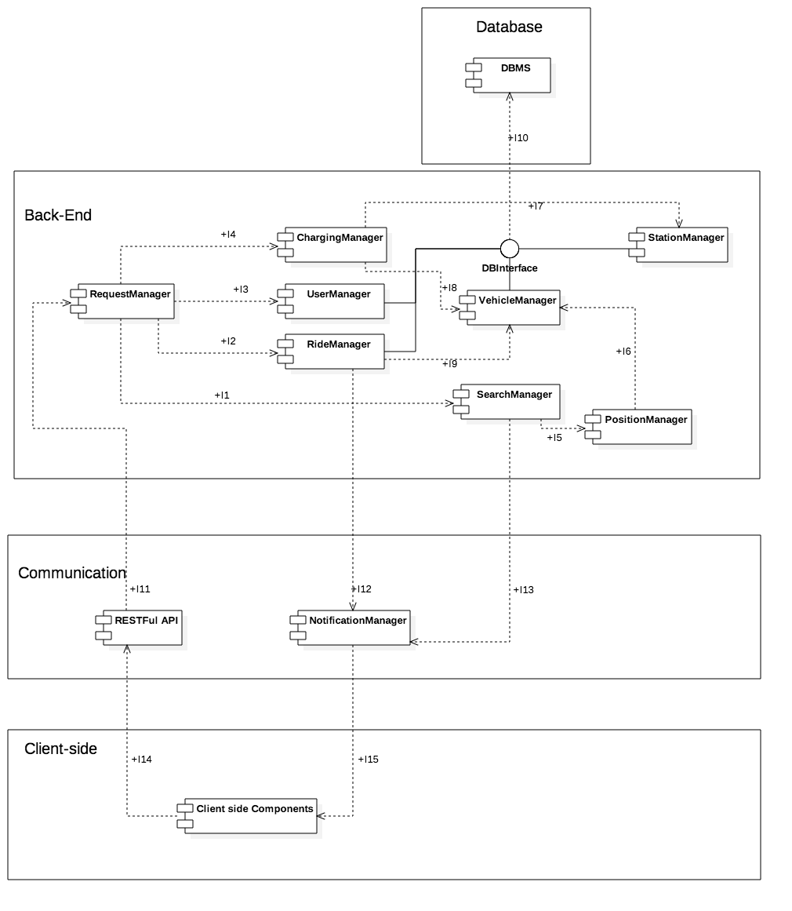
3. ELEMENTS TO BE INTEGRATED

Slide 29
3. ELEMENTS TO BE INTEGRATED

Slide 30
3. TESTING TOOLS AND EQUIPMENT
Manual Testing:
Client/Server requests
Arquillian+ JUnit & Mockito:
Integration test environment for Java EE components.
Creation of stubs and mocks

Slide 31
4. PROJECT PLANNING
Purpose: give an overview about project size, cost calculation ,tasks and resource allocation.
Overview:
Projects size, effort and costs ( Function Points & COCOMO II)
Tasks
Resource allocations
Risks

Slide 32
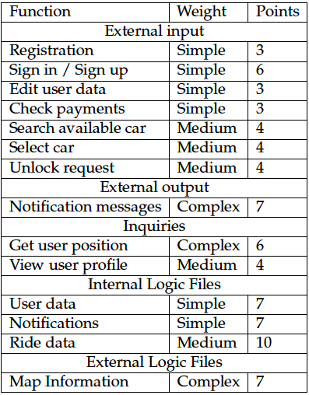
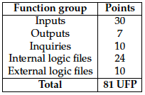
4. FUNCTION POINTS

Slide 33

4. COCOMO II
Effort in Person-Months
A = 2.94
SIZE = 81UFP x 53 = 4.293KLOC
E = 1.038
ΠEM = 0.624
Effort = 8.32 PM

Slide 34
4. TASKS
Gantt chart of the schedule:
Order | Task
1 | Requirements and specifications
2 | Software design
3 | Integration test planning
4 | Project planning
5 | Code inspection
 | 2016 |  |  | 2017
 | 10 | 11 | 12 | 01 | 02 | 03 | 04 | 05 | 06
RASD
DD
ITPD
PP
Code
Testing
100%
100%
100%
100%
0%
0%
Today

Slide 35
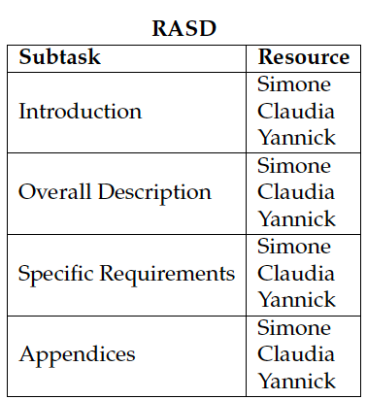
4. RESOURCE ALLOCATION - Example
Allocation of human resources to tasks :
Requirements & Specs are a crucial part of the project : everybody should work together in this phase of the project.

Slide 36
4. RISKS
Analyze risks of different nature :
Requirements flows
Architecture flows
Design flows
Forecast inaccuracies
External issues ( ex : legal issues )
User related issues
Each risk = probability of happening + possible solution
Example
Forecast inaccuracy : development requires more time than planned
Chance of happening: low
Solution: plan for more releases with limited functionalities

Slide 37
Q&A TIME
audience.ask(questions);

