Slide 1


POLITECNICO DI MILANO
A.A. 2016/2017
Amico Simone
Chianella Claudia
Giovanakis Yannick

Slide 2
PROJECT OVERVIEW
Requirements and Specifications Document
Design Document
Integration Test Plan Document
Project Plan Document
Code Inspection Document

Slide 3
1.REQUIREMENTS AND SPECIFICATIONS
Purpose: give an overview of requirements (functional and non-functional) analyzing needs of future costumers and stakeholders. Goals: what are the objectives of the system?
Applications : what must be developed?
Functional requirements & scenarios : what are the functionalities of the system and how can they be used in the real world?

Slide 4
1. GOALS
PRACTICAL & CONVENIENT: offer a price competitive and eco friendly solution that common public transport often can’t offer.
USER FRIENDLY: using the system must be intuitive and easy for every kind of potential user.
FAST:
- Search time : < 30s.
- Reservation time : < 1 min
AVAILABILITY: run as application on the most common mobile devices (phones, tablets ,computers ) but offer also a web page reachable from the most common browsers.

Slide 5
1. APPLICATIONS
Client-side applications:
Mobile application
Web applications
On-board application
Server-side application:
Back-end application

Slide 6
1. APPLICATIONS – Web & Mobile
Addressed towards the end users.
Accessible from any internet enabled devices.
Both offer the same core functionalities:
Manage user profile and user data
Search for a car
Reserve a car
User friendly intuitive graphic interfaces

Slide 7
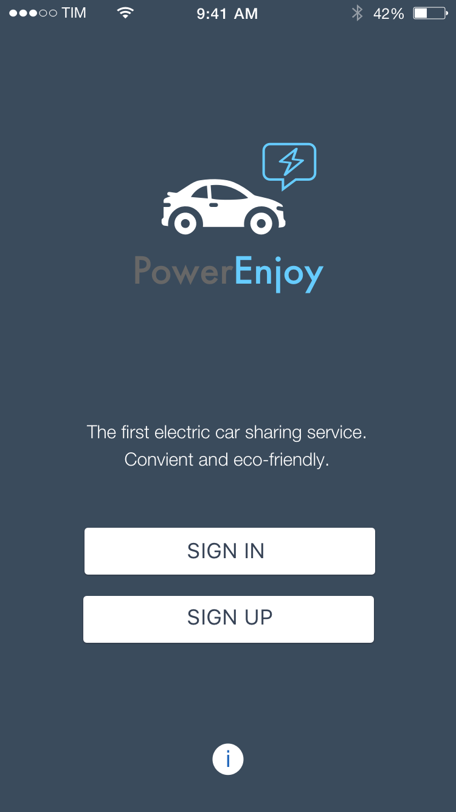
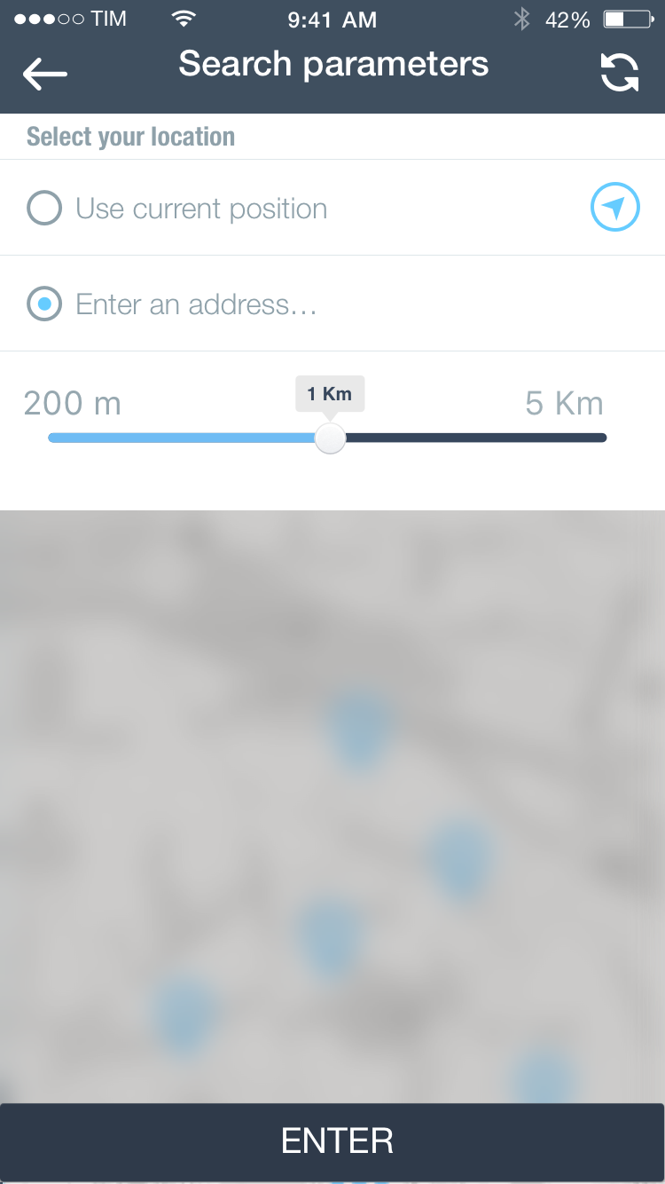
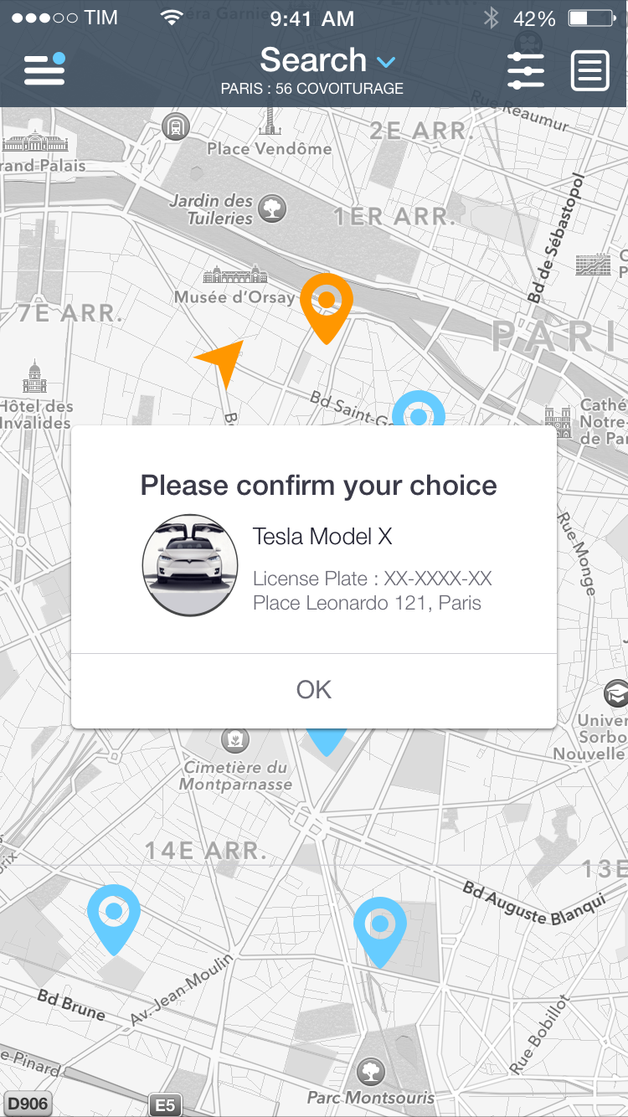
APPLICATIONS – Mobile example
Home
Car search
Confirm reservation

Slide 8
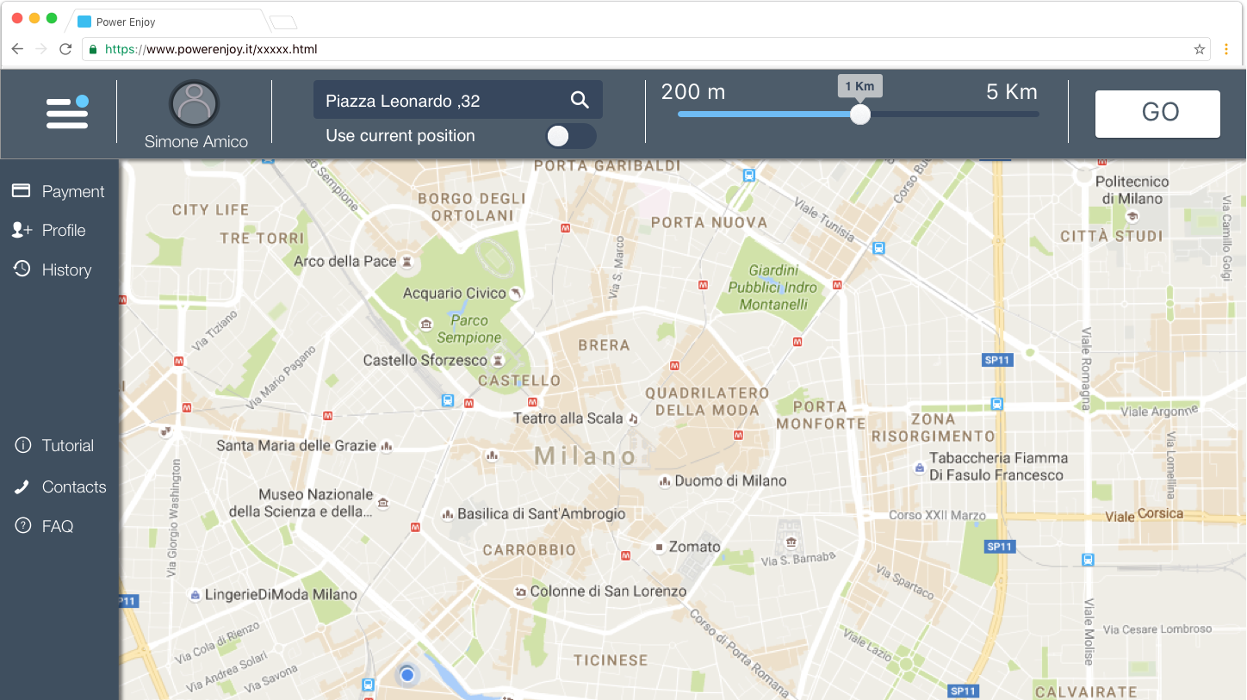
APPLICATIONS – Web example
Main page with side menu

Slide 9
APPLICATIONS – On-Board
Addressed towards the end users .
System always connected to the internet
Functionalities:
- User login
Navigation via Google API
Enable route preferences and money saving options.
- Show current car information
- Allow car charging
User friendly intuitive graphic interfaces

Slide 10
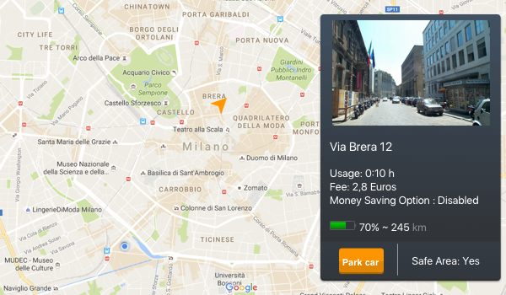
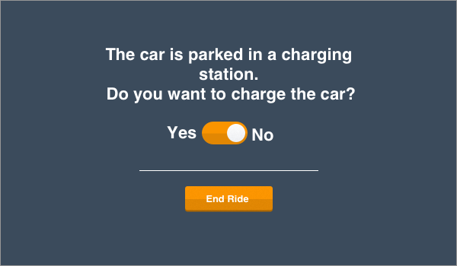
APPLICATIONS – On-Board example
Main navigation page
End ride with charging option

Slide 11
APPLICATIONS – Back-End
Addressed towards the company’s employees.
Implements the main business logic of the system
Functionalities:
Manages user requests (search, booking ,parking ...)
Manages user data
- Manages the cars and charging stations
Manages database requests and interactions
Manages interaction with external payment system.
Must be expandable and easy to maintain.

Slide 12
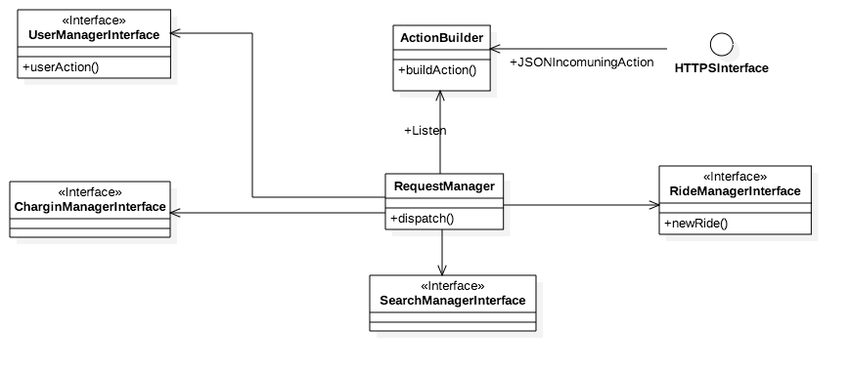
APPLICATIONS – Back-End example
User request handling

Slide 13
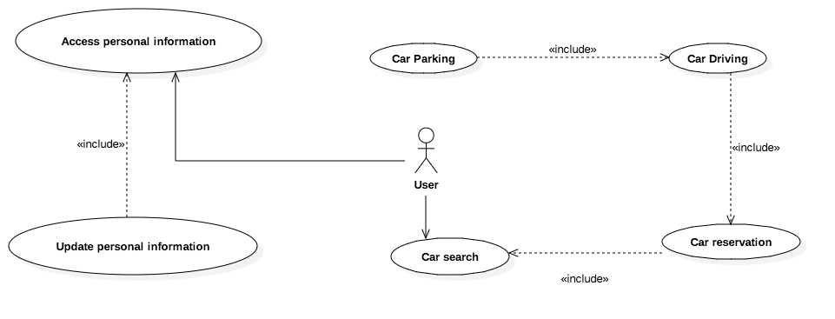
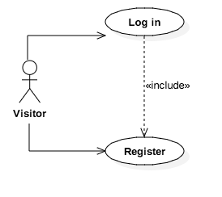
FUNCTIONAL REQ. & SCENARIOS
What must the system do in order to meet the goals and specifications? Uses case help explaining what each actor in the system should be able to do.
Note: the uses cases have been simplified to show only some of the
main functionalities

Slide 14
FUNCTIONAL REQ. & SCENARIOS
Scenarios help to understand how system functions are applied in the real world by future customers and why they have been selected to be implemented. INSERT QUA

