Slide 1

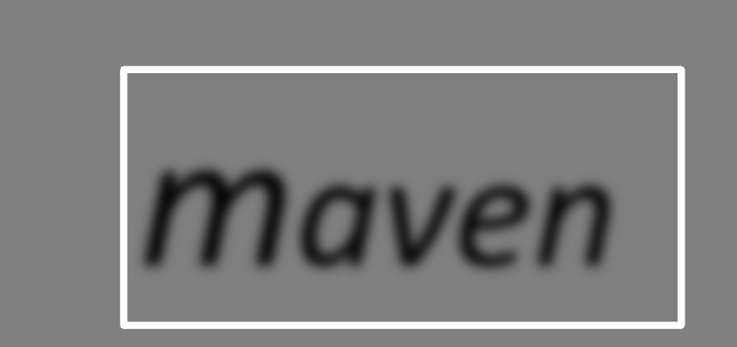

maven
Juven Xu Leijuan
http://www.juvenxu.com/
Tuesday, 2010-05-25

Slide 2





Juven Xu 许晓斌
南京大学
Nexus开发团队成员
维护Maven中央仓库
《Maven权威指南》
http://www.juvenxu.com/
juvenshun@gmail.com

Slide 3
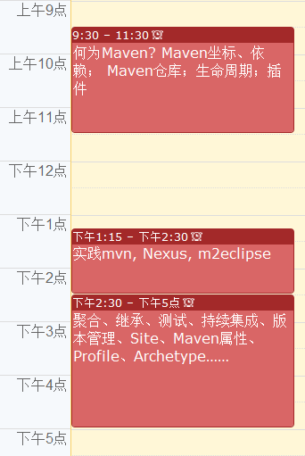


Slide 4

何为Maven？
答案1：构建工具
清理
编译
测试
报告
打包
部署
Ant
TARGET… : PREREQUISITE…
COMMAND
….
…
<?xml version="1.0"?>
<project name="Hello" default="compile">
<target name="compile" description="compile the Java source code to class files">
<mkdir dir="classes"/>
<javac srcdir="." destdir="classes"/>
</target>
<target name="jar" depends="compile" description="create a Jar file ">
<jar destfile="hello.jar">
<fileset dir="classes" includes="**/*.class"/>
<manifest>
<attribute name="Main-Class" value="HelloProgram"/>
</manifest>
</jar>
</target>
</project>
Make
IDE
Shell

Slide 5
理想的构建
高度自动化
跨平台
丰富的可重用组件
标准化

Slide 6

何为Maven？
答案2：依赖管理工具
log4j:log4j:1.2.15
log4j
org.springframework:spring-core:2.5
spring
org.apache.struts:struts-core:2.1.0
struts
… : … : …
…
…
中央仓库

Slide 7
何为Maven？
答案3：项目信息聚合
  版本控制系统信息，缺陷跟踪系统信息，开发者信息，许可证信息……
  项目站点：javadoc，测试覆盖，代码静态分析报告……

Slide 8
Maven核心概念
坐标
依赖
仓库
生命周期
插件

Slide 9
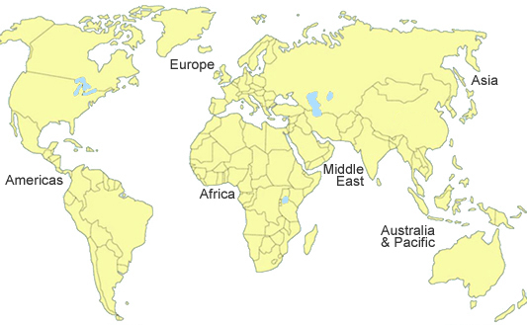
中国，杭州
120.2E ,30.3N

Slide 10
坐标
groupId: com.juvenxu.mvn-training
artifactId mvn-training-ppt (mvn-training-book …)
version 1.0 (2.0，3.0-SNAPSHOT …)
packaging jar (war …)
classifier javadoc, jdk15
com/juvenxu/mvn-training/mvn-training-ppt/1.0/mvn-training-ppt-1.0.jar

Slide 11
坐标
<?xml version="1.0" encoding="UTF-8"?>
<project>
<modelVersion>4.0.0</modelVersion>
<groupId>junit</groupId>
<artifactId>junit</artifactId>
<version>4.6</version>
<name>JUnit</name>
<url>http://junit.org</url>
<description>
JUnit is a regression testing framework written by Erich Gamma and Kent Beck. It is used by the developer who implements unit tests in Java.
</description>
<!– 其它元素…-->
</project>

Slide 12
依赖
<project>
...
<dependencies>
<dependency>
<groupId>log4j</groupId>
<artifactId>log4j</artifactId>
<version>1.2.15</version>
</dependency>
<dependency>
<groupId>junit</groupId>
<artifactId>junit</artifactId>
<version>3.8.1</version>
<scope>test</scope>
</dependency>
<dependency>
<groupId>javax.servlet</groupId>
<artifactId>servlet-api</artifactId>
<version>2.4</version>
<scope>provided</scope>
</dependency>
</dependencies>
...
</project>
中央仓库

Slide 13
依赖范围
依赖范围（Scope） | 对于主代码classpath有效 | 对于测试代码classpath有效 | 被打包，对于运行时classpath有效 | 例子
compile | Y | Y | Y | log4j
test | - | Y | - | junit
provided | Y | Y | - | servlet-api
runtime | - | - | Y | JDBC Driver Implementation

Slide 14
传递性依赖
commons-logging
my-app
spring-core
junit
commons-collections
使用spring-core的时候，不用考虑spring-core依赖了什么
万一出现问题的时候，不得不去了解spring-core依赖了什么

Slide 15
依赖调解
原则一：最短路径优先
原则二：第一声明者优先
c
d 1.0
my-app
a
b
d0.9

Slide 16

依赖相关技巧
依赖归类
排除传递性依赖
<project>
…
<properties>
<spring.version>2.5</spring.version>
</properties>
...
<dependencies>
<dependency>
<groupId>org.springframework</groupId>
<artifactId>spring-core</artifactId>
<version>${spring.version}</version>
</dependency>
<dependency>
<groupId>org.springframework</groupId>
<artifactId>spring-context</artifactId>
<version>${spring.version}</version>
</dependency>
<dependency>
<groupId>org.springframework</groupId>
<artifactId>spring-aop</artifactId>
<version>${spring.version}</version>
</dependency>
</dependencies>
...
</project>
<project>
…
<dependencies>
<dependency>
<groupId>org.hibernate</groupId>
<artifactId>hibernate</artifactId>
<version>3.2.5.ga</version>
<exclusions>
<exclusion>
<groupId>javax.transaction</groupId>
<artifactId>jta</artifactId>
</exclusion>
</exclusions>
</dependency>
<dependency>
<groupId>org.apache.geronimo.specs</groupId>
<artifactId>geronimo-jta_1.1_spec</artifactId>
<version>1.1</version>
</dependency>
</dependencies> ...
</project>

Slide 17

Dependency Management
父项目
<project>
<modelVersion>4.0.0</modelVersion>
<parent>
<groupId>com.juvenxu.training</groupId>
<artifactId>training-parent</artifactId>
<version>1.0.0</version>
</parent>
<artifactId>training-ppt</artifactId>
<dependencies>
<dependency>
<groupId>mysql</groupId>
<artifactId>mysql-connector-java</artifactId>
</dependency>
</dependencies>
</project>
<project>
<modelVersion>4.0.0</modelVersion>
<groupId>com.juvenxu.training</groupId>
<artifactId>training-parent</artifactId>
<version>1.0.0</version>
...
<dependencyManagement>
<dependencies>
<dependency>
<groupId>mysql</groupId>
<artifactId>mysql-connector-java</artifactId>
<version>5.1.6</version>
</dependency>
</dependencies>
</dependencyManagement>
...
</project>
子项目
training-doc
training-ppt

Slide 18


依赖分析
mvn dependency:analyze
[INFO] [dependency:analyze]
[WARNING] Used undeclared dependencies found:
[WARNING] javax.persistence:persistence-api:jar:1.0:compile
[WARNING] Unused declared dependencies found:
[WARNING] org.hibernate:hibernate-annotations:jar:3.3.0.ga:compile
[WARNING] org.hibernate:hibernate:jar:3.2.5.ga:compile
[WARNING] junit:junit:jar:3.8.1:test
mvn dependency:tree
[INFO] [dependency:tree]
[INFO] org.sonatype.mavenbook.optimize:simple-model:jar:1.0
[INFO] +- org.hibernate:hibernate-annotations:jar:3.3.0.ga:compile
[INFO] | - javax.persistence:persistence-api:jar:1.0:compile
[INFO] +- org.hibernate:hibernate:jar:3.2.5.ga:compile
[INFO] | +- net.sf.ehcache:ehcache:jar:1.2.3:compile
[INFO] | +- commons-logging:commons-logging:jar:1.0.4:compile
[INFO] | +- asm:asm-attrs:jar:1.5.3:compile
[INFO] | +- dom4j:dom4j:jar:1.6.1:compile
[INFO] | +- antlr:antlr:jar:2.7.6:compile
[INFO] | +- cglib:cglib:jar:2.1_3:compile
[INFO] | +- asm:asm:jar:1.5.3:compile
[INFO] | - commons-collections:commons-collections:jar:2.1.1:compile
[INFO] - junit:junit:jar:3.8.1:test

Slide 19
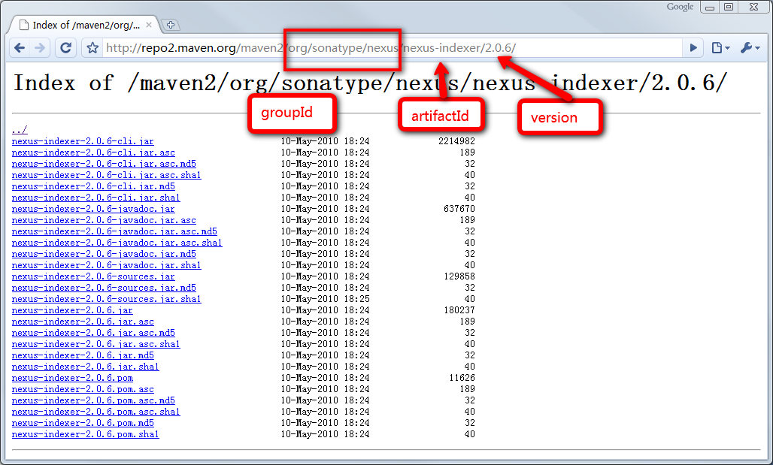
仓库（Repository）

Slide 20

仓库（Repository）
远程仓库
本地仓库
中央仓库
远程仓库
http://repo1.maven.org/maven2/
~/.m2/repository
Project A
Project B
Project …
默认的，本地所有Maven项目都复用一个本地仓库
本地仓库从远程仓库（可配置）下载必要的构件
中央仓库是唯一内置的远程仓库

Slide 21
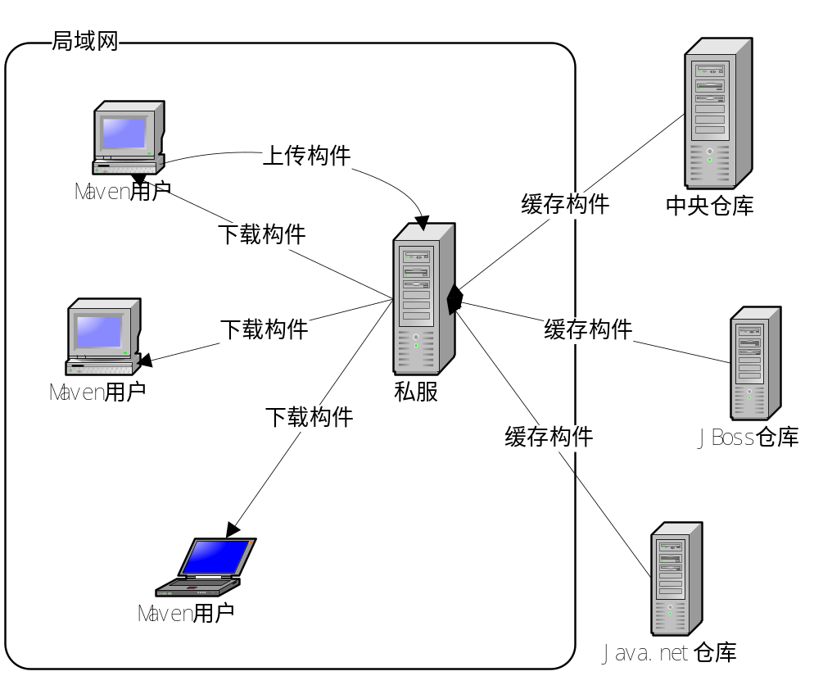
私服
节省外网带宽
加速Maven构建
部署第三方构件
提高稳定性，增强控制
降低中央仓库负荷

Slide 22
<project>
...
<repositories>
<repository>
<id>maven-net-cn</id>
<name>Maven China Mirror</name>
<url>http://maven.net.cn/content/groups/public/</url>
<releases>
<enabled>true</enabled>
</releases>
<snapshots>
<enabled>false</enabled>
</snapshots>
</repository>
</repositories>
<pluginRepositories>
<pluginRepository>
<id>maven-net-cn</id>
<name>Maven China Mirror</name>
<url>http://maven.net.cn/content/groups/public/</url>
<releases>
<enabled>true</enabled>
</releases>
<snapshots>
<enabled>false</enabled>
</snapshots>
</pluginRepository>
</pluginRepositories>
...
</project>
添加远程仓库
更改本地库位置
<settings>
...
<localRepository>D:\java\repository</localRepository>
...
</settings>
~/.m2/settings.xml
怎么使用远程仓库呢？

Slide 23
<!-- in pom.xml -->
<distributionManagement>
<repository>
<id>your-id-releases</id>
<name>Your Staging Repository</name>
<url>http://oss.sonatype.org/service/local/staging/deploy/maven2/</url>
</repository>
<snapshotRepository>
<id>your-id-snapshots</id>
<name>Your Snapshot Repository</name>
<url>http://oss.sonatype.org/content/repositories/your-id-snapshots/</url>
</snapshotRepository>
</distributionManagement>
release/snapshot对应不同仓库地址
<!-- in settings.xml -->
<settings>
...
<servers>
...
<server>
<id>your-id-releases</id>
<username>***</username>
<password>***</password>
</server>
<server>
<id>your-id-snapshots</id>
<username>***</username>
<password>***</password>
</server>
</servers>
...
</settings>
认证信息
现在分享我的东西！

Slide 24
镜像
<settings>
...
<mirrors>
<mirror>
<id>maven.net.cn</id>
<name>one of the central mirrors in China</name>
<url>http://maven.net.cn/content/groups/public/</url>
<mirrorOf>central</mirrorOf>
</mirror>
</mirrors>
...
</settings>

Slide 25

<settings>
...
<mirrors>
<mirror>
<id>nexus</id>
<mirrorOf>*</mirrorOf>
<url>http://localhost:8081/nexus/content/groups/public</url>
</mirror>
</mirrors>
<profiles>
<profile>
<id>nexus</id>
<repositories>
<repository>
<id>central</id>
<url>http://central</url>
<releases><enabled>true</enabled></releases>
<snapshots><enabled>true</enabled></snapshots>
</repository>
</repositories>
<pluginRepositories>
<pluginRepository>
<id>central</id>
<url>http://central</url>
<releases><enabled>true</enabled></releases>
<snapshots><enabled>true</enabled></snapshots>
</pluginRepository>
</pluginRepositories>
</profile>
</profiles>
<activeProfiles>
<activeProfile>nexus</activeProfile>
</activeProfiles>
...
</settings>
只使用私服

Slide 26



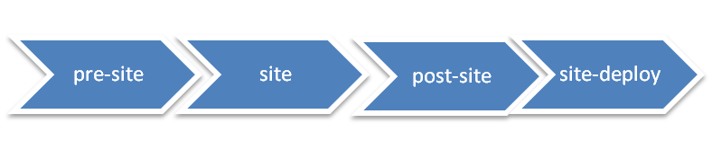


生命周期
mvn clean install
mvn test
mvn site
三套生命周期（clean, default, site）相互独立
一套生命周期中，生命周期阶段前后依赖
mvn 命令指向生命周期阶段

Slide 27

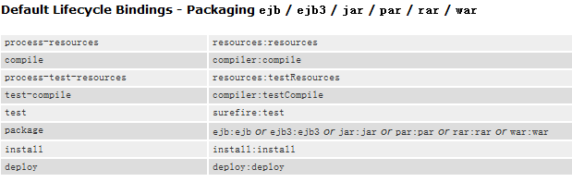
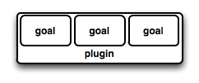

Maven插件
Maven本身是一个框架，实际的任务都由插件完成
插件与生命周期阶段绑定，用户通过指定生命周期阶段就能够隐式的通过插件执行任务
打包类型(packaging)控制default生命周期与插件目标(plugin goal)的绑定

Slide 28
生命周期和插件绑定
Default
…
maven-compiler-plugin
compile
compile
…
…
…

Slide 29
内置绑定
生命周期阶段 | 插件目标 | 执行任务
process-resources | maven-resources-plugin:resources | 复制主资源文件至主输出目录
compile | maven-compiler-plugin:compile | 编译主代码至主输出目录
process-test-resources | maven-resources-plugin:testResources | 复制测试资源文件至测试输出目录
test-compile | maven-compiler-plugin:testCompile | 编译测试代码至测试输出目录
test | maven-surefire-plugin:test | 执行测试用例
package | maven-jar-plugin:jar | 创建项目jar包
install | maven-install-plugin:install | 将项目输出构件安装到本地仓库
deploy | maven-deploy-plugin:deploy | 将项目输出构件部署到远程仓库

Slide 30
自定义绑定
<build>
<plugins>
<plugin>
<groupId>org.apache.maven.plugins</groupId>
<artifactId>maven-source-plugin</artifactId>
<version>2.1.1</version>
<executions>
<execution>
<id>attach-sources</id>
<phase>verify</phase>
<goals>
<goal>jar-no-fork</goal>
</goals>
</execution>
</executions>
</plugin>
</plugins>
</build>

Slide 31
配置插件
命令行： $ mvn help:describe -Dcmd=compiler:compile
插件全局：
插件任务：
<plugin>
<groupId>org.apache.maven.plugins</groupId>
<artifactId>maven-compiler-plugin</artifactId>
<configuration>
<source>1.5</source>
<target>1.5</target>
</configuration>
</plugin>
<plugin>
<artifactId>maven-antrun-plugin</artifactId>
<executions>
<execution>
<phase>validate</phase>
<goals>
<goal>run</goal>
</goals>
<configuration>
<tasks>
<echo>Hi, Ant Run!</echo>
</tasks>
</configuration>
</execution>
</executions>
</plugin>
类似的，我们可以在父POM中使用<dependencyManagement>配置插件，然后在子POM中简单通过groupId和artifactId使用

Slide 32

Nexus
mvn
m2eclipse

Slide 34
多模块&继承
多模块
multi-module
继承
inheritance
<modules>
<module>module-a</module>
<module>module-b</module>
<module>module-c</module>
</modules>
<parent>
<groupId>com.juvenxu.training</groupId>
<artifactId>training-parent</artifactId>
<version>1.0</version>
</parent>

Slide 35
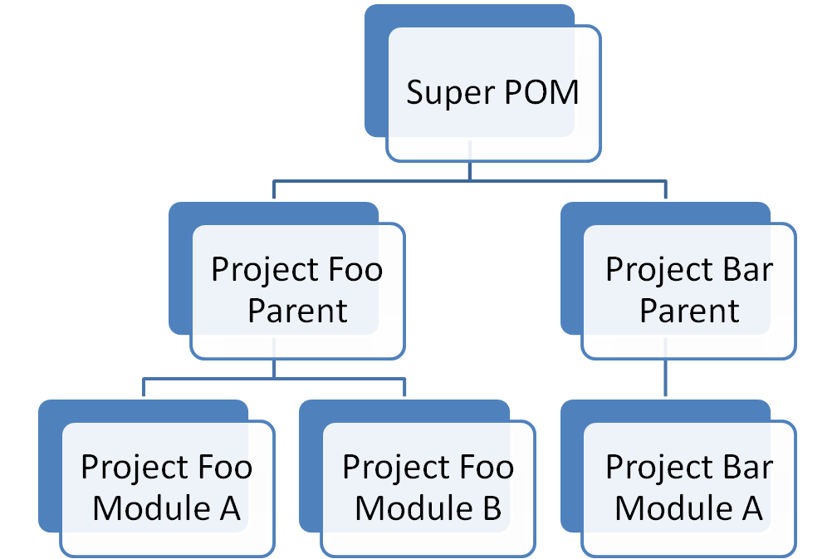
继承
目的:复用配置
目录结构不一定要遵循继承结构
隐式
<parent>
<groupId>com.juvenxu.training</groupId>
<artifactId>training-parent</artifactId>
<version>1.0</version>
<relativePath>../training-parent/pom.xml</relativePath>
</parent>
显式

Slide 36

Super POM
<pluginManagement>
<plugins>
<plugin>
<artifactId>maven-antrun-plugin</artifactId>
<version>1.3</version>
</plugin>
<plugin>
<artifactId>maven-assembly-plugin</artifactId>
<version>2.2-beta-2</version>
</plugin>
<plugin>
<artifactId>maven-clean-plugin</artifactId>
<version>2.2</version>
</plugin>
<plugin>
<artifactId>maven-compiler-plugin</artifactId>
<version>2.0.2</version>
</plugin>
<plugin>
<artifactId>maven-dependency-plugin</artifactId>
<version>2.0</version>
</plugin>
<plugin>
<artifactId>maven-deploy-plugin</artifactId>
<version>2.4</version>
</plugin>
…
…
</pluginManagement>
</build>
<repositories>
<repository>
<id>central</id>
<name>Maven Repository Switchboard</name>
<layout>default</layout>
<url>http://repo1.maven.org/maven2</url>
<snapshots>
<enabled>false</enabled>
</snapshots>
</repository>
</repositories>
<build>
<directory>${project.basedir}/target</directory>
<outputDirectory>${project.build.directory}/classes</outputDirectory>
<finalName>${project.artifactId}-${project.version}</finalName>
<testOutputDirectory>${project.build.directory}/test-classes</testOutputDirectory>
<sourceDirectory>${project.basedir}/src/main/java</sourceDirectory>
<!-- TODO: MNG-3731 maven-plugin-tools-api < 2.4.4 expect this to be relative... -->
<scriptSourceDirectory>src/main/scripts</scriptSourceDirectory>
<testSourceDirectory>${project.basedir}/src/test/java</testSourceDirectory>
<resources>
<resource>
<directory>${project.basedir}/src/main/resources</directory>
</resource>
</resources>
<testResources>
<testResource>
<directory>${project.basedir}/src/test/resources</directory>
</testResource>
</testResources>

Slide 37
Company POM
维护一个公司（组织）级别的POM，供所有项目继承
  固定常用插件版本
  固定常用插件配置，如maven-compiler-plugin支持java 1.5
  项目部署地址（结合Nexus）

Slide 38
多模块
目的：聚合构建，Maven build父模块的时候，会自动build子模块
父模块的packaging必须为POM
<groupId>..
<artifactId>…
<version>…
<packaging>pom</packaging>
<modules>
<module>module-a</module>
<module>module-b</module>
<module>../module-o</module>
</modules>
相对文件路径，
并非一定要父子结构

Slide 39
反应堆
在一个多模块的Maven项目中，反应堆（Reactor）是指所有模块组成的一个构建结构，对于单模块的项目，反应堆就是该模块本身，但对于多模块项目来说，反应堆就包含了各模块之间继承与依赖的关系，从而能够自动计算出合理的模块构建顺序。
裁剪反应堆
  -am, --also-make 同时构建所列模块的依赖模块
  -amd, -- also-make-dependents 同时构建依赖于所列模块的模块
  -pl, --projects <arg> 构建指定的模块，模块间用逗号分隔
  -rf , --resume-from <arg> 从指定的模块回复反应堆

Slide 40
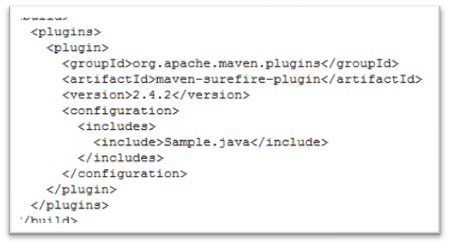
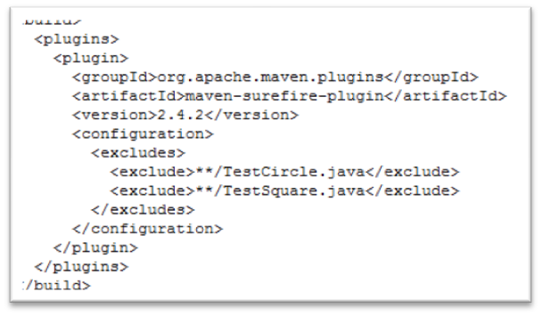
测试 (maven-surefire-plugin)
唯一的目标surefire:test与生命周期阶段test 绑定
测试报告：${basedir}/target/surefire-reports
默认运行的测试类
  **/Test*.java
  **/*Test.java
  **/*TestCase.java
包含和排除测试
跳过测试
  mvn test -DskipTests
  mvn test -Dmaven.test.skip=true （同时跳过编译测试）
单独运行某个测试
  mvn test -Dtest=SquareTest
  mvn test -Dtest=List*Test
  mvn test -Dtest=SquareTest,List*Test

Slide 41
重用测试代码
默认的，测试代码不会被打包
依赖之
生成测试代码包
<dependencies>
<dependency>
<groupId>com.myco.app</groupId>
<artifactId>foo</artifactId>
<version>1.0-SNAPSHOT</version>
<type>test-jar</type>
<scope>test</scope>
</dependency>
</dependencies>
<plugin>
<groupId>org.apache.maven.plugins</groupId>
<artifactId>maven-jar-plugin</artifactId>
<version>2.2</version>
<executions>
<execution>
<goals>
<goal>test-jar</goal>
</goals>
</execution>
</executions>
</plugin>

Slide 42
Maven的版本规范
1.3.4-beta-2
<主版本>.<次版本>.<增量版本>-<限定符>
1.0.0-SNAPSHOT & 1.4.1-20091030-124744-108
  处于开发中的不稳定版本
  方便及时的获得团队其它模块的状态
  Maven自动更新(by day)，强制更新： -U
  原则：不要依赖任何外部构建的SNAPSHOT版本
主要版本发布
相对次要版本发布
重要Bug修复
里程碑版本，alpha, beta…

Slide 43
版本发布
1.0-SNAPSHOT
1.0
1.1-SNAPSHOT
1.1
1.2-SNAPSHOT
所有自动化测试应当全部通过。
项目没有配置任何快照版本的依赖。
项目没有配置任何快照版本的插件。
项目所包含的代码已经全部提交到版本控制系统中。

Slide 44

maven-release-plugin
如何发布版本？
  (trunk) 1.0-SNAPSHOT -> 1.0
  tag 1.0
  (trunk) 1.0 -> 1.0-SNAPSHOT
  签出1.0，构建并部署至仓库
4
1
mvn release:prepare
<scm>
<connection>scm:svn:http://localhost/svn/myapp/trunk/</connection>
<developerConnection>scm:svn:https://localhost/svn/myapp/trunk/</developerConnection>
</scm>
5
mvn release:perform
2
<distributionManagement>…
3
<plugin>
<groupId>org.apache.maven.plugins</groupId>
<artifactId>maven-release-plugin</artifactId>
<version>2.0-beta-7</version>
<configuration>
<tagBase>https://localhost/svn/myapp/tags/</tagBase>
</configuration>
</plugin>

Slide 45
Maven属性
POM. eg: ${project.version}
Settings. eg: ${settings. localRepository}
系统属性.
  Java内置: ${user.home}
  通过mvn命令行传入：mvn test -Dmaven.test.skip=true ${maven.test.skip}
环境变量. eg: ${env.M2_HOME}
自定义：
<properties>
<spring.version>2.5</spring.version>
<struts.version>2.0</struts.version>
</properties>
…
${spring.version}
….

Slide 46
Maven资源过滤
Super POM中定义的默认资源目录
  ${project.basedir}/src/main/resources
  ${project.basedir}src/test/resources
自定义资源目录（不推荐）
开启资源过滤
...
<resources>
<resource>
<directory>src/resource1</directory>
</resource>
<resource>
<directory>src/resource2</directory>
</resource>
<resource>
<directory>src/resource3</directory>
</resource>
</resources>
...
...
<resource>
<directory>src/main/resources</directory>
<filtering>true</filtering>
</resource>
...
/pom.xml
<properties>
<mysql.username>mysql-admin</mysql.username>
<mysql.password>mysql-pwd</mysql.password>
/target/classes/database.properties
mysql.username=mysql-admin
mysql.password=mysql-pwd
/src/main/resources/database.properties
mysql.username=${mysql.username}
mysql.password=${mysql.password}

Slide 47
Profile
开发环境
开发环境
-Pdev
测试环境
产品环境
测试环境
-Ptest
构建
产品环境
-Pproduction

Slide 48
Profile
定义Profile：POM/settings
激活Profile
<profiles>
<profile>
<build>
<defaultGoal>...</defaultGoal>
<finalName>...</finalName>
<resources>...</resources>
<testResources>...</testResources>
<plugins>...</plugins>
</build>
<reporting>...</reporting>
<modules>...</modules>
<dependencies>...</dependencies>
<dependencyManagement>...</dependencyManagement>
<distributionManagement>...</distributionManagement>
<repositories>...</repositories>
<pluginRepositories>...</pluginRepositories>
<properties>...</properties>
</profile>
</profiles>
方法一：命令行
mvn clean install –Pdev
方法二：默认激活 (settings.xml)
<activeProfiles>
<activeProfile>dev</activeProfile>
</activeProfiles>
方法三：系统属性
<profile>
<activation>
<property>
<name>environment</name>
<value>test</value>
</property>
</activation>
...
</profile>
其它方法：
操作系统
Java版本
文件是否存在
显示激活的Profile
mvn help:active-profiles

Slide 49
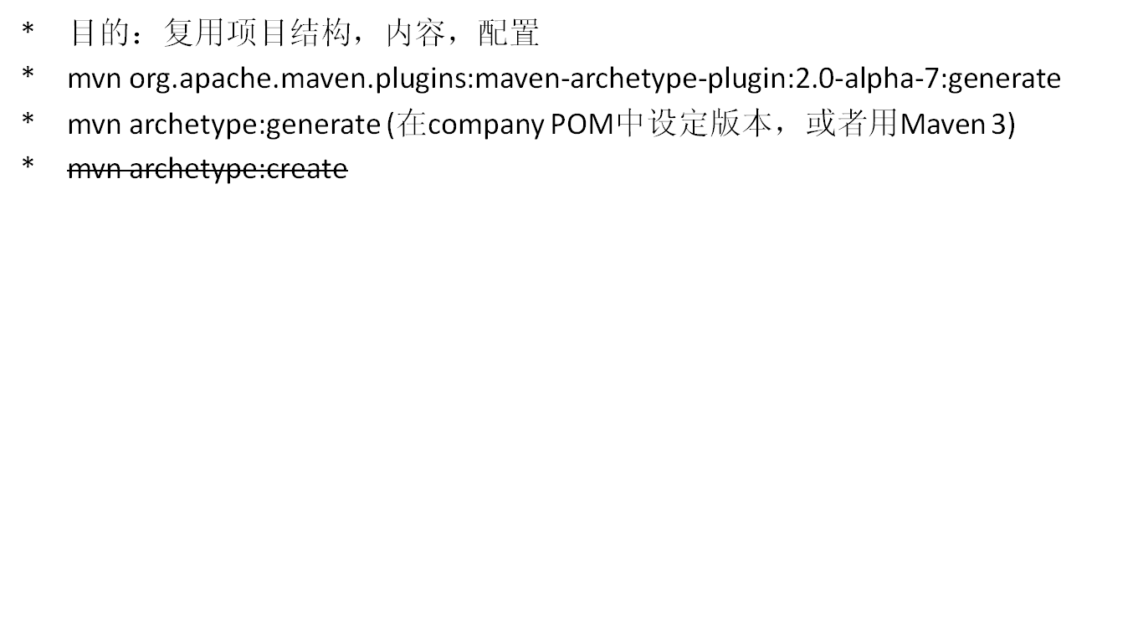
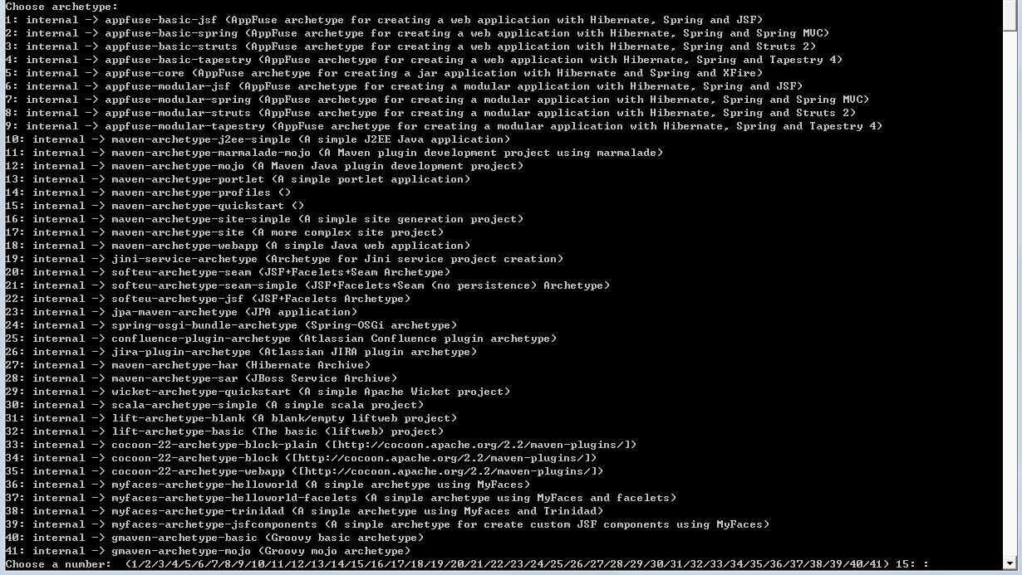
Archetype

Slide 50
制作Archetype
<project>
<modelVersion>4.0.0</modelVersion>
<groupId>com.juven</groupId>
<artifactId>training</artifactId>
<version>1.0-SNAPSHOT</version>
<project>
/pom.xml
/src/main/resources/archetype-resources/**
/src/main/resources/META-INF/maven/archetype-metadata.xml
/src/main/resources/archetype-resources/pom.xml
<archetype-descriptor name="sample">
<fileSets>
<fileSet filtered="true" packaged="true">
<directory>src/main/java</directory>
<includes>
<include>**/*.java</include>
</includes>
</fileSet>
<fileSet filtered="true" packaged="false">
<directory>src/main/resources</directory>
<includes>
<include>**/*.properties</include>
</includes>
</fileSet>
</fileSets>
</archetype-descriptor>
package ${package};
public class App
{
public static void main( String[] args )
{
System.out.println( "Hello Maven!" );
}
}
src/main/java/App.java
<project>
<modelVersion>4.0.0</modelVersion>
<groupId>${groupId}</groupId>
<artifactId>${artifactId}</artifactId>
<packaging>jar</packaging>
<version>${version}</version>
…
<project>
$ mvn archetype:generate \
-DarchetypeGroupId=com.juven \
-DarchetypeArtifactId=training \
-DarchetypeVersion=1.0-SNAPSHOT

Slide 51
高质量POM
正确的groupId, artifactId, version, packaging
name, description, url
SCM
license (open source)
Developers
签名： maven-gpg-plugin
Javadoc.jar
Sources.jar
满足上述条件的开源构件可同步至中央仓库
http://nexus.sonatype.org/oss-repository-hosting.html
Notes:
groupId：项目组或产品名称
开发人员：项目经理，系统分析师，程序员，测试人员

Slide 52
maven-enforcer-plugin
在父POM中定义一系列规则，以约束所有项目(模块)的一配置。
预定义规则
  bannedDependencies - enforces that excluded dependencies aren't included.
  evaluateBeanshell - evaluates a beanshell script.
  requireReleaseDeps - enforces that no snapshots are included as dependencies.
  requireReleaseVersion - enforces that the artifact is not a snapshot.
  requireMavenVersion - enforces the Maven version.
  requireJavaVersion - enforces the JDK version.
  requireOS - enforces the OS / CPU Archictecture.
  requirePluginVersions - enforces that all plugins have a specified version.
  requireProperty - enforces the existence and values of properties.
  requireFilesDontExist - enforces that the list of files do not exist.
  requireFilesExist - enforces that the list of files do exist.
  requireFilesSize - enforces that the list of files exist and are within a certain size range.
自定义规则
  创建一个Maven项目，实现EnforcerRule
  配置enforcer插件依赖我们的项目
  配置enforcer插件使用我们的规则

Slide 53
站点
1
<plugin>
<groupId>org.apache.maven.plugins</groupId>
<artifactId>maven-site-plugin</artifactId>
<version>2.1</version>
</plugin>
配置最新的site插件
2
<distributionManagement>
<site>
<id>local_nexus</id>
<url>dav:http://localhost:8081/nexus/content/sites/site/</url>
</site>
</distributionManagement>
配置站点发布地址
Id对应于settings.xml中的server认证配置
该例中，服务器需要支持dav协议
3
<reporting>
<plugins>
<plugin>
<groupId>org.apache.maven.plugins</groupId>
<artifactId>maven-changelog-plugin</artifactId>
<version>2.1</version>
</plugin>
</plugins>
</reporting>
配置需要的报告插件
官方插件列表： http://maven.apache.org/plugins/index.html
4
$ mvn clean site-deploy
构建并发布站点

Slide 54




maven

Slide 55
参考资料
Maven: The Definitive Guide: http://www.sonatype.com/books/maven-book/reference/public-book.html
Maven权威指南：http://www.sonatype.com/books/maven-book/reference_zh/public-book.html
Sonatype Blog: http://www.sonatype.com/people/
主要Maven插件列表：http://maven.apache.org/plugins/index.html
Maven中文博客：http://juvenshun.javaeye.com/
Maven中文讨论组：http://groups.google.com/group/maven-zh

