Slide 1
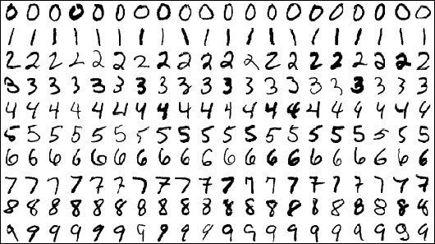
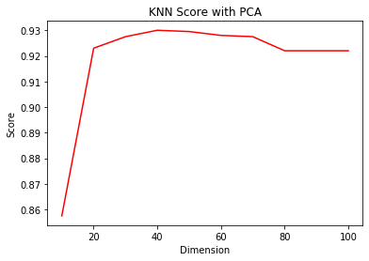
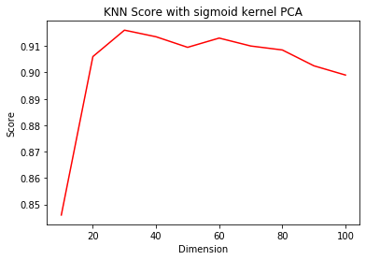
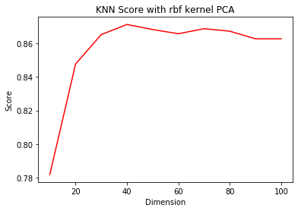
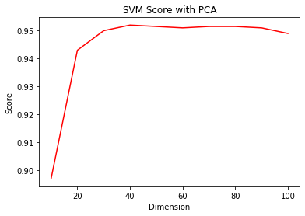
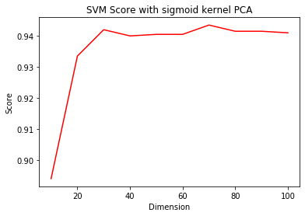
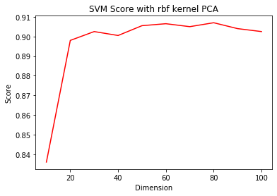
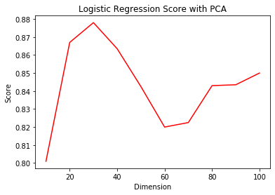
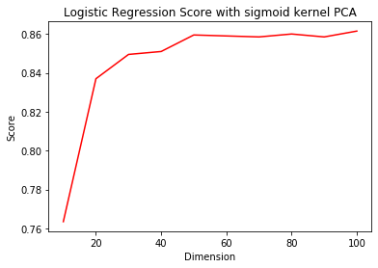
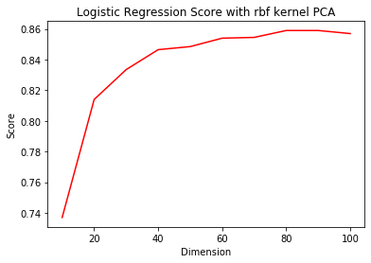
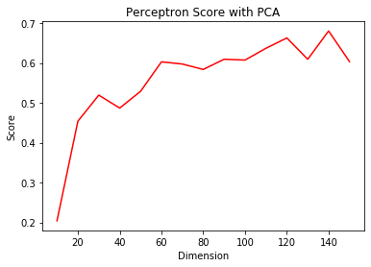
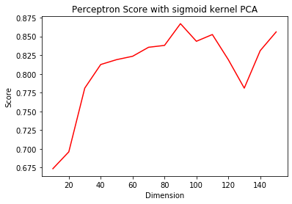
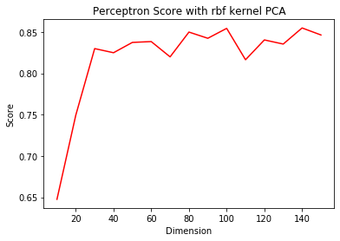
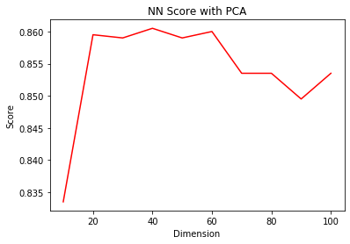
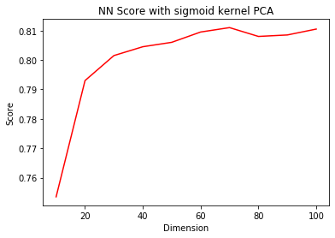
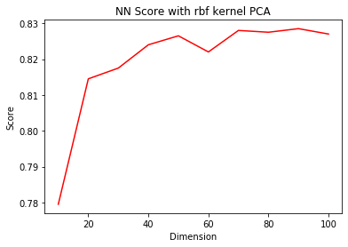
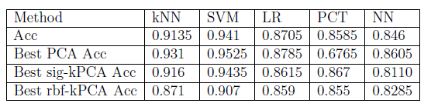

MNIST Digit Classification
Ce Zhang, Student No. 55542639
Yang Ji, Student No. 56064832
Objective
We have a hands on experience of MNIST handwritten digital classification task, which is a branch of supervised learning. Given 4,000 images of handwriting digits, the task is to learn images' corresponding digits from 2,000 training images and evaluate machine learning methods with the left 2,000 test images. The number of training set is much smaller than the traditional MNIST benchmark's, where the training set contains 60,000 images. This makes our problem more challenging.
Methodology
Experiment
Supervised Classication In this part, we consider to evaluate: (1) logistic
regression, (2) k-nearest-neighbor (kNN), (3) perceptron (4) SVM, (5) Simple Neural Net-
work.
Figure 3.1 KNN-PCA
Figure 3.2 KNN-SIG-PCA
Figure 3.2 KNN-RBF-PCA
Figure 3.1 KNN-PCA
Figure 3.2 KNN-SIG-PCA
Figure 3.2 KNN-RBF-PCA
Figure 3.3 SVM-PCA
Figure 3.4 SVM-SIG-PCA
Figure 3.6 SVM-RBF-PCA
Figure 1 MNIST Dataset Sample
Figure 3.3 SVM-PCA
Figure 3.4 SVM-SIG-PCA
Figure 3.6 SVM-RBF-PCA
Step 1: Feature Selection: PCA/kPCA, which is essentially a method that reduces the dimension of the feature space in such a way that new variables are orthogonal to each other.
Step 2: Supervised Classification. We consider to evaluate: (1) logistic regression, (2) k-nearest-neighbor (kNN), (3) perceptron (4) SVM, (5) Simple Neural Network.
Figure 3.7 LR-PCA
Figure 3.8 LR-SIG-PCA
Figure 3.9 LR-RBF-PCA
Figure 3.7 LR-PCA
Figure 3.8 LR-SIG-PCA
Figure 3.9 LR-RBF-PCA
Experiment Setup
Figure 3.10 P-PCA
Figure 3.11 P-SIG-PCA
Figure 3.12 P-RBF-PCA
All of the experiments of the classical machine learning methods (kNN, SVM, Logistic Regression, Perceptron) are implemented using Python and the scikit learn library. To
make things easier, these methods are evaluated in a single file test.py. Observing the datasets in digits4000 txt directory, there are total 4,000 images with corresponding labels. The training set and test set both include 2,000 images. All of the training tasks will be done with the 2,000 training images. For each of the classical methods, we first evaluate the method using the raw training set. Then, different dimension reduction techniques like PCA, kPCA will be applied to the
training set. Since the reduced dimension is a hyper -parameter, we test different dimensions and try to find the optimal one.
For simple Neural Network, we leverage the widely used Keras library, which is based on the Tensorflow framework. We set three layers of the Neural Network: (1) First layer is
the input layer and contains 500 neuron units with the ReLU activation function. (2) The second layer is the hidden layer, which also contains 500 neuron units and the activation
function is also ReLU. (3) The last layer is the output layer, with 10 units and softmax activation function.
Figure 3.10 P-PCA
Figure 3.11 P-SIG-PCA
Figure 3.12 P-RBF-PCA
Figure 3.13 NN-PCA
Figure 3.14 NN-SIG-PCA
Figure 3.15 NN-RBF-PCA
Figure 3.13 NN-PCA
Figure 3.14 NN-SIG-PCA
Figure 3.15 NN-RBF-PCA
Summary
Figure 4 Summary of Used Algorithms
Conclusion
Overall Performance: SVM > kNN > LR > PCT > NN
PCA can help improve the classification accuracy in the most cases, except Peceptron.
sig-kPCA can slightly improve the performance.
Unsuitable kernel PCA like rbf-kPCA might cause negative effects on most learning methods.

