Slide 1
Four in A Row
CS 271 – Final Project
Zeyu Su, Martin Mao, Yang Jiao

Slide 2
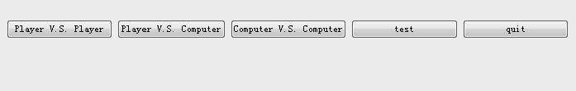
Game Description
Game Object
get four in a row.
player1 and player2 alternatively place their chesses until one player has 4 in a row or the board is entirely filled with pieces.
Available Choices
Player v.s. Player
Player v.s. Computer
Computer v.s. Computer

Slide 3
Game Description (Continued)
Strategic game
Adversary in Game
Ideal moves may be blocked
Very large branching factor of moves
Board size of 64
Not all moves will contribute anything
Good moves are deep, need to plan ahead
Because of nature of the game, obvious winning moves are easy to block. AI needs to plan ahead
Goal: To make a capable AI that can make moves in reasonable time
Make good moves that requiring planning ahead
Overcome speed issues of huge branching factor

Slide 4
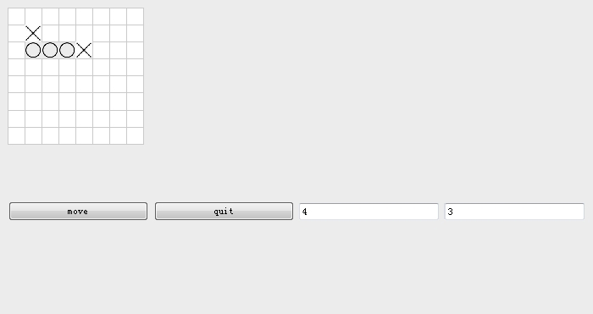
Game GUI

Slide 5
Utility Function
Utility function
Tiles next to existing moves are more ideal
A tile’s value increases the more tiles are in the vicinity
Need to chain tiles together to win
Value = # of same tiles distance 4 away on same row/col/diagonal
Minus # of non-empty tiles distance 4 away on same row/col/diagonal
However
Linear utility function not completely ideal. Winning moves need to have a higher value so that these moves are committed to first.
 |  |  |  |  | 1 | 1 | 1
 | X |  |  |  | 1 | X | 1 | 1
 |  |  |  |  | 1 | 1 | 1
 |  |  |  |  |  | 1 |  | 1
 |  |  |  |  | 2 | 1 | 2
 | X |  |  |  | 1 | X | 2 | 2
 |  | X |  |  | 2 | 2 | X | 1
 |  |  |  |  |  | 2 | 1 | 2
Notes:
This is the only the first version
Had to adjust winning moves and moves to block winning moves to have higher value, otherwise the AI will not pick them.
The AI may commit to a tile that has a very high value for a tile, even though there’s a winning move somewhere else.
It should also prioritize blocking a winning move (a move that has a negative value) which is does not look very obviously good

Slide 6
Algorithm
Implement an Iterative Deepening Search Tree with Alpha Beta Pruning
Maintain a variable called depth
and increase/decrease depth based on timing requirements
If there is extra time in the current search, then increase depth for next iteration, and run depth first search again.
If this search is taking too long, then decrease depth. The next move will use a search with a lower depth
Alpha beta pruning to speed up searches
Ignore searching the rest of the children in a branch if this branch is bad
Maintain a beta and alpha value in searching. If beta <= alpha, we know the adversary will attempt a very good move. Do not bother to expand the rest
Gives algorithm more time, allowing for a larger depth
Notes:
This allows the algorithm to search for good moves and plan ahead
Not make very obvious moves and also consider that the opponnent is making moves against them
Start with this DFS search with alpha beta pruning
Then if there’s extra time, redo search with depth = depth + 1
Else decrease depth for next turn

Slide 7
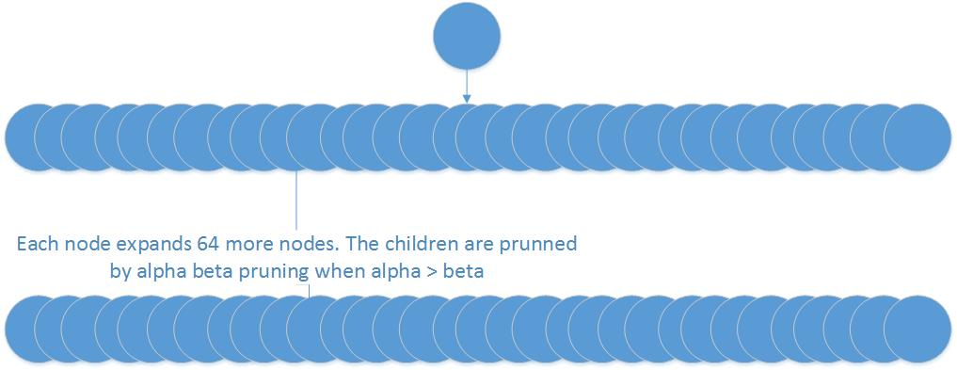
Algorithm
Notes:
This allows the algorithm to search for good moves and plan ahead
Not make very obvious moves and also consider that the opponnent is making moves against them
Start with this DFS search with alpha beta pruning
Then if there’s extra time, redo search with depth = depth + 1
Else decrease depth for next turn

Slide 8
Algorithm Speed Enhancements
Even with Alpha Beta Pruning, the algorithm is too slow when we want Iterative Deepening to increase the depth more
Not all tiles are good to search
Avoid branching on all of 64 tiles
Ignore illegal moves
Restrict branching to tiles near existing tiles. A distance of 3 away from existing tiles(since 4 moves needed to win)
By reducing branching factor, we are able to speed up algorithm. This gives it more time to evaluate better branches to a larger depth
However, time still grew exponentially as more moves are placed on board and more tiles become qualified for being distance 3 away
Notes:
When we completed algorithm, the algorithm was still too slow. Alpha beta prunning requires a deep search of all 64 initial children in order for the rest of the children to be pruned away.
We didn’t want to go deep into all possible 64 tiles. This will take too long when depth is huge
Modified search to only consider tiles that are 4 distance away from exisiting tiles. Placing a move that would not build up a combo to win didn’t seem obvious for victory.
This significantly reduced branching, so didn’t have to search all 64 tiles and only consider making moves that could combination for victory.

Slide 9
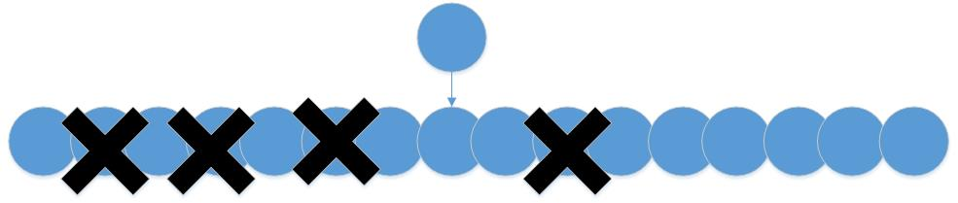
Algorithm Speed Enhancements
*Less than 64 children will be expanded.
Notes:
When we completed algorithm, the algorithm was still too slow. Alpha beta prunning requires a deep search of all 64 initial children in order for the rest of the children to be pruned away.
We didn’t want to go deep into all possible 64 tiles. This will take too long when depth is huge
Modified search to only consider tiles that are 4 distance away from exisiting tiles. Placing a move that would not build up a combo to win didn’t seem obvious for victory.
This significantly reduced branching, so didn’t have to search all 64 tiles and only consider making moves that could combination for victory.
However even this wasn’t good enough. Later in the game, there would be even more tiles on the board and more tiles are eligible to distance 4 away from exisiting tiles.
The threshold will grow with time and reduce branching factor.

Slide 10
Improving Utility Function
We were able to improve the cost function after running several instances of our initial AI
Tile location of the first move doesn’t matter too much
We can save time by starting the algorithm with a low depth value
Depth will increase on successive moves
Let depth increase with time, instead of decrease with time
Tile values needed to be improved
Original algorithm would increase tile values for nearby tiles of same color and decrease tile values for tiles of adversary’s color
This led to occasional bad moves of the AI where it would place tiles very far from its own tiles and from the adversary’s tiles
Revised Utility Function
Algorithm was adjusted to base tile values only it’s own color. Each tile thus had two values, it’s worth to the AI and it’s worth to the adversary
The value of each state was recalculated to the be sum of all tiles’ worth to AI minus the sum of all tiles’ worth to the adversary
Notes:
The revised function made it more appealing to place moves closer to own moves
After placing a move, the state resulting from that move would have higher values for the AI and because the tile is now occuppied, decrease the worth to the adversary

Slide 11
Result of New Utility Function
Before the algorithm wasn’t very good.
Values for some good moves and better moves were the same
Some bad moves looked more appealing than actual good moves
Modified algorithm now has have higher values for better moves
A move that helped make a 4 in a row for the AI AND blocks the opponent now seems better than a move that only makes a 4 in a row
Given
Better to do than
x
x
 | 0 | 0
x
x
x | 0 | 0
x
x
x
 | 0 | 0

Slide 12
Win Rate
Compared to Bad AI
Algorithm will always win against very bad AI, such as Random AI
It will also usually win against AI using only depth of 0
Depth 0 AI will not expand moves, but just find max of tile values and commit to max
Algorithm sometimes lost if made obvious winning chains. The depth 0 AI was smart enough to block the AI and become in the lead
Compared to Decent AI
Against our original AI with the original utility function, the algorithm was very good
This was because the original AI would make occasional very bad moves
Compared to Players
Compared to players, the algorithm would win sometimes, not often
It was very good at making plans that led to it’s own victory
Moves that allowed multiple possible winning moves
However it was bad at stopping Player’s strategy of making good plans
It can be easy to beat by players who plan ahead
AI did not make good blocking moves that could stop players early on

Slide 13
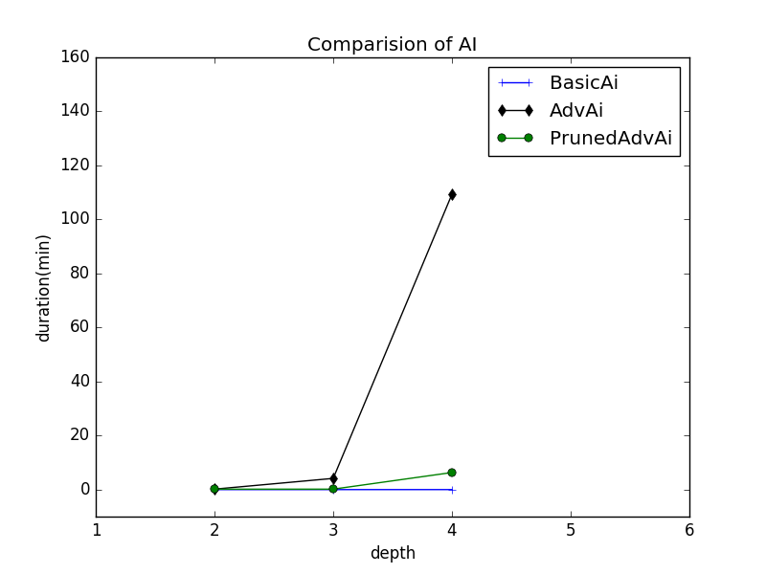
Timing Results
Timing
Very fast if depth does not increase too much
Without alpha beta pruning, going beyond depth 2 would take over a minute
Without speed ups or pruning, depth 2 took less than a minute, but depth 3 and more would take too long
Speeds up of reducing branch size allowed more depth within reasonable time
Algorithm was able to increase to depth 4 or 5
Removing speed ups would have made a high depth infeasible
64 possible tiles was a huge branching factor

Slide 14
Problems with the Algorithm
Although the algorithm was very good at trying to win
Very bad at stopping an opponent from winning if the opponent is going for a not obvious winning strategy plan
This could have been fixed by making our utility function more complicated
Trying to win appears better than trying to block, didn’t block often
Human players can search deeper for very good plans and strategies
AI was limited to search all strategies to the same depth
Searching a bad strategy takes time and the algorithm will not increase depth value when time is wasted

Slide 15
Conclusion
Early in the game, large depth has little deciding factor
Values do not fluctuate a lot when few pieces on board
Large depth matters more later in the game
Tile values will differ more as the game progresses
The best moves are not as obvious
Allowing depth to fluctuate and potentially increase will help the AI make smarter moves when needed
Alpha beta pruning and branch reduction are necessary
Branching factor of game is huge
AI’s moves will take too long when depth increases
Having deep searches is not enough
Utility function that is too simple makes okay and very good moves seem indifferent
Notes:
Making obvious winning moves wasn’t very good. The other player could easily block those moves. Whoever when we increase the depth of the searches, the AI would choose to rather make more tricky moves that allowed multiple winning moves. Being able to plan moves ahead has a large advantage.
Bad utility function will cause deep searches to be meaningless. If the utility function is not very good, then the good and better moves will have the same values. The AI will think they will have both just as good as the other and will not make the better move. The heuristic needs to be improved to better differentiate between what’s a good move and what is better or else having deep searches will not be as effective.

