Slide 1
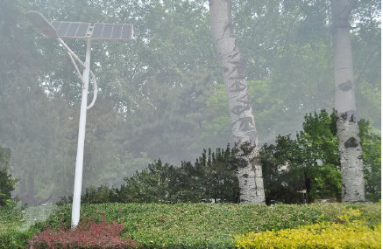
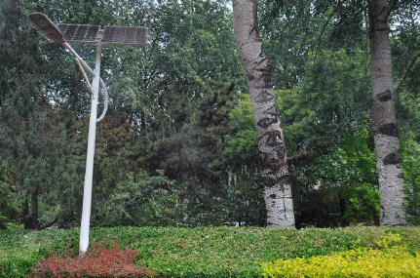

Alignment-invariant loss
Channel Context
Spatial Context
GAN loss
ERRNet

