Slide 1
Effect of Lunar Phase on Root Angle
Aaron Kusmec
Huimin Chen

Slide 2
The Data
Root angle taken every 3 min. over 3 hours (61 data points)
2 genotypes
B73
Mo17
2 camera setups
S2 for B73
S3 for Mo17
1-6 replicates per trial

Slide 3
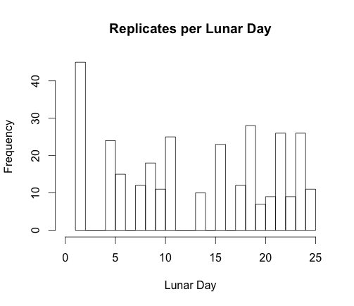
The Data
17 unique lunar days sampled across 3 lunar months
Lunar days were unevenly sampled
18.29 ± 9.97 replicates per lunar day (mean ± s.d.)

Slide 4
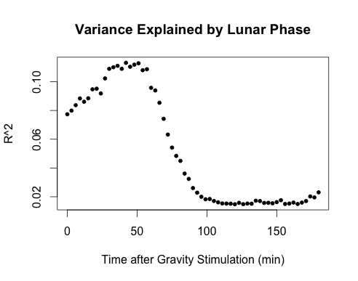
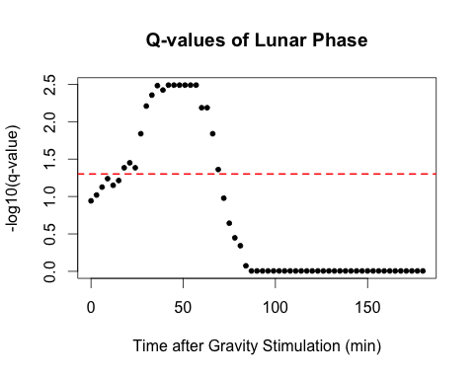
Effect of Lunar Phase on Root Angle
Angle = Lunar day + Genotype + Replicate(Genotype)
Lunar day = fixed effect
Genotype and replicate = random effects
Replicate nested by genotype
(Red line indicates FDR = 0.05.)
Thanks to Jinliang Yang for help with model specification.

Slide 5
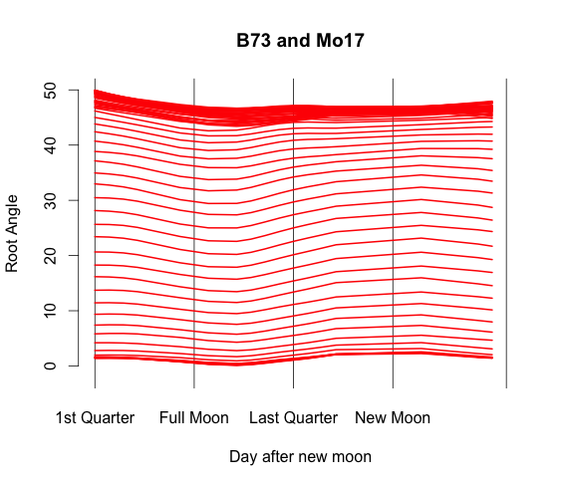
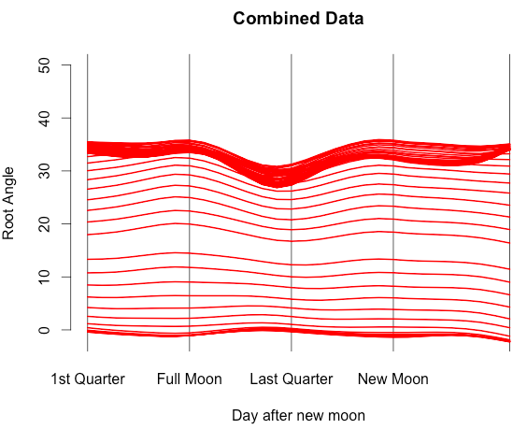
Comparison to Previous Analysis
B73/Mo17 show the same decrease in root angle as the NAM parents & diallel do (black arrows)
Not as well defined
Shifted closer to the full moon
NAM Parents & Diallel
(Jinliang Yang)

Slide 6
Summary
Evidence for an effect of lunar phase on root angle 18-63 min. after gravity stimulation (maximal right before 50 min.).
Lunar phase explains a maximum of ~11% of the variation in root angle.
A maximum of ~40% of the variation is accounted for by lunar phase, genotype, and replicate.

Slide 7
Summary
Timing and direction of the lunar phase effect are similar between the two analyses
Differences could be explained by
Fewer genotypes (2 vs. 235)
Fewer replicates (311 vs. 1,910)
Different distribution of trials across lunar days

Slide 8

Summary
Huimin Chen, a student in Schnable Lab at China Agricultural University, helped with this analysis.
Using these data, Huimin was introduced to
R statistical software
Data manipulation/formatting
Mixed linear model analysis

