Slide 1
SAM population GWAS plan
Hung-Ying Lin

Slide 2
For SNP GWAS plan
Reference SNP (R_SNP) GWAS
R_SNP + SNP_SAM_PAV
+ SNP_PlantCell_PAV GWAS
SNP haplotype GWAS
Specific allele
Combining strategy
Chunk

Slide 3
For Read Depth GWAS
RD GWAS
RD_haplotype GWAS
Specific allele
Combining strategy
Chunk

Slide 4
Large RNA-seq GWAS package
Is this possible to combine all the information
(Slide2 & 3) to build a automatically analysis package for researcher?

Slide 5
Phenotype data
SAM size
Stalk size, Brace root from Lisa
The ear height, Day to anthesis, Plant height
Data from Pfeiffer JA et al. (2014) Genetics, 196(4): 1337-56.
365 line overlap
Lignin content from Sarah

Slide 6
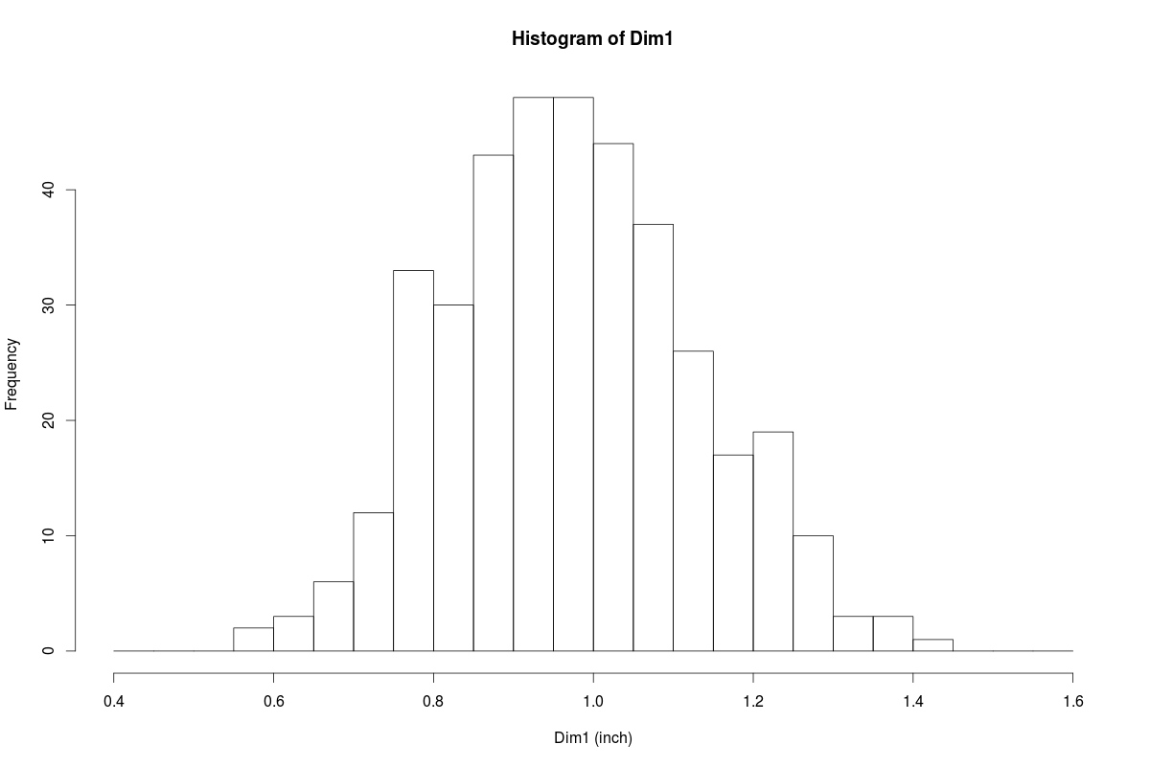

Slide 7
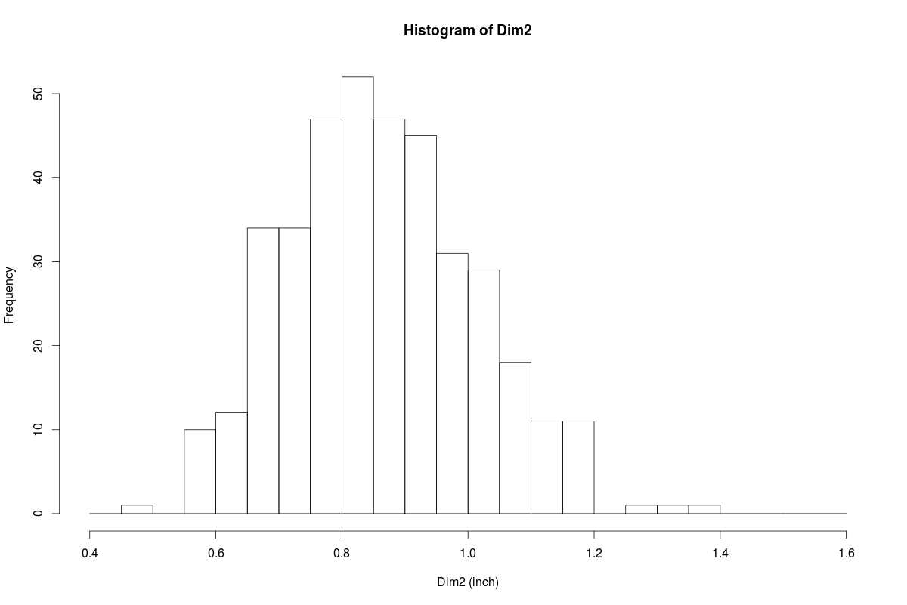

Slide 8
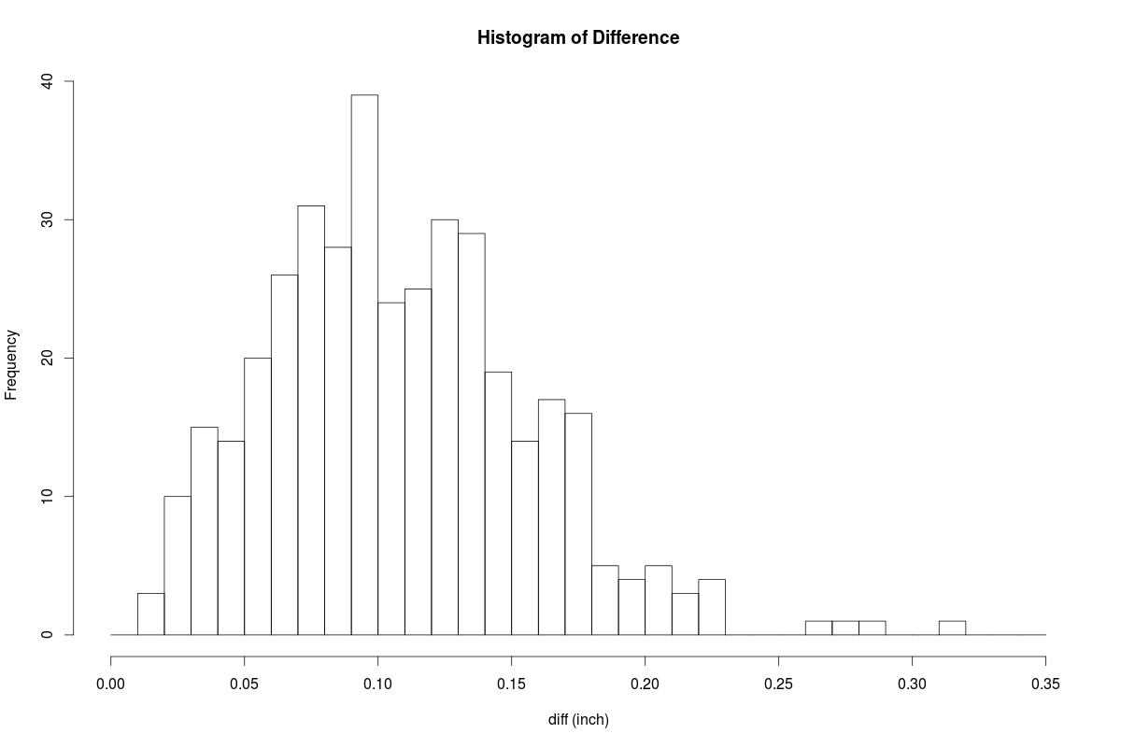

Slide 9
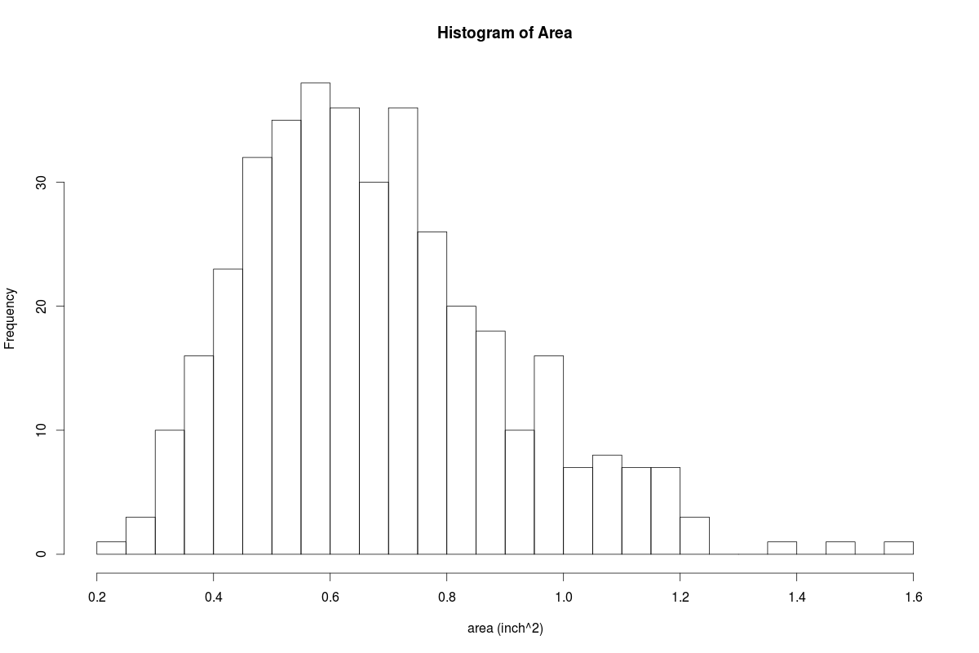

Slide 10
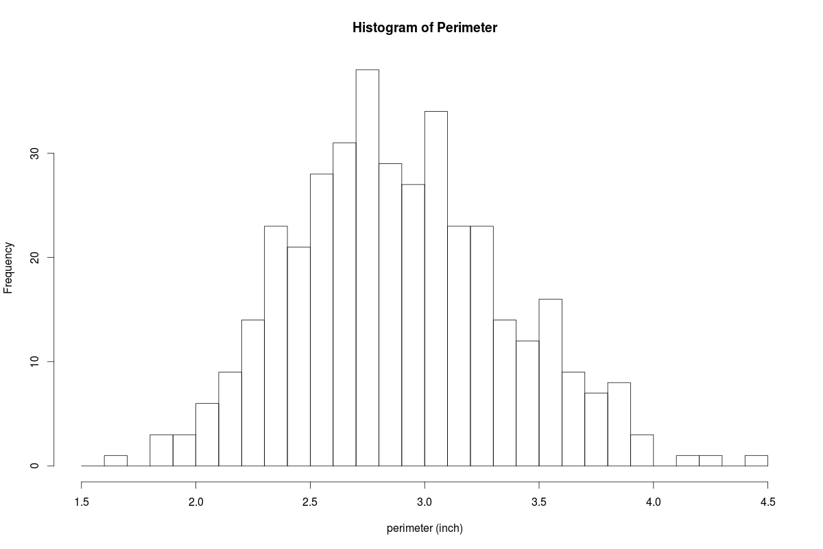

Slide 11
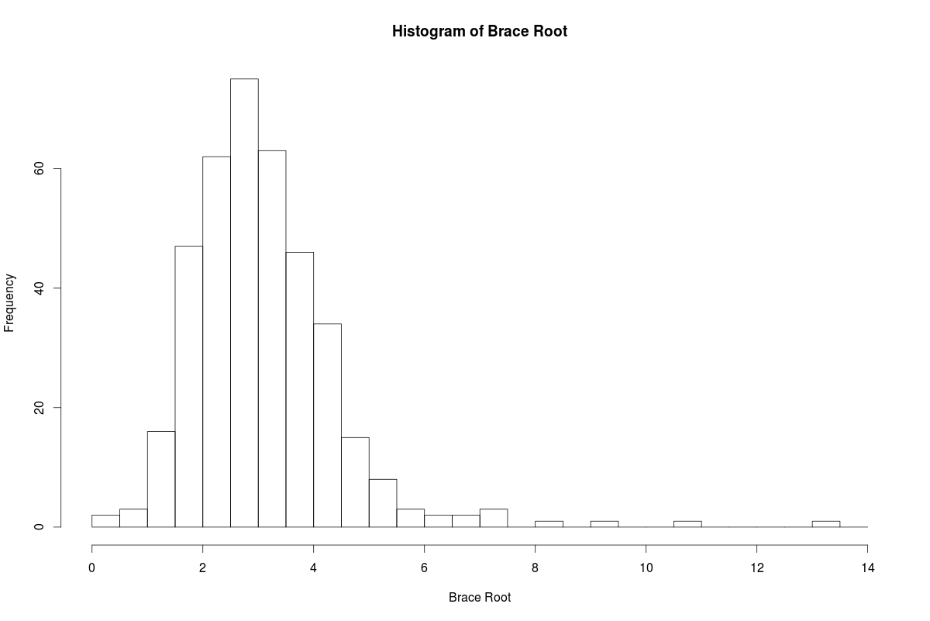

Slide 12
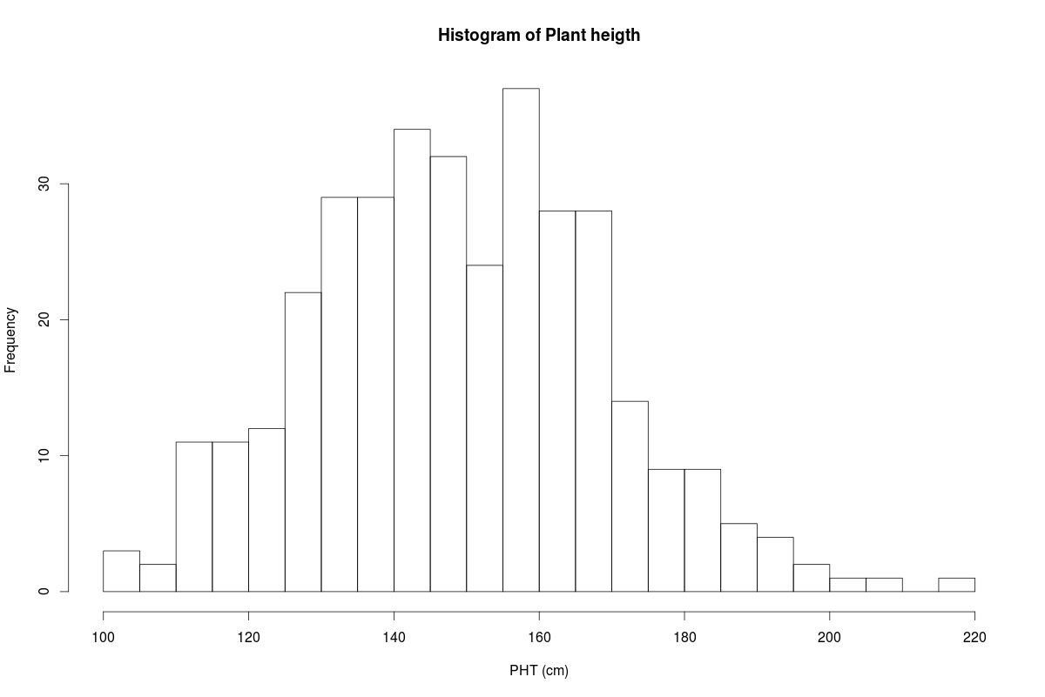

Slide 13
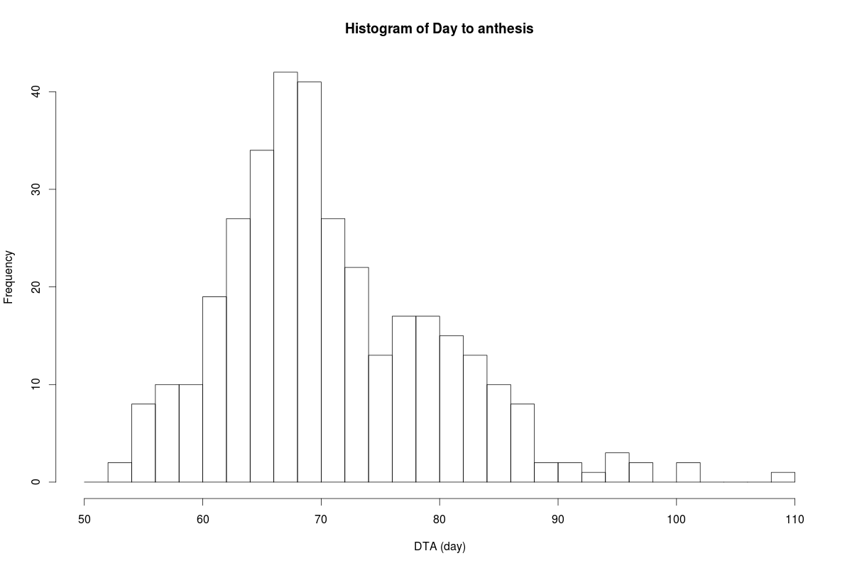

Slide 14
