Slide 1
Description Embedding Module
Complementary Learning Module
Inference Stage
Entity
Property
Value
Property
Value
Sub-Graph Generation
Greate..
Type
Original
MLP
e
a
b
c
3WAY FM
Slogan
a
a
e
e
Mask
Description Embedding
Word Embedding
b
b
d
Entity
Property (p)
Value (v)
d
First Node Choose
c
c
b
Concatenate
e
Zero padding
Link Encoder
a
d
d
DisenGCN
e
a
b
c
d
i
e
K-Means
Link Representation
Link Prediction
MLP
b
a
b
g
c
a
c
h
d
c
f
e
i
Concatenate
d
Link Prediction
Cluster-1
Cluster-2

Slide 3
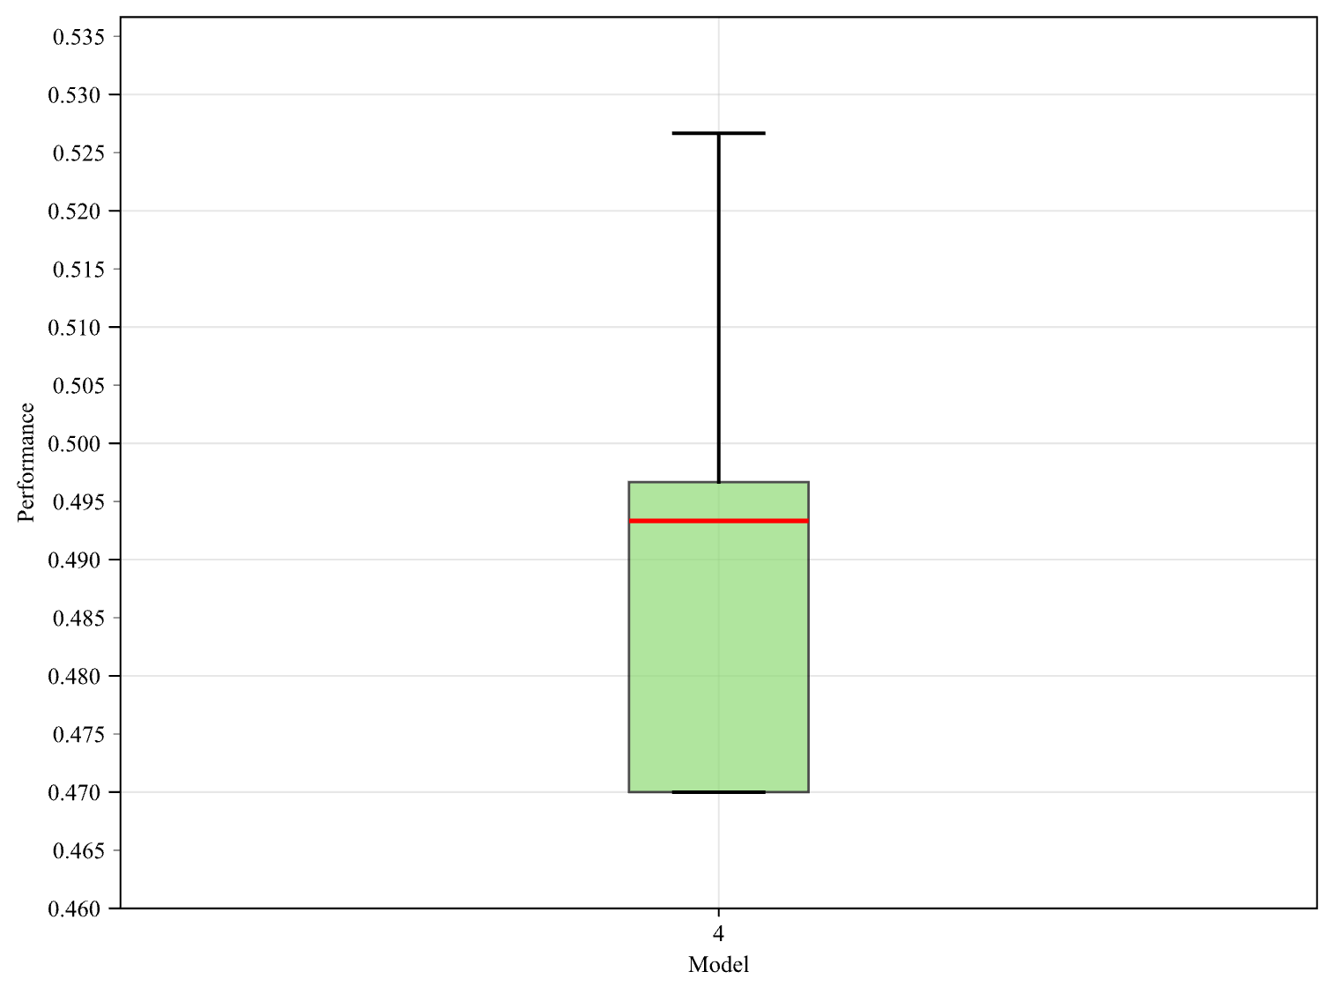
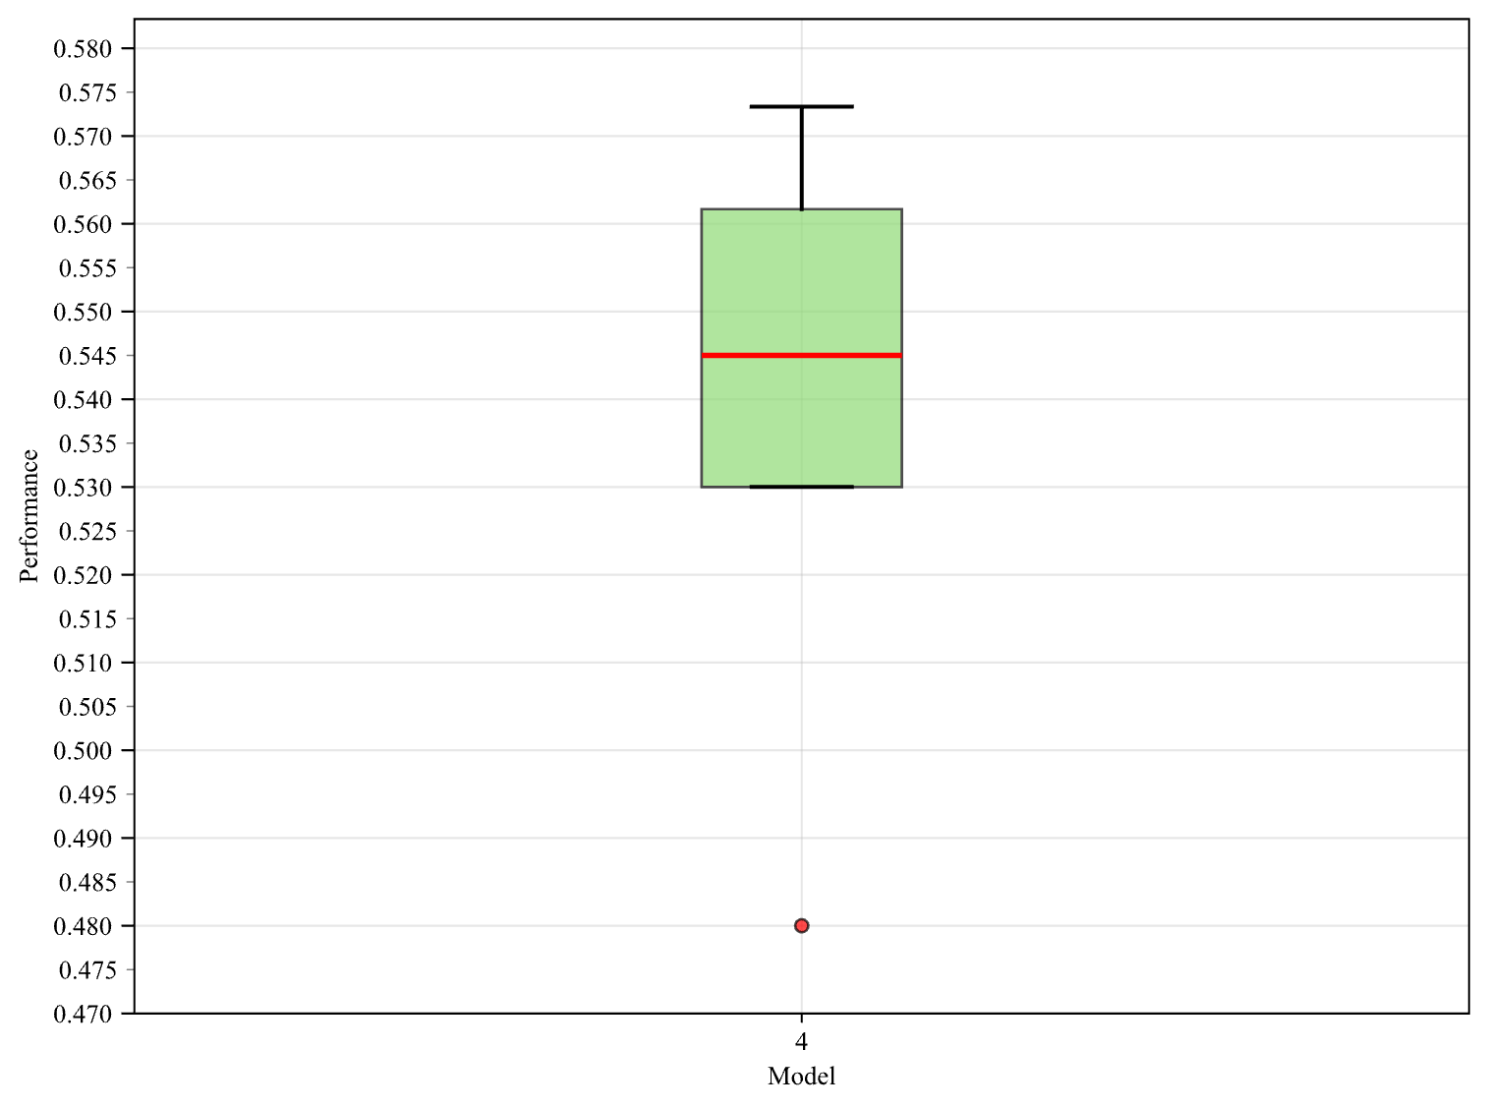
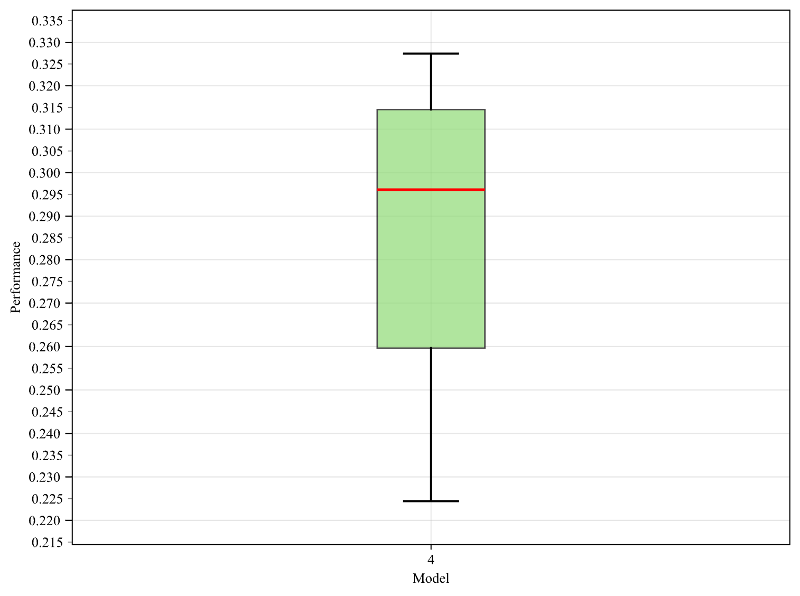
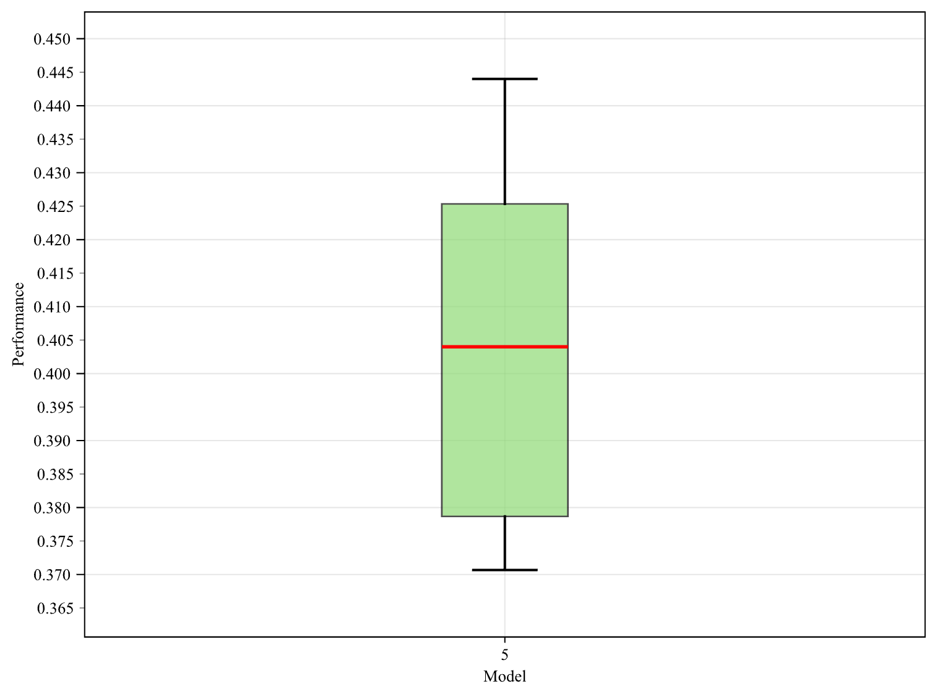
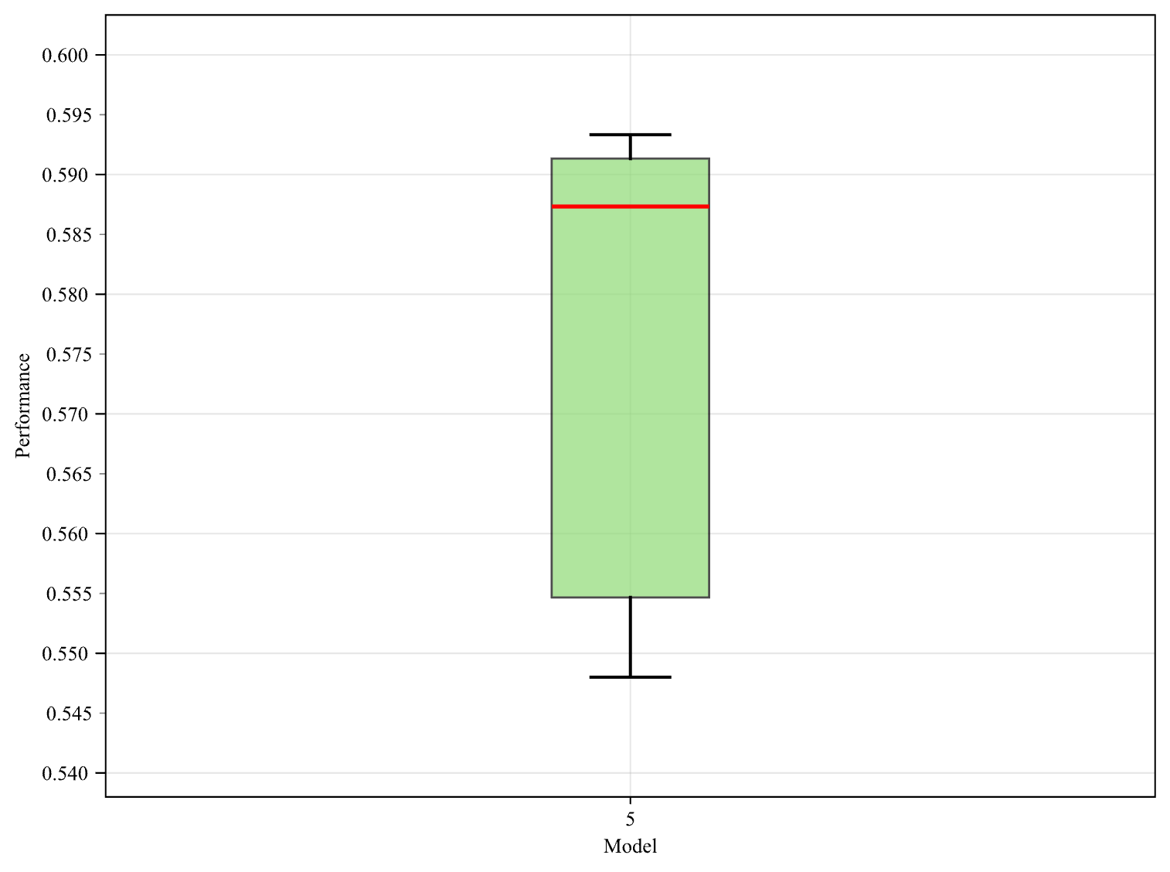
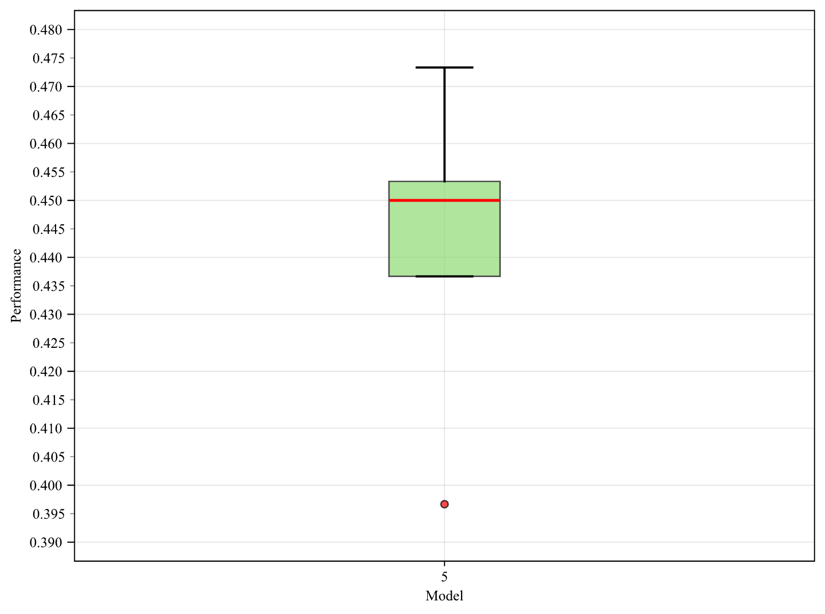
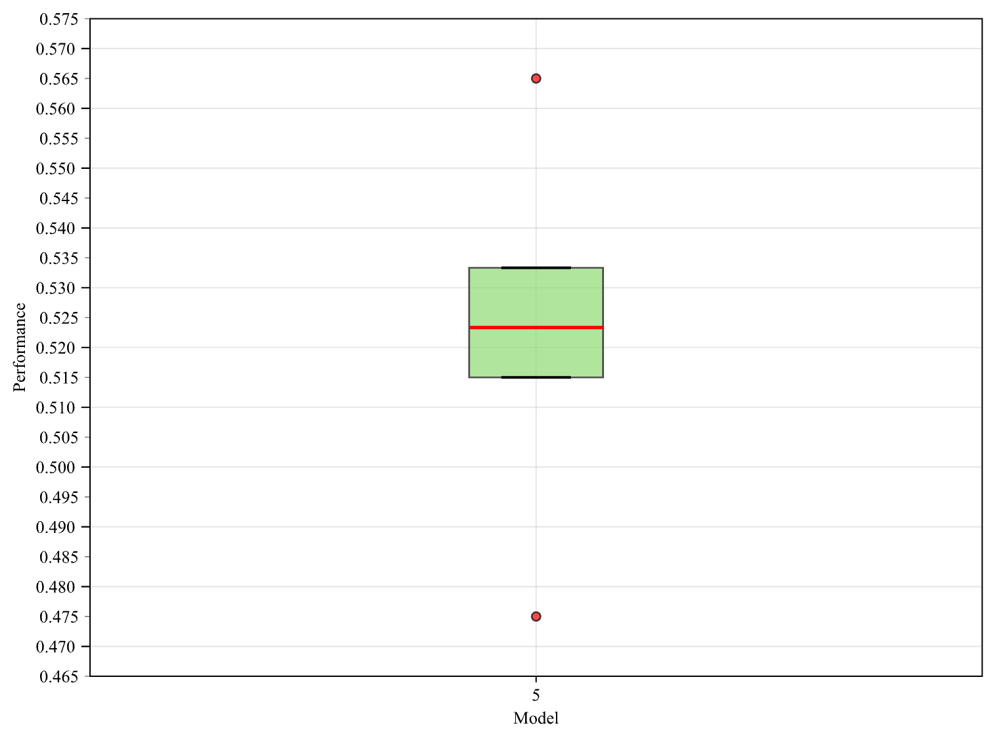
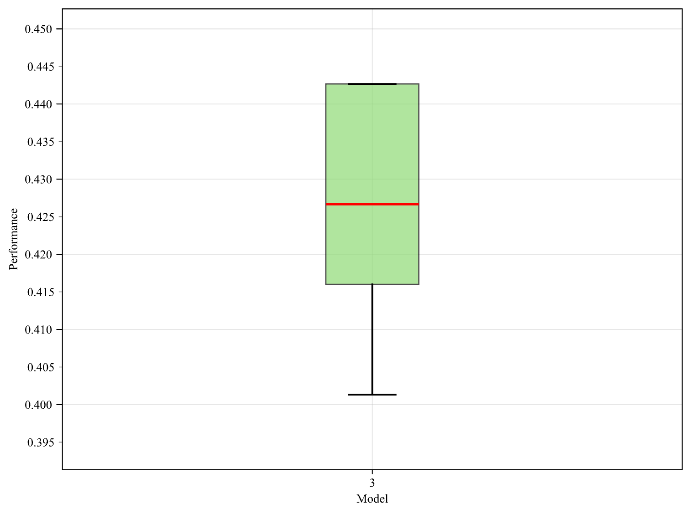
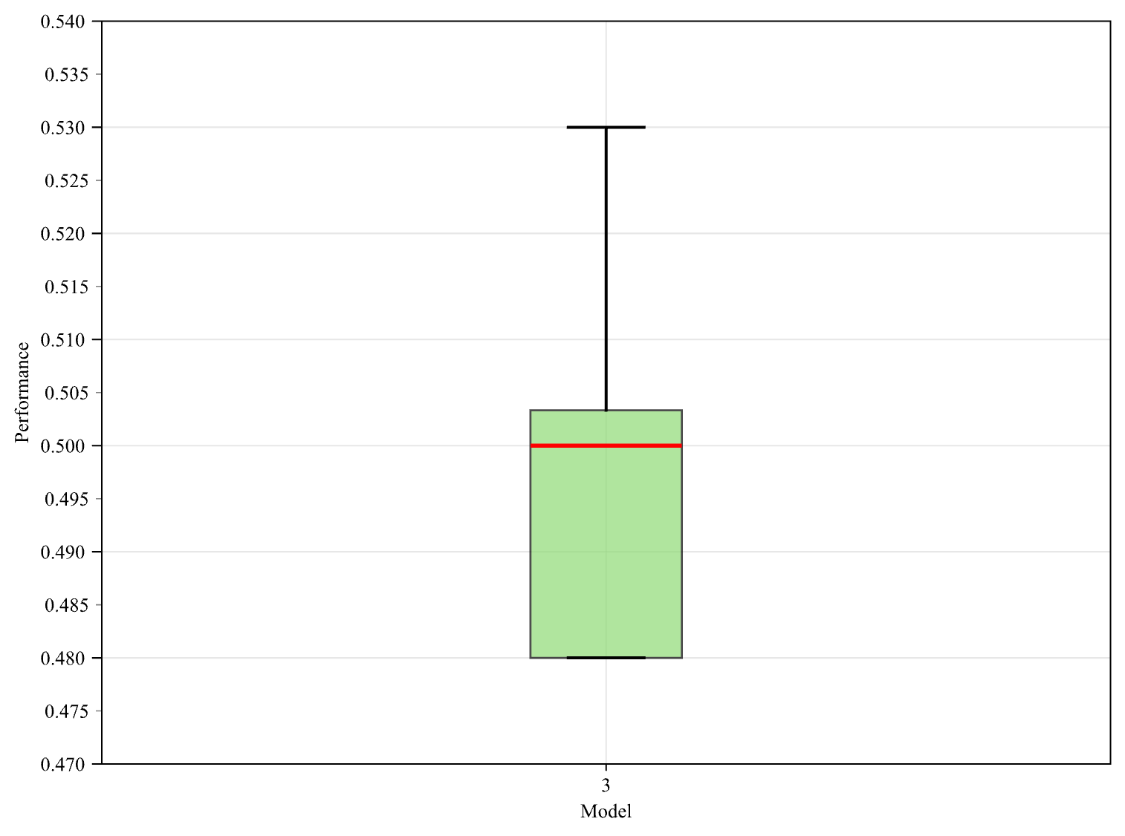
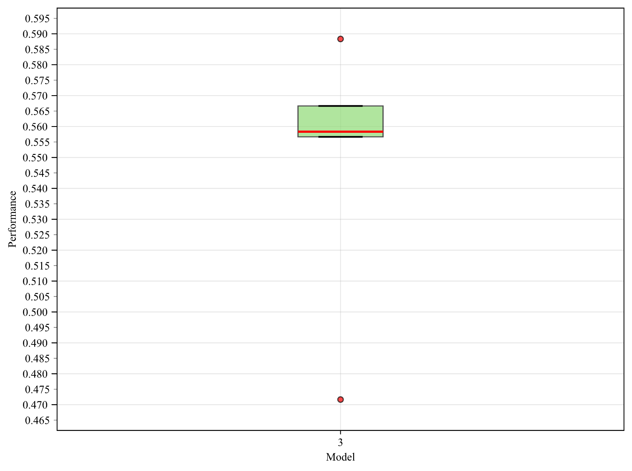
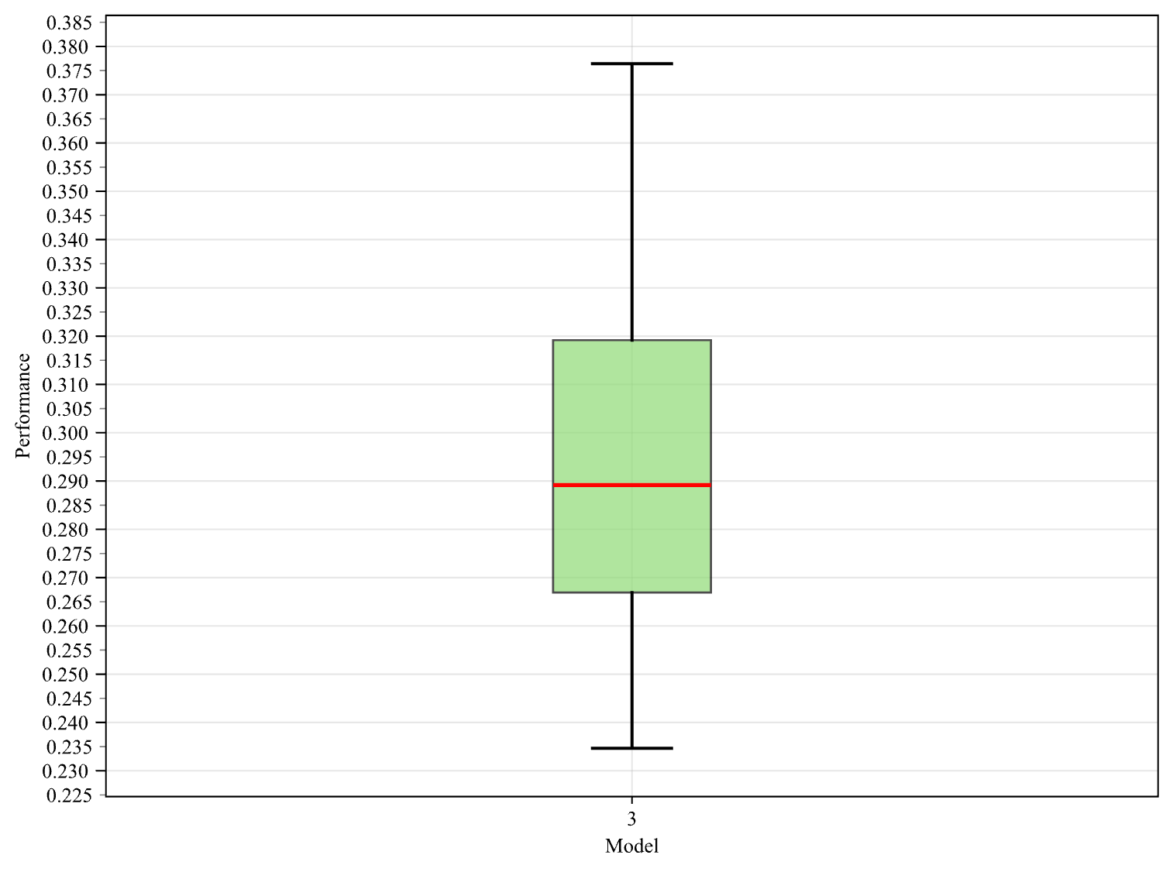
dbpedia
lmdb
w/o
calibration loss
w/o
triplet loss
w
all losses

Slide 4
Ludwigsburg University
ESCS
Groundtruth
Property | Value
HomePage | http://www.ph-ludwigsburg.de
Name | Pädagogische Hochschule Ludwigsburg (Ludwigsburg University of Education)
Label | Ludwigsburg University"@en
City | Ludwigsburg
Country | Germany
Property | Value
HomePage | http://www.ph-ludwigsburg.de
Name | Pädagogische Hochschule Ludwigsburg (Ludwigsburg University of Education)
Label | Ludwigsburg University"@en
City | Ludwigsburg
Country | Germany
Property | Value
HomePage | http://www.ph-ludwigsburg.de
Type | University
Label | Ludwigsburg University"@en
City | Ludwigsburg
Country | Germany
Kotumachagi
Property | Value
IsPartOf | Karnataka
Country | India
TimeZone | Indian_Standard_Time
Label | Kotumachagi"@en
Point | 15.54259 75.77102
Property | Value
UtcOffset | "+5:30"
Country | India
TimeZone | Indian_Standard_Time
Name | "ಕೋಟುಮಚಗಿ"@en
Point | 15.54259 75.77102
Property | Value
IsPartOf | Karnataka
Country | India
Type | Village
Label | Kotumachagi"@en
Point | 15.54259 75.77102
3WAY FM
Property | Value
Slogan | Great Ocean Radio
Label | 3WAY FM
BroadcastArea | Warrnambool
BroadcastArea | Victoria_(Australia)
ProgrammeFormat | Community_radio
Property | Value
Homepage | http://3wayfm.org.au
Label | 3WAY FM
BroadcastArea | Warrnambool
BroadcastArea | Victoria_(Australia)
Type | entity/Q15265344
Property | Value
Slogan | Great Ocean Radio
Label | 3WAY FM
BroadcastArea | Warrnambool
BroadcastArea | Victoria_(Australia)
ProgrammeFormat | Community_radio

