Slide 1
Sparse signal detection and fingerprint feature recognition based on fast 2D DFRFT
Jun Yang and Jinshun Shen
Xidian University, China
May 8, 2022

Slide 2
Outline
1. Research Motivation
1.1 Fingerprint feature recognition
1.2 Fractional Fourier transform
1.3 Numerical calculation of 2D FRFT
2. The Sparse 2D Fractional Fourier Transform Algorithm
2.1 Algorithm flow
2.2 Comparison with traditional methods
2.3 Algorithm convergence analysis
3. Fingerprint Feature Recognition Simulation
3.1 2D chirp signal detection
3.2 Fingerprint feature recognition

Slide 3
Outline
1. Research Motivation
1.1 Fingerprint feature recognition
1.2 Fractional Fourier transform
1.3 Numerical calculation of 2D FRFT
2. The Sparse 2D Fractional Fourier Transform Algorithm
2.1 Algorithm flow
2.2 Comparison with traditional methods
2.3 Algorithm convergence analysis
3. Fingerprint Feature Recognition Simulation
3.1 2D chirp signal detection
3.2 Fingerprint feature recognition

Slide 4
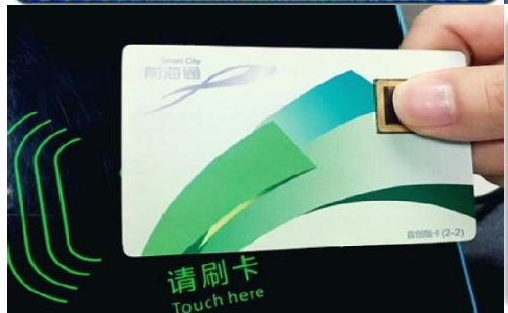
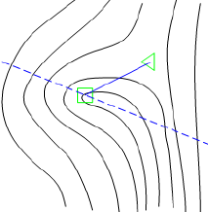
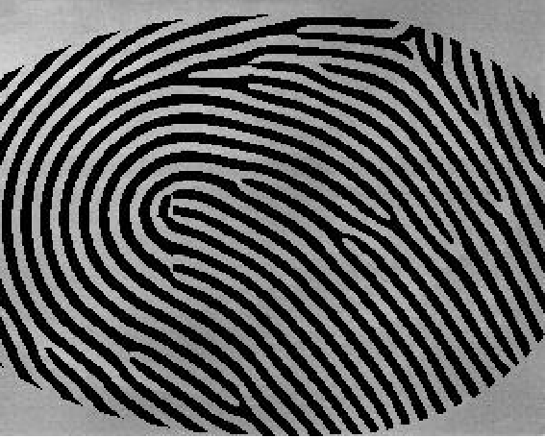
1.1 Fingerprint feature recognition
Traditional Method passwords, tokens, etc.
Risk---- Be lost, forgotten, stolen.
Individual Identification
local and detailed fingerprint structure
Computationally intensive
Biological Features
e.g. fingerprint
Our Method
Based on 2D DFRFT
An efficient implementation is also given.
Research Motivation
STDFRFT Algorithm
Fingerprint Simulation
4

Slide 5
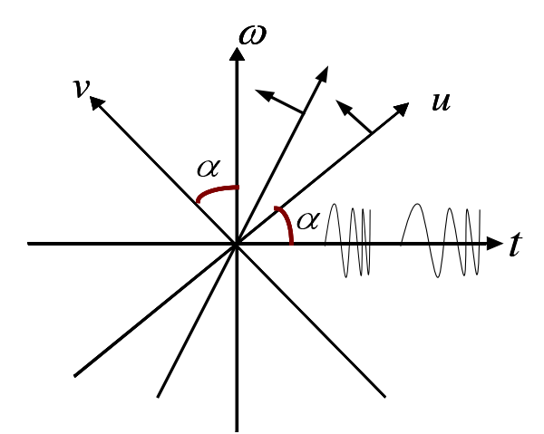
1.2 Fractional Fourier transform
Definition of pei-type 2D DFRFT:
where
Explanation: Signals rotate in the time-frequency plane with free-rotation parameters . Therefore, fingerprint images can show more comprehensive features by FRFT.
Research Motivation
STDFRFT Algorithm
Fingerprint Simulation
5

Slide 6
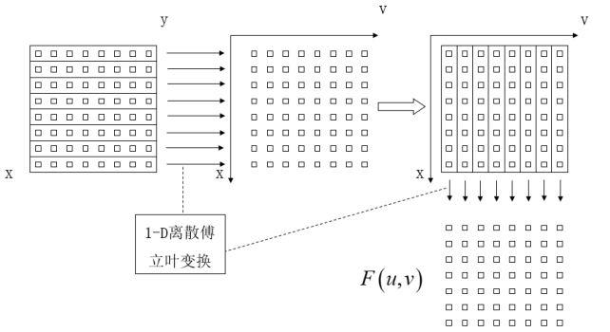
1.3 Numerical calculation of 2D FRFT
Traditional Methods: Decomposing and fast 1D FRFT.
1D FRFT
Runtime Complexity: times of 1D FRFT.
For applications with large amounts of data, this calculation is very expensive.
It also cannot meet the needs of real-time processing.
Research Motivation
STDFRFT Algorithm
Fingerprint Simulation
6

Slide 7
Outline
1. Research Motivation
1.1 Fingerprint feature recognition
1.2 Fractional Fourier transform
1.3 Numerical calculation of 2D FRFT
2. The Sparse 2D Fractional Fourier Transform Algorithm
2.1 Algorithm flow
2.2 Comparison with traditional methods
2.3 Algorithm convergence analysis
3. Fingerprint Feature Recognition Simulation
3.1 2D chirp signal detection
3.2 Fingerprint feature recognition

Slide 8
2.1 STDFRFT algorithm flow
Suppose: is -sparse.
Purpose: estimate the locations and amplitudes of the significant frequencies.
First chirp modulation
2D SFT
Iteration to estimate the spectrum of .
Only a few 1D FFT and simple mappings are used by aliasing filter.
Second chirp modulation
Research Motivation
STDFRFT Algorithm
Fingerprint Simulation
8

Slide 9
2.1 STDFRFT algorithm flow
An iteration of 2D SFT
Bucketing:
extract random parallel slices in ,
perform FFT on slices to get
update buckets
Estimating:
for each 1-sparse large-value bucket , estimate the frequency:
Noise-free: Significant frequencies can be estimated accurately with a high probability.
Noisy-case: Voting method to reduce the probability of decoding errors.
Research Motivation
STDFRFT Algorithm
Fingerprint Simulation
9

Slide 10
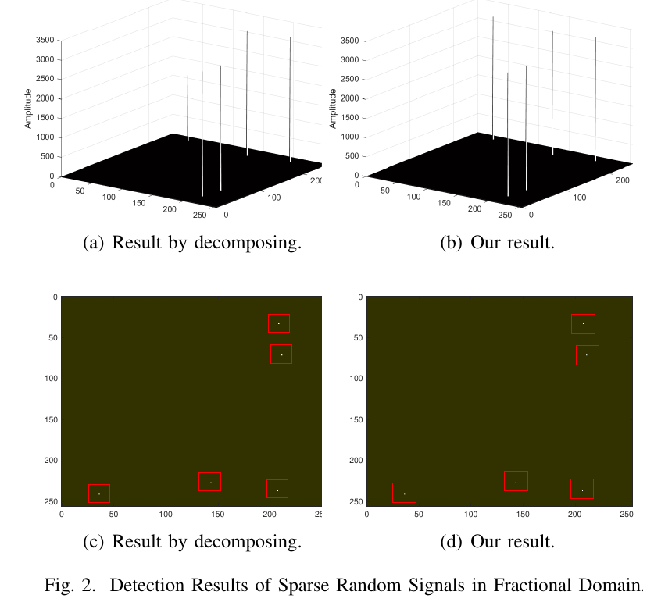
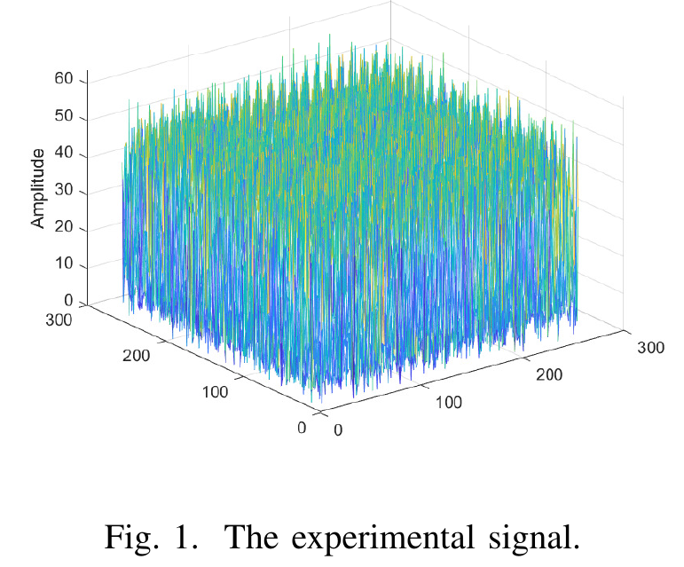
2.2 Comparison with traditional methods
Fractional Domain Sparse Random Signal Detection
Research Motivation
STDFRFT Algorithm
Fingerprint Simulation
10

Slide 11
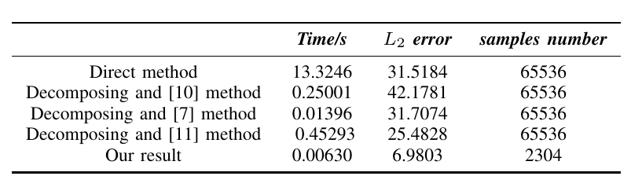
2.2 Comparison with traditional methods
[7] S.-C. Pei and J.-J. Ding, “Closed-form discrete fractional and affine Fourier transforms,” IEEE
Transactions on Signal Processing, vol. 48, no. 5, pp. 1338–1353, 2000.
[10] H. M. Ozaktas, O. Arikan, M. A. Kutay, and G. Bozdagt, “Digital computation of the fractional
Fourier transform,” IEEE Transactions on signal processing, vol. 44, no. 9, pp. 2141–2150, 1996.
[11] J. R. de Oliveira Neto, J. B. Lima, G. J. da Silva Jr, and R. M. C.de Souza, “Computation of an
eigendecomposition-based discrete fractional Fourier transform with reduced arithmetic
complexity,” Signal Processing, vol. 165, pp. 72–82, 2019.
Research Motivation
STDFRFT Algorithm
Fingerprint Simulation
11

Slide 12
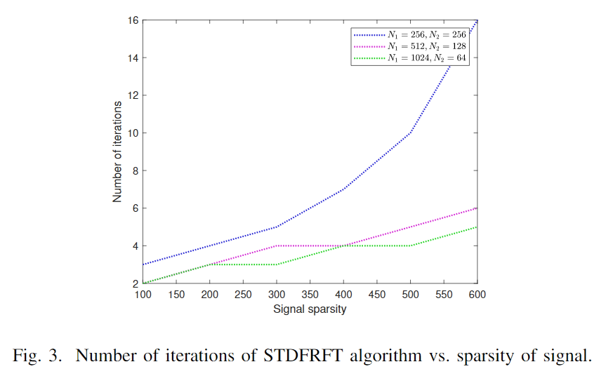
2.3 Algorithm convergence analysis
Research Motivation
STDFRFT Algorithm
Fingerprint Simulation
12

Slide 13
Outline
1. Research Motivation
1.1 Fingerprint feature recognition
1.2 Fractional Fourier transform
1.3 Numerical calculation of 2D FRFT
2. The Sparse 2D Fractional Fourier Transform Algorithm
2.1 Algorithm flow
2.2 Comparison with traditional methods
2.3 Algorithm convergence analysis
3. Fingerprint Feature Recognition Simulation
3.1 2D chirp signal detection
3.2 Fingerprint feature recognition

Slide 14
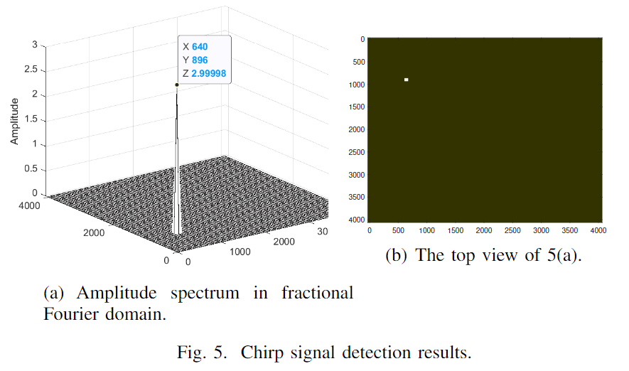
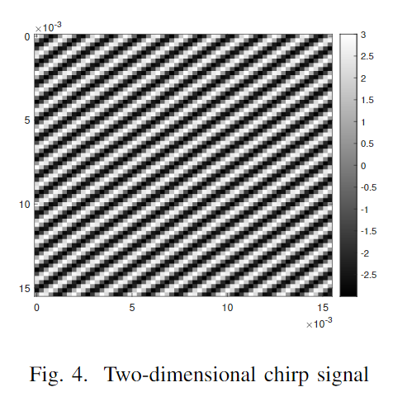
3.1 2D chirp signal detection
parameters
parameters
pulse amplitude | 3
modulation frequency | (-16.4Hz/s, -7.8Hz/s)
center frequency | (640Hz,896Hz)
sample rate | 4096Hz/s
pulse duration | s
Research Motivation
STDFRFT Algorithm
Fingerprint Simulation
14

Slide 15
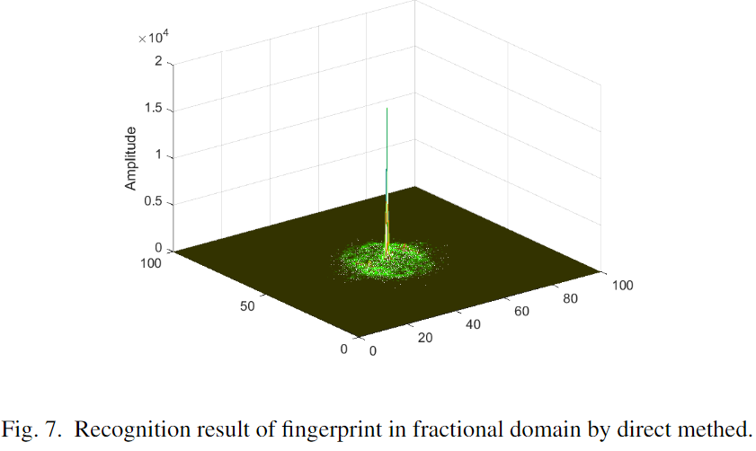
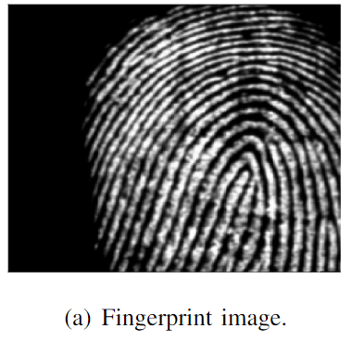
3.2 Fingerprint feature recognition
Gao [12] proposed that the phase of FRFT has relative time-shift invariance.
The texture of the fingerprint can be approximated as 2D chirp signals.
Research Motivation
STDFRFT Algorithm
Fingerprint Simulation
15

Slide 16
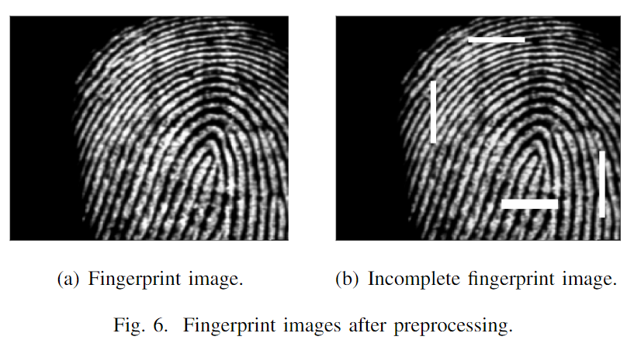
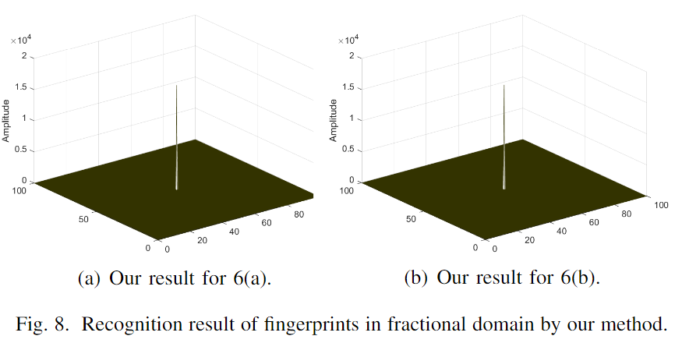
3.2 Fingerprint feature recognition
Our algorithm can extract the main features even for incomplete fingerprints.
Research Motivation
STDFRFT Algorithm
Fingerprint Simulation
16

Slide 17
Thanks for listening and feel free to ask questions!
Sparse signal detection and fingerprint feature recognition based on fast 2D DFRFT

