Slide 1
Seedlings grow faster under a 16-hour light schedule
Sample Author
Sample deck with made-up data
October 2026

Slide 2
A longer light schedule raises seedling height in this made-up trial
Need
Approach
Evidence
Take-homes
Indoor seedlings lag
Three light schedules
Height by day 20
Longer light helps
Notes:
The talk has four parts. First the need: indoor seedlings grow slowly. Then the approach, a trial with three schedules. Then the evidence from the height curves. Last, the results that you should take with you.

Slide 3
Indoor seedlings reach less than half the field height by day 20
Setting | Height on day 20
Field plot | 24 cm
Indoor, 8 h light | 10 cm
A gap of 14 cm on day 20
Made-up data for this sample deck.
Notes:
This is the need. A field plot gives seedlings 24 centimeters on day 20. The same seedlings indoors, with the usual eight hours of light, reach 10. Ask the room what a grower loses with that gap before you show the trial.

Slide 4
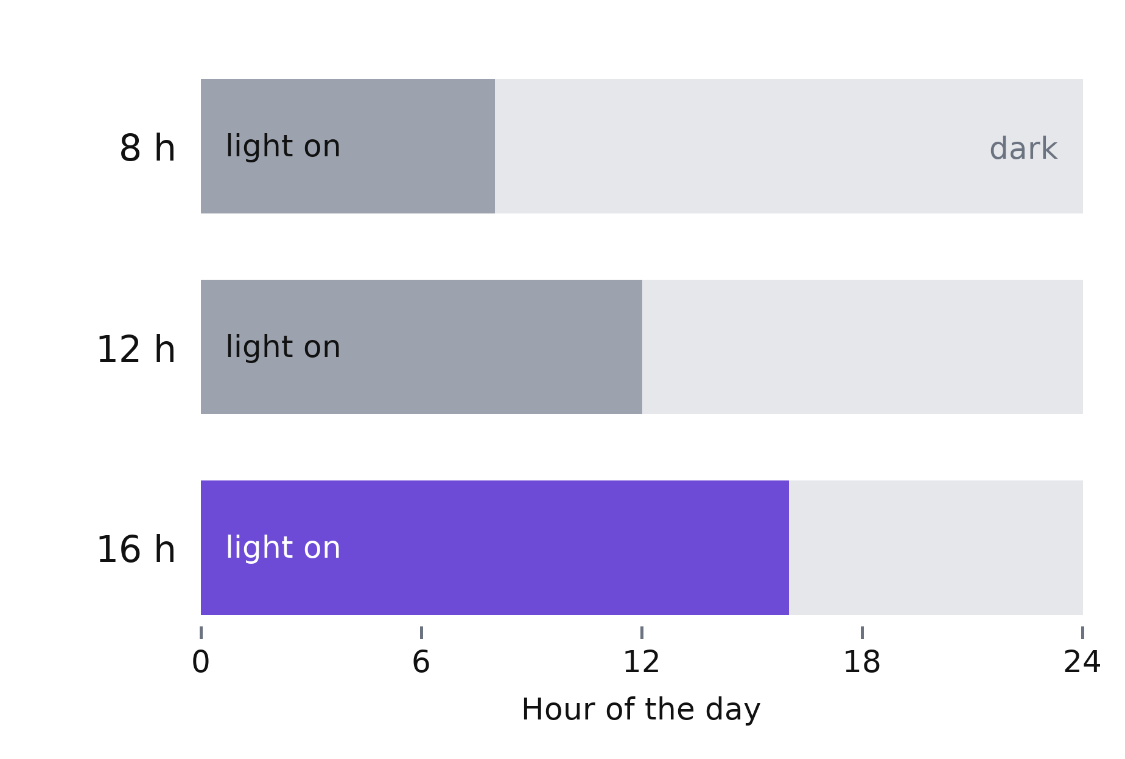
The trial compares three light schedules on 90 seedlings
30 seedlings per schedule
Same soil, water and temperature
Made-up data for this sample deck.
Notes:
Each bar is one day. The light is on for the shaded part. The 16-hour schedule is the new one, so it carries the accent color. We changed nothing else: each group has 30 seedlings in the same soil, with the same water and temperature.

Slide 5
The 16-hour schedule gives the tallest seedlings by day 20
Height in cm, mean of 30 seedlings
The gap opens by day 10
Made-up data for this sample deck.
Notes:
All three groups start at 2 centimeters. The lines part by day 10, when the 16-hour group stands at 7.9 against 6.3 for the 8-hour group. On day 20 the order is clear. The curves show means, so say that the spread sits on the backup slide.

Slide 6
The 16-hour schedule adds 40 percent to the height on day 20
+40%
Baseline: the 8-hour schedule, 10 cm on day 20.
taller than the 8-hour schedule
Made-up data for this sample deck.
Notes:
Forty percent is 14 centimeters against 10. The 12-hour schedule gives 11.5, which is 15 percent. Name the baseline out loud, because a percentage means little without it.

Slide 7
Longer light gave taller seedlings, and the gain grew with the hours
The 16-hour schedule raised height by 40 percent
Baseline: the 8-hour schedule, 10 cm on day 20
The 12-hour schedule raised height by 15 percent
Baseline: the same 8-hour schedule
The 16-hour group led by day 10, at 7.9 cm
Baseline: the 8-hour group, 6.3 cm on day 10
Notes:
Leave this slide up during questions. Say the three claims in your own words. Each one names its baseline, so a question about a number has an answer on the screen.

Slide 8
Mean height on day 20 rises with the hours of light
Schedule | Mean (cm) | SD (cm) | n
8 h | 10.0 | 1.1 | 30
12 h | 11.5 | 1.3 | 30
16 h | 14.0 | 1.6 | 30
Made-up data for this sample deck.
Notes:
Use this slide if someone asks about the spread. The standard deviation grows a little with the hours of light. Each group has 30 seedlings.

