Slide 1
The Osprey score picks designs that bind Target T
A. Author
Example Lab
October 2026
Notes:
Open with the question of the study: does a score that ranks designs before the assay pick the designs that bind in the assay? Say that every name and number in this talk comes from one run.

Slide 2
The Osprey score picked designs that bound Target T: the hit rate rose from 20 percent to 70 percent across four rounds.
Need
Approach
Evidence
Take-homes
Round 1
Score and assay
Hits and cost
Three claims
Notes:
The talk has four parts. First the need, then how the designs were scored and assayed, then three pieces of evidence. The last part gives the claims to keep. Read the message aloud once and move on.

Slide 3
Only 20 percent of the designs in Round 1 bound Target T.
20%
A hit is a signal of 50 au or more.
hit rate in Round 1
results.csv, fig1
Notes:
Each round held ten designs. A hit means a binding signal of 50 au or more, read at 60 minutes in the Kestrel assay. Treat Round 1 as the starting point for every later comparison.

Slide 4
The Osprey score ranks each design before the assay.
Term | Meaning
Osprey score | Ranks a design 0 to 10
Hit | Signal of 50 au or more
notes.md, Methods
Notes:
The team computed the score before the assay. The Mallard filter then dropped each design with a score below 4, so every design of the Heron set passed it and no score under 4 appears in the later figures. The Kestrel assay reads a plate every 10 minutes for 60 minutes. The signal of a design is the reading at the last time point.

Slide 5
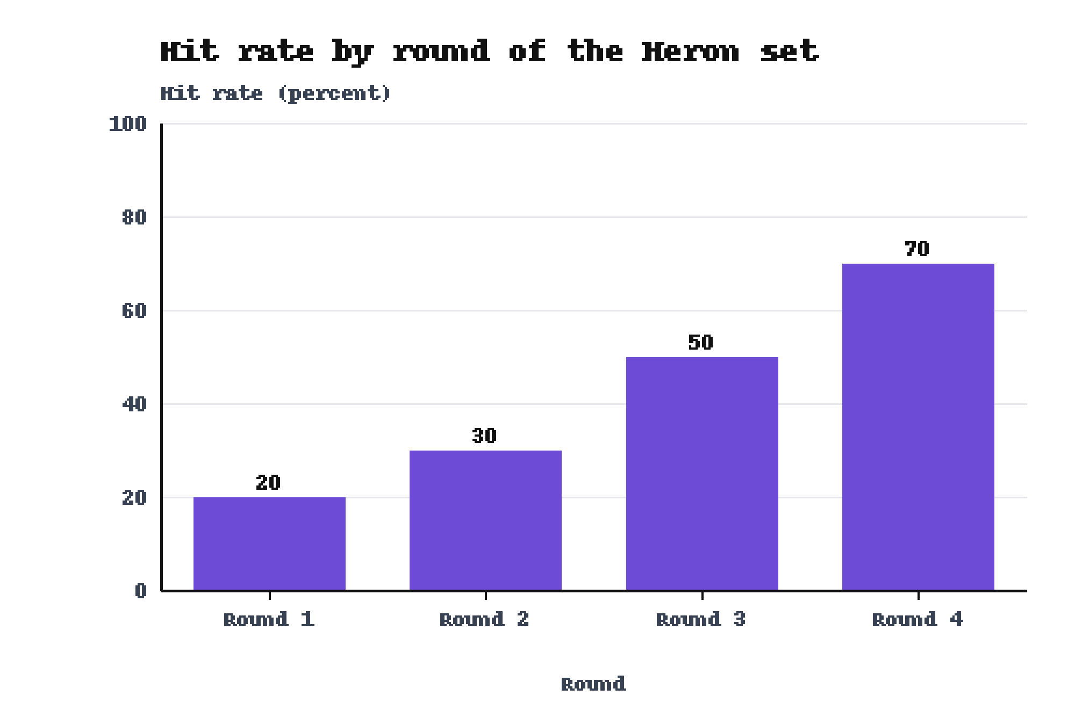
The hit rate rose from 20 percent to 70 percent across the four rounds.
Round 4: 70 percent
results.csv, fig1
Notes:
Each bar is one round of ten designs, so the Heron set holds 40 designs. The study ran once, on one plate layout. Say that the rise is an observed change over rounds and does not isolate the score.

Slide 6
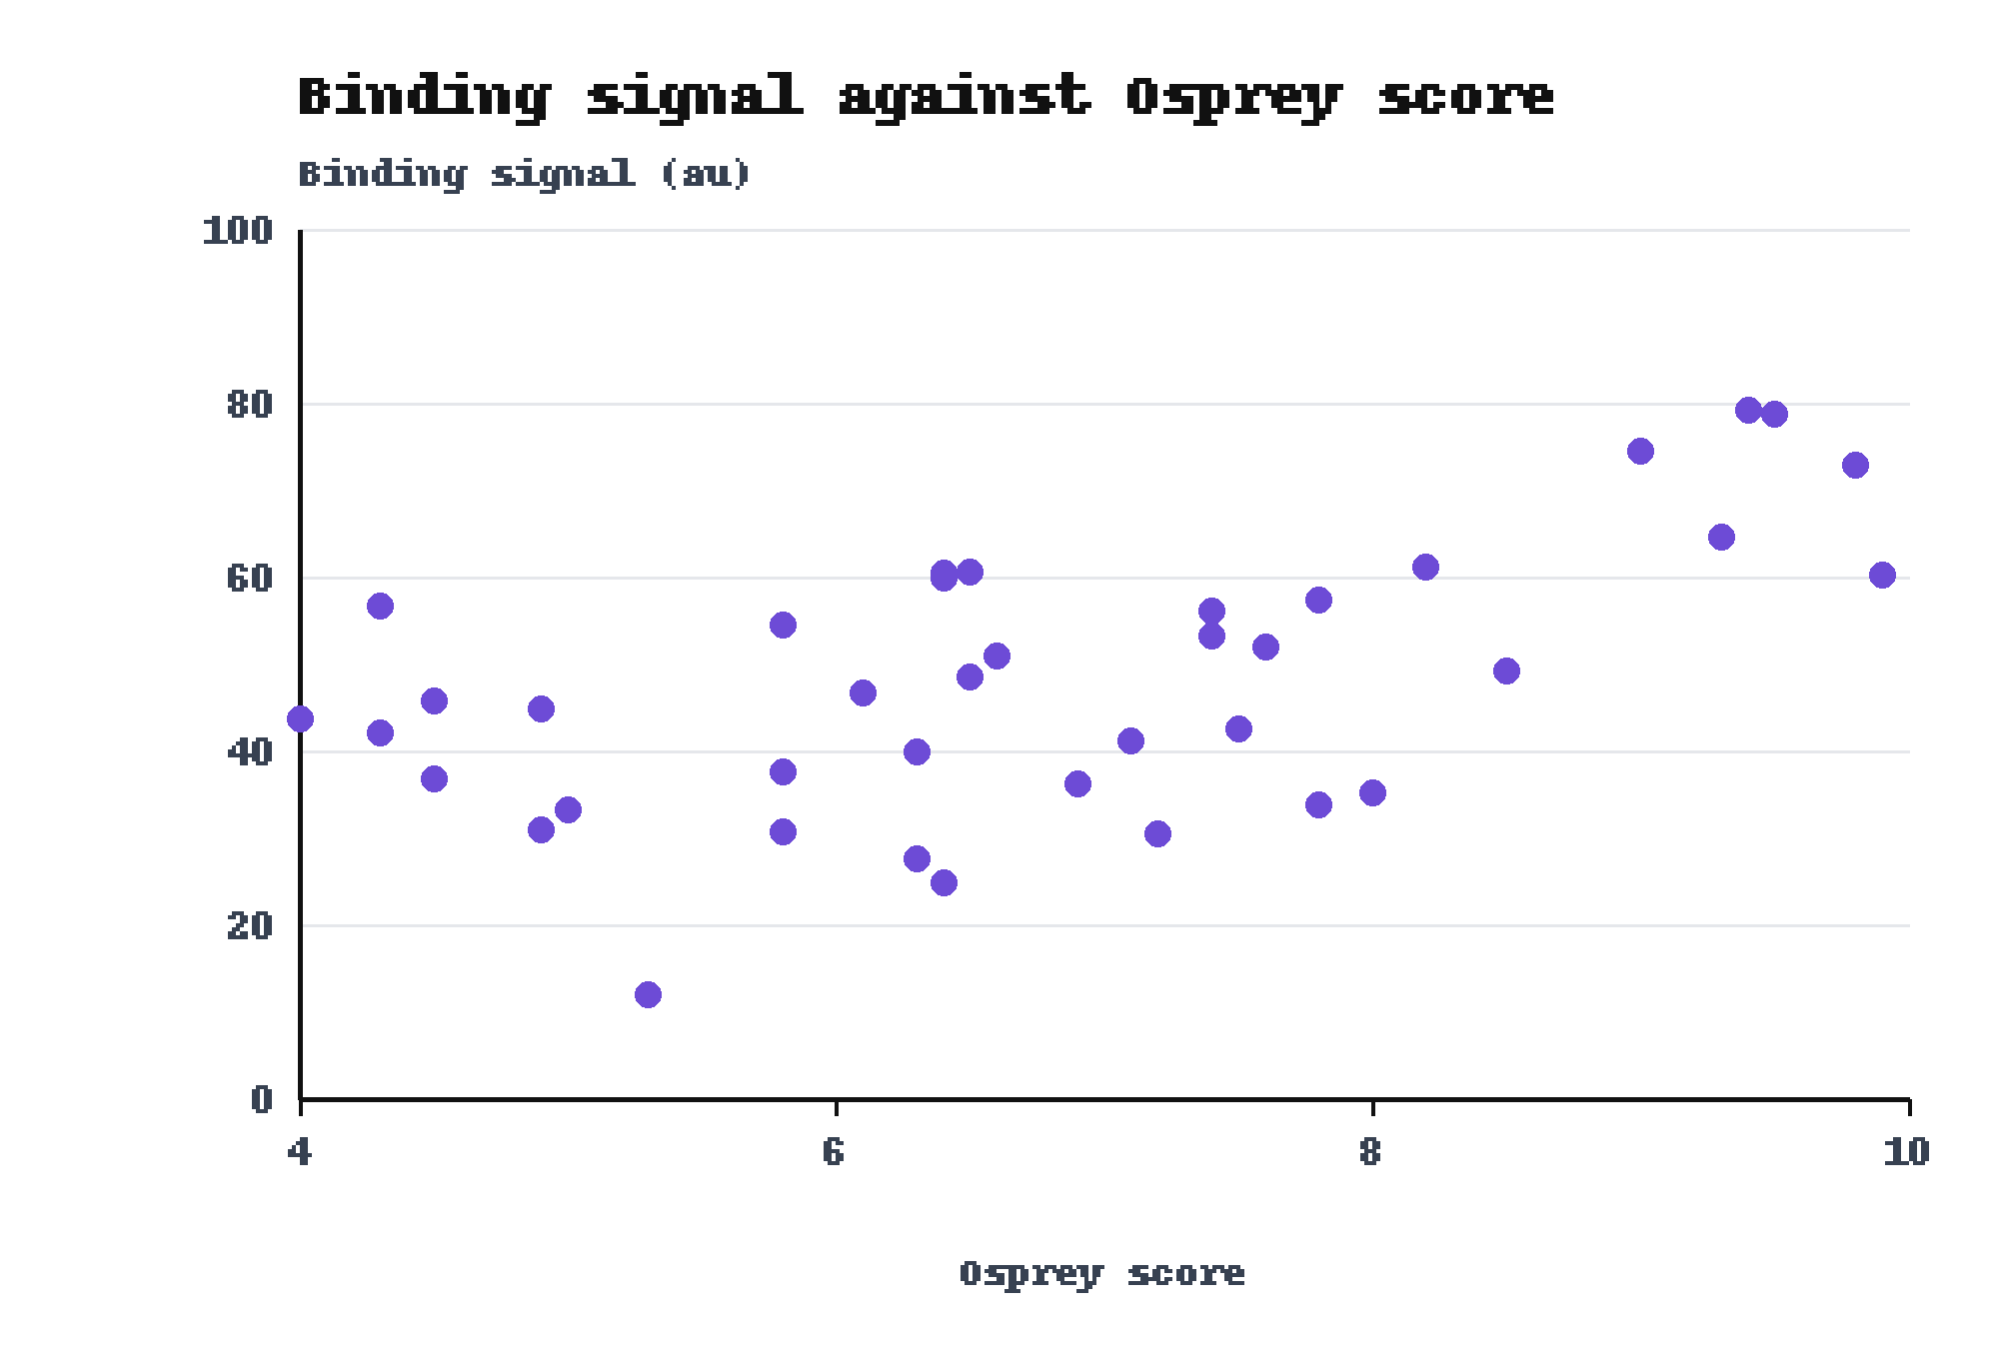
Every design with an Osprey score of 9 or more gave a signal above 60 au.
Scores of 9 or more
results.csv, fig3
Notes:
Each point is one design. The design with the highest score, 9.9, gave 60.3 au, so the top score is not the top signal. The best signal, 79.2 au, came at a score of 9.4. The plot shows a trend and does not show a cause. Scores below 4 are absent because of the Mallard filter.

Slide 7
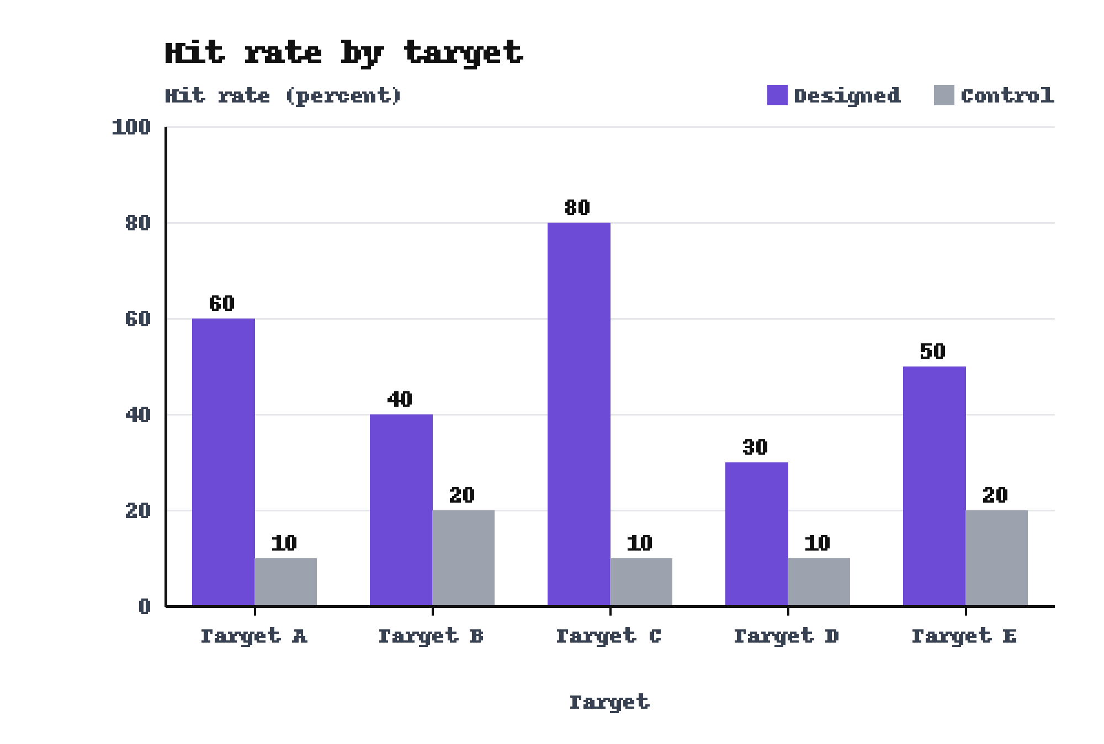
On Target C the designed set beat the control, 80 percent to 10 percent.
Target C: 80 versus 10 percent
results.csv, fig2
Notes:
Each target has 10 designed and 10 control peptides. These peptides do not belong to the Heron set. The designed set stands ahead on all five targets, and Target C shows the widest gap. State the caveat: the control peptides were not matched to the designed peptides for length.

Slide 8
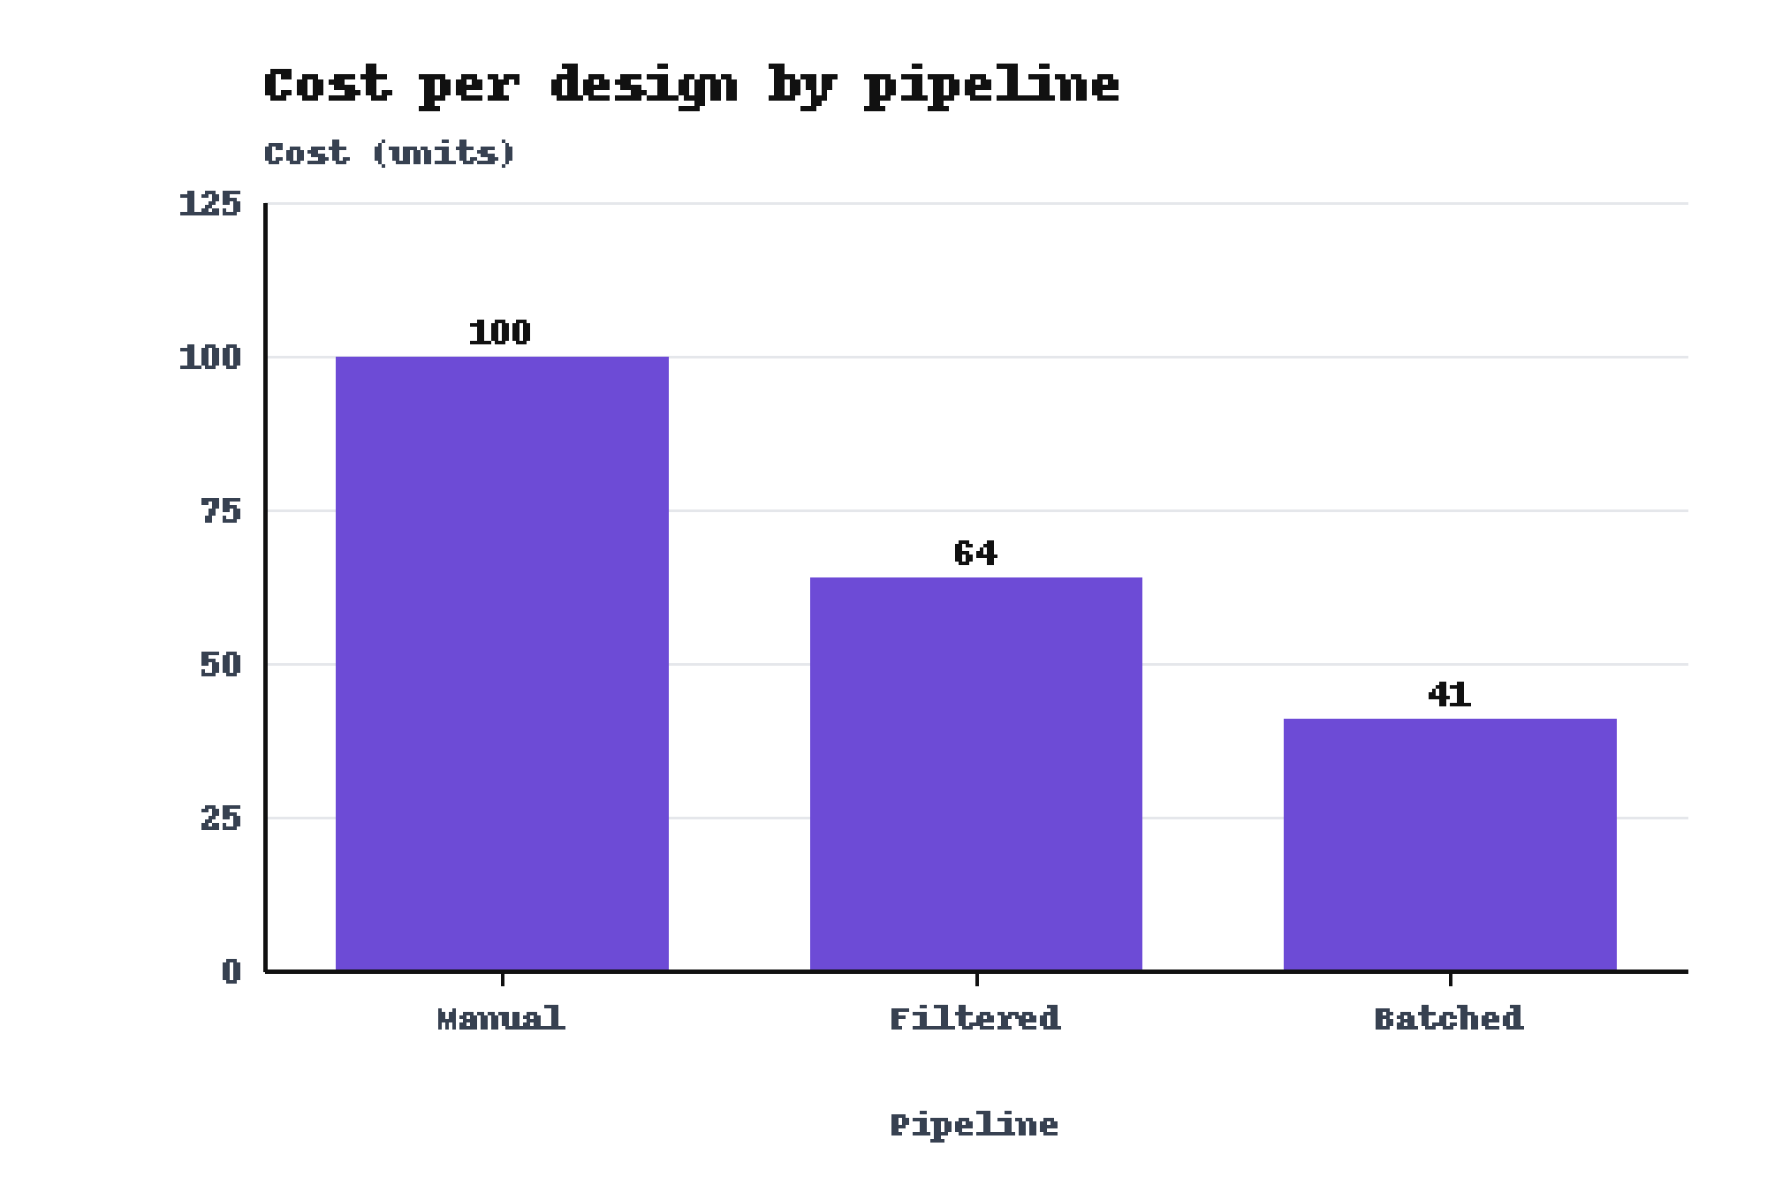
The Batched pipeline cost 41 units per design, against 100 for the Manual pipeline.
Batched: 41 units per design
results.csv, fig7
Notes:
The third pipeline, Filtered, cost 64 units per design. The notes of the study do not define a unit of cost, so define it aloud before you give the numbers.

Slide 9
Each of the three results improves on its baseline.
The hit rate rose from 20 percent to 70 percent in four rounds.
Round 1 gave 20 percent.
On Target C the designed set beat the control, 80 percent to 10 percent.
The control reached 10 percent.
The Batched pipeline cost 41 units per design.
The Manual pipeline cost 100 units.
Notes:
Leave this slide up during questions. Say each claim in your own words and name its baseline. Mention the caveats of the study: it ran once, on one plate layout, and the control peptides were not matched for length.

Slide 10
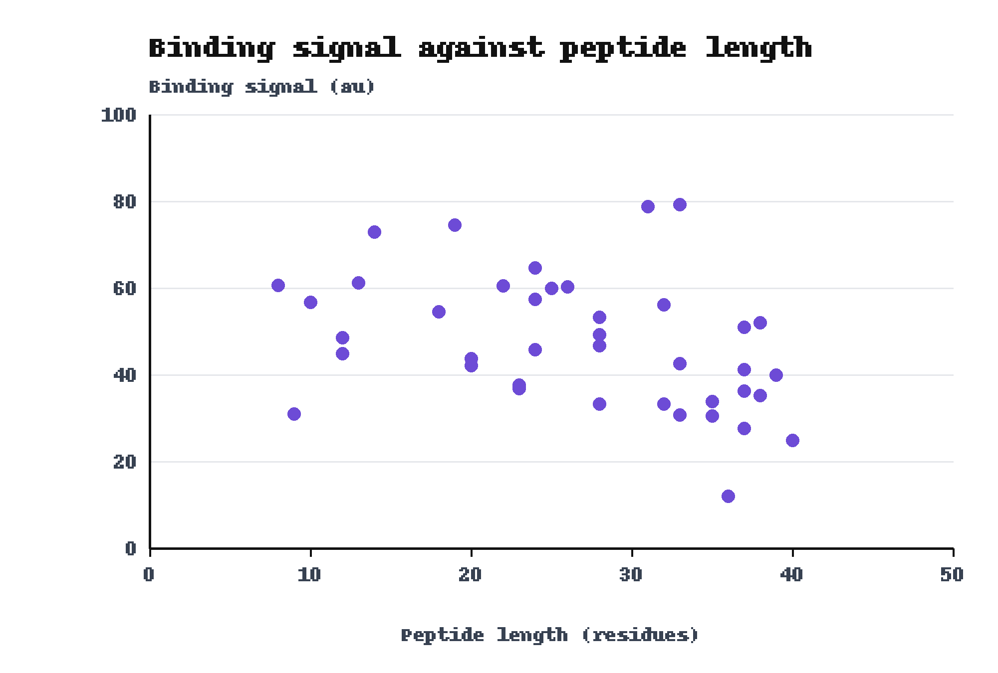
The 40-residue peptide gave 24.9 au and the 8-residue peptide gave 60.6 au.
8 residues: 60.6 au
40 residues: 24.9 au
results.csv, fig4
Notes:
Use this slide if someone asks whether peptide length drives the signal. The plot holds the same 40 designs as the score plot. Do not claim a trend from the two extremes.

