Slide 1
The Osprey score picks designs that bind Target T
A. Author
Example Lab
October 2026

Slide 2
The Osprey score is worth using only if the designs it picks bind Target T
• Question: Does the Osprey score pick designs that bind Target T in the Kestrel assay?
• Score: The Osprey score ranks each design from 0 to 10 before the assay.
• Test: The Heron set holds 40 designs, built in 4 rounds of 10.
Message: The Osprey score picked designs that bound Target T: the hit rate rose from 20 percent to 70 percent across four rounds.

Slide 3
The Mallard filter passed only designs with an Osprey score of 4 or higher
Heron set (40 designs, 4 rounds of 10)
-> Osprey score (0 to 10, before the assay)
-> Mallard filter (drop each score below 4)
-> Kestrel assay (binding signal at 60 minutes)
-> Hit (signal of 50 au or more)
• Filter: The Mallard filter drops each design with a score below 4.
• Set: Each of the 40 Heron designs passed the filter.
• Range: Scores run from 4.0 to 9.9, so the data say nothing about scores below 4.

Slide 4
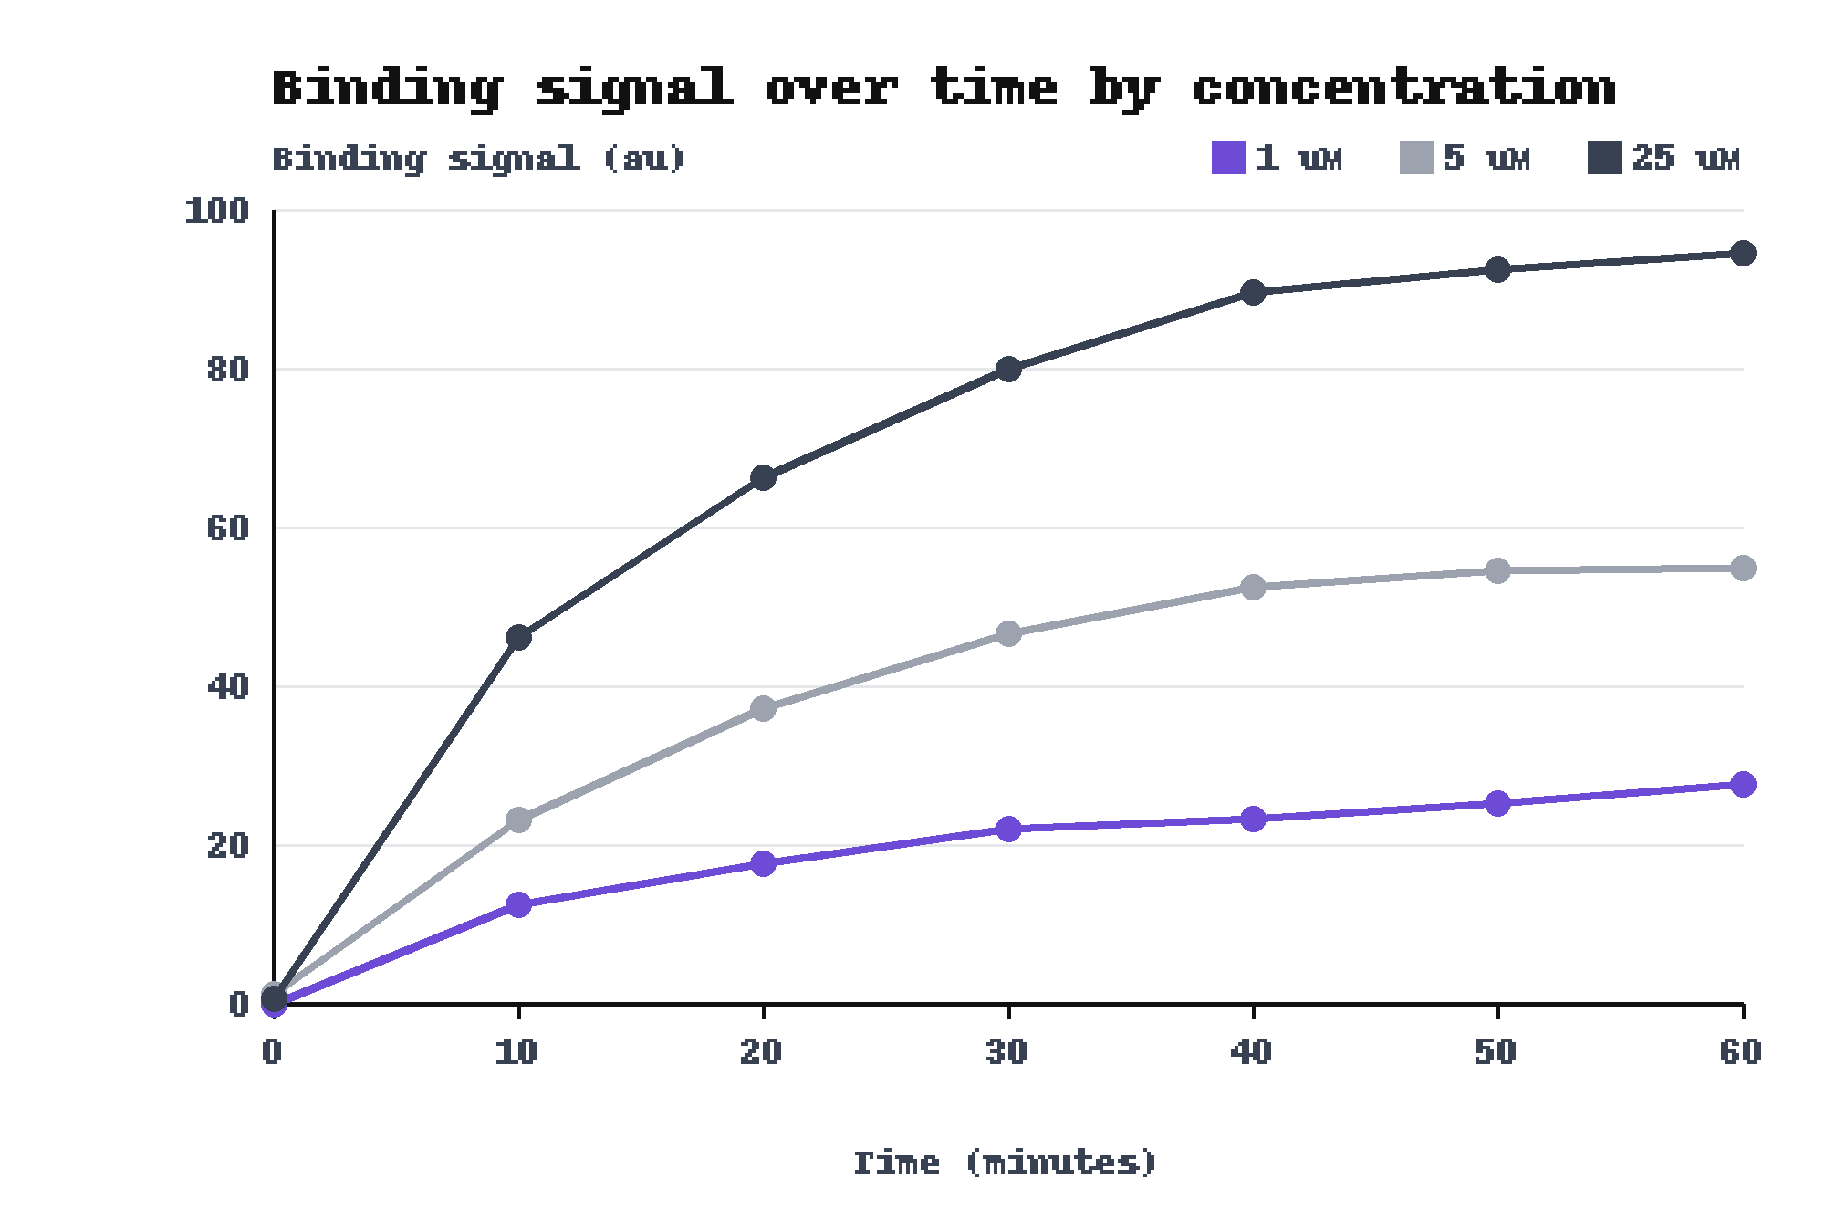
The Kestrel assay reads a signal that rises with concentration
• Reading: The signal of a design is the reading at 60 minutes.
• Hit: A hit is a design with a signal of at least 50 arbitrary units (au).
• Reference design: At 60 minutes it read 27.7 au at 1 uM and 94.5 au at 25 uM.
One reference design, 3 concentrations, 7 readings each.

Slide 5
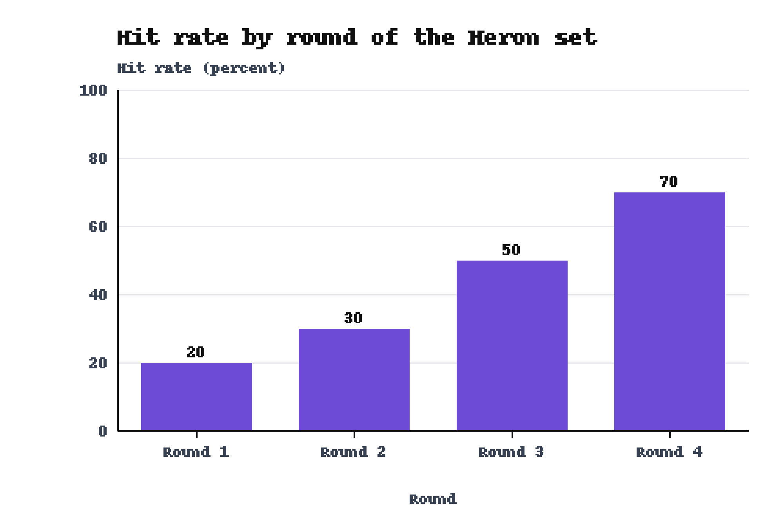
The hit rate rose from 20 percent to 70 percent in four rounds
• Rounds: Each round holds 10 designs, so one design moves the hit rate by 10 points.
• Middle rounds: Round 2 gave 30 percent and Round 3 gave 50 percent.
• Hit rate: The hit rate is the share of designs that are hits.
Baseline: Round 1 gave 20 percent.

Slide 6
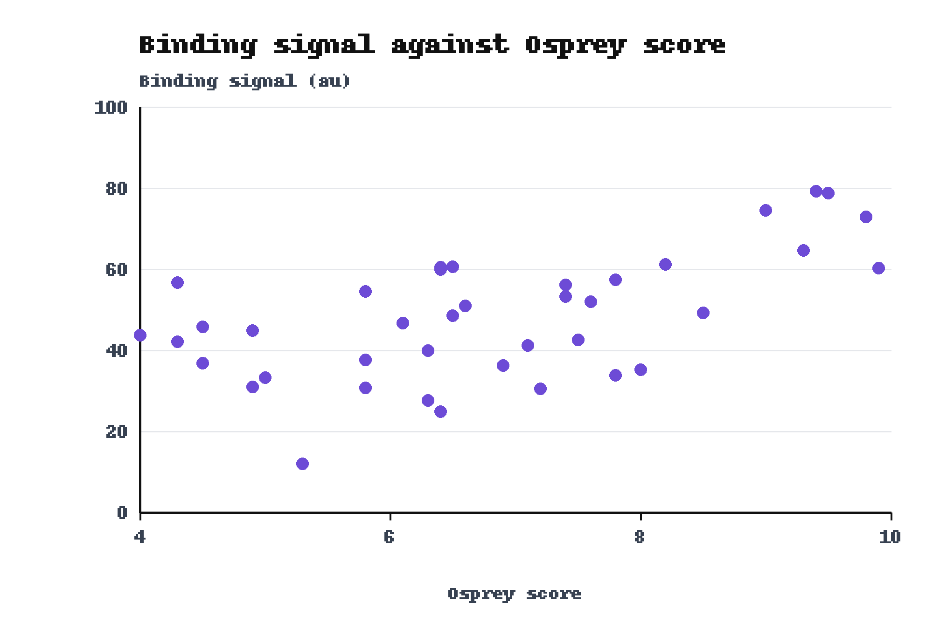
Designs with a higher Osprey score gave a higher binding signal
• Trend: Pearson r is 0.60 across the 40 designs.
• Top scores: The six designs scoring 9 or higher gave 60.3 to 79.2 au. All six are hits.
• Low scores: Only 2 of 13 designs scoring below 6 are hits.
Pearson r and hit counts: computed from results.csv (n = 40).

Slide 7
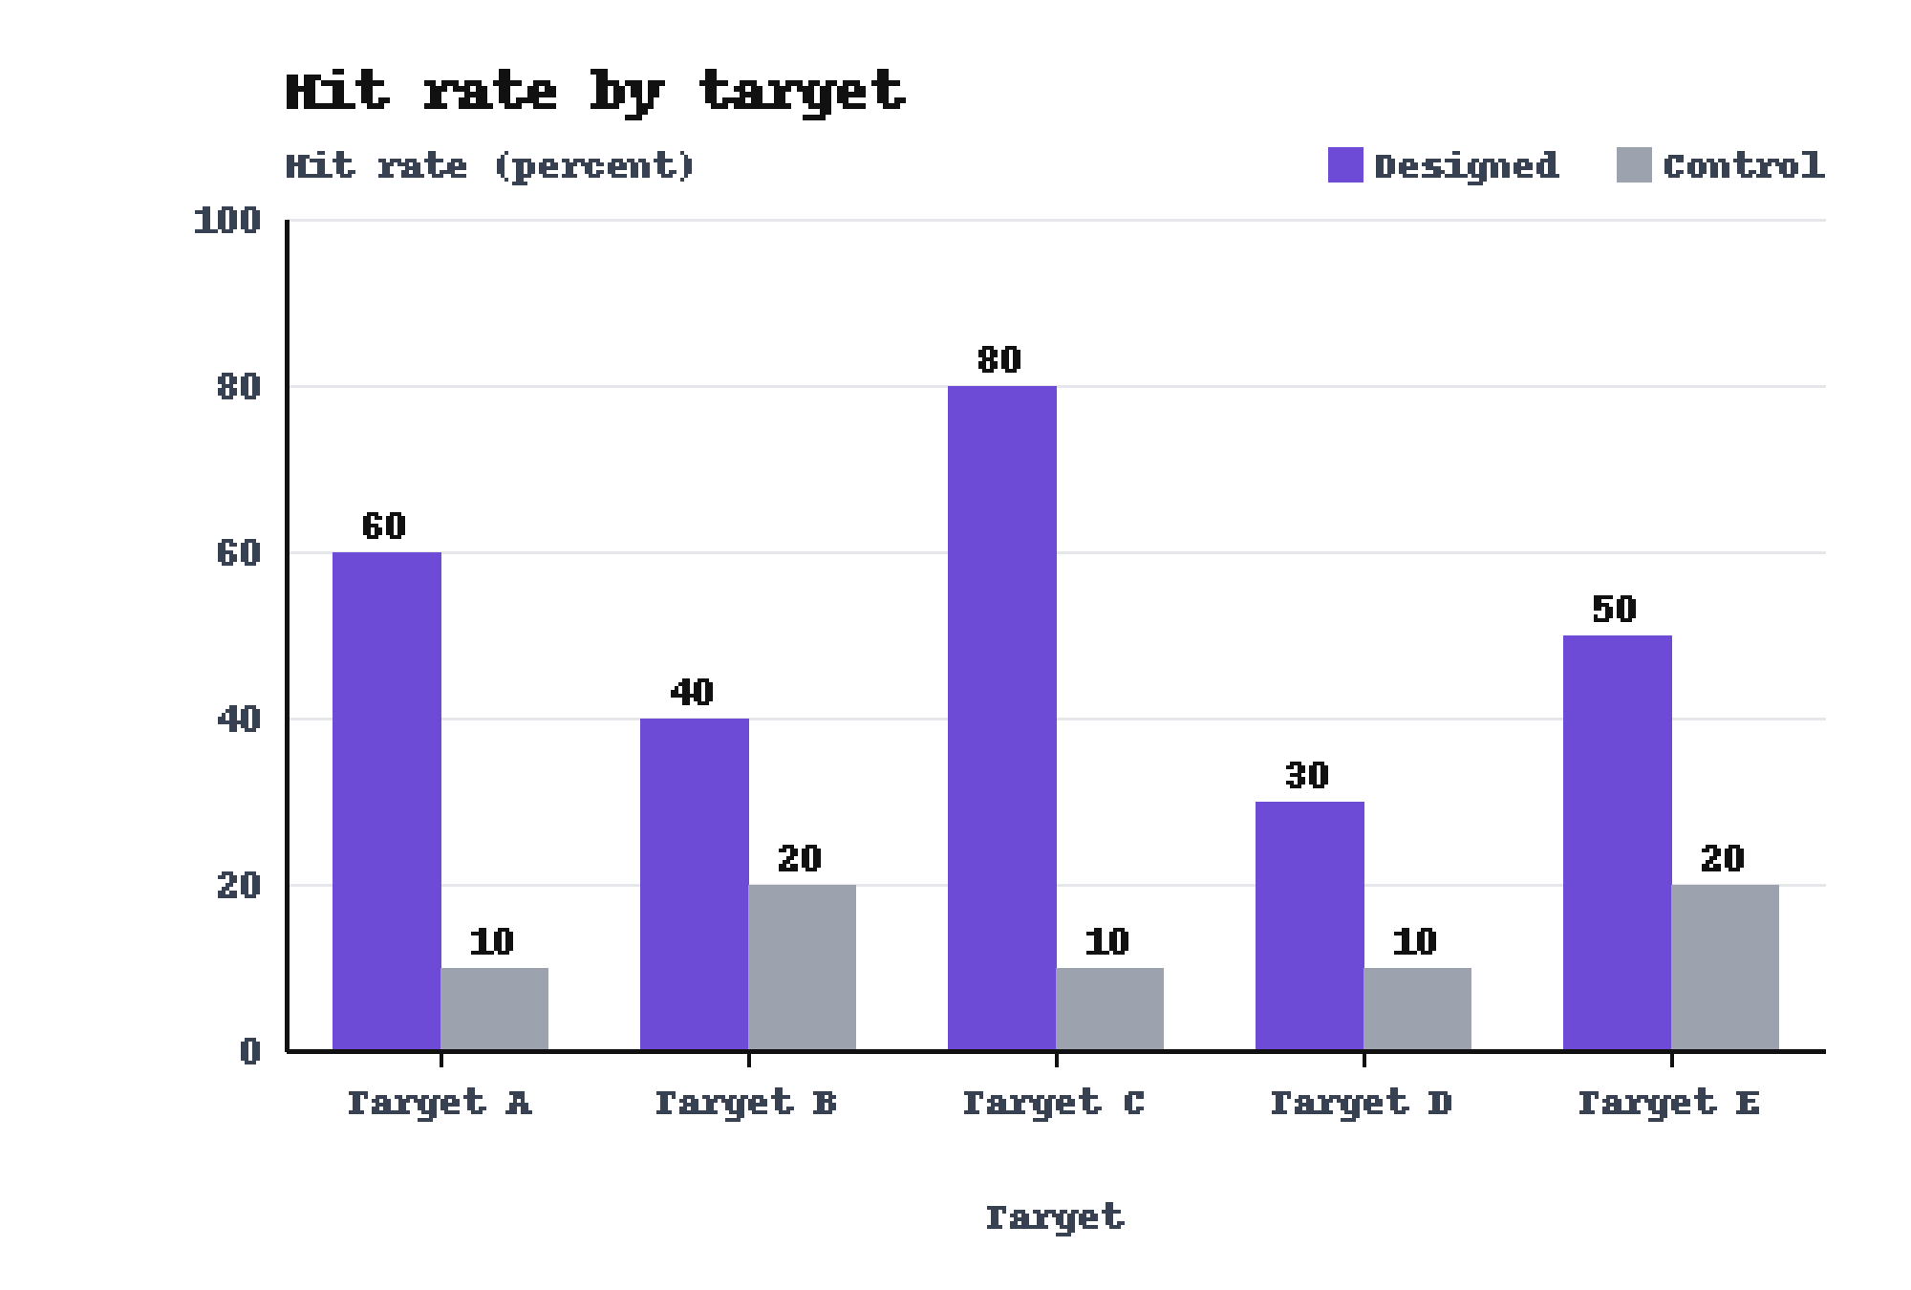
On Target C the designed set beat the control, 80 percent to 10 percent
• All targets: The designed set beat the control on each of the 5 targets.
• Group size: Each group holds 10 peptides.
• Set: These peptides do not belong to the Heron set.
Baseline: The control reached 10 percent.

Slide 8
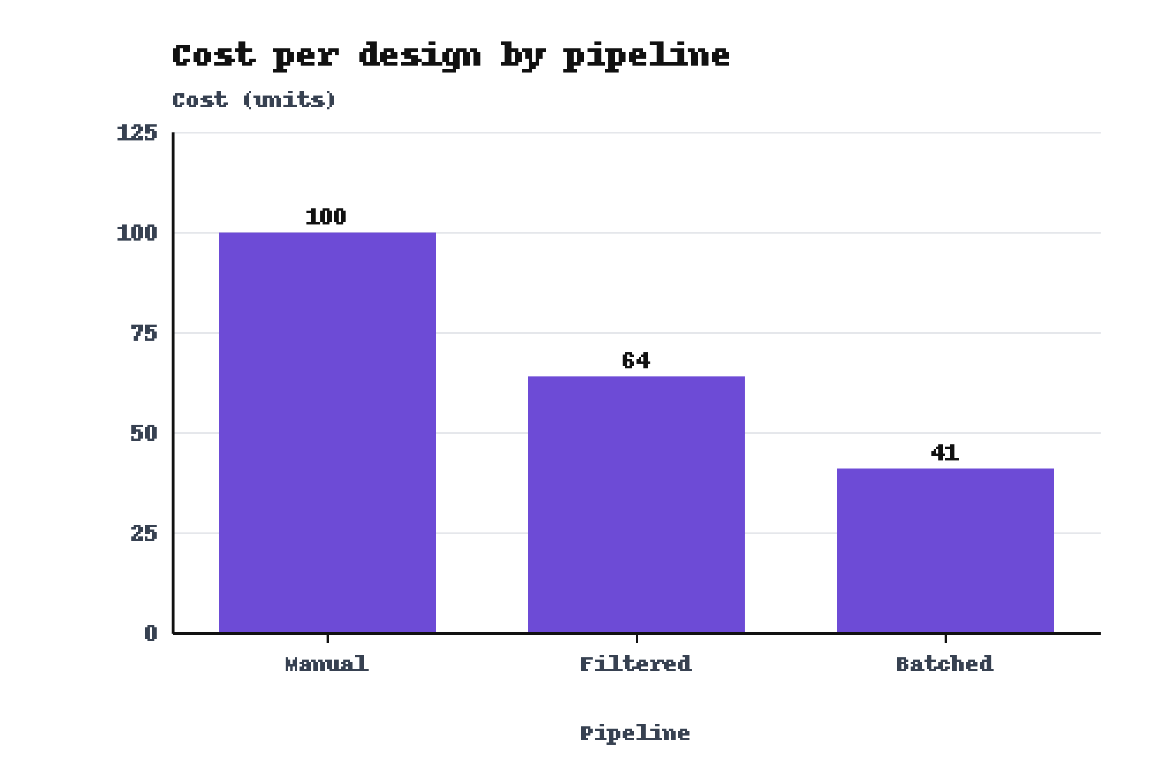
The Batched pipeline cost 41 units per design
• Comparison: The Batched pipeline cost 59 units less per design than the Manual pipeline.
• Middle: The Filtered pipeline cost 64 units per design.
Baseline: The Manual pipeline cost 100 units.

Slide 9
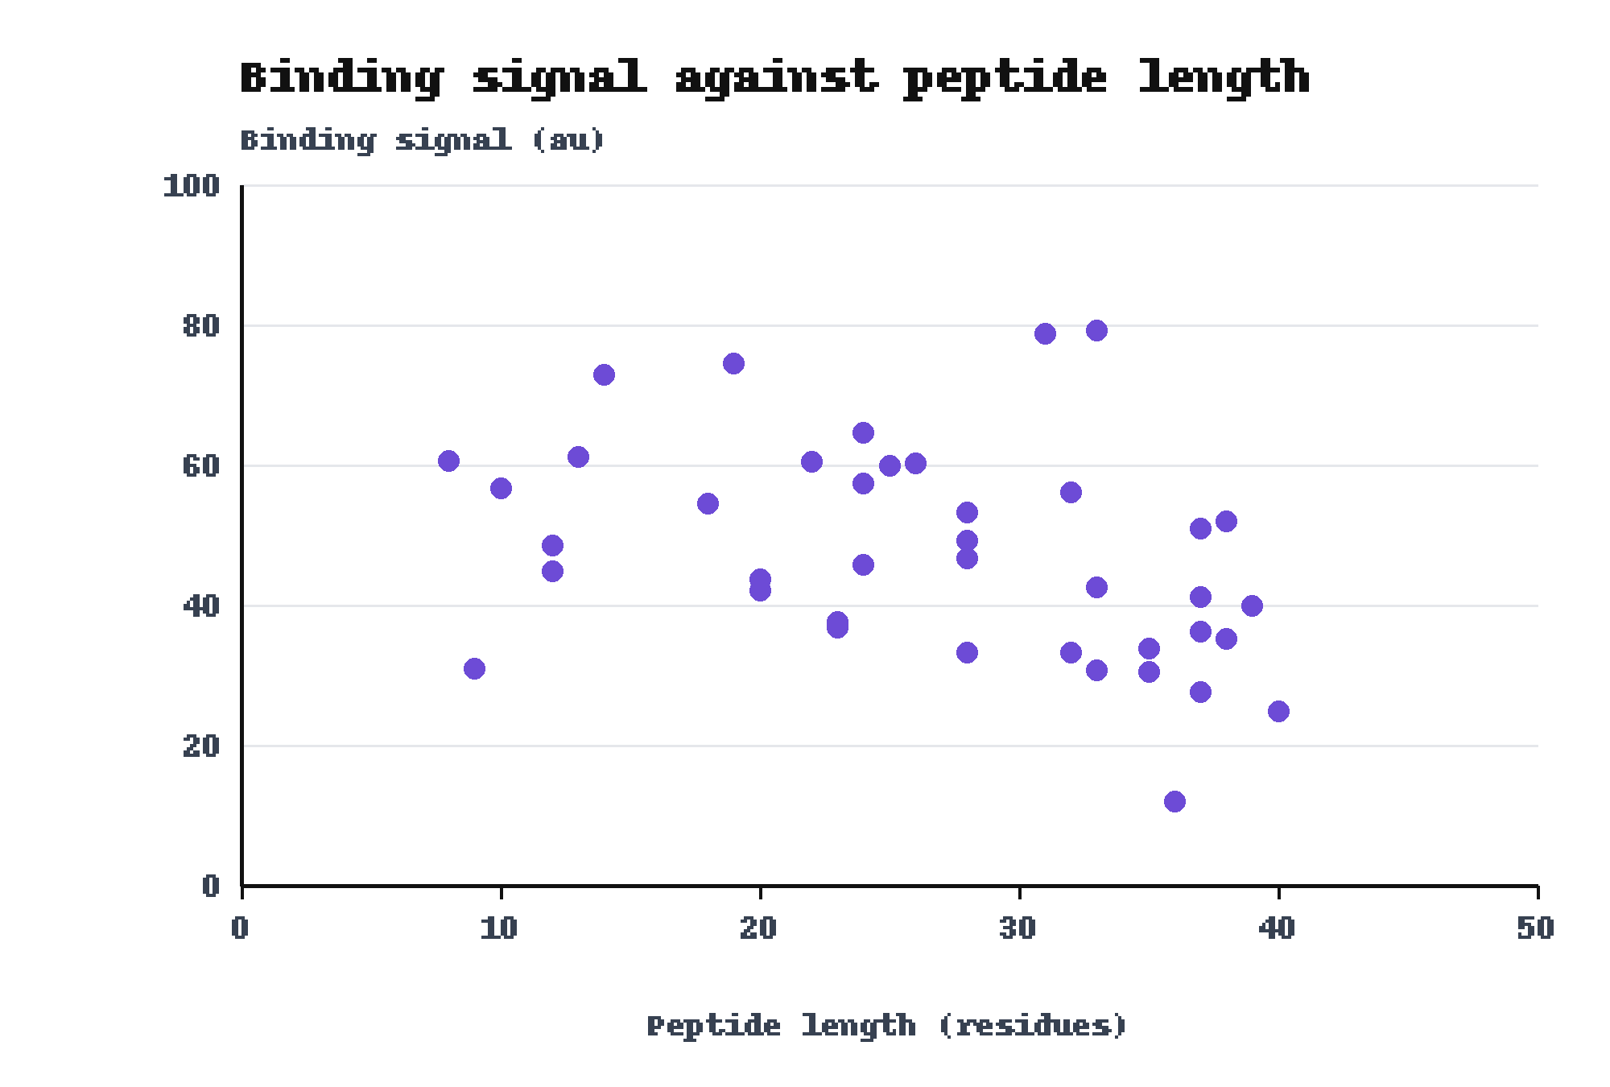
Binding signal tended to fall as peptide length rose in the Heron set
• Trend: Pearson r is -0.38 across the 40 designs.
• Shortest: The 8-residue peptide gave 60.6 au.
• Longest: The 40-residue peptide gave 24.9 au.
Pearson r: computed from results.csv (n = 40).

Slide 10
The study ran once, on one plate layout, with controls not matched for length
• Replicates: The study ran once, on one plate layout.
• Controls: The control peptides were not matched to the designed peptides for length.
• Group size: Each target group holds 10 peptides, so one peptide moves a hit rate by 10 points.
• Score range: The Mallard filter removed scores below 4, so the data cover scores from 4.0 to 9.9 only.

Slide 11
The next study repeats the assay on a second plate layout with length-matched controls
• Repeat: Run the Kestrel assay again on a second plate layout.
• Match: Build control peptides that match the designed peptides for length.
• Extend: Add designs with an Osprey score below 4 to cover the full score range.

Slide 12
The Osprey score picked designs that bound Target T
1. The hit rate rose from 20 percent to 70 percent in four rounds. Baseline: Round 1 gave 20 percent.
2. On Target C the designed set beat the control, 80 percent to 10 percent. Baseline: The control reached 10 percent.
3. The Batched pipeline cost 41 units per design. Baseline: The Manual pipeline cost 100 units.
Message: The Osprey score picked designs that bound Target T: the hit rate rose from 20 percent to 70 percent across four rounds.

Slide 13
Hit share rose from 2 of 13 designs to 7 of 9 across three Osprey score bands
Osprey score band | Designs | Hits | Hit share
4 to under 6 | 13 | 2 | 15 percent
6 to under 8 | 18 | 8 | 44 percent
8 to 10 | 9 | 7 | 78 percent
All 40 designs | 40 | 17 | 42.5 percent
A hit is a design with a binding signal of at least 50 au. Source: results.csv, 40 designs of the Heron set.

Slide 14
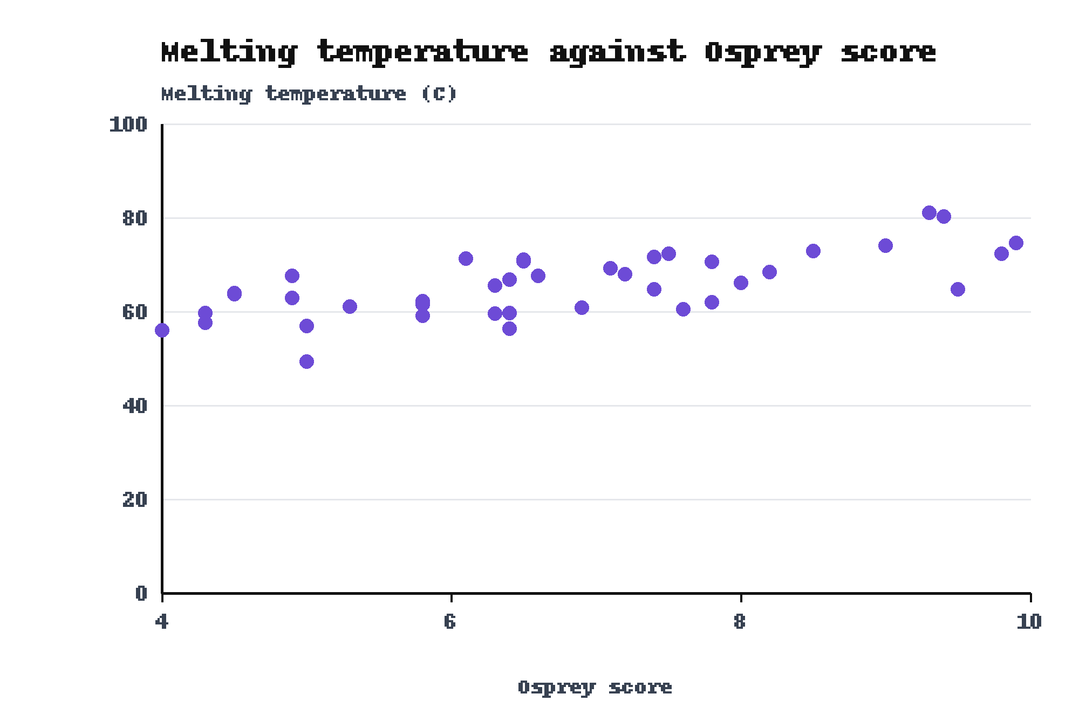
Melting temperature rose with Osprey score, up to 81.1 C at a score of 9.3
• Trend: Pearson r is 0.70 across the 40 designs.
• Highest: The most stable design melted at 81.1 C and had an Osprey score of 9.3.
Pearson r: computed from results.csv (n = 40).

Slide 15
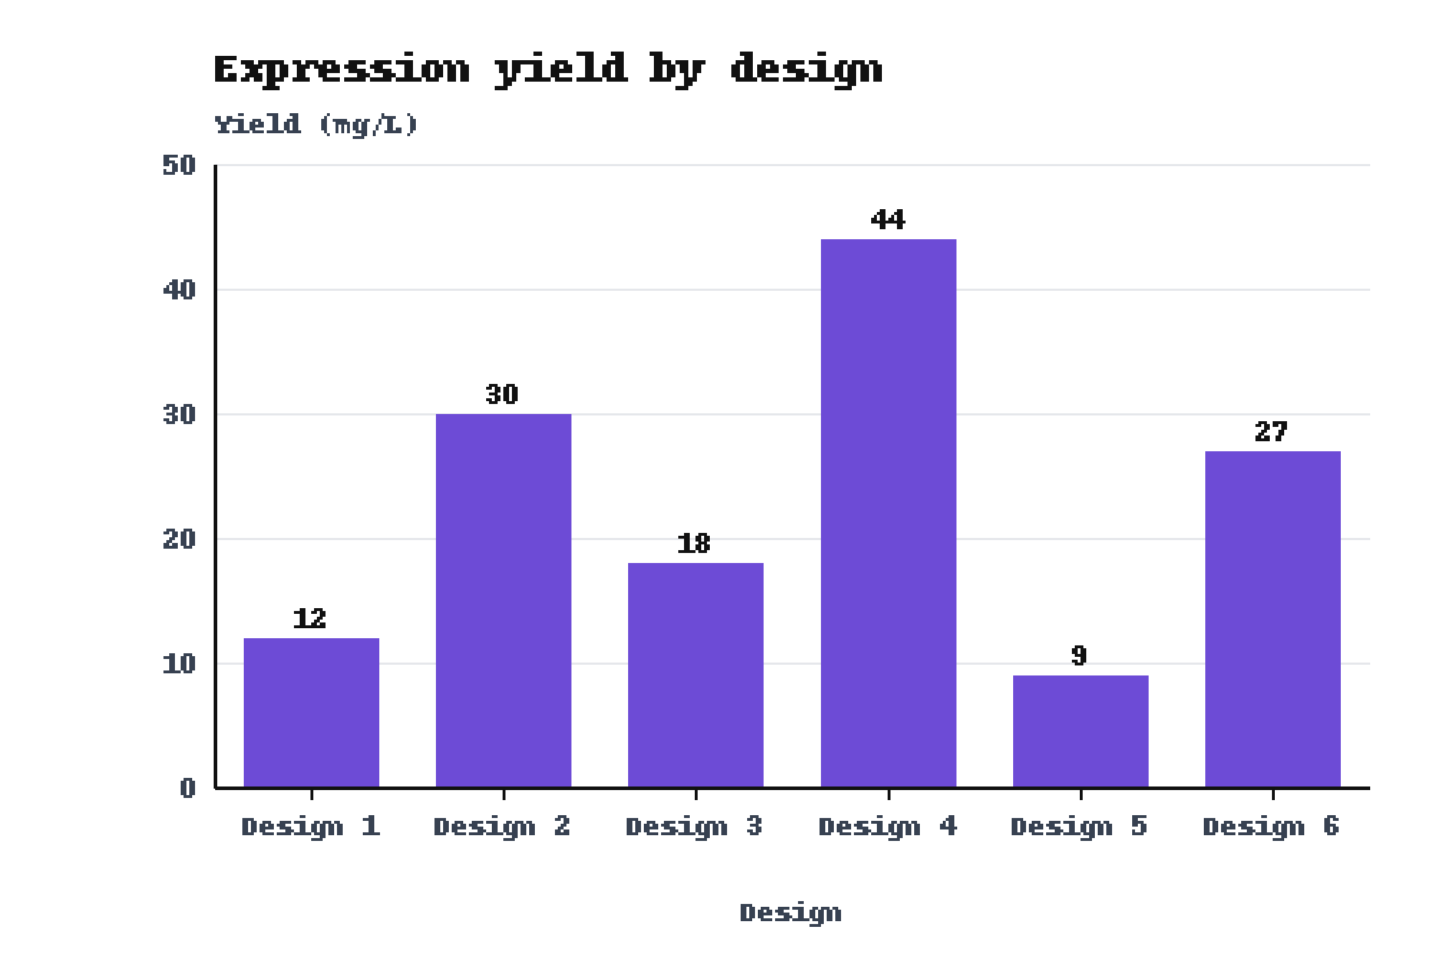
Expression yield of the 6 designs ranged from 9 to 44 mg/L
• Highest: Design 4 gave the best yield, 44 mg/L.
• Lowest: Design 5 gave the lowest yield, 9 mg/L.
The 6 designs belong to the Heron set.

