Slide 1
The Osprey score picks designs that bind Target T
A. Author
Example Lab
October 2026

Slide 2
A score helps only if its top-ranked designs bind Target T in the assay
Question: Does the Osprey score pick designs that bind Target T in the Kestrel assay?
• Score: The Osprey score ranks each design from 0 to 10 before the assay.
• Data: The Heron set holds 40 designs, built in 4 rounds of 10 designs each.
• Filter: The Mallard filter drops each design with a score below 4. Each design of the Heron set passed the filter.

Slide 3
Each design gets an Osprey score, passes the Mallard filter, and is assayed
Design
|
v
Osprey score (0 to 10)
|
v
Mallard filter (drops score < 4)
|
v
Kestrel assay (signal at 60 min)
|
v
Hit (signal >= 50 au)
• Filter: scores run from 4.0 to 9.9 because the filter removes lower scores
• Hit rate: the share of designs in a group that are hits

Slide 4
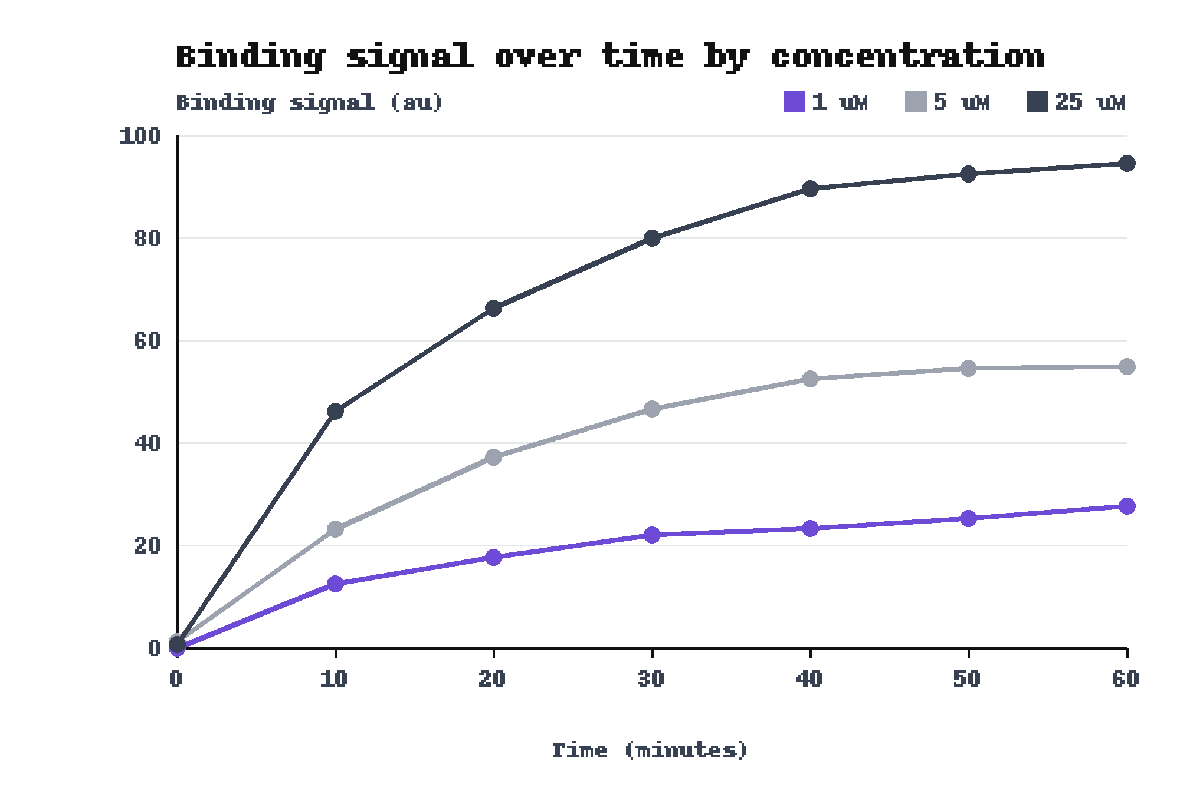
The Kestrel assay reads binding at 60 minutes, and a hit needs at least 50 au
• Plate assay: reads the binding signal every 10 minutes for 60 minutes
• Signal: the reading at 60 minutes
• Hit: a signal of at least 50 arbitrary units (au)
One reference design at 3 concentrations, 7 readings each. At 60 minutes: 94.5 au at 25 uM and 27.7 au at 1 uM.

Slide 5
Three comparisons carry the result, and each one has its own baseline
Comparison | Measure | Baseline
Hit rate across the four rounds | Round 4 hit rate | Round 1 hit rate
Designed set against control | Hit rate on Target C | Control hit rate on Target C
Pipeline cost per design | Batched pipeline cost | Manual pipeline cost

Slide 6
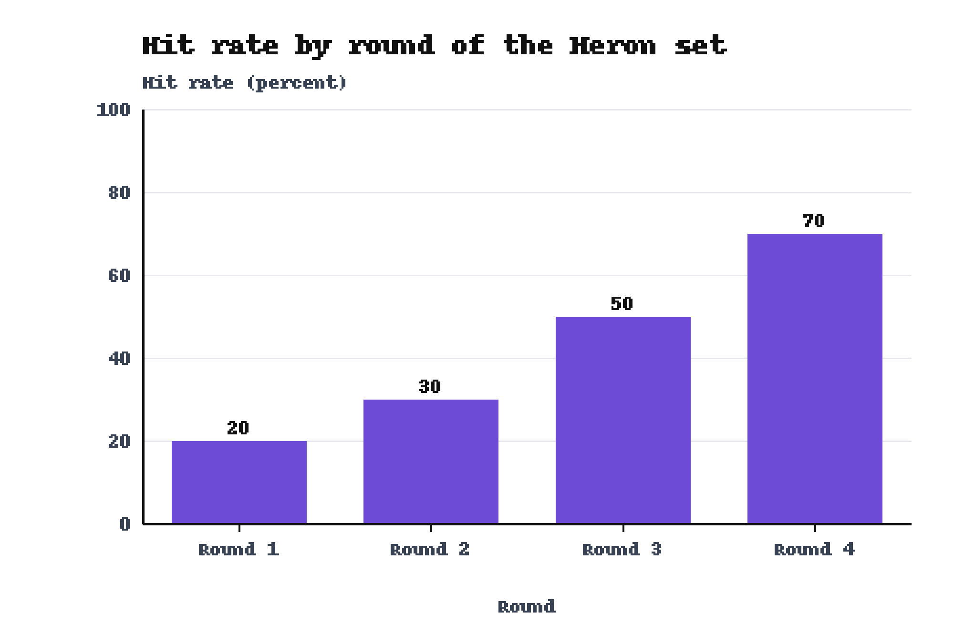
The hit rate rose from 20 percent in Round 1 to 70 percent in Round 4
• Round 1: 2 of 10 designs were hits (20 percent)
• Round 4: 7 of 10 designs were hits (70 percent)
• All rounds: 17 of 40 designs were hits
A hit is a signal of at least 50 au. Each round holds 10 designs.

Slide 7
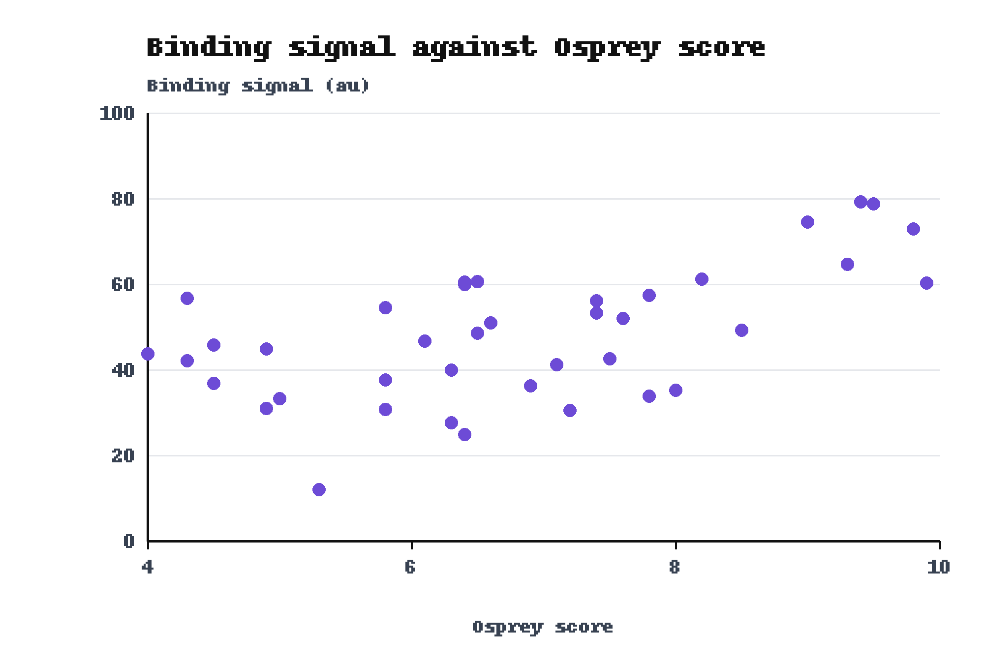
Designs with higher Osprey scores gave hits more often
• Score below 6: 2 of 13 designs were hits
• Score 6 to below 8: 8 of 18 designs were hits
• Score 8 or more: 7 of 9 designs were hits
A hit is a signal of at least 50 au. The score bins were set after the data were in. Spearman correlation of score and signal: 0.53 (n = 40).

Slide 8
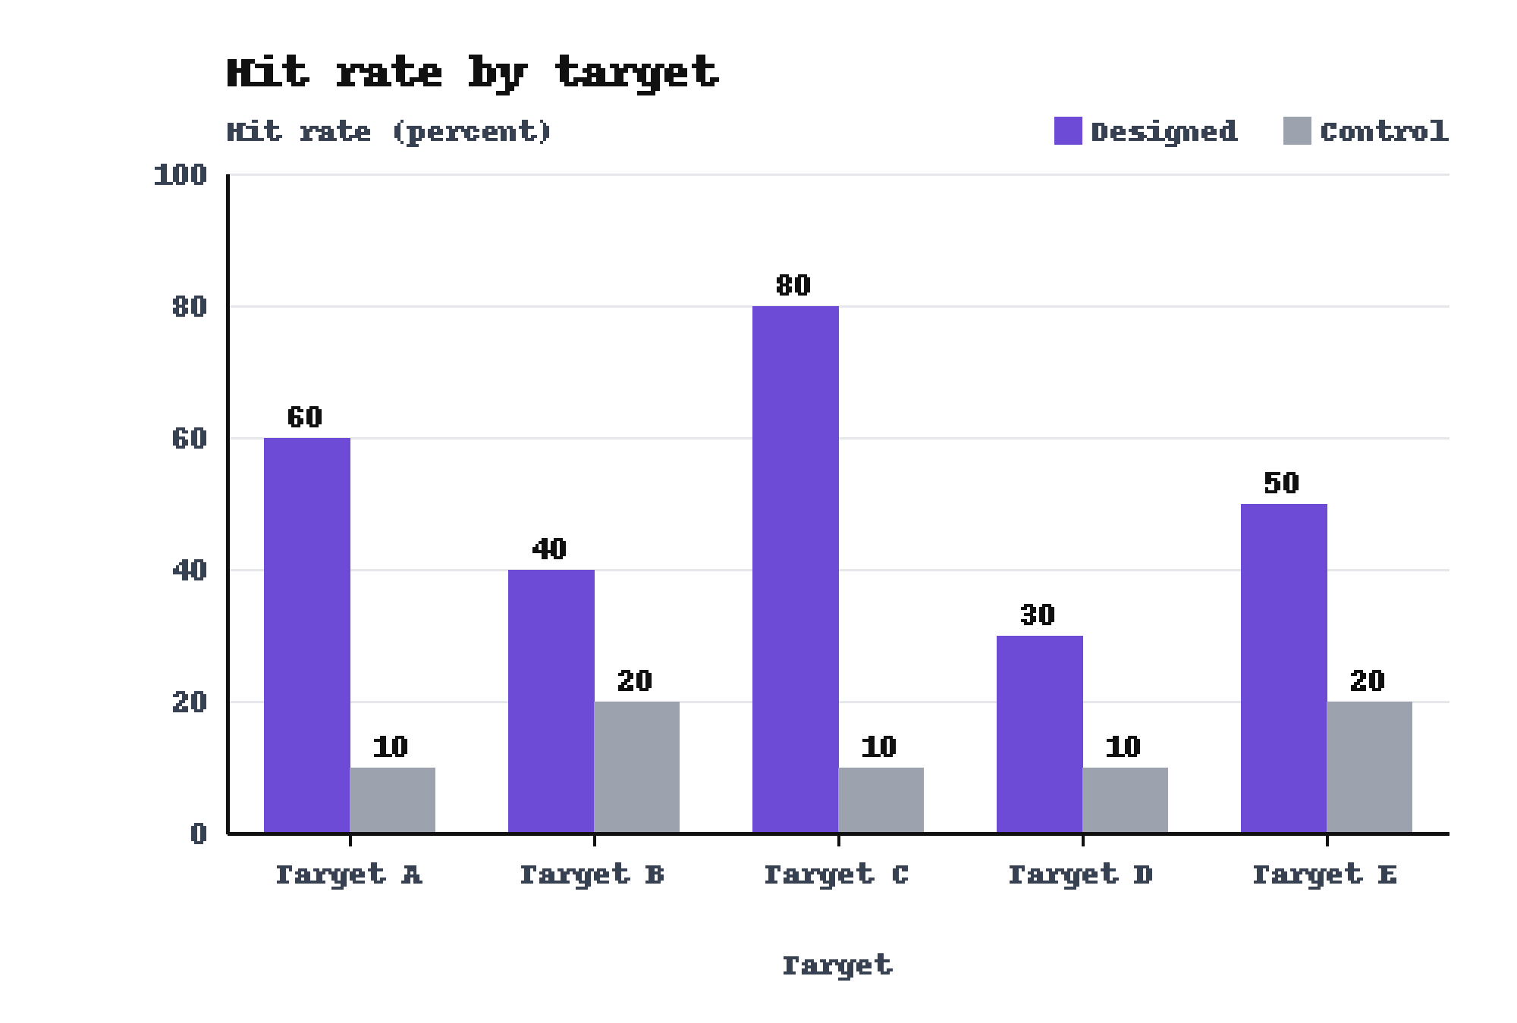
On Target C the designed set beat the control, 80 percent to 10 percent
• Target C: designed set 80 percent, control 10 percent
• All 5 targets: the designed set beat the control on each
• Control range: 10 to 20 percent hit rate
Each group holds 10 peptides per target. These peptides do not belong to the Heron set. The control peptides were not matched to the designed peptides for length.

Slide 9
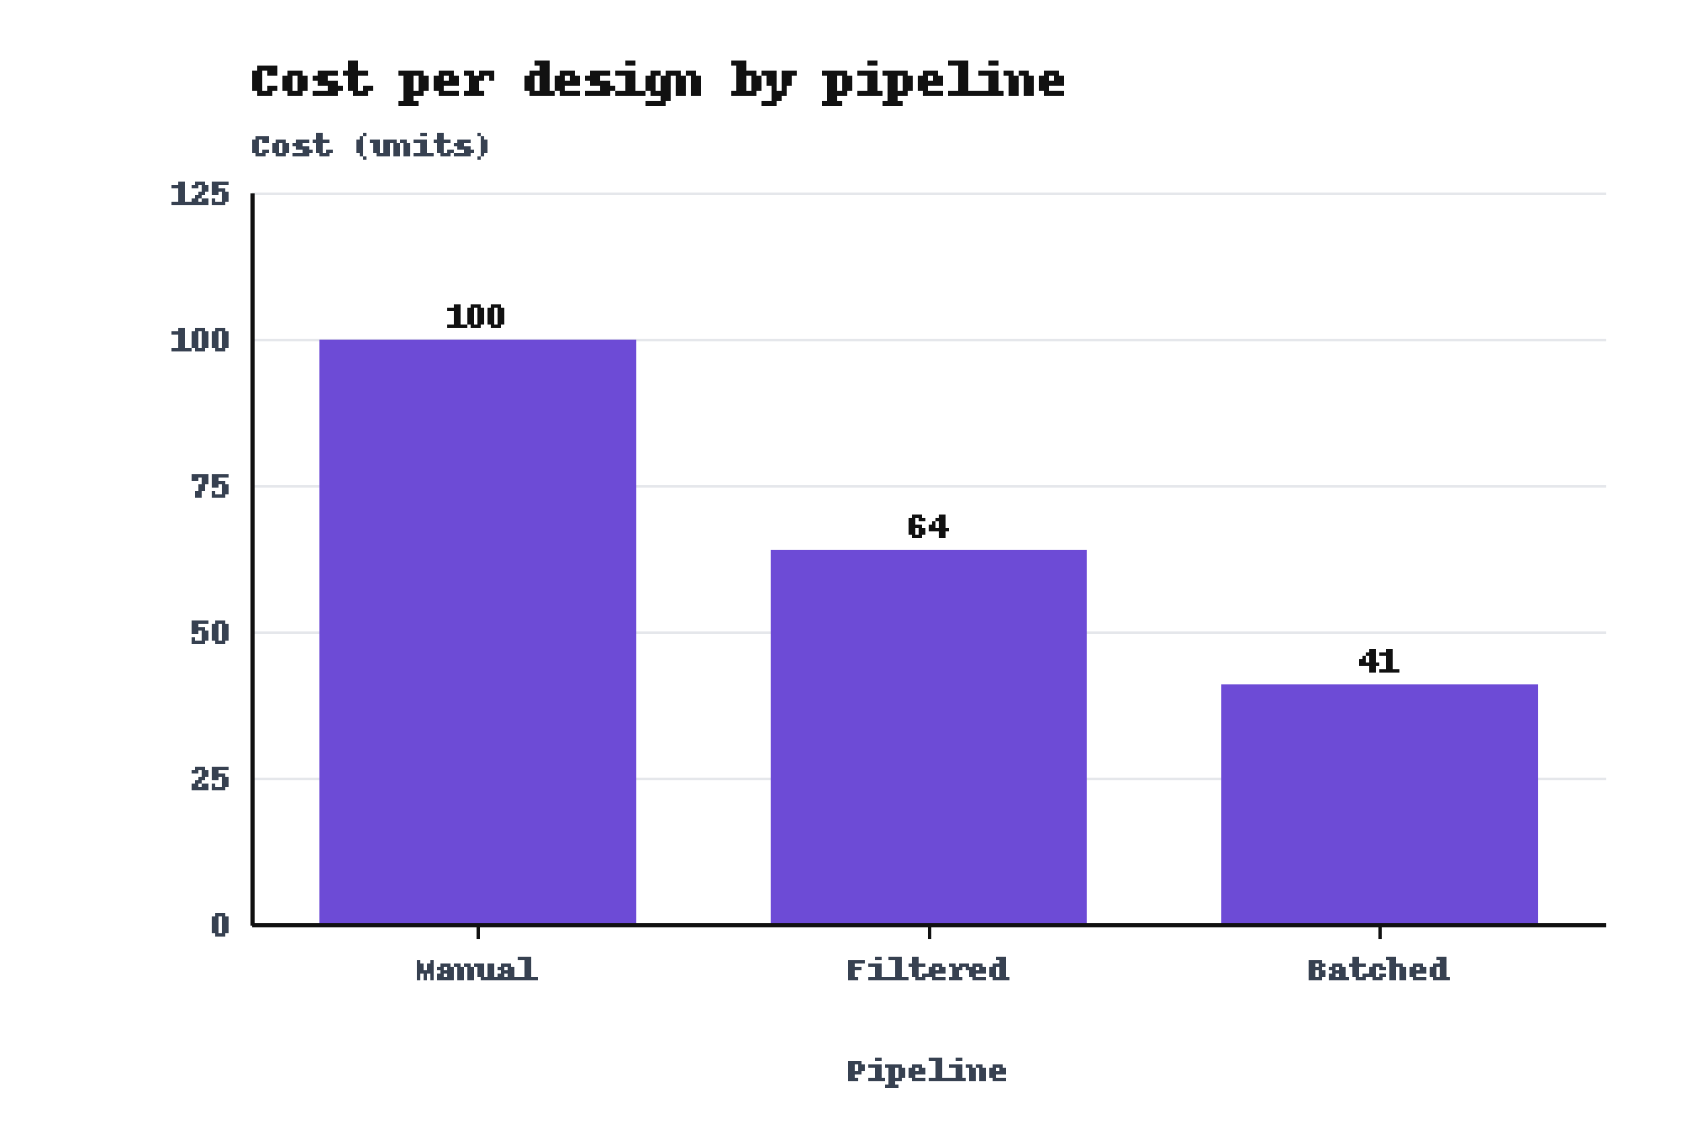
The Batched pipeline cost 41 units per design against 100 for the Manual pipeline
• Batched: 41 units per design
• Filtered: 64 units per design
• Manual: 100 units per design, the baseline

Slide 10
One plate layout and unmatched control lengths limit what these results show
• Single run: The study ran once, on one plate layout.
• Control length: The control peptides were not matched to the designed peptides for length.
• Separate sets: The Target C control comparison used peptides outside the Heron set.
• Score range: The Mallard filter removed scores below 4, so the data cover scores 4.0 to 9.9.
• Length: Longer peptides gave lower signals in the Heron set (backup slide).

Slide 11
The next test needs a second plate layout and length-matched controls
• Replicate: Run the assay again on a second plate layout.
• Match: Build a control set that matches the designed peptides for length.
• Link rounds to scores: Test whether the Osprey score caused the rise in hit rate across the rounds.

Slide 12
Higher Osprey scores gave more hits, and the hit rate rose from 20 to 70 percent
1. The hit rate rose from 20 percent in Round 1 to 70 percent in Round 4.
2. On Target C the designed set beat the control, 80 percent to 10 percent.
3. The Batched pipeline cost 41 units per design; the Manual pipeline cost 100.
4. Hits were 7 of 9 designs scoring 8 or more and 2 of 13 scoring below 6.
Limit: one plate layout, and control peptides not matched for length.

Slide 13
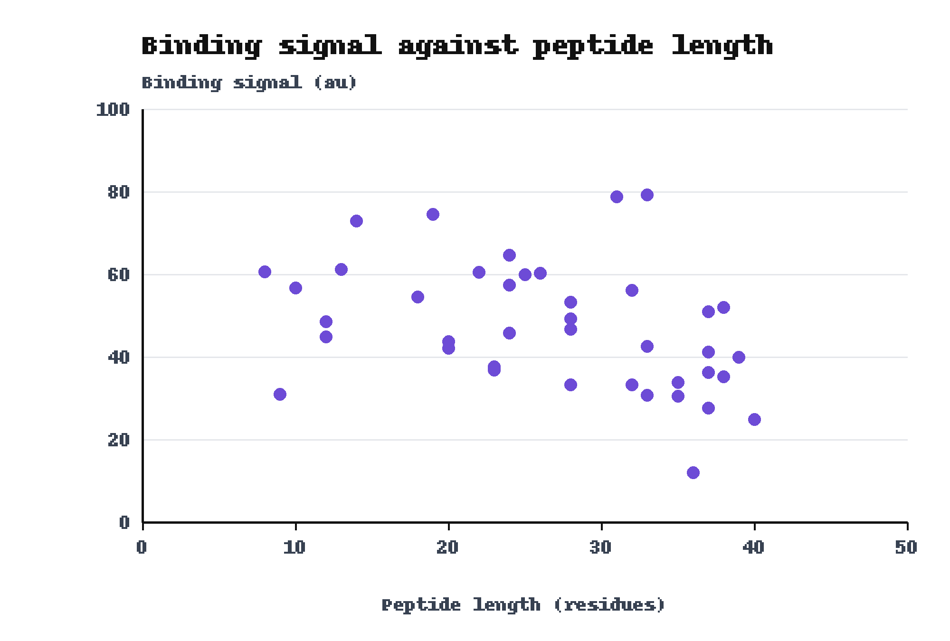
Longer peptides gave lower binding signals in the Heron set
• Longest: 40 residues gave 24.9 au
• Shortest: 8 residues gave 60.6 au
• Trend: Spearman correlation -0.45 across 40 designs
Backup slide. Same 40 designs as the plot of signal against Osprey score.

Slide 14
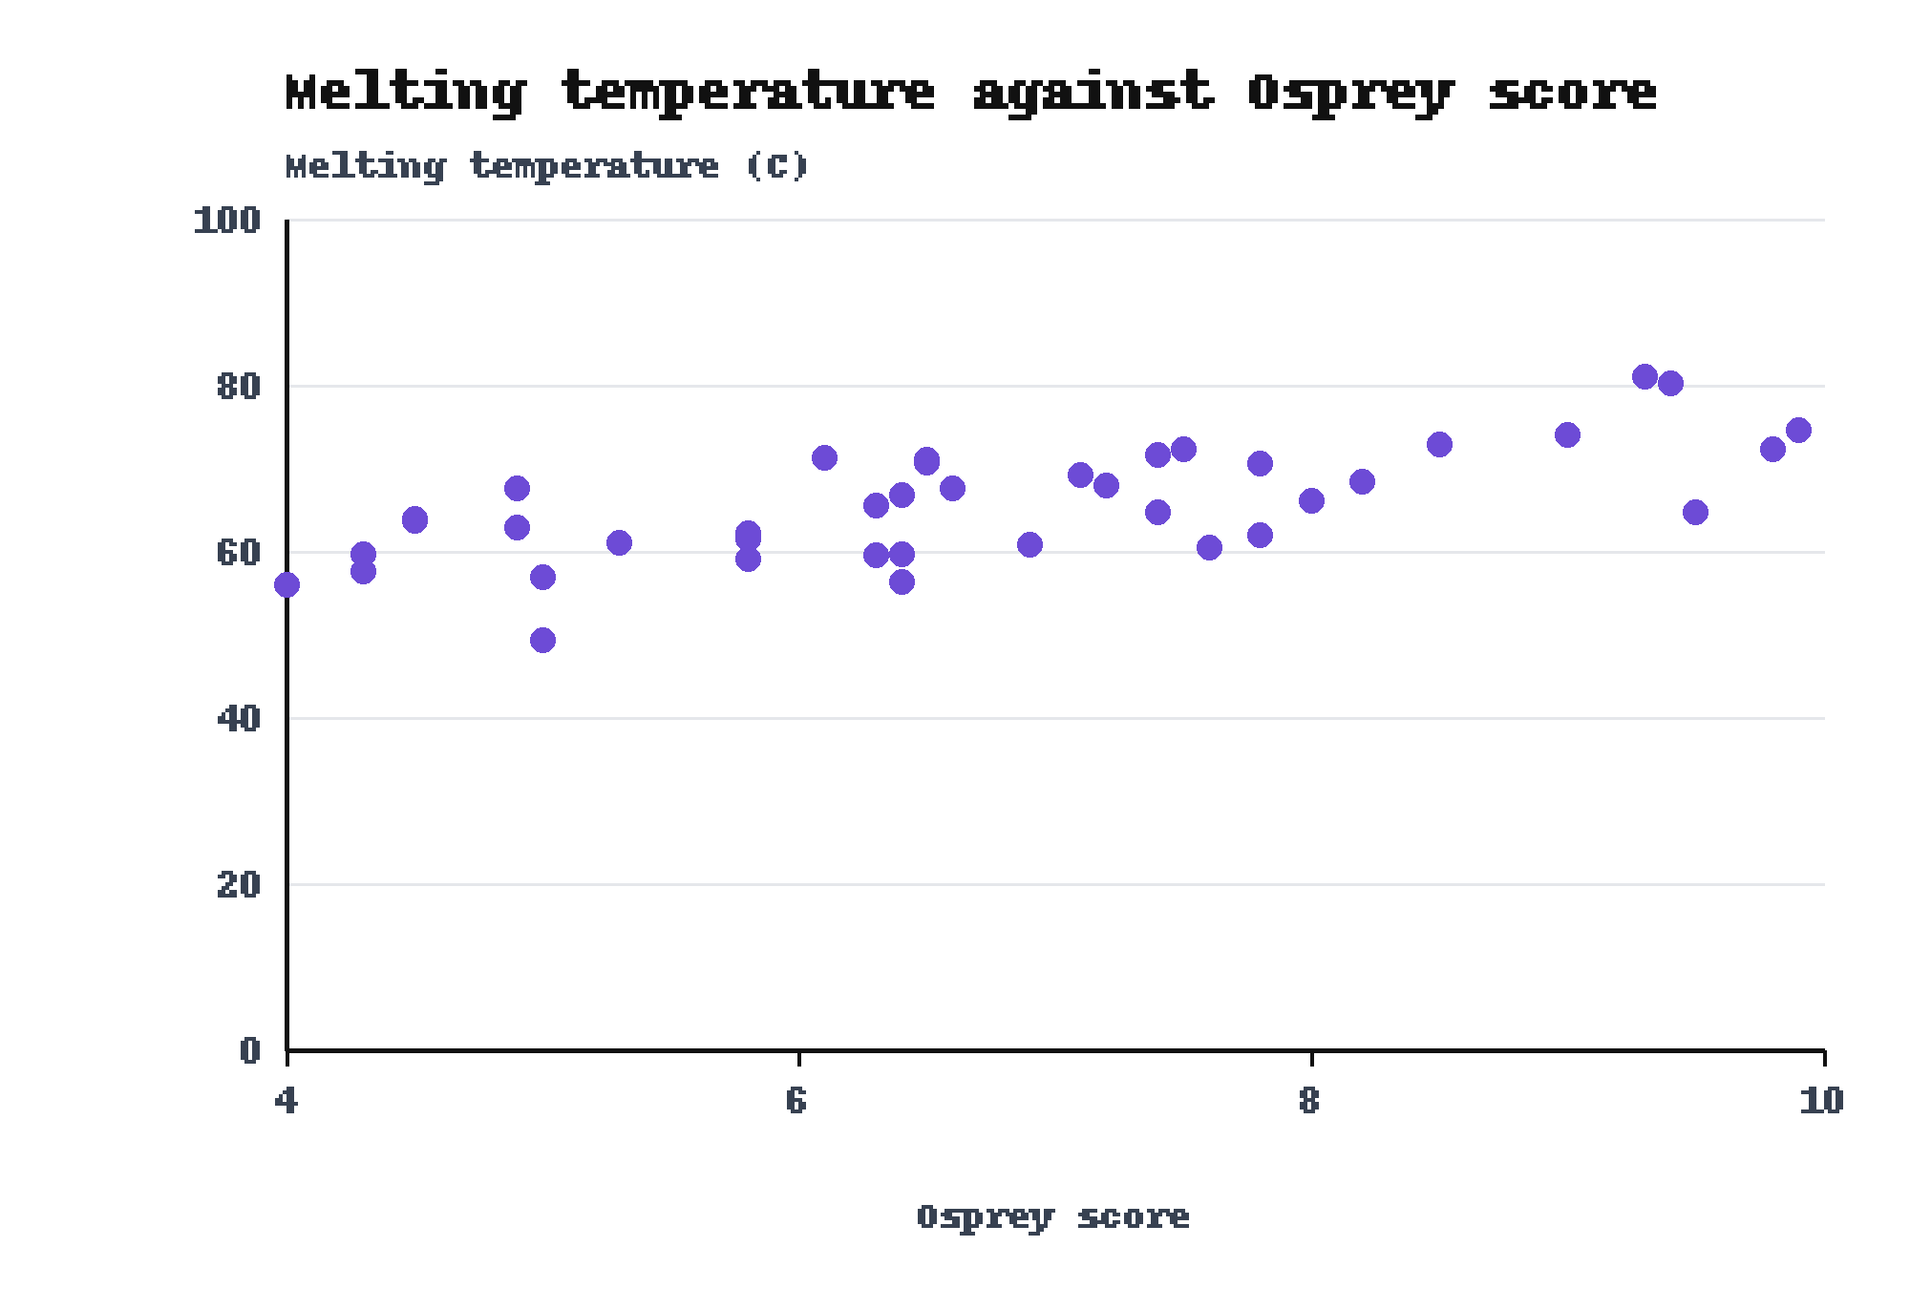
Higher Osprey scores went with higher melting temperatures
• Most stable: 81.1 C at an Osprey score of 9.3
• Trend: Spearman correlation 0.69 across 40 designs
Backup slide. Same 40 designs as the plot of signal against Osprey score.

Slide 15
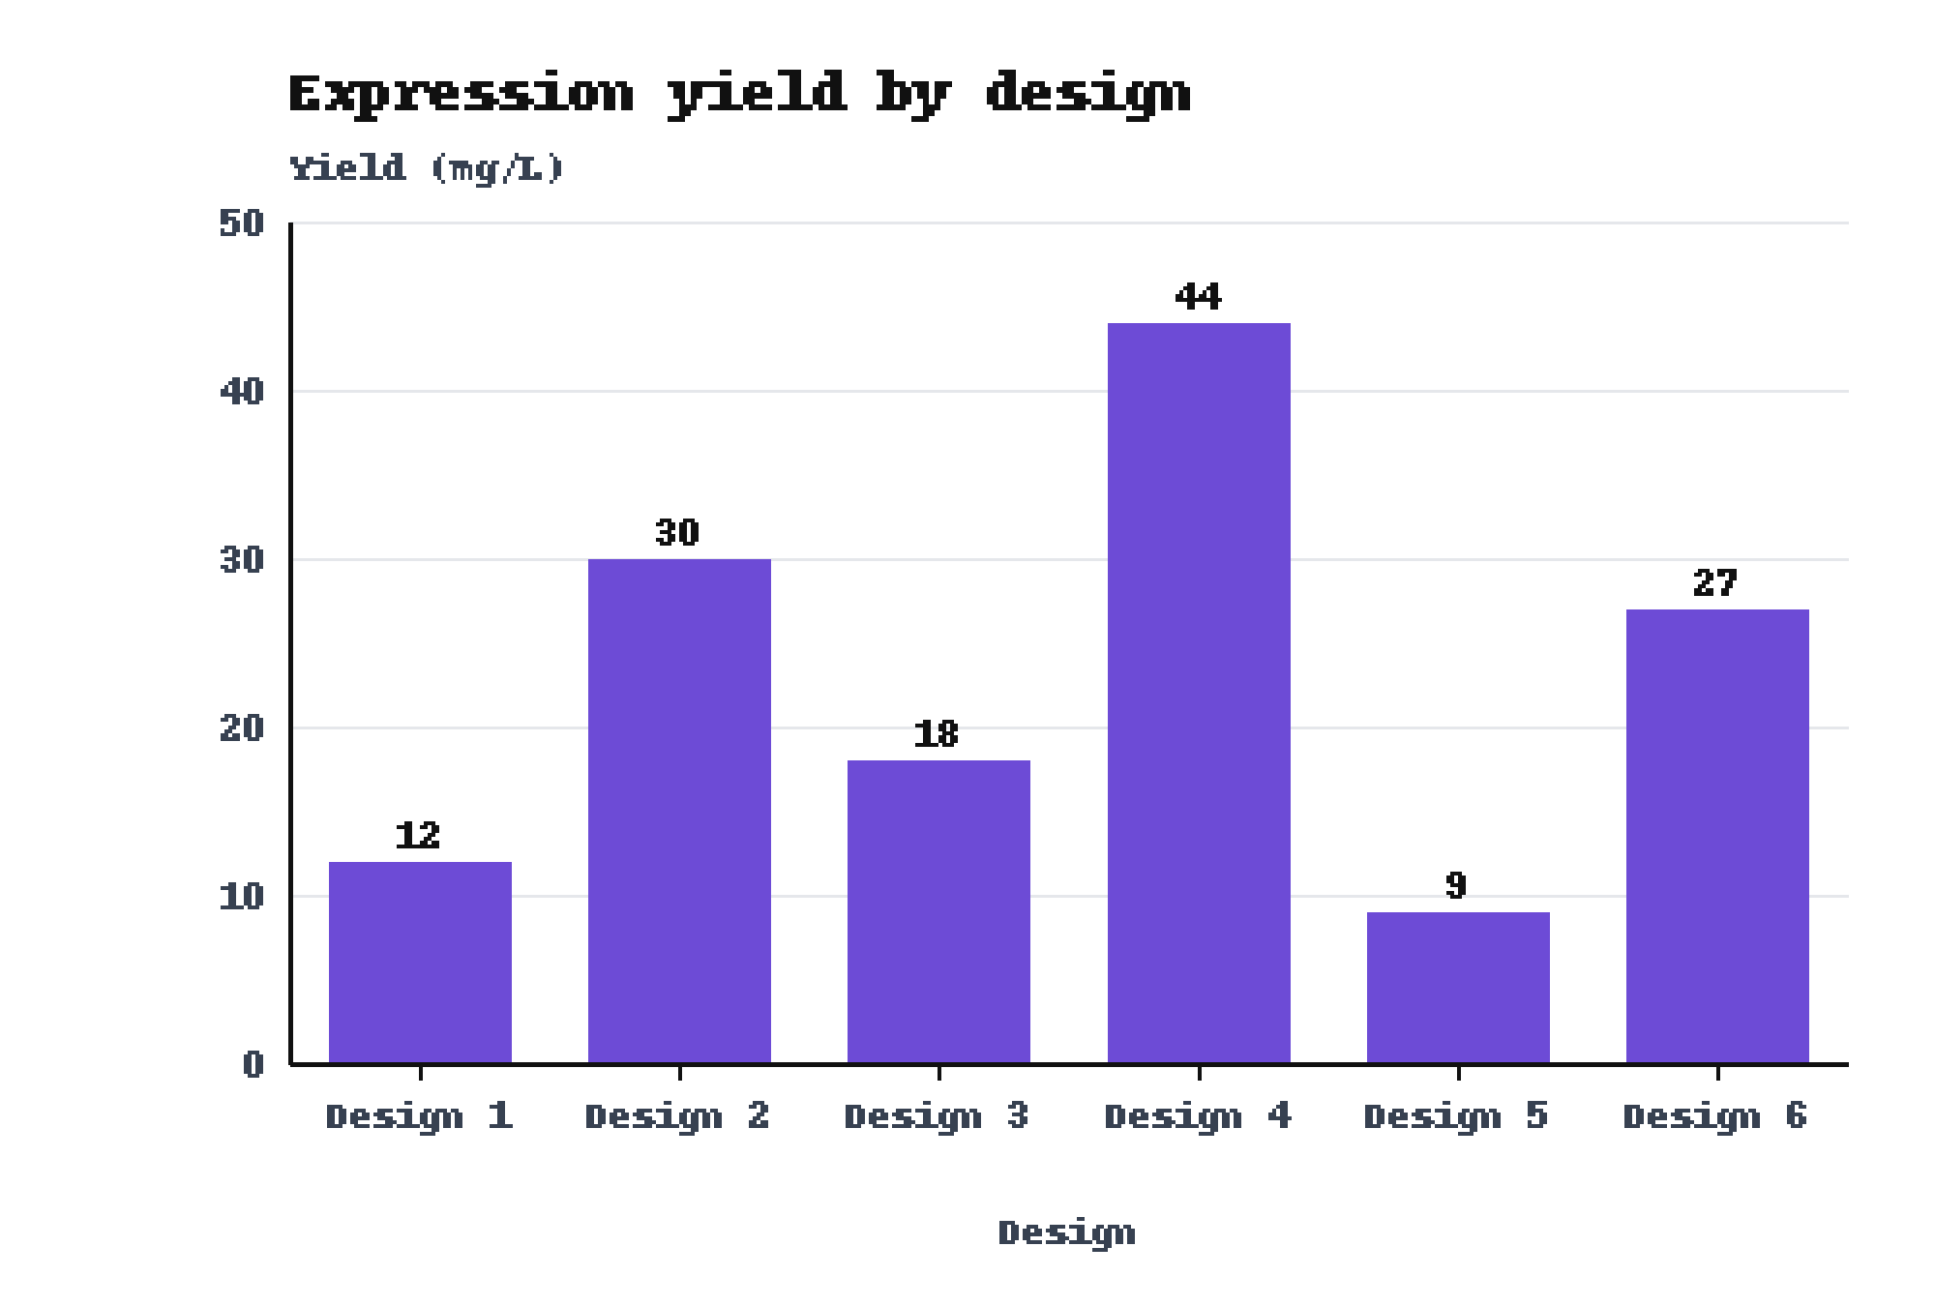
Expression yield ranged from 9 mg/L for Design 5 to 44 mg/L for Design 4
• Best yield: Design 4 gave 44 mg/L
• Lowest yield: Design 5 gave 9 mg/L
• Sample: 6 designs of the Heron set
Backup slide.

