Slide 1
The Osprey score picks designs that bind Target T
A. Author
Example Lab
October 2026
Notes:
Say who you are and name the question of the study: does the Osprey score pick designs that bind Target T in the Kestrel assay? The project notes label every name and number as invented. Remove this line for a real talk.

Slide 2
The Osprey score picked designs that bound Target T: the hit rate rose from 20 percent to 70 percent across four rounds.
Need
Approach
Evidence
Take-homes
The gap to close
Score and filter
Rounds, controls, cost
Claims to keep
Notes:
Say the message aloud before you name the parts. Slides 3 to 8 hold the body of the talk. Backup slides follow the last slide, for questions about the assay and about length.

Slide 3
Only 20 percent of Round 1 designs bound Target T.
20%
Baseline: a hit is 50 au or more.
hit rate in Round 1
results.csv, fig1
Notes:
The Kestrel assay reads the binding signal at 60 minutes. Each round holds 10 designs. Ask the room what hit rate they would accept before you show the later rounds.

Slide 4
The Osprey score ranks each design before the assay.
Term | Meaning
Osprey score | Ranks a design, 0 to 10
Mallard filter | Drops scores below 4
notes.md, Methods
Notes:
The Heron set holds 40 designs of a fictional peptide family. The team built it in four rounds of 10 designs. Each design passed the Mallard filter, so every score in the set is 4 or higher. The assay is a plate assay that reads the signal every 10 minutes for 60 minutes.

Slide 5
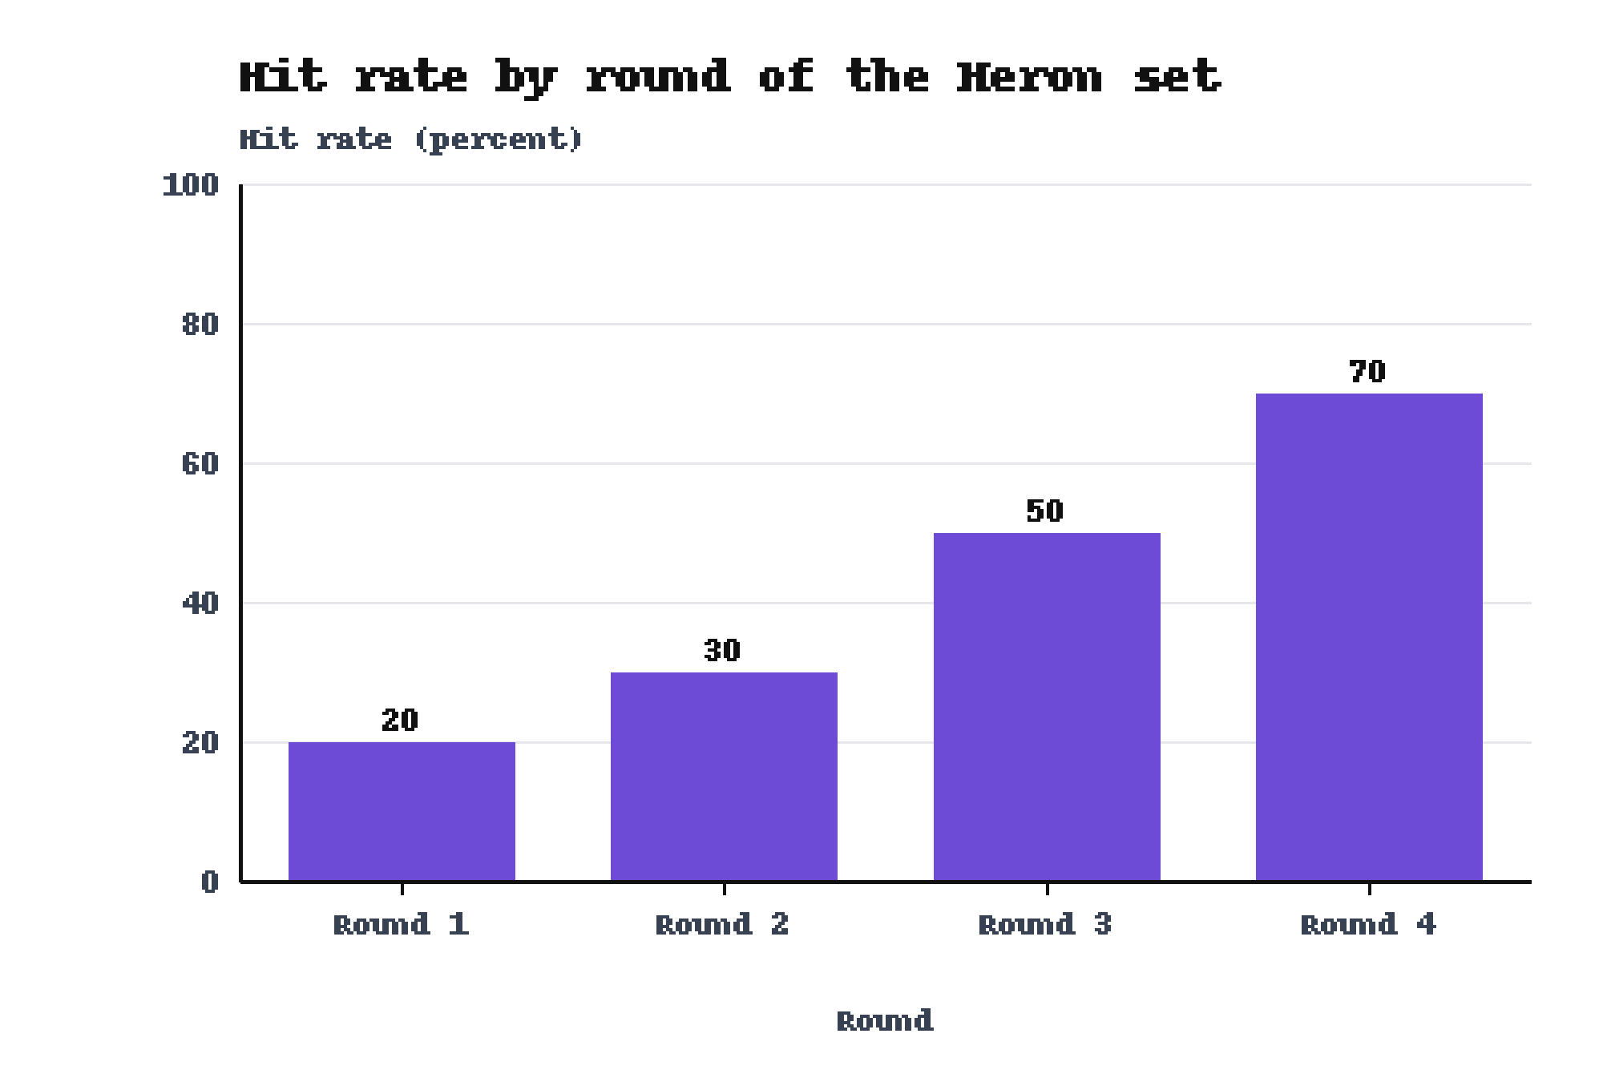
The hit rate rose from 20 percent in Round 1 to 70 percent in Round 4.
Round 4: 70 percent
results.csv, fig1
Notes:
The team built the Heron set of 40 designs in four rounds. The study ran once, on one plate layout, so the rounds carry no replicate. Say so before a question asks.

Slide 6
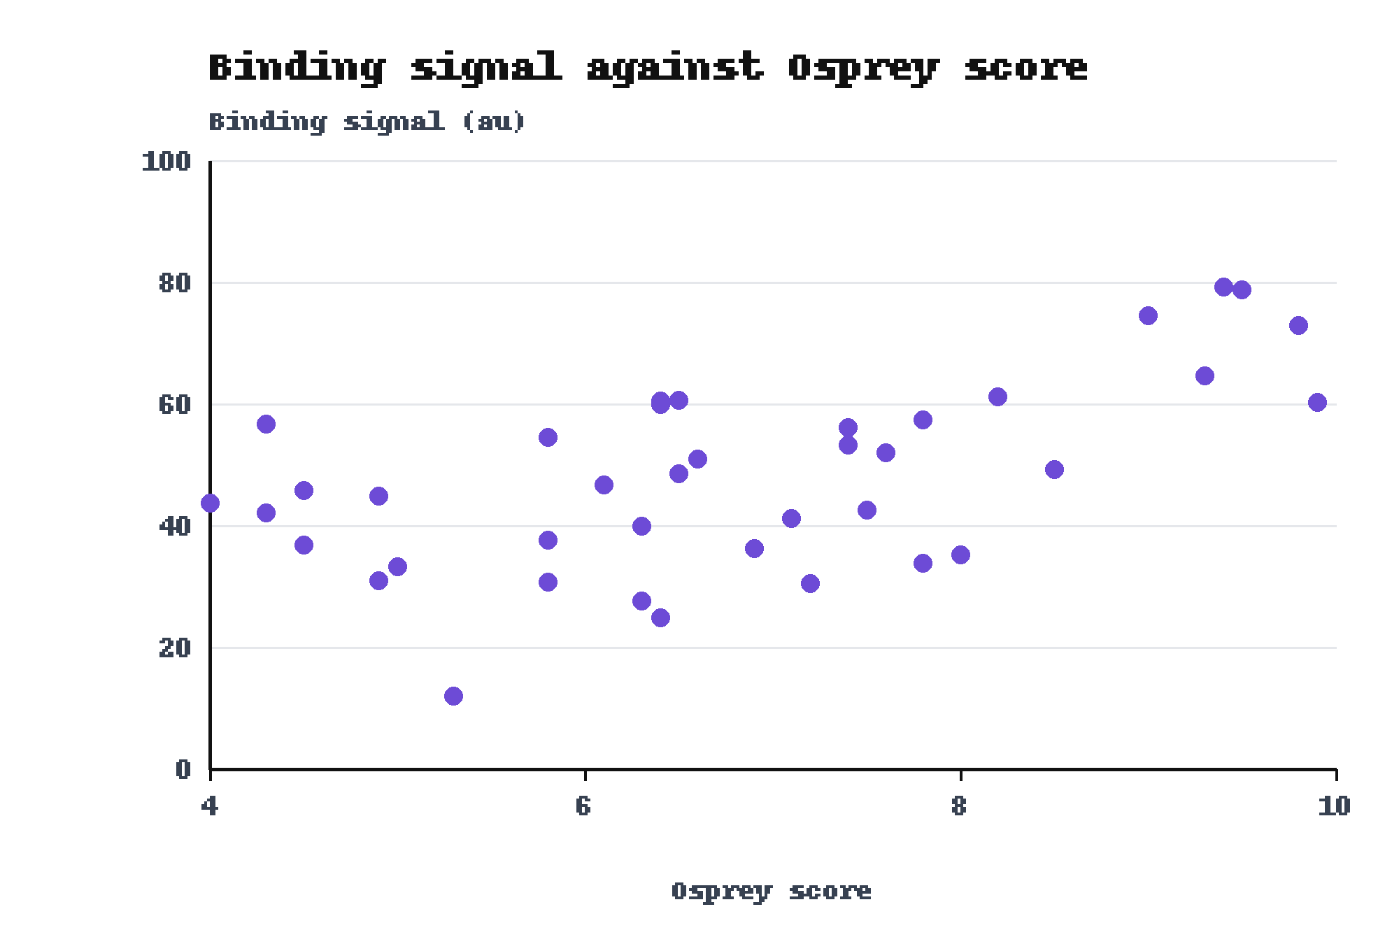
Binding signal rose with the Osprey score across the 40 designs.
Peak: 79.2 au at score 9.4
Highest score 9.9: 60.3 au
results.csv, fig3
Notes:
Each point is one design. The scatter is wide, so say that the score ranks designs and does not predict a signal. The top-scoring design gave 60.3 au, below the peak, and you should name it before a question does.

Slide 7
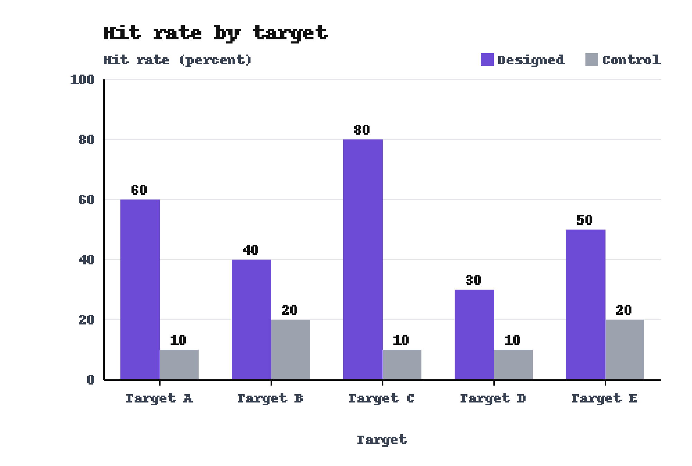
Designed peptides beat control peptides on all five targets.
Target C: 80 versus 10 percent
results.csv, fig2
Notes:
Each group holds 10 peptides per target. These peptides do not belong to the Heron set. Name the caveat: the control peptides were not matched to the designed peptides for length.

Slide 8
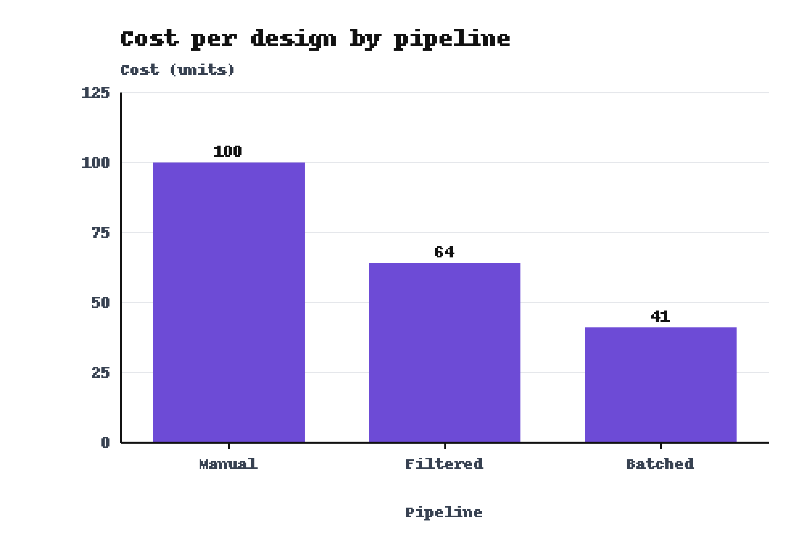
The Batched pipeline cost 41 units per design against 100 for the Manual pipeline.
Batched: lowest cost, 41 units
results.csv, fig7
Notes:
The Filtered pipeline sits between the two, at 64 units. The project notes do not define the unit or the three pipelines. Define them aloud before you show this slide.

Slide 9
Three results support the message of this talk.
The hit rate rose from 20 percent to 70 percent in four rounds.
Round 1 gave 20 percent.
On Target C the designed set beat the control, 80 percent to 10 percent.
The control reached 10 percent.
The Batched pipeline cost 41 units per design.
The Manual pipeline cost 100 units.
Notes:
Leave this slide up during questions. Say the claims in your own words. Each claim names its baseline, so a question about a number has an answer on the screen.

Slide 10
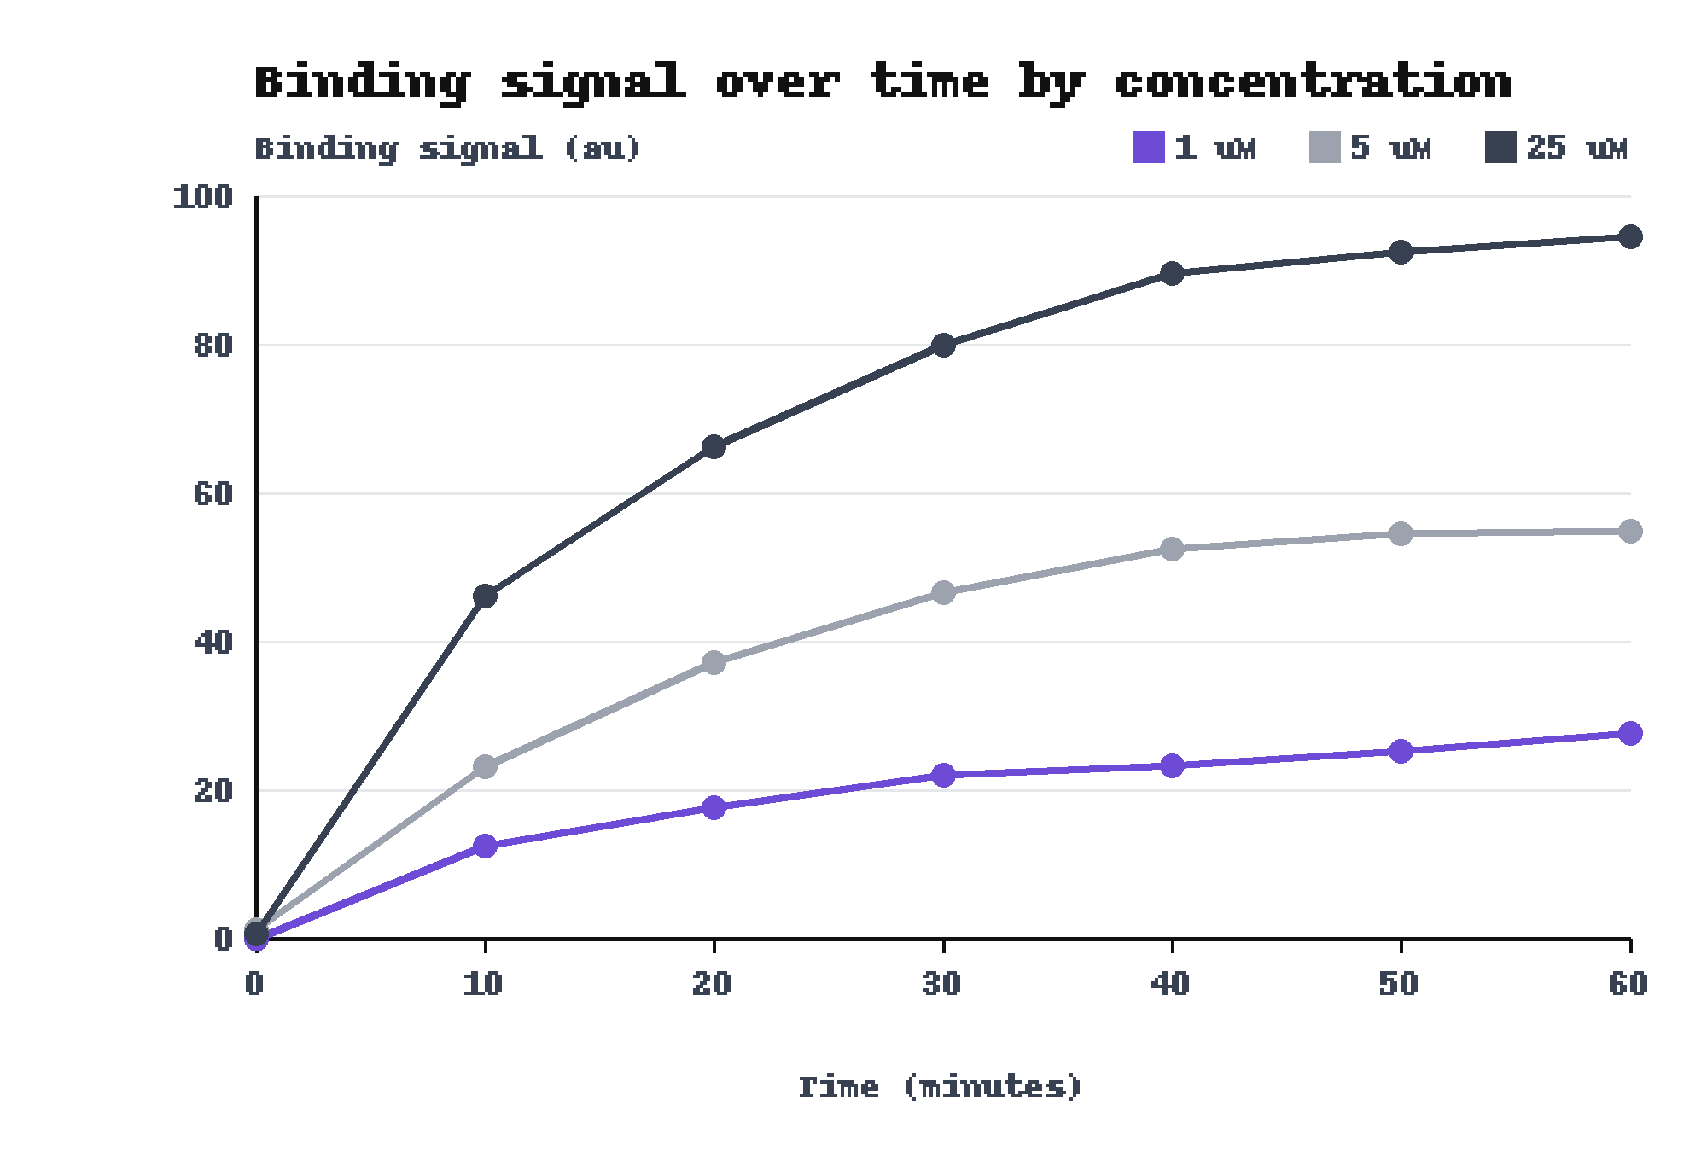
The reference design gave a stronger signal at each higher concentration.
25 uM: 94.5 au at 60 min
results.csv, fig8
Notes:
Use this slide if someone asks how the assay reads the signal. Each concentration has seven readings, one every 10 minutes. The signal of a design is the reading at 60 minutes. The 1 uM series read 27.7 au at 60 minutes.

Slide 11
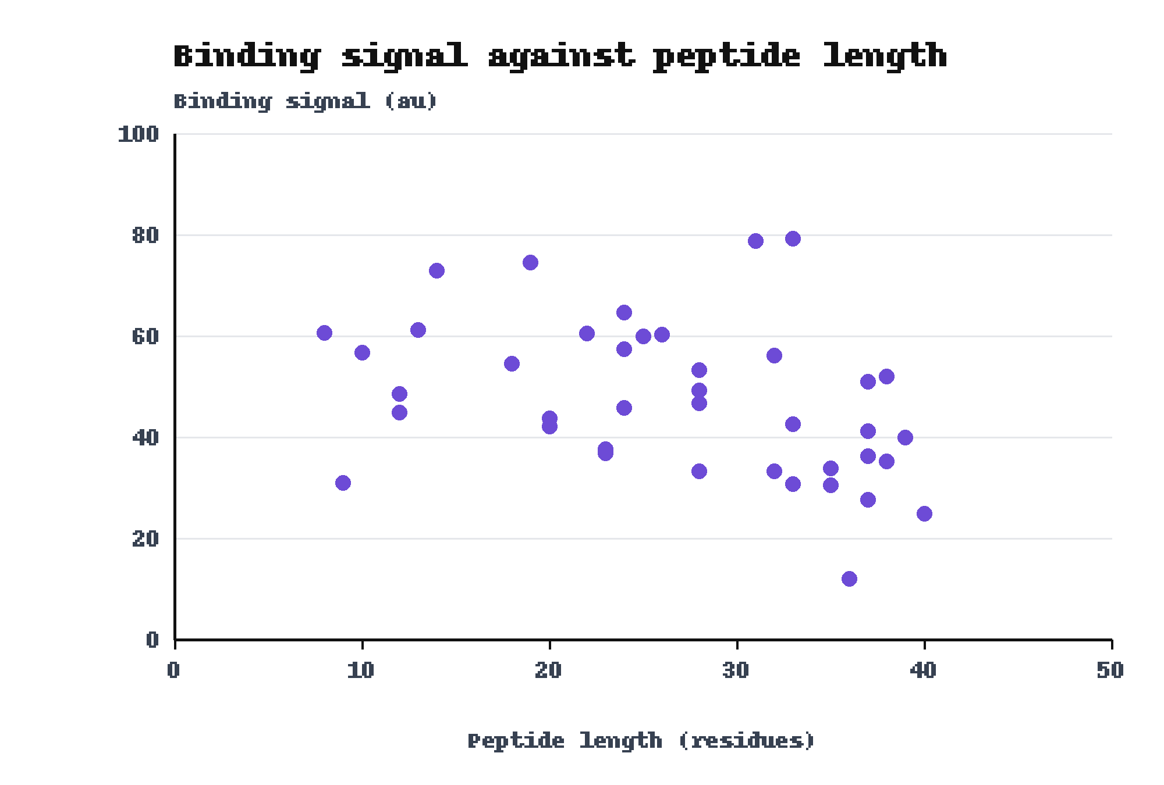
The longest peptide gave 24.9 au and the shortest gave 60.6 au.
Longest: 40 residues, 24.9 au
Shortest: 8 residues, 60.6 au
results.csv, fig4
Notes:
Use this slide if someone asks about length. The plot shows a wide spread at every length. Length may affect the designed against control comparison, because the control peptides were not matched for length.

