Slide 1
The Osprey score picks designs that bind Target T
A. Author
Example Lab
October 2026
Notes:
Open with the question that the deck answers: does the Osprey score pick designs that bind Target T? Say who ran the study and where, then go to the plan.

Slide 2
The Osprey score picked designs that bound Target T: the hit rate rose from 20 percent to 70 percent across four rounds.
Need
Approach
Evidence
Take-homes
Round 1 had few hits
Score, assay, terms
Rounds, score, control
Three claims to keep
Notes:
Say the message in one breath. Then name the four parts: the need, the approach, the evidence and the three claims to keep. Tell the room that the claims return on the last slide.

Slide 3
Only 20 percent of the designs in Round 1 bound Target T
20%
Baseline: Round 1 is the starting point of the Heron set.
hit rate in Round 1
Source: results.csv, fig1
Notes:
A hit is a design with a binding signal of at least 50 au on the Kestrel assay. Round 1 was the first of four rounds of ten designs. Ask the room what hit rate would justify the plate time. Then say that every later round is compared with this value.

Slide 4
The Osprey score ranks each design before the assay reads it
Term | Meaning
Osprey score | Ranks a design, 0 to 10
Hit | A signal of 50 au or more
Source: notes.md, Methods
Notes:
Define the terms once, so that no later slide needs a glossary. The score comes before the assay and costs no plate time. The Mallard filter dropped every design with a score below 4, so each design of the Heron set passed it. The signal of a design is the reading at 60 minutes.

Slide 5
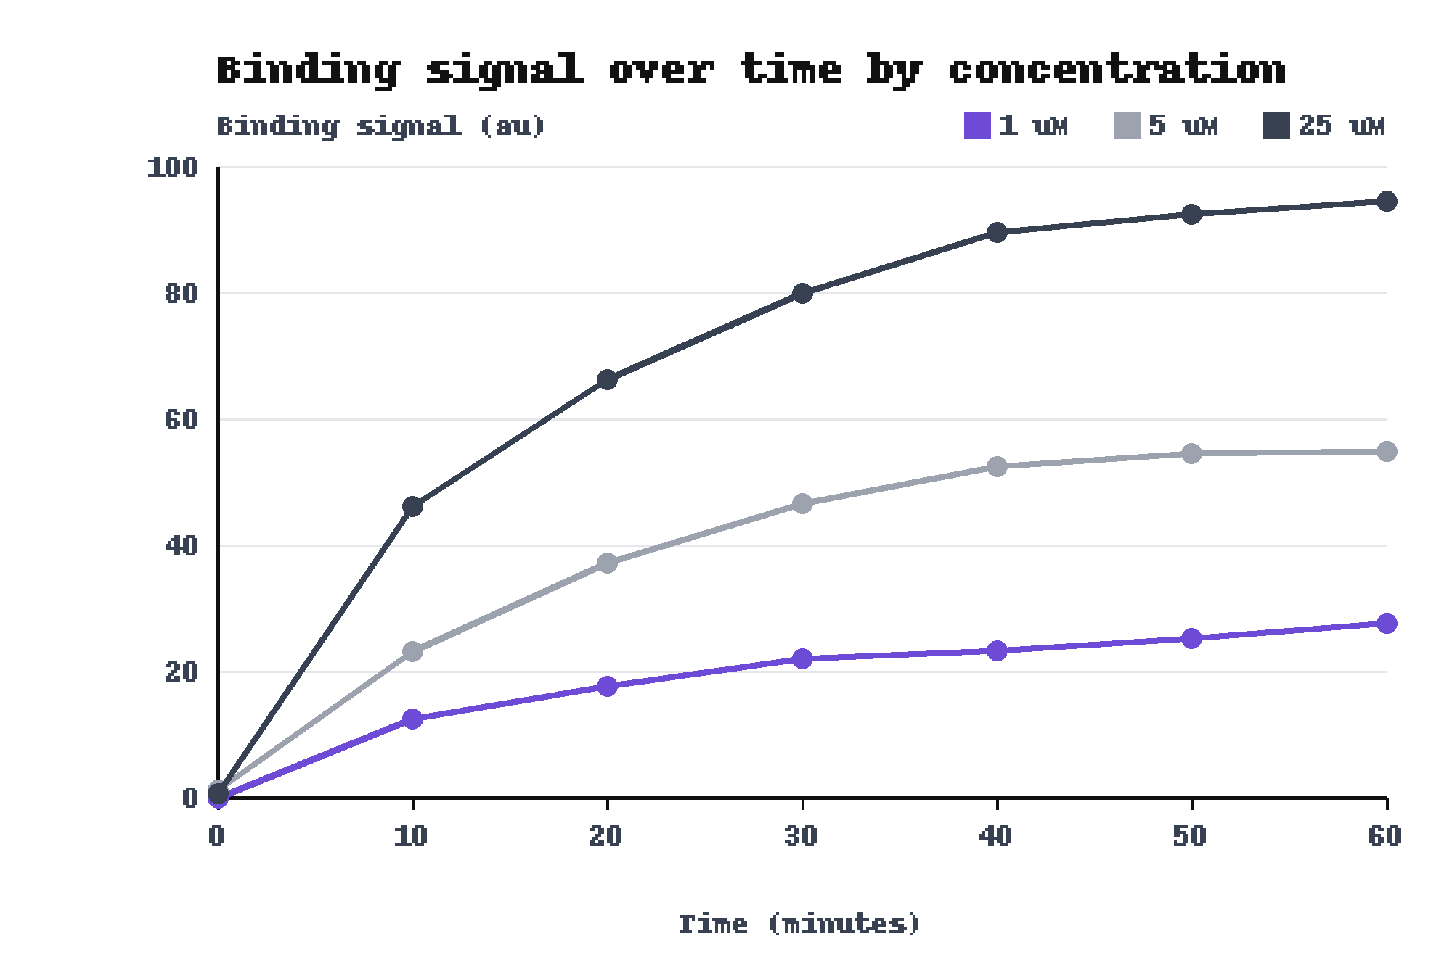
The reference design gave a signal that rose with concentration over 60 minutes
25 uM reads 94.5 au at 60 min
1 uM reads 27.7 au
Source: results.csv, fig8
Notes:
This is one reference design, not a design of the Heron set. Each curve has seven readings, one every 10 minutes. The 5 uM and 25 uM curves flatten by 50 minutes, but the 1 uM curve still rises, so call the 60 minute reading a fixed time point and not a plateau. Name the curves by their labels, since color alone separates them.

Slide 6
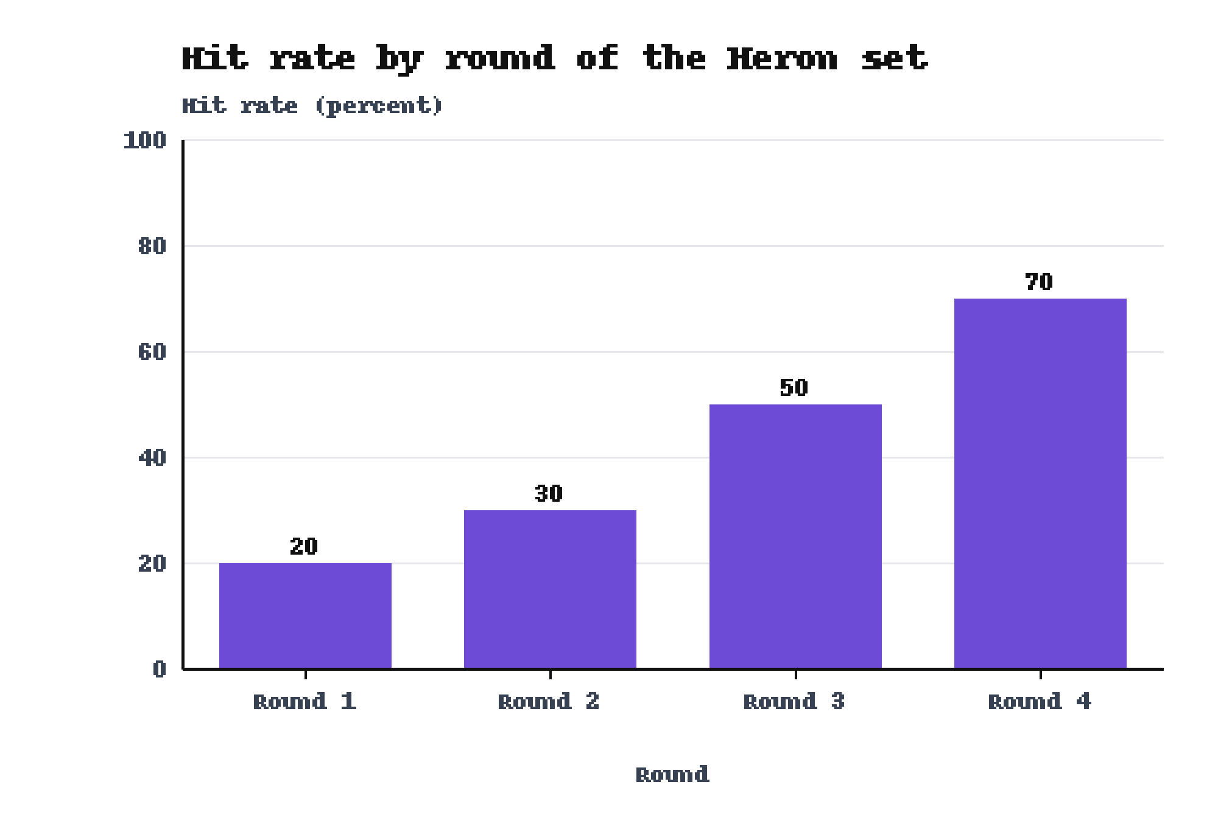
The hit rate of the Heron set rose from 20 to 70 percent across four rounds
Round 4 reaches 70 percent
Source: results.csv, fig1
Notes:
Each round holds ten designs, so one design moves a round by ten percentage points. Say that the study ran once, on one plate layout, and that the bars carry no error bars.

Slide 7
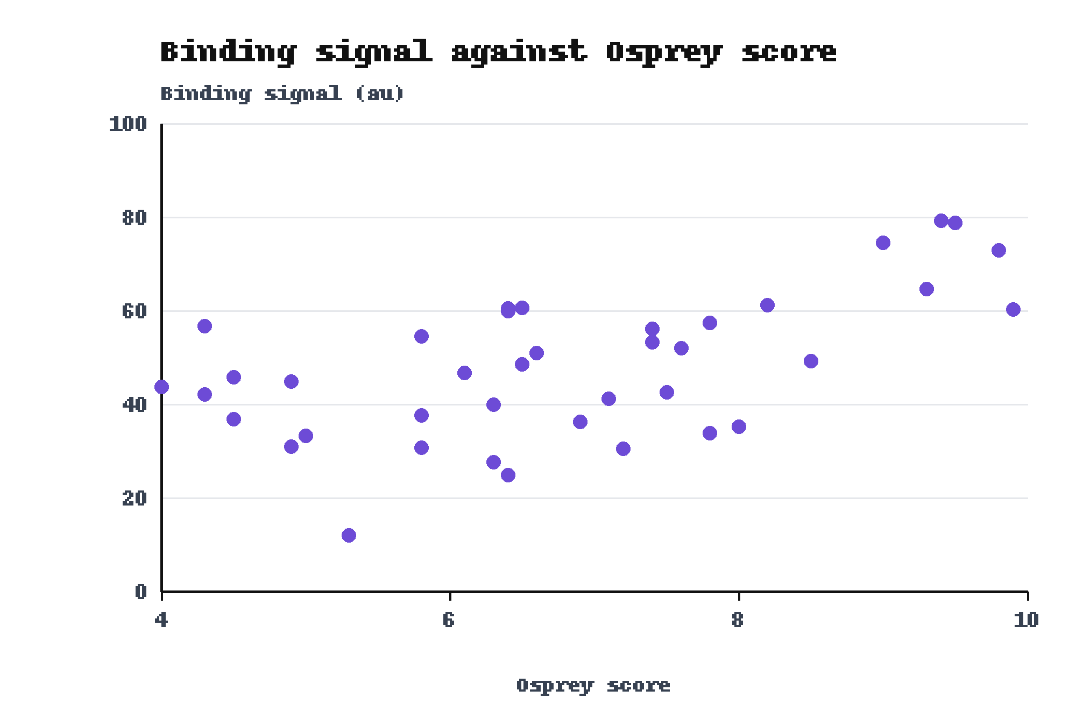
Binding signal rose with the Osprey score across the 40 designs
Scores of 9 or more: 60.3 to 79.2 au
All designs passed the filter at 4
Source: results.csv, fig3
Notes:
The slope is modest. Between scores of 4 and 8.5 the signals overlap widely, from 12 to 61.2 au. Only the six designs with a score of 9 or more all read above 60 au. No design below a score of 4 appears, because the Mallard filter removed them before the assay.

Slide 8
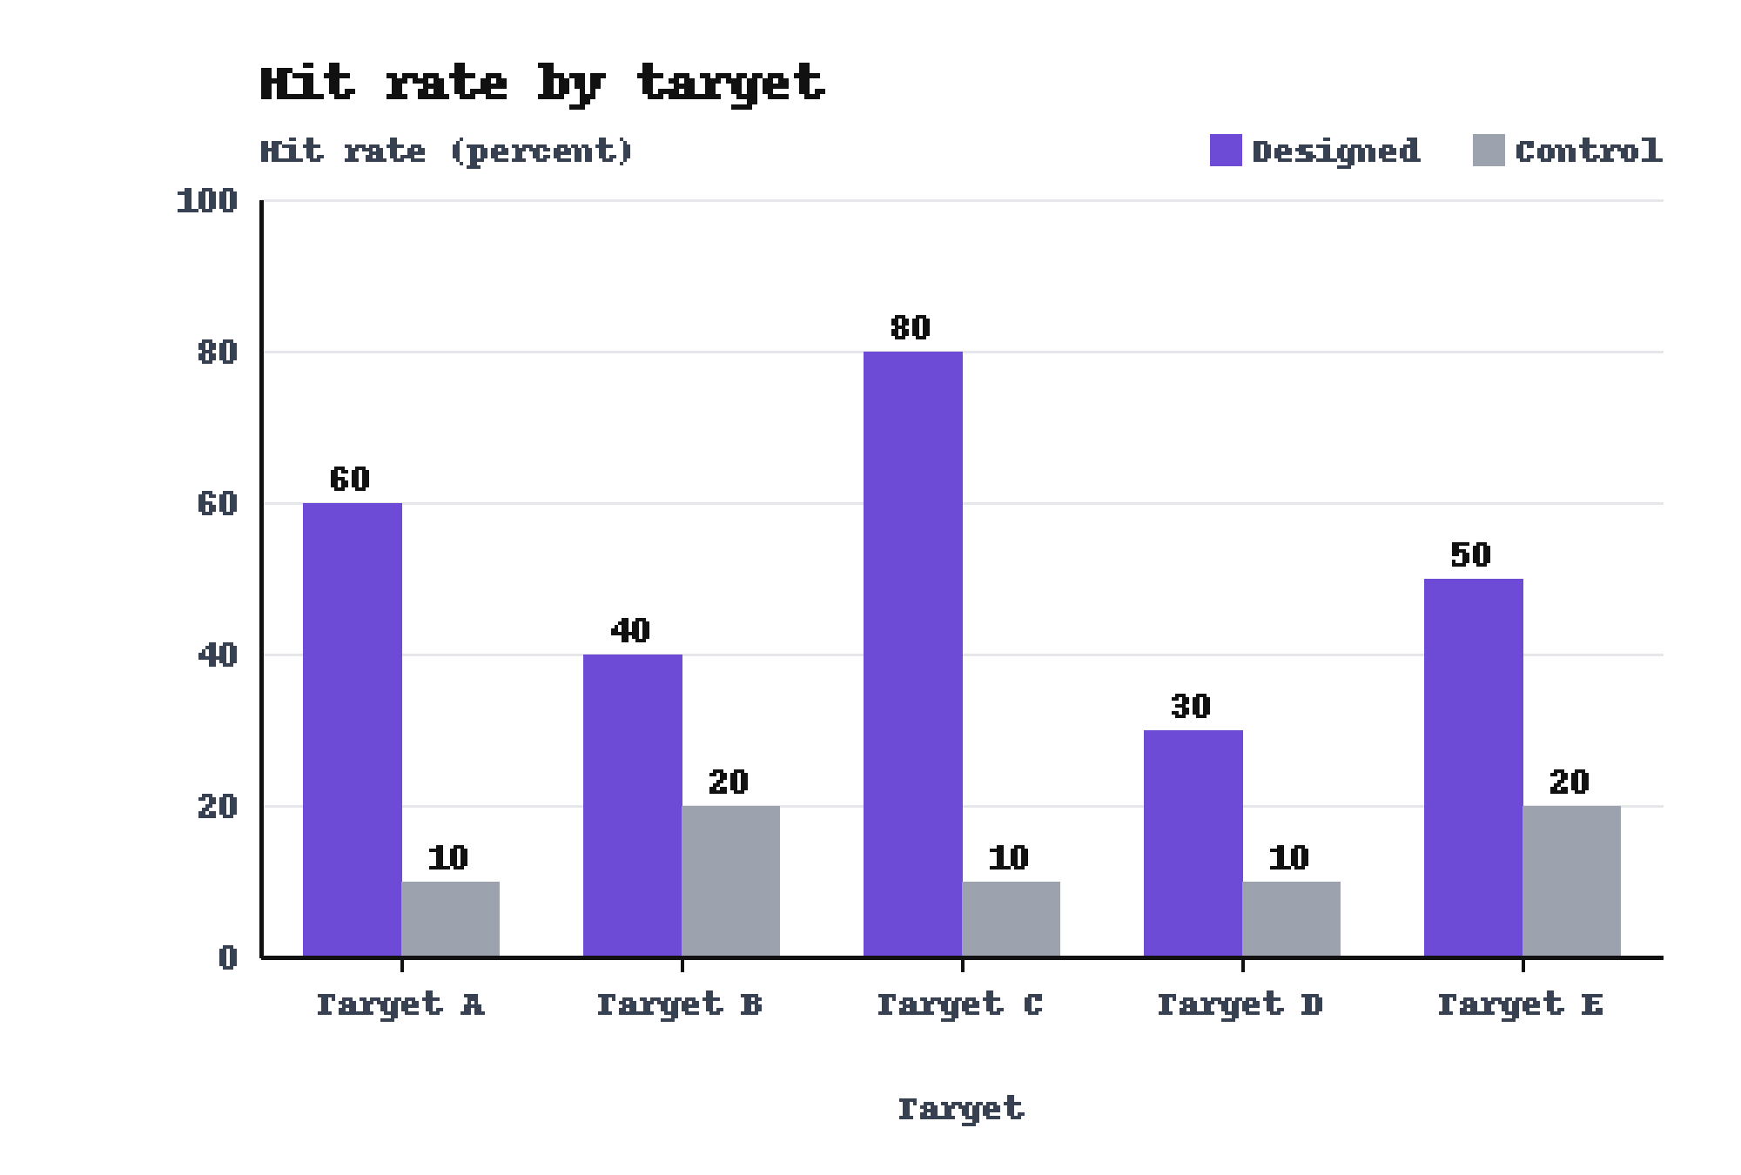
Designed peptides beat control peptides on all five targets
Target C: 80 against 10 percent
Controls not matched for length
Source: results.csv, fig2
Notes:
Each bar holds ten peptides, and none of them belongs to the Heron set. Target C shows the widest gap. Say that the control peptides were not matched to the designed peptides for length, and point to the length plot on the backup slide.

Slide 9
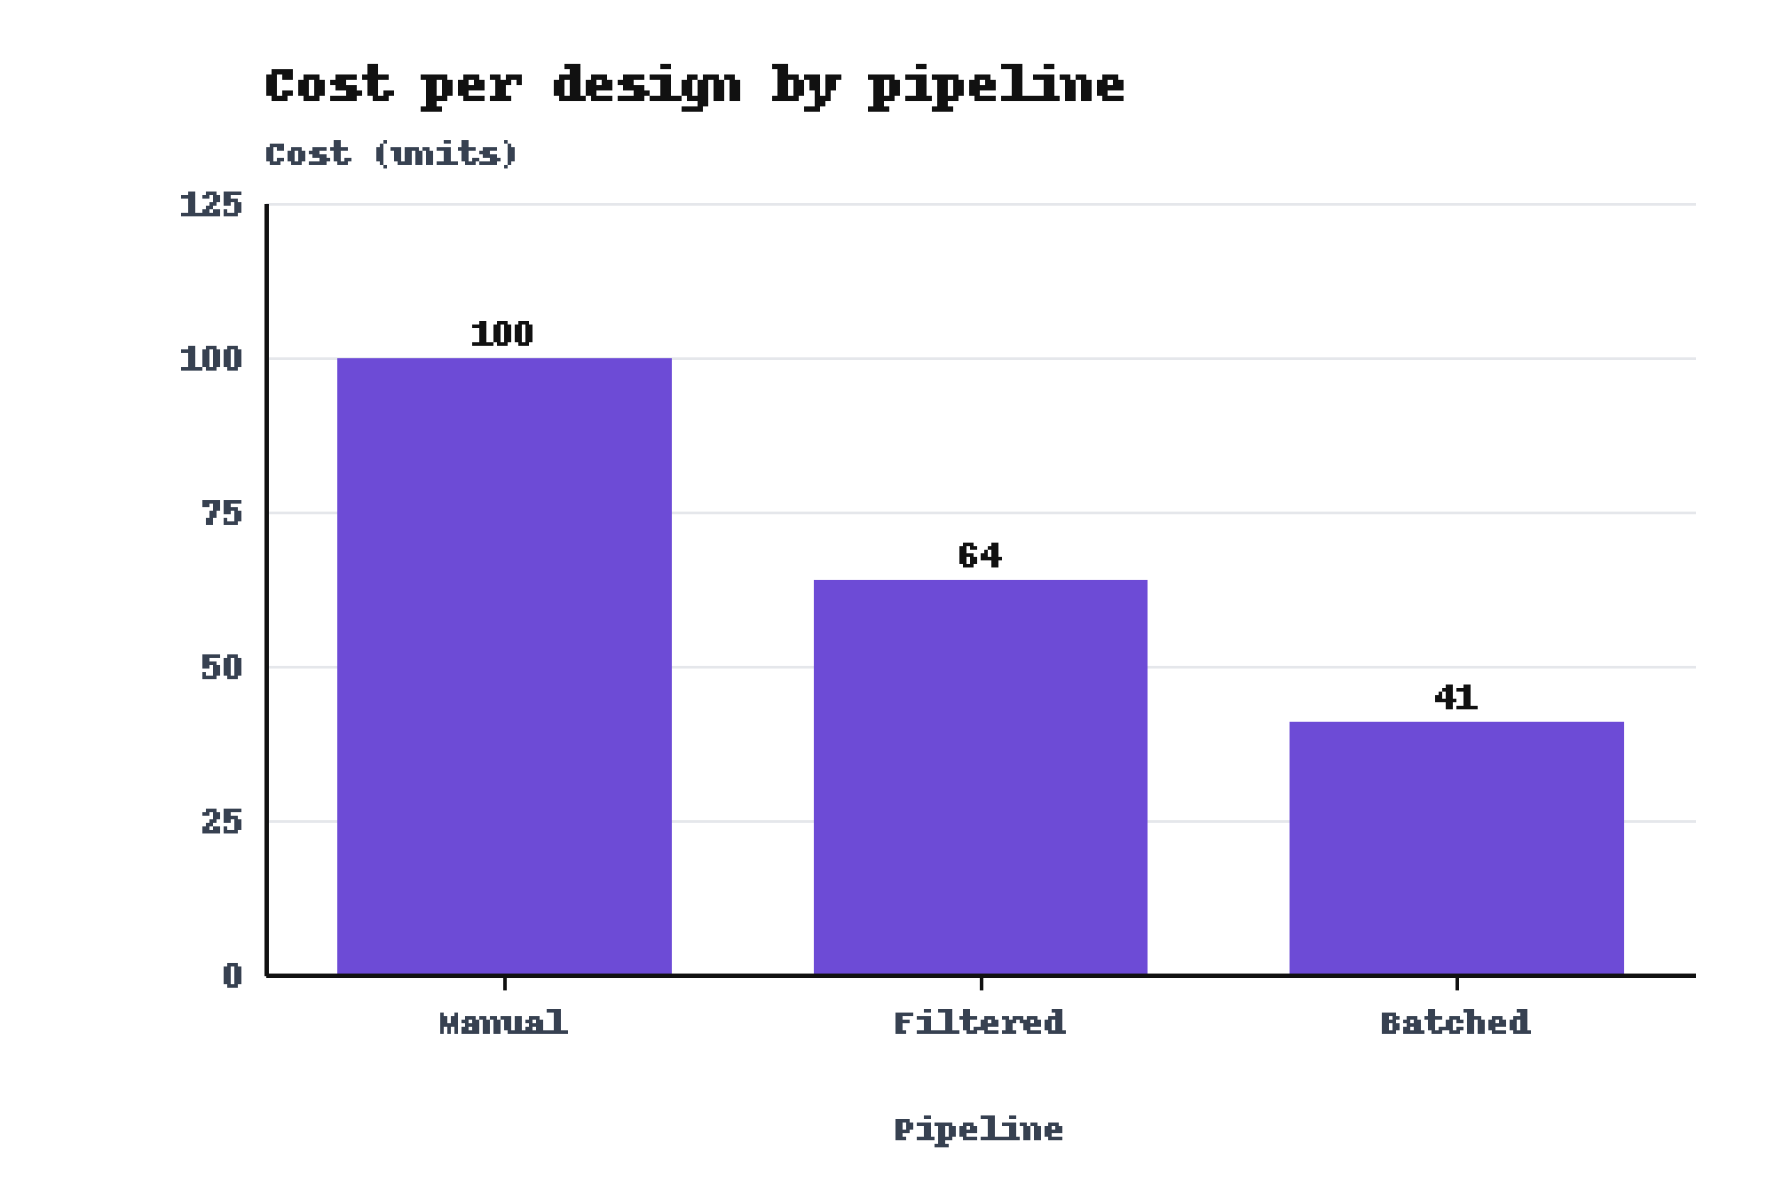
The Batched pipeline cost 41 units per design against 100 for the Manual pipeline
Batched: 41 units
Manual: 100 units
Source: results.csv, fig7
Notes:
Cost is per design, in units. The Filtered pipeline sits between the two. The notes of the study do not say which pipeline made the Heron set, so do not link this cost to the hit rate.

Slide 10
The hit rate rose, the designs beat the control and the Batched pipeline cost less
The hit rate rose from 20 percent to 70 percent in four rounds
Round 1 gave 20 percent.
On Target C the designed set beat the control, 80 percent to 10 percent
The control reached 10 percent.
The Batched pipeline cost 41 units per design
The Manual pipeline cost 100 units.
Notes:
Leave this slide up during questions. Say each claim in your own words and name its baseline. Say that the study ran once, on one plate layout.

Slide 11
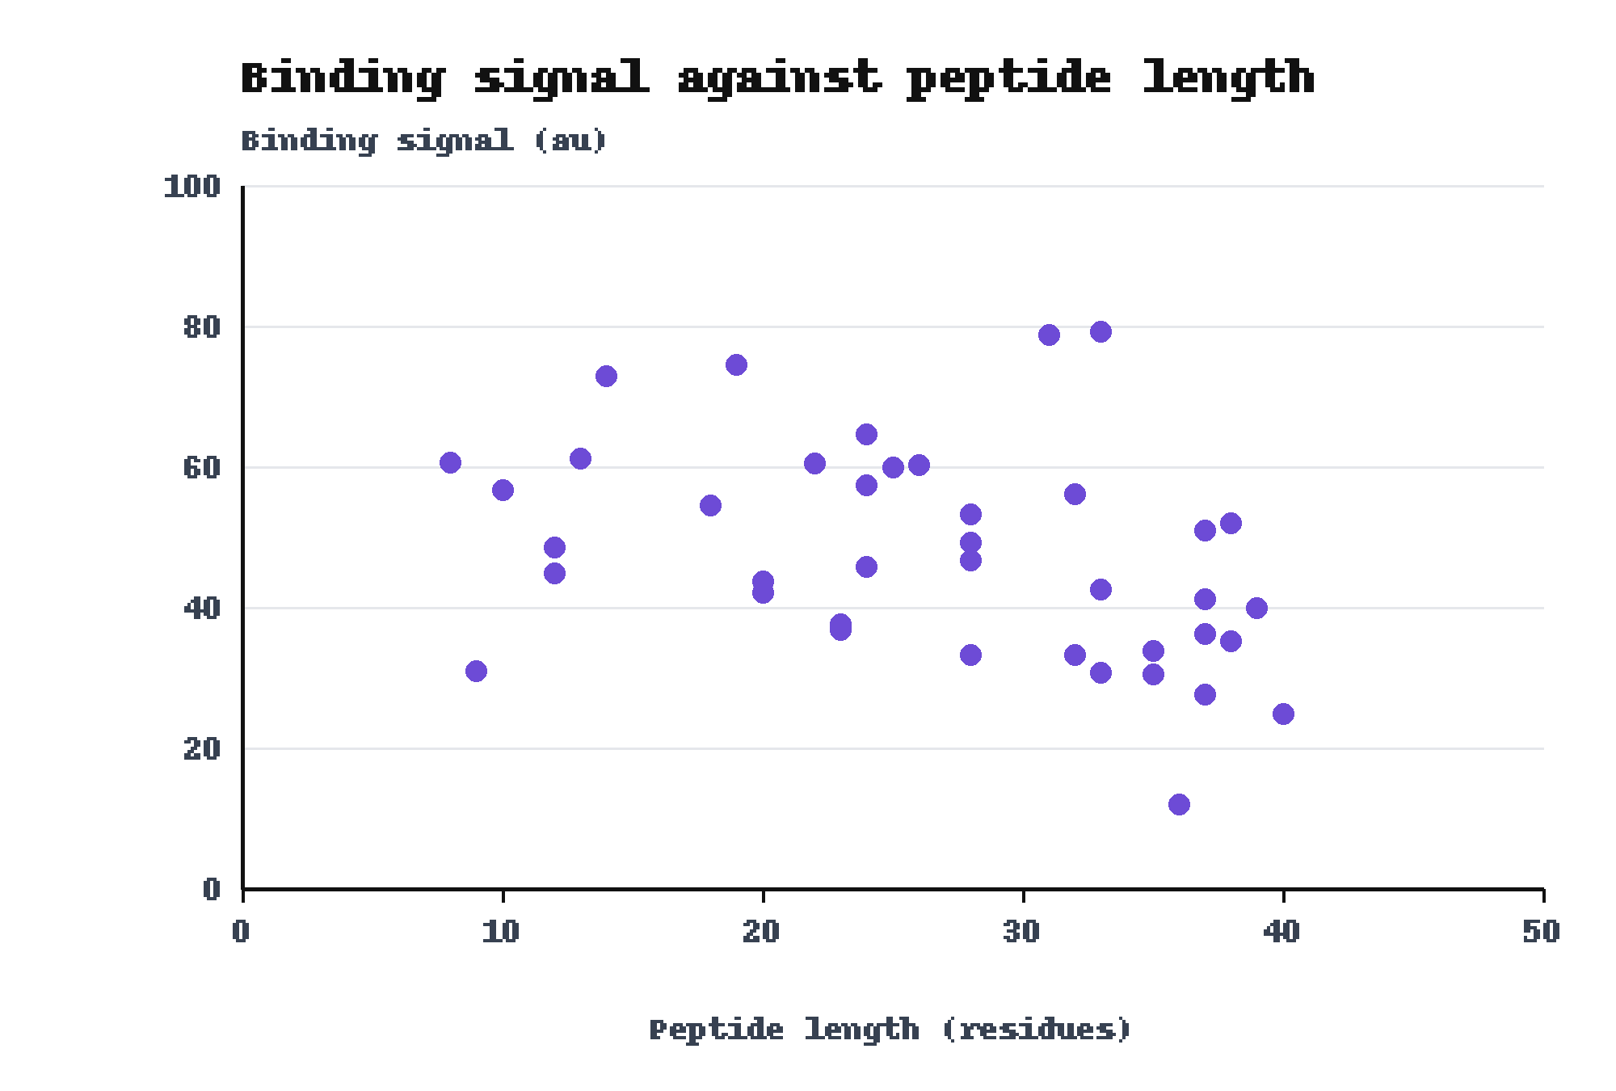
Binding signal tended to fall as the peptide length rose
8 residues gave 60.6 au
40 residues gave 24.9 au
Source: results.csv, fig4
Notes:
Use this slide if someone asks whether length explains the signal. The longest peptide gave 24.9 au, but the lowest signal, 12 au, came from a peptide of 36 residues. The controls of the Target C slide were not matched for length, so a gap could partly reflect length.

Slide 12
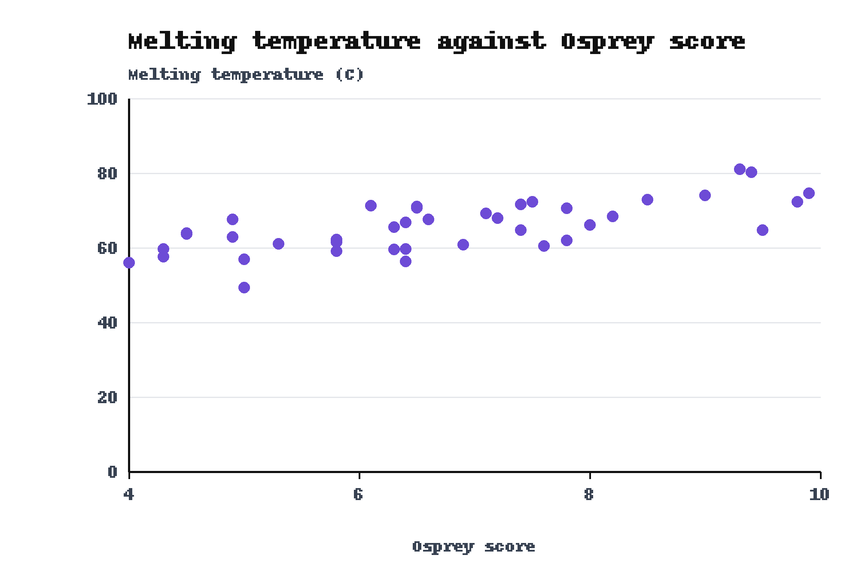
Melting temperature rose with the Osprey score
Top: 81.1 C at score 9.3
Source: results.csv, fig6
Notes:
Use this slide if someone asks about stability. The trend has the same direction as the binding signal. The most stable design is not the design with the highest score.

Slide 13
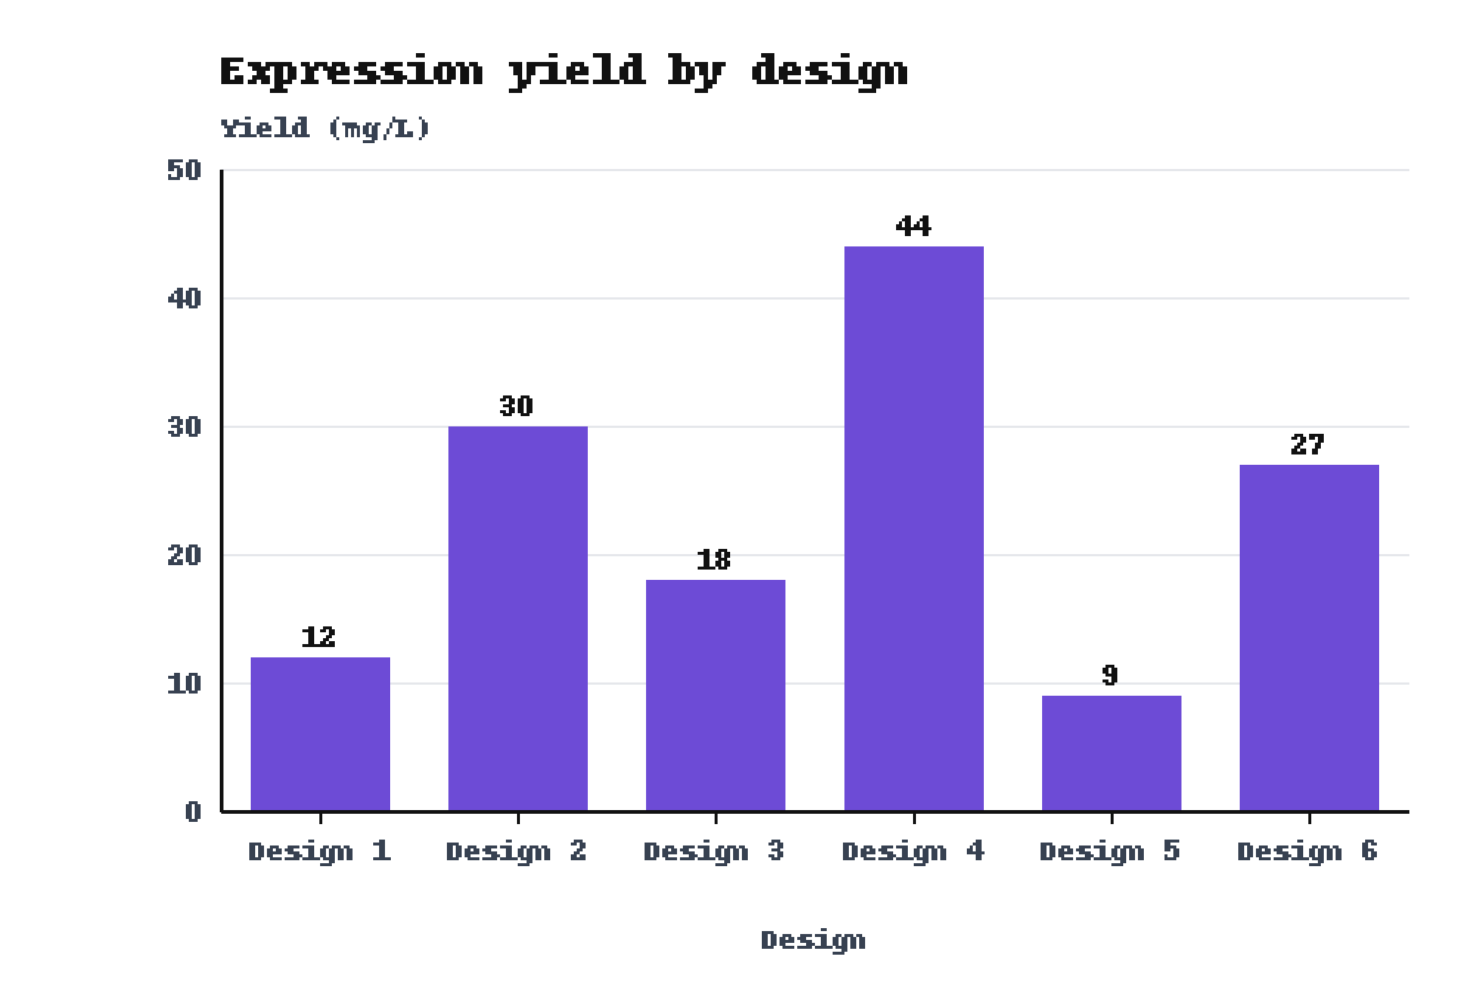
Expression yield ranged from 9 to 44 mg/L across six designs
Design 4: 44 mg/L
Design 5: 9 mg/L
Source: results.csv, fig5
Notes:
Use this slide if someone asks about yield. Six designs make a spot check and not a screen, and the notes of the study do not say how the six were chosen.

