Slide 1
The Osprey score picks designs that bind Target T
A. Author
Example Lab
October 2026

Slide 2
A score that ranks designs before the assay helps only if high scores mean binding
• Question: Does the Osprey score pick designs that bind Target T in the Kestrel assay?
• Need: The Osprey score ranks a design from 0 to 10 before the assay. A ranking helps only if high-scored designs bind.
• Test: 40 designs of the Heron set, built in 4 rounds of 10 designs, each read in the Kestrel assay.
Keep this: The Osprey score picked designs that bound Target T: the hit rate rose from 20 percent to 70 percent across four rounds.

Slide 3
The Kestrel assay scored 40 filtered designs, and a hit is a signal of at least 50 au
1. Osprey score ranks each design from 0 to 10, before the assay
2. Mallard filter drops each design with a score below 4
3. Kestrel assay reads the binding signal (au) every 10 min for 60 min
4. Hit a design with a signal of at least 50 au at 60 min
• Heron set: 40 designs, built in 4 rounds of 10 designs each.
• Signal: The signal of a design is the reading at 60 minutes.
• Hit rate: The hit rate of a group is the share of its designs that are hits.

Slide 4
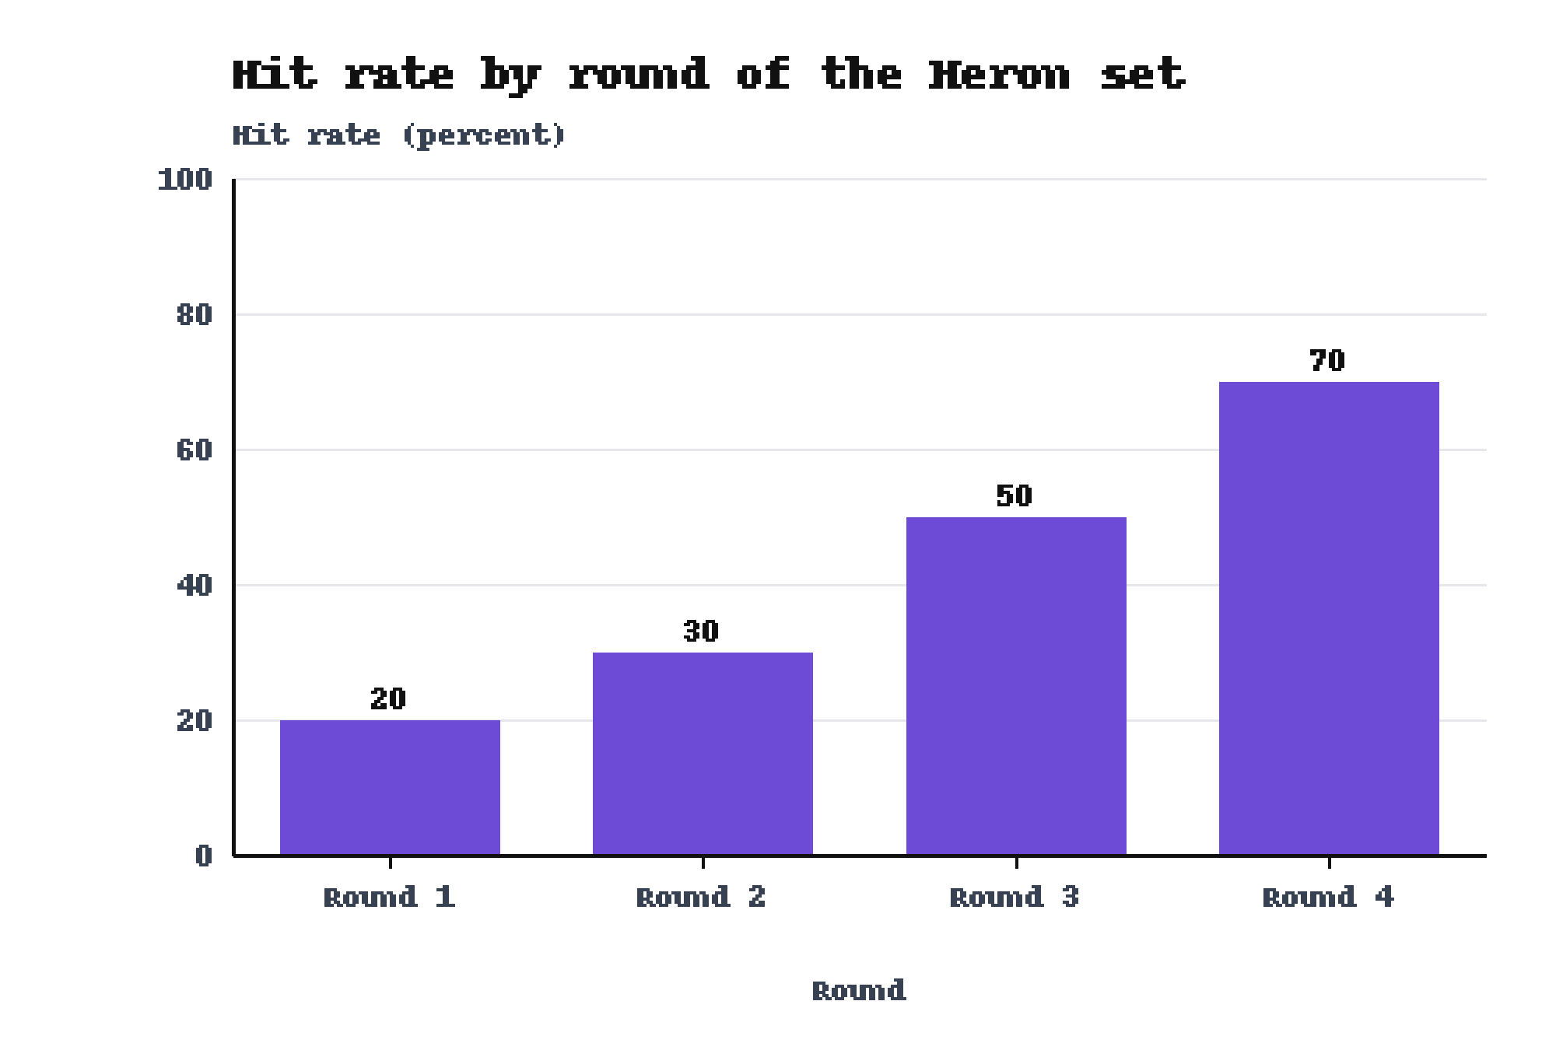
The hit rate rose from 20 percent to 70 percent in four rounds
• Round 1: 20 percent, 2 of 10 designs were hits.
• Rounds 2 and 3: 30 percent and 50 percent.
• Round 4: 70 percent, 7 of 10 designs were hits.
Baseline: Round 1 gave 20 percent.
Source: figures/fig1.png. Each round holds 10 designs of the Heron set.

Slide 5
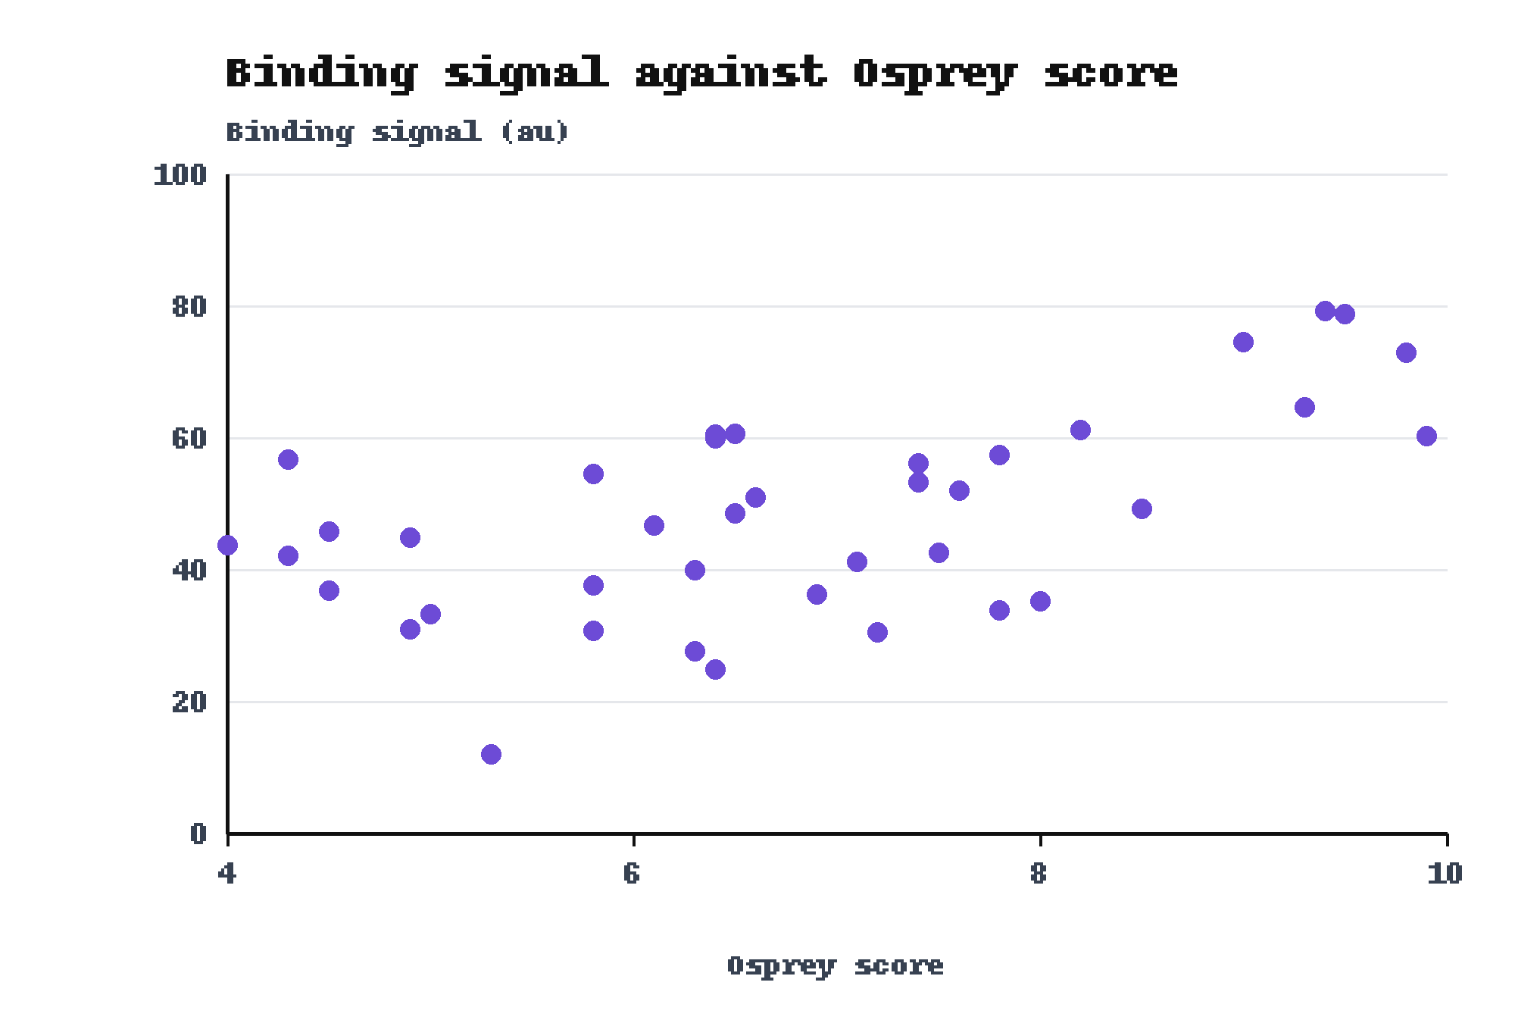
All 6 designs with an Osprey score of 9 or higher were hits
• Score 9 or higher: 6 of 6 designs were hits.
• Highest score: 9.9, with a signal of 60.3 au.
• Score range: 4 to 9.9 only, because the Mallard filter dropped each design below 4.
Baseline: Below a score of 9, 11 of 34 designs were hits.
Source: figures/fig3.png. 40 designs of the Heron set. Pearson r between score and signal: 0.60, computed from results.csv.

Slide 6
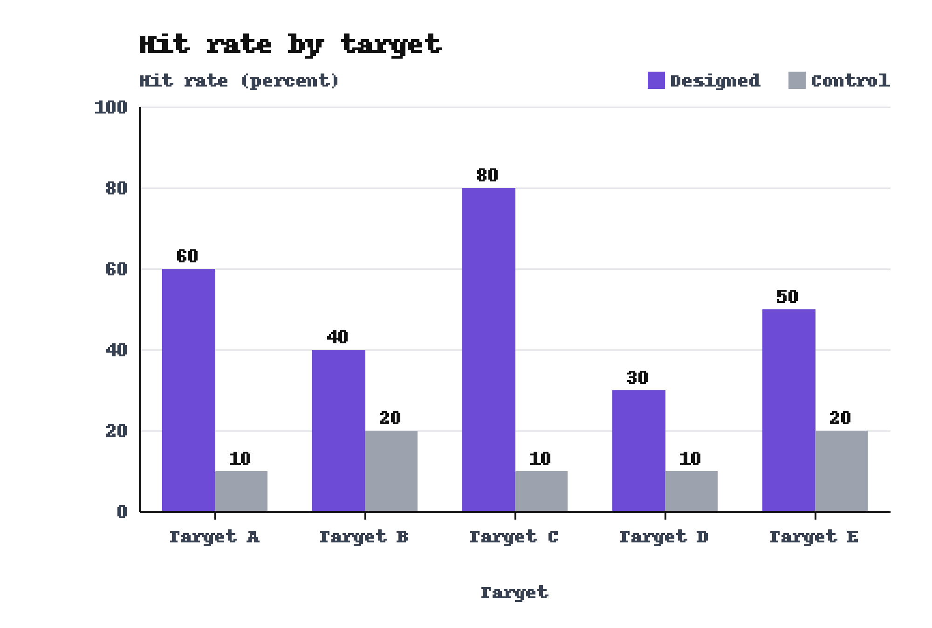
On Target C the designed set beat the control, 80 percent to 10 percent
• Five targets: the designed peptides beat the control peptides on every target.
• Groups: 10 designed peptides and 10 control peptides. None belongs to the Heron set.
• Caution: The control peptides were not matched for length.
Baseline: The control reached 10 percent.
Source: figures/fig2.png.

Slide 7
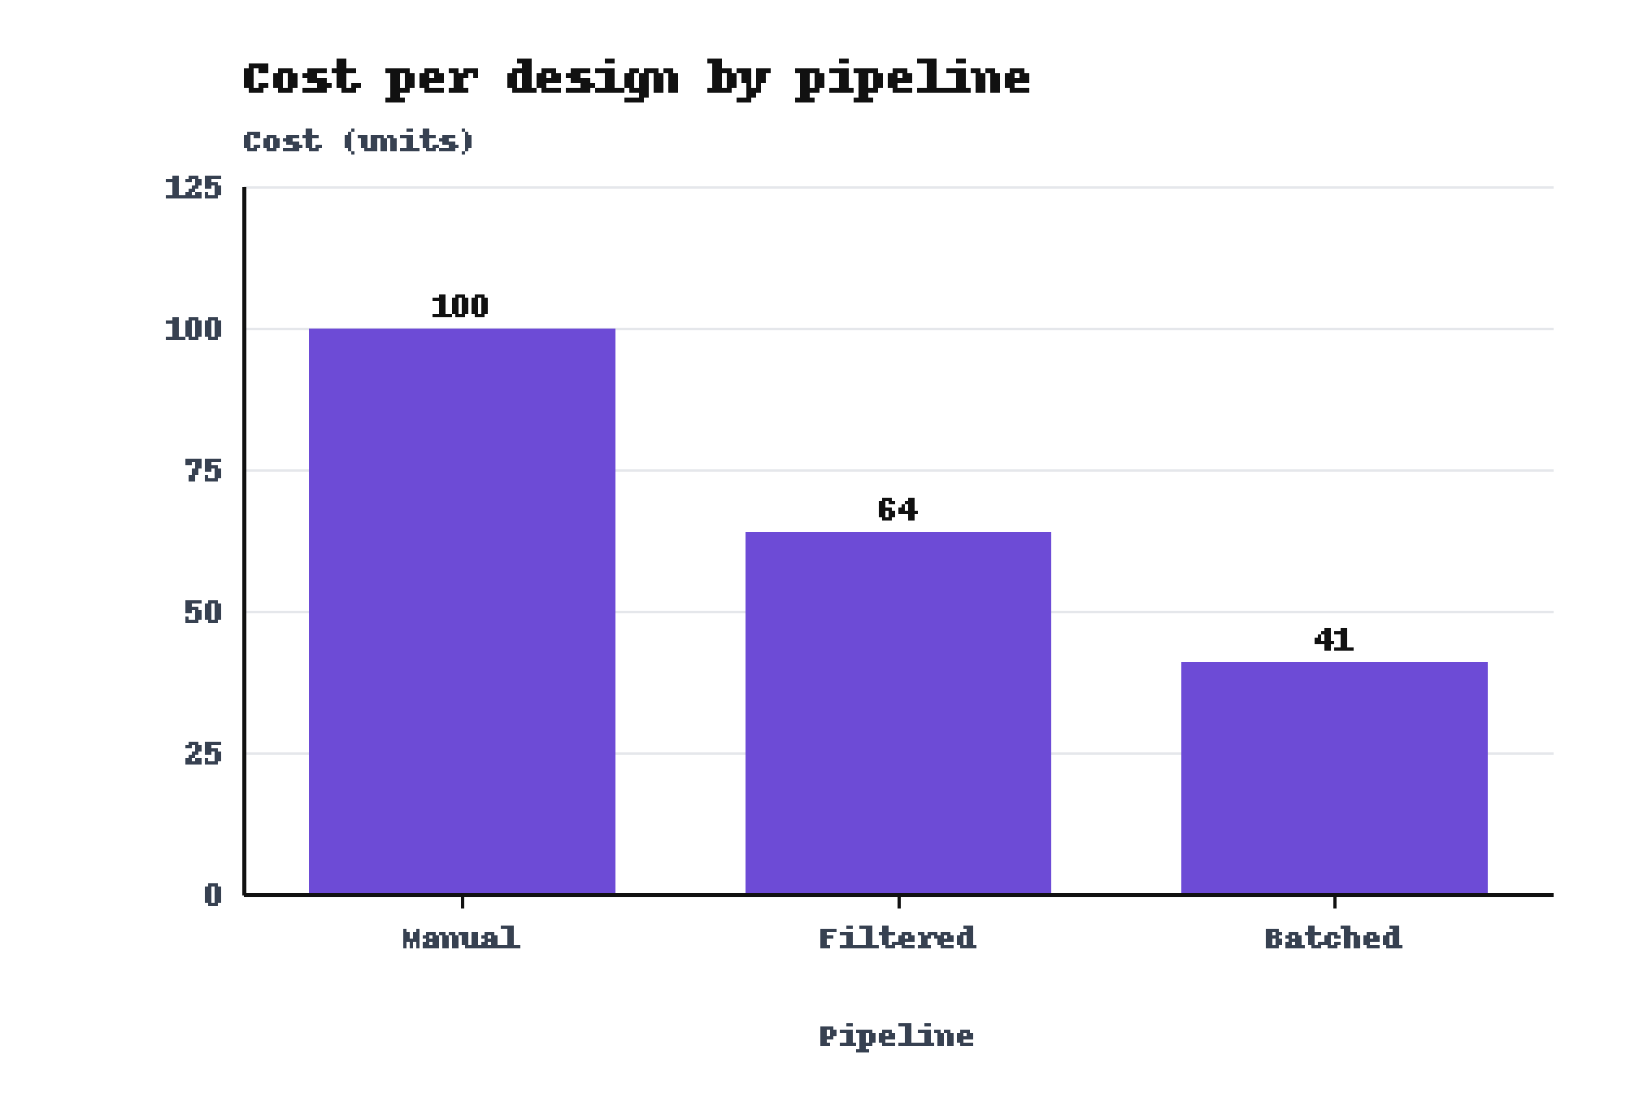
The Batched pipeline cost 41 units per design, against 100 units for the Manual pipeline
• Manual: 100 units per design.
• Filtered: 64 units per design.
• Batched: 41 units per design, 59 units below Manual.
Baseline: The Manual pipeline cost 100 units.
Source: figures/fig7.png. Cost per design of 3 pipelines.

Slide 8
The study ran once on one plate layout, and the controls were not matched for length
• One run: The study ran once, on one plate layout.
• Controls: The control peptides were not matched to the designed peptides for length.
• Score range: Each design passed the Mallard filter, so the data cover scores from 4 to 9.9 only.
• Group size: Each round and each peptide group holds 10 designs, so one design moves a hit rate by 10 points.

Slide 9
The next run repeats the assay on a second plate layout with length-matched controls
• Second plate layout: Repeat the assay to test whether the result holds beyond one layout.
• Length-matched controls: Match each control peptide to a designed peptide for length.
• Scores below 4: Assay designs that the Mallard filter dropped, to cover the full score range.

Slide 10
Three results support the message: the hit rate rose, the designs beat the control, the cost fell
1. The hit rate rose from 20 percent to 70 percent in four rounds.
Baseline: Round 1 gave 20 percent.
2. On Target C the designed set beat the control, 80 percent to 10 percent.
Baseline: The control reached 10 percent.
3. The Batched pipeline cost 41 units per design.
Baseline: The Manual pipeline cost 100 units.
Keep this: The Osprey score picked designs that bound Target T: the hit rate rose from 20 percent to 70 percent across four rounds.

Slide 11
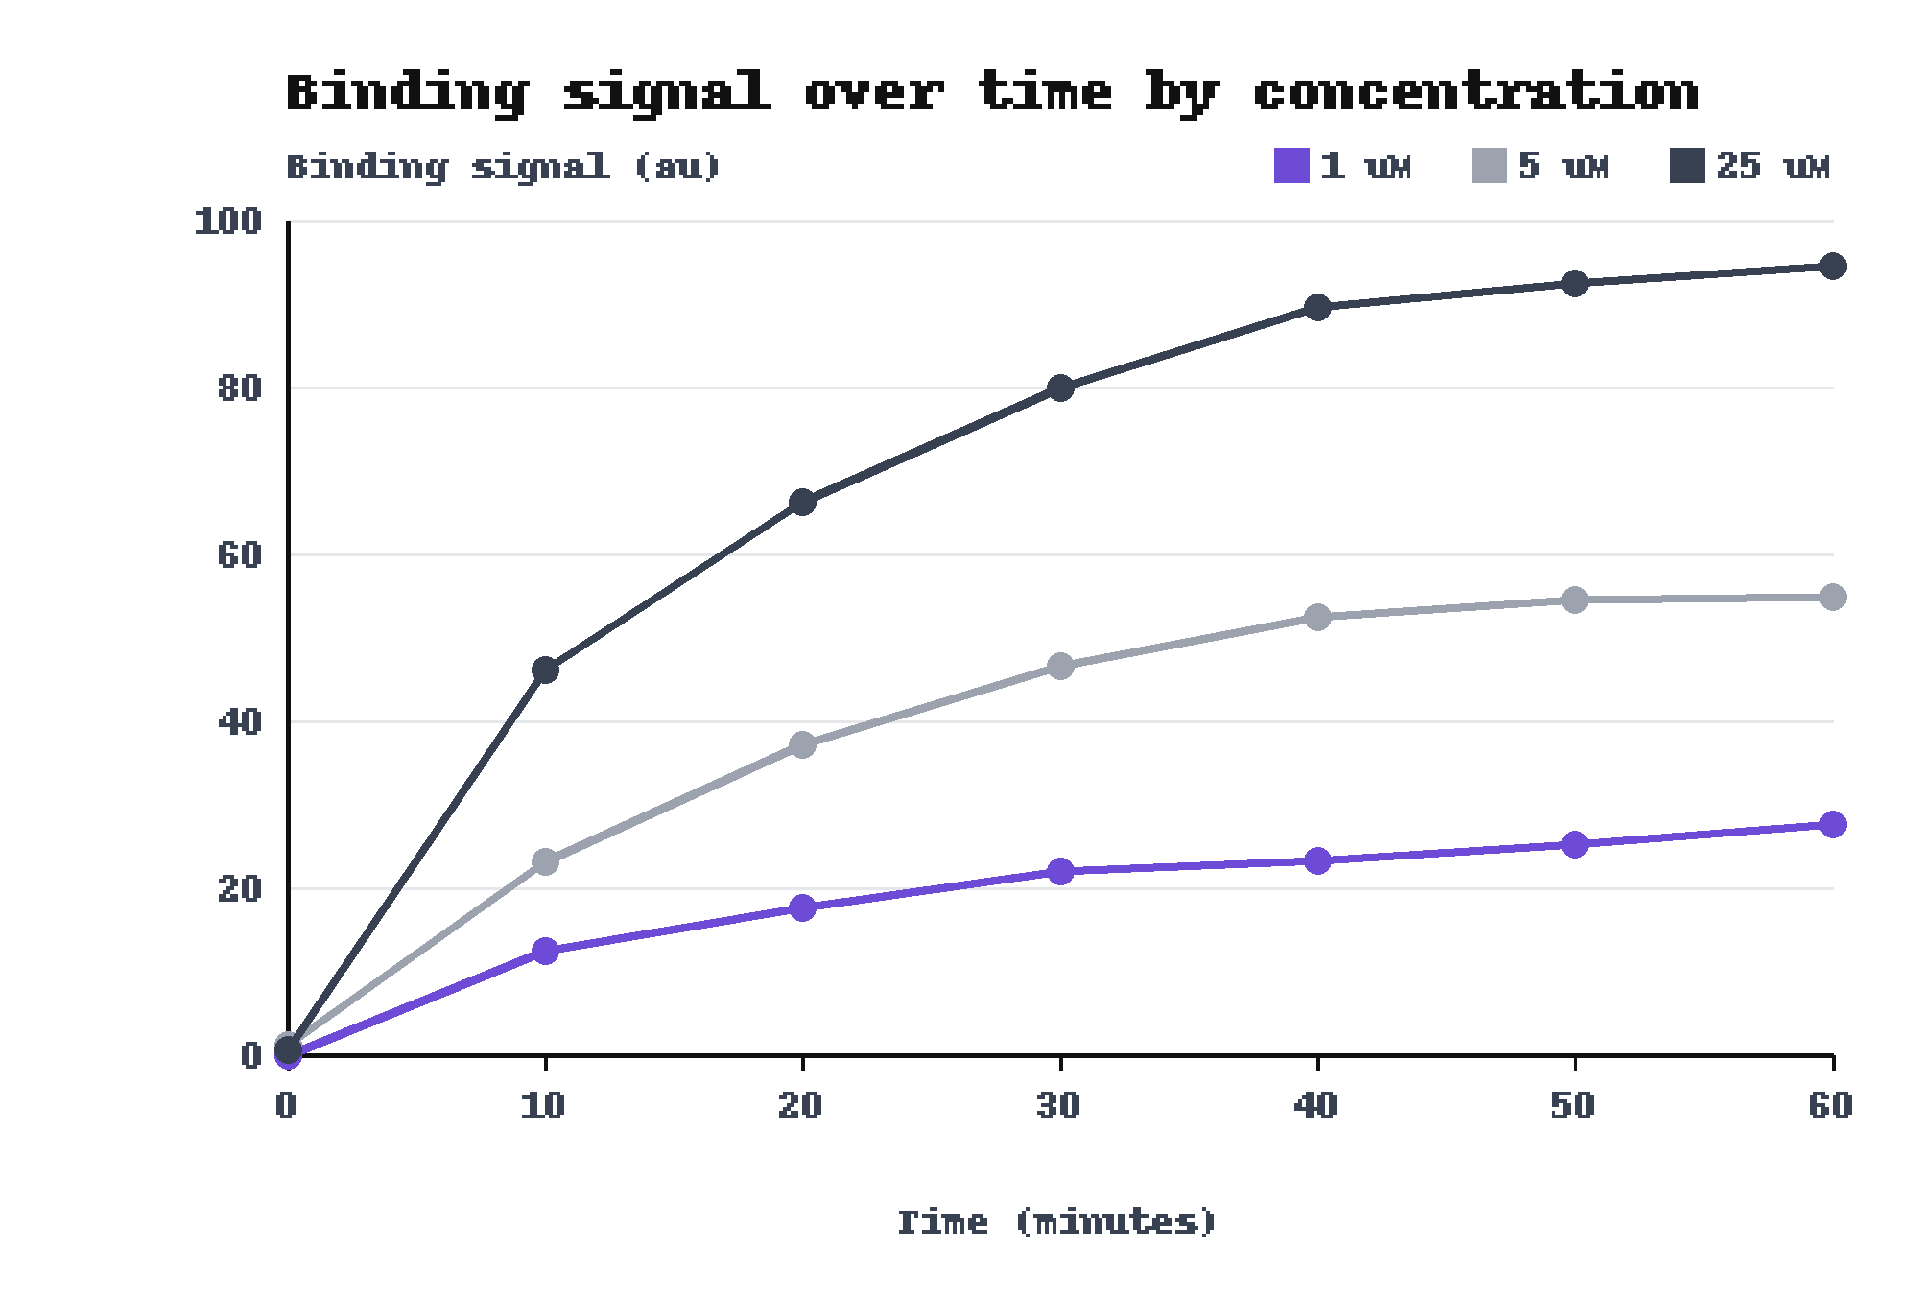
Backup: At 60 minutes the reference design read 94.5 au at 25 uM and 27.7 au at 1 uM
• Design: one reference design at 3 concentrations, 1, 5 and 25 uM.
• Readings: 7 readings per concentration, every 10 minutes for 60 minutes.
• Signal: The signal of a design is the reading at 60 minutes.
Middle series: At 5 uM the reference design read 54.9 au.
Source: figures/fig8.png.

Slide 12
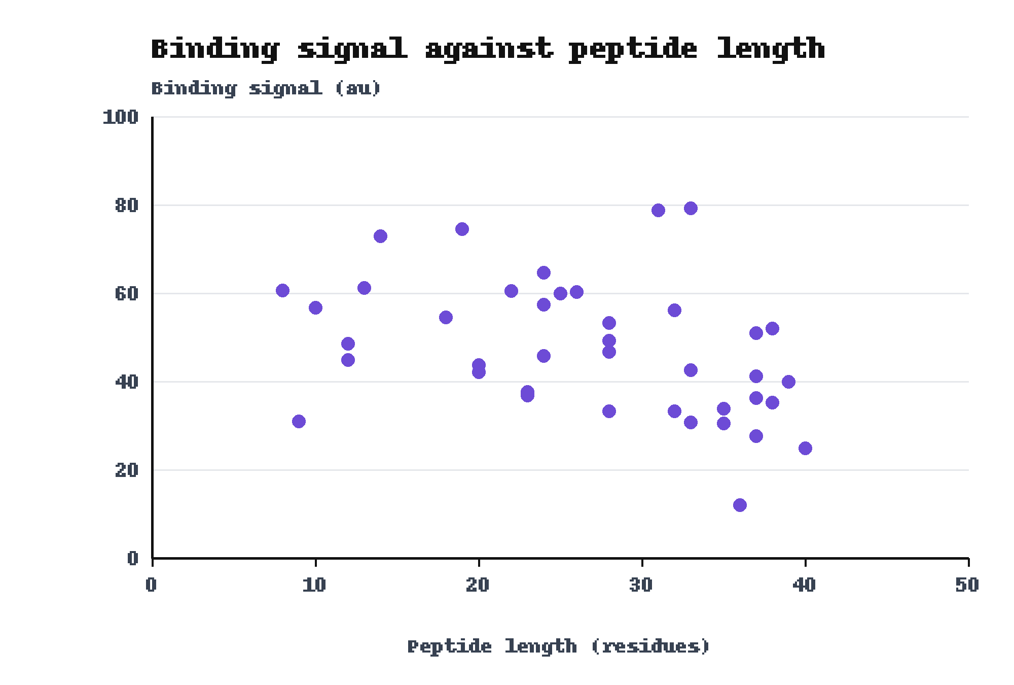
Backup: Binding signal fell with peptide length, 24.9 au at 40 residues and 60.6 au at 8 residues
• Longest peptide: 40 residues, 24.9 au.
• Shortest peptide: 8 residues, 60.6 au.
• Link to controls: The control peptides were not matched for length.
Correlation: Pearson r between length and signal is -0.38.
Source: figures/fig4.png. Same 40 designs as the score plot. Pearson r computed from results.csv.

