Slide 1
Installation Guide

Slide 2
Installation Guide
Get the file onto your Android device
Locate the app-release.apk.1.1 File on Your Device
Initiate the Installation
Verify Installation Success

Slide 3
Installation Guide
Get the file onto your Android device (select one):
Option A: Download the file directly to your device (e.g., via email, cloud storage like Google Drive/Dropbox).
Option B: Transfer the file from a computer to your device via USB cable.
Option C: Save the file to a USB flash drive (OTG-compatible) and connect it to your device. Package Installation

Slide 4
Installation Guide
Locate the app-release.apk.1.1 File on Your Device：
Open your File Manager app.
Navigate to the folder where you saved the APK file: Downloaded via browser: Go to Downloads (usually under "Internal Storage" > "Download").
Transferred via USB: Go to Internal Storage > "Download" or the folder you selected during transfer.
USB drive (OTG): Go to USB Storage (or "External Storage") and find the file.
Identify the file: Look for the name app-release.apk.1.1.

Slide 5
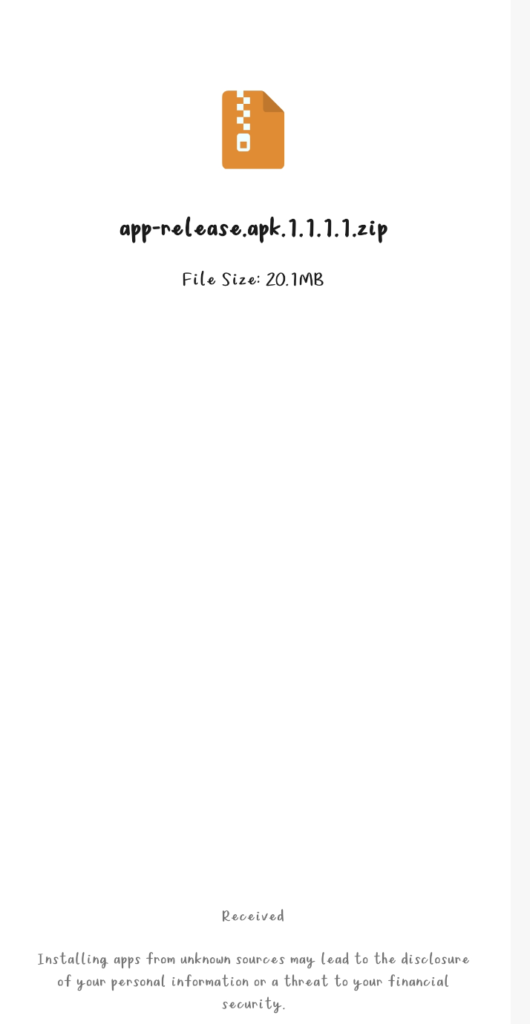
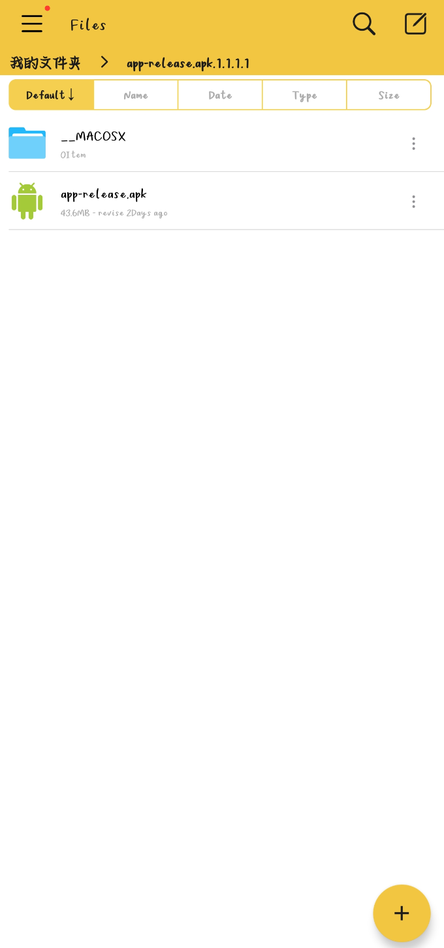
Installation Guide
Initiate the Installation (Manual APK Installation)
Unzip the software installation package

Slide 6
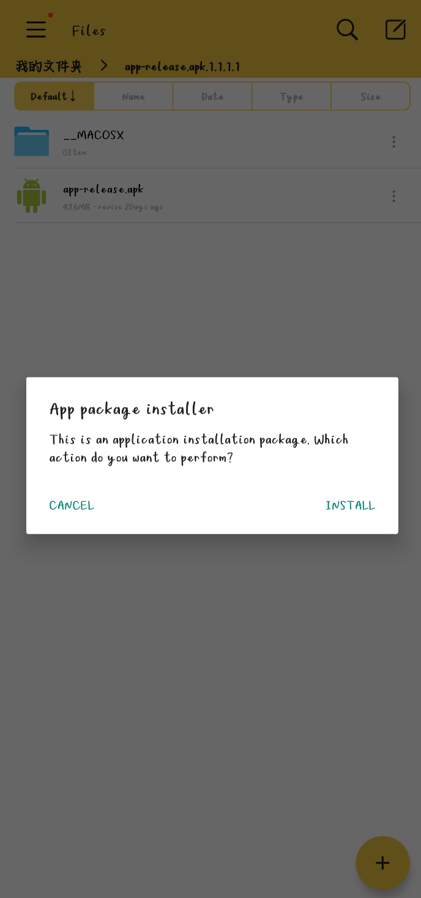
Installation Guide
End User Installation (Manual APK Installation)
Click the installation package to install the APP

Slide 7
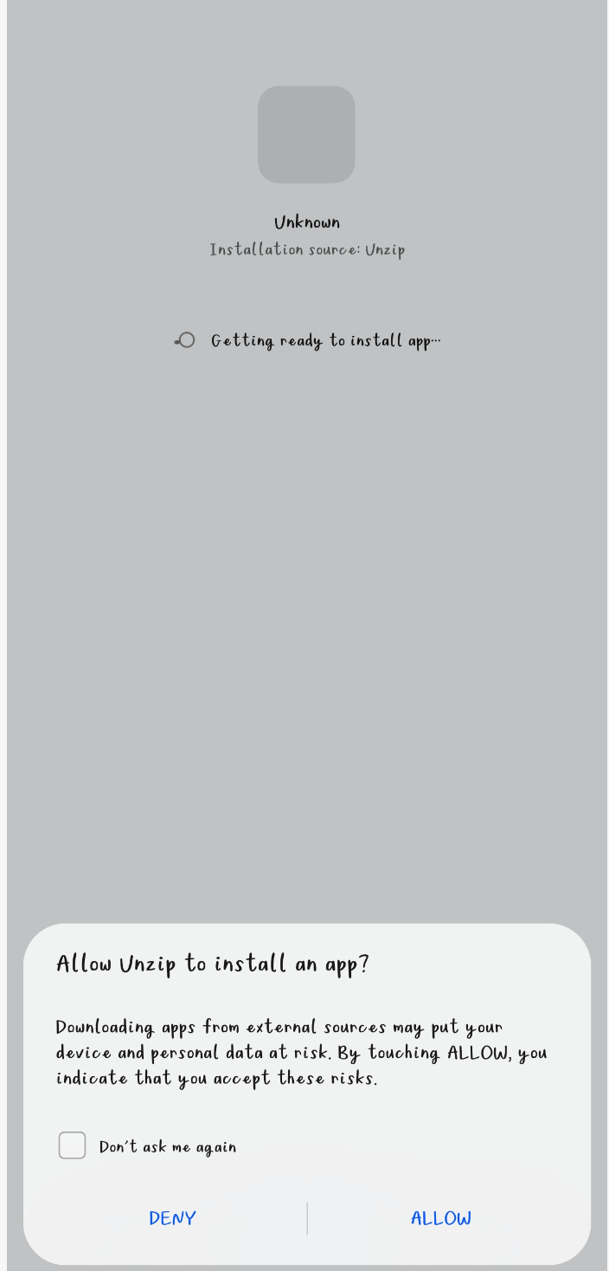
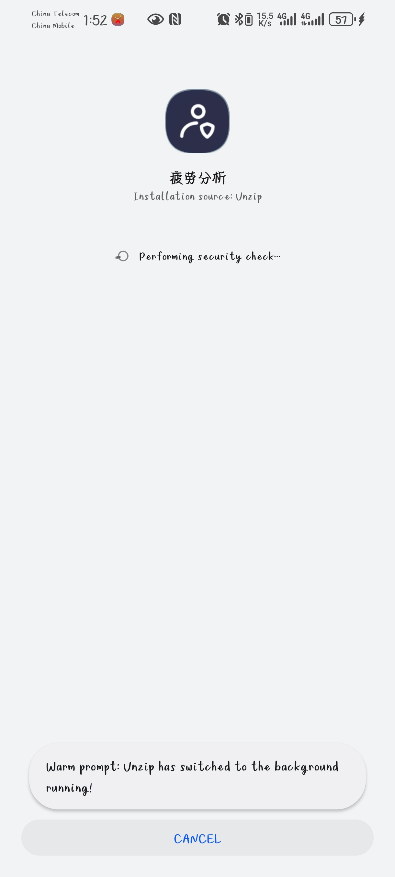
Installation Guide
End User Installation (Manual APK Installation)
Enable "Install Unknown Apps" for the Source Folder/APP

Slide 8
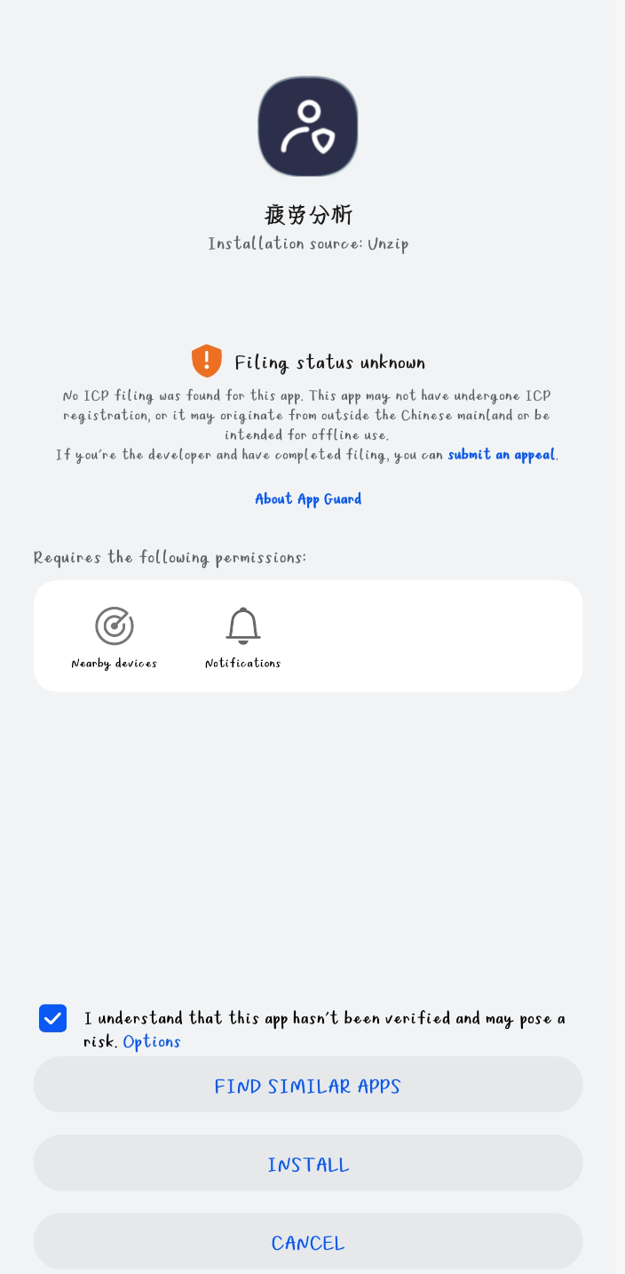
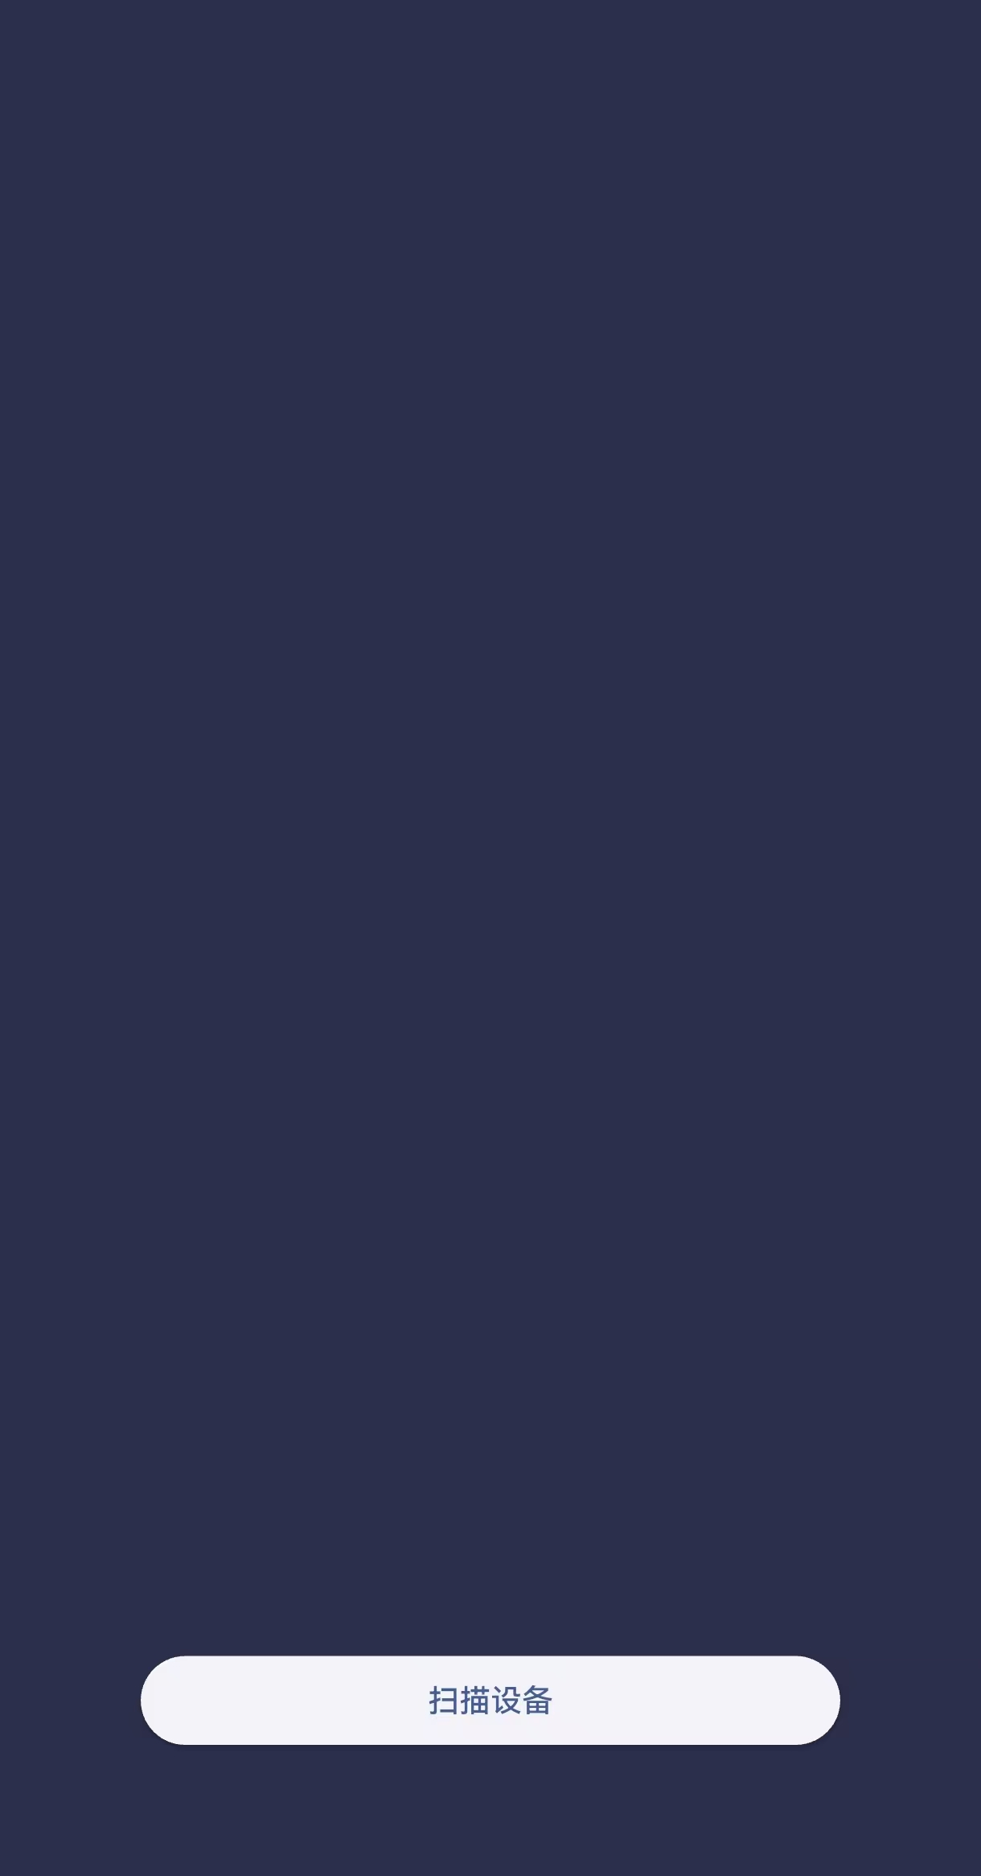
Installation Guide
Verify Installation Success

Slide 9
APP in mobile

Slide 10
Quick Start:
Tap the "Fatigue Analysis" icon. Ensure Bluetooth is enabled on the device (the app will prompt to enable Bluetooth if disabled).
Scan for Wearable Devices: Tap the " Scan Devices " button on the initial screen. The app will automatically search for nearby wearable sweat monitoring devices (device name starts with "KT"). The app will connect to the first detected device automatically.

Slide 11
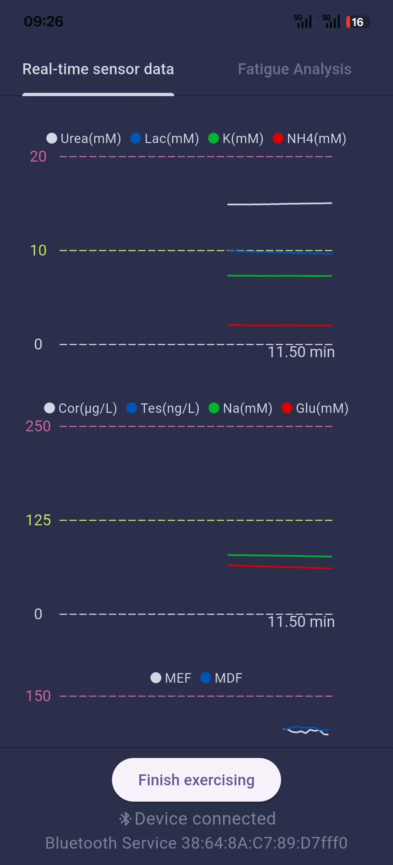
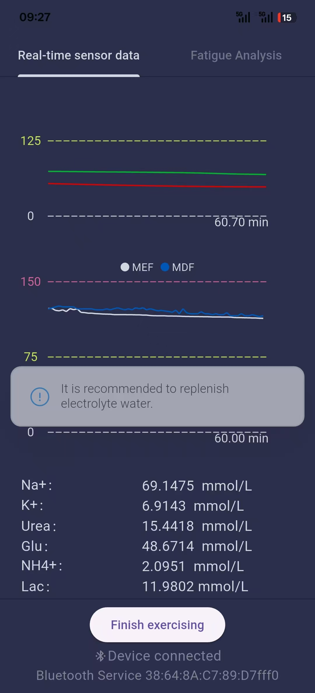
Functionality Walkthrough
Tab 1: Real-time Sensor Data
Data Visualization: Three line charts display:

Slide 12
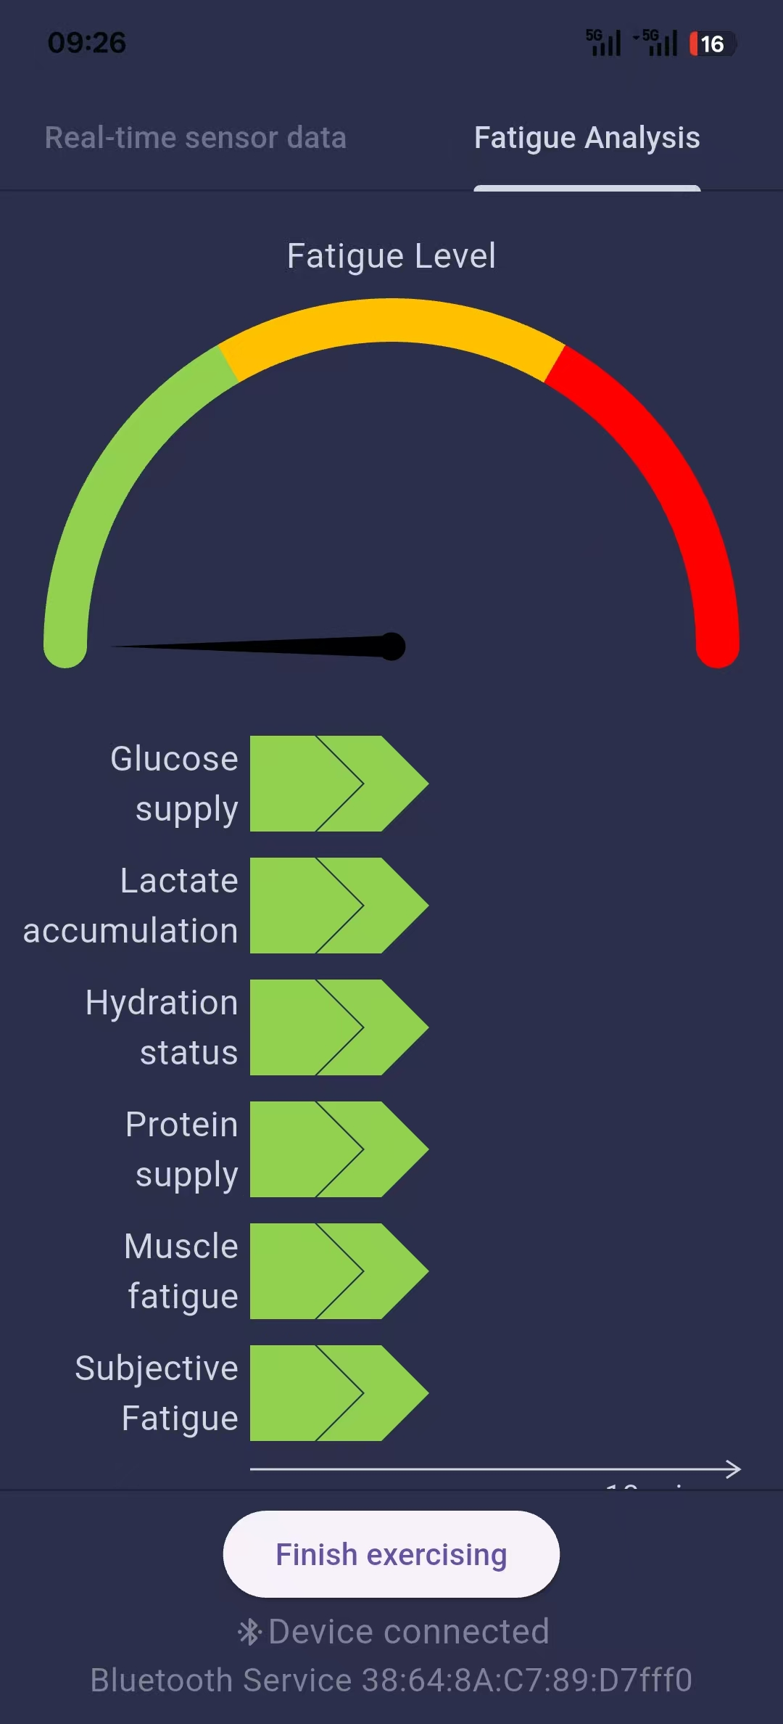
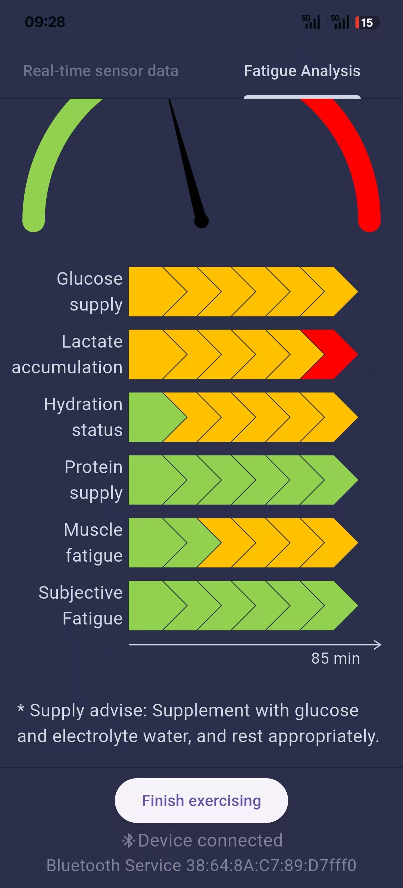
Functionality Walkthrough
Tab 2: Fatigue Analysis
Fatigue Level Gauge
Fatigue Classification Chart
Supply Recommendations

