Slide 1
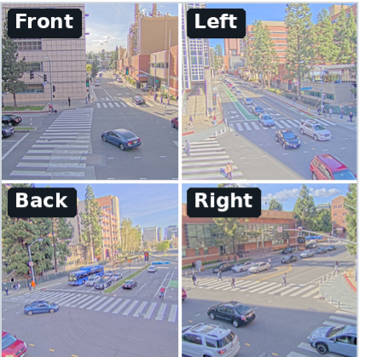
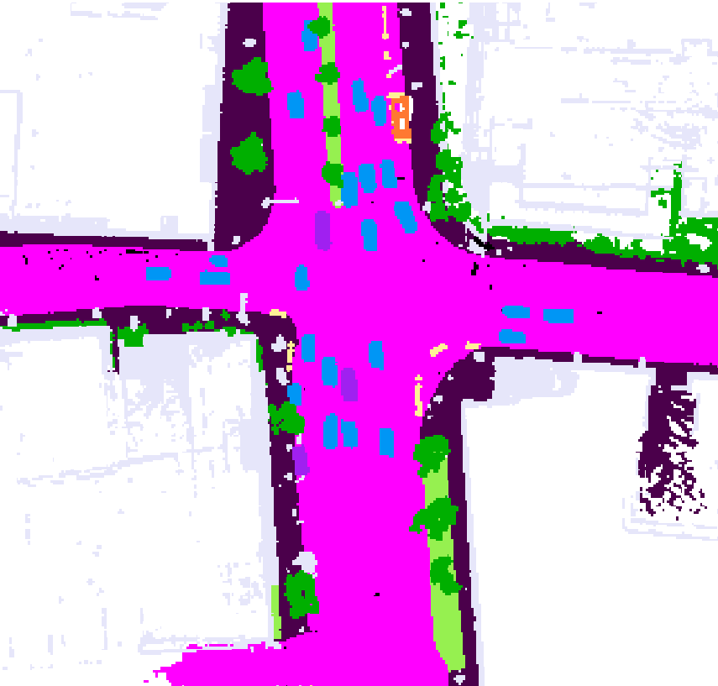
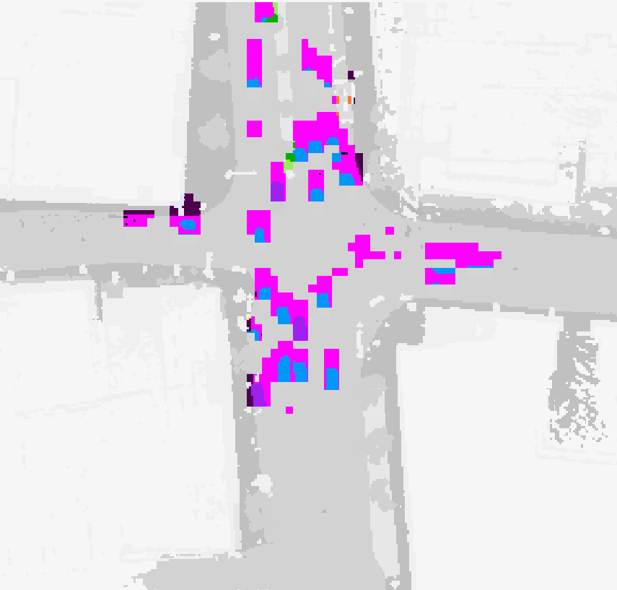
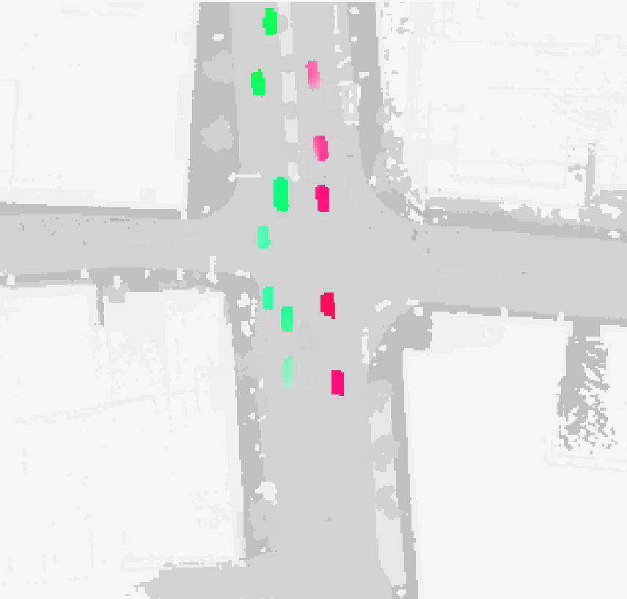
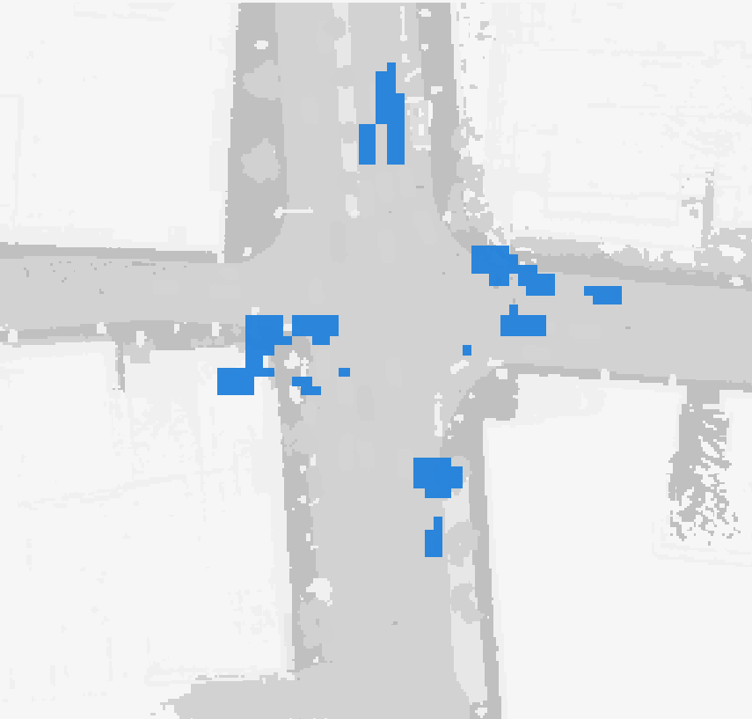
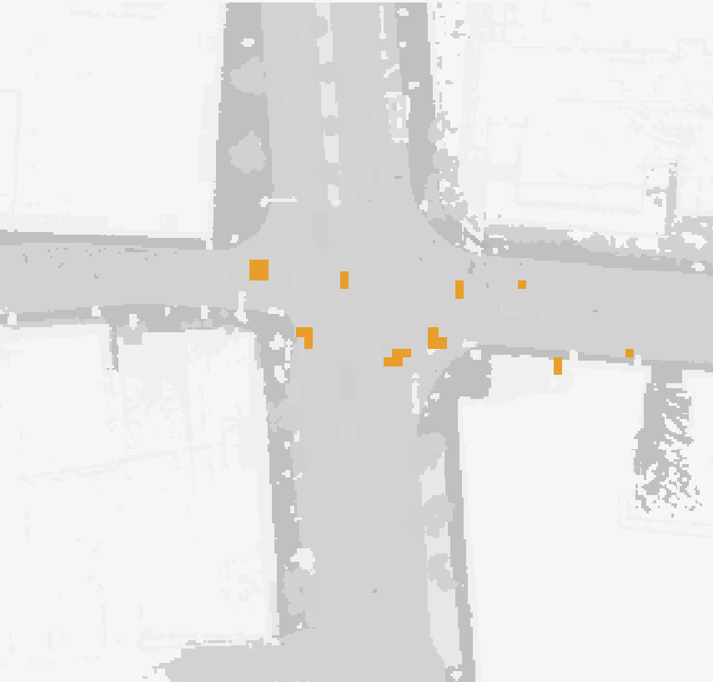
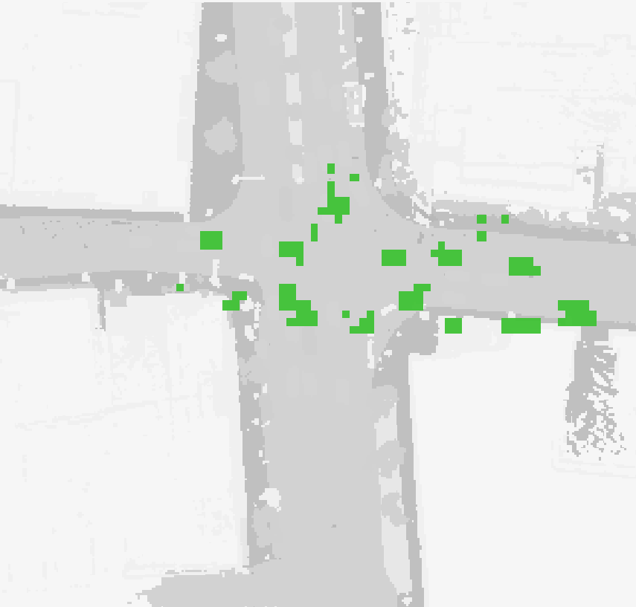
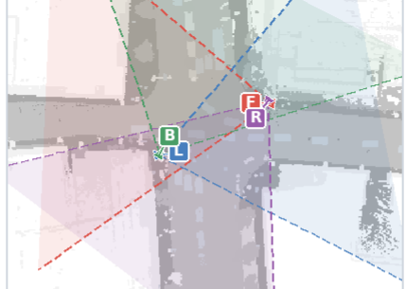
Roadside images
Predictions
RoadOcc coarse-to-fine decoder
shared across
1/8
1/4
1/2
native route
DCA
Where needed?
VVE
Where to read?
VDSF
Which source?
image
encoder
P
Persist
T
Transport
R
Refresh
Σ
current voxel
x − τv̂
current frame t
feature Qₜˢ
H(x)
H(x − τv̂)
Qₜ(x)
soft route
sparse fusion
calibration + depth
αP
αT
αR
semantic occupancy
candidate-guided re-query
local current–history match
supervised P/T/R source routing
training only
candidate targets
velocity targets
P/T/R targets
voxel velocity
TEMPORAL MEMORY LOOP
VVE prior v̂ₜˢ
full-resolution
scene state
slot t−1
same-grid multi-slot memory
fixed roadside coordinates
nearest slot → VVE
append current state
slot t−2
slot t−3
fused Hₜˢ + VVE v̂ₜˢ
cached feature + VVE prior
all valid slots → VDSF
camera geometry
reuse as history at t+1

