Slide 1
Mining Evidences for Named Entity Disambiguation
Yang Li, Chi Wang, Fangqiu Han, Jiawei Han, Dan Roth, Xifeng Yan
March 4, 2013

Slide 2
Acknowledgement
We sincerely thank Chi Wang at UIUC for his great help in modeling. We also greatly thank Prof. Jiawei Han & Prof. Dan Roth at UIUC, and Prof. Heng Ji at CUNY for their valuable comments in discussions.

Slide 3
Outline
Motivation
Problem Statement
Model & Algorithm
Experiments
Conclusions

Slide 4
Roadmap
Motivation
Problem Statement
Model & Algorithm
Experiments
Conclusions

Slide 5
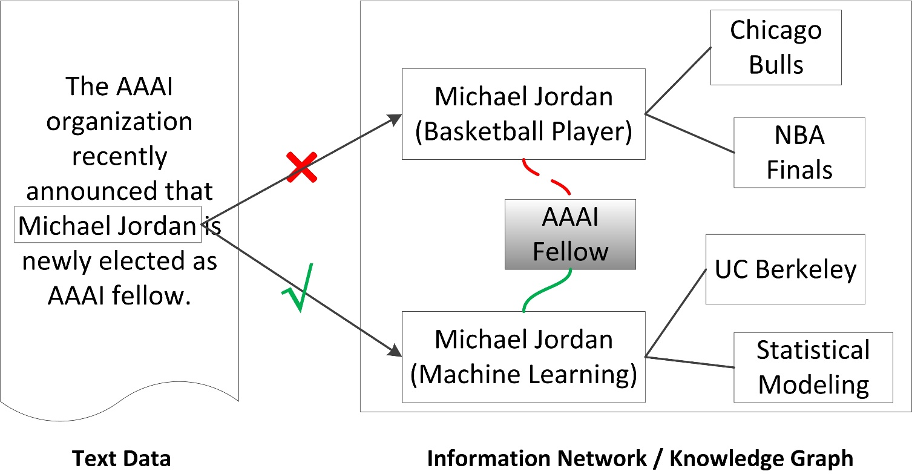
Named Entity Disambiguation
Named Entity Disambiguation (NED) is an important component in constructing high-quality information network or knowledge graph from unstructured text

Slide 6
Named Entity Disambiguation
Named Entity Disambiguation
Input:
A textual named entity mention m, along with the unstructured text t in which it appears, and a reference knowledge base K
Output:
A mapping from the mention m to its referent real world entity e in K

Slide 7
Previous Methods for NED
Prior Popularity
Assume the most prominent entity for a given mention is the most probable underlying entity for that mention.
Context Similarity
Define a similarity measure between the text around the entity mention and the document describing the referent entity in the knowledge base.
Topical Coherence
Define a topical/semantic coherence measure between the mention’s referent entity and other entities within the same context.

Slide 8

Mining Evidences for NED
What if the information contained in the reference knowledge base is insufficient?
No evidence failure
Knowledge base does not cover the information in the query
[E.g.] Eric Xing worked with [Michael Jordan] from 1999 to 2004
Insufficient evidence failure
Important disambiguation evidences appear rarely in the knowledge base, thus overwhelmed by other evidences
[E.g.] [Michael Jordan] won the best paper award
Mining additional evidences scattered in internal and external corpus to augment the knowledge base and enhance its disambiguation power

Slide 9
Roadmap
Motivation
Problem Statement
Model & Algorithm
Experiments
Conclusions

Slide 10
Mining Evidences for NED
Mining Evidences for Named Entity Disambiguation
Input:
A textual named entity mention m, a reference knowledge base K, and a document corpus C outside K
Output:
Additional evidences scattered in K and C which can further help the disambiguation of m with respect to K
Mining Evidences for Named Entity Disambiguation (MENED) is independent of query context, therefore it shall run offline as a preprocessing step.

Slide 11
Roadmap
Motivation
Problem Statement
Model & Algorithm
Experiments
Conclusions

Slide 12
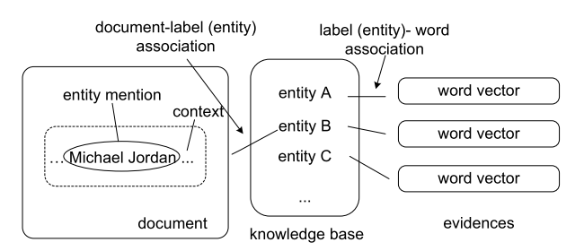
Our Model for MENED
Intuitions behind the model
Entity:
Each referent entity candidate is modeled as a topic/label
Document:
Each mention along with its context is modeled as a document
Word:
Words associated with a topic/label are modeled as the disambiguation evidences for the corresponding entity

Slide 13
Our Model for MENED
Two special topics/labels
“Background”:
To capture words which are general to some or all topics/labels
“Default”:
To capture words from the documents whose underlying entities are not within the referent entity candidates
For a mention with K referent entity candidates, the total number of topics/labels is K+2

Slide 14
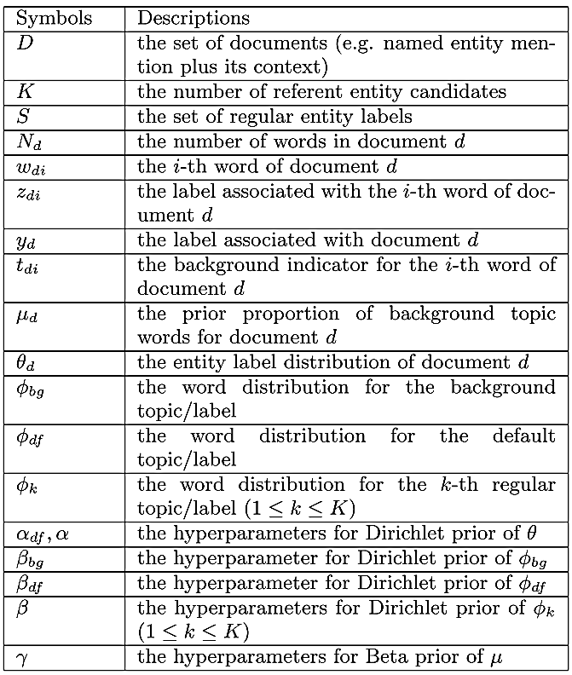
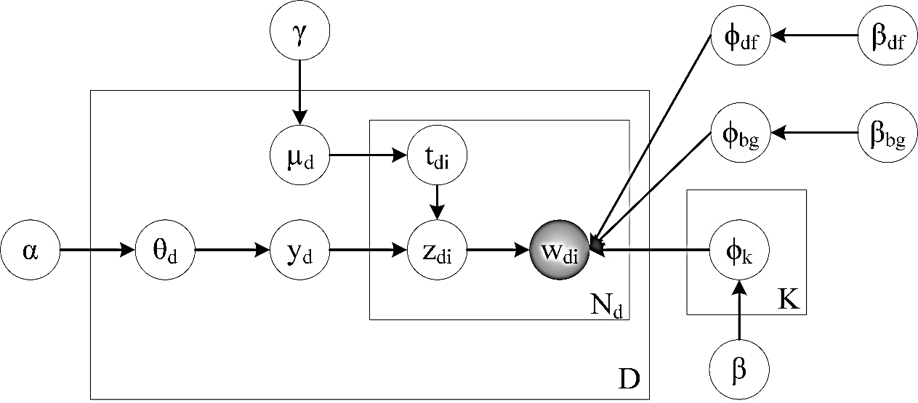
Our Model for MENED
A generative model for MENED

Slide 15
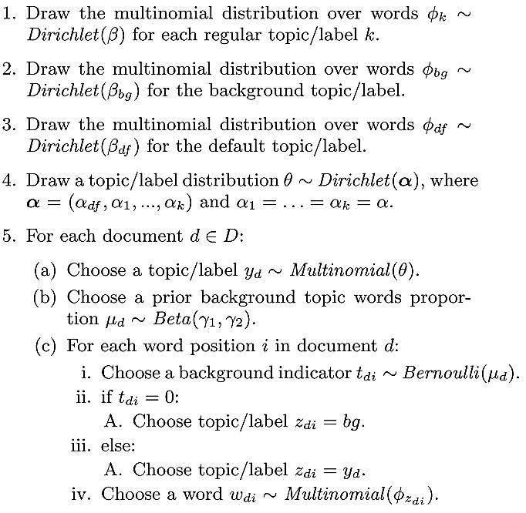
Our Model for MENED
Generative Process:

Slide 16
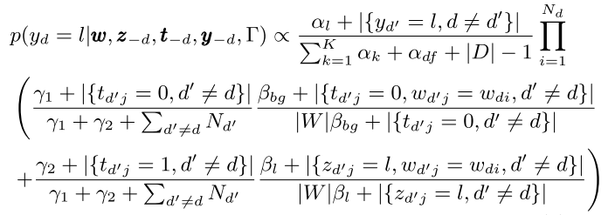

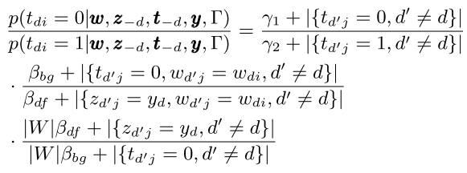
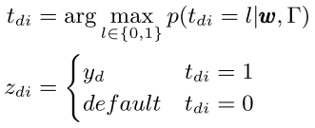

Our Model for MENED
Model Inferences via Gibbs Sampling
Estimating Document Label:
Estimating Label-Word Association:

Slide 17
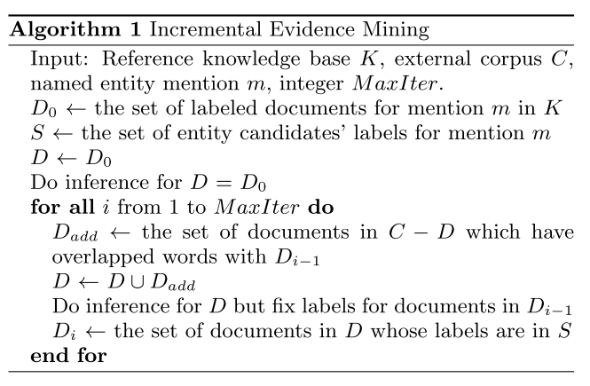
Incremental Evidence Mining
Incremental Evidence Mining Algorithm:

Slide 18
Roadmap
Motivation
Problem Statement
Model & Algorithm
Experiments
Conclusions

Slide 19
Experiments Setup
Datasets
News data from TAC-KBP2009 dataset (424 queries)
We modified the dataset to keep only a fixed-size (in this work, 60) word window surrounding the query mention as its “context”
Tweets data (340 queries)
Reference Knowledge Base: Wikipedia
External Corpus: documents indexed by Google
Parameter Setting: tuned on a small test dataset
α = 0.001, α_{df} = 0.01, β = 0.001, β_{df} = 0.01, β_{bg} = 0.1,
γ₁ = 0.0003, γ₂ = 0.001, η = 0.9

Slide 20
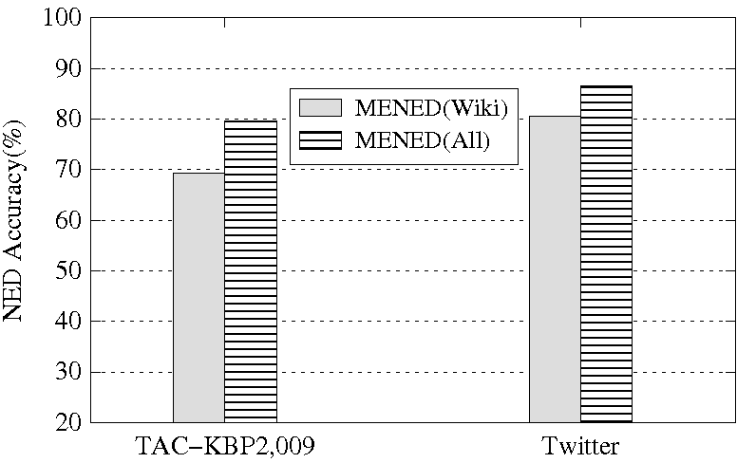
Effectiveness of Evidence Mining

Slide 21
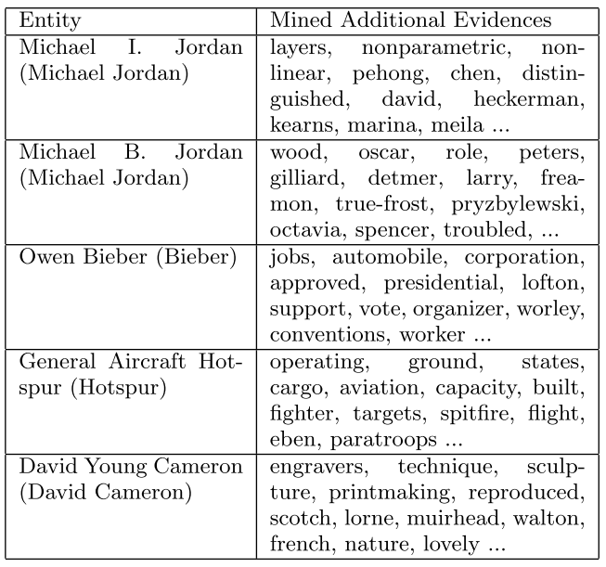
Effectiveness of Evidence Mining

Slide 22
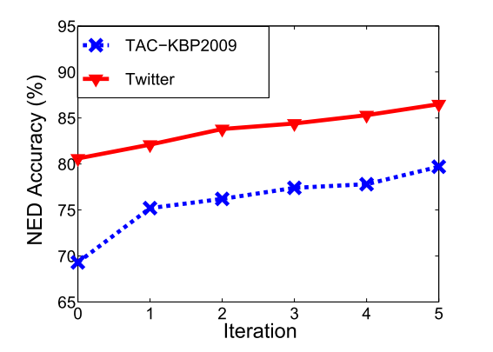
Impact of Incremental Iterations

Slide 23
Roadmap
Motivation
Problem Statement
Model & Algorithm
Experiments
Conclusions

Slide 24
Conclusions
MENED is helpful for boosting NED performance
The proposed generative model and incremental algorithm are effective in performing MENED
The mined evidences (in the form of words) can be utilized by other NED algorithms

Slide 25
Thanks! Q&A

Slide 26
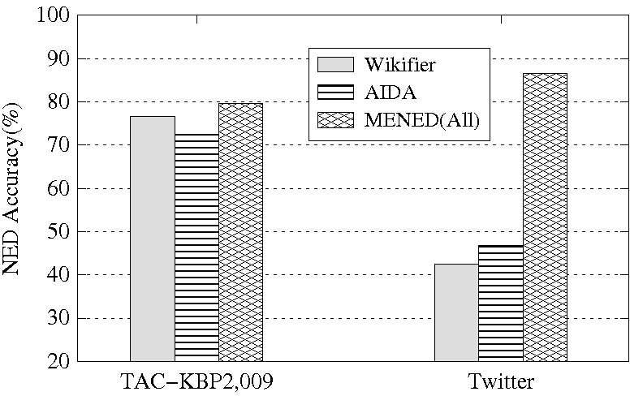
NED Accuracy

