Slide 1
Cross-Documents Evidence Mining for Entity Linking
University of California, Santa Barbara
(collaborate with Prof. Dan Roth at UIUC)
Nov 26, 2012

Slide 2
Acknowledgement
We sincerely thank Prof. Dan Roth at UIUC and Prof. Heng Ji at CUNY for their valuable comments in discussions.

Slide 3
Outline
Entity Linking
Problems of Existing EL Algorithms
Possible Solution
Problem Definition
Baseline Methods
Our Possible Solution
Conclusion

Slide 4
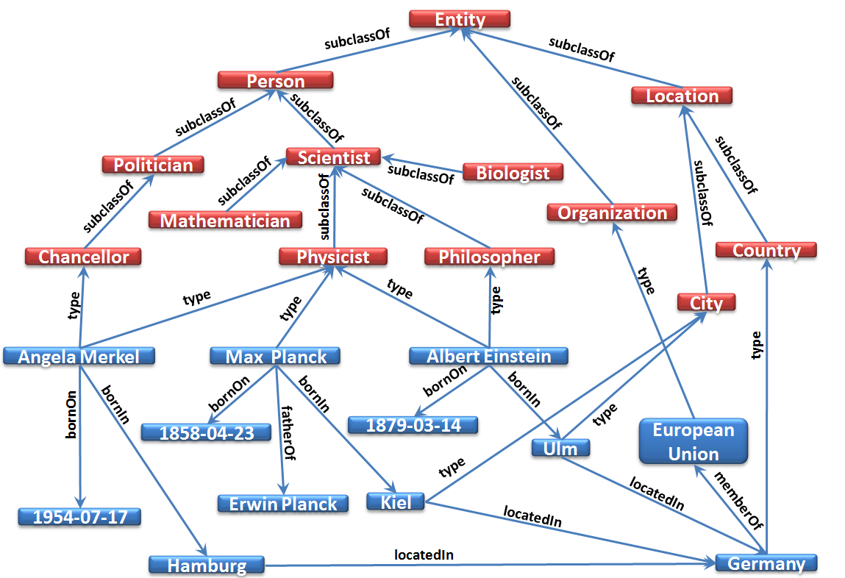
Entity Linking
Entity Linking [1] is an important component in constructing high-quality information/knowledge network from unstructured text
Mrs. Merkel, born on 1954-07-17, is the current premier of Germany, which is an important member of EU.
Figure modified from “Information to Knowledge: Harvesting Entities and Relationships from Web Sources”. PODS’10.

Slide 5
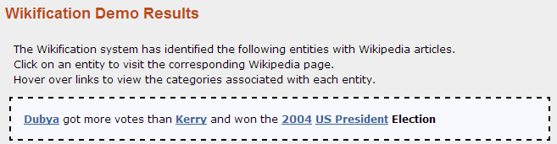
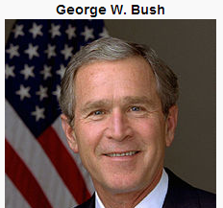
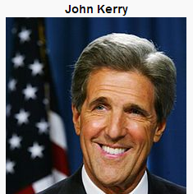
Entity Linking
Wikifier [2] is a state-of-the-art Entity Linking tool
It uses the following information:
Prior Popularity
Context Similarity
Semantic Similarity/Coherence
It handles both Name Variations (Bush case), and Name Ambiguity (Kerry case) well
Notes:
This example shows that Wikifier can handle both Name Variations (Bush case), and Name Ambiguity (Kerry case)

Slide 6
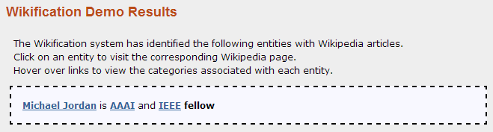
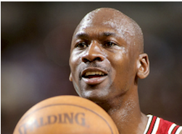

Problems of Existing EL Algos
Prior popularity could be troublesome
Here the Wikifier got the wrong answer mainly due to the strong prior popularity of the basketball star.
Notes:
Here the Wikifier got the wrong answer mainly due to the strong prior popularity of the basketball star.

Slide 7
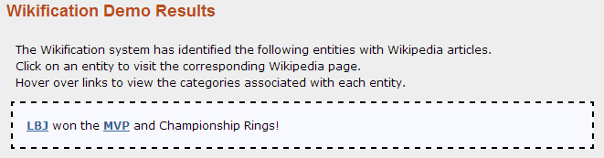
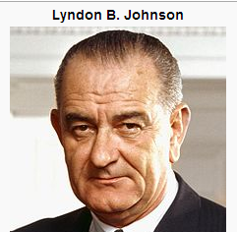
Problems of Existing EL Algos
No enough context in short queries (e.g. news title, tweets)
Here the Wikifier got the wrong answer due to the lack of enough context.
Notes:
Here the Wikifier got the wrong answer due to the lack of enough context.

Slide 8
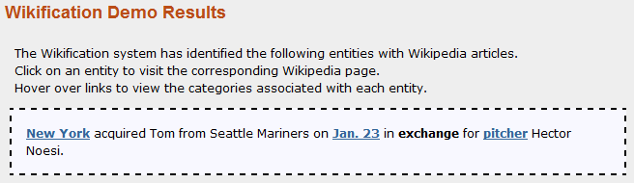
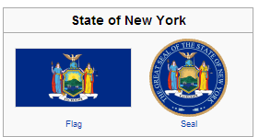
Problems of Existing EL Algos
Information contained in query may not offer direct help
Here the Wikifier got the wrong answer mainly due to the lack of useful information in the context. (e.g. since there is no wiki page for Tom etc., the semantic coherence info cannot be obtained and used)
Notes:
Here the Wikifier got the wrong answer mainly due to the lack of useful information in the context. (e.g. since there is no wiki page for Tom etc., the semantic coherence info cannot be obtained and used)

Slide 9
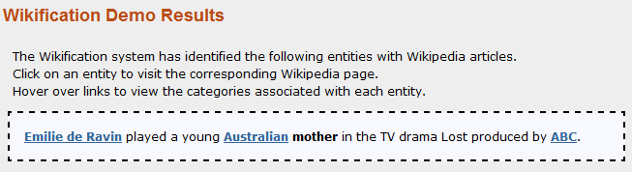
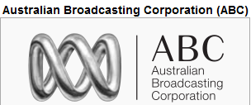
Problems of Existing EL Algos
Information contained in query may be misleading
Here the Wikifier got the wrong answer mainly due to the misleading information “Australian” in the context.
Notes:
Here the Wikifier got the wrong answer mainly due to the misleading information “Australian” in the context.

Slide 10
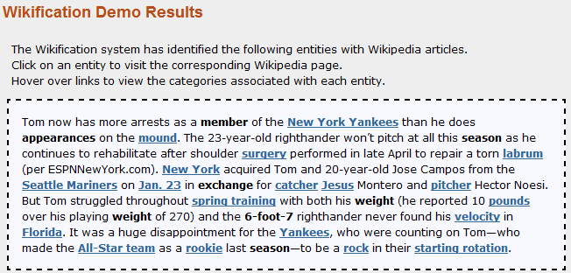
Problems of Existing EL Algos
Information contained in (long) query includes lots of noises
Notes:
Here the Wikifier got the wrong answer mainly due to the noises contained in the long query.

Slide 11
Possible Solution
A Possible Solution: Mining evidences from other docs.
Intuition: Human beings can handle these problematic cases correctly because they have some other accumulated knowledge/evidences to help make the decision. If we can design a method to automatically add such evidences to a query, then computer can also make right decision. Most of these evidences are available in digital text but scattered across multiple documents. Mining evidences across documents becomes a natural way to facilitate entity linking.

Slide 12
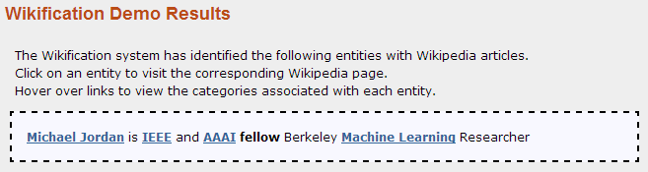
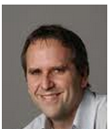

Possible Solution
Mined strong evidences could help balance prior popularity
Those strong evidences can be mined from related documents (e.g. Michael Jordan’s bio)
Notes:
Those strong evidences can be mined from related documents (e.g. Michael Jordan’s bio)

Slide 13
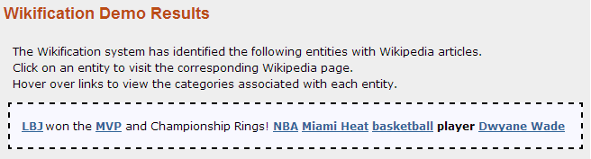
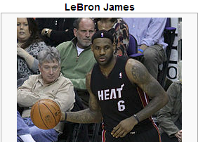
Possible Solution
Mined evidences could provide enough context information
Evidences can be mined from detailed descriptions (e.g. sports news, sports blogs) of the event that LBJ won the champions
Notes:
Evidences can be mined from detailed descriptions (e.g. sports news, sports blogs) of the event that LBJ won the champions

Slide 14

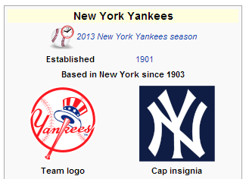
Possible Solution
Supporting evidence mined elsewhere can offer direct help
Evidences can be mined from the corresponding reports of this acquisition.
Notes:
Evidences can be mined from the corresponding reports of this acquisition.

Slide 15
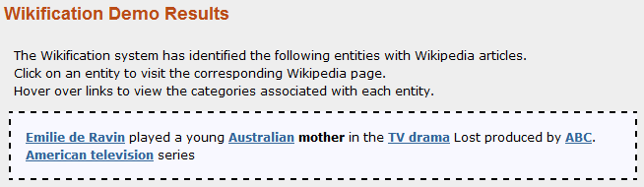
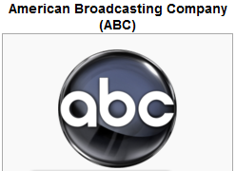
Possible Solution
Mined evidence can counterbalance the misleading info
Evidences can be mined from the related descriptions of the drama
Notes:
Evidences can be mined from the related descriptions of the drama

Slide 16
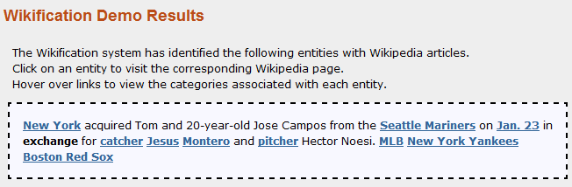
Possible Solution
Mined evidence can help discard the noises
Evidences can be mined from the related descriptions of the acquisition
Notes:
Evidences can be mined from the related descriptions of the acquisition

Slide 17
Problem Definition
Cross-Doc Evidence Mining For Entity linking
Input:
A textual named entity mention m, along with the unstructured text in which it appears.
Output:
The useful evidences (e.g. context, entities) mined from other related documents which can greatly help the existing entity linking algorithms to find the corresponding real world entity e in the knowledge base

Slide 18
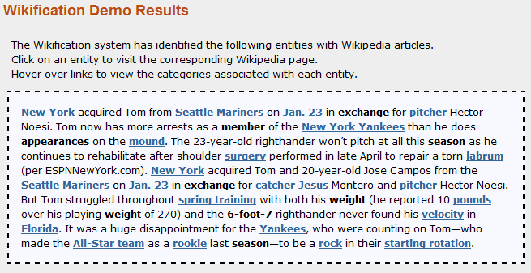
Problem Definition
Only useful evidences matter! Not the more the better!

Slide 19
Baseline Methods
Basic Query Expansion [3,4]: use co-reference resolution, acronym expansion etc. to expand queries
Drawbacks:
Co-reference resolution becomes less helpful when the query is short (no enough context), or the named entity mention m is not the “focus” of the query (no co-reference exists in query).
Acronym expansion is not helpful when there are no acronyms in the query or the acronyms themselves are ambiguous.

Slide 20
Baseline Methods
Micro Collaborative Entity Linking [5,6]: search a group of related documents (instance-level collaborators) by clustering, and make the joint decision (Voting/Averaging/Merging) from the group using a stand-alone entity linking algorithm.
Drawbacks:
Documents clustering makes less sense when the query is not the “dominating topical focus” of the retrieved documents. (e.g. query appears infrequently in the retrieved documents)
Voting/Averaging/Merging is too coarse as it does not consider the various disambiguation abilities of different evidences.

Slide 21
Baseline Methods
Pseudo-Relevance Feedback [7,8]: trust the top 10~20 documents retrieved by original query as relevant results and select top 20-30 terms from these documents (e.g. using tf-idf weights) to expand the original query.
Drawbacks:
The assumption that the top 10~20 documents are relevant may not be true. The top retrieved documents frequently contain non-relevant documents, which introduce noise into the expanded query
Selecting expansion terms using tf-idf is not very semantically meaningful.
Notes:
For example, in the case we show previously, the retrieved documents may discuss a match between New York Yankee and Boston Red Sox. It is normal to see that these documents mention “Boston Red Sox” only once at the beginning and then use “Boston” to refer to the team. Then using tf-idf we will get “Boston” as expansion term, but not “Boston Red Sox”. However, “Boston” is not a helpful evidence in this case. Adding “Boston” into the query will not help Wikifier make the right decision.

Slide 22
Our Possible Solution (Pipeline)
Query
Search
Rank
Web
documents
Ranked Web
documents
Extraction
evidence₁
Scoring&
Ranking
Helpful Evidence
Filtering
Related Web
documents
Extraction
evidence₂
Filtering
Extraction
evidence₃
22
Notes:
For long query, we choose the sentence containing the name entity mention m as original query and treat the rest sentences as a related document/paragraph

Slide 23
Our Possible Solution
We are interested in two types of evidences:
Entity evidence: the evidence itself is an entity/concept
Context evidence: the evidence is just regular context
We propose a two-step method to mine evidences:
(1) Find related entity evidences
(2) Use mined entity evidences along with original query to generate regular context evidence
23

Slide 24
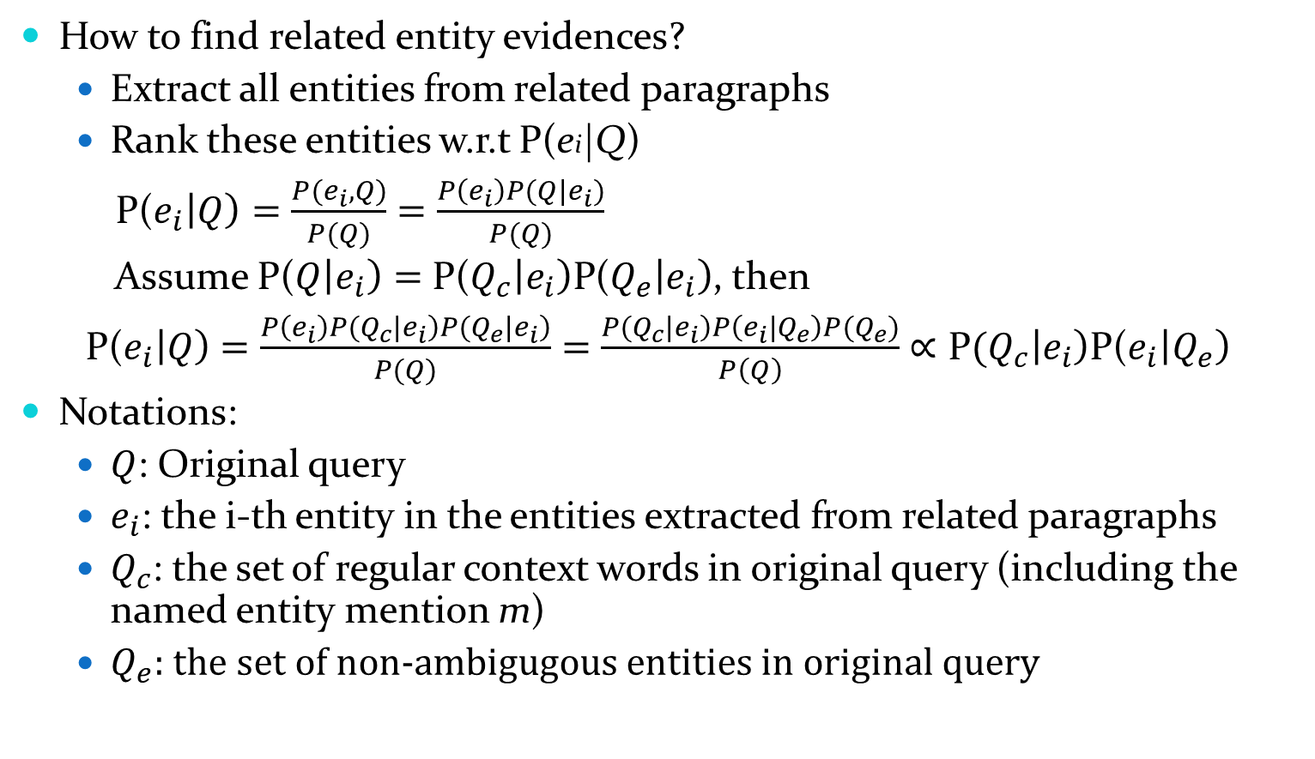
Our Possible Solution
How to find related entity evidences?
Extract all entities from related paragraphs
Rank these entities w.r.t P(ei|Q)
P($e_{i}\left|Q\right)=\frac{P(e_{i},Q)}{P(Q)}$ $=\frac{P\left(e_{i}\right)P(Q|e_{i})}{P(Q)}$
Assume P($Q\left|e_{i}\right)=$ P($Q_{c}\left|e_{i}\right)\text{P}\text{(}Q_{e}\left|e_{i}\right)$, then
P($e_{i}\left|Q\right)$ $=\frac{P\left(e_{i}\right)P(Q_{c}\left|e_{i}\right)P(Q_{e}\left|e_{i}\right)}{P(Q)}=$ $\frac{P(Q_{c}\left|e_{i}\right)P\left(e_{i} | Q_{e}\right)P{(Q}_{e})}{P\left(Q\right)}$ $∝\text{P}(Q_{c}\left|e_{i}\right)$P($e_{i}\left|Q_{e}\right)$
Notations:
$Q$: Original query
$e_{i}$: the i-th entity in the entities extracted from related paragraphs
$Q_{c}$: the set of regular context words in original query (including the named entity mention m)
$Q_{e}$: the set of non-ambigugous entities in original query
24

Slide 25

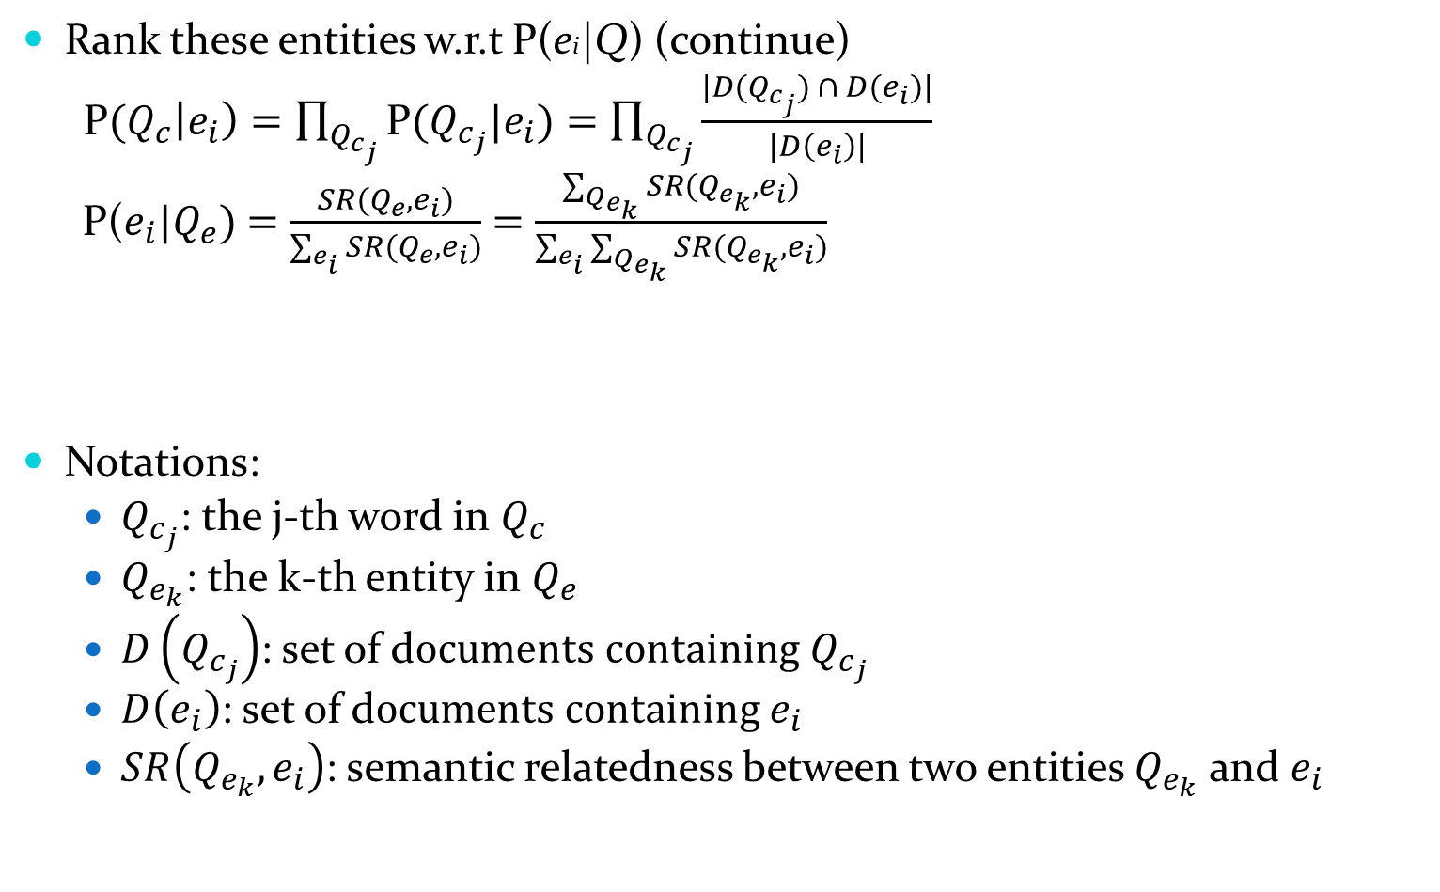
Our Possible Solution
Rank these entities w.r.t P(ei|Q) (continue)
P$(Q_{c}\left|e_{i}\right)=\prod_{Q_{c_{j}}}{\text{P}(Q_{c_{j}}|e_{i})=\prod_{Q_{c_{j}}}{\frac{|D(Q_{c_{j}}) ∩ D(e_{i})|}{|D\left(e_{i}\right)|}}}$
P($e_{i}|Q_{e})$ $=$ $\frac{SR(Q_{e},e_{i})}{\sum_{e_{i}}{SR(Q_{e},e_{i})}}$ $=$ $\frac{\sum_{Q_{e_{k}}}{SR(Q_{e_{k}},e_{i})}}{\sum_{e_{i}}{\sum_{Q_{e_{k}}}{SR(Q_{e_{k}},e_{i})}}}$
Notations:
$Q_{c_{j}}$: the j-th word in $Q_{c}$
$Q_{e_{k}}$: the k-th entity in $Q_{e}$
$D\left(Q_{c_{j}}\right)$: set of d$ocuments containing Q_{c_{j}}$
$D\left(e_{i}\right)$: set of d$ocuments containing e_{i}$
$SR\left(Q_{e_{k}},e_{i}\right)$: semantic relatedness between two entities $Q_{e_{k}}$ and $e_{i}$
25
Notes:
A and B are the sets of Wikipedia concepts that hyperlink to a and b respectively, and W is the set of all concepts in Wikipedia

Slide 26
Our Possible Solution
How to find related entity evidences? (Continue)
Among top-ranked entities, choose N entities as entity evidences
Need to consider those entities’ semantic complementarities
Possible Solution: make use of entity-entity graph in Wikipedia structure to measure complementarities.
Entity-entity graph: entities as nodes, anchor links as edges
Assume the larger the diameter of the entity-entity graph formed by the entity evidences, the better their semantic complementarities
26

Slide 27
Our Possible Solution
How to generate regular context evidence?
Use entity evidences to generate regular context evidence
Assumption 1: frequently mentioned words in all entity evidence’s wiki pages are useful context evidences.
Choose top TF-IDF words in all entity evidences’ wiki pages as regular context evidences.
Assumption 2: the generalization descriptions of all entity evidences are useful context evidences.
Choose shared category descriptions of all entity evidences’ wiki pages as regular context evidences.
27

Slide 28
Conclusion
Cross-Documents Evidence Mining for Entity Linking
Essential for both short/less informative queries (e.g. tweets, news titles) and noisy long queries (e.g. a paragraph)
Could be beneficial to any Entity Linking algorithms
Existing solutions have drawbacks
Need an advanced model/algorithm to solve the problem

Slide 29
References
[1] Heng Ji and Ralph Grishman. 2011. Knowledge Base Population: Successful Approaches and Challenges. Proc. ACL2011.
[2] Lev Ratinov, Dan Roth, Doug Downey and Mike Anderson. 2011. Local and Global Algorithms for Disambiguation to Wikipedia. Proc. ACL2011.
[3] Swapna Gottipati and Jing Jiang. 2011. Linking Entities to a Knowledge Base with Query Expansion. Proc. EMNLP2011.
[4] Wei Zhang, Yan Chuan Sim, Jian Su and Chew Lim Tan. 2011. Entity linking with effective acronym expansion, instance selection and topic modeling. Proc. IJCAI2011
[5] Zheng Chen and Heng Ji. 2011. Collaborative Ranking: A Case Study on Entity Linking. Proc. EMNLP2011
[6] Taylor Cassidy, Heng Ji, Lev Ratinov, Arkaitz Zubiaga and Hongzhao Huang. 2012. Analysis and Enhancement of Wikification for Microblogs with Context Expansion. Proc. COLING2012
[7] Jinxi Xu and W. Bruce Croft. 1996. Query expansion using local and global document analysis. Proc. SIGIR1996
[8] Laura Dietz and Jeffrey Dalton. Across-Document Neighborhood Expansion.
Proc. TAC2012
29

Slide 30
Thanks! Q&A

Slide 31
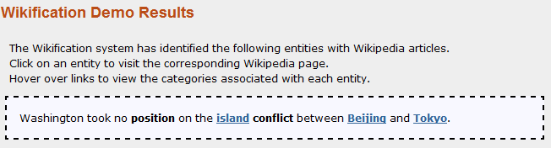

Harder Case/Future Work
The following case is even harder, it requires not only cross-document evidence mining, but also a more intelligent way for candidate generation.

