Slide 1
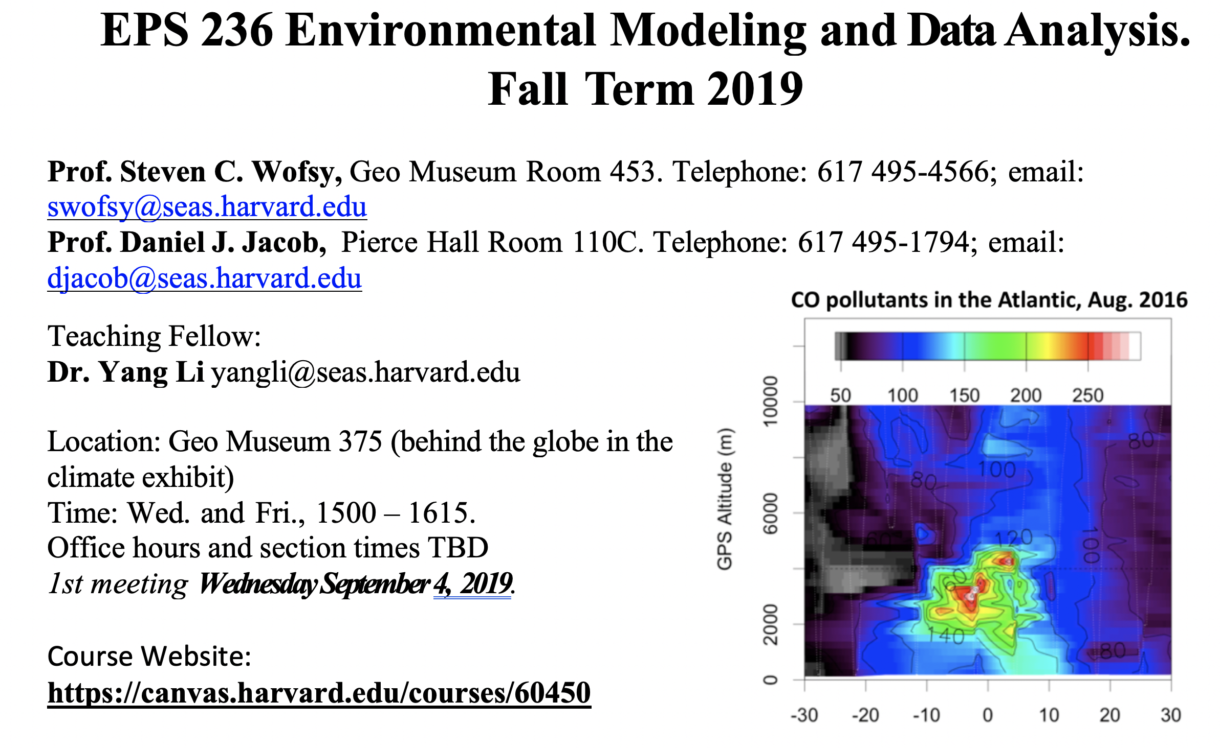
Latitude

Slide 2
Course overview
EPS 236 is a project-oriented, hands-on course that provides a graduate-level introduction to modeling, data analysis, and data visualization suitable for students from many fields, with applications drawn from the atmospheric science, environmental engineering, and climate science.
It is suitable for graduate students and advanced undergraduates in Earth and Planetary Sciences, Engineering Sciences/Environmental Science and Engineering, and allied natural science departments (e.g. Organismic and Evolutionary Biology, Chemistry and Chemical Biology, Physics; at MIT, students from EAPS and Civil &. Environmental have often enrolled).
Prerequisite: Applied Mathematics 105b (ordinary differential equations) or equivalent (may be taken concurrently); preparation in atmospheric chemistry is helpful, but not required; or permission of the instructors.

Slide 3
The course is divided into two parts:
1. Data analysis focusing on gaining science knowledge from complex environmental data sets and quantifying sources of error. Hands-on learning is emphasized. Data examples are drawn from surface networks, aircraft observations, and satellite sensors.
Emphasis is on:
concepts that underlie statistical inference
applications of these concepts to data analysis and visualization R will be used as a tool for visualization, time series analysis, Monte Carlo methods, and statistical assessment.
2(a). Models in environmental science: linear models (mathematical principles, time evolution, eigenvalues, eigenvectors); stochastic models (Markov chains); included with part 1, data analysis.
2(b). Chemical transport models including basic principles, numerical methods, and inverse modeling (optimal estimation, Kalman filter, adjoint methods).

Slide 4
Collaboration Policy for EPS 236 (FAS requirement)
Homework is intended to be an individual effort. You are allowed/encouraged to consult your classmates as you work on the homework. However, after discussion you should be able to work through the homework yourself and the answers that you submit have to be a result of your own efforts. Please list the names of students with whom you have collaborated.
Not permitted: Collaboration between students in the writing the solutions; accessing homework or solution sets from previous years is strictly forbidden; photographing a fellow student’s homework.
Class projects are intended to represent the joint effort of 2 – 3 students (solo projects are of course permitted). All students should participate with high energy and concentration to each project, and naturally collaborators should be named explicitly.

