Slide 1
Musicians meets big data
Umber, Lin,
W205 Final project

Slide 2
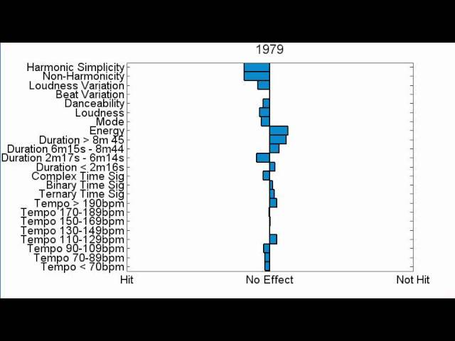
PROBLEM
Growing trend to predict a song’s success
Based on Characteristics – Million Song Dataset
Based on Lyrics - Journal of Advertising Research
The Opportunity
A lot of focus on looking at predicting success at personal level
Social media/APIs allow the ability to watch interest build up
The Potential
A scalable and real-time solution that enables marketers to understand what songs will be successful and how to replicate that success

Slide 3
Goal
Enable musicians and businesses to predict a song’s success using the following 3 step method:
UNDERSTAND – determine the best predictors for a song’s success
ENABLE – use best predictors for real time future success
ITERATE – continually reconcile prediction effectiveness against actual outcome

Slide 4


Data source
Twitter
YouTube
Others
Twitter: number of tweets mentioning artist, number of tweets from artist
Facebook: musician page comments
Google: search hits
Wikipedia: number of page revisions
YouTube: Song comments
Billboard: Date song reaches peak position, peak position

Slide 5



Data pipeline
API to get data and download into flat files
Import into AWS EC2 instances, and create HFDS files
Extract features from data using Hive (MR/TEZ)
Connect with reporting tool on Microsoft Power BI

Slide 6
Get data from public api
We investigated:
Sound Cloud(https://developers.soundcloud.com/docs/api/reference#comments )
YouTube(https://developers.google.com/youtube/v3/docs/videos )
Twitter(https://dev.twitter.com/rest/reference/get/search/tweets )
iTunes(https://www.apple.com/itunes/affiliates/resources/documentation/itunes-store-web-service-search-api.html )
lastfm(http://www.last.fm/api )
facebook likes for singer or band(http://stackoverflow.com/questions/9728279/getting-the-facebook-like-share-count-for-a-given-url )
Echonest(http://developer.echonest.com/docs/v4/)
We decided to use:
Echonest(http://developer.echonest.com/docs/v4/)
Twitter(https://dev.twitter.com/rest/reference/get/search/tweets )

Slide 7
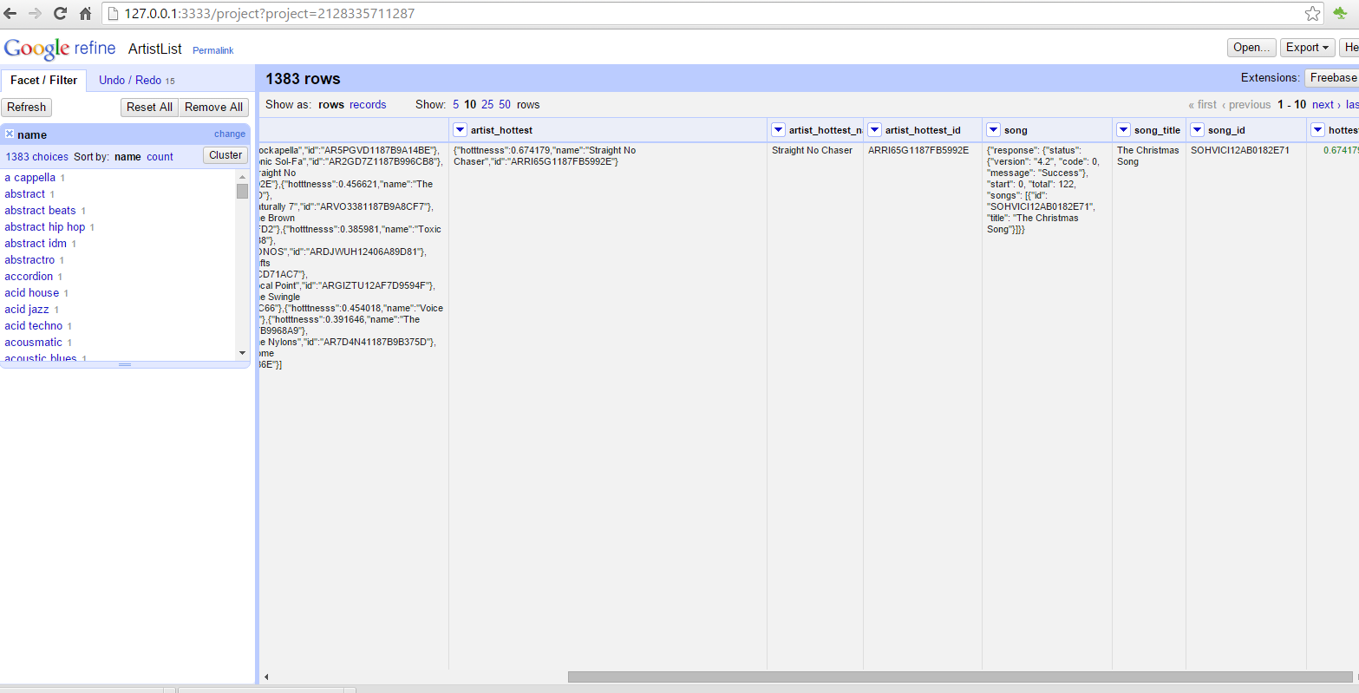
Data in google refine

Slide 8
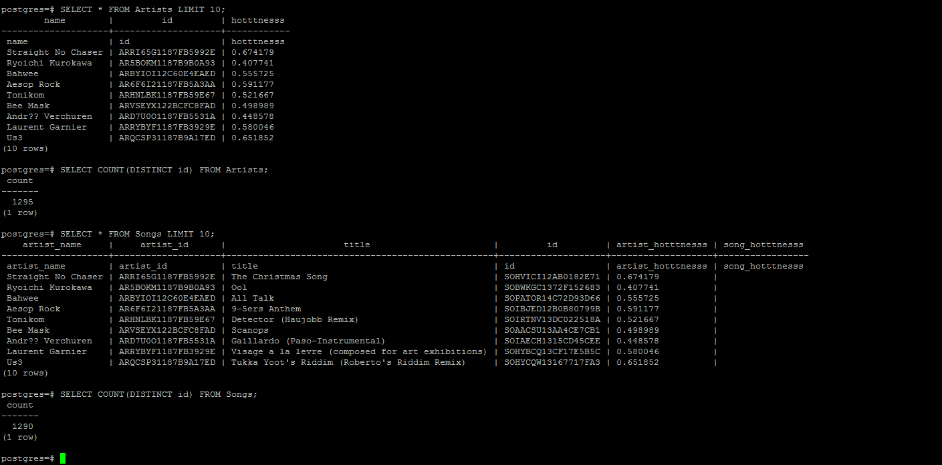
DATA TRANSFORMATION
After setting up the data pipeline. We transformed json data into relational data and imported into postgres DB.
Then added data attribute we need to enrich, such as tweet count, and song hotness.
Data Structure: Json
Size: M-L
Processing Time: Short-Medium

Slide 9
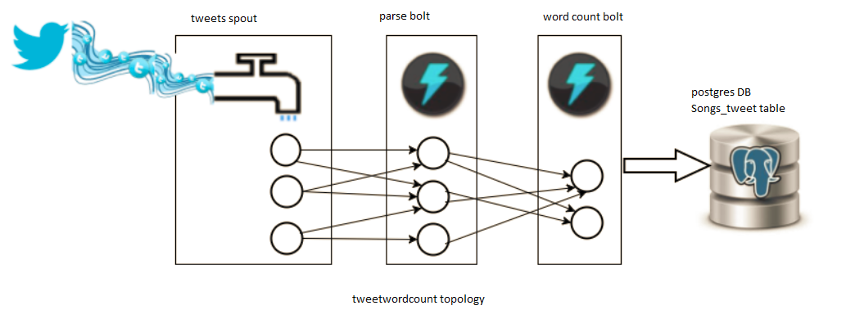
Tweet topologies

Slide 10
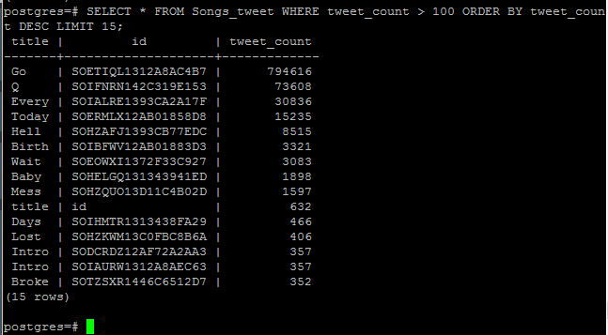
Data collected

Slide 11
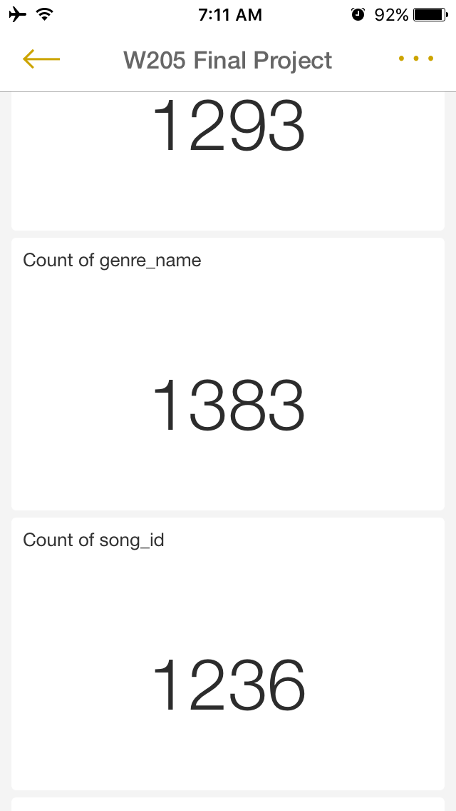
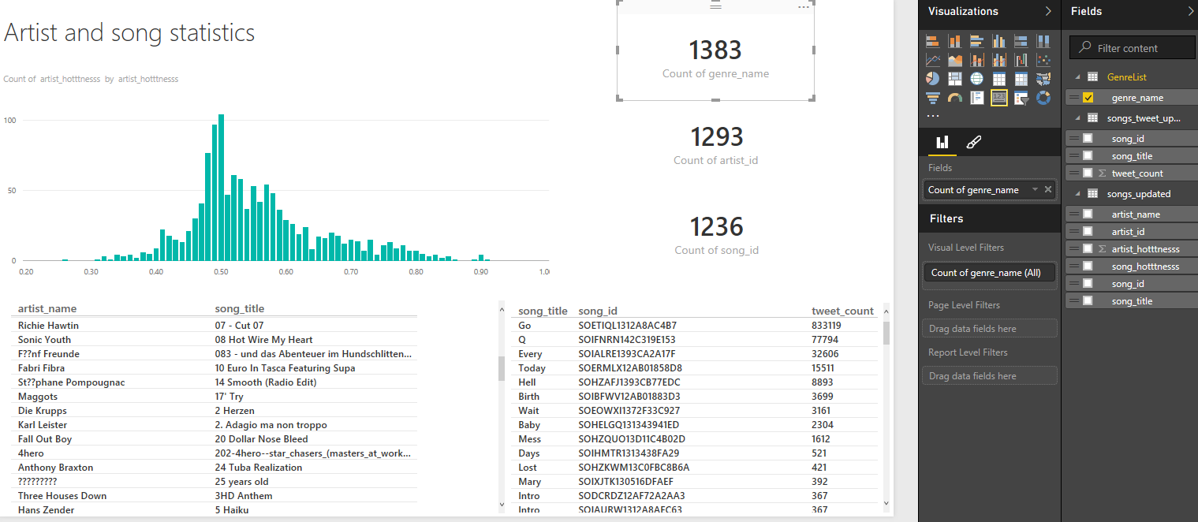
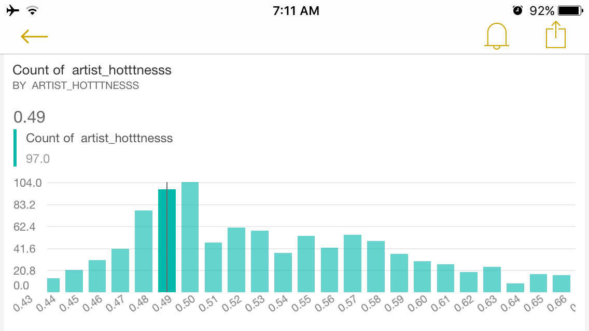
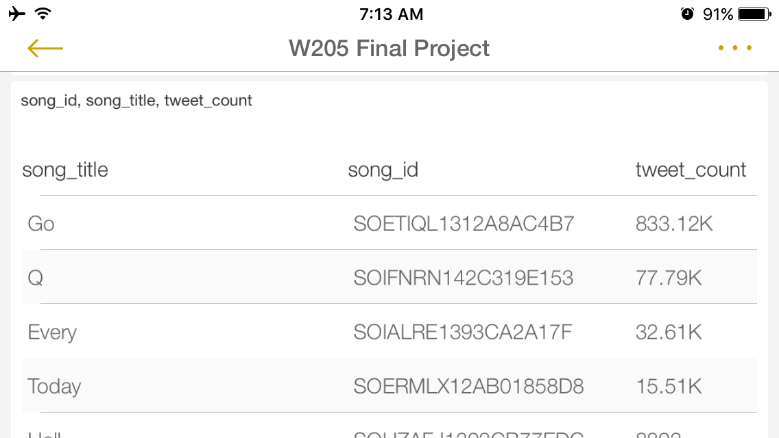
Visualize data
We monitor our data pipeline in Microsoft Power BI website.
We can also easily view this chart from iPhone or tablet.

Slide 12
LOOKING AT CAUSES OF FLUCTUATION
In this example, we change the inputs and data transformation
look at multiple data sources for week to week: total tweets mentioning artist & song, change from previous week billboard chart, change in google hits

Slide 13
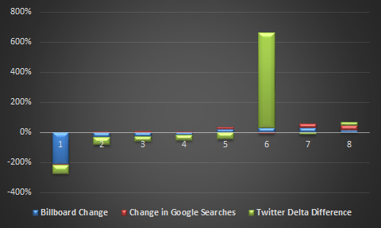
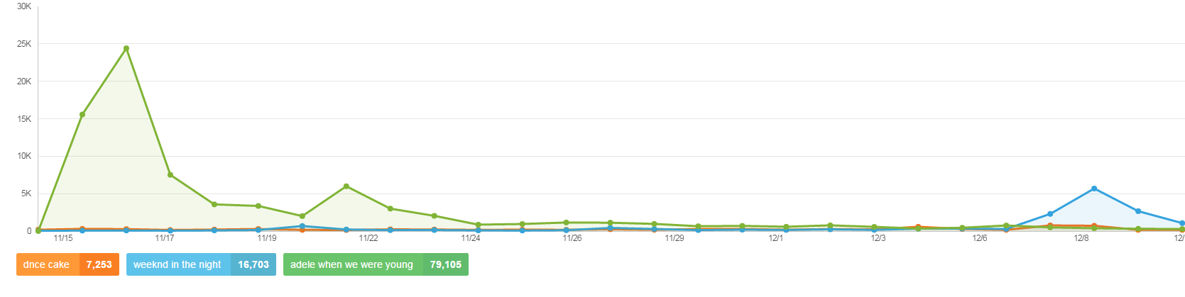

Slide 14
FUTURE
Explore more data sources, not just tweet
Explore more songs, the API we use allow us to get 15 artists per genre, and 100 songs per artist, we are only exploring 1 song from 1 artist per genre for now.
Leverage Machine Learning algorithms to automate learning and iterative feedback process
Enable structure and scale as more predictor inputs can easily be added or taken away
Automate reporting to visualization layer, currently some parts are manual.
Bug fixes if needed.

Slide 15
Scale and evolve
To Scale
PostgresSQL is already a good choice for storage, Power BI may be limited when data reaches more than 2G, so we may need to partition the data based on some attribute, for example based on first alphabet in the song title
More AWS machines and running more MR jobs to scrape historical data, and get data faster
To Evolve
Instantiate YouTube data scraping pipeline, including counting music video view counts, and comment count. If possible, also read all comments under the music video and start natural language processing machine learning process to extra key words that may predict a hit.
Power BI can directly connect to PostgresSQL DB, so instead of manually download data into CSV, we can directly connect from Power BI to PostgresSQL.

