Slide 1
Musicians meets big data
Umber, Lin,
W205 project 1, week 5

Slide 2
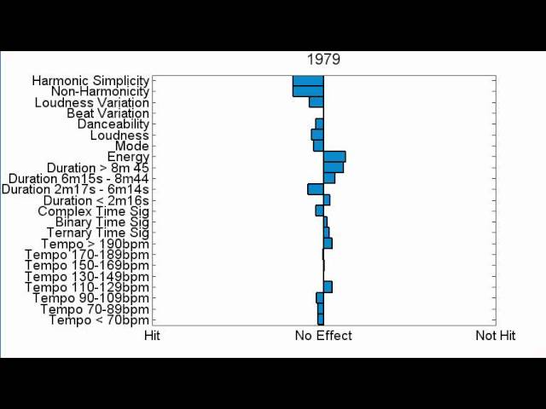
PROBLEM
Growing trend to predict a song’s success
Based on Characteristics – Million Song Dataset
Based on Lyrics - Journal of Advertising Research
The Opportunity
A lot of focus on looking at predicting success at personal level
Social media/APIs allow the ability to watch interest build up
The Potential
A scalable and real-time solution that enables marketers to understand what songs will be successful and how to replicate that success

Slide 3
Goal
Enable musicians and businesses to predict a song’s success using the following 3 step method:
UNDERSTAND – determine the best predictors for a song’s success
ENABLE – use best predictors for real time future success
ITERATE – continually reconcile prediction effectiveness against actual outcome

Slide 4


Data source
Twitter
YouTube
Others
Twitter: number of tweets mentioning artist, number of tweets from artist
Facebook: musician page comments
Google: search hits
Wikipedia: number of page revisions
YouTube: Song comments
Billboard: Date song reaches peak position, peak position

Slide 5



Data pipeline
API to get data and download into flat files
Import into AWS EC2 instances, and create HFDS files
Extract features from data using Hive (MR/TEZ)
Connect with reporting tool on Microsoft Power BI

Slide 6

DATA TRANSFORMATION
After setting up the data pipeline. We take averages of predictor data for 1 month leading up to song’s peak position on Billboard charts
Then factor correlated factors into predictive model and run against future songs
Data Structure: Semistructured
Size: M-L
Processing Time: Short-Medium
Schema on Read

Slide 7
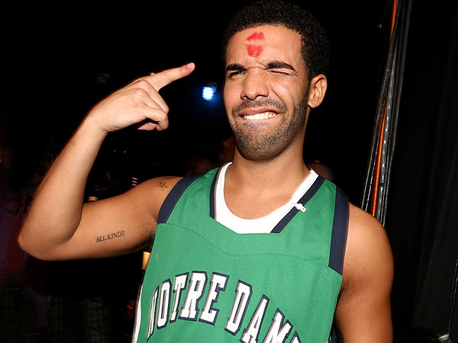
Proof of Concept example: DRAKE
For pilot example, scrape list of all Drake song’s that reached Billboard top 100 charts, get the date it reached the peak, and the peak position it reached
For predictive data, leverage google results for “Drake” query and take average for 1 month prior to each song’s peak position date
Run correlation to determine relationship

Slide 8
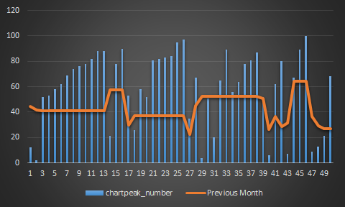
Proof of Concept example: DRAKE (Cont.)
0.7635 coefficient with .0518 significance in google query’s predictive abilities

Slide 9
EXAMPLE 2: LOOKING AT CAUSES OF FLUCTUATION
In this example, we change the inputs and data transformation
look at multiple data sources for week to week: total tweets mentioning artist & song, change from previous week billboard chart, change in google hits

Slide 10
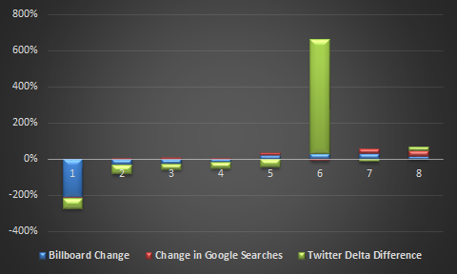
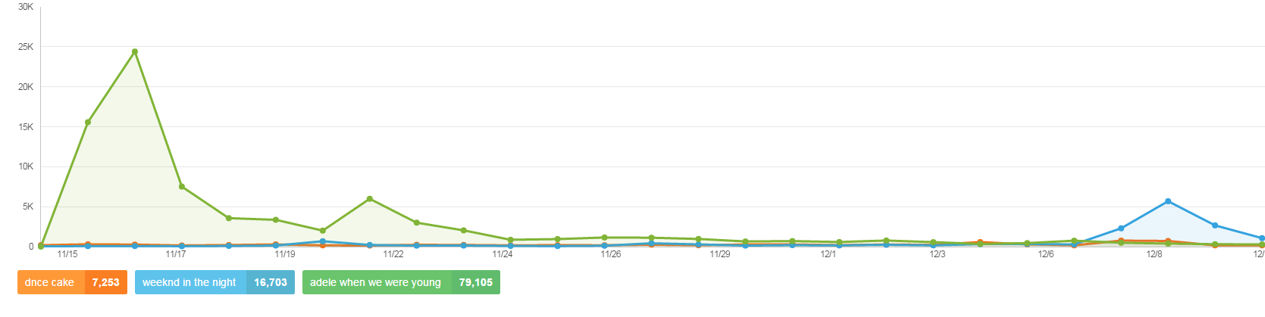
EXAMPLE 2:

Slide 11
EXAMPLE 2:

Slide 12
FUTURE
Make connection between UNDERSTAND, ENABLE, & ITERATE process in real time
Leverage Machine Learning algorithms to automate learning and iterative feedback process
Enable structure and scale as more predictor inputs can easily be added or taken away
Automate reporting to visualization layer

