Slide 2
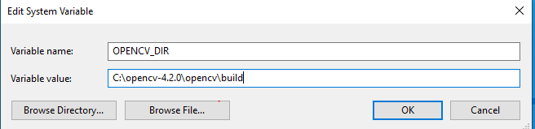
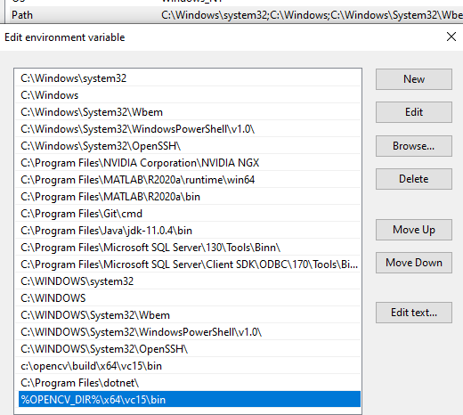
Set system variable OPENCV_DIR
Add bin to system path

Slide 3
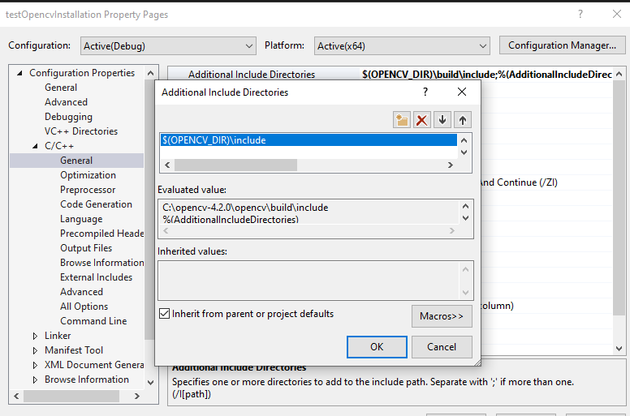
C/C++ -> General -> Additional Include Directories

Slide 4
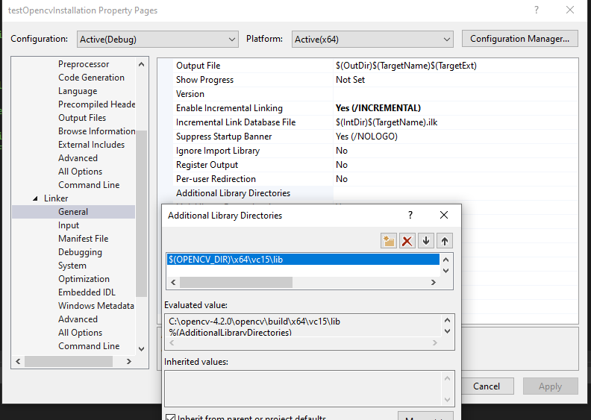
Linker-> General -> Additional Library Directories

Slide 5
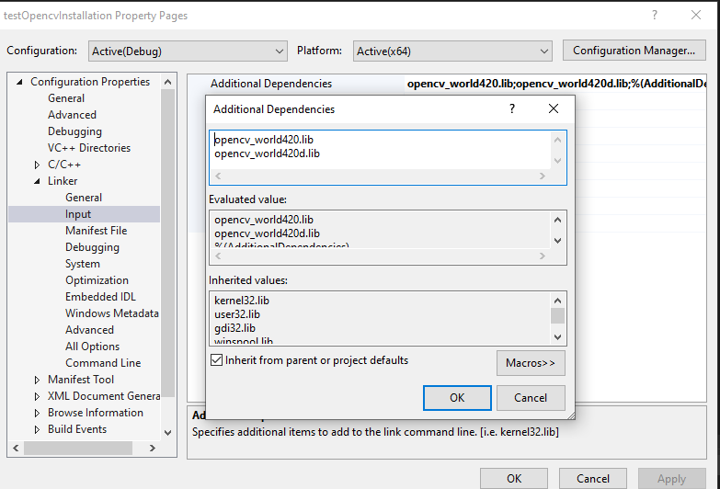
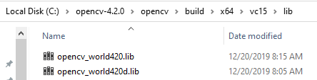
Linker-> Input -> Additional Dependencies
Looking in opencv\build\x64\vc15\lib

Slide 6
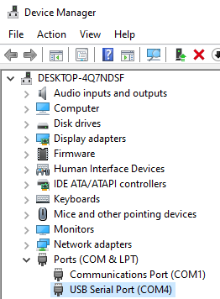
Check COM

